Slide 1
Chapter 3:
Methods of Structure Prediction

Slide 2
The 3D structure of proteins can be determined using lab methods
Diffraction methods:
X-ray diffraction/scattering
Neutron scattering
Electron microscopy/crystallography
Spectroscopic methods:
Nuclear magnetic resonance (NMR) spectroscopy
Electron paramagnetic resonance (EPR) spectroscopy
Others: FTIR, Raman spectroscopy, circular dichroism, mass spectrometry

Slide 3
Why predict protein structure?
Lab methods provide accurate 3D structures
However:
They are slow
Some are expensive
Membrane and large proteins are a problem
Thus, only a small part of known proteins have solved structure
Computational methods are less accurate, but faster and cheaper
Notes:
Today (19/07/20) there are over 166,500 structures in the PDB. This number is only a fraction of the number of proteins in nature. For example, in UniProt there are 26 million entries that share no more than 50% of their sequence (a measure of the number of unique proteins). So, only ~0.6% of the proteins have solved structures.

Slide 4
Overview
The physical (ab initio) approach
Force-field-based calculation of the potential energy
Configurational sampling
The mean-field approach
The template-based (comparative) approach
Homology modelling
Fold recognition
Integrative methods
Experimentally guided computational prediction
Evolutionary methods (correlated mutations)

Slide 5
The physical approach

Slide 6
The physical approach
Assumptions
Protein folding involves a free energy decrease
Native structure has the lowest free energy (global minimum)
G₁
G₂
ΔG = G₂ - G₁ < 0
Notes:
Under fixed temperature and pressure the Gibbs free energy of spontaneous processes decreases until equilibrium is reached. In isolated systems, where energy and volume are fixed, entropy is the measure of spontaneity (second law of thermodynamics).

Slide 7
The physical approach
Assumptions:
The folding process can be followed, given:
An explicit description of the unfolded structure and its surrounding (water, ions, lipids)
A mathematical description of the total energy of the system in a given configuration (‘force field’)
An algorithm for sampling different configurations of the system, to find the lowest-energy one (native)
Notes:
A configuration is the exact spatial distribution of all system atoms at a certain point in time.

Slide 8
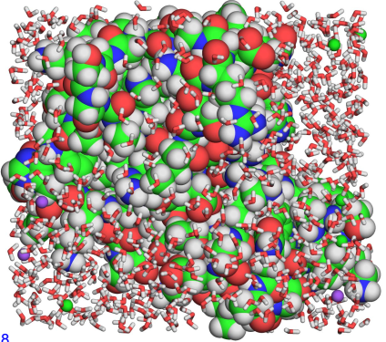
The physical approach
Explicit system description
Protein
Water
Na⁺
Cl⁻
Notes:
Figure 3-8. Explicit description in molecular mechanics calculation. (a) A small globular protein (barnase, PDB entry 1b2x) soaked in solvent, which includes water molecules and ions (0.5 M NaCl). The protein is presented as blue atom spheres, whereas the surrounding water molecules are presented as sticks, colored by atom type. Na⁺ and Cl⁻ ions are presented as small yellow and magenta spheres, respectively. All atoms should be included in the simulation.

Slide 9
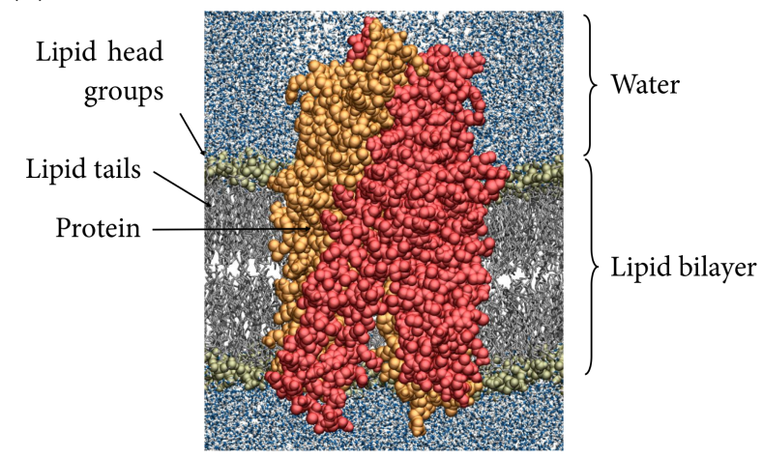
Notes:
(b) A molecular dynamics snapshot of the ABC transporter Sav1866 in a palmitoyl-oleyl phosphatidylethanilamine (POPE) lipid bilayer, surrounded by aqueous solvent. The lipid head groups and the protein are shown in a space-filling representation, whereas the lipid tails and aqueous solvent are shown in a wireframe representation. Lipid molecules are gray, water molecules are blue (oxygen) and white (hydrogen), and the two protein subunits are colored in red and orange, respectively. Courtesy of Drew Bennett and Peter Tieleman, University of Calgary.

Slide 10
The physical approach
Force-field-based calculation of the potential energy
Folding involves a drop in the free energy of the system:
G₁
G₂
ΔG = G₂ - G₁ < 0

Slide 11
The physical approach
Force-field-based calculation of the potential energy
The potential energy can approximate the free energy:
ΔG = ΔH - TΔS_{sys}
(constant temp)
(ΔE + Δ(PV))
(ΔU + ΔK)
In biological systems:
ΔG = ΔU + ΔK + Δ(PV) - TΔS_{sys}
proportional to k_{B}T
Notes:
G is the ‘useful’ energy in the system, i.e. energy that can be used for doing non-expansion work. True calculation of the free energy can only be done by QM methods. Therefore, an approximation must be used.
The potential energy results from all covalent and most non-covalent interactions (except nonpolar) in the molecular system.
The kinetic energy depends on the temperature. If the latter doesn’t change, than ΔK = 0
[Note: the dependence of ΔG in ΔH and TΔS is when all these physical parameters correspond to the system. When the entropy of the universe is used, then ΔG = -TΔS_{universe}, which means that as the entropy increases the free energy becomes more negative. It also means that ΔS_{universe} includes ΔH.]

Slide 12
The physical approach
Force-field-based calculation of the potential energy
U is calculated using a force-field (molecular mechanics):
covalent bond length
covalent bond angle
covalent bond dihedral angle
improper dihedral angle
vdW interactions
electrostatic interactions
Notes:
Box 3-1 Figure 1. A simple force field. (a-d) The dependency of the potential energy of the system on the following covalent bond factors: (a) Length, b_{i}. (b) Valence angle, θ_{i} (c) Dihedral angle, φ_{I}, and (d) improper dihedral angle, ω_{i}, i.e. deviation from planarity. In all cases, the interaction is depicted as a comparison between the actual value found in the coordinate file (e.g., b_{i} and θ_{i}) and the theoretical equilibrium value (e.g., b_{i,0} and θ_{i,0}). (e) The dependency of the van-der Waals potential energy on the distance (r_{ij}) between interacting atoms i and j. (f) The dependency of the electrostatic potential energy on the local dielectric (D), and the distance (r_{ij}) between atoms i and j, with charges q_{i} and q_{j}. The parameters k_{b,i}, k_{θ,i}, k_{φ,i}, k_{ω,i}, are the force constants of interactions a-d, respectively. A_{ij} and B_{ij} are parameters associated with the van der Waals interaction.

Slide 13
The physical approach
Configurational sampling
Option 1: sampling all possible configurations randomly and finding the lowest-energy one - impractical
Option 2: Energy minimization
Calculate the potential energy of unfolded protein
Introduce small changes in atoms location and recalculate
If energy is lower – accept and repeat steps 1-2. If energy is higher, make another change until energy is lower

Slide 14
The physical approach
Configurational sampling
Problem: random changes in atomic locations may drive the system towards higher-energy configurations
Solution: the changes in atom location are predicted in response to the force applied on the atoms (molecular dynamics)
velocity
position
acceleration
-
mass
time
(Newton’s 2nd law of motion)

Slide 15
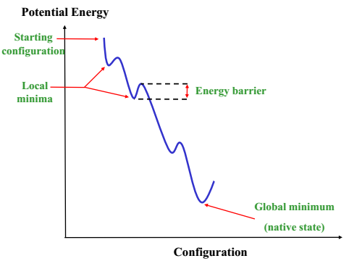
The physical approach
Configurational sampling
Problem: protein folding involves local energy minima → the simulation gets the stuck!
Notes:
Figure 3-9. Local energy minima and barriers in proteins. The hypothetical energy landscape of a protein-solvent system is shown. In the plot, each distinct system configuration is characterized by a potential energy value. During a simulation, different configurations are sampled in a certain pattern. As the plot demonstrates, finding the global energy minimum (corresponding to the most stable configuration) often requires the simulation to overcome energy barriers that separate different local energy minima.

Slide 16
The physical approach
Configurational sampling
Solution: the kinetic barriers are overcome by virtual heating, which translates into atomic motions (simulated annealing)
Extensive sampling allows to estimate ΔS_{sys}:
S = k_{B}lnΩ
number of possible system configurations

Slide 17
The physical approach
MD cannot describe protein folding. Why?
Explicit models → the simulations cover ns-μs (folding takes ms)
The potential energy is just an approximation of the free energy
The description of bonds as springs is highly approximated
Solvation effects are not fully accounted for
The force constants are obtained by fitting calculations to empirical data

Slide 18
The physical approach
So why use MD?
Refining models
Producing near-native structures
Exploring dynamic changes in proteins
Learn about the separate contributions to the total free energy
Deriving structure-function relationships
Engineering proteins
Notes:
* Another reason for using the physical approach is that is allows decomposing the total free energy into components that correspond to specific interactions and changes in the system. This is important in studying structure-function relationships and in engineering proteins.

Slide 19
The physical approach
Implicit (mean-field) calculations
MD’s biggest problem: describing all electrostatic interactions between fixed protein charges and mobile solvent charges (solvation/polarization energy)
G_{elec} =

Slide 20
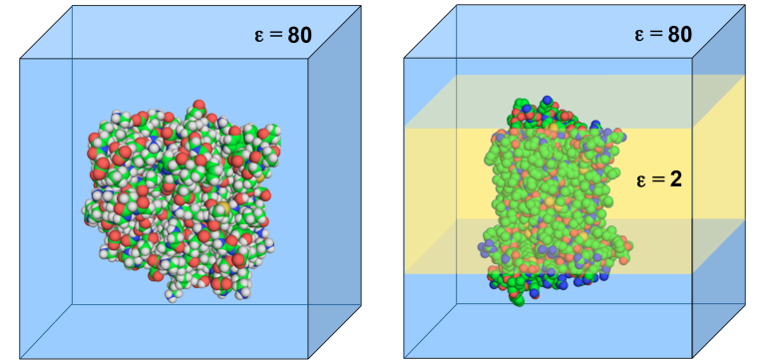
The physical approach
Implicit (mean-field) calculations
Solution:
Fixed protein charges – described by charge distribution (ρ)
Mobile solvent charges - described by the dielectric (ε)
G_{elec} – described as a function of ρ and the potential (Φ)
Notes:
Notice that ΔG_{elec} includes both the Coulomb energy and the polarization energy.
Notice that Φ, ρ and ε are position-specific parameters.
Figure 3-10. Implicit (mean-field) description of protein-based systems. The figure shows a continuum-solvent (CS) model of the system, which is a type of mean-field treatment. In this model, the protein is described explicitly whereas the solvent is described implicitly, using its dielectric properties. Two common CS models are shown. (a) A globular protein in a high-dielectric environment representing the aqueous solution. (b) A membrane-bound protein in a heterogeneous environment, which includes a high-dielectric aqueous solvent and a low-dielectric slab of fixed dimensions, representing the hydrocarbon region of a biological lipid bilayer (in semi-transparent yellow).

Slide 21
The physical approach
Implicit (mean-field) calculations
The elec. potential:
Notes:
Box 1-3 Figure 1. The potential (Φ) is the energy acquired by a probe charge (q₂) positioned within an electrostatic field (black arrows) that is emitted by a source charge (q₁). This is also a way to measure the potential.
In the case of two point charges in a uniform dielectric, Φ = (1/4πε₀)(q₁/R), where R is the distance from q₁. That’s because the potential is the energy divided by the probe charge: U_{coul}/q₂ = (1/4πε₀)(q₁q₂/R)/q₂ = (1/4πε₀)(q₁/R). When the potential is created by a collection of charges (q_{i}), then Φ = (1/4πε₀)(Σ (q_{i}/R_{i})).

Slide 22
The physical approach
Implicit (mean-field) calculations
Φ is calculated by the Poisson equation
.
In the presence of mobile ions, the Poisson-Boltzmann equation is used:
.
(I - the ionic strength in the system)
Notes:
When the potential is created by the a collection of charges in a non-uniform dielectric, the potential is calculated based on the mean-field model, by solving the Poisson-Boltzmann equation.
The first operator is a divergence and the second is a gradient. Both express the same thing, but the first is applied to vectors, whereas the second to scalars. The potential is a scalar but its gradient (the field) is a vector.

Slide 23
The physical approach
Implicit (mean-field) calculations
The total nonpolar energy (hydrophobic + vdW) is derived using an empirical surface area dependency:
change in buried surface area upon folding

Slide 24
Template-based methods
The 3D structure of the query protein is deduced from proteins of known structure (templates) that:
Have a very similar sequence to the query protein (homologs)
Share physicochemical properties or statistical tendencies with the query protein
Main methods:
Homology modeling
Fold recognition (threading)

Slide 25
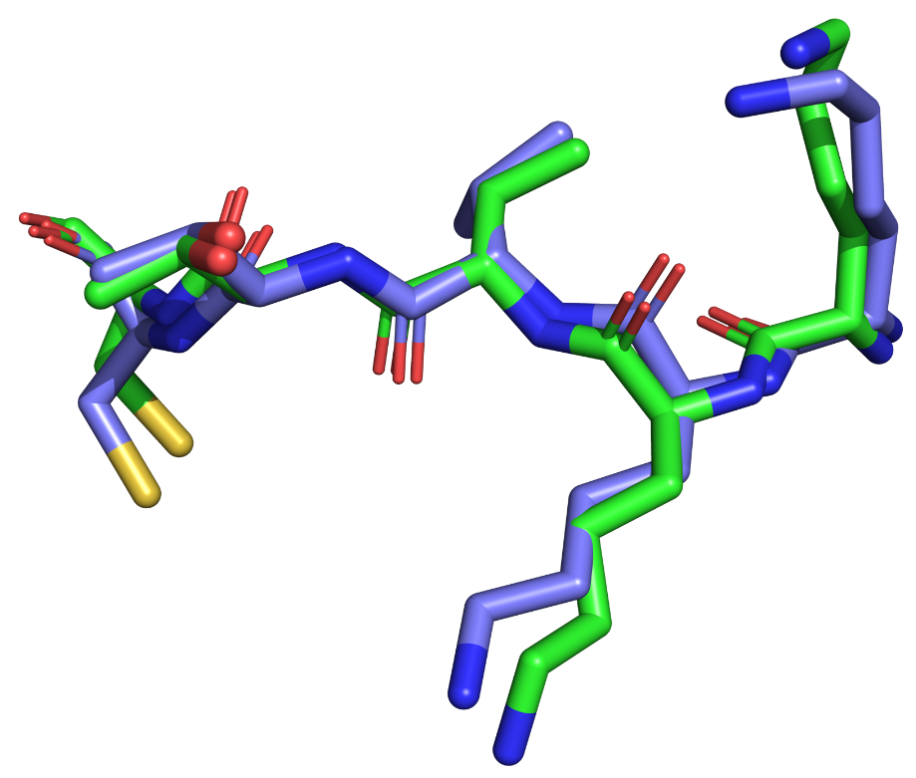
Measuring structural similarity
R.M.S.D - root-mean-square deviation
δ ²₍₃₎
N - the number of equivalent atoms compared between the two structures
δ_{i} - the distance (in Å) between the atom pair i (one from each protein):
δ²₍₁₎
δ² = (x_{a}-x_{b})² + (y_{a}-y_{b})² + (z_{a}-z_{b})²
δ ² ₍₂₎
Smaller R.M.S.D = more similar structures

Slide 26
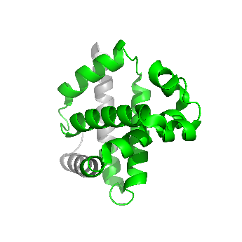
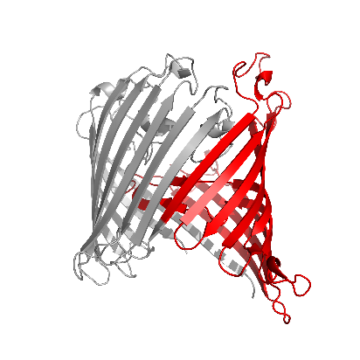
Template-based methods
Homology modeling: basic logics
Proteins with similar sequences have similar structures
Thus, the structure of a protein can be predicted based on the structures of its sequence homologs
Templates
Query
Notes:
Chothia and Lesk noted that proteins with 50% sequence identity have a corresponding structural r.m.s.d. of ~1 Å

Slide 27
Template-based methods
Homology modeling: steps
Finding templates with ≥ 30% sequence identity in shared regions (psi-BLAST)
Aligning the two sequences
Transferring the coordinates of identical amino acids from the template to the query protein
Performing energy optimization to get rid of clashes and distortions
Model evaluation (WHATIF, Verify3D) – also for ranking models
Software/servers: Modeller, SwissModel, NEST
Notes:
Model evaluation is done based on statistical tendencies: bond lengths/angles, residue occurrence in secondary structures, residue burial, etc.
50% identity → rmsd = 1-2 Å (in regions covered by the templates)
30-50% identity → rmsd = 2-4 Å

Slide 28
Template-based methods
Homology modeling: multiple sequence alignment
MSA quality usually determines model accuracy
Software: Clustal-ω, MAFFT, MUSCLE, T-Coffee
Notes:
Figure 3.11. Multiple sequence alignment. (a) Part of a multiple sequence alignment of homologous glucokinase enzymes. For clarity, the different residue types (e.g. polar-neutral, nonpolar, charged, etc.) are colored differently. The alignment was taken from the Pfam database ^{[308]}. The sequence names are listed on the left and the sequences are aligned to maximize the amino acid similarity in each column without opening too many sequence gaps.

Slide 29
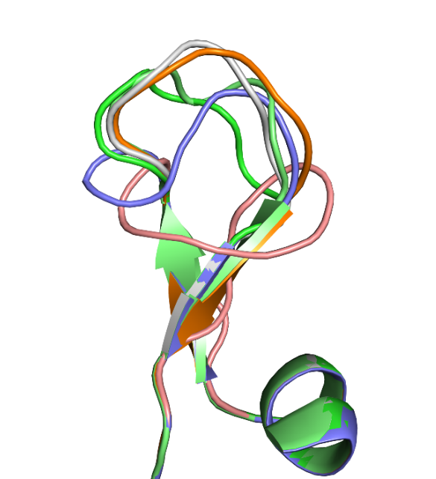
Template-based methods
Homology modeling: problems
The number of available templates is limited
Loops have low conservation → difficult to predict
Partial solution: using other methods for loop prediction
Still, HM is currently the best method for structure prediction
Notes:
The shortage of templates is especially severe in membrane proteins, which are hard to crystallize.

Slide 30
Template-based methods
Fold recognition: basic logics
Proteins of similar structures share certain sequence-encoded properties or statistical tendencies
Thus, a protein of known structure can serve as a template if it has similar properties/tendencies to those of the query protein

Slide 31
Template-based methods
Fold recognition: types of properties/tendencies
Amino acids-related: angles, surface area, polarity, 2nd structure preference, etc.
Purely statistical – detected from multiple sequence alignment

Slide 32
Template-based methods
Fold recognition: steps
Each position in the query protein is coded in a way describing the specific tendencies of this position. This yields a sequence profile for the query protein
The profile is systematically compared to a library containing the profiles of all proteins of known structure
A match represents a protein with similar fold
If a match is not found, the query protein is assumed to have a novel fold
Software/servers: GenTHREADER, SPARKS-X, HHPred, TASSER

Slide 33
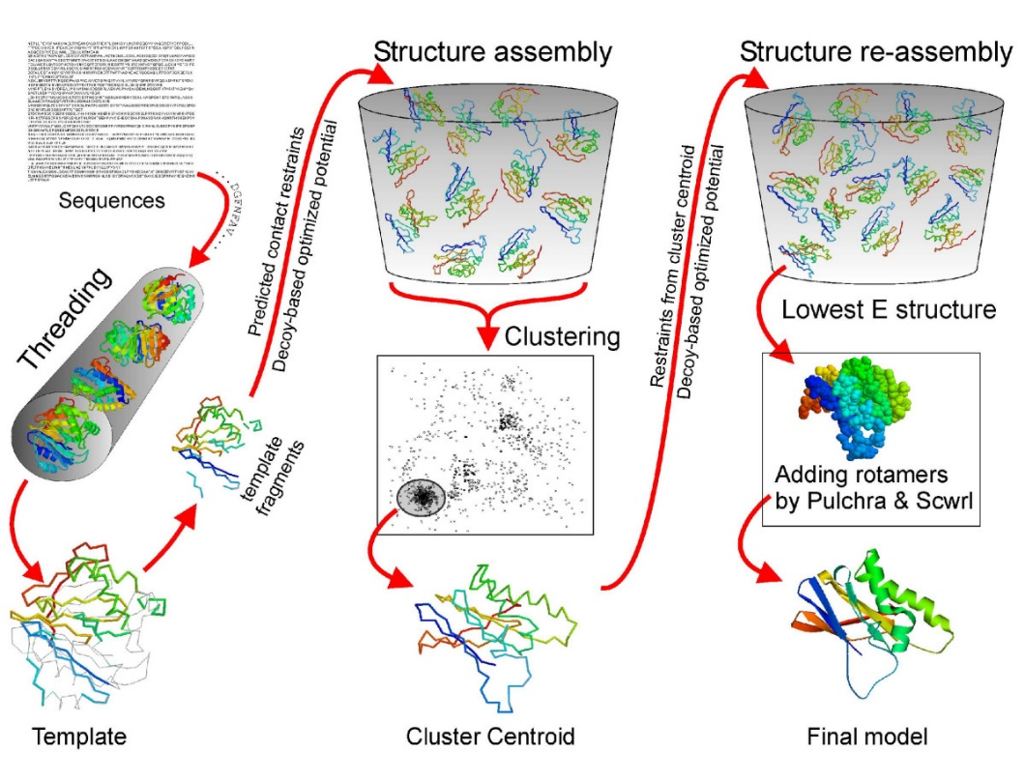
Template-based methods
Integrative methods
Integrate different approaches to get best results
E.g.: HM for initial models, energy methods for refinement
Software/servers: I-TASSER, Rosetta
Nature Protocols (2010) 5 725–738
Notes:
I-TASSER uses threading to find templates, then cuts the best aligned fragments from the structures and reassembles them using MC simulations and energy refinement.
Figure 3.12 The I-TASSER protocol for protein structure prediction. The figure is taken from ^{[361]} and used under the terms of the Creative Commons Attribution License (http://creativecommons.org/licenses/by/2.0).

Slide 34
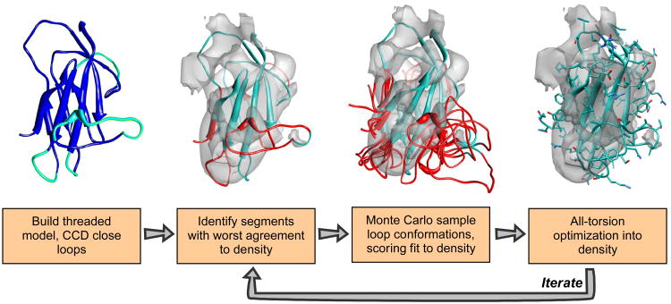
Template-based methods
Experimentally guided methods
Structural data are derived from low-resolution lab methods (EM, SAXS) and used as constraints in computational structure prediction
J Mol Biol. (2009) 392: 181-90
A Rosetta implementation with cryo-EM constraints
Notes:
Figure 3.14. Model building by guiding Rosetta’s comparative modeling using cryo-EM density maps. A threaded model is built from some alignment (blue), using cyclic coordinate descent to close gaps in the alignment (cyan). This model is then docked into the EM density map, and regions with poor local agreement with the density data are identified (red). The conformations in these regions are aggressively resampled, with each potential conformation scored with Rosetta's low-resolution energy function together with an agreement-to-density score. Finally, sidechain rotamers are optimized and all backbone and sidechain torsions are minimized using Rosetta's high-resolution potential, also augmented with this agreement-to-density score. These three steps are iterated over until the lowest-energy models converge, at each iteration enriching the population for those models with both favorable Rosetta energy as well as good fit to density.

Slide 35
Databases of predicted structures
The protein model portal (PMP) at the NIH: http://www.proteinmodelportal.org/
The protein model database (PMDB): https://bioinformatics.cineca.it/PMDB/

Slide 36
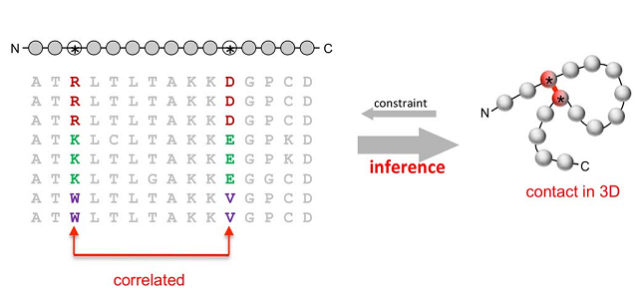
Evolutionary methods
Prediction by correlated mutations
Positions that are close in space tend to co-evolve
Therefore, data on co-evolving positions can be used as distance constraints on structure prediction
PLoS One (2011) 6: e28766
Notes:
Figure 3.3.1. Structure prediction based on identification of correlated mutations. The process is based on the inference of contacts between nearby residues in the native structure of a protein from correlated mutations in its sequence. (a) The prediction process, demonstrated for clarity on two positions forming a single 3D contact. Left: Multiple sequence alignment of the target protein with the sequences of other family members, all of which have the same fold. The two correlated positions are marked. Right: A schematic representation of the 3D structure of the folded protein, showing the proximity of the two correlated positions.

Slide 37
Evolutionary methods
Prediction by correlated mutations
The sequence information is used to build a contact map, which is integrated into a structure prediction algorithm.
bioRxiv 021022; doi: https://doi.org/10.1101/021022
Notes:
Figure 3.3.1. Structure prediction based on identification of correlated mutations. (b) A contact map of top-ranked evolutionary inferred couplings (EICs) (red) overlaid on contacts from a crystal structure of human β₂-adrenergic receptor (grey). The top 350 evolutionary couplings are shown, covering nearly the entire length of the protein. EICs between residues that are less than 5 Å away from each other are omitted; hence, there are no red marks along the long diagonal. The dark and light green bars on the axes show the locations of experimentally-determined and predicted α-helices in the sequence, respectively; these are easily inferred from the high density of EICs along the short diagonals. The light blue areas correspond to a large flexible loop missing from the crystal structure. The image was adapted from the Evfold ^{[374]} website by Yana Gofman.

Slide 38
Evolutionary methods
Prediction by correlated mutations
Web servers: EVcouplings, RaptorX-Contacts, GREMLIN, DESTINI

Slide 39
Summary of Chapter 3
The 3D structure of proteins can be determined by lab methods but most of these methods are slow and expensive, resulting in a small number of known structures compared to the explosion of protein sequences that are determined every day.
A partial solution to this problem is given by fast computational methods that predict protein structures.

Slide 40
Summary of Chapter 3
Physics-based methods attempt to predict the structures of proteins by sampling many folded conformations and calculating their energy. Since the calculations are heavy and approximated, such methods are usually unable to predict protein structures from scratch, but can refine near-native conformations and elucidate their dynamics.
Comparative (template-based) methods rely on proteins with known structure, and on their sequence similarity to the query protein, to predict its structure.

Slide 41
Summary of Chapter 3
The best structure predictors combine comparative and physics-based methods, and use data from NMR, SAXS, and EM experiments to guide the prediction process.
Recently developed methods that rely on the tendency of protein positions close in 3D space to co-evolve have been producing encouraging results.
Experimentally structures are deposited in the Protein Data Bank (PDB), whereas predicted structures can be found in several databases.

