Slide 1
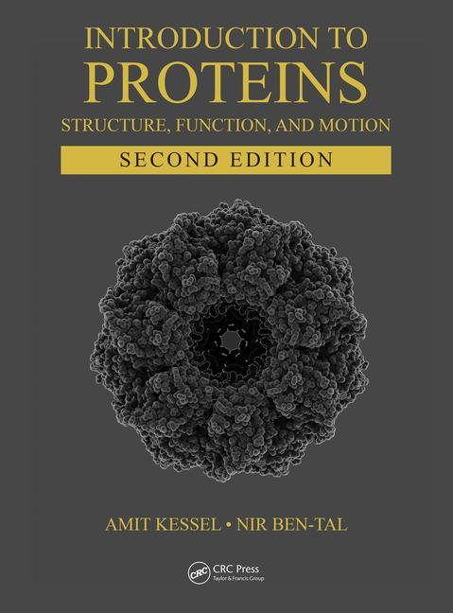
This PPT presentation is provided as suppl. material to the book:
Introduction to Proteins: Structure, Function, and Motion
2nd Edition (2018)
Amit Kessel & Nir Ben-Tal

Slide 2
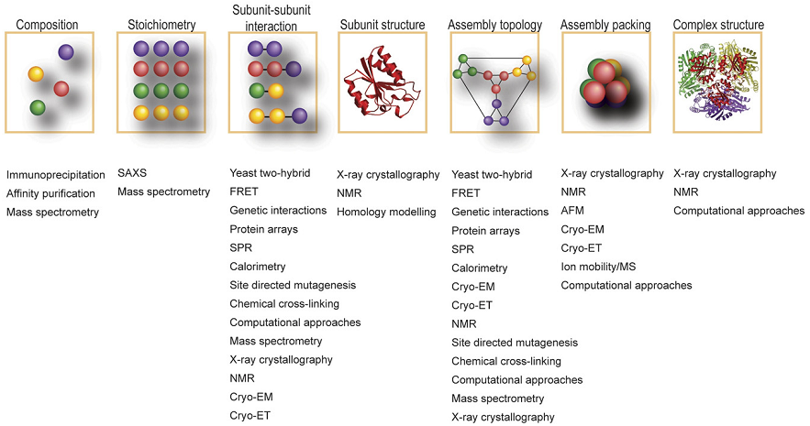
Figure 3.1

Slide 3
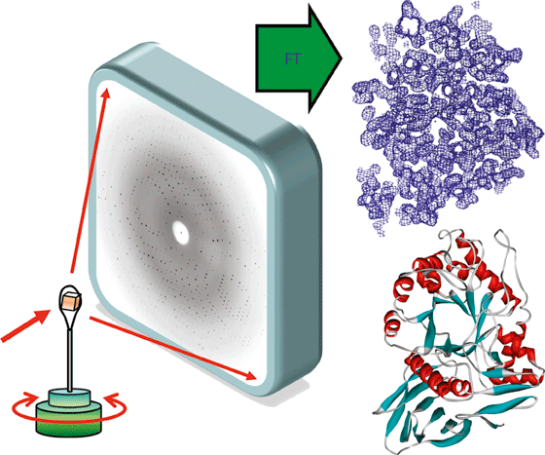
c
b
a
d
Figure 3.2

Slide 4
e
4 Å
8 Å
16 Å
32 Å

Slide 5
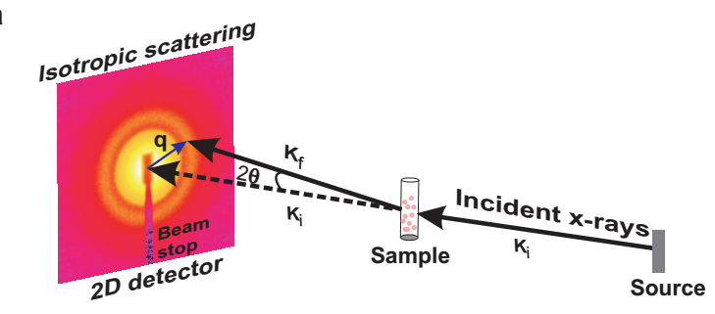
a
Figure 3.3

Slide 6
b

Slide 7
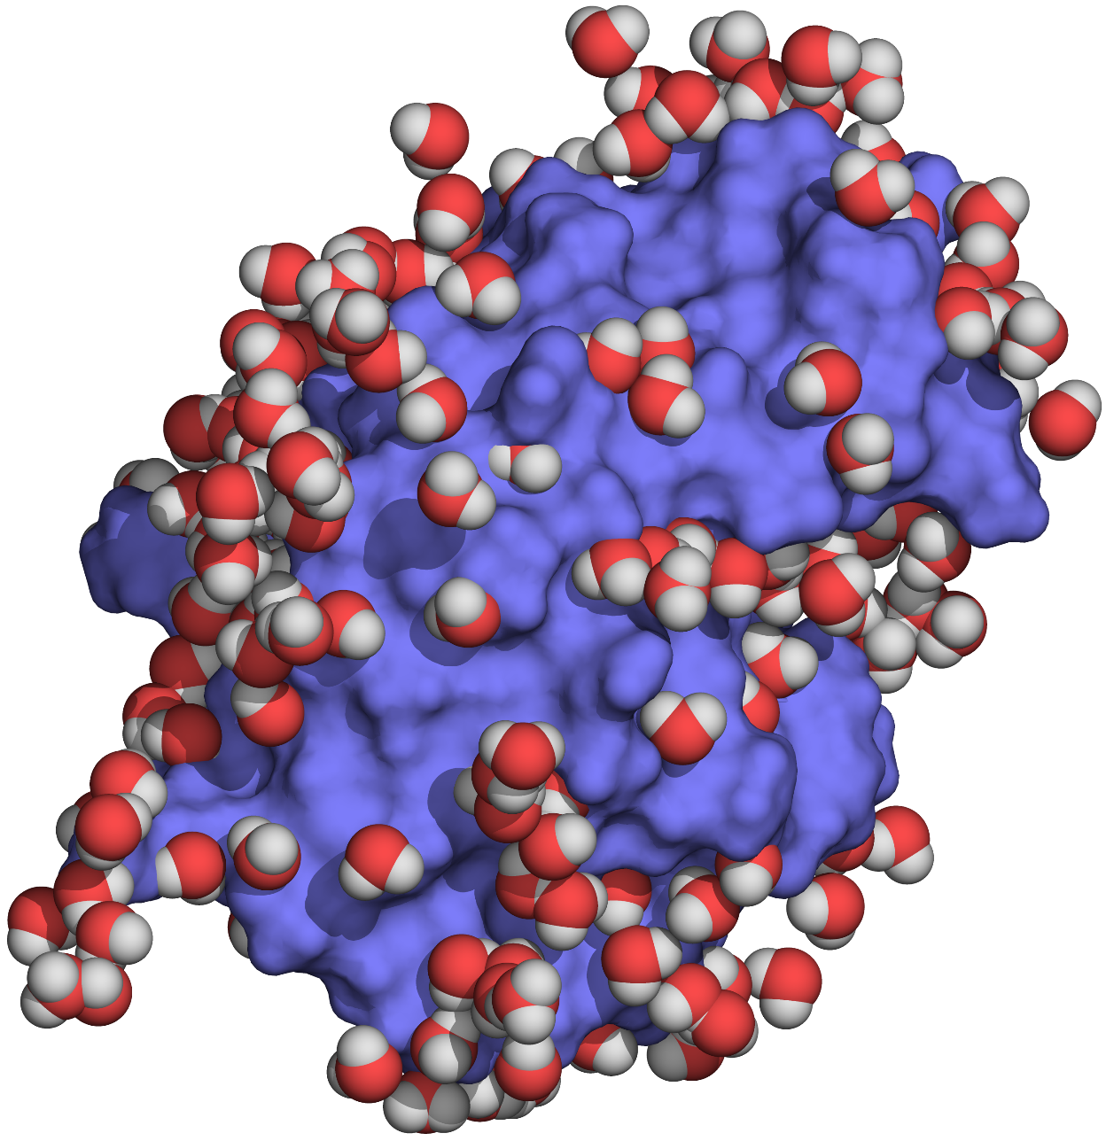
Figure 3.4

Slide 8
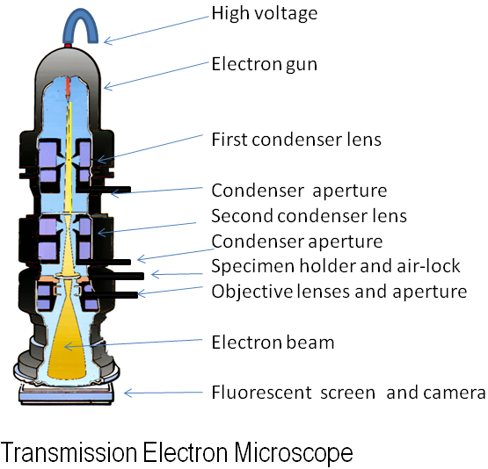
a
Figure 3.5

Slide 9
b

Slide 10
c
I

Slide 11
c
II

Slide 12
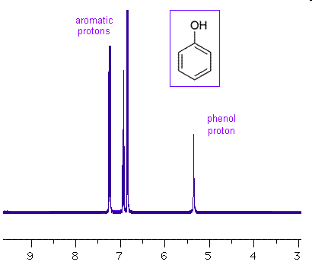
a
Signal
Wavelength
Figure 3.6

Slide 13
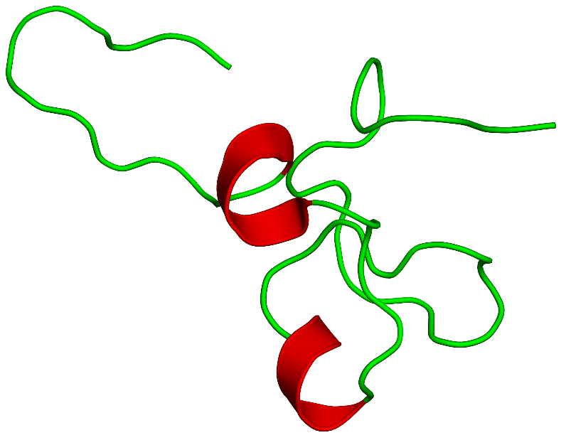
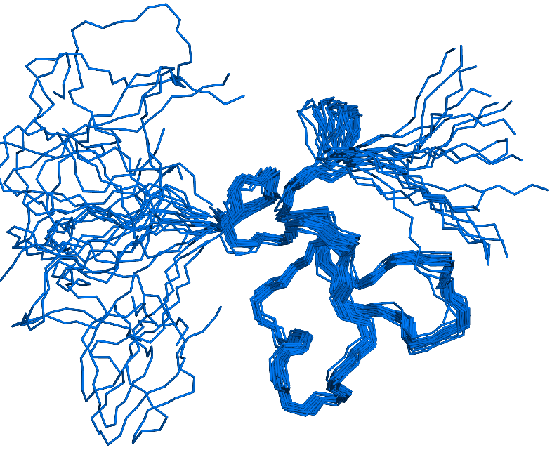
b

Slide 14
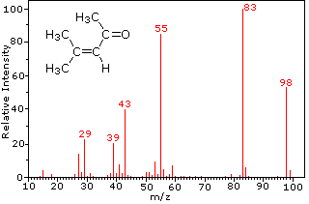
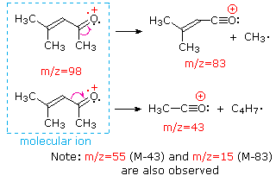
a
Figure 3.7

Slide 15
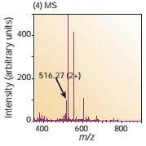
b

Slide 16
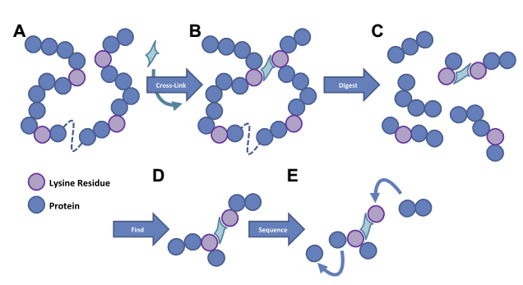
c

Slide 17
a
Figure 3.8

Slide 18
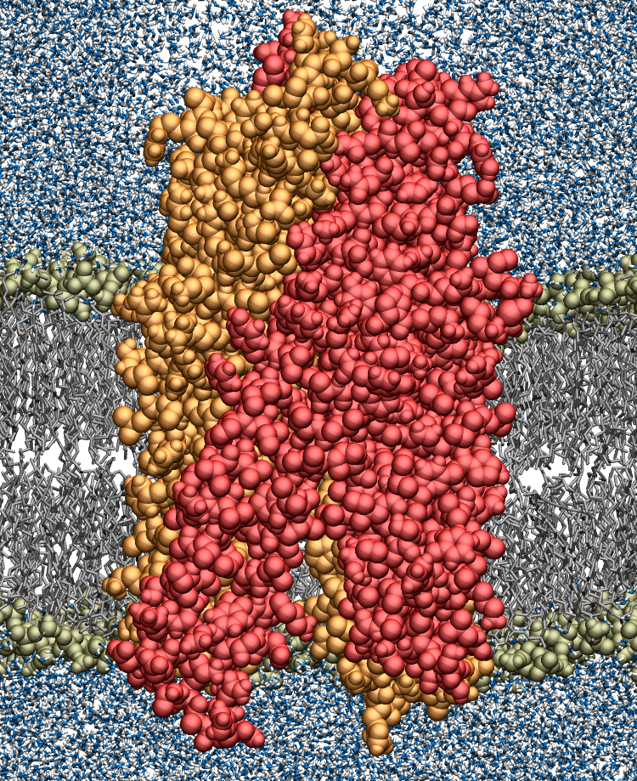
b
Lipid head groups
Water
Lipid tails
Protein
Lipid
bilayer

Slide 19
Potential Energy
Starting configuration
Local minima
Energy barrier
Global minimum
(native state)
Configuration
Figure 3.9

Slide 20
Figure 3.10

Slide 21
a
Figure 3.11

Slide 22
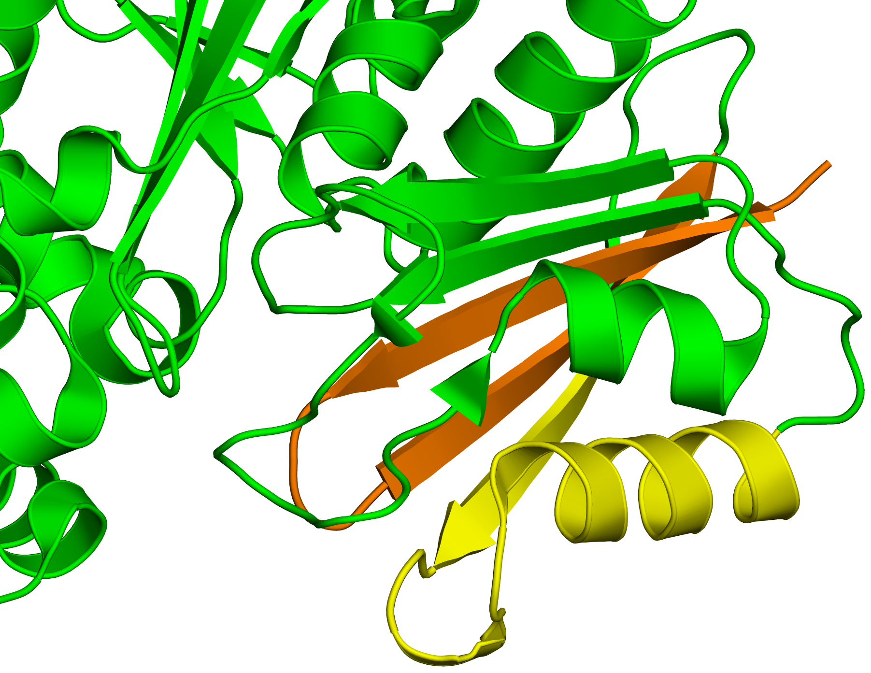
b

Slide 23
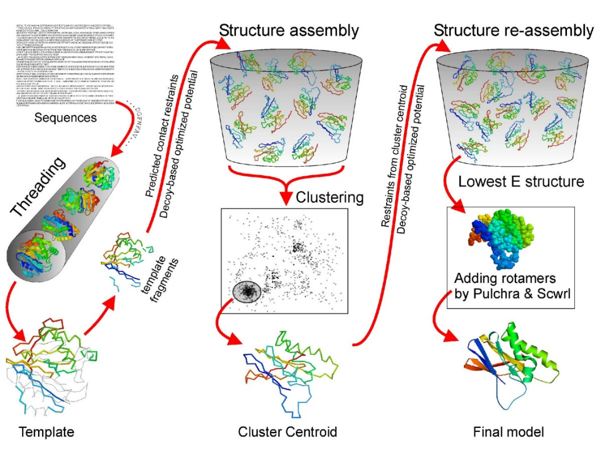
Figure 3.12

Slide 24
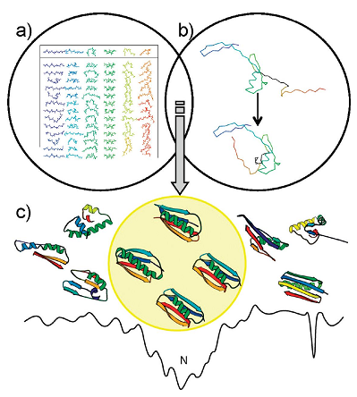
Figure 3.13

Slide 25
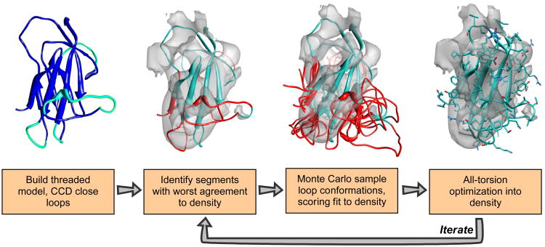
Figure 3.14

Slide 26
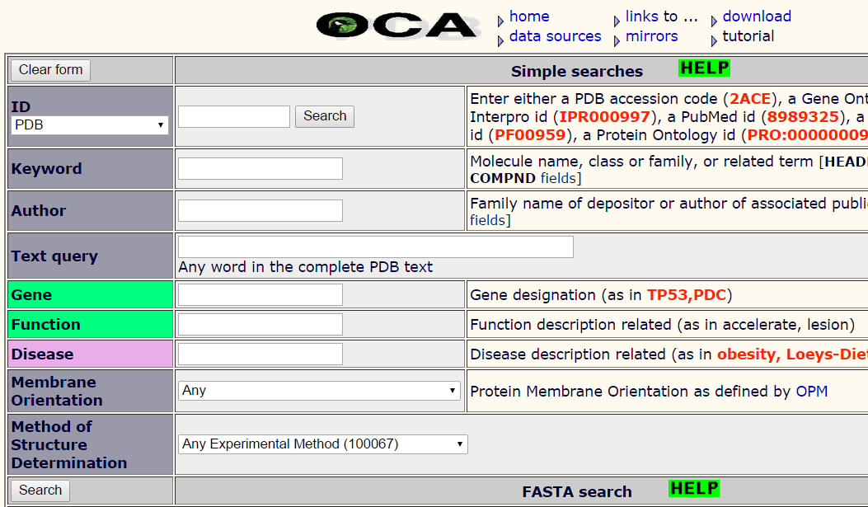
a
Figure 3.15

Slide 27
b
Atom number
Atom name
Residue name
Residue number
Occupancy
Chain
X
Y
Z
B-factor

Slide 28
Box 3.1

Slide 29
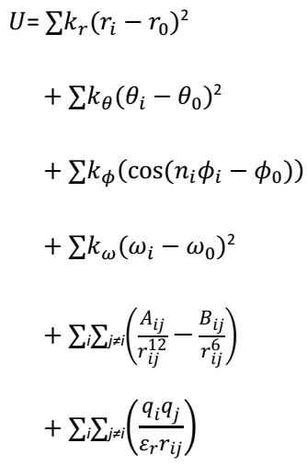
r
a
θ
b
ϕ
c
d
r
e
+
-
f
Figure 3.1.1

Slide 30
Box 3.2

Slide 31
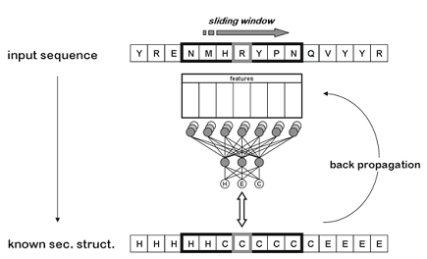
Figure 3.2.1

Slide 32
Box 3.3

Slide 33
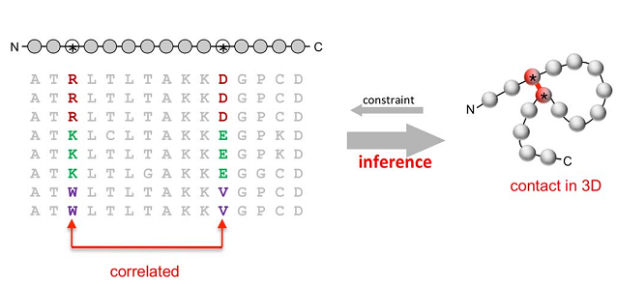
a
Figure 3.3.1

Slide 34
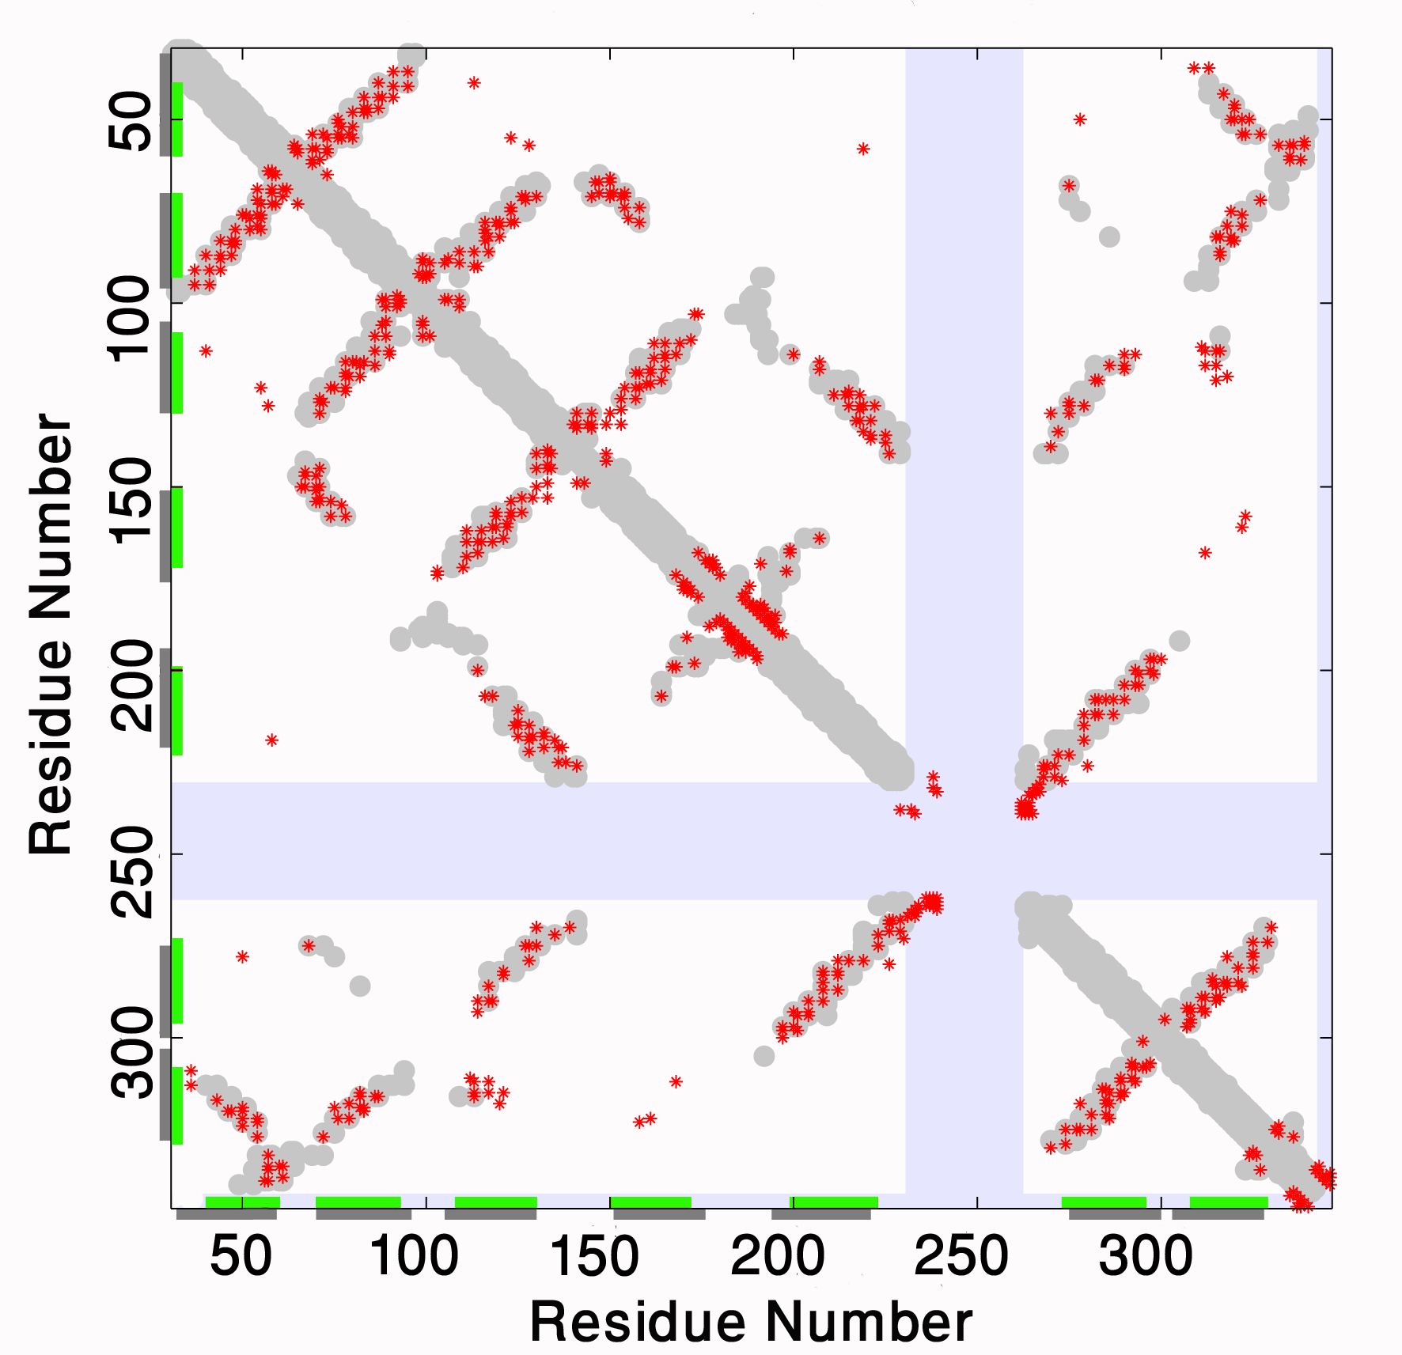
b

Slide 35
c

