Slide 1
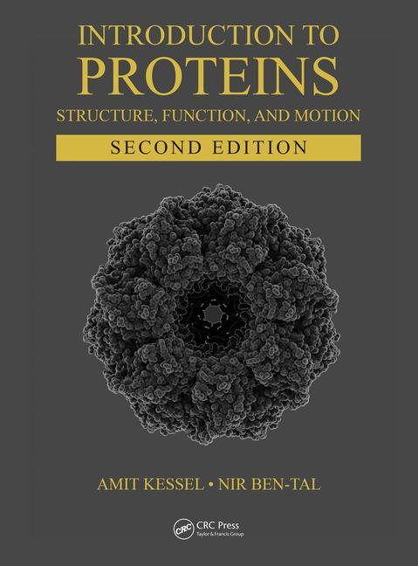
This PPT presentation is provided as suppl. material to the book:
Introduction to Proteins: Structure, Function, and Motion
2nd Edition (2018)
Amit Kessel & Nir Ben-Tal

Slide 2
Chapter 4:
Thermodynamics & Protein Stability

Slide 3
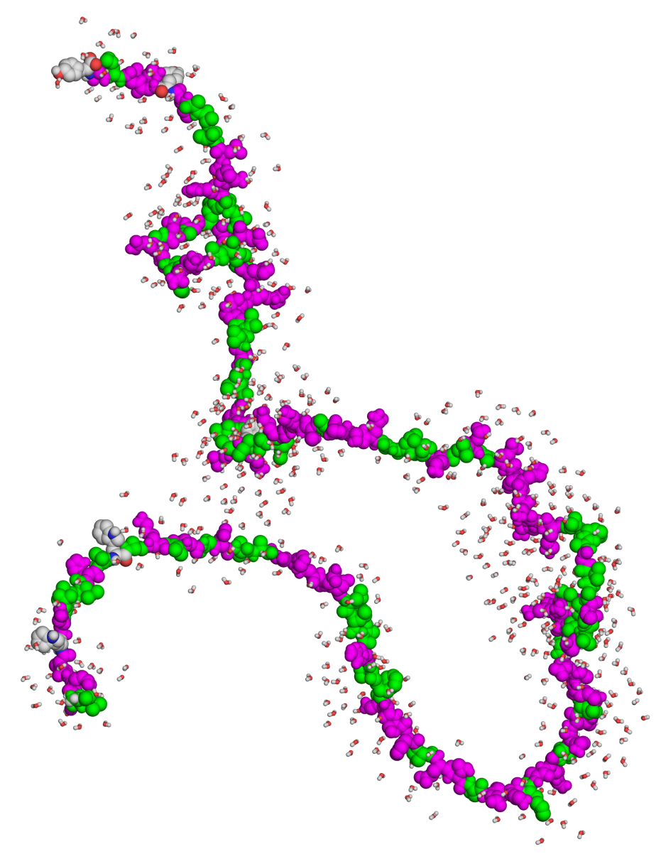
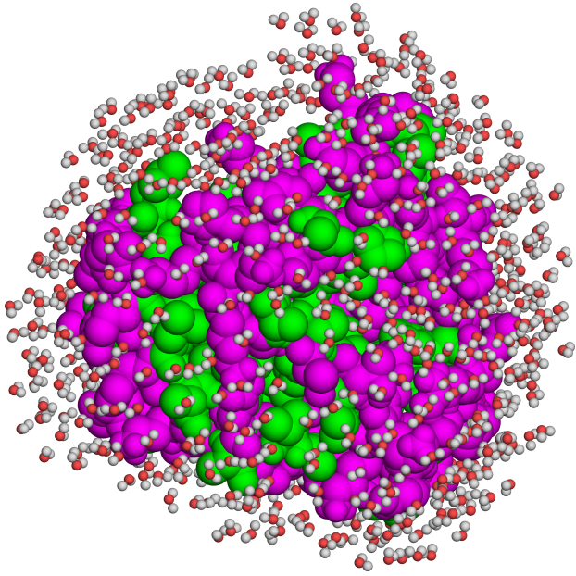
Overview
Unfolded
Folded
ΔG_{folding} = G_{folded} - G_{unfolded}
(const. TP)
Notes:
Folding is a spontaneous process, which means it involves a negative change in free energy. ΔG is used instead of ΔS because the latter is a measure of process direction only in an isolated system, which has constant energy and volume. Biological systems are based on solids and liquids. Therefore, in these systems the temperature and pressure are constant, and the energy (and to a lesser extant the volume) are those that change. G is defined as the energy that can be used for non-expansion work under conditions of constant temp. and pressure.
Figure 2.23. Solvent exposure of various protein regions in the folded vs. unfolded states. Polar and nonpolar residues are colored in magenta and green, respectively. The solvent (water) molecules surrounding the protein are represented as spheres. In the folded state, nonpolar residues reside mainly in the protein core away from the solvent, whereas in the unfolded state both polar and nonpolar residues are exposed to the solvent. Still, the folded state contains patches of hydrophobic residues, as explained in the main text. Water molecules were added to the protein computationally by the PDB_hydro server ^{[277]} (Delarue group, Institut Pasteur ^{[278]}).

Slide 4
Overview
Unfolded
Folded
ΔG_{folding} = 5-20 kcal/mol
Notes:
For comparison, the dissociation of a single covalent bond requires ~65-175 kcal/mol.
Figure 2.23. Solvent exposure of various protein regions in the folded vs. unfolded states. Polar and nonpolar residues are colored in magenta and green, respectively. The solvent (water) molecules surrounding the protein are represented as spheres. In the folded state, nonpolar residues reside mainly in the protein core away from the solvent, whereas in the unfolded state both polar and nonpolar residues are exposed to the solvent. Still, the folded state contains patches of hydrophobic residues, as explained in the main text. Water molecules were added to the protein computationally by the PDB_hydro server ^{[277]} (Delarue group, Institut Pasteur ^{[278]}).

Slide 5
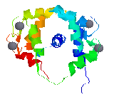
Overview
Why is protein stability marginal?
Even at -5 kcal/mol the native structure dominates (99.9%)
Allows proteins to remain folded yet flexible (functionally important)
Different conformations of Calmodulin in complex with its target peptide (NMR ensemble)
Notes:
The fact that at -5 kcal/mol the native state is 99.9% occupied suggests that there has been no impetus for the evolutionary process to create proteins, which are much more stable than what we see today.

Slide 6
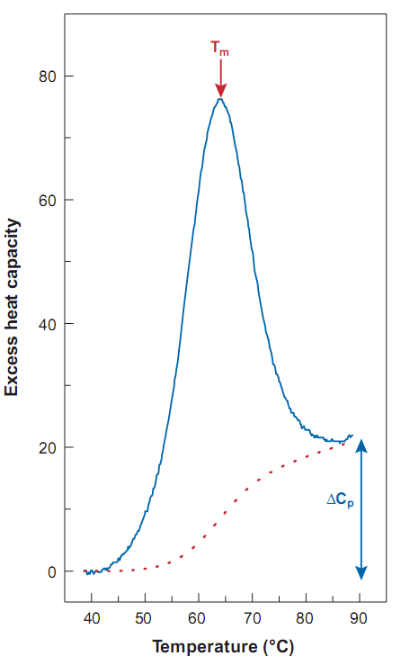
Overview
Understanding protein stability requires breaking ΔG_{folding} into separate contributions
The basic breakdown to enthalpy (ΔH) and entropy (-TΔS) is convenient because they can be measured
ΔG = ΔH - TΔS
(constant T)
C_{P}
ΔH
T
Notes:
An enthalpic-favorable process (e.g. the formation of a covalent bond or non-covalent interaction) involves a decrease in enthalpy, by releasing heat from the molecule to its environment.
Figure 4.2. DSC measurement of the thermal denaturation of the protein ubiquitin (adapted from ^{[5]}). The curve depicts C_{P} as a function of temperature, where T_{m} is the transition temperature.

Slide 7
Overview
ΔH can be reduced to ΔU (U = potential energy), which results from formation/breaking of chemical bonds and atom-atom interactions
ΔG = ΔH – TΔS_{sys}
(constant temp)
(ΔE + Δ(PV))
(ΔU + ΔK)
(K α k_{B}T)
In biological systems:
ΔG = ΔU – TΔS_{sys}
Notes:
The change in kinetic energy at a fixed temperature is zero.
The potential energy is the position-dependent energy of an object within a field (electric, gravitational, magnetic). In molecules, the objects are atoms, and the fields are electric. The interactions between them can be represented as covalent bonds and non-covalent interactions (electrostatic and vdW, but not nonpolar).

Slide 8
Overview
Breaking down ΔU to its separate contributions usually requires integration of experiments and calculations
ΔG_{tot} = ΔG_{elec} + ΔG_{np} + ΔG_{vdW} + ΔG_{ent}
Electrostatic
van der Waals
Protein entropy
Nonpolar
(solvent entropy)
Notes:
Electrostatic and vdW interactions involve mainly enthalpy changes, whereas nonpolar interactions involve solvent entropy changes.

Slide 9
Overview
For example: force-field-based calculations
covalent bond length
covalent bond angle
covalent bond dihedral angle
improper dihedral angle
vdW interactions
electrostatic interactions
Notes:
Figure 3.1.1. A simple force field. (a-d) The dependency of the potential energy of the system on the following covalent bond factors: (a) Length, r_{i}. (b) Valence angle, θ_{i}. (c) Dihedral angle, φ_{i}. (d) Improper dihedral angle, ω_{i}, i.e. deviation from planarity. In all cases, the interaction is depicted as a comparison between the actual value found in the coordinate file (e.g., r_{i} and θ_{i}) and the theoretical equilibrium value (e.g., r_{i,0} and θ_{i,0}). The parameters k_{r,i}, k_{θ,i}, k_{φ,i}, k_{ω,i}, are the force constants of interactions (a)-(d), respectively. (e) The dependency of the van der Waals potential energy on the distance (r_{ij}) between interacting atoms i and j. A_{ij} and B_{ij} are parameters associated with the van der Waals interaction. (f) The dependency of the electrostatic potential energy on the local dielectric (ε), and the distance (r_{ij}) between atoms i and j, with charges q_{i} and q_{j}.

Slide 10
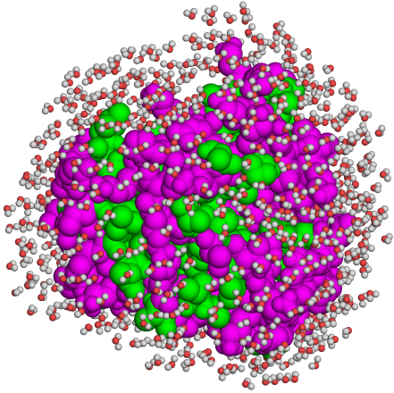
Interactions and physical effects
Components
Nonopolar
-
Intraprotein
van der Waals
Protein-solvent
Protein-solvent, protein-protein
Electrostatic
Protein-solvent
Protein-solvent, protein-protein
Chain entropy
High
Low
Notes:
Figure 2.23. Solvent exposure of various protein regions in the folded vs. unfolded states. Polar and nonpolar residues are colored in magenta and green, respectively. The solvent (water) molecules surrounding the protein are represented as spheres. In the folded state, nonpolar residues reside mainly in the protein core away from the solvent, whereas in the unfolded state both polar and nonpolar residues are exposed to the solvent. Still, the folded state contains patches of hydrophobic residues, as explained in the main text. Water molecules were added to the protein computationally by the PDB_hydro server ^{[277]} (Delarue group, Institut Pasteur ^{[278]}).

Slide 11
Nonpolar and vdW interactions
Nonpolar - exist only in the folded state → drive folding
vdW - exist in both the folded and unfolded states, but stronger in the tightly-packed protein core than in the unfolded state → drive folding
Notes:
Figure 2.23. Solvent exposure of various protein regions in the folded vs. unfolded states. Polar and nonpolar residues are colored in magenta and green, respectively. The solvent (water) molecules surrounding the protein are represented as spheres. In the folded state, nonpolar residues reside mainly in the protein core away from the solvent, whereas in the unfolded state both polar and nonpolar residues are exposed to the solvent. Still, the folded state contains patches of hydrophobic residues, as explained in the main text. Water molecules were added to the protein computationally by the PDB_hydro server ^{[277]} (Delarue group, Institut Pasteur ^{[278]}).

Slide 12
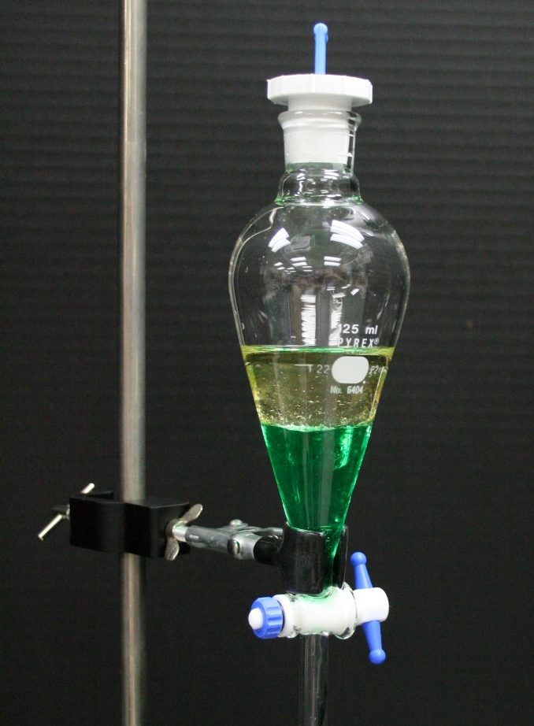
Nonpolar and vdW interactions
ΔG_{np} + ΔG_{vdW} can be estimated based on partitioning experiments of nonpolar amino acids:
[A_{oct}]
K_{eq} =
[A_{wat}]
octanol
ΔG⁰ = -RTlnK_{eq}
water
The energy correlates with surface area (SA): ΔG ≈ -0.025×SA [kcal/mol] (SA in Å²)
Notes:
Mutational and partitioning studies yield a similar correlations between ΔG_{np} and SA. For example, -2 kcal/mol for the complete burial of a methyl group (SA=80 Å²).

Slide 13
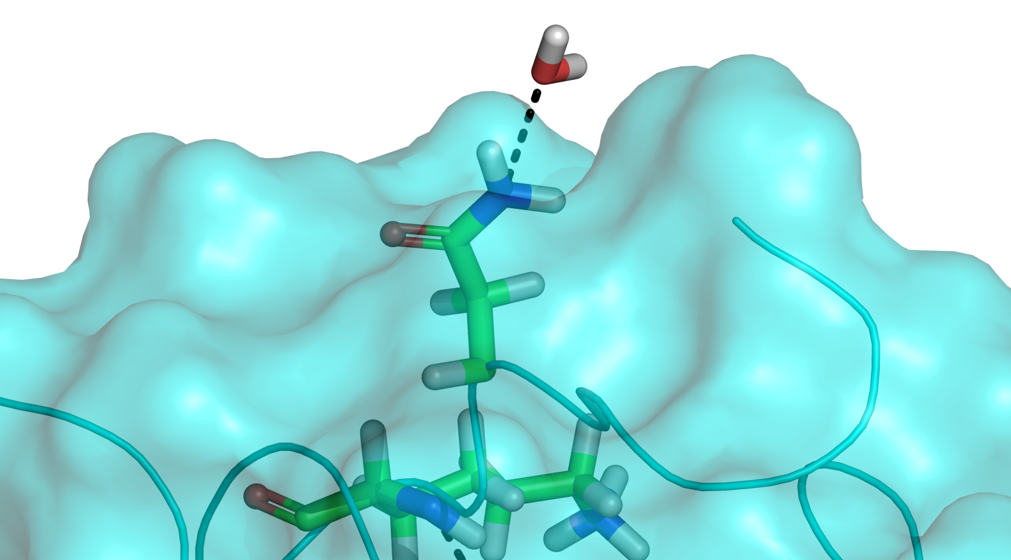
Electrostatic interactions
Surface-water interactions
Exist both in the unfolded and folded state → do not contribute to folding
Notes:
Figure 2.6. Hydrogen bonds involving protein amino acids. (b) The surface of the enzyme acetylcholine esterase (PDB entry 1acj) is shown in cyan. Two hydrogen bonds are shown (black dashed lines). The first is between an Asn residue of the protein and a solvent water molecule. The other hydrogen bond is between two Lys residues inside the protein. All interacting residues are presented as sticks and colored by atom type.

Slide 14
Electrostatic interactions
Surface charge-charge interactions
Efficiently screened by the solvent → marginal contribution to folding
Notes:
Figure 2.23. Solvent exposure of various protein regions in the folded vs. unfolded states. Polar and nonpolar residues are colored in magenta and green, respectively. The solvent (water) molecules surrounding the protein are represented as spheres. In the folded state, nonpolar residues reside mainly in the protein core away from the solvent, whereas in the unfolded state both polar and nonpolar residues are exposed to the solvent. Still, the folded state contains patches of hydrophobic residues, as explained in the main text. Water molecules were added to the protein computationally by the PDB_hydro server ^{[277]} (Delarue group, Institut Pasteur ^{[278]}).

Slide 15
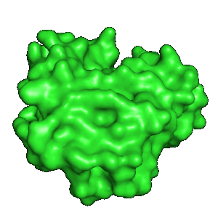
Electrostatic interactions
Core charge-charge interactions
Favorable pairwise interactions (G_{coul} = )
Unfavorable polarization interactions (G_{pol} = ; )
(desolvation)
ε = 80
+
+
-
ε = 2-4
-
Notes:
Figure 4.4. Two views of charge desolvation during protein folding. In the unfolded state, protein charges (partial or full) are electrostatically screened by the surrounding water molecules (left). Theoretically, during folding, these charges should be desolvated inside the protein core, losing the screening of each of the charges (right).

Slide 16
Electrostatic interactions
Core charge-charge interactions
ΔG_{elec} depends on the charges’ micro-environment
Extensive charge network → favorable ΔG_{elec}
Increasing the number of Coulomb interactions
Increasing ε (~2 to ~20) → decreasing desolvation
-
+
G_{pol} =
+
-
-
+
Notes:
The total free energy of burying core charges is under dispute, however, there seems to be more weight in the stabilization direction. Still, even in studies showing stabilization, the value of the total electrostatic energy varies from 0 to -7.5 kcal/mol for a salt bridge, and 0 to -3.6 kcal/mol for a hydrogen bond.
Figure 4.4. Two views of charge desolvation during protein folding. However, in reality, buried charges are almost always surrounded by other charges, which provide at least partial screening.

Slide 17
Electrostatic interactions
Why bury charges in the first place?
Functionality: catalysis, ligand binding
Fine-tuning the folded structure: conformational change → loss of ΔG_{Coul}, higher ΔG_{pol}
G_{pol} =
+
-

Slide 18
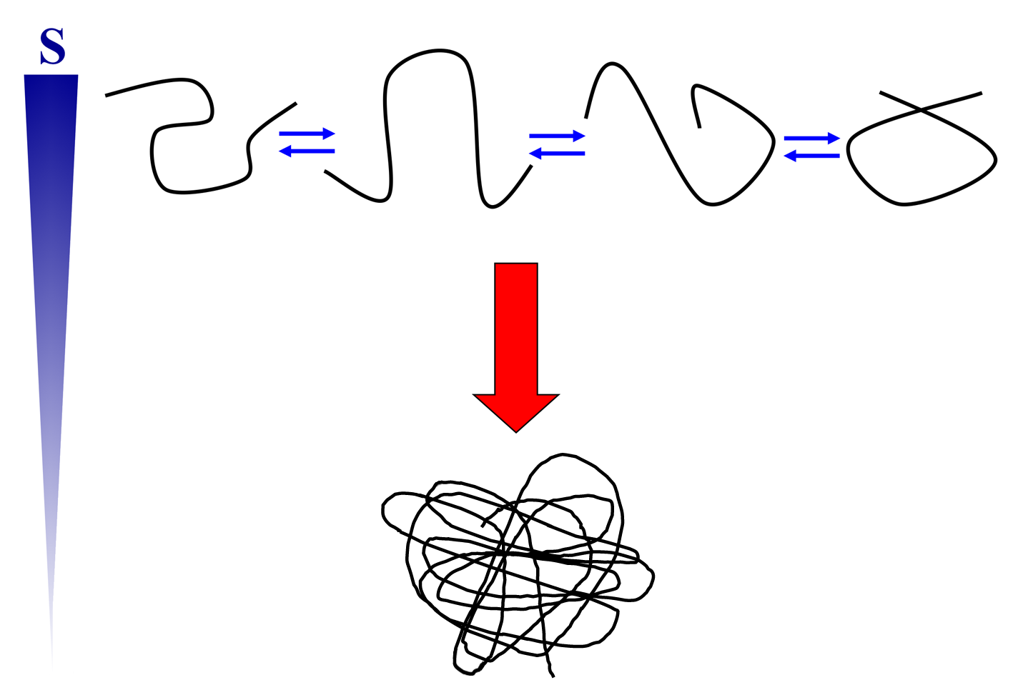
Entropy changes
Folding involves partial loss of configurational entropy → opposes folding
Notes:
Figure 4.1.2. Entropy changes accompanying the folding of a biopolymer. The unfolded (top) and folded (bottom) states of the polymer chain are depicted simplistically. The entropy (S) change of the polypeptide chain during the process is shown on the left. The unfolded state is an ensemble of conformations existing in equilibrium, whereas the folded state has only one average conformation*. Thus, the entropy change (of the polypeptide) of the folding process is negative.
* As explained in detail in Chapter 5, the native state is itself an ensemble of conformations, which exist in equilibrium. However, it is much smaller than the unfolded state's ensemble. Thus, a significant drop in the entropy of the polypeptide chain takes place upon folding.

Slide 19
Entropy changes
Estimates:
ΔS_{con}: 4-6 cal/(mol×K) per residue
ΔG_{con}: 1.2-1.9 kcal/mol per residue, at 37 °C (310 K)
ΔG_{con} = -TΔS_{con}
For an ‘average’ residue (SA ≈ 100 Å²) buried in core:
ΔG_{np} = -0.025×SA = -2.5 kcal/mol
ΔG_{con}: 1.2-1.9 kcal/mol
Thus, nonpolar interactions overcompensate for the entropy loss, but not by much

Slide 20
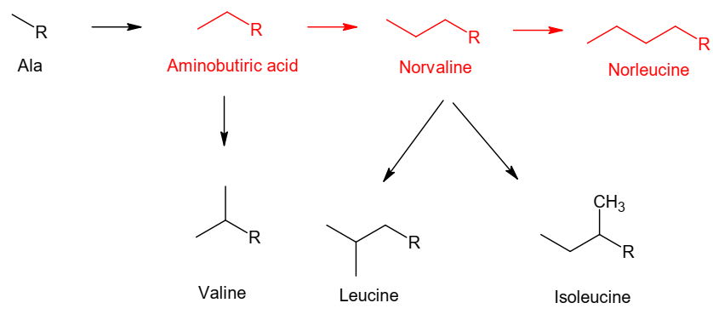
Entropy changes
Branching and rings create larger amino acids with less increase in folding entropy cost
(R – backbone; arrows – additions of CH₃; red – not in proteins)

Slide 21
Entropy changes
Entropy loss upon folding varies for different parts of the protein
Notes:
Figure 4.3. Solvent accessibility of protein residues. The protein acetylcholine esterase (PDB entry 1acj) is colored by solvent accessibility, from yellow (most accessible) to dark blue (least accessible). The front of the protein has been removed, to make the core visible. Surface, subsurface, and core locations in the protein are marked.

Slide 22
Summary
Proteins folding is driven by nonpolar interactions and to a lesser extent by vdW interactions
Electrostatic interactions (H-bonds, salt bridges) stabilize/destabilize, depending on the charges’ environment. They also help fine-tune the folded structure and contribute to function
Protein entropy changes are the main force opposing folding
The opposing forces partially compensate for each other, resulting in a relatively small net stabilization (~5-20 kcal/mol)
Notes:
* Two interesting points:
The two main factors in protein folding are entropic: the hydrophobic effect (solvent entropy) which supports folding, and the protein’s entropy, which opposes it.
The hydrophobic effect is not just the driving force for protein folding but also for membrane formation and the formation of the first cells on Earth. This is not surprising considering that life appeared and developed in an aqueous environment.

Slide 23
Protein Denaturation and Adaptation to Extreme Conditions

Slide 24
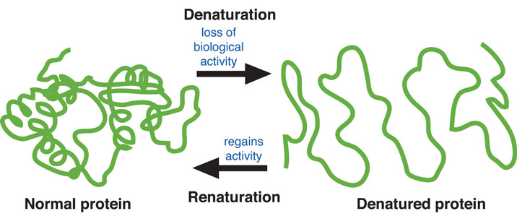
Denaturation
Denaturation
Loss of protein activity due to environmental changes
Results from changes in protein structure or dynamics
Used to study protein stability and the folding process
http://2012books.lardbucket.org/
Notes:
Proteins fold spontaneously into their native states because under the conditions that exist within living organisms these folded structures have the least energy, and therefore they are the most stable form of the protein chain. However, when these conditions change, sometimes momentarily, the proteins may lose their native folds and their biological activity. This process is called denaturation.
The scheme is taking denaturation to the extreme; the native structure doesn’t necessarily have to be lost completely to lose activity.

Slide 25
Denaturation
Thermal
~45 ºC (~113 ºF) or higher
Increased atomic motions (K α k_{B}T) → weakening of non-covalent interactions
Cold
0 - 5 ºC (32-41 ºF): decreased dynamics → reversible drop in activity
< 0 ºC (32 ºF): ice formation → loss of solubility → sedimentation → loss of activity
Notes:
A more thermodynamic explanation to thermal denaturation: added kinetic energy → unfolded state entropy increases much more than folded state entropy → entropy difference between the two states becomes large enough to drive unfolding.

Slide 26
Denaturation
pH-induced
Due to changes in protonation & ionization of residues
Direct – changes in catalytic or ligand-binding residues
Indirect – unfavorable change in the electrostatic free energy of the folded state → structural changes
pH drop
+
-
+
+
Lys-NH₃⁺
-
Asp-COO⁻
Notes:
The scheme shows an example for indirect loss of activity: a salt bridge is broken due to a pH drop, which protonates an Asp/Glu, making it electrically neutral. The loss of Coulombic stabilization and the increase in polarization energy may lead to structural changes and loss of activity.

Slide 27
Denaturation
Pressure-induced
Results from 'pushing' water into protein core
Chemical
Organic solvents – stabilize the unfolded state
Urea/guanidinium chloride – most likely acts by disrupting polar interactions (e.g. backbone-backbone H-bonds)

Slide 28
Adaptation to extreme environments
Hyperthermophiles (80-113 ºC; 176-235 ºF)
Structural rigidification – Pro↑ Gly↓ aromatics↑
Strengthening the core – more nonpolar and secondary structure-promoting residues
Strengthening of electrostatic interactions inside protein – more salt bridges
Strengthening protein-solvent interactions (more H-bonding residues on the surface) – increase solubility
Notes:
In multicellular organisms the cells are protected from denaturation thanks to homeostasis. In unicellular organisms the cells must cope with changing conditions.
Such adaptations appear in certain organisms, many of which belong to the Archaea kingdom, which live constantly under extreme environmental conditions: high temperatures (e.g., geysers, warm springs, openings of volcanoes, hydrothermal vents), high salt concentration (e.g., the Dead Sea), or high pressure (e.g., the ocean floor).
Secondary-structure formation is beneficial to stability for two reasons. First, it reduces local chain motions. Second, it allows the pairing of polar backbone groups in hydrogen bonds, which reduces the exposure of these groups to the nonpolar core of the protein.
Salt bridges in hyperthermophiles may be stabilizing due to decrease of the desolvation penalty by (1) optimization of charge masking via polar networks, (2) the fact that the water’s dielectric is decreased at high temperatures, which decreases the dielectric difference between the water and protein core.

Slide 29
Adaptation to extreme environments
Psychrophiles (< 15 ºC; 59 ºF)
Increasing the internal dynamics – polar-small ↑, nonpolar ↓ residues in the core
Strengthening protein-solvent interactions (more H-bonding residues) – increase solubility
Notes:
Both thermophiles and psychrophiles increase solubility for different reasons: in the former the added kinetics of protein and solvent makes the bonds between them short-lasting. In the latter the decreased kinetics makes solvent-solvent Hbonds long-lasting, thus reducing the number of protein-solvent bonds.

Slide 30
Protein Engineering for Increased Stability

Slide 31
Industrial enzymes
Which industries?
Food (e.g. fermentation, emulsification)
Textile (e.g. laundry detergents, fabric processing)
Pharmaceuticals (both as drugs and catalysts in drug synthesis)
Why engineer enzymes?
Increase stability (longer shelf life, harsh conditions) & solubility
Protect from inactivation by harsh conditions (e.g. oxidation)
Increase catalytic efficiency (faster production)
Change substrate specificity (e.g. for unnatural substrates)

Slide 32
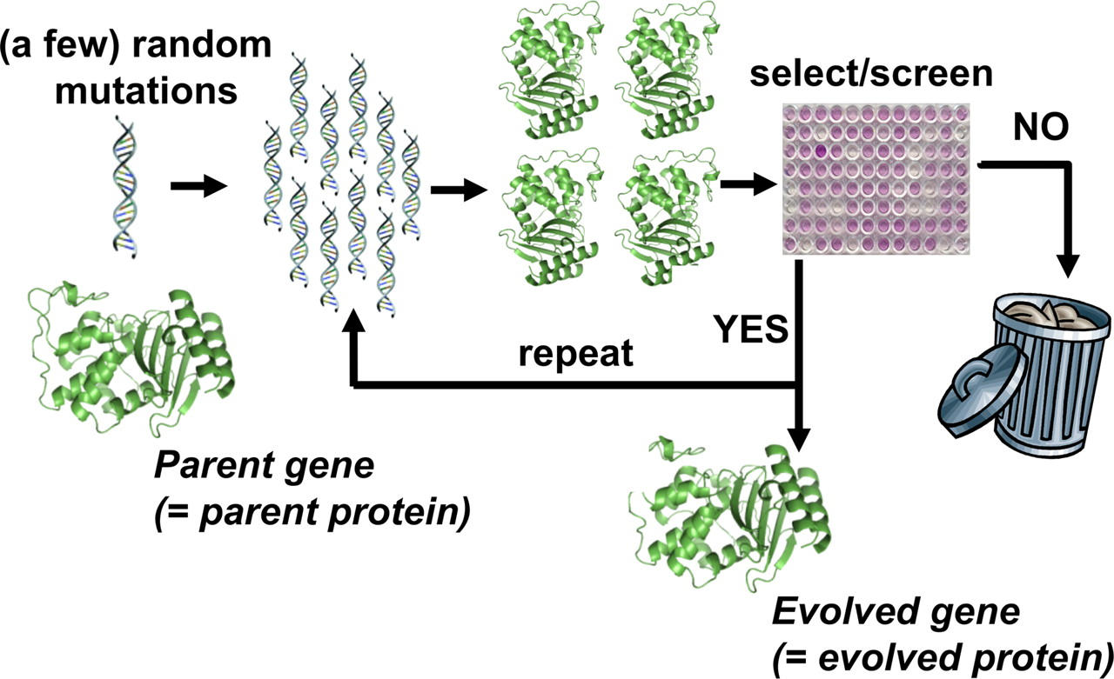
Engineering
Strategies
Rational– for a small number of mutations around active site
Random (e.g. directed evolution) – for a large number of mutations or outside active site
Semi-rational – integrates both rational and random
Directed evolution experiment
Jesse D. Bloom, and Frances H. Arnold PNAS 2009;106:9995-10000

Slide 33
Engineering enzymes for increased stability
Mutations that are used resemble those found in hyperthermophiles:
Structural rigidification – Pro↑ Gly↓ aromatics↑ S-S bonds ↑
Strengthening the core – more nonpolar and secondary structure-promoting residues
More salt bridges

Slide 34
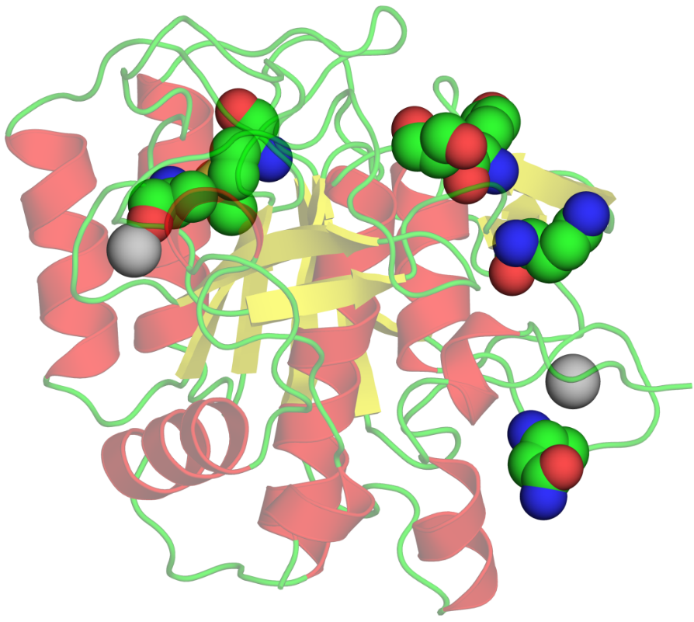
Engineering enzymes for increased stability
Engineering studies also suggest other strategies:
Enhance protein-solvent interactions – renders unfolding reversible by preventing subsequent aggregation
Enhance ion-binding (e.g. Ca²⁺)
Engineered subtilisin
Notes:
Figure 4.5. Stabilizing mutations in subtilisin. (b) The mutated subtilisin BPN. The six mutations shown (as atom-type colored spheres) have been found to confer the highest degree of stabilization to the protein: N218S, G169A, Y217K, M50F, Q206C, and N76D. The change of stability is represented by the free energy change of unfolding, as measured by differential scanning calorimetry ^{[224]}. Each individual mutation increased stability by 0.3-1.3 kcal/mol, and together they increased stability by 3.8 kcal/mol. The image demonstrates the surface location of all the mutations save one, and the proximity of some to the two Ca²⁺ binding sites (the two cations are colored gray).

