Slide 1
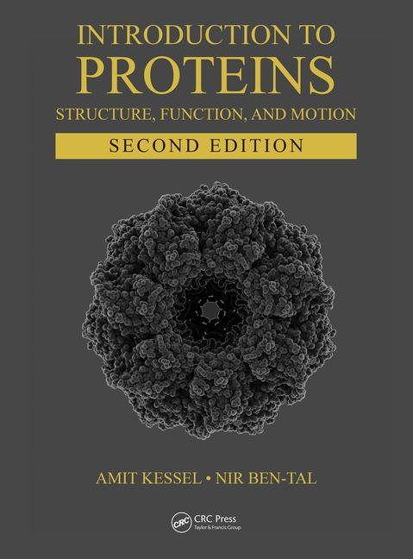
This PPT presentation is provided as suppl. material to the book:
Introduction to Proteins: Structure, Function, and Motion
2nd Edition (2018)
Amit Kessel & Nir Ben-Tal

Slide 2
Chapter 1:
Introduction

Slide 3
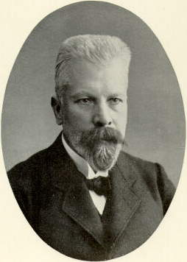
Protein Chemistry: the Beginning
The life-chemistry-proteins relationship:
Pasteur: microorganisms ferment sugar to alcohol (life involves chemistry)
Berthelot & Buchner: chemical processes can be catalyzed in vitro by cellular extracts (the zymase concept)
Later: the active ingredient in the extracts are proteins (enzymes), which are the products of genes
Eduard Buchner, winner of 1907 Nobel Prize in chemistry
Notes:
Figure 1.1. Eduard Buchner, winner of the 1907 Nobel Prize in chemistry. The image is taken from ^{[9]} (originally from ^{[10]}).

Slide 4
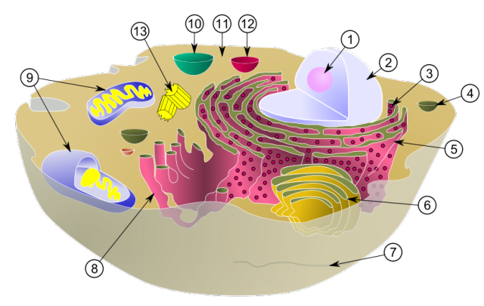
The molecular organization of life
Proteins function within cells, the basic unit of living organisms
Notes:
Figure 1.2. An illustration of the inner organization of a eukaryotic animal cell. (1) Nucleolus. (2) Nucleus. (3) Ribosome. (4) Vesicle. (5) Rough endoplasmic reticulum (rER). (6) Golgi apparatus. (7) Cytoskeleton. (8) Smooth endoplasmic reticulum (sER). (9) Mitochondria. (10) Vacuole. (11) Cytosol. (12) Lysosome. (13) Centriole. The image is taken from ^{[14]}.

Slide 5
The molecular organization of life
Life processes involve 2 additional macromolecules
Nucleic acids: encoding and expression of genetic information
Nucleic acids
(B-DNA double helix )
Notes:
Figure 1.3. The three types of macromolecules in biological cells and tissues. (b) Nucleic acids. The B-DNA double helix is shown, with covalent bonds shown as sticks. The color code follows the convention: carbon atoms are green, oxygen atoms are red, hydrogen atoms are white, nitrogen atoms are blue, and phosphorus atoms are orange.

Slide 6
The molecular organization of life
Life processes involve 2 additional macromolecules
Complex carbohydrates:
Energy stores in animals (glycogen) and plants (starch)
Building blocks of plant cell wall (cellulose) and insect exoskeleton (chitin)
Molecular recognition
Notes:
Figure 1.3. The three types of macromolecules in biological cells and tissues. (c) Complex carbohydrates. The image shows cycloamylose (a.k.a. cyclodextrin), an enzymatic product of starch. Cycloamylose is a cyclic oligosaccharide, in which the α-D-glucopyranoside units are linked via 1→4 glycosidic bonds ^{[36]}. The atoms are presented as in (b).

Slide 7
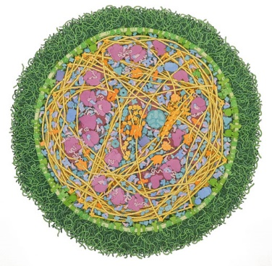
Why Are Proteins Interesting?
The most abundant macromolecules:
~50% of the cell’s dry mass
No. of proteins ≈ 4 times the number of their coding genes.
Up to 15,000 protein in one cell
© David S. Goodsell 2011

Slide 8
Why Are Proteins Interesting?
Functionally diverse:
Catalysis of metabolic processes
Energy transfer
Gene expression
Transport of solutes across membranes
Cellular communication
Molecular recognition
Defense
Forming intracellular & extracellular structures

Slide 9
Protein Roles: Enzymatic Catalysis
Cellular needs: 10⁻⁵-10² seconds for each reaction
Outside cells: seconds to 10⁹ years (room temp)
Enzymes:
Efficient (10¹¹-10¹⁶ acceleration, up to 10²¹)
Specific (substrate, reaction)
Can be controlled
Can couple endergonic to exergonic reactions
+
+
Notes:
Figure 1.5. The specificity of enzymes. A highly schematic representation of an enzyme’s specificity to its intended substrate. In the depicted reaction, the enzyme (blue circle) facilitates the cleavage of a substrate (in orange) into two identical products. As the scheme shows, the enzyme will act only on its intended substrate, even in the presence of other chemical entities. This results from the three-dimensional structure of the enzyme, which creates a geometric match between its active site and the structure of the intended substrate (but not the other possible substrates).

Slide 10
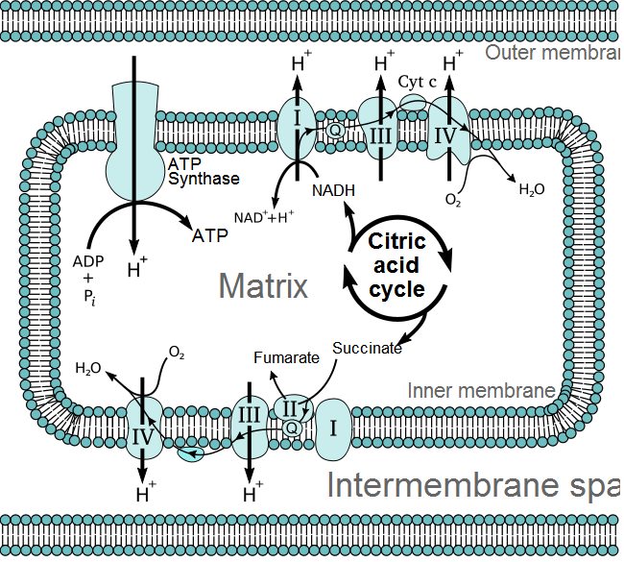
Protein Roles: Energy Transfer
Proteins extract energy from foodstuff
Outer membrane
Intermembranal Space
Notes:
Figure 1.6. Cellular respiration within mitochondria. The schematic illustration shows the main players in this multi-component system. The citric acid (Krebs) cycle completes the aerobic oxidation of foodstuff inside the mitochondrial matrix. The high-energy electrons released by this process are first stored as NADH and FADH₂, and are then passed on to the first component of the electron transport chain, embedded within the inner mitochondrial membrane. The electrons pass through several cytochromes and finally pass to molecular oxygen, which is reduced to water. The electron chain contains 3 protein complexes (I, III, IV), which use the energy released upon electron transport to pump protons from the matrix into the intramembrane space. The energy stored in the gradient is released when the latter dissipates via ATP synthase, a protein complex that couples proton movement to ATP synthesis from ADP and inorganic phosphate. The image is taken from ^{[43]}.

Slide 11
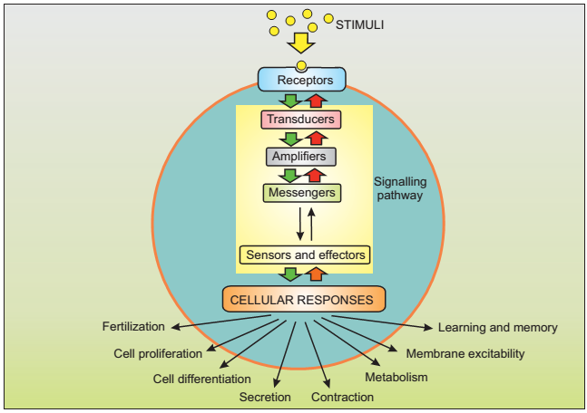
Protein Roles: Signal Transduction
Transducing external signals into cells requires multiple elements
Notes:
Figure 1.7. The main players in a typical signal transduction cascade. (a) A general scheme showing the principal components in a signal transduction cascade. Stimuli (e.g., hormones, neurotransmitters, or growth factors) act on cell-surface receptors, which activate transducers to relay the signal into the cell. The transducers use amplifiers to generate internal messengers, which either act locally or diffuse throughout the cell. These messengers then engage sensors that are coupled to the effectors responsible for activating cellular responses. Note that the order of participation of pathway components may vary across different signaling pathways. For example, messengers may be used to activate amplifiers instead of being produced by them (see panel (b)). The green arrows indicate ON mechanisms, during which information flows down the pathway, and the red arrows indicate opposing OFF mechanisms that switch off the different steps of the signaling pathway. Virtually all of the components mentioned above may be proteins. The image is taken from ^{[56]}.

Slide 12
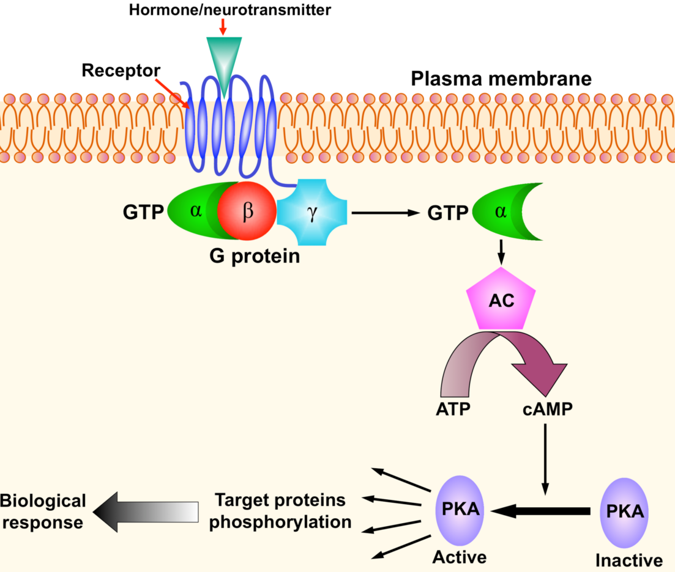
Protein Roles: Signal Transduction
Many of these elements are proteins, e.g. surface receptors and intracellular enzymes
Notes:
Figure 1.7. The main players in a typical signal transduction cascade. (b) The cAMP-PKA cascade. Binding of an external chemical messenger (hormone, neurotransmitter, etc.) to a membrane-bound protein receptor induces the activation of an enzyme called a G-protein, which acts as a transducer. This activation makes one of the protein's subunits detach from the other, bind to the enzyme adenylyl cyclase (AC), and activate it. Activated AC catalyzes the conversion of ATP into cyclic AMP, which acts as an intracellular messenger. It binds to and activates the enzyme amplifier PKA, which in turn phosphorylates a large set of cytoplasmic proteins. The phosphorylated proteins may activate other cellular components, or perform a certain function (that is, they may act as sensors and/or effectors). In any case, this signal transduction eventually leads to changes in the cell's behavior, i.e., to a biological response.

Slide 13
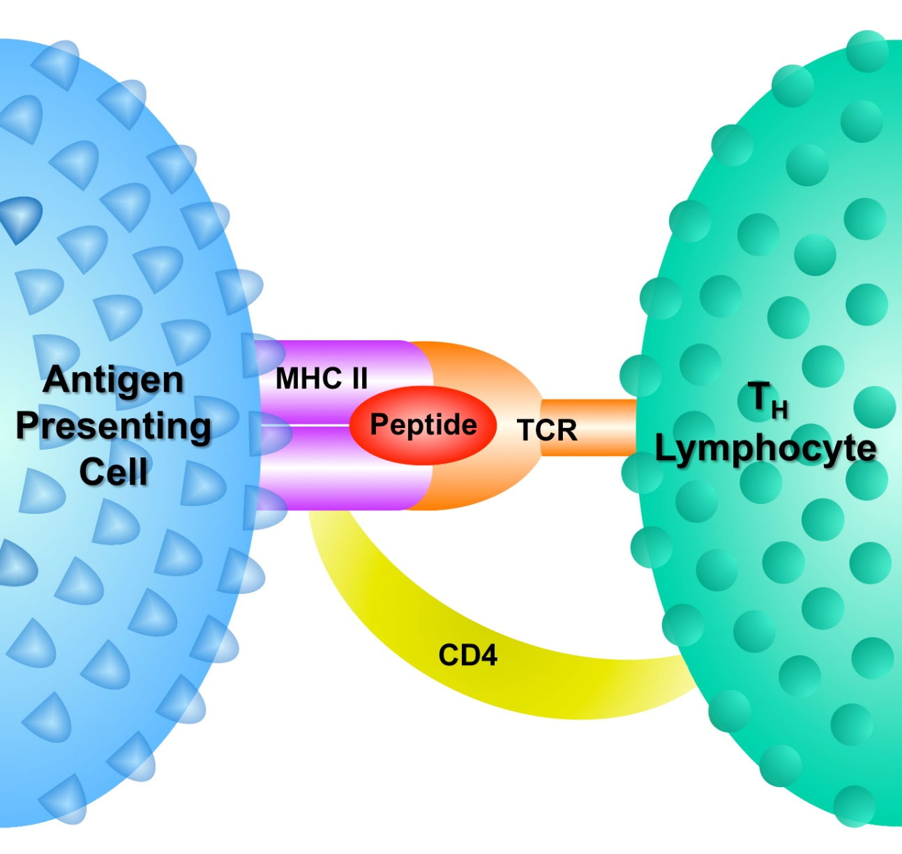
Protein Roles: Defense
Immune cells recognize pathogens using protein receptors
Notes:
Figure 1.8. Proteins involved in the interactions between an antigen-presenting cell and a T helper (T_{H}) lymphocyte. Antigen-presenting cells (APCs), such as macrophages, can internalize bacteria, cleave their proteins to peptides, and present these peptides on their surfaces while bound to some of their own proteins, called MHC-II (major histocompatibility complex type II). T_{H} lymphocytes, a type of immune cell, can recognize the APC-foreign antigen complex using their own cell-surface proteins. Specifically, the T-cell receptor (TCR) of the lymphocyte recognizes the particular foreign antigen presented by the APC, whereas another protein, called CD4 (complementarity determinant number 4), recognizes the MHC-II protein. There are other recognition proteins that are not presented here. The recognition process described above allows the T_{H} lymphocyte to alert the rest of the immune system about the presence of a pathogen inside the body, which leads to the mounting of a full-scale immune response against the threat.

Slide 14
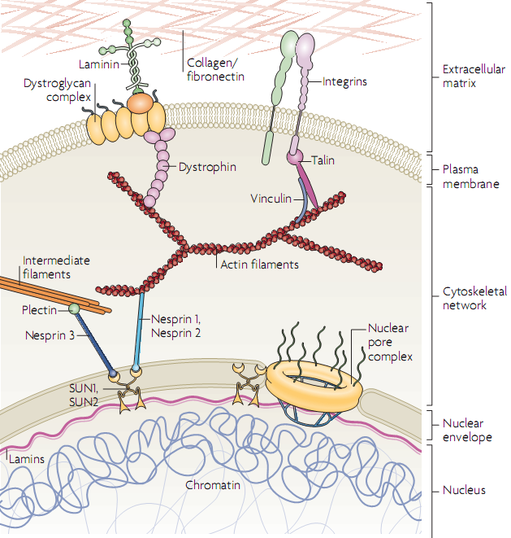
Protein Roles: Building Cells and Tissues
Notes:
Figure 2.48. Connectivity of the extracellular matrix and intracellular elements. The figure shows the continuous protein network starting from collagen and fibronectin fibers outside the cell, to membrane-crossing elements such as integrins, to intracellular elements such as actin- and intermediate-filaments of the cytoskeleton, and finally to elements inside the cell nucleus, such as lamins.

Slide 15
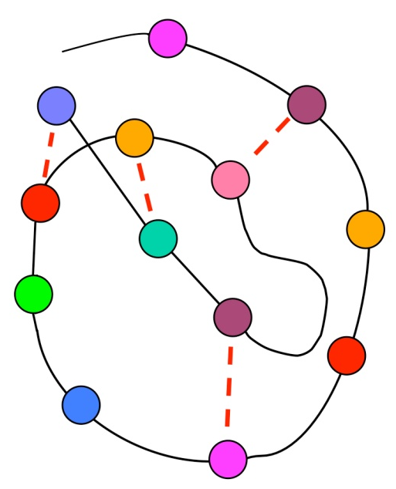
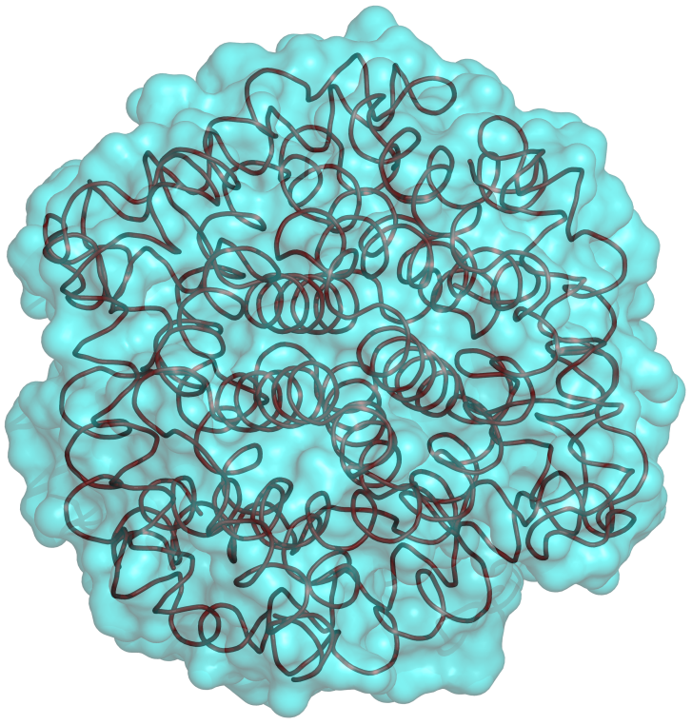
Proteins’ functionality results from their chemical and structural complexity
Each protein is built from a chain of amino acids that folds into a 3D structure due to attraction and repulsion forces
Notes:
The functional complexity of proteins results from the fact that:
They are polymers built from chemically diverse building blocks.
They fold into a complex 3D fold that positions some of these building blocks in a way that allows them to perform a function.
Figure 1.10. The principal structure and folding of proteins. (a) The protein's amino acid sequence, shown schematically as beads on a string. The different colors represent the physical-chemical diversity of amino acids. (b) A folding intermediate, in which some of the total possible amino acid interactions are satisfied (represented by dotted lines). (c) The final (native) structure of the protein.

Slide 16
Proteins’ functionality results from their chemical and structural complexity
The action of all proteins involves ligand binding:
Enzyme-substrate
Receptor-hormone/neurotransmitter
G-protein-GTP
Histone-DNA
Hemoglobin-O₂
Channel/transporter-ion/solute
Cytoskeleton proteins
Extracellular proteins
Notes:
The action of virtually all proteins involves binding of a ligand (small molecule, another macromolecule).

Slide 17
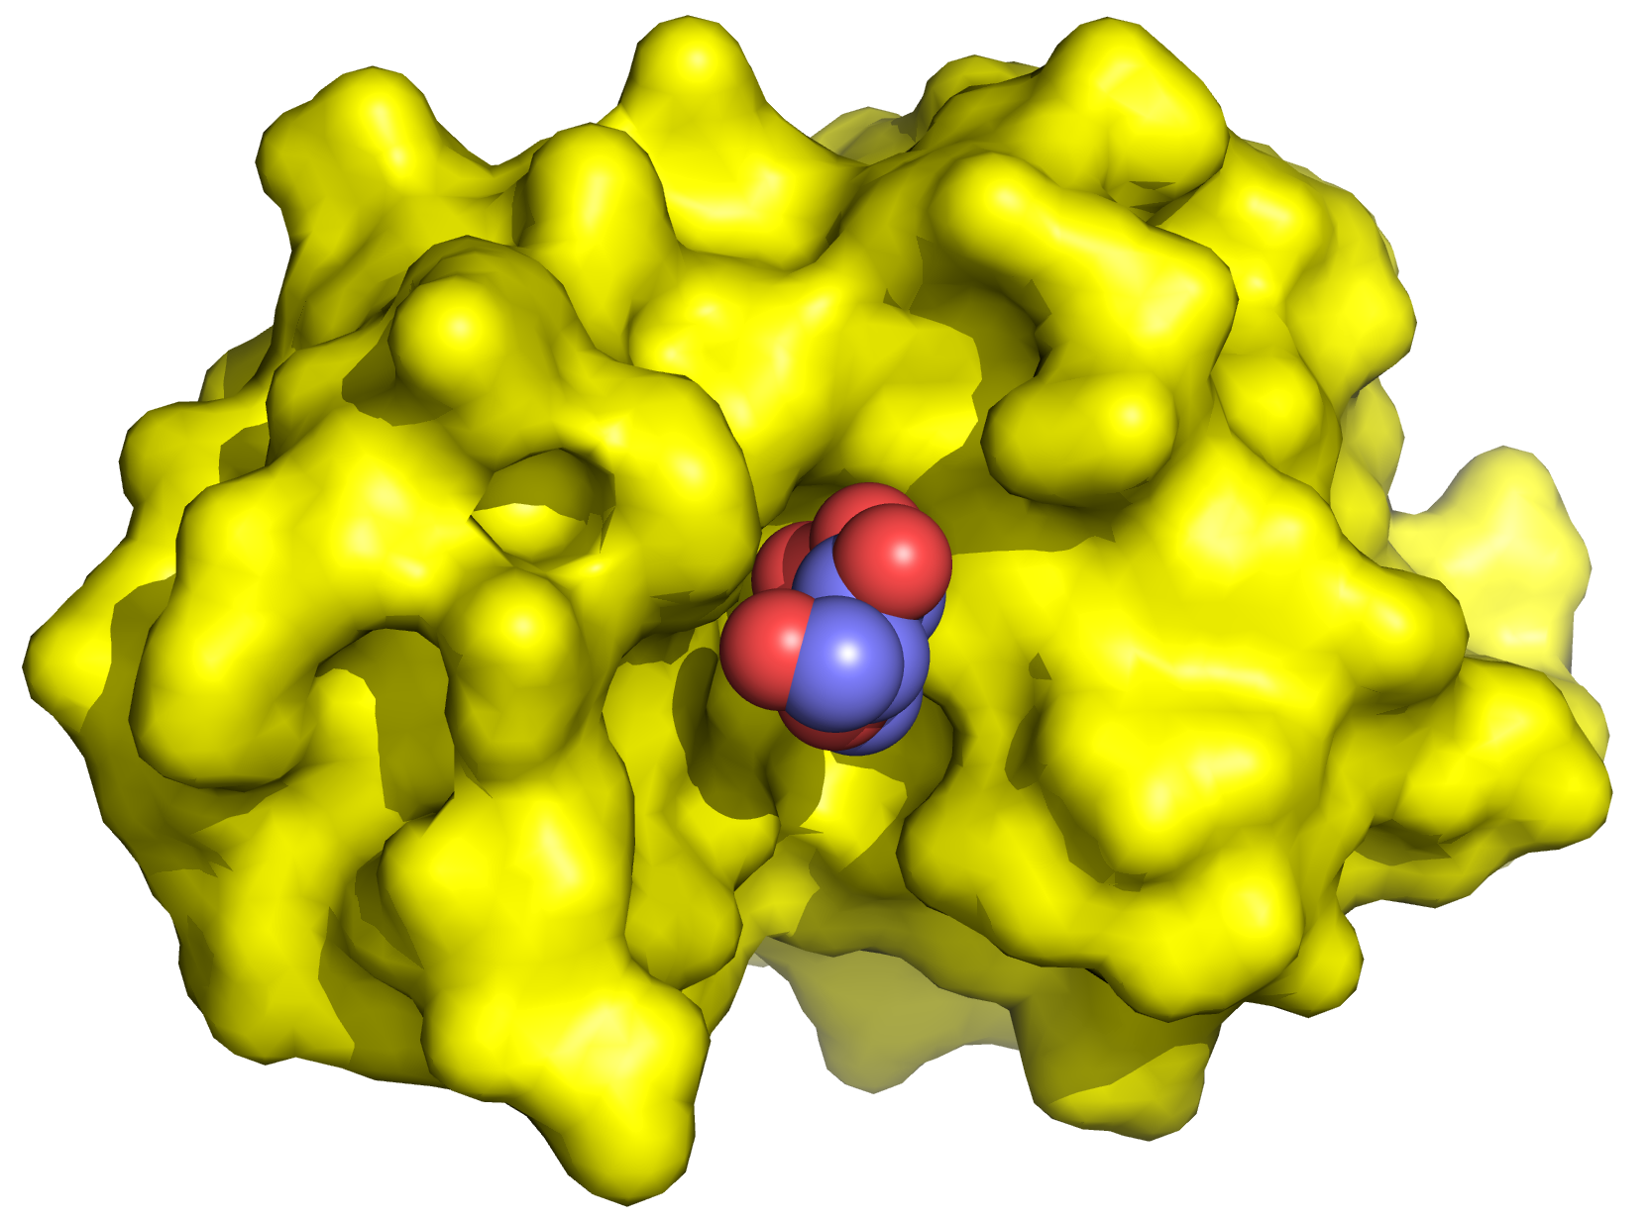
Proteins’ functionality results from their chemical and structural complexity
Ligand binding occurs at specific proteins sites
The binding involves non-covalent interactions of ligand with amino acids in the binding site
Notes:
Figure 1.11. Structure-function relationship in the binding site of an enzyme (lysozyme). Left: The overall structure of an enzyme (PDB entry 9lyz). The contours of the enzyme are shown as a yellow surface. The substrate (blue spheres) is shown within the binding site (red circle). Right: A magnification of the binding site, showing the substrate and some of the enzyme’s amino acids that participate in the binding (green sticks) and catalysis (orange sticks) of the substrate.

Slide 18
Proteins’ functionality results from their chemical and structural complexity
In enzymes, the amino acids within the binding site change the ligand (substrate) chemically
Notes:
Figure 1.11. Structure-function relationship in the binding site of an enzyme (lysozyme). Left: The overall structure of an enzyme (PDB entry 9lyz). The contours of the enzyme are shown as a yellow surface. The substrate (blue spheres) is shown within the binding site (red circle). Right: A magnification of the binding site, showing the substrate and some of the enzyme’s amino acids that participate in the binding (green sticks) and catalysis (orange sticks) of the substrate.

Slide 19
Proteins’ functionality results from their chemical and structural complexity
Each protein:
Different amino acid sequence → different 3D structure → different binding/catalytic sites
Notes:
Figure 1.11. Structure-function relationship in the binding site of an enzyme (lysozyme). Left: The overall structure of an enzyme (PDB entry 9lyz). The contours of the enzyme are shown as a yellow surface. The substrate (blue spheres) is shown within the binding site (red circle). Right: A magnification of the binding site, showing the substrate and some of the enzyme’s amino acids that participate in the binding (green sticks) and catalysis (orange sticks) of the substrate.

Slide 20
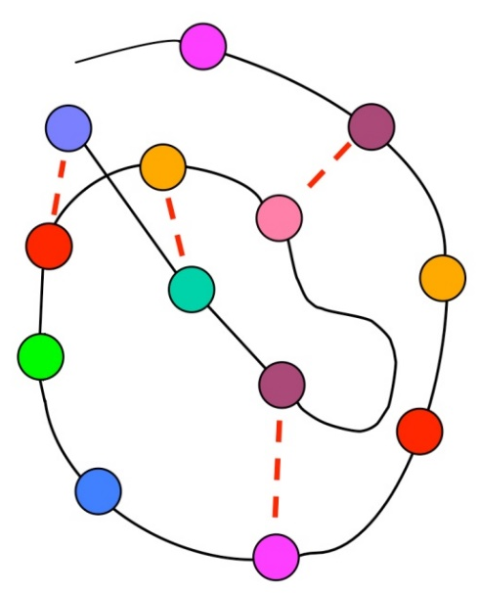
Non-covalent interactions
Non-covalent interactions:
Drive the folding of the protein chain into a specific 3D structure
Drive the binding of ligands (substrate, hormone, messenger, allosteric modulator) to a binding/catalytic site in the proteins

Slide 21
Non-covalent interactions
Much weaker than covalent bonds
Make biomolecules flexible, and allow them to interact reversibly with each other
Strength: ≤ 10 kcal/mole

Slide 22
Non-covalent interactions
Most types are electrostatic
Notes:
Figure 1.12. Main non-covalent interactions found in proteins. (a) The relationship between the interaction types (see more detailed description in the main text). The dominant interactions in proteins are colored in blue. vdW: van der Waals.

Slide 23
Electrostatic interactions
Charge 1
Charge 2
Charge-charge:
+
-
Charge
Dipole
δ-
δ+
Charge-dipole:
+
δ-
δ+
Dipole 1
Dipole 2
δ+
δ-
δ+
δ-
Dipole-dipole:
δ-
δ+
δ-
δ+
Notes:
Figure 1.12. Main non-covalent interactions found in proteins. (b) Types of charges involved in attractive electrostatic interactions. + and – indicate full positive and negative charges (respectively) on the atoms. δ+ and δ- indicate (permanent) partial positive and negative charges (respectively). Left: A schematic representation of the interactions. The covalent bonds are marked by bars, and the electrostatic interaction is marked by the orange dotted line. Right: Examples of the interactions, between the following groups: a positively-charged ammonium and a negatively charged carboxylate (top), a positively-charged ammonium and a hydroxyl dipole (middle), and an amino dipole and a hydroxy dipole (bottom).

Slide 24
Electrostatic interactions
Ionic bonds (salt bridges)
long-range interactions (e.g. in tutorial)
ε
q_{i}
r_{ij}
q_{j}
[pcu]
[Å]
[kcal/mol]
Notes:
The charges are in proton charge units (+1, -2, etc.).
Figure 1.13. Electrostatic interaction between two point charges of opposite sign. (a) The charges are depicted as two points, with r denoting the distance separating them. One of the charges, q_{i}, is positive (blue), whereas the other, q_{j}, is negative (red). The gray box represents the medium, of dielectric constant e, in which the charges are situated. Note that in cases in which the charges are also chemical entities (atoms, molecules), they too have dielectric constants.
(pcu – proton charge units)

Slide 25
Electrostatic interactions
Ionic interactions (salt bridges): the dielectric (ε)
The capability of a medium to mask electrostatic interactions
Results from the polarity of the molecules composing the medium
Vacuum (ε = 1): E = -332 kcal/mol
Oil (ε ≈ 2): E = -166 kcal/mol
Water (ε ≈ 80): E ≈ -4 kcal/mol
r = 1
Na⁺
Cl⁻

Slide 26
Electrostatic interactions
Polarity
r
Debye = 3.34×10⁻³⁰ Coulomb (q) × meter (r)
Notes:
Polarity involves a dipole, that is, a bond that connects two partial charges of opposite signs, formed by the electronegativity difference (full charges involve extra/fewer electrons in binding orbitals, like the binding of nitrogen’s unpaired electrons to a 4th hydrogen, or the extra electron of a carboxyl group). The polarity of the bond is usually described by the dipole moment, which is the separation of the charges, and whose direction is from the negative charge to the positive charge. This is because the dipole moment correlates with the size of the electric field emanating from the dipole.
The units of the dipole moment are Coulombmeter (thus, q must be in Coulombs), or Debye, which are 3.34×10⁻³⁰ Coulombmeter.
The dipole moment equation shown assumes that the two partial charges are of the same magnitude. When they are not, two half-dipoles can be calculated (one for each charge, with r/2), and then summed to get the value of the entire dipole (for that, the negative dipole must be considered as positive).
Figure 1.1.1. The polarity of a water molecule. The electronegativity value of each atom is noted. The most electronegative atom and its bonded partner are noted by red and blue numbers, respectively. δ+ and δ- denote the positive and negative poles of each bond.
Figure 1.1.3. The nonpolar nature of methane. The electronegativity values and colors are presented as in Figure 1.1.1. The hydrogen atom bonded by the solid wedge points out of the plane of the paper or screen, towards the observer, whereas the hydrogen atom bonded by the hashed wedge points into the plane of the paper or screen, away from the observer.

Slide 27
Electrostatic interactions
Polarity
r
d
r
θ = 104.45°
Notes:
Figure 1.1.2. The geometry of a water molecule. θ is the angle between the two O-H bonds. The direction of the molecular dipole (d) is shown on the right.

Slide 28
Electrostatic interactions
H
H
O
H
H
H
H
O
O
H
H
H
H
H
H
O
H
H
O
H
H
H
H
O
+
O
-
O
O
H
H
H
H
H
H
O
O
O
H
H
O
H
H
H
H
H
H
O
O
O
Notes:
Figure 1.1.4. Charge screening by surrounding water molecules. The dotted lines represent hydrogen bonds. The angle separating the two O-H bonds in water molecules is 104.45º. Here we used a smaller value for graphic purposes.

Slide 29
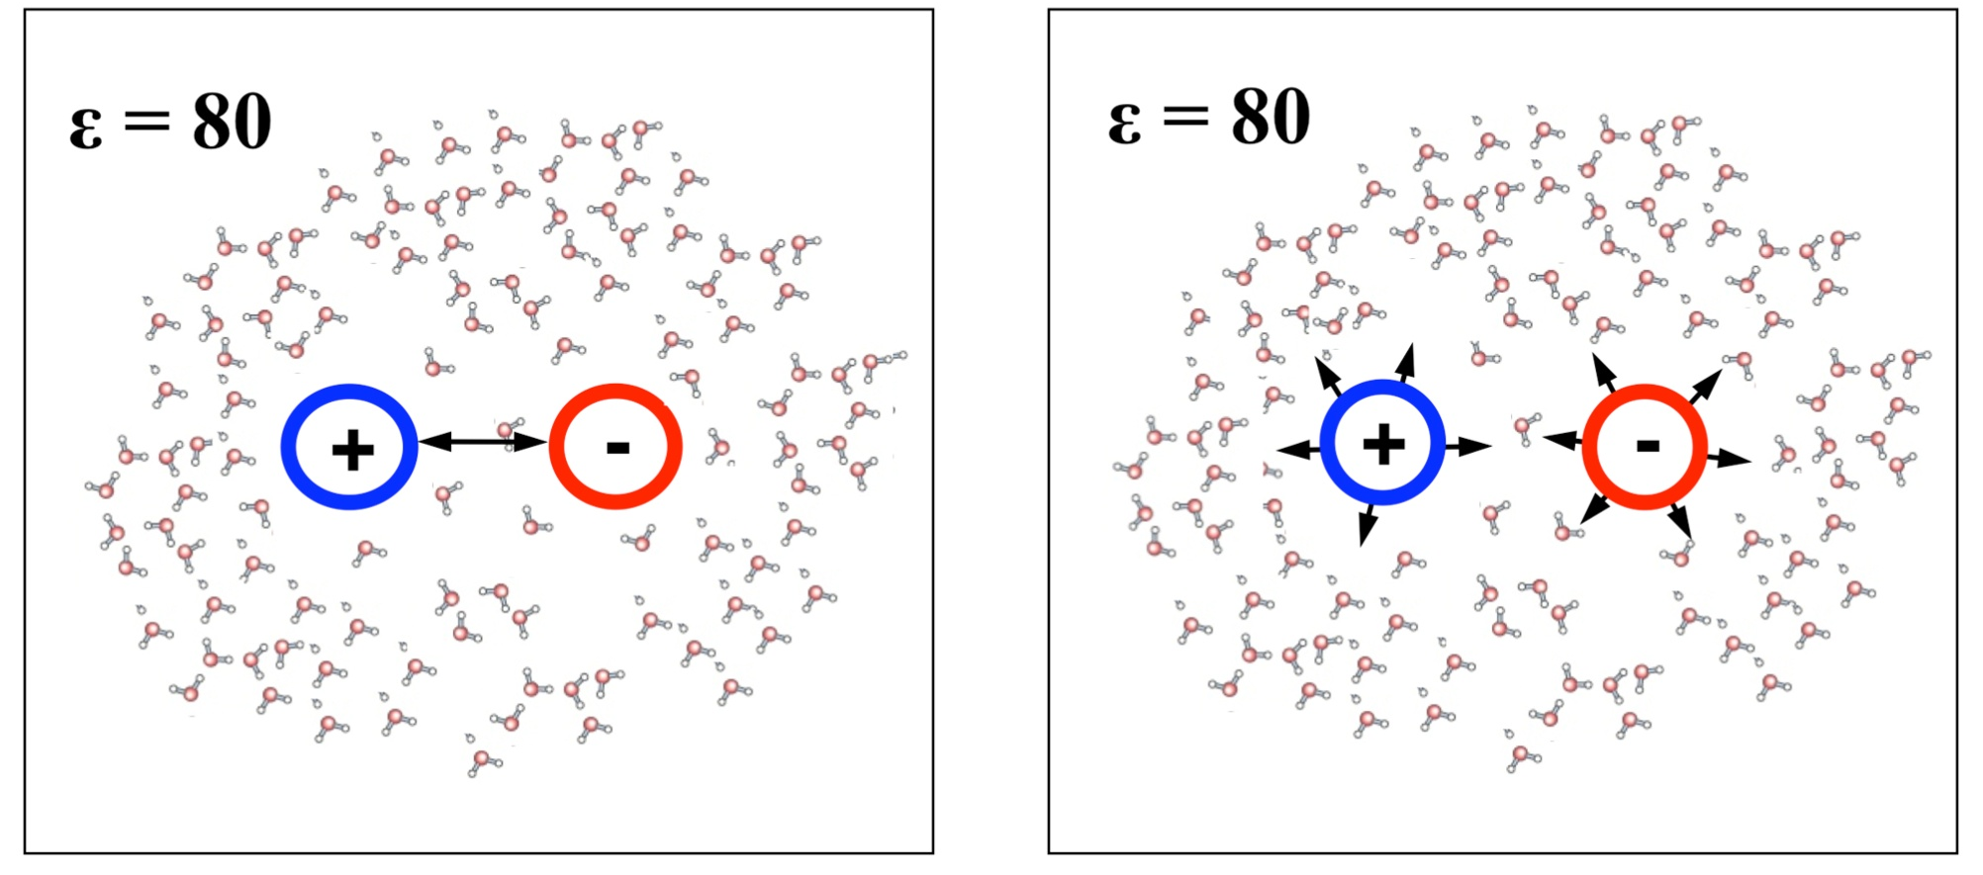
Electrostatic interactions
The total electrostatic energy: E_{tot} = E_{coul} + E_{pol}
E_{Coul}
E_{pol}
Notes:
Figure 1.14. Components of the total electrostatic interaction. (a) Schematic illustration of the two types of interactions involving two simple ionic charges (blue and red circles) inside water: pairwise (Coulomb) interactions between the two charges (left), and the (polarization) interactions between each of the charges and the aqueous environment (right). U_{Coul} and U_{pol} denote the potential energies of the two types of interactions, respectively.

Slide 30
Electrostatic interactions
The polarization energy
The Born model:
q .
r
→ ΔE_{transfer} = 166 (q²/r) (1/ε_{o} - 1/ε_{w})
water-to-oil transfer (r = 1.6Å):
ΔE = 166 (1²/1.6)(1/2-1/80) = 50 kcal/mol
Notes:
The transfer of polar solutes between media of different polarity is highly relevant in biological systems, which contain both high-dielectric media (cytoplasm, intercellular fluid, blood, lymph, urine) and low-dielectric media (plasma membrane, membranes of eukaryotic organelles, the blood-brain barrier)

Slide 31
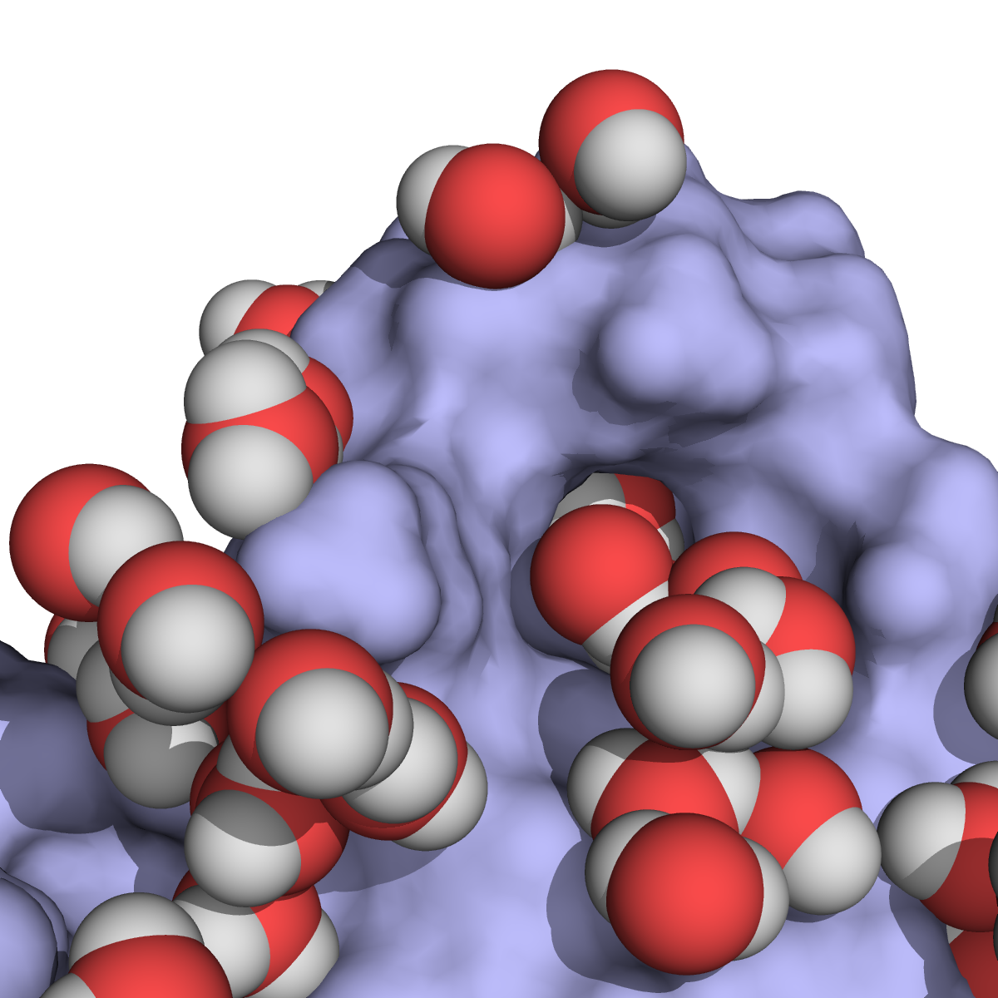
Electrostatic interactions
The total electrostatic energy
-
-
+
+
-
+
Notes:
Figure 1.14. Components of the total electrostatic interaction. (b) The same types of interactions, but when the interacting charges (white circles with + or - signs) are in a protein. The surface area of the protein is shown in blue, along with the first layer of solvent water molecules around it (red and white spheres). Two types of electrostatic interactions are presented: between charges within the protein (green dotted line), and between protein and solvent charges (yellow dotted lines).

Slide 32
Electrostatic interactions
The electrostatic field and potential
Notes:
Figure 1.3.1. The electrostatic potential. The potential (Φ) is the energy acquired by a probe charge (q₂) positioned within an electrostatic field (black arrows) that is emitted by a source charge (q₁). This is also a way to measure the potential.

Slide 33
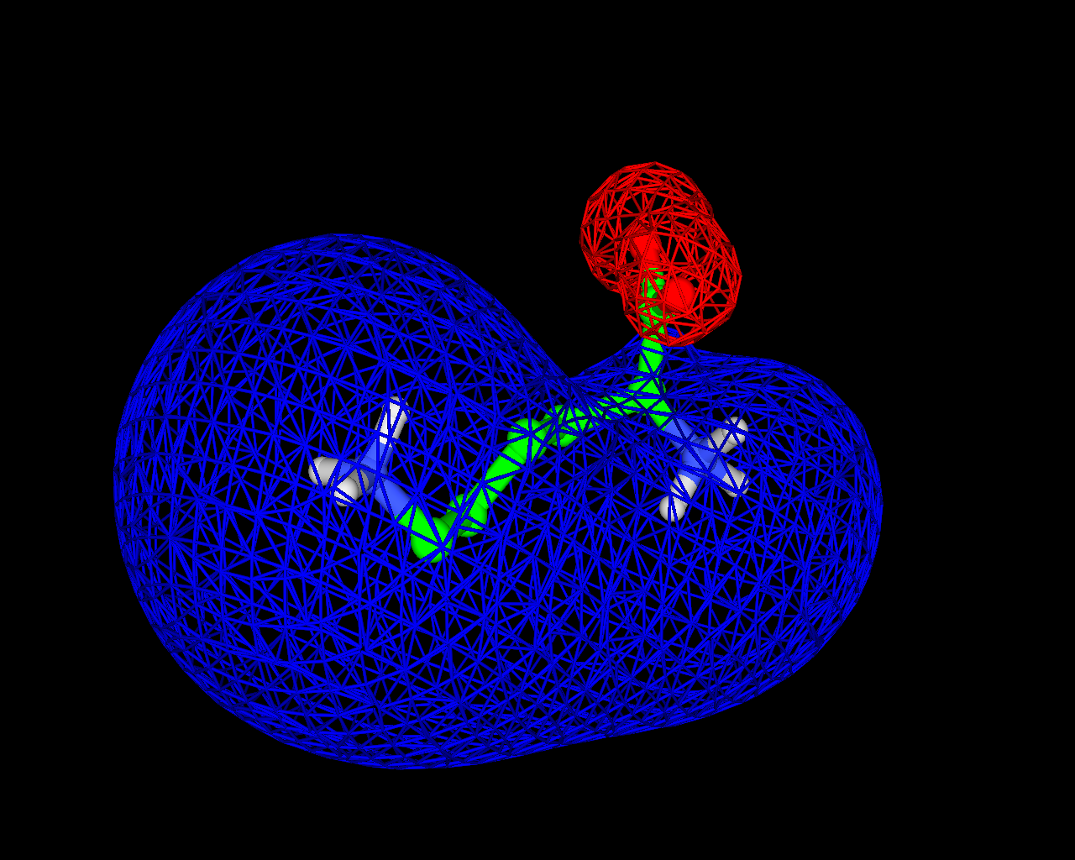
Electrostatic interactions
The electrostatic potential
q₂
Notes:
Figure 1.3.2. An equipotential surface representation of Φ around the amino acid Lys. The blue and red nets represent equipotential surfaces, i.e., all points in space in which Φ is +2 or -2 k_{B}T/e, respectively).

Slide 34
Electrostatic interactions
Hydrogen bonds
Notes:
Note that the scheme describes hydrogen bonds in proteins, which is why the heavy atom on the right is bonded to carbon. Generally speaking, hydrogen bonds can be between any two dipoles that ‘share’ a hydrogen.
Figure 1.15. The hydrogen bond. (a) Left: A general depiction of the hydrogen bond between a donor D and an acceptor A. δ+ and δ- indicate the signs of the partial positive and negative charges (respectively) on the atoms. The covalent bonds are marked by bars, and the hydrogen bond is marked by the orange dotted line.

Slide 35
Electrostatic interactions
Hydrogen bonds
Typical distances:
D--A: 2.8-3.0 Å
H--A: ~2 Å
Notes:
Figure 1.15. The hydrogen bond. (a) Right: examples of hydrogen bonds found in proteins. The R groups signify the moieties bound to the reactive groups; in all cases the heavy atom in the reactive group is bound to a carbon atom in the R group.

Slide 36
Electrostatic interactions
Hydrogen bonds
Like ionic interactions hydrogen bonds depend on q, r, and ε
Unlike ionic interactions hydrogen bonds are geometry-dependent
Hydrogen bonds are weaker and more distance-dependent than ionic interactions (r³ instead of r)
H
A
θ_{i}
θ_{k}
r
( )
D
C
Notes:
In the equation, μ should be in Debye, and the resulting energy is in kcal/mol.
Figure 1.15. The hydrogen bond. (b) The three geometric parameters used to characterize hydrogen bonds (see main text for details). The bond is shown schematically, with the four atoms involved represented as spheres, and each of the covalent bonds between them represented as a bar.

Slide 37
Electrostatic interactions
Hydrogen bonds
Water
1 Å
O
H
N
C
μ = 1.5 D
μ = 0.2 D
-14.4[1.5×0.2(2cos(0)cos(0) – sin(0)sin(0))]
E_{Coul} =
= -0.11 kcal/mol
80(1³)
ε
r
Notes:
The equation shows that even when the hydrogen bond is strongest (linear and short), the potential energy is much lower than that of the ionic bond (~4 kcal/mol). Note, however, that if the interactions was between two OH and NH groups (μ of N-H is 1.3 D), the energy would be 0.7 kcal/mol.
The moment dipole values are taken from Ouellette and Rawn (2018) Organic chemistry, 2ed, Chapter 1, Section 1.9. (https://www.sciencedirect.com/topics/chemistry/bond-moment)

Slide 38
Electrostatic interactions
π (aromatic) interactions
Notes:
Figure 1.16. Weak electrostatic interactions in proteins. (a) (I) Electrostatic properties of aromatic rings. Delocalization of π electrons in aromatic rings (in this case benzene) creates a partially negative charge above and below the ring plane (marked by the dashed line), and a partially positive charge at the ring plane.

Slide 39
Electrostatic interactions
π (aromatic) interactions
Dipole-dipole
Ion-dipole
Dipole-dipole
Notes:
Figure 1.16. Weak electrostatic interactions in proteins. (a) (II) Cation-π interactions between an Na⁺ ion (purple sphere) and an indole ring (shown as sticks with carbon atoms colored green and nitrogen atoms colored blue) in the protein lysozyme (PDB entry 1lpi). (III) π-hydrogen bond between an OH group and a phenol ring (both shown as sticks) in the protein glutathione transferase (PDB entry 6gst). The atoms are colored as in II, with the hydrogen atom colored white. (b) Interactions between thiol groups (represented here by SH₂) and aromatic rings. The three geometric configurations shown in the figure are known to be common in proteins ^{[148]}. Configuration I represents simple electrostatic interactions between (i) the lone electron pair of S (shown as red dots) and the positive potential around the plane of the aromatic ring (the potential’s extrema are shown as blue spheres (created using TorchLite*^{[165]})), and (ii) the partial positive charges of the thiol’s hydrogen atoms (δ+ signs) and the π electron clouds above and below the ring’s plane (red shapes, created using TorchLite). In configurations II and III the sulfur atom is right above the plain of the aromatic ring. These configurations are stabilized primarily by interactions between the sulfur’s low-lying σ* orbitals and the aromatic ring’s π electron cloud. (c) Interactions between halogens and electronegative species. (I) Schematic representation of electron distribution on the halogen. Reprinted with permission from ^{[158]}. Copyright (2013) American Chemical Society. (II) The σ-hole resulting from redistribution of the valence electron in the p_{z}-atomic orbital (blue) to form the covalent C-X σ-bond (yellow) of a halomethane (X-Me) molecule (taken from ^{[162]}). (III) Interactions between a carbonyl oxygen (red) in the enzyme MEK kinase and an iodine atom (purple) in its ligand (PDB entry 3dv3). Reprinted with permission from ^{[158]} (Copyright (2013) American Chemical Society).
* Cresset BioMolecular Discovery Ltd.

Slide 40
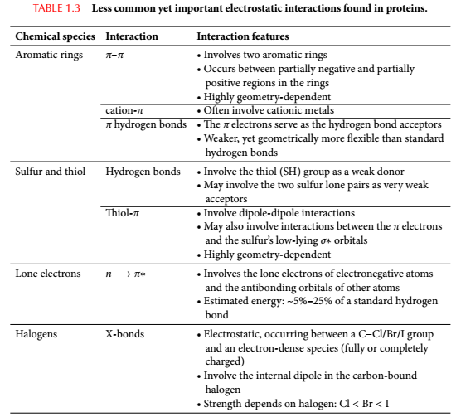
Electrostatic interactions

Slide 41
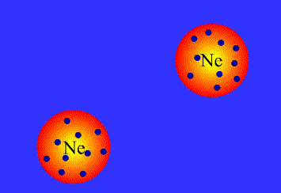
van der Waals Attraction (Dispersion)
Interaction between induced dipoles (all atom types)
http://www.chm.bris.ac.uk/webprojects2003/swinerd/forces/forces.htm

Slide 42
van der Waals Interactions (Dispersion)
Highly distance-dependent (optimal only at short distances)
Notes:
Figure 1.17. Van der Waals interactions. The van der Waals interaction energy as a function of the distance between the nuclei within an argon dimer. The energy was calculated using an empirical potential ^{[175]}. The long-ranged (electrostatic) attraction, resulting from the dispersion force between the atoms, and the repulsion, resulting from Pauling's exclusion principle at short distance, are noticeable. The image is taken from ^{[176]}.

Slide 43
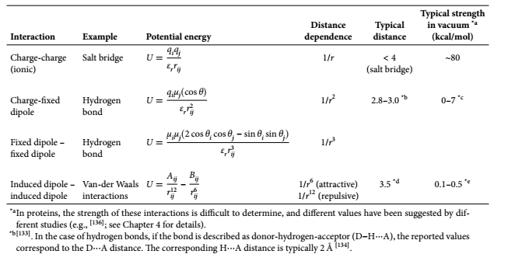
Summary
Notes:
Table 1.2. A summary of the the main types of electrostatic interactions found in proteins. Van der Waals interactions are also described here because of their electrostatic nature. q is the full charge (in electron charges), μ is the dipole moment (in Debye), r_{ij} is the distance between the charges (in Å), and ε_{r} is the relative dielectric constant of the medium. The θ angles in the second and third equations are defined in Figure 1.15b. To obtain the energy in kcal/mol, the following pre-factors should be used: 332 for the first equation, 69.1 for the second equation, and 14.4 for the third equation. * In proteins, the strength of these interactions is difficult to determine, and different values have been suggested by different studies (e.g., ^{[137]}; see Chapter 4 for details). *² ^{[134]}. In the case of hydrogen bonds, if the bond is described as donor-hydrogen-acceptor (D-H∙∙∙A), the reported values correspond to the D∙∙∙A distance. The corresponding H∙∙∙A distance is typically 2 Å

Slide 44
Nonpolar interactions
Notes:
At room temperature the hydrophobic effect is entropy drive. Above ~110 °C it is enthalpy driven (Baldwin 1986 PNAS 83: 8069-8072,). This is because at high temperature the water molecules in the cages around the isolated solutes are almost as dynamic as in bulk water. So, when the solutes bind to each other there is only negligible change in entropy, which leaves only the enthalpy changes. These result from breaking the hydrogen bonds between the water molecule in the cage, which means the enthalpy change is positive (unfavorable). So, at high temperature the hydrophobic effect is weaker, or even unfavorable.
Figure 1.18. The hydrophobic effect. The effect is demonstrated by the amino acid phenylalanine (Phe), which possesses a polar part containing amide and carbonyl groups, and a large nonpolar benzene ring. (a) Two Phe molecules in solvent. Each of the molecules is surrounded by a hydration shell, in which the water molecules are more ordered than in the bulk water. The Phe are shown as sticks and the surrounding water molecules as lines. Water molecules that separate the two Phe molecules are in blue. (b) Association of the two Phe molecules pushes the water molecules separating them (in blue) into the bulk, and a single hydration shell is formed around the complex. The order of the released water molecules decreases, which means that the overall entropy of the system increases.

