Slide 1
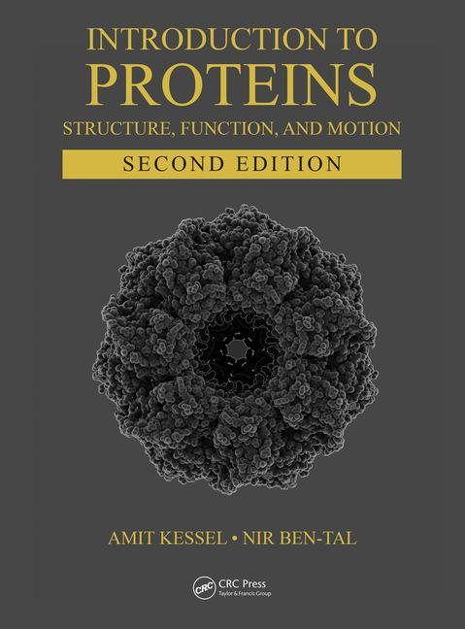
This PPT presentation is provided as suppl. material to the book:
Introduction to Proteins: Structure, Function, and Motion
2nd Edition (2018)
Amit Kessel & Nir Ben-Tal

Slide 2
Chapter 2:
Protein Structure
(cont.)

Slide 3
Tertiary Structure

Slide 4
Topics
Types of proteins by 3rd structure
Characteristics of the globular structure
Architecture of globular proteins
Simple motifs
Complex motifs and superfolds
Domains
Protein classification by 3rd structure
Evolutionary aspects
Water molecules inside proteins

Slide 5
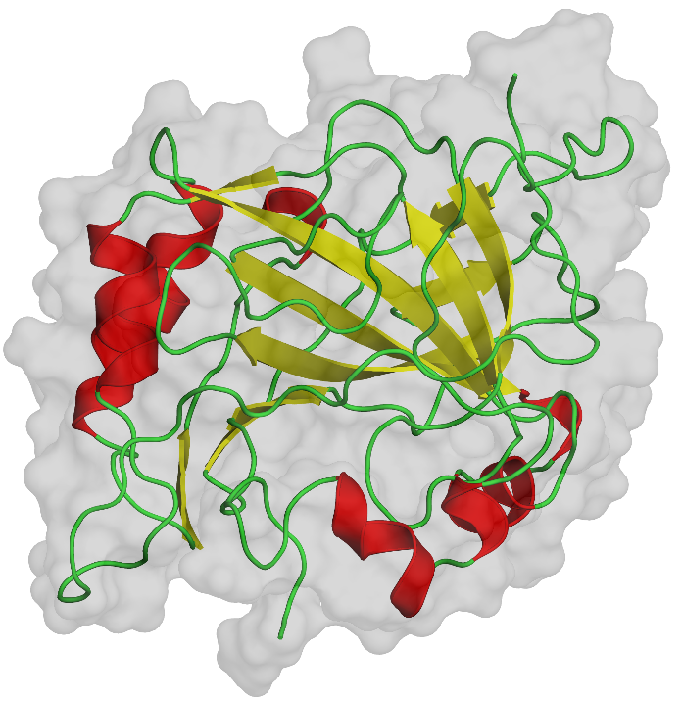
Two types of proteins
Globular
Fibrous
Notes:
Figure 2.22. Globular vs. fibrous proteins. The former type of protein is represented in the figure by the enzyme carbonic anhydrase (PDB entry 1ray), and the latter is represented by the structural protein collagen (PDB entry 1bkv). The secondary structures and the general shape of the protein are shown by a ribbon representation and by a semi-transparent surface representation, respectively.

Slide 6
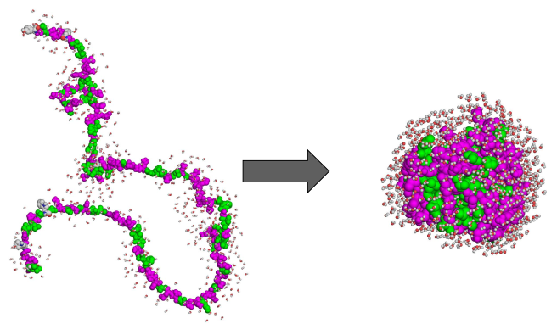
Globular Proteins
Characteristics of the globular structure:
Compact (many molecules in cytoplasm)
Hydrophobic core (stability)
Hydrophilic surface (water soluble)
Notes:
The globular shape results from the polypeptide chain’s ability to change direction. This leads to several important outcomes that characterize globular proteins.
Figure 2.23. Solvent exposure of various protein regions in the folded vs. unfolded states. Polar and nonpolar residues are colored in magenta and green, respectively. The solvent (water) molecules surrounding the protein are represented as spheres. In the folded state, nonpolar residues reside mainly in the protein core away from the solvent, whereas in the unfolded state both polar and nonpolar residues are exposed to the solvent. Still, the folded state contains patches of hydrophobic residues, as explained in the main text. Water molecules were added to the protein computationally by the PDB_hydro server ^{[277]} (Delarue group, Institut Pasteur ^{[278]}).

Slide 7
Globular Proteins
Characteristics of the globular structure:
Brings together functional residues in 3D space → formation of binding/catalytic/regulatory sites → diverse functions (catalysis, transport, immunity, regulation)
Molecular biology of the cell 4th ed. (2002)

Slide 8
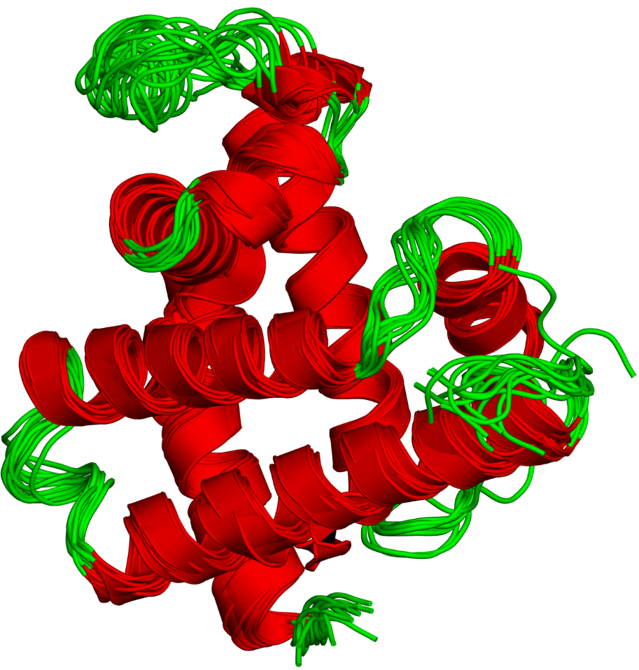
Globular Proteins
Characteristics of the globular structure:
Stabilized by non-covalent interactions → flexible
In some cases – also S-S bonds

Slide 9
Globular Proteins
Architecture of globular proteins:
α (e.g. HLH)
Simple Motifs
β (e.g. β-hairpin, β-meander)
mixed (e.g. β-α-β)
Complex Motifs
(e.g. Ig, Rossmann, P-loop, TIM barrel)
Domains
(e.g. SH2, SH3, PH)

Slide 10
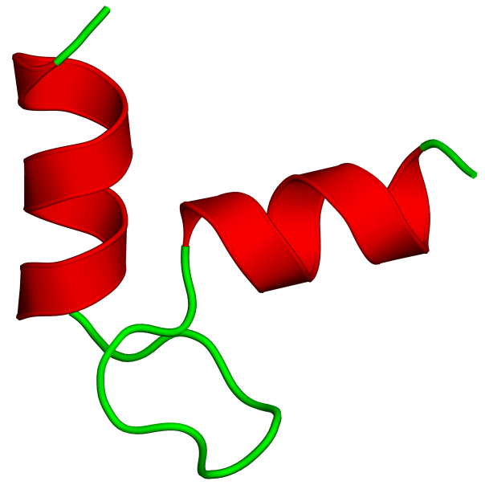
Simple motifs: The HLH motif
EF-hand (Ca²⁺ binding)
bHLH (DNA-binding)
Notes:
Figure 2.24. The helix-loop-helix (HLH) motif. (a) The isolated motif.

Slide 11
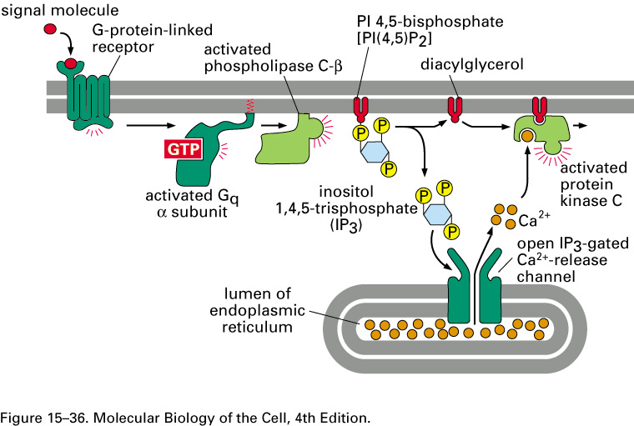
Simple α motifs: The HLH motif
EF-hand (Ca²⁺ binding)
Appears in signaling and muscle contraction proteins
Serves as a molecular 'switch‘ in response to rise in cytosolic Ca²⁺ levels
Notes:
The EF-hand motif is found in small proteins (e.g. calmodulin), or within the domains of larger proteins (e.g. myosin or calpain)

Slide 12
Simple α motifs: The HLH motif
EF-hand (Ca²⁺ binding)
Ca²⁺ binds to polar side-chain and main-chain atoms in the loop region, and to water.
Binding → small movement of helix → conformational change in protein → change of function (usually binding)
a
b
X, Y: Asp/Gln
Z: Asp/Gln/Ser
Y: Main-chain carbonyl
X: H₂O
Z: Asp/Glu
(Lewit-Bentley and Rety 2000)
Notes:
Figure 2.24. The helix-loop-helix (HLH) motif. (a) The isolated motif. (b) The HLH motif as part of the EF-hand structure (adapted from ^{[284]}). The figure on the left demonstrates the 'hand' analogy of the motif, whereas the figure on the right shows the calcium binding residues.

Slide 13
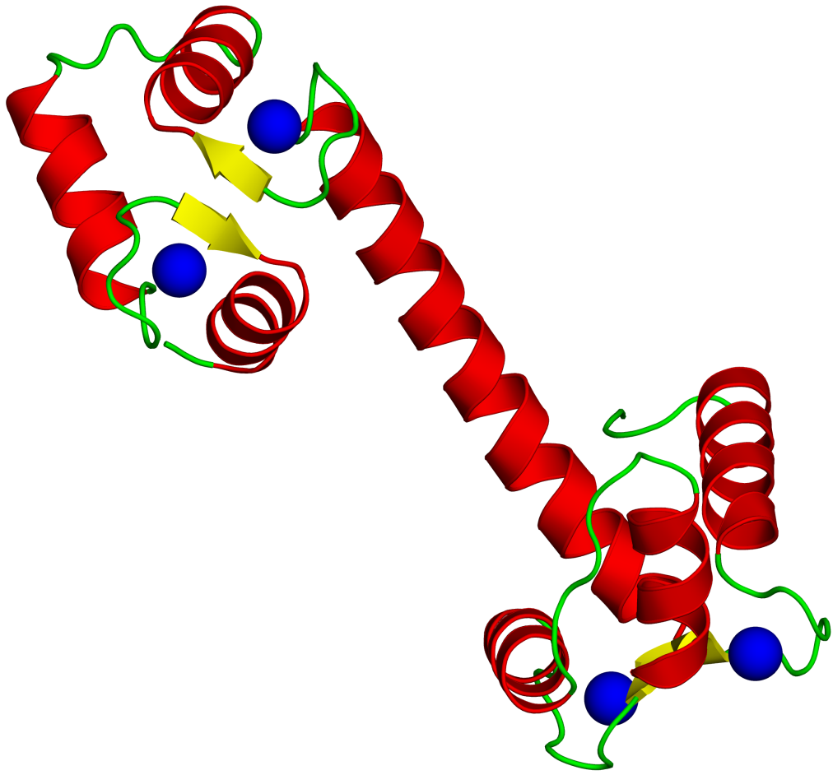
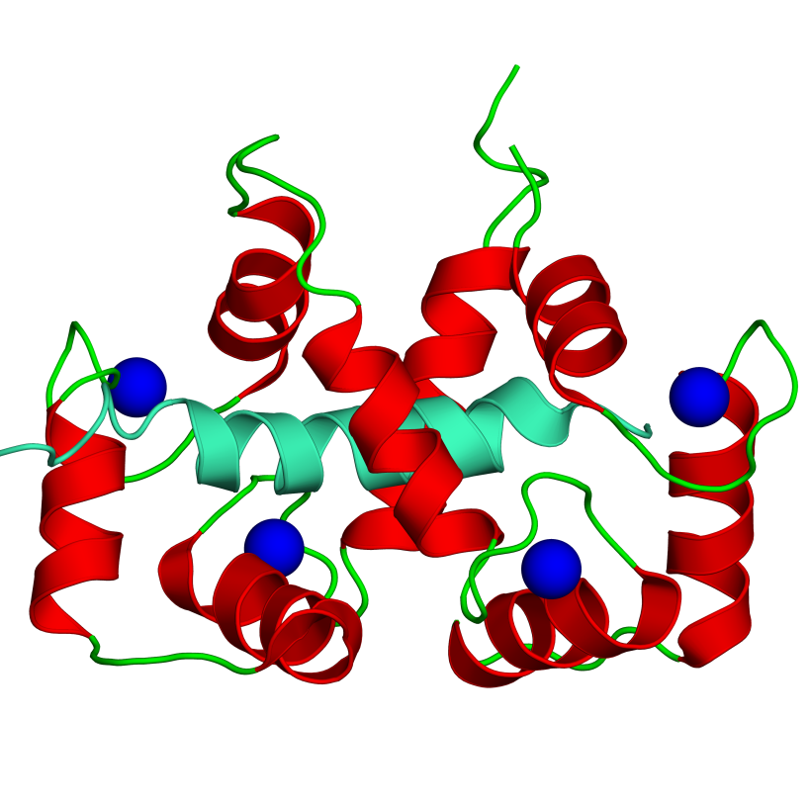
Simple α motifs: The HLH motif
EF-hand (Ca²⁺ binding)
Calmodulin (CaM) - small protein, binds to enzymes and activates them upon Ca²⁺ binding, uses 4 EF-hand motifs
c
myosin light chain
d
Ca²⁺
Free
Bound
Notes:
Figure 2.24. The helix-loop-helix (HLH) motif. (c) Calmodulin (CaM) in its free state (PDB entry 1osa). The molecule contains four HLH motifs, each binding one Ca²⁺ ion (blue sphere). (d) CaM bound to the myosin light chain (PDB entry 2bbm).

Slide 14
Simple α motifs: The HLH motif
EF-hand (Ca²⁺ binding)
Some of these enzymes (e.g. Ca²⁺/CaM-dependent kinases) act on other proteins when activated
c
myosin light chain
d
Ca²⁺
Free
Bound
Notes:
Calmodulin activates CaM-dependent kinases by disrupting the interactions between an autoinhibitory domain and the catalytic domain in the enzymes.
Figure 2.24. The helix-loop-helix (HLH) motif. (c) Calmodulin (CaM) in its free state (PDB entry 1osa). The molecule contains four HLH motifs, each binding one Ca²⁺ ion (blue sphere). (d) CaM bound to the myosin light chain (PDB entry 2bbm).

Slide 15
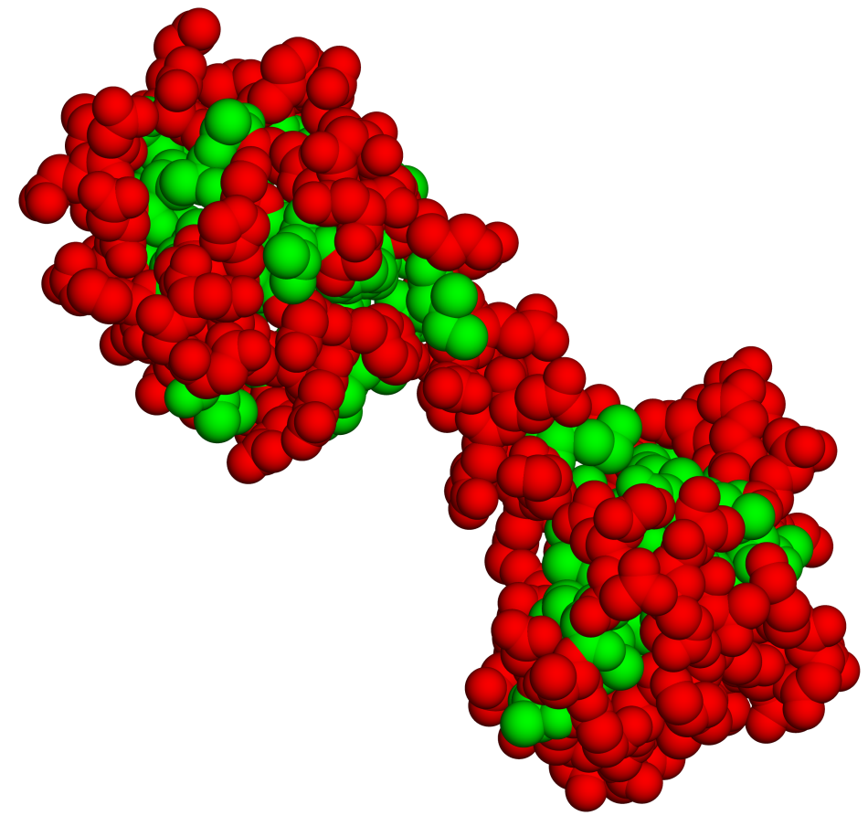
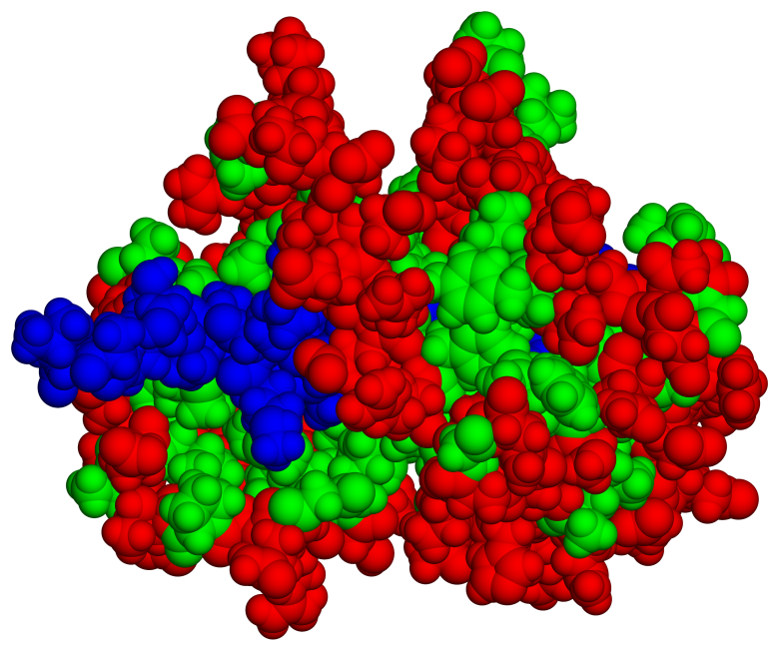
Simple α motifs: The HLH motif
EF-hand (Ca²⁺ binding)
Externalization of hydrophobic residues (e.g. Met) → binding to aromatic residues in target protein
e
f
Notes:
Figure 2.24. The helix-loop-helix (HLH) motif. (e,f) Free and bound states of CaM, with polar and nonpolar residues colored in red and green, respectively. The myosin chain in (f) is colored in blue. The figure shows how CaM folds so as to surround the bound peptide with nonpolar residues.

Slide 16
Simple α motifs: The HLH motif
2. bHLH (DNA binding)
Found in many transcription factors
Molecular biology of the cell, 4th ed.

Slide 17
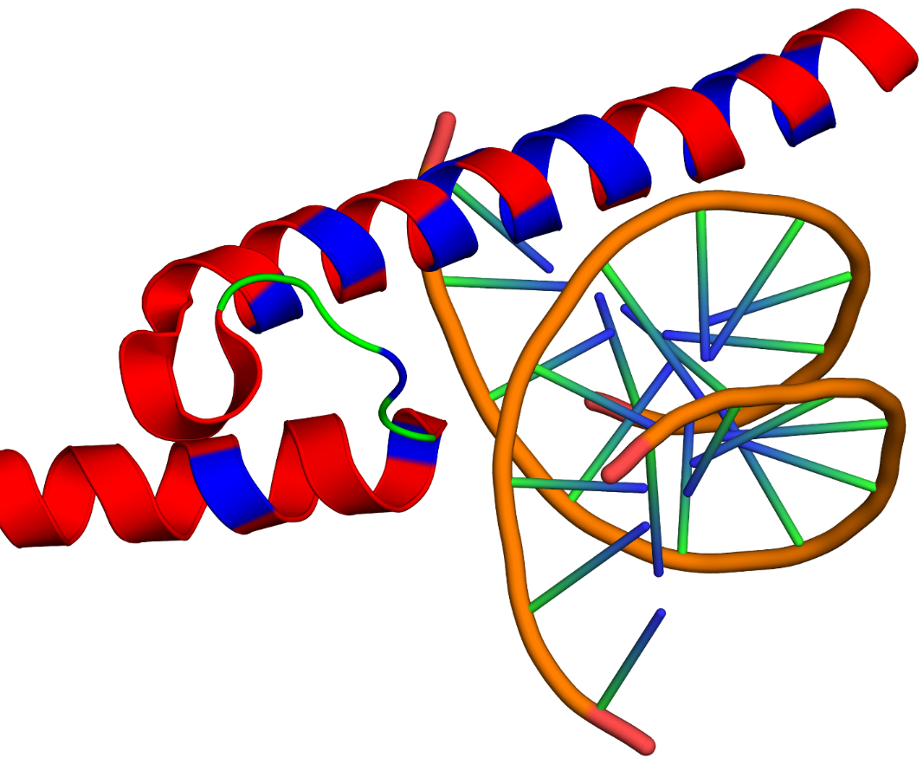
Simple α motifs: The HLH motif
2. bHLH (DNA binding)
Penetration of one of helices into the major DNA groove allows tight binding and recognition of specific sequences in the DNA
Interacting residues – basic (bHLH)
TF
DNA
Notes:
Figure 2.24. (g) Human transcription factor (TF) Max in complex with DNA (PDB entry 1hlo). Max contains an HLH motif, which positions the second helix in a way that allows it a close contact with the DNA. Helices are colored red, except for the basic residues, which are colored in blue.

Slide 18
Simple α motifs: The HLH motif
Other DNA-binding motifs
zinc finger
β-hairpin packed against a helix
Common in proteins regulating gene expression
His
His
Cys
+
Cys
Notes:
The zinc finger motif also serves for amino acid binding in certain protein-binding domains.
Figure 2.8. Roles of cysteine residues in proteins. (b) Cys as a metal binding residue. The figure on the left shows a complex between a protein (red) and DNA (light blue). The protein contains a 'zinc finger' motif as a mean of attaching to the negatively charged DNA molecule. The figure on the right is a magnification of the motif, revealing 4 residues coordinating the zinc cation, two of which are Cys residues. The zinc atom is presented as a gray sphere, and the residues as balls and sticks, colored according to atom type.

Slide 19
Simple α motifs: The HLH motif
Other DNA-binding motifs
Helix-turn-helix (HTH)
Found in many proteins that regulate gene expression
In eukaryotes – important for development (e.g. homeodomain proteins)
Similar to the HLH motif but has shorter linker
Notes:
Figure 2.24. The helix-loop-helix (HLH) motif. (h) The structurally similar HTH motif of the λ phage repressor (PDB entry 1lmb). The dimeric protein and the DNA to which it is bound are shown as ribbons. The chains of the protein are in green and cyan, where the two HTH motifs (one in each chain) are colored in red

Slide 20
β motifs
β hairpin
3
2
1
4
Greek key
β meander
Notes:
Figure 2.25. β motifs. (a,b) Three-dimensional structure of the β-hairpin and β-meander motifs (respectively), represented implicitly by ribbons. (c) Schematic representation of the Greek key.

Slide 21
β motifs
Jellyroll
Notes:
(c) The jelly-roll motif.

Slide 22
β motifs
The β-sandwich motifs
Efficient packing of nonpolar residues inside core → very stable → good for creating functional sites
β-sheet
β-sheet
Notes:
The beta-sandwich motif constitutes the basis for the Ig fold (next slide)
(e) Three-dimensional structure of the β sandwich motif (PDB entry 1igt).

Slide 23
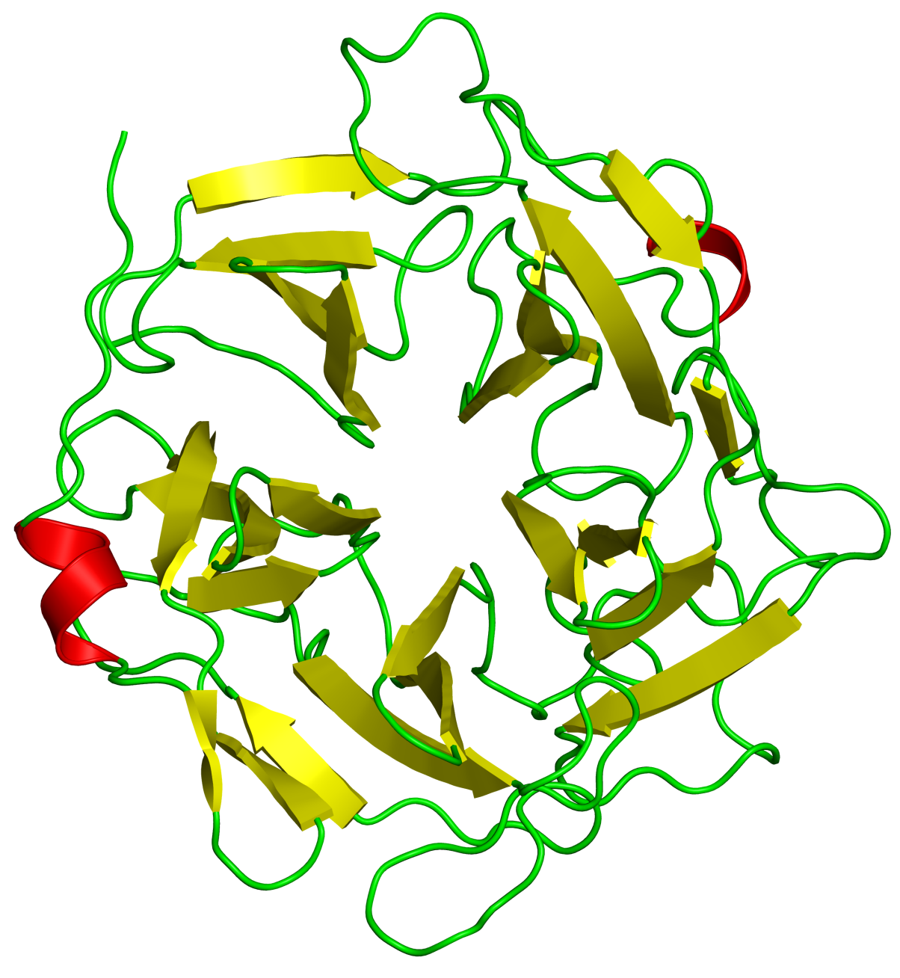
β motifs
β propeller
β helix
Notes:
(h) The β propeller motif (PDB entry 1gyd). (i) The β helix motif (PDB entry 1ezg).

Slide 24
Mixed motifs
The β-α-β motif
The most common mixed motif
Allows formation of parallel β-sheets
Allows efficient packing of nonpolar residues inside the core
1st loop often participates in ligand binding to protein binding sites
Binds nucleotides in the Rossmann & P-loop folds (see next)
Notes:
Figure 2.26. The β-α-β motif and Rossmannoid folds. (a) The structure and topology of the β-α-β motif.

Slide 25
Complex folds
Formed from combinations of simple folds/motifs
Their distribution in proteins exhibits a ‘power-law’:
Most folds appear in a small set of proteins
A few folds (‘superfolds’) appear in numerous proteins (commonest 10 - in more than ⅓ of the proteins)
JMB (2001) 313, 673–681
Notes:
The number of folds is estimated as 10³-10⁴, much lower than the number of sequences (‘structure is more conserved than sequence’).

Slide 26
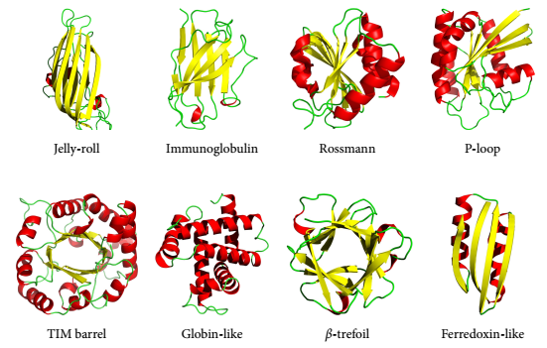
Superfolds
Highly common complex folds in proteins
May appear in proteins that have very little sequence similarity (structure is more conserved than sequence)
Notes:
It has been shown that the 10 most frequent superfolds account for more than ⅓ of the genes in a typical genome.
The number of folds is estimated as 10³-10⁴, much lower than the number of sequences (‘structure is more conserved than sequence’).
Figure 2.29. Examples of superfolds. The PDB entries corresponding to the structures are: 2stv (jelly-roll), 1igt (immunoglobulin), 1jg2 (Rossmann), 1jah (P-loop), 8tim (TIM barrel), 1hho (globin-like), 1bfg (β-trefoil), and 1sc6 (ferredoxin-like).

Slide 27
Superfolds
Examples:
The Immunoglobulin (Ig) fold – based on the β-sandwich motif
The Rossmann fold
The P-loop fold
The TIM barrel fold
Based on the β-α-β motif

Slide 28
Superfolds
The immunoglobulin (Ig) fold
Found in immune system molecules (Ab, TCR, MHC) and other recognition molecules
Notes:
Ab - antibodies
TCR – T-cell receptor
MHC – major histocompatibility complex
Figure 2.25. β motifs. (f+g) The immunoglobulin fold (IgF). The full atomic structure of IgG and an enlargement of one of its antigen-binding 'arms' (secondary elements only) are shown, respectively (PDB entry 1igt). The C_{H} (constant-heavy), C_{L} (constant-light), V_{H} (variable-heavy) and V_{L} (variable-light) domains, as well as the antigen-binding site are denoted.

Slide 29
Superfolds
The immunoglobulin (Ig) fold
Antibodies contain 2 heavy chains + 2 light chains
The antigen binds to the loops

Slide 30
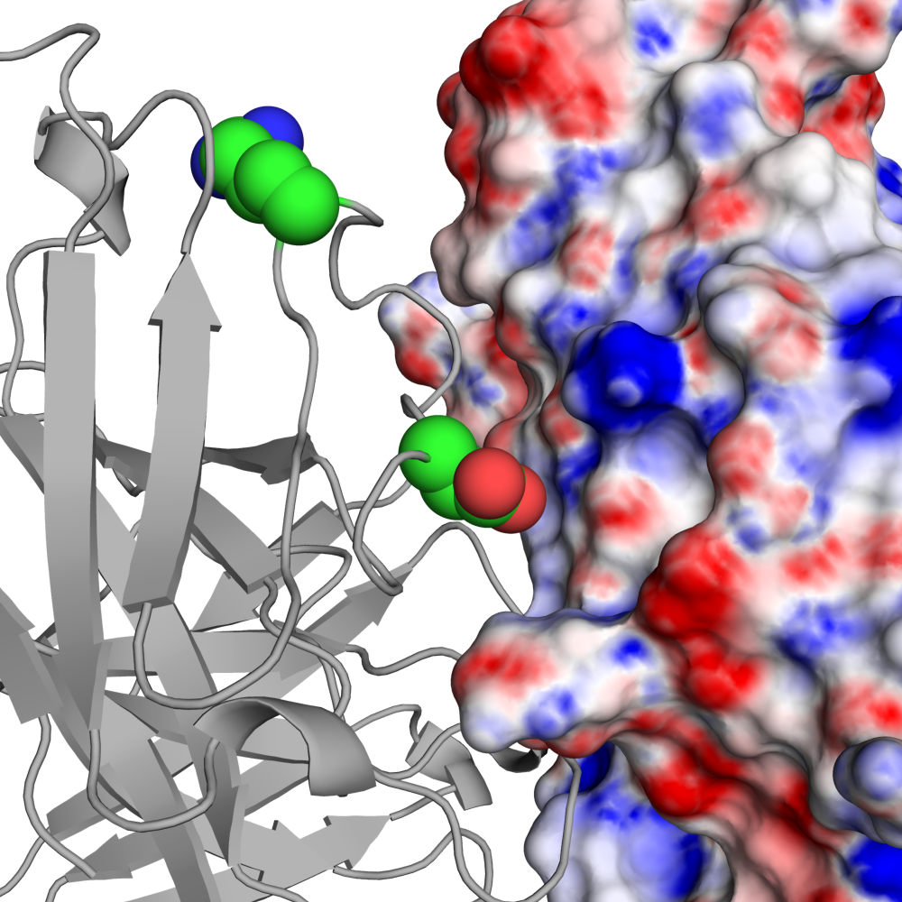
Superfolds
The immunoglobulin (Ig) fold
Binding specificity results from electrostatic interactions
Arg
Antibody
Asp
Antigen
Notes:
Electrostatic complementarity between an antibody (residues R61 and D53) and its cognate antigen. PDB entry 1adq.

Slide 31
Superfolds
The immunoglobulin (Ig) fold
The antigen-binding site has very low evolutionary conservation → allows variability despite common structure
(http://consurf.tau.ac.il)
Notes:
The need for variability in antibodies makes their functional sites non-conserved. In most other proteins functional sites are highly conserved because they bind same/similar ligands or carry out the same type of catalysis.
The variability results from both the sequence and the loops’ inherent flexibility.
. Figure 2.25. β motifs. (h) The evolutionary conservation of IgG, as calculated by the ConSurf web server (http://consurf.tau.ac.il) ^{[196, 292]} (cyan - lowest, maroon - highest. See color-code in figure). The hypervariable antigen binding site as well as other regions are marked.

Slide 32
Superfolds
The Rossmann fold
A common dinucleotide-binding motif
Built from two β-α-β-α-β units
β-α-β
malate dehydrogenase
Notes:
Figure 2.26. The β-α-β motif and Rossmannoid folds. (c) The Rossmann fold in the enzyme malate dehydrogenase (PDB entry 1cme, residues 1-146). For clarity, helices are depicted as solid cylinders, loops are smoothened, and the entire chain is colored by the sequential β-α units. Strands and helices are numbered.

Slide 33
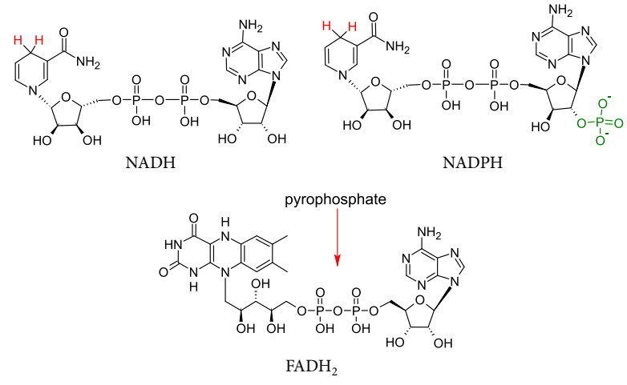
Superfolds
The Rossmann fold
Binds all three dinucleotide coenzymes
Redox enzymes: energy production, biosynthesis, detoxification, etc.
Notes:
(b) The dinucleotide co-enzymes NADH, NADPH, and FADH₂.

Slide 34
Superfolds
The Rossmann fold
Gly residues → efficient helix-strand packing → stability
Notes:
(d) The β₁-loop-α₁₋₂ structure in sarcosine oxidase (PDB entry 1el5). The interactions stabilizing the structure are detailed in the main text.

Slide 35
Superfolds
The Rossmann fold
Nucleotide’s PP_{i} binds to backbone polar groups in first loop
Gly12 is important:
Allows close contact between PP_{i} and backbone groups
Its amide group carries positive end of helix dipole → better interactions with PP_{i} oxygen
Notes:
(e) Interactions between the β₁-α₁₋₂ loop of sarcosine oxidase, and the pyrophosphate unit of it FADH₂ co-enzyme.

Slide 36
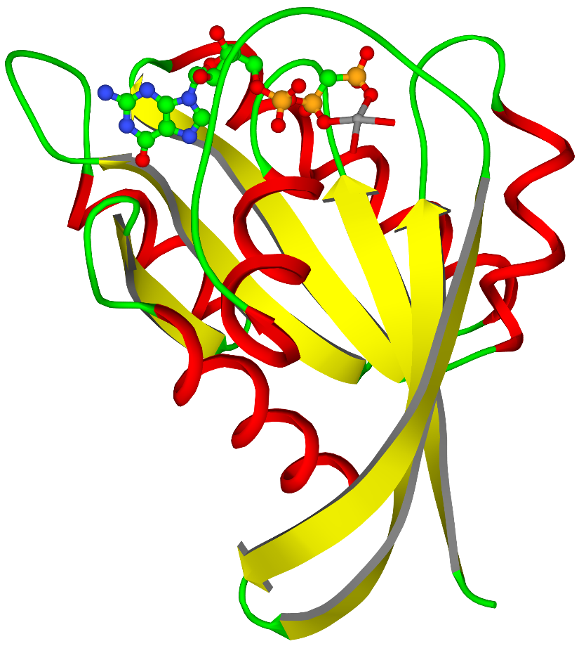
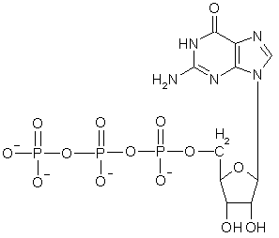
Superfolds
The P-loop fold
Binds mononucleotides (ATP, GTP)
One of the oldest and most common folds
GTP
γ
β
α
GTP
p21_{ras}
Notes:
(f) The Rossmannoid fold in p21_{ras} (PDB entry 1jah). The location of the mononucleotide co-enzyme is marked.

Slide 37
Superfolds
The P-loop fold
Long nucleotide binding loop: (3 phosphates)
3 Gly → tight interactions
Phosphates have twice negative charge than dinucleotides → require Lys⁺ and Mg²⁺ to stabilize
Pγ
Pα
Pβ
Mg²⁺
Lys
Notes:
(g) Interactions between GTP (h), and the corresponding loop of p21_{ras}.

Slide 38
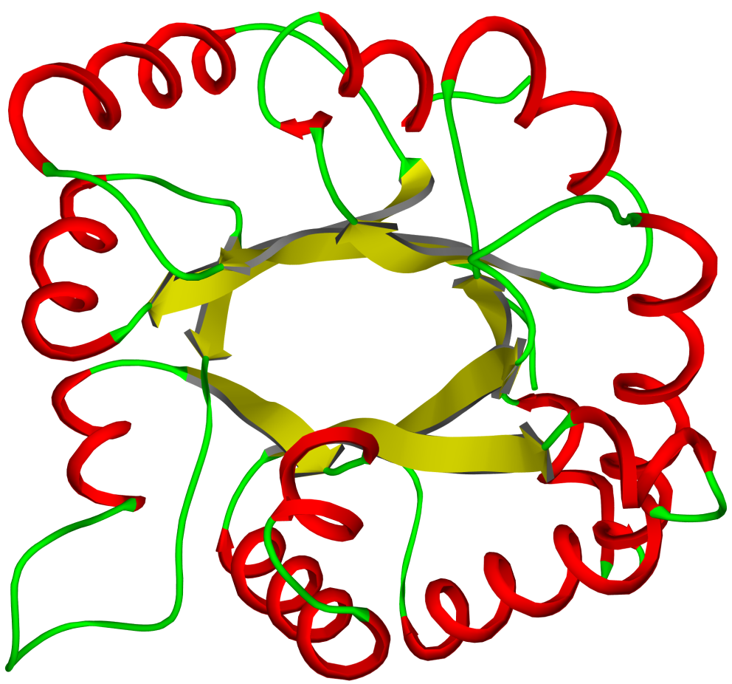
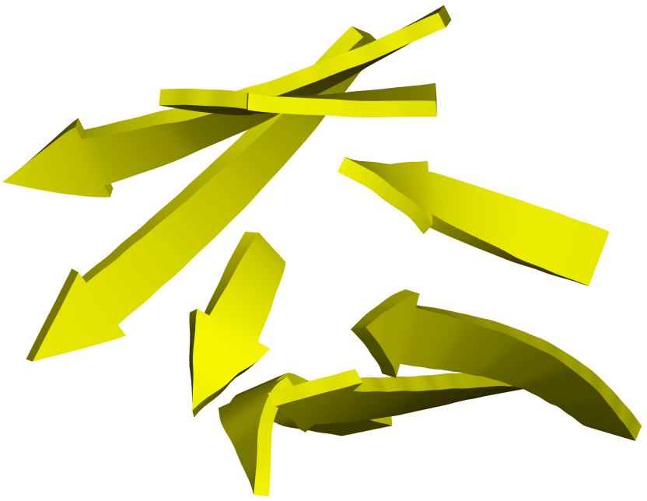
Superfolds
The TIM barrel fold
Very common (~10% of protein structures), mainly in enzymes catalyzing diverse reactions
5 β-α-β units
2
1
8
3
7
6
4
5
The β barrel
Triosphosphate IsoMerase
Notes:
TIM Barrel enzymes catalyze diverse reactions, therefore the catalytic residues and even their location are not conserved (may appear on any of the β→α loops).
Figure 2.27. The TIM barrel fold. (a) The topology of the fold (PDB entry 8tim). The strands are numbered by their order. (b) A side view of the β-strands constituting the barrel shape.

Slide 39
Superfolds
The TIM barrel fold
May act as scaffold or in catalysis (on one of the β→α loops)
5 β-α-β units
2
1
8
3
7
6
4
5
The β barrel
Triosphosphate IsoMerase
Notes:
Like in the Ig fold, the TIM Barrel loops too provide functional diversity within a fold that has the same shape in all proteins in which it appears
Figure 2.27. The TIM barrel fold. (a) The topology of the fold (PDB entry 8tim). The strands are numbered by their order. (b) A side view of the β-strands constituting the barrel shape.

Slide 40
Superfolds
The TIM barrel fold
Barrel center not hollow – densely packed with nonpolar residues → provides shielding from the external environment
Notes:
Figure 2.27. The TIM barrel fold. (c) A sphere representation of the fold, showing the tight packing of nonpolar (cyan) residues within the core.

Slide 41
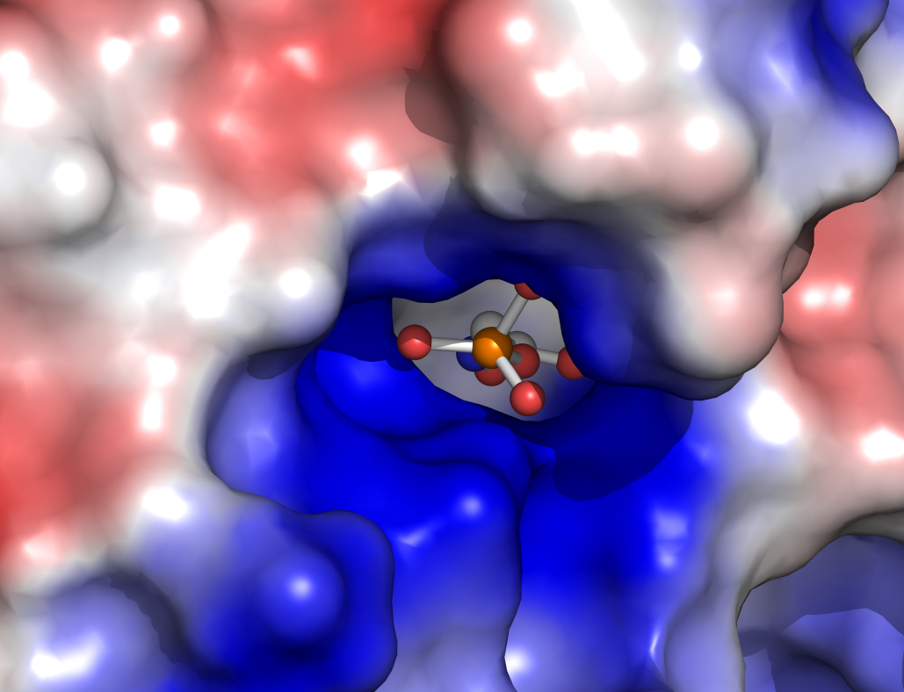
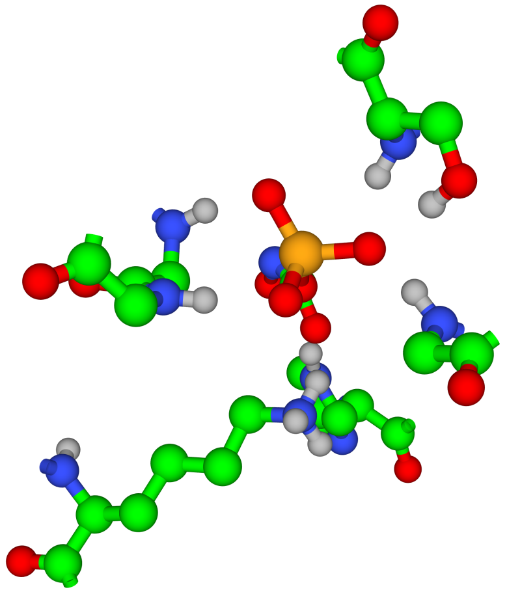
Superfolds
The TIM barrel fold
When ligand is a nucleotide: positive binding site, interactions with backbone groups + Mg²⁺/Mn²⁺/Zn²⁺
d
e
Substrate
Ser211
Gly232
Gly171
Gly233
Lys13
His95
The phosphate binding site
Notes:
(d) The phosphate-binding site. The surface of the protein is colored according to electrostatic potential, calculated using APBS ^{[196]} in the absence of the phosphate group, represented by balls and sticks. Red represents negative potential (0k_{B}T/e > Φ > -50k_{B}T/e); blue represents positive potential (0k_{B}T/e < Φ < 50k_{B}T/e); and white represents neutral potential. The positive electrostatic potential of the binding site is complementary to the negatively-charged phosphate group. (e) The specific interactions of the substrate in its binding site. The figure reveals Lys13 and His95 to be the primary source of the positive electrostatic potential at the phosphate-binding site, as well as the backbone NH groups of Gly171, Ser2111, Gly232 and Gly233. These residues come from different segments of the chain, but the three-dimensional fold brings them close together, near strand β₈.

Slide 42
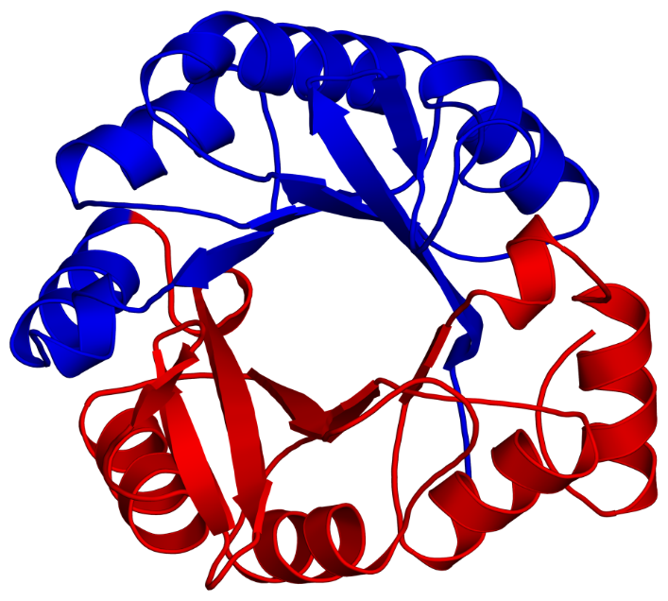
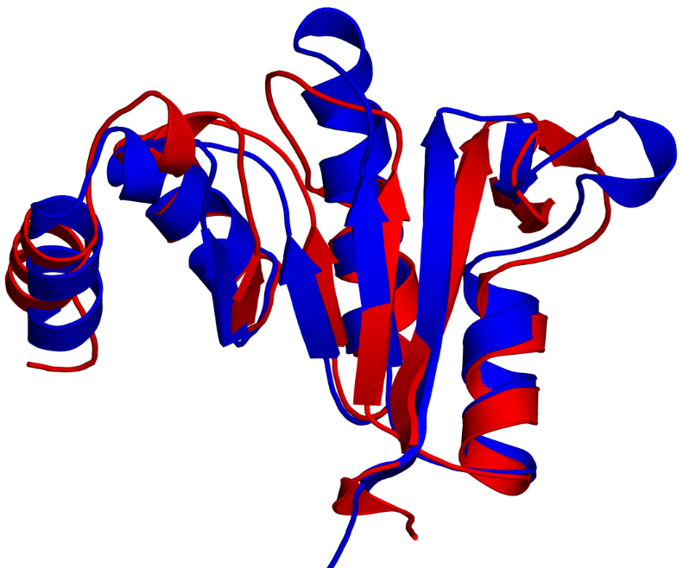
Superfolds
The TIM barrel fold
Studies suggest divergent evolution of ancestral fold into many different functional forms
The basic structural unit of the fold – the (βα)₄ 'half barrel'
f
g
C’
N’
Formation of a TIM barrel fold in HisF by gene duplication
Notes:
Studies carried out on TIM Barrel families suggest that the basic structural unit of the fold in not the (βα)₈ barrel, but rather the (βα)₄ 'half barrel‘.
Figure 7.27. (f,g) Formation of a TIM barrel fold in the protein HisF by duplication of the gene coding for half of the barrel. The complete structure is shown in (g) with the two half-barrels colored differently. In (f), the two half-barrels are superimposed and shown from the side.

Slide 43
Superfolds
Why are superfolds so common?
Structural stability - amino acid packing, 2nd structures…
Functional efficiency - create binding/active sites
Notes:
It has been shown that the 10 most frequent superfolds account for more than ⅓ of the genes in a typical genome.
The number of folds is estimated as 10³-10⁴, much lower than the number of sequences (‘structure is more conserved than sequence’).
Figure 2.29. Examples of superfolds. The PDB entries corresponding to the structures are: 2stv (jelly-roll), 1igt (immunoglobulin), 1jg2 (Rossmann), 1jah (P-loop), 8tim (TIM barrel), 1hho (globin-like), 1bfg (β-trefoil), and 1sc6 (ferredoxin-like).

Slide 44
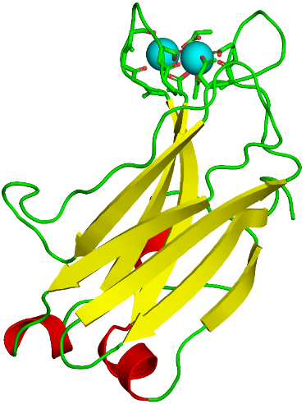
Domains
Functional units of proteins
‘Ideal’ domain: 100-250 residues, stable, repetitive, has own 2nd elements, has function
In reality: different definitions, by structure, sequence, function
Estimates: most proteins have > 1 domains, usually 2-5, 12 at the most
Pfam: ~16,300 domains by sequence (http://pfam.sanger.ac.uk/)

Slide 45
Domains
Domain versatility confers functional complexity to proteins
phosphotyrosine binding
phosphorylation
polyproline binding
SH3
Kinase
Lck (Src family)
SH2
phospholipid binding (IP₃, PIP₂)
PH
SH3
Kinase
Tec (Btk family)
SH2
Notes:
Since there is no one definition to domains, there is little point in going over examples for structures and folds of domains. The importance of domains is mainly as modular functional units. This can be illustrated by the SH2, SH3 and PH domains.
The presence of SH2 in a protein enables it to recognize membrane-bound receptors, which are activated by phosphorylation. SH3 is a protein-recognition domain.
Lck participates in the activation of T-lymphocytes following antigen binding. The SH2-SH3-kinase domain sequence enables Lck to relay a signal from the T-cell receptor in the membrane (via SH2) to target proteins (via SH3) by activating them via phosphorylation (by the kinase domain). Tec works in a similar way, but the PH domain in it allows it to act on proteins in certain locations in the plasma membrane.
Figure 2.31. Domain composition of the proteins Lck and Tec. The function of each domain is specified.

Slide 46
Protein classification
Sequence-structure-evolution relationships:
Family (≥ 40% sequence identity, homologs): very similar structures, common evolutionary path
Superfamily (~20-30% identity): similar structures, far evolutionary relatives
Class: same overall organization of 2nd elements
Notes:
Understanding of protein structure allows us to classify them and find those that share a common evolutionary origin. To do this, the classification relies not only on structure but also on sequence. These reflect different levels of evolutionary kinship.
The general fold of protein analogs is expressed in the types of secondary elements, their number, their relative orientation, and the way they are connected.

Slide 47
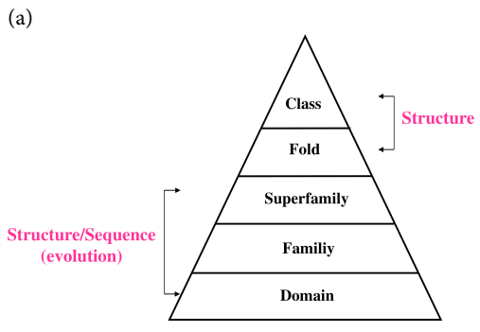
Protein classification
SCOP (Structural Classification Of Proteins)
URL: http://scop.mrc-lmb.cam.ac.uk/scop/
Notes:
The fold category includes proteins with very different sequences, yet similar general fold (protein analogs). The fold is expressed in the types of secondary elements, their number, their relative orientation, and the way they are connected.
Figure 2.32. Protein classification. (a) The hierarchical classification of SCOP.

Slide 48
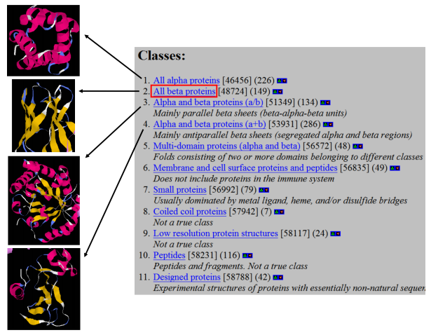
Protein classification
SCOP (Structural Classification Of Proteins)
Notes:
(b) Detailed view of SCOP's classes. The first four classes are demonstrated by graphic examples.

Slide 49
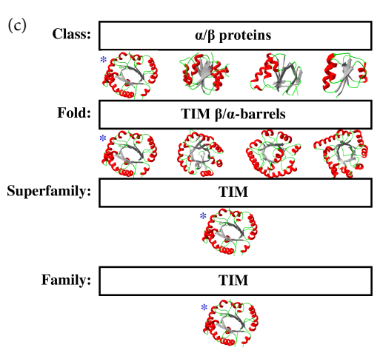
Protein classification
SCOP (Structural Classification Of Proteins)
Notes:
(c) Illustration of SCOP classification with the example of triosephosphate isomerase (TIM). Representative structures are shown in each category, and the one corresponding to TIM is marked with an asterisk.

Slide 50
Protein classification
CATH (Class, Architecture, Topology, Homolgous superfamily)
Class
(more general types than in SCOP)
Architecture
(orientations of the 2nd elements)
(similar to SCOP, also considering the connectivity of 2nd elements)
Topology/Fold
Homologous superfamily
(similar to SCOP)
Family, Domain
(similar to SCOP)
URL: http://www.cathdb.info/
Notes:
(e) The CATH classification hierarchy.

Slide 51
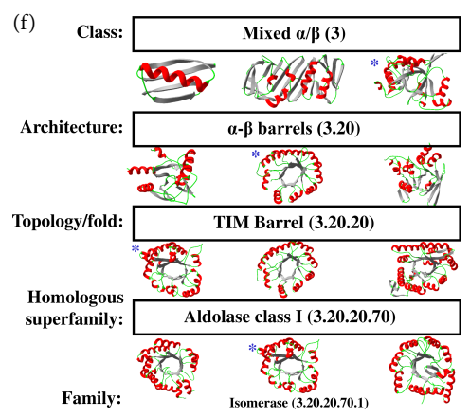
Protein classification
CATH (Class, Architecture, Topology, Homolgous superfamily)
Notes:
(f) Illustration of CATH classification with the example of TIM, as in (c). The numbers in brackets are CATH codes for each group.

Slide 52
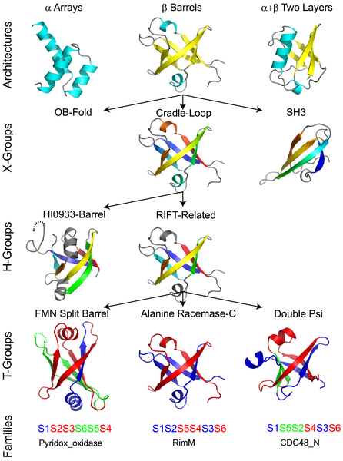
Protein classification
ECOD
Groups domains primarily by homology → detects relationship between structurally different domains, detects functionally important regions within domain.
URL: http://prodata.swmed.edu/ecod/

Slide 53
Evolutionary aspects
Evolution acts at the species level by random mutations and natural selection
On the organism level, mutations might lead to disease or death
A single mutation in a protein is usually harmless, unless it appears in the following:
An active site (enzymes)
A binding site (receptors, antibodies, signaling proteins)
A site that may promote toxic aggregation (e.g. sickle-cell anemia)

Slide 54
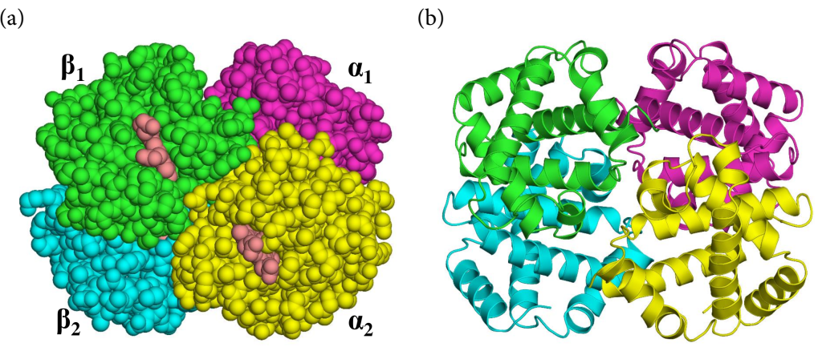
Evolutionary aspects: Sickle cell anemia
Hemoglobin: O₂ and CO₂ carrier in blood
Globular shape made of 4 chains (HbA)
Notes:
Figure 2.34. Hemoglobin and sickle-cell anemia. (a) The quaternary structure of normal hemoglobin (HbA). The four subunits are denoted. (b) The secondary structure of HbA.

Slide 55
Evolutionary aspects: Sickle cell anemia
Glu → Val replacement in β₂ turns HbA to HbS
1
2
3
4
5
6
7
HbA:
VAL
HIS
LEU
THR
PRO
GLU
GLU
CH₂
CH₂
COO⁻
1
2
3
4
5
6
7
HbS:
VAL
HIS
LEU
THR
PRO
VAL
GLU
CH
CH₃
CH₃
Notes:
The mutation is on chromosome 11.
(c) The difference in the sequence of the β₂ subunit between normal (HbA) and mutated (HbS) hemoglobin. The side chains of amino acids at position 6 of HbA and HbS are shown in detail to demonstrate physicochemical differences.

Slide 56
Evolutionary aspects: Sickle cell anemia
The replacement promotes aggregation of HbS in peripheral tissues (low O₂ concentration)
Notes:
The aggregation happens mainly under low oxygen concentrations (i.e., in peripheral tissues), were a non-oxygen-binding form of hemoglobin is dominant. This is because in this form the hydrophobic depression to which Val6 binds becomes exposed, thus enabling the binding.
(d) The interaction between subunits β₁ and β₂ (in red and blue, respectively) of different HbS molecules. The overall binding topology between the two molecules is shown on the left, whereas the exact nonpolar interaction between Val6 of β₂ and the hydrophobic pocket of β₁ is magnified on the right.

Slide 57
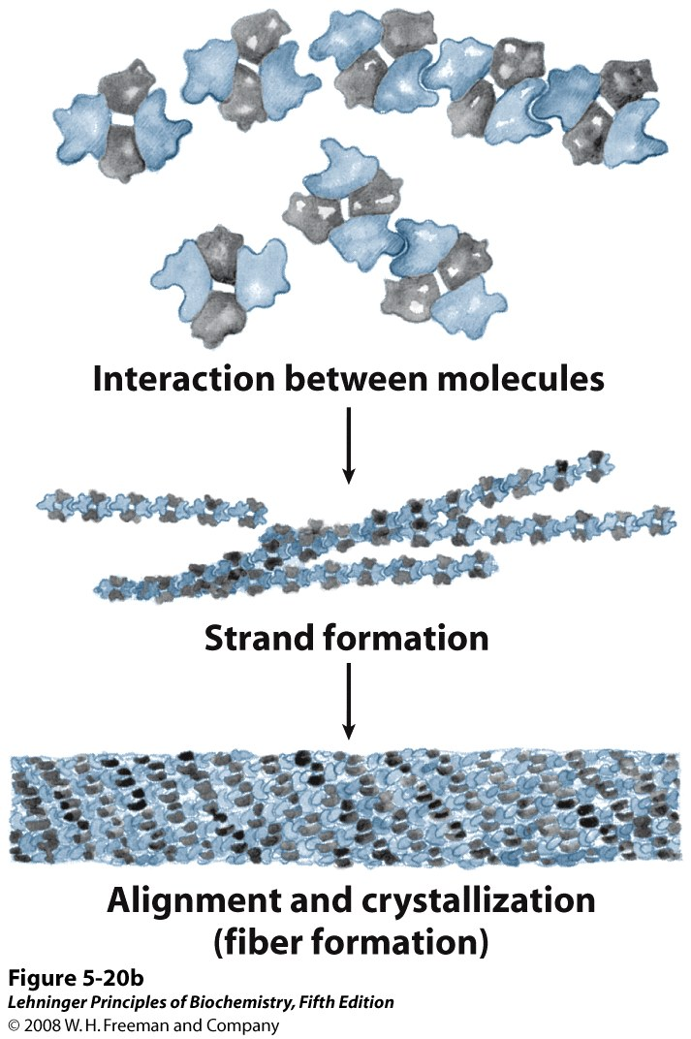
Evolutionary aspects: Sickle cell anemia
Aggregation → sickle shape, resulting in:
Brittle membrane → increased lysis in spleen → anemia
Obstruction of small blood vessels → organ damage, stroke
Notes:
The anemia causes fatigue and short of breath. In addition, the obstruction of small blood vessels, causing damages to the kidneys, liver, spleen, and lungs.
These usually appear in people that are HbS homozygotes. In these people, all blood cells contain HbS, which constantly shifts between regular and sickle forms. Heterozygotes carry the sickle-cell trait but usually don’t have symptoms, because half of their RBC contain HbA, and in those that contain HbS, the latter shifts between regular and sickle forms. However, when they are deprived of oxygen (exercise, high altitude), the sickle form in the RBC with HbS becomes dominant, and they developed symptomes.

Slide 58
Evolutionary aspects
In reality – many residues can be replaced without losing structure/function. Why?
Only certain parts must be conserved:
Functional sites (catalytic, binding, etc.)
Protein core (densely packed – important for stability)
Helices and sheets (usually in core, less flexible than loops)
Some mutations are conservative (e.g. Val → Leu; Asp → Glu)
Correlated mutations compensate for each other
Notes:
In antibodies the trend is opposite: the functional sites are the least conserved.
The sequence and structure around catalytic residues can change dramatically and they’ll still perform catalysis (e.g. chymotrypsin vs. subtilisin)
Some mutations in binding sites are allowed, as they form different substrate/ligand specificities in related proteins.
Loops can tolerate mutations for two reasons: (1) they tend to appear on the surface, and (2) they can change conformation more easily to compensate for change.

Slide 59
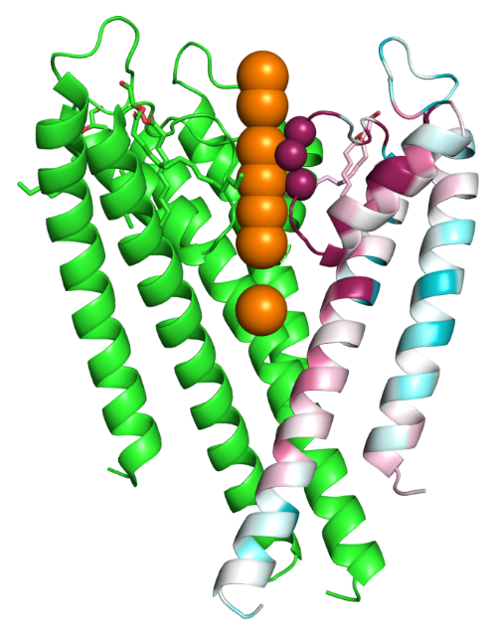
Evolutionary aspects
Example: the K⁺ channel
Pore residues - more conserved than the others
G77, Y78 and G79 (selectivity filter) - highly conserved
K⁺ ions
G₇₇-Y₇₈-G₇₉
Notes:
A cross section of the Kcsa (K⁺) channel, with one subunit colored by conservation. The orange spheres denote the potassium ions in the middle of the channel. The red spheres denote the residues forming the selectivity filter. The evolutionary conservation was calculated with the ConSurf web server (http://consurf.tau.ac.il).

Slide 60
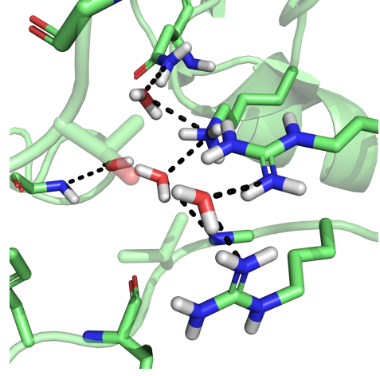
Water molecules inside proteins
Roles of ‘structural water’ inside proteins:
Masking polar groups (stabilization)
Assisting ligand-binding
Assisting catalysis (acid/base, polarizing bonds)
Assisting transport (channels, transporters)
Notes:
Figure 2.35. Polar interactions mediated by intraprotein water molecules. The interactions are demonstrated by horseradish peroxidase C1a (PDB entry 1w4y). The two water molecules involved in the interactions are marked by asterisks.

Slide 61
Quaternary Structure

Slide 62
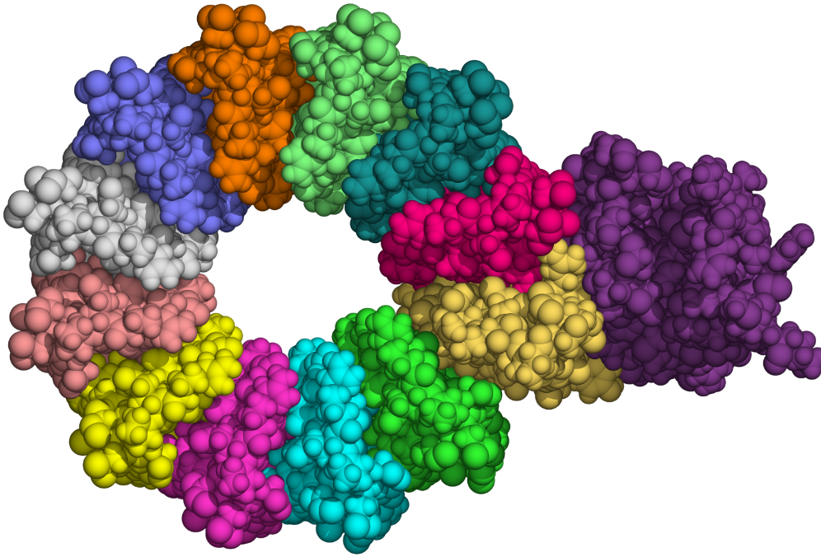
Some proteins have multiple chains
Identity & number (homo-dimer, hetero-trimer..)
Degree of obligation: quaternary (oligomer) vs. quinary (complex)
Association:
Mainly nonpolar
S-S bonds (membrane/secreted)
Covalent involving Lys (fibrous)
Antibody
F₀-ATP synthase
Notes:
Most oligomers have a few chains, others (like viral capsid proteins) may get to 60 subunits.
In heteromers, it is sometimes difficult to determine whether it is hetero-oligomer of the same protein or different proteins working as a complex. This is usually decided according to the degree of obligation presented by the protein.
Figure 2.36. The multi-subunit character of the enzyme F₀-ATP synthase (PDB entry 1c17). The subunits are marked with different colors.

Slide 63
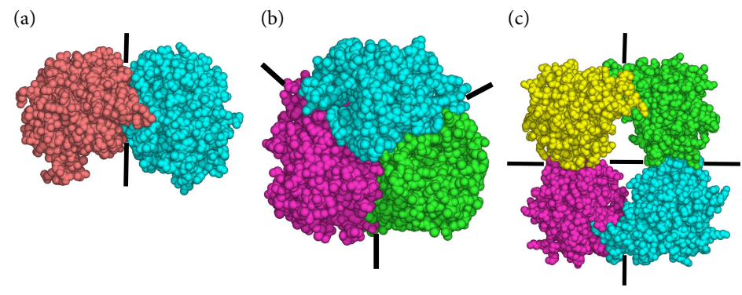
Oligomeric proteins tend to be symmetrical
2-fold
3-fold
Dihedral
Notes:
Symmetry is usually formed by duplication of genes, and is probably another consequence of evolution's general tendency towards parsimony, as it allows the cell to achieve a higher function using copies of the same structural unit. Asymmetrical oligomers appeared only later in evolution.
Figure 2.37. Symmetry in homo-oligomers. (a) 2-fold symmetry in dimeric triosephosphate isomerase (PDB entry 1amk). The binding surfaces of the two subunits are identical and rotated 180º with respect to each other, making the interface 'isologous'. (b) 3-fold symmetry in trimeric chloramphenicol acetyltransferase (PDB entry 3cla). The interface includes two different binding surfaces, i.e., it is 'heterologous'. (c) Dihedral symmetry in tetrameric β-tryptase (PDB entry 1a01), including two isologous interfaces. Dihedral symmetry appears in most tetrameric and hexameric proteins. The axes of symmetry are denoted in each structure.

Slide 64
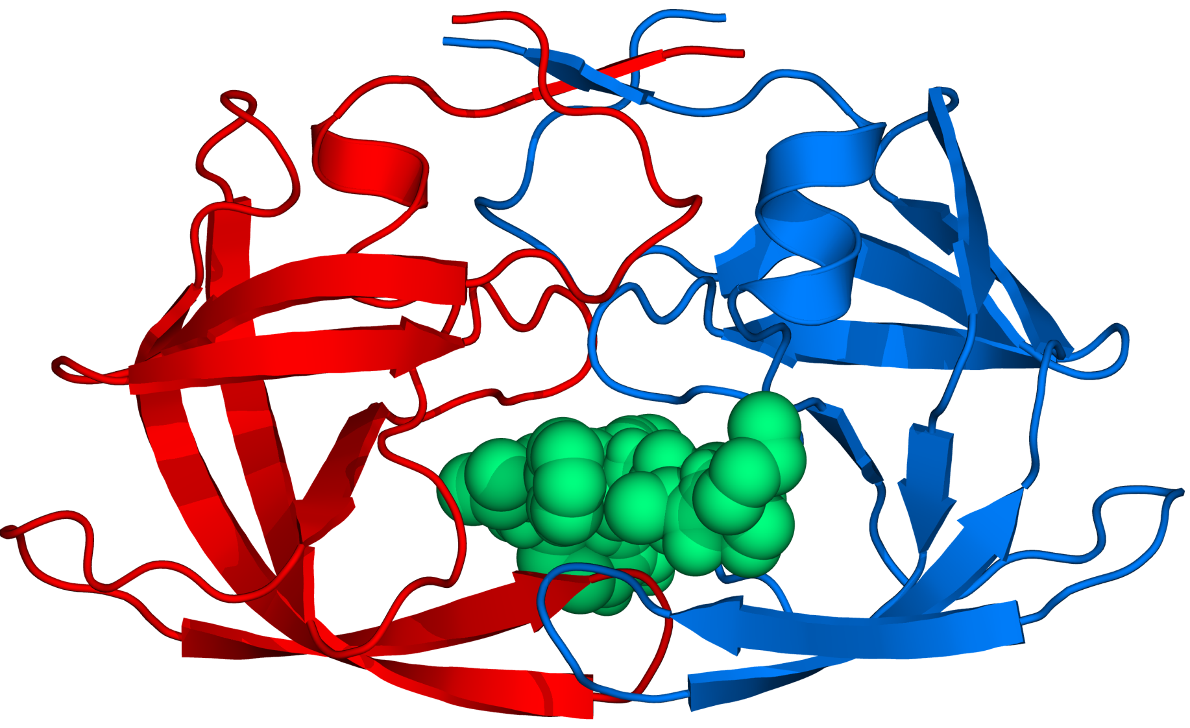
Advantages of the quaternary structure
Allows the formation of versatile active sites
The HIV-1 aspartyl protease
Notes:
Figure 2.39. The active site of HIV-1 aspartyl protease (PDB entry 1a8k). The enzyme is shown in ribbon representation, and the peptide ligand as an atom-sphere model. The two polypeptide chains building the entire enzyme (including the binding site) are colored differently.

Slide 65
Advantages of the quaternary structure
Enhances the regulation of protein activity
Protein kinase A (PKA) activation
Notes:
Figure 2.40. A schematic depiction of the enzyme protein kinase A (PKA) and the process of its activation by the secondary messenger cAMP. The catalytic and regulatory subunits of PKA are marked as 'Cat' and 'Reg', respectively. cAMP is represented by cyan spheres. Binding of cAMP induces the detachment of catalytic and regulatory subunits, allowing the former to bind to other proteins and phosphorylate them.

Slide 66
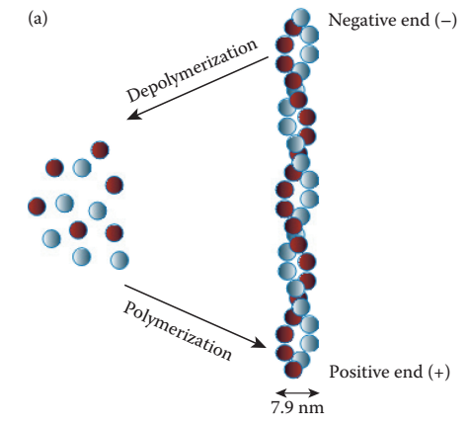
Advantages of the quaternary structure
Increases stability by restraining internal motions
Insulin – hexamer in pancreas (days), monomer in blood (minutes)
Allows the formation of large structures (e.g. the cytoskeleton)
Notes:
Figure 2.42. Constituents of the cytoskeleton. The figure depicts the three types of cytoskeletal fibers, and their assembly from the basic units (taken from ^{[543]}). (a) Microﬁlaments made of F-actin. Although F-actin forms structural fibers, it is a globular protein (see subsection 2.7.2 in the main text for details). The fiber is dynamic; each of the F-actin monomers, depicted as spheres, can join the fiber from its (+) side or depart from it at the (-) side.

Slide 67
Post-Translational Modifications

Slide 68
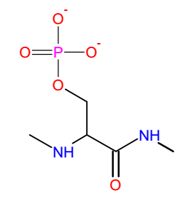
Proteins contain different modifications
Phosphorylation (Ser/Thr/Tyr)
O-glycosylation (Ser/Thr)
N-acylation (Lys)
N-alkylation (Lys)
Notes:
Figure 2.41. Post-translational modifications in proteins. (a) Phosphorylation of serine's side chain. (b) O-glycosylation of serine’s side chain. (c) N-acylation of lysine's side chain, with R denoting any chemical group. (d) N-alkylation of lysine's side chain.

Slide 69
Proteins contain different modifications
Acylations:
N-Myristoylation (Gly)
S-Palmitoylation (Cys)
Notes:
(e) N-myristoylation of glycine's amino terminus. (f) S-palmitoylation of cysteine's side-chain.

Slide 70
Proteins contain different modifications
Alkylations:
S-farnesylation (Cys)
S-geranyl-geranylation (Cys)
Notes:
(g) S-farnesylation of cysteine's side-chain. (h) S-geranyl-geranylation of cysteine's side-chain.

Slide 71
Proteins contain different modifications
N-carboxy-biotinylation (Lys)
N-lipoatylaion (Lys)
Notes:
Some PTM add a specific functional group, like biotin and lipoic acid in pyruvate dehydrogenase.
(i) N-carboxy-biotinylation of lysine's side-chain. (j) N-lipoatylaion of lysine's side-chain.

Slide 72
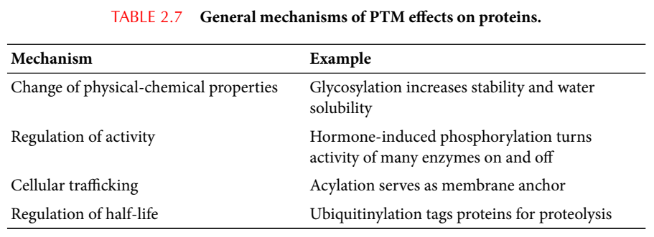
PTM affect proteins in different ways
Notes:
Table 2.7. General mechanisms of PTM's affect on proteins.

Slide 73
Phosphorylation
Occurs mainly on Ser, Thr or Tyr (in prokaryotes – also His), but also on Arg, Lys, Asp/Glu, and Cys
Role: regulating protein activity
Mechanisms: conformational change, ligand binding, catalytic residues
Reversible: kinases vs. phosphatases

Slide 74
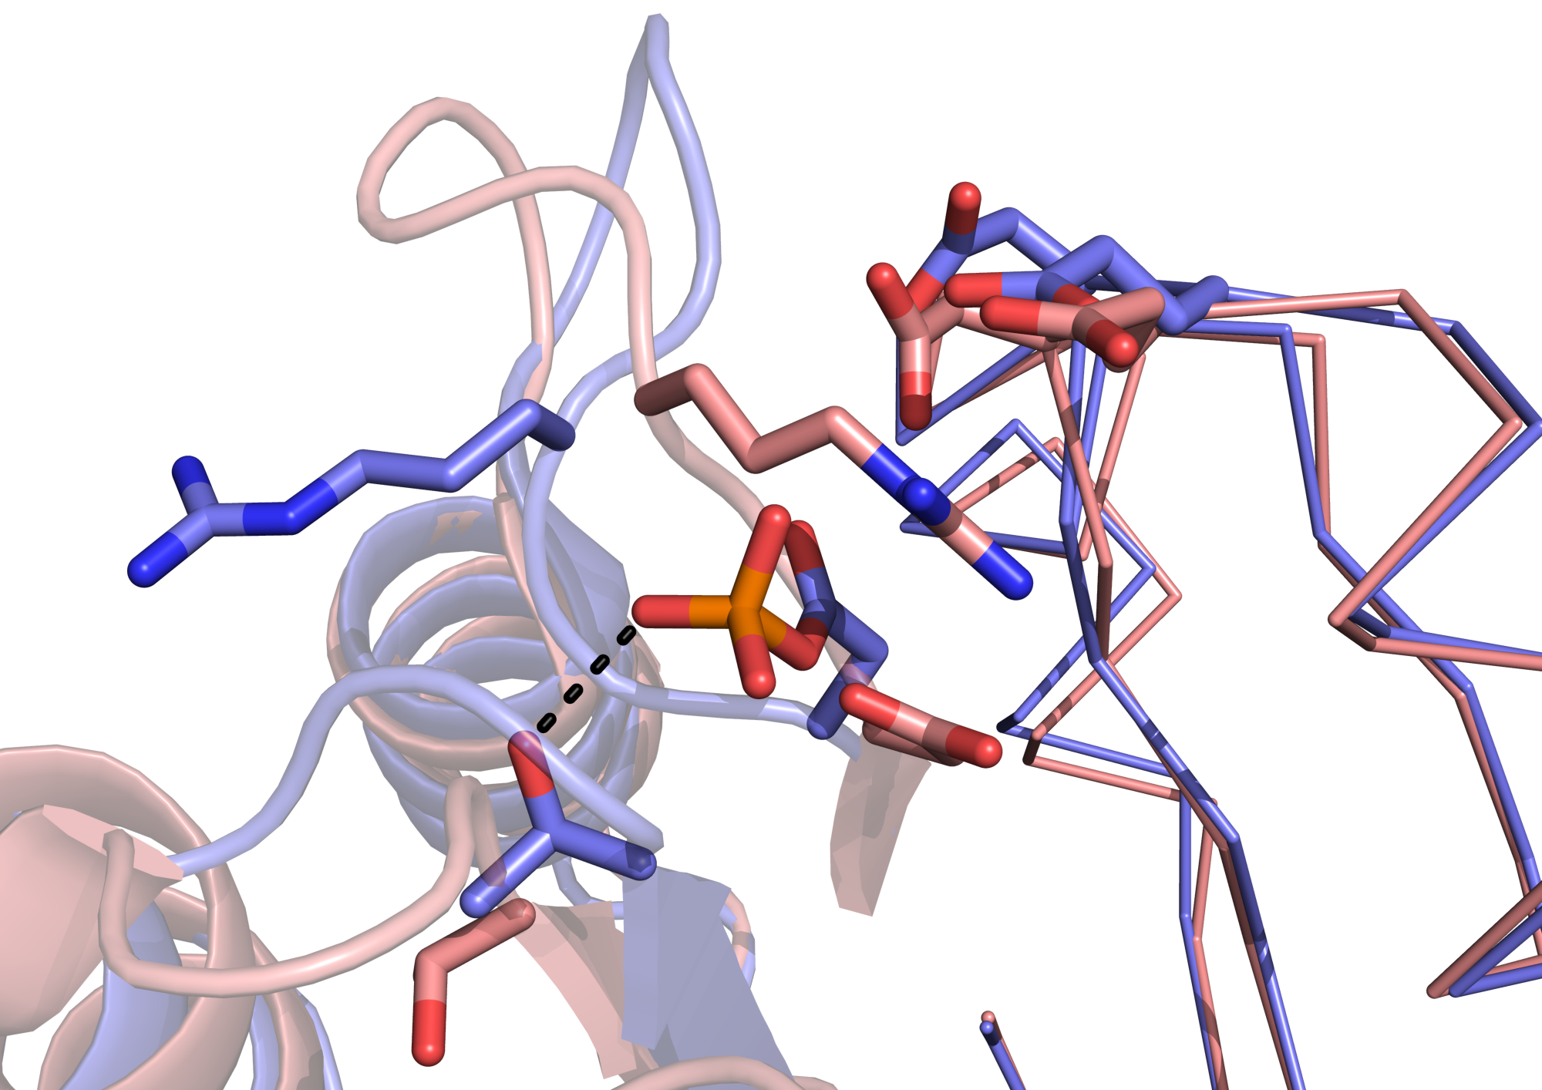
Phosphorylation
Phosphorylation-induced conformational change
D11
D12
R56
D54
T82
Notes:
The change from the native (1dbw, pink) and phosphorylated (1d5w, blue) forms of the FixJ receiver domain is shown. The change mainly involves movements of two loops (red arrows). The phosphate group (on D54) moves to the left to get away from D11 and D12, as well as to hydrogen bond with T82 (which moves towards it). The appearance of the bulky phosphate group also compels R56 to make way by moving to the left (black arrow).

Slide 75
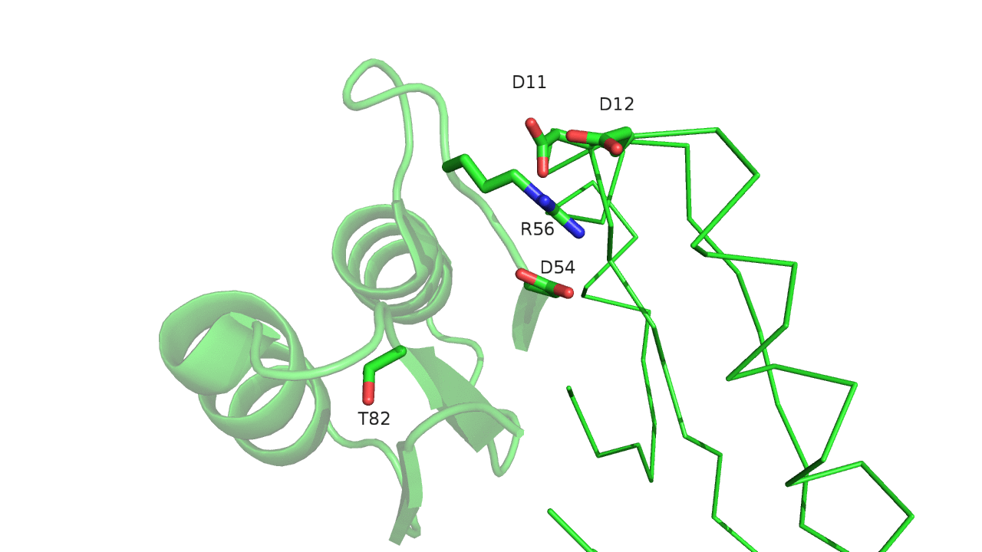
Phosphorylation
Animation:
Notes:
The animation was produced by intrapolation between the phosphorylated and non-phosphorylated structures.

Slide 76
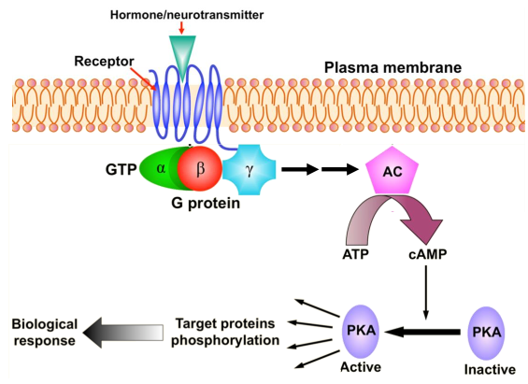
Phosphorylation
Notes:
Figure 1.7. The main players in a typical signal transduction cascade. (b) The cAMP-PKA cascade. Binding of an external chemical messenger (hormone, neurotransmitter, etc.) to a membrane-bound protein receptor induces the activation of an enzyme called a G-protein, which acts as a transducer. This activation makes one of the protein's subunits detach from the other, bind to the enzyme adenylyl cyclase (AC), and activate it. Activated AC catalyzes the conversion of ATP into cyclic AMP, which acts as an intracellular messenger. It binds to and activates the enzyme amplifier PKA, which in turn phosphorylates a large set of cytoplasmic proteins. The phosphorylated proteins may activate other cellular components, or perform a certain function (that is, they may act as sensors and/or effectors). In any case, this signal transduction eventually leads to changes in the cell's behavior, i.e., to a biological response.

Slide 77
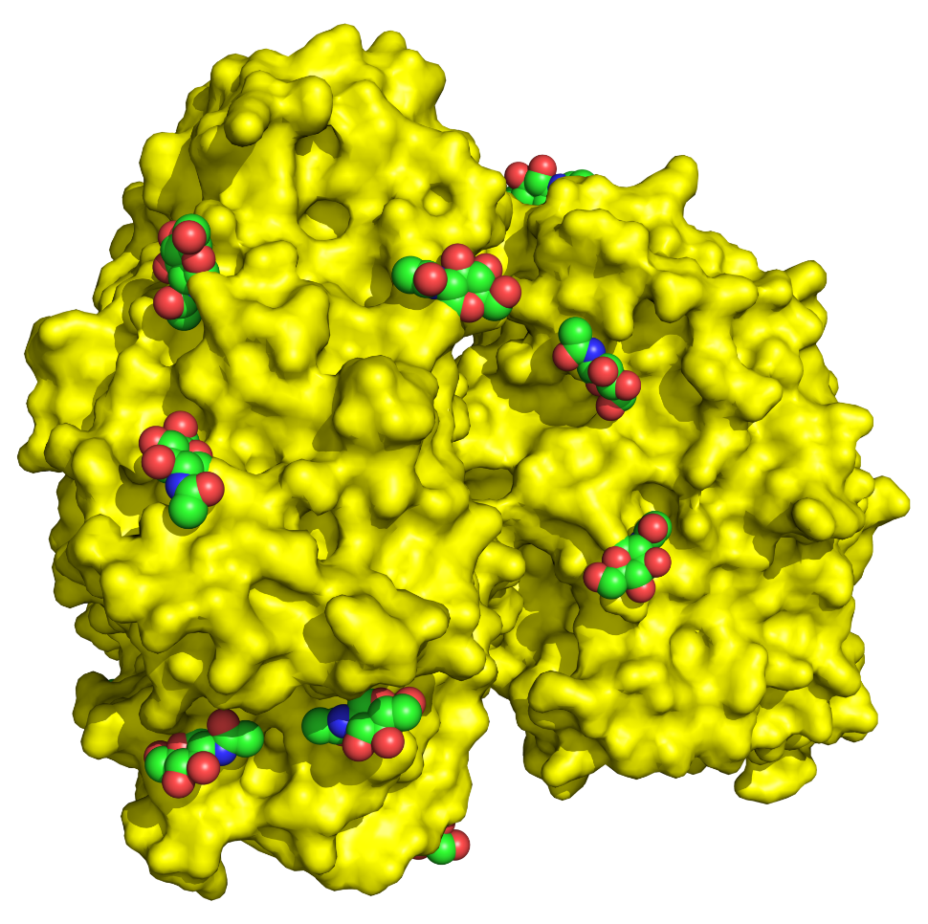
Glycosylation
Creates glycoproteins and proteoglycans
Hemagglutinin esterase
(Glycoprotein)

Slide 78
Glycosylation
N-linked: on Asn, context-dependent, in ER
O-linked: on Ser or Thr, context-independent, in Golgi
Roles: solubility, stabilization, protection, molecular recognition

Slide 79
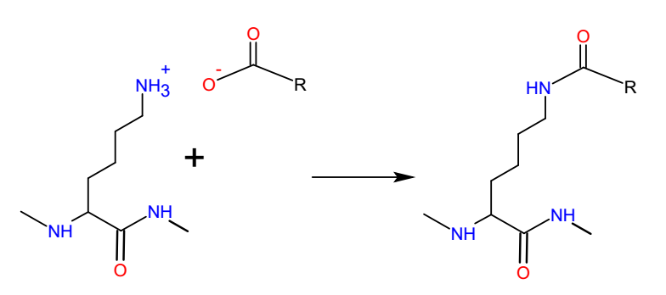
Acylation
Includes acetylation, myristoylation, palmitoylation and ubiquitinylation
Residues: Lys, Cys, Gly-α-amino
Direct effect: charge neutralization, mol. recognition
Role: regulation of protein activity and ligand binding, membrane attachment, degradation
Notes:
The tumor suppression protein p53 can be either ubiquitinylated (when targeted for degradation) or acetylated (when it should remain active). The acetylation prevents ubiquitinylation.

Slide 80
Alkylation
Examples: methylation, prenylation, adenylation
Residues: Lys, Arg, Cys, Tyr
Role: regulation of protein activity, molecular recognition, membrane attachment
Notes:
The alkyl group is often attached to pyrophosphate, which leaves upon bond formation.

Slide 81
Acylations and alkylations
Acylations and certain alkylations are used to attach peripheral proteins to the membrane, e.g. for signal transduction
Notes:
1) Fatty acyl group (myristate or palmitate) covalently attached to an N-terminal glycine of internal cysteine (respectively).
2) Hydrocarbon prenyl chain (farnesyl, geranyl-geranyl) attached to a cysteine residue at or near the C-terminus.

Slide 82
Hydroxylation and Sulfation
Residues: Pro, Lys, Asn, Glu (hydroxylation)
Tyr (sulfation)
Role: stabilization (e.g. HO-Lys/Pro in collagen), molecular recognition (e.g. ligand recognition by sulfate-CCR5)
Proteolysis
Usually carried out in hydrolytic enzymes
Role: activation

Slide 83
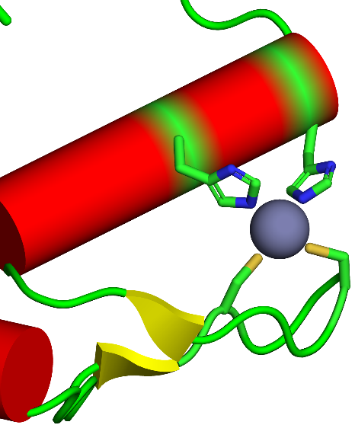
Metal cation addition
E.g. Fe²⁺/Fe³⁺, Zn²⁺, Cu²⁺/Cu⁺, Mg²⁺, Mn²⁺/Mn³⁺, Mo³⁺/Mo⁴⁺/Mo⁶⁺, Co²⁺, Ni⁺
Metal bound directly or via a prosthetic group
Metal may appear in clusters
Role: stabilization (e.g. Zn-finger), ligand binding, electron transport, catalysis (e.g. bond polarization, TS stabilization)
Zn
Zinc finger

Slide 84
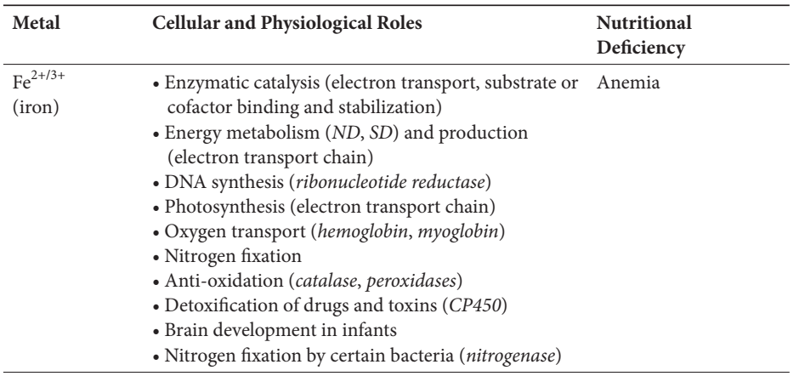
Metal cation addition
Transition metals (Fe, Cu, Co, Mn) can acquire in multiple oxidation states → often used for electron transfer and redox catalysis
For example: iron (Fe):
Notes:
Table 2.8. Cellular and physiological roles of key cationic metals in living organisms.

Slide 85
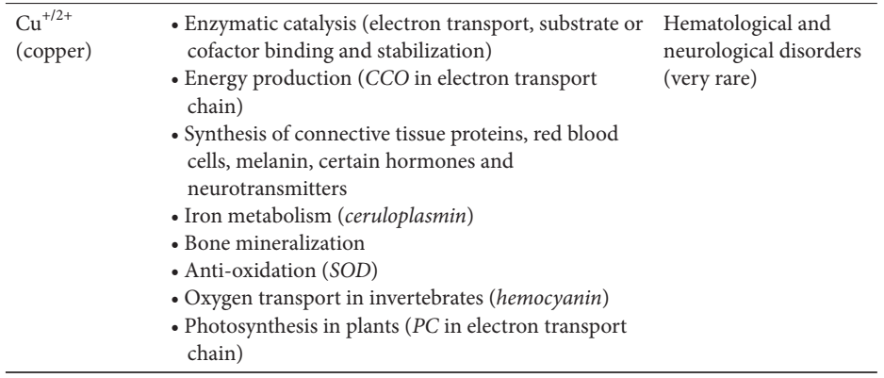
Metal cation addition
Transition metals (Fe, Cu, Co, Mn) can acquire in multiple oxidation states → often used for electron transfer and redox catalysis
For example: copper (Cu):
Notes:
Table 2.8. Cellular and physiological roles of key cationic metals in living organisms.

Slide 86
ADP-ribosylation
One or more ADP-ribosyl units
Reversible (enzymatic: ADP ribosyltransferases)
NAD⁺
Protein-Arg
+
Protein-
Notes:
There are also poly-ADP-ribosylations, which occur in eukaryotes, and are involved in cell signaling, DNA repair, gene regulation and apoptosis. They are not carried out by ADP-ribosyltransferases, but rather by Poly-(ADP-ribose) polymerases (PARPs).

Slide 87
ADP-ribosylation
Involved in:
Cell signaling
DNA repair
Gene regulation
Apoptosis
Clinical significance:
Cancer (improper ADP-ribosylation)
Infection (bacterial toxins)

Slide 88
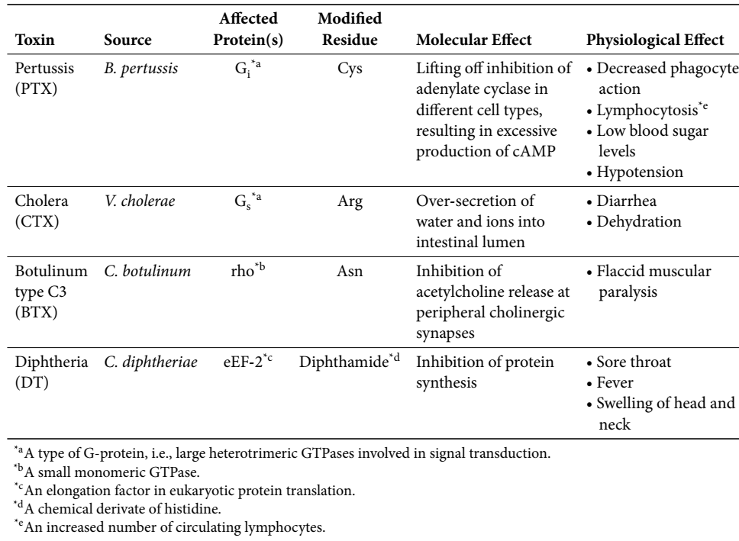
ADP-ribosylation
Used by certain bacterial toxins to harm the host
Notes:
Table 2.9. Some of the bacterial toxins using ADP-ribosylation on host proteins.

Slide 89
Fibrous Proteins

Slide 90
Fibrous vs. globular
Form large fibrous structures inside and outside cells
Different from globular proteins in:
Shape, water solubility, atomic packing & density, hydrophobicity, dynamics, and folding energetics
Globular
Fibrous
Notes:
Figure 2.22. Globular vs. fibrous proteins. The former is represented in the figure by the enzyme carbonic anhydrase (PDB entry 1ray), and the latter is represented by the structural protein collagen (PDB entry 1bkv).

Slide 91
Fibrous proteins play various roles
Mechanical support
Cytoskeleton (keratin in intermediate filaments)
Extracellular matrix (collagen, elastin, fibronectin, laminin)
Tissue organization
Cell-environment communication
Motion
External structures (e.g. silk)
Regulation
Skin pigmentation
Hair follicle growth
Regeneration of epithelial cells
Notes:
We will focus on the first two roles.
The mechanical protection provided by fibrous proteins is especially important in cells that are exposed to this type of mechanical stress, including the intestinal and skin epithelia, as well as the oral mucosa, cornea, and muscle.

Slide 92
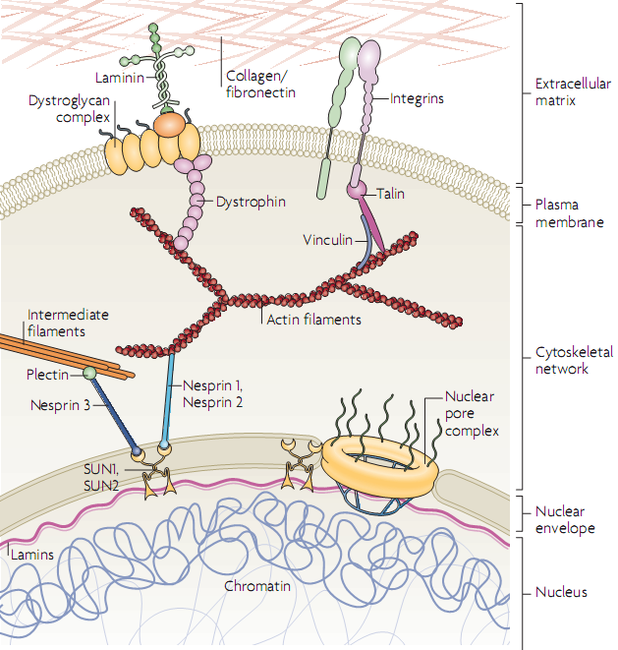
Mechanical support
Notes:
Figure 2.48. Connectivity of the extracellular matrix and intracellular elements. The figure shows the continuous protein network starting from collagen and fibronectin fibers outside the cell, to membrane-crossing elements such as integrins, to intracellular elements like actin- and intermediate-filaments of the cytoskeleton, and finally to elements inside the cell nucleus, such as lamins.

Slide 93
Mechanical support: the cytoskeleton
Composition
Microfilaments (actin): fiber-forming, globular
Intermediate filaments (e.g. keratin): fibrous
Microtubules (tubulin): fiber-forming, globular
Microtubules
Microﬁlaments made of F-actin
Notes:
Figure 2.42. Constituents of the cytoskeleton. The figure depicts the three types of cytoskeletal fibers, and their assembly from the basic units. (a) Microﬁlaments made of F-actin. Although F-actin forms structural fibers, it is a globular protein (see section 2.2 in the main-text for details). The fiber is dynamic; each of the F-actin monomers, depicted as spheres, can join the fiber from its (+) side or depart from it at the (-) side. (c) Microtubules made of α/β-tubulin. As F-actin, tubulin is also a globular protein. The orange lines delineate the α and β tubulin arrangements transversely to the fiber's axis. The image on the right shows the microtubule fiber from an angle perpendicular to the left image.

Slide 94
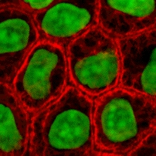
Mechanical support: the cytoskeleton
Intermediate filaments
In epithelia – built from α-keratin (Types I & II IF)
Notes:
Epithelia are tissues that line organs. They include organized lines and columns of tightly packed cells.
Left: Figure 2.42. (b) Intermediate ﬁlaments made of α-keratin. In contrast to F-actin, α-keratin (shown as elongated blue line) is a fibrous protein. As a result, it oligomerizes sideways to create a super-secondary (dimeric) structure called 'coiled-coil'. Two such dimers can align head-to-tail to form a tetrameric structure, assemble along a single axis to form a 'protofilament'. Finally, a number of protofilaments may join in a parallel formation to create a filament.
Right: Figure 2.44. Keratin intermediate filaments. (a) Fluorescence scanning laser confocal microscopy of keratin intermediate filaments in epithelial cells. The keratin intermediate filament constitutes most of the red stain in the image, whereas nuclear DNA is colored in green. The image is taken from ^{[552]}.

Slide 95
Mechanical support: the cytoskeleton
Intermediate filaments
In skin epithelium (epidermis) – formed by keratinocytes
Notes:
The innermost layer of skin epidermis is composed of keratinocytes. Some of these cells differentiate while physically moving towards the external side of the epidermis, creating the other four layers of cells (from inside to outside) that differ in their degree of differentiation, metabolic activity, and amount of keratin. The differentiation process involves the disappearance of the nucleus and organelles, increase in keratin content, and the abolishing of metabolic activity. It ends after 26-42 days, with the activation of programmed cell death (apoptosis). At this stage, the dead cells are full of keratin and reside at the outermost layer of the skin. This layer is highly efficient in protecting the inner layers against physical attrition, and as a barrier preventing the penetration of water and chemical/biological agents into the tissue.
Figure 2.44. Keratin intermediate-filaments. (b) The structure of skin. The entire structure is shown on the left. A blow up of the epidermal layer is shown on the right, along with the major protein-based structures.

Slide 96
Mechanical support: the extracellular matrix
The ECM
Constitutes most of the volume of connective tissues (bone, cartilage, tendons)
Epidermis
Dermis (connective)
Notes:
Connective tissues support, connect, or separate different types of tissues and organs in the body. The ECM constitutes most of the volume of connective tissues, with the cells sparsely checkered in it. All connective tissues include fibers, ground substance and cells (except blood and lymph that lack fibers).
Figure 1-9 Types of animal tissues. (a) Connective tissue. A longitudinal section of skin tissue. Beneath the epithelium is the thick connective tissue (dermis), which includes fibroblasts (ECM-synthesizing cells), protein fibers, and other components.

Slide 97
Mechanical support: the extracellular matrix
The ECM
Made of proteins (mainly collagen), polysaccharides, minerals
Notes:
Figure 2.48. Connectivity of the extracellular matrix and intracellular elements. The figure shows the continuous protein network starting from collagen and fibronectin fibers outside the cell, to membrane-crossing elements such as integrins, to intracellular elements like actin- and intermediate-filaments of the cytoskeleton, and finally to elements inside the cell nucleus, such as lamins.

Slide 98
Mechanical support: the extracellular matrix
ECM proteins have various roles
Notes:
Table 2.10. Types of extracellular (ECM) proteins and their functions. ECM: extracellular matrix.

Slide 99
Tissue organization and cell-environment communication
The ECM is linked to the cytoskeleton
Anchors cells to tissue
Relays mechanical signals from the external environment to the cell
Notes:
The link between microfilaments and the ECM leads to integrin clustering in one area of the membrane and activation of tyrosine kinases in that area.
Cell-ECM interactions affect significantly the shape, proliferation, differentiation, and even death of the former
Figure 2.48 Connectivity of the extracellular matrix and intracellular elements. The figure shows the continuous protein network starting from collagen and fibronectin fibers outside the cell, to membrane-crossing elements such as integrins, to intracellular elements like actin- and intermediate-filaments of the cytoskeleton, and finally to elements inside the cell nucleus, such as lamins.

Slide 100
Common properties of fibrous proteins
Supersecondary structure with either α or β elements
Hydrophobic surface → insoluble in water
Self-assembly into quaternary structure (covalent + non-covalent)
Relax
Extended
α-keratin (coiled-coil)
Collagen (triple helix)
Spider silk fibroin
Notes:
In contrast to globular proteins, which need to be soluble in order to create transient contacts with other molecules without forming aggregates, fibrous proteins act mainly as building blocks for large stable structures, which does not require water solubility.
The complex tertiary structure characterizing globular proteins is usually absent in fibrous proteins, since the sophistication it confers to the protein is not needed.
Silk fibroin is composed of β sheets bound to each other via flexible linkers.
Figure 2.50. Super-secondary structure in fiber-forming proteins. (a) The coiled-coil structure of α-keratin. (b) The triple helix structure of collagen. (c) The complex β-structure of spider silk-forming protein from Nephila clavipes. A model of both relax and extended forms of the protein are shown.

Slide 101
Structure-function relationship: α-keratin
Principle protein of intermediate filaments in mammalian epithelia
Forms nails, horns, hoofs, feathers
Confers toughness and allows tissues to resist mechanical pressure
Notes:
Figure 2.44. Keratin intermediate filaments. (a) Fluorescence scanning laser confocal microscopy of keratin intermediate filaments in epithelial cells. The keratin intermediate filament constitutes most of the red stain in the image, whereas nuclear DNA is colored in green. The image is taken from ^{[552]}.

Slide 102
Structure-function relationship: α-keratin
Left-handed coiled-coil, made of two right-handed α-helices
~450 Å long
Rich in Ala & Gly → compactness
Also in globular proteins (leucine-zipper → dimerization)
GCN4
Notes:
The leucine zipper in the dimerization domain of the transcriptional activator GCN4 (also coiled-coil) is used here since there is no available keratin structure.
The coiled-coil is one of the commonest structural arrangements in proteins, promoting dimerization of proteins and domains.
Figure 2.51. The structure of α-keratin. (a) The basic coiled-coil structure of α-keratin. Since a high-resolution structure of keratin is unavailable, we used the structure of another coiled-coil, that of the leucine zipper, formed by the dimerization domain of the yeast transcriptional activator GCN4 (PDB entry 1zik). The latter is an accepted model of coiled-coils ^{[597]}. The image shows the structure as semi-transparent spheres, with each helix colored differently and the intertwined backbones of the two helices visible.

Slide 103
Structure-function relationship: α-keratin
Heptad repeat (hxxhcxc) → nonpolar interactions between helices → stability
Surface also nonpolar (not in GCN4) → water insoluble
Helix 1
Helix 2
GCN4
Notes:
The heptad repeat contains hydrophobic (h) and charged (c) amino acids, separated by others (x): hxxhcxc
(b) A helical wheel projection of the two helices in the coiled-coil structure, showing the distribution of the heptad residues (marked by their positions, from 1 to 7) along the helix axis. (c) The tilted hydrophobic stripe along the axis of each helix in the coiled-coil structure. The surface of one of the chains in the structure of GCN4 is colored using the Kessel-Ben-Tal hydrophobicity scale (see Figure 2-7 for details). The nonpolar stripe is colored in yellow.

Slide 104
Structure-function relationship: α-keratin
Self-assembly into higher structures → stability, length
S-S bonds → toughness:
'Hard' keratin - nails, horns, and hoofs
'Soft' keratin – skin and muscle
Parallel coiled-coil dimer
Anti-parallel tetramer
Octamer
ULF fiber
Notes:
The S-S bonds are between helices of different coiled-coils.
In 'soft' keratin, the ULFs are able to slide against each other, thus allowing the fiber to increase its length by 350%
(d) Assembly of the unit length filament (ULF). The process is described in the main text.

Slide 105
Structure-function relationship: α-keratin
S-S bonds in ‘perm’:
(Lehninger’s Principles of Biochemistry)
Notes:
The S-S bonds are between helices of different coiled-coils.
In 'soft' keratin, the ULFs are able to slide against each other, thus allowing the fiber to increase its length by 350%
(d) Assembly of the unit length filament (ULF). The process is described in the main text.

Slide 106
Structure-function relationship: collagen
Background
Most abundant protein in the human body (33%) and the main protein in connective tissues (bones, tendons, cartilage, the cornea)
28 known types in vertebrates, I-IV are most common
Notes:
In humans, collagen constitutes 33% of the total protein and 67% of the skin's dry weight.

Slide 107
Structure-function relationship: collagen
Roles:
Helping tissues endure mechanical pressure
Forming a scaffold for macromolecular deposits (laminin networks, proteoglycan, cellular receptors)
Confers tissues with characteristic properties:
Tensile strength: cartilage, skin, tendons/ligaments (binds elastin and polysaccharides)
Toughness: bone, teeth (deposited with Ca²⁺ and PO₄³⁻)
Notes:
The laminins are an important and biologically active part of the basal lamina, influencing cell differentiation, migration, and adhesion. They connect the ECM to the plasma membrane.

Slide 108
Structure-function relationship: collagen
Collagen fibers have a highly hierarchical structure
Tropocollagen formation:
Secretion to ECM
Notes:
Procollagen has a secretion signal peptide in the N’. After secretion to the ECM the termini are cleaved to form tropocollegen
Figure 2.47. Collagen maturation. The figure shows the proteolytic processing of pro-collagen into tropocollagen (upper left side) and the assembly of tropo-collagen units into collagen fibers (right side).

Slide 109
Structure-function relationship: collagen
Collagen fibers have a highly hierarchical structure
Association of tropocollagen into collagen fibers:
Fiber
Fibril
Notes:
Figure 2.47. Collagen maturation. The figure shows the proteolytic processing of pro-collagen into tropocollagen (upper left side) and the assembly of tropo-collagen units into collagen fibers (right side).
Right: collagen fibers in skin tissue (SEM, taken from https://www.pinterest.com/pin/338121884494190097/)

Slide 110
Structure-function relationship: collagen
Triple helix → stability
Length: ~1000 residues (~3000Å)
Each helix - left-handed PPII, no intra-helical Hbonds (available for inter-helical Hbonds), 3.3 residues/turn; 2.9Å rise/residue
Notes:
The 3D structure of the collagen triple-helix is difficult to determine because of its low solubility and its self-assembly into higher-order structure. Instead, biologists usually relate to structures of models, like the collagen-like peptide (1qsu).
Figure 2.52. The structure of collagen. (a) Ribbon representation of the triple helix of a collagen-like peptide (PDB entry 1qsu). Each chain is colored differently, and a segment extending one turn of the coil (7/2 residues) is marked. (b) A spacefill model of the triple helix.

Slide 111
Structure-function relationship: collagen
Large Pro/Hyp occupancy → PPII conformation → required for packing
Hyp
Pro
Gly
Hyp
Gly-X-Y motif
Pro
Gly
Notes:
The PPII helical conformation is geometrically compatible, and even required, for the formation of the triple helix. First, the Pro/Hyp-induced kink produces the right curvature of the chain needed for the tree helices to fit around each other. Second, the PPII helical conformation is much more flexible than the α-helix.
(c) The topology of the triple helix. The glycine residues of each helix face the center of triple helix unit, whereas proline and hydroxy-proline (Hyp) residues face outwards.

Slide 112
Structure-function relationship: collagen
Large Hyp occupancy → stereoelectronic stabilization
Hyp
Pro
Gly
Hyp
Gly-X-Y motif
Pro
Gly
Notes:
Originally, it was proposed that the OH group of Hyp stabilizes the triple-helix by forming hydrogen bonds between the helices, but the solved structure showed that the side chain of Hyp turns away from the triple-helical interface. Then, it was proposed that the bond exists, and is mediated by a water molecule, but this was refuted too. It should be mentioned, though, that while Hyp does not H-bonds within the triple-helix, it does seem to do so between triple-helices each from a different fibril.
Stereoelectronic effects - effects resulting from the alignment of electronic orbitals.
(c) The topology of the triple helix. The glycine residues of each helix face the center of triple helix unit, whereas proline and hydroxy-proline (Hyp) residues face outwards.

Slide 113
Structure-function relationship: collagen
Hyp is formed by the vitamin C-dependent enzyme prolyl hydroxylase
Vitamin C deficiency → scurvy:
General weakness
Anemia
Loosening of teeth
Skin hemorrhages
Vitamin C (ascorbic acid)
Notes:
Figure 2.6.1. Vitamin C (ascorbic acid). The molecule is colored by atom type.

Slide 114
Structure-function relationship: collagen
Large Gly occupancy
Tight helical packing (vdW) → stability
Hyp
Pro
Gly
Hyp
Gly-X-Y motif
Pro
Gly
Notes:
X and Y in the motif can be any residues, but are often Pro and Hyp.
(c) The topology of the triple helix. The glycine residues of each helix face the center of triple helix unit, whereas proline and hydroxy-proline (Hyp) residues face outwards.

Slide 115
Structure-function relationship: collagen
Large Gly occupancy
More H-bonds between helices → stability
d
Notes:
Interestingly, the interactions within the triple helix do not seem to be sufficient; the triple helix unit (tropocollagen) becomes stable only following the formation of the fibril. Indeed, mutations that disrupt interactions between triple-helices lead to pathologies far worse than mutations interfering with interactions within each triple-helix.
(d) A schematic representation of the hydrogen bonds within the triple helix. A four-residue segment of each helix is depicted, from the amino terminus (top) to carboxy terminus (bottom). Hydrogen bonds are depicted as dotted lines connecting the N-H and C=O backbone groups of the residues, which are also marked schematically.

Slide 116
Structure-function relationship: collagen
Lysine oxidative deamination→ covalent cross-links between fibrils → increased stability of collagen's ultra-structure
Ageing → too many crosslinks → brittle collagen
oxidative deamination
Notes:
The oxidative deamination is enzyme-catalyzed (lysyl amino oxidase).
The crosslinking is between helices within a fibril or between fibrils.
Ageing increases the number of crosslinks, which makes collagen brittle
(e) Allysine (left), compared to Lys (right).

Slide 117
Structure-function relationship: collagen
Types of crosslinks:
Allysine-lysine (Schiff base)
Allysine-allysine (aldol crosslink)
Allysine-leucine (C-NH-C)
http://lion.freeoda.com/files/page_54.html

Slide 118
Structure-function relationship: collagen
Still, collagen is less tough than α-keratin, since the latter contains many S-S bonds
Therefore it has been selected by evolution to confer tensile strength
http://lion.freeoda.com/files/page_54.html

Slide 119
Structure-function relationship: collagen
Large Gly/Pro/Hyp occupancy → low aggregation risk
Gly and Pro - low propensity to appear in β-sheets
Hyp – OH group increases surface polarity
Hyp
Pro
Gly
Hyp
Pro
Gly

