Slide 1
Chapter 8:
Protein-Ligand Interactions

Slide 2
Importance of protein-ligand interactions

Slide 3
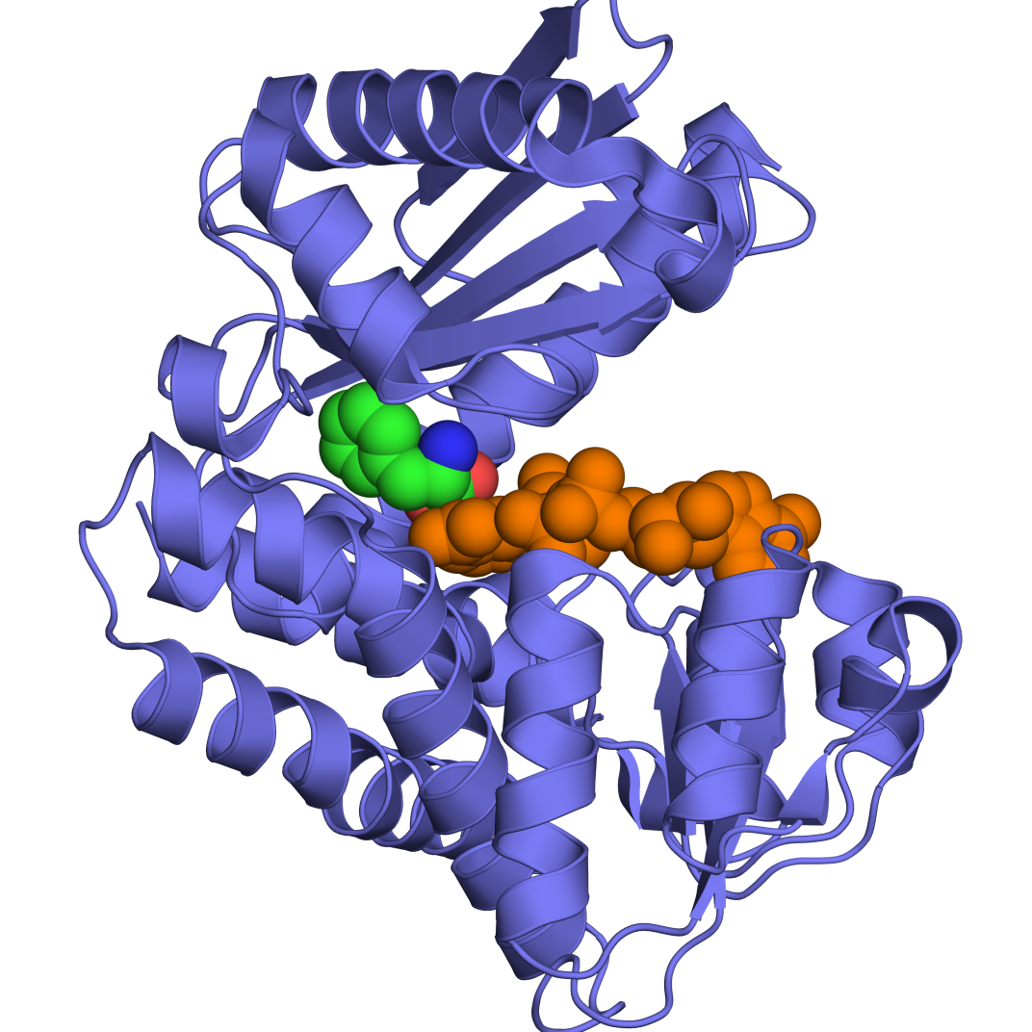
Protein-ligand interactions are crucial to biological function
Catalysis (enzyme-substrate/cofactor)
Notes:
Figure 8-1. Examples of biologically important protein-ligand interactions. (a) Enzyme substrate/cofactor binding. Here, L-phenylalanine dehydrogenase is the enzyme (in blue ribbon representation), bound to both substrate (colored by atom type) and cofactor (NADH, colored in orange) (PDB entry 1c1d).

Slide 4
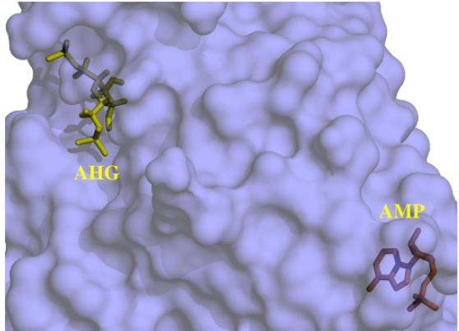
Protein-ligand interactions are crucial to biological function
Regulation (enzyme-activator/inhibitor, receptor-agonist/antagonist)
Example: allosteric regulation:
Notes:
(b) Allosteric regulators. The figure shows the protein fructose-1,6-bisphosphatase with 2,5-anhydro-D-glucitol-1,6-bisphosphate (AHG, an analogue of its substrate), and AMP (an allosteric inhibitor) (PDB entry 1fpd). As clearly seen, the allosteric ligand occupies a distinct binding site, which is quite distant from the catalytic site.

Slide 5
Protein-ligand interactions are crucial to biological function
Transport (channel/transporter-ion/molecule)

Slide 6
Protein-ligand interactions are crucial to biological function
Communication (hormones, neurotransmitters, second messengers, downstream regulators)
Protein trafficking (e.g. proteins attachment to phosphoinositides)
Prosthetic groups (e.g. heme, retinal)
Defense/offense (e.g. bacterial toxins)

Slide 7
Binding affinity & specificity

Slide 8
Key aspects in protein-ligand binding
Affinity
Types of complexes
Measuring and calculating the binding energy
Thermodynamics
Specificity
Models
Determinants
Promiscuity
Notes:
The two central aspects of protein-ligand interactions are affinity and specificity.

Slide 9
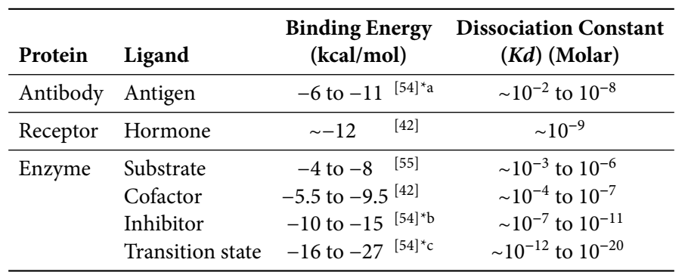
Protein-ligand binding affinity
The affinity usually does not exceed 15 kcal/mol
Different complexes have diverse affinities that match their biological purpose
a
[PL]
[P][L]
P+L
PL
K_{a} =
K_{d} =
= 1/K_{a}
d
[P][L]
[PL]
Notes:
The affinity, or binding energy, is within a range of values, and matches the biological role of the binding.

Slide 10
Protein-ligand binding affinity
Example: an enzyme has higher affinity to the substrate’s transition state than ground state

Slide 11
Measuring binding energies
The standard free energy of binding can be obtained from the equilibrium constant (K_{eq}):
ΔG⁰ = - RTlnK_{eq}
R = 1.989 cal/(molºK); RT ≈ 0.6 kcal/mol (25° C/298 K)

Slide 12
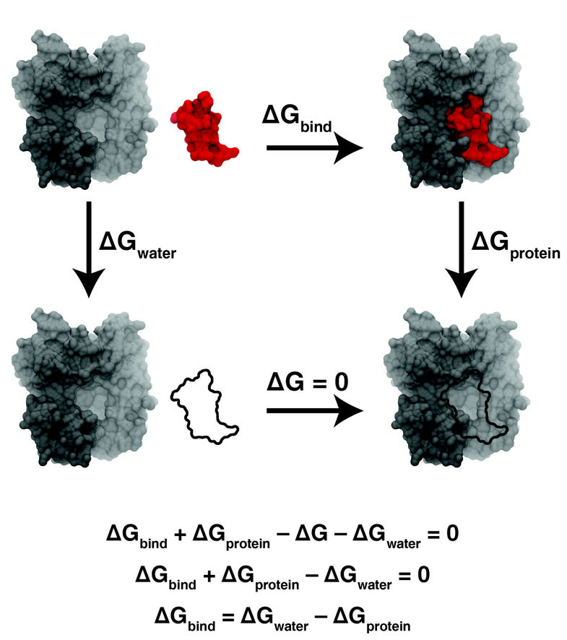
Calculating binding energies
Alchemical methods (free energy perturbation): all-atom MD simulations of binding via non-physical intermediates
unbound ligand is 'annihilated'
bound ligand is 'annihilated'
binding of ‘ghost’ ligand
non-interacting (‘ghost’) ligand
BMC Biology (2011) 9:71
Notes:
Calculation of the absolute free energy of binding requires simulating the entire binding event in solvent, which is often too long for MD simulations. Thus, easier protocols have been devised.
In the above example, a free energy cycle is built from non-physical events, allowing easier simulations. The cycle includes a ‘ghost’ ligand, which has the shape of the real one, but cannot interact with the protein (it’s vdW + electrostatic interacting capabilities are turned off gradually). The binding of the real ligand to the protein is calculated by running two simulations – one involving the annihilation of the ghost ligand in its bound state and the other involving its annihilation in water.

Slide 13
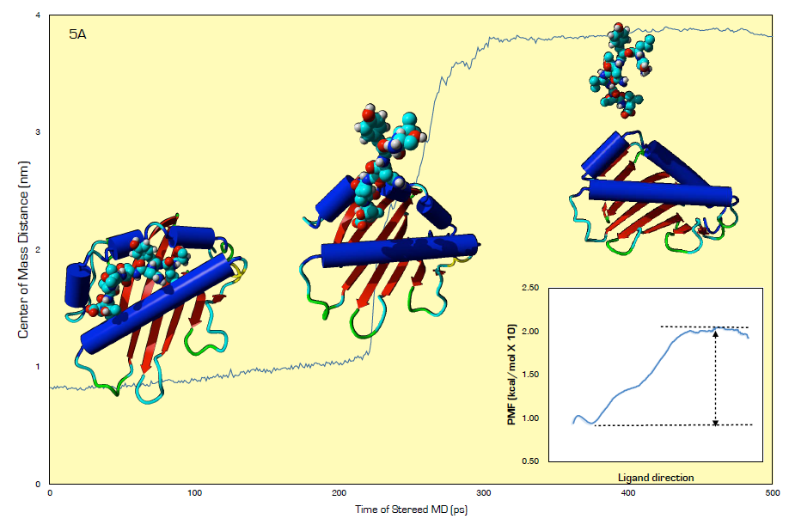
Calculating binding energies
Steered MD: all atom simulations that pull the ligand from the protein in a physically consistent manner
American Journal of Bioinformatics Research (2015), 5: 1-8

Slide 14
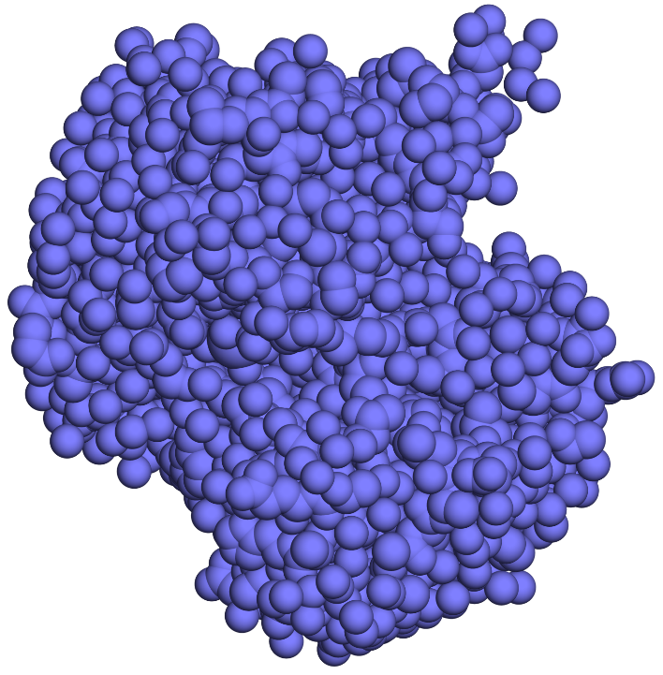
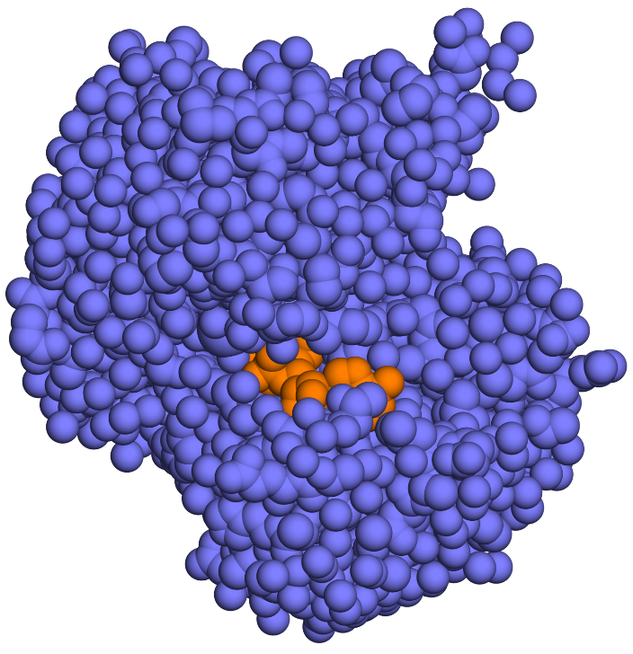
Calculating binding energies
MM/PBSA: end-point calculation (ΔG_{bound}-ΔG_{free}) using mean field model (computationally cheap)
ε = 80
ε=2
ε=2
+
ε=2

Slide 15
Thermodynamics of protein-ligand binding
Determinants of the binding affinity:
Favorable:
Enthalpy changes (Coulomb + vdW interactions)
Solvent entropy changes (nonpolar interactions)
Unfavorable
Desolvation of protein and ligand
Protein + ligand entropy changes (restriction of various movements)
Notes:
The overall affinity of the protein to its ligand gives us only partial information about the binding process. A deeper understanding requires us to describe the forces and interactions contributing to it. In protein-ligand binding, these contributions are similar to those of protein folding..
The exact magnitude of each of the entropy contributions is unclear, and changes with ligand type.
When the ligand is small the entropy of the protein does not change much, but when the ligand is a protein or a peptide, both protein and ligand undergo entropic changes.

Slide 16
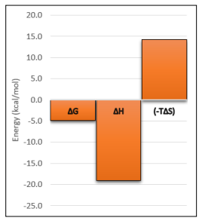
Thermodynamics of protein-ligand binding
The two large contributions cancel each other out, resulting in a small binding energy (enthalpy-entropy compensation)
Hydrophobic effects drives binding whereas electrostatic interactions render it specific
Notes:
Some binding sites for nonpolar molecules do not contain any water molecules. In such cases, the binding is not driven by the hydrophobic effect but rather by vdW and electrostatic interactions.
Specificity is particularly conferred by hydrogen bonds, which are geometry-dependent and also very common in P-L interfaces.
Figure 8.3. Enthalpy-entropy compensation. The image shows the free energy (ΔG) of binding of streptavidin to the peptide HDHPQNL, as well as the binding enthalpy (ΔH) and entropy (-TΔS) components. The values were measured by isothermal titration calorimetry (taken from the SCORPIO database). Notice that the enthalpy and entropy components are large and opposite in sign. The resulting binding free energy value is therefore relatively small.

Slide 17
Specificity of protein-ligand binding: models
Lock & key model (Emil Fischer, 19th century)
The protein’s active site is rigid and geometrically pre-adjusted to the ligand
+
Notes:
The binding specificity is a hallmark of protein-ligand binding. It results from the match between the protein’s binding site and the ligand.
The lock-and-key theory was originally proposed for enzymes, but can relate to any protein-ligand binding.
However, in subsequent years, accumulating evidence began to indicate that in many cases the binding sites of enzymes do not match the substrate perfectly, and that the binding process is accompanied by conformational changes in the enzyme
Figure 8-2. Schematic representation of three popular protein-ligand binding theories. (a) The 'lock & key' theory. The protein is represented as a blue circle and the ligand as an orange shape. The ligand-binding site of the protein matches the ligand perfectly.

Slide 18
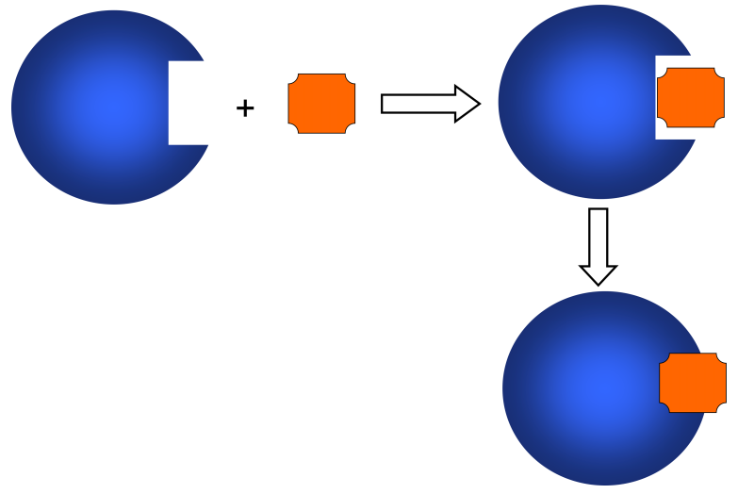
Specificity of protein-ligand binding: models
Induced fit model (Daniel Koshland, 1950s)
General pre-existing match → further adjustment to ligand
Notes:
(b) The 'induced fit' theory. The binding site fits the ligand generally. However, the fit is significantly improved following the binding, due to ligand-induced conformational changes in the protein.

Slide 19
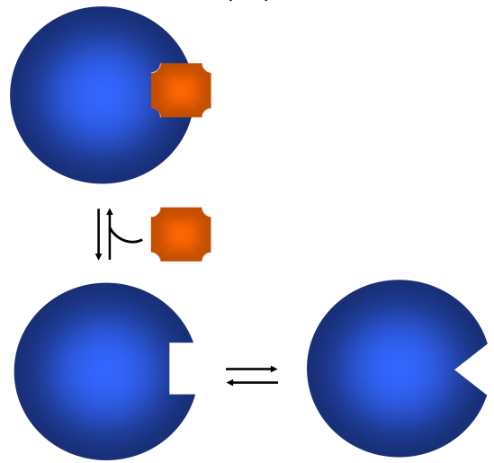
Specificity of protein-ligand binding: models
Conformational selection model (Monod, 1965)
Proteins shift spontaneously between different conformations (MWC model)
Notes:
(c) The conformational selection (a.k.a. population shift) theory. The protein changes conformation constantly, with at least one of these conformations matching the ligand. The ligand selects this conformation by binding to it.

Slide 20
Specificity of protein-ligand binding: models
Conformational selection model (current)
The ligand binds preferentially to one of the sample conformations, thus stabilizing it
Some induced fit may still be necessary to optimize the complex
Notes:
(c) The conformational selection (a.k.a. population shift) theory. The protein changes conformation constantly, with at least one of these conformations matching the ligand. The ligand selects this conformation by binding to it.

Slide 21
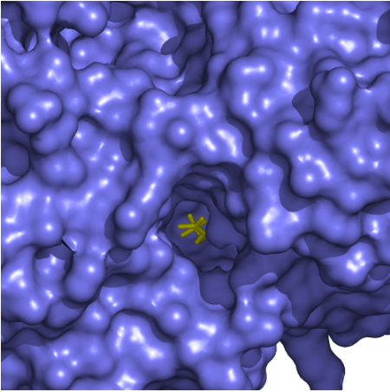
Specificity of P-L binding: ligand-site match
Geometric match (vdW & nonpolar interactions)
Binding sites for small molecules – deep depression
Notes:
The match is both in geometry, which allows optimization of vdW and nonpolar interactions, and in electrostatics.
Figure 8-6. Geometric match between the protein's binding site and its ligand. (a) The figure shows the structure of acetylcholine esterase (AChE) in complex with its substrate, acetylcholine (ACh) (PDB entry 2ha4). An overall view of ACh (yellow sticks) inside the binding site of AChE (blue surface). (b) The intertwined subunit-subunit interface in the Bence-Jones Protein (immunoglobulin light chain dimer) (PDB entry: 1bjm). The protein atoms are represented as spheres, with the two subunits in different colors.

Slide 22
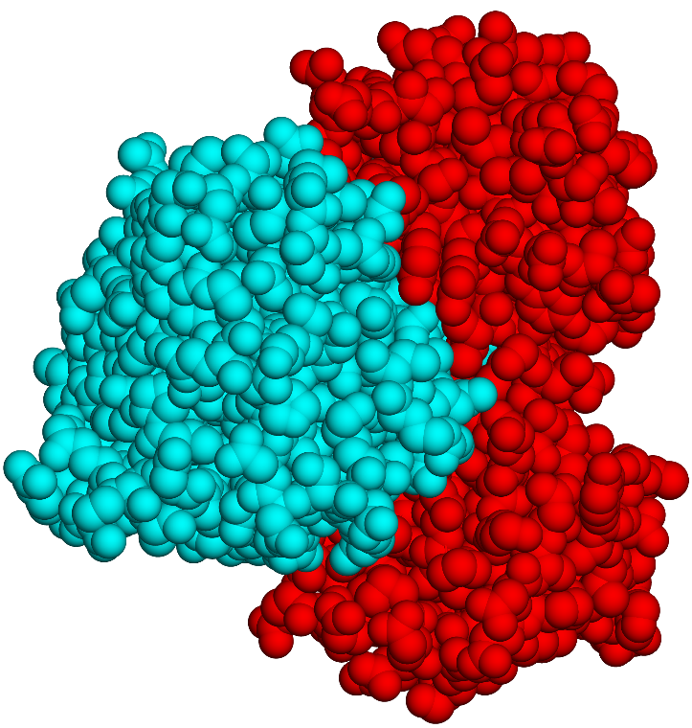
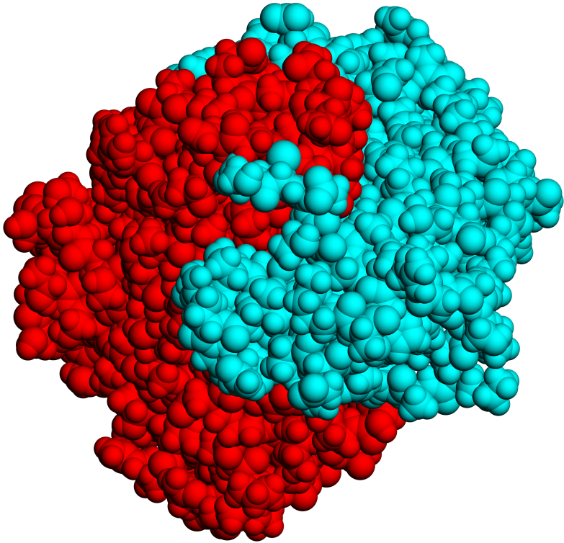
Specificity of P-L binding: ligand-site match
Geometric match (vdW & nonpolar interactions)
Binding sites for peptides/proteins – usually flat, subunit-subunit interfaces may be intertwined
Ras-RalGDS complex
Bence-Jones protein
Notes:
Figure 8-6. Geometric match between the protein's binding site and its ligand. (a) The figure shows the structure of acetylcholine esterase (AChE) in complex with its substrate, acetylcholine (ACh) (PDB entry 2ha4). An overall view of ACh (yellow sticks) inside the binding site of AChE (blue surface). (b) The intertwined subunit-subunit interface in the Bence-Jones Protein (immunoglobulin light chain dimer) (PDB entry: 1bjm). The protein atoms are represented as spheres, with the two subunits in different colors.

Slide 23
Specificity of P-L binding: ligand-site match
Electrostatic match (ionic interactions, Hbonds, π)
The binding site of AChE has a strong negative potential that draws the positively charged ACh
Positive
Negative
Notes:
Figure 8-7. Electrostatic match between the protein's binding site and its ligand. The figure shows the same structure as in Figure 8-5a. (a) The chemical structure and electric charge of ACh. (b) The strong negative potential of the binding site in AChE. The enzyme is represented as a surface colored by electrostatic potential, with positive, neutral, and negative potentials represented by the colors blue, white, and red, respectively. The electrostatic potential is calculated using APBS and ranges between -5 to 5 kT/electron charge. Left - the entire enzyme. Right - a magnification of the binding site.

Slide 24
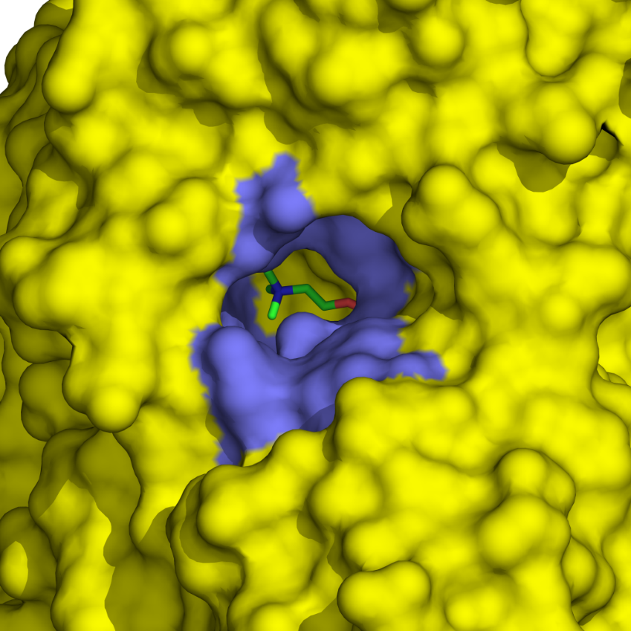
Specificity of P-L binding: ligand-site match
Electrostatic match (ionic interactions, Hbonds, π)
ACh is drawn to the catalytic site by an electric gradient along a low-dielectric path (electrostatic steering)
180º
W84
Notes:
(d) The aromatic gorge of AChE. The structure shown in the figure is that of AChE complexed with ACh in its transition state (PDB entry: 2ace). Left - the aromatic gorge (colored blue) when viewed from outside the enzyme (colored yellow). Right - The 14 conserved aromatic residues forming the gorge. These include F120, F288, F290, F330, F331, W84, W233, W279, W432, Y70, Y121, Y130, Y334, and Y442.

Slide 25
Specificity of P-L binding: ligand-site match
Electrostatic match (ionic interactions, Hbonds, π)
The weak partial charges of aromatic residues prevent the substrate and products from getting stuck in the gorge
180º
W84
Notes:
The weak electrostatic gradient at the aromatic gorge may explain why AChE is one of the fastest enzymes in nature, with a rate approaching the diffusion limit (~10⁸/(meter second)).
(d) The aromatic gorge of AChE. The structure shown in the figure is that of AChE complexed with ACh in its transition state (PDB entry: 2ace). Left - the aromatic gorge (colored blue) when viewed from outside the enzyme (colored yellow). Right - The 14 conserved aromatic residues forming the gorge. These include F120, F288, F290, F330, F331, W84, W233, W279, W432, Y70, Y121, Y130, Y334, and Y442.

Slide 26
Specificity of P-L binding: ligand-site match
Aromatic residues are common in binding sites
They are large – can form extensive nonpolar & vdW interactions with the ligand
They are polar (π electrons, OH and NH in Tyr and Trp) – can also interact electrostatically
They are planar – can form pocket shapes, interactions are geometry-dependent
Notes:
(d) The aromatic gorge of AChE. The structure shown in the figure is that of AChE complexed with ACh in its transition state (PDB entry: 2ace). Left - the aromatic gorge (colored blue) when viewed from outside the enzyme (colored yellow). Right - The 14 conserved aromatic residues forming the gorge. These include F120, F288, F290, F330, F331, W84, W233, W279, W432, Y70, Y121, Y130, Y334, and Y442.

Slide 27
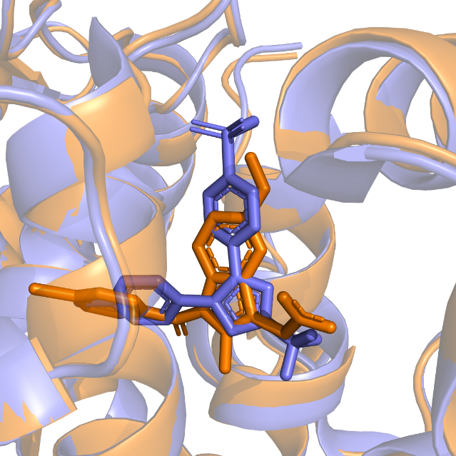
Specificity of P-L binding: promiscuity
Many proteins are capable of binding different ligands at the same site (e.g. signaling proteins with many partners)
The ligands may be of the same type (e.g. sterols) or different
Allows same protein to act on different molecules (PKA, cytochrome P₄₅₀)
Similar conformations in celecoxib/indomethacin binding to COX-2
Notes:
Protein binding promiscuity shows that specific binding is not always an advantage; it all depends on the biological role of the protein. For example, the D/D binding domain of Protein Kinase A (PKA) can bind multiple different proteins with high affinity, and this property enables PKA to attach to different cellular locations where its activity is required.
Figure 8.8. Binding of two different ligands to the same binding site in cyclooxygenase-2 (COX-2). (a) Superposition of two COX-2 structures bound to two different inhibitors. The first binds celecoxib (PDB entry 3ln1, blue), and the second binds indomethacin (PDB entry 4cox, orange). The binding site of COX-2 is shown as ribbons, and the inhibitors are shown as sticks. As can be clearly seen, the binding sites in the two structures share the same conformation, in essence, which means that the binding of the two different inhibitors is not based primarily on conformational selection.

Slide 28
Specificity of P-L binding: promiscuity
Mechanisms:
The ligands may bind to different protein conformations
The ligands may bind to different residues
The ligands may bind to the same residues with different affinity
Similar conformations in celecoxib/indomethacin binding to COX-2
Notes:
Figure 8.8. Binding of two different ligands to the same binding site in cyclooxygenase-2 (COX-2). (a) Superposition of two COX-2 structures bound to two different inhibitors. The first binds celecoxib (PDB entry 3ln1, blue), and the second binds indomethacin (PDB entry 4cox, orange). The binding site of COX-2 is shown as ribbons, and the inhibitors are shown as sticks. As can be clearly seen, the binding sites in the two structures share the same conformation, in essence, which means that the binding of the two different inhibitors is not based primarily on conformational selection.

Slide 29
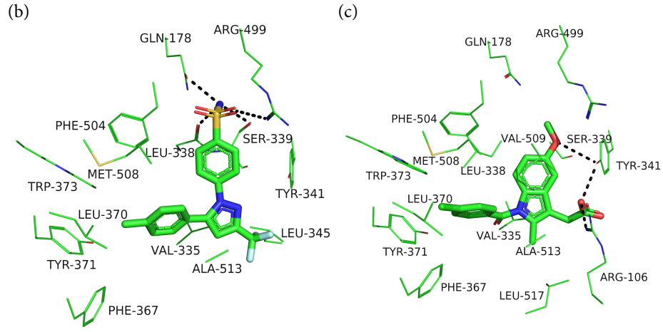
Specificity of P-L binding: promiscuity
Example: celecoxib/indomethacin binding to COX-2
Q178, R499 and S339 stabilize only celecoxib (left); Y341 stabilizes only indomethacin
Notes:
Figure 8.8. Binding of two different ligands to the same binding site in cyclooxygenase-2 (COX-2). (b,c) The non-covalent interactions of celecoxib (b) and indomethacin (c) with binding site residues. In both cases the inhibitor is shown as sticks, colored according to atom type, and the binding site residues are noted and shown as lines. Most of the residues on the left side of the image stabilize both inhibitors via nonpolar and π-π interactions. In contrast, the polar residues on the upper-right side of the image stabilize one inhibitor or the other selectively, via hydrogen bonds (dashed lines); Q178, R499 and S339 form hydrogen bonds only with celecoxib, whereas Y341 forms hydrogen bonds only with indomethacin.

Slide 30
Specificity of P-L binding: promiscuity
Binding affinity
Disordered structure → binding-folding coupling → larger ΔS_{bind} compared to globular proteins → weaker binding → higher partner exchange rate (advantage for signaling proteins)
Notes:
Transient binding of signaling proteins to their ligands can also be achieved by intrinsically unstructured proteins (IUPs); their disordered structure can adapt to different ligands, and the low affinity (because of the binding-induced decrease in chain entropy) makes the binding transient.
Figure 6.2. An IUP-protein complex involving partial folding. The image shows the binding of the anti-apoptotic protein Bcl-xL (yellow surface) to the unstructured protein Bad (blue ribbon). Upon binding, a 25-residue segment from the death promoting region of Bad acquires an α-helical conformation, whereas the rest of the protein remains unstructured. The complex between Bcl-XL and the 25-residue segment of Bad is taken from PDB entry 1g5j, whereas the rest of Bad is modelled as a random coil.

Slide 31
Protein-protein binding domains
SH2 – phosphotyrosine-including segments (pYxx)
PTB – phosphotyrosine-including segments (NPxpY)
SH3 – proline-rich segments (xPxxP)
WW – proline-rich segments (PPxY)
PDZ – short C’ sequences (16 different motifs)
EH – (NPF)
(x – any residue; p – phospho-)
Notes:
Motifs recognized by the PDZ domain are described by Lee et al. (2010) Cell Commun Signal 8, 8.

Slide 32
Protein-protein binding domains
Src-homology 2 (SH2)
Common in signaling proteins
Binds phosphotyrosine residues (pY) in the target protein
The peptide usually has a β conformation

Slide 33
Protein-protein binding domains
Src-homology 2 (SH2)
The pY interacts with conserved basic residues (pY pocket)
The specificity pocket recognizes positions C’ to pY (pYXX)
pY pocket
specificity pocket
Notes:
The PTB domain also recognizes pY residues, but the specificity is obtained by recognition of residues N-terminal (rather than C-terminal) to the pY sequence (NPXpY motif)

Slide 34
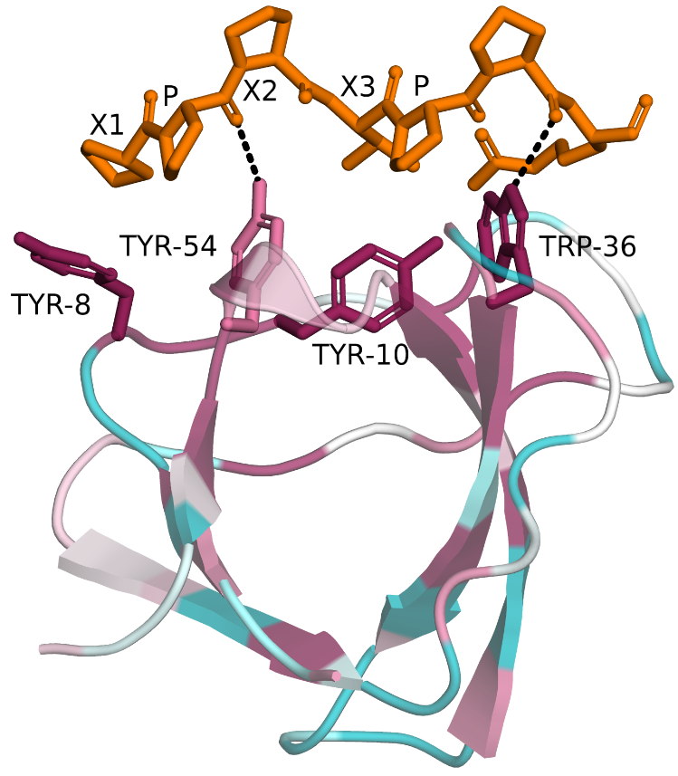
Protein-protein binding domains
Src-homology 3 (SH3)
Common in signaling proteins
Binds proline-rich sequences in target proteins
Notes:
Figure 8.13. The interaction of an SH3 domain with the mSos-derived polyproline peptide that has a PPII conformation. The SH3 domain is from the actin-binding protein Abp 1P PDB entry 1jo8). It is superimposed on the SH3 domain of the protein 1sem, which is bound to the mSos-derived peptide with the amino acid sequence PPPVPPRRR (PDB entry 1sem). The SH3 domain is presented as ribbon with the residues interacting with the peptide presented as sticks. The protein is colored according to evolutionary conservation.

Slide 35
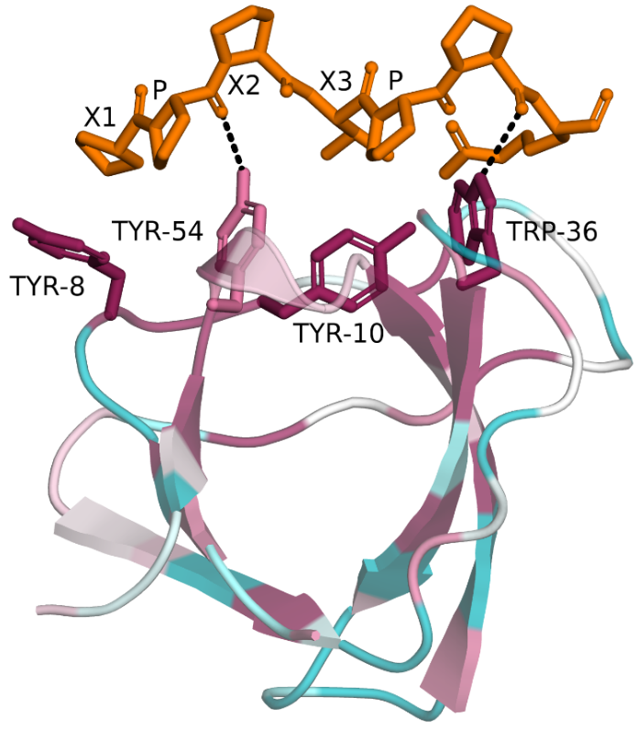
Protein-protein binding domains
Src-homology 3 (SH3)
The peptide contains the xPxxP motif and has PPII conformation
It interacts with conserved aromatic residues
Notes:
Figure 8.13. The interaction of an SH3 domain with the mSos-derived polyproline peptide that has a PPII conformation. The SH3 domain is from the actin-binding protein Abp 1P PDB entry 1jo8). It is superimposed on the SH3 domain of the protein 1sem, which is bound to the mSos-derived peptide with the amino acid sequence PPPVPPRRR (PDB entry 1sem). The SH3 domain is presented as ribbon with the residues interacting with the peptide presented as sticks. The protein is colored according to evolutionary conservation.

Slide 36
Protein-protein binding domains
Src-homology 3 (SH3)
The PPII conformation allows the hydrophobic pyrolidone sidechains to intercalate between the aromatic residues of the domain
Notes:
Figure 8.13. The interaction of an SH3 domain with the mSos-derived polyproline peptide that has a PPII conformation. The SH3 domain is from the actin-binding protein Abp 1P PDB entry 1jo8). It is superimposed on the SH3 domain of the protein 1sem, which is bound to the mSos-derived peptide with the amino acid sequence PPPVPPRRR (PDB entry 1sem). The SH3 domain is presented as ribbon with the residues interacting with the peptide presented as sticks. The protein is colored according to evolutionary conservation.

Slide 37
Protein-protein binding domains
Src-homology 3 (SH3)
The lack of intra-molecular backbone H-bonds in the peptide allows the carbonyls to H-bond with the domain
Notes:
Figure 8.13. The interaction of an SH3 domain with the mSos-derived polyproline peptide that has a PPII conformation. The SH3 domain is from the actin-binding protein Abp 1P PDB entry 1jo8). It is superimposed on the SH3 domain of the protein 1sem, which is bound to the mSos-derived peptide with the amino acid sequence PPPVPPRRR (PDB entry 1sem). The SH3 domain is presented as ribbon with the residues interacting with the peptide presented as sticks. The protein is colored according to evolutionary conservation.

Slide 38
Protein-Ligand Interactions in AChE Inhibition by Toxins and Drugs

Slide 39
AChE as a model for P-L interactions
Catalysis
Covalent binding
AChE
Natural toxins
Synthetic agents

Slide 40
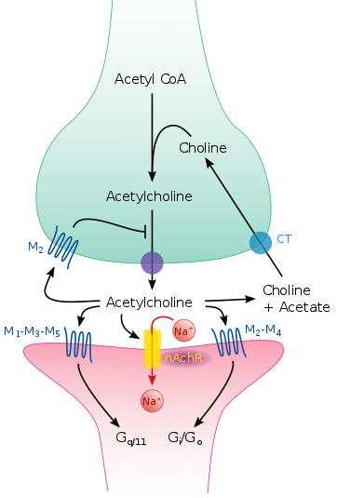
Acetylcholine (ACh)
A very common neurotransmitter in animals
Acts in the central and peripheral nervous systems
Mediates communication between:
Nerve cells
Nerve cells and muscle cells
Nerve cells and glands
Acts in cholinergic synapses
Smedlib (2017) Wikimedia (URL)

Slide 41
AChE
The activity of ACh in the synapse is terminated by AChE-catalyzed hydrolysis
AChE
AChE
Smedlib (2017) Wikimedia (URL)

Slide 42
Inhibition of AChE and other synaptic elements by natural toxins
Botulinum
(bacterial)
fasciculin
(snake)
Tubocurarine
(plant)
AChE
Atropine
(plant)
Smedlib (2017) Wikimedia (URL)
Notes:
ACh-inhibiting toxins lead to ACh accumulation and to cholinergic crisis. This in turn leads to complex symptoms, from tearing and gastrointestinal disturbances, to flaccid paralysis, which may result in death due to respiratory failure.

Slide 43
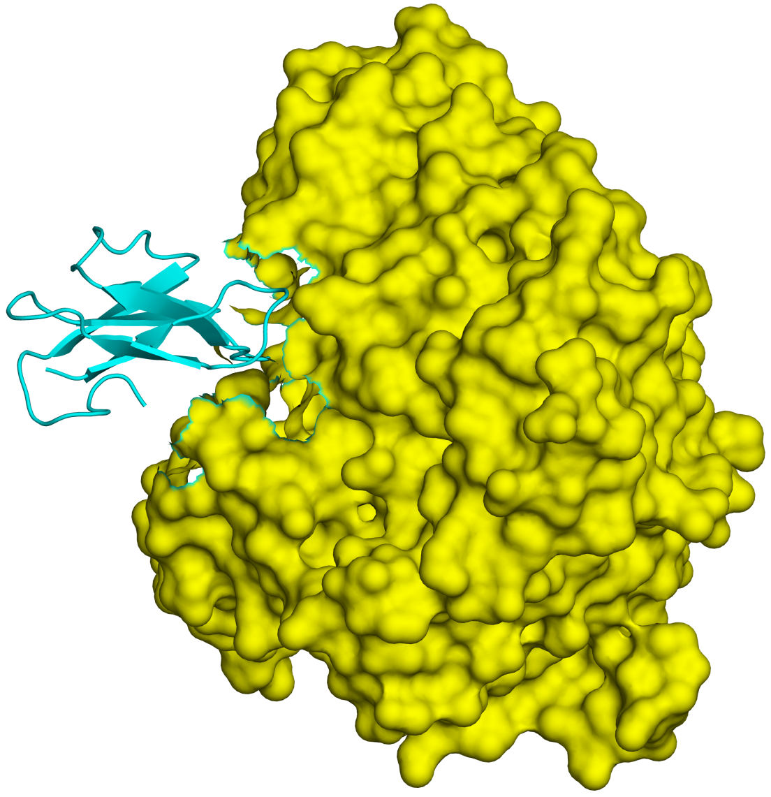
AChE is targeted by natural toxins
Fasciculin has evolved to bind AChE
1. Geometrically
Fasciculin-2
(green mamba)
AChE
Notes:
Box 8-1 Figure 2. AChE-fasciculin-2 complex. (a) A side view of the complex, illustrating the geometric complementarity of the two interacting proteins. AChE is presented as a yellow surface and fasciculin-2 as a blue ribbon.

Slide 44
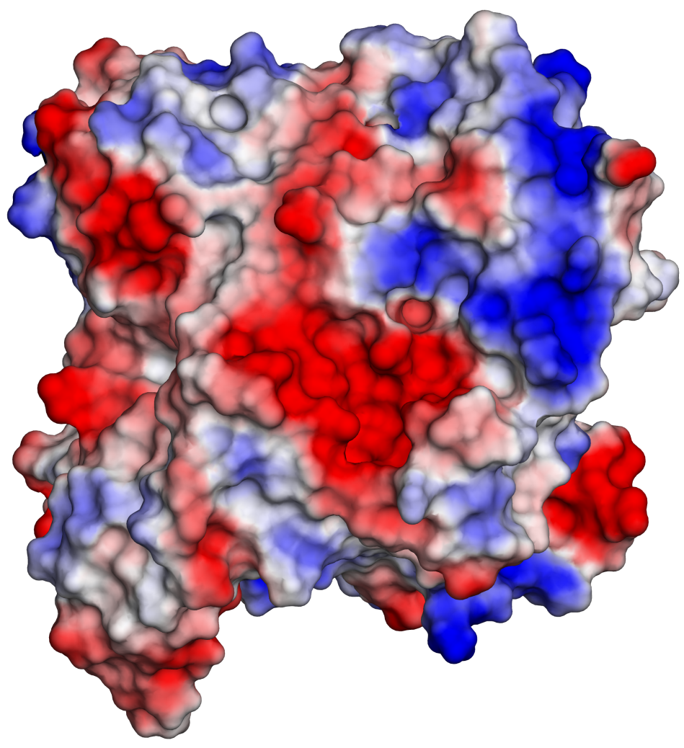
AChE is targeted by natural toxins
Fasciculin has evolved to bind AChE
2. Electrostatically
Positive
Negative
Notes:
(b) A front view of both interacting proteins, presented separately as surfaces colored by electrostatic potential (blue is positive, white is neutral, and red is negative). To create this view, both proteins were rotated 90º compared to their position in a, AChE to the right and fasciculin to the left. The electrostatic compatibility between the two proteins is clear; The positively charged part of fasciculin matches the entrance to AChE's binding site, which is negatively charged.

Slide 45
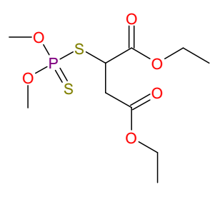
Synthetic inhibitors of AChE
Many synthetic AChE inhibitors are organophosphates (OP)
These include insecticides
Parathion
Malathion
Notes:
Box 8-1 Figure 3. Organophosphates (OP). (a) Weak OP usually used as insecticides.

Slide 46
Synthetic inhibitors of AChE
And nerve agents
Tabun
Sarin
VX
Soman
Notes:
Figure 8.1.3. Organophosphates (OPs). (b) Strong OP used as nerve agents.

Slide 47
AChE mechanism
The hydrolytic mechanism involves a covalent intermediate
(-)
*
Notes:
Mechanism: elevation of His-440’s pKa due to Glu326-induced polarization → proton transfer from Ser-200 to His-440 → nucleophilic attack of Ser-200’ O⁻ atom on ACh‘s carbonyl and formation of acyl-enzyme intermediate.
(b) The active site of AChE. The structure shown is that of the AChE-ACh transition state, in which ACh is covalently attached to Ser 200 and has a tetrahedral configuration (PDB entry 2ace). The acyl-enzyme intermediate results from deprotonation of Ser-200 (curved red arrow), followed by a nucleophilic attack of this residue on acetylcholine’s carbonyl group. In the deprotonation step, the proton of Ser-200 is transferred to His-440, thanks to a decrease in the latter’s pKa by Glu-327-induced polarization (see details in Chapter 9 Figure 9.26). The active site is a subsite of the aromatic gorge shown in Figure 8.10. It includes the catalytic triad, Trp 84, and Phe 330.

Slide 48
AChE mechanism
The hydrolytic mechanism involves a covalent intermediate
(-)
Ester bond
(-)
Notes:
Mechanism: elevation of His-440’s pKa due to Glu326-induced polarization → proton transfer from Ser-200 to His-440 → nucleophilic attack of Ser-200’ O⁻ atom on ACh‘s carbonyl and formation of acyl-enzyme intermediate.
(b) The active site of AChE. The structure shown is that of the AChE-ACh transition state, in which ACh is covalently attached to Ser 200 and has a tetrahedral configuration (PDB entry 2ace). The acyl-enzyme intermediate results from deprotonation of Ser-200 (curved red arrow), followed by a nucleophilic attack of this residue on acetylcholine’s carbonyl group. In the deprotonation step, the proton of Ser-200 is transferred to His-440, thanks to a decrease in the latter’s pKa by Glu-327-induced polarization (see details in Chapter 9 Figure 9.26). The active site is a subsite of the aromatic gorge shown in Figure 8.10. It includes the catalytic triad, Trp 84, and Phe 330.

Slide 49
Synthetic inhibitors of AChE
OPs phosphorylate Ser-200 irreversibly, rendering it inactive
Phosphoester
S200
Soman
AChE
Notes:
Figure 8.1.3. Organophosphates (OPs). (c) Soman-phosphoryated serine residue.

Slide 50
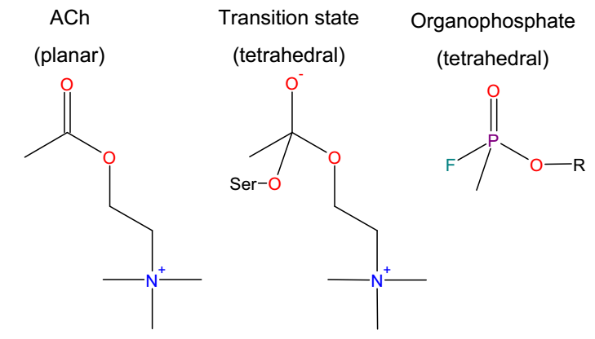
Synthetic inhibitors of AChE
OP have greater affinity to AChE because they resemble ACh’s tetrahedral transition state
Some also contain a good leaving group

Slide 51
Other inhibitors of AChE
Carbamates inhibit AChE reversibly → used to alleviate the symptoms of neurodegenerative diseases (Alzheimer’s, Parkinson’s)
Physostigmine
Neostigmine
Rivastigmine
Notes:
Physostigmine is a plant alkaloid whereas rivastigmine and neostigmine are artificial.
Figure 4. AChE inhibitors of the carbamates class.

Slide 52
Other inhibitors of AChE
Reversible binding is due to easy hydrolysis of the carbamoyl bond
They are also used to prevent AChE inactivation by organophosphates
carbamoyl
AChE
Neostigmine
Notes:
Carbamates also bind covalently to the catalytic serine. However, since the carbamoyl group hydrolyzes spontaneously in a few hours, the action of carbamates is considered to be reversible and short-lived (i.e., safe).
Figure 4. AChE inhibitors of the carbamates class.

Slide 53
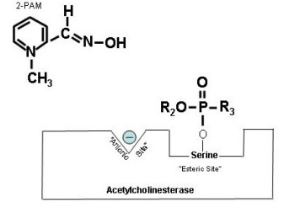
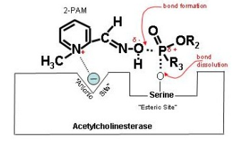
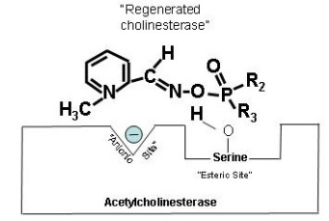
Other inhibitors of AChE
Oximes are used to remove nerve agents from the AChE active site, thus allowing its reactivation
+
Pralidoxime
Cholinesterase Inhibitors (2010) CDC course WB1102 (URL)
Notes:
Oximes are positively-charged compounds that initiate a nucleophilic attack on the OP-AChE bond and hydrolyze it.

Slide 54
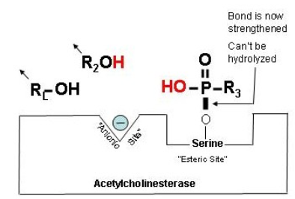
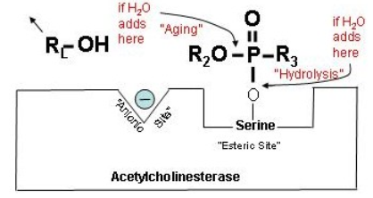
Other inhibitors of AChE
Certain nerve agents (e.g. Sarin) undergo de-alkylation (‘ageing’), which prevents AChE recovery by oximes
Cholinesterase Inhibitors (2010) CDC course WB1102 (URL)

Slide 55
Protein-ligand Interactions in Drug Design

Slide 56
Proteins involvement in diseases
Loss of activity (hereditary, environmental) – e.g. galactosemia
Receptor overstimulation – e.g. cancer, metabolic
Misfolding and aggregation – e.g. Alzheimer's, Huntigton's, MCD
Autoimmune response – e.g. multiple sclerosis
Some proteins actively cause disease (toxins)
Proteins constitute ~80% of all drug targets, mainly cell-surface receptors and enzymes
Notes:
In galactosemia the activity of one of the three galactose-degrading enzyme is missing due to inborn genetic errors. The result of the accumulation of galactose and its derivatives includes liver enlargement, kidney failure, brain damage, cataract, and sepsis.

Slide 57
How drugs work
Most drugs work by changing the activity of endogenous proteins, usually enzymes or receptors:
Directly - following binding to the target protein
Indirectly – by affecting a regulatory protein
In enzymes: activators vs. inhibitors
Competitive, non-competitive, uncompetitive
In receptors: agonists vs. antagonists and inverse agonists

Slide 58
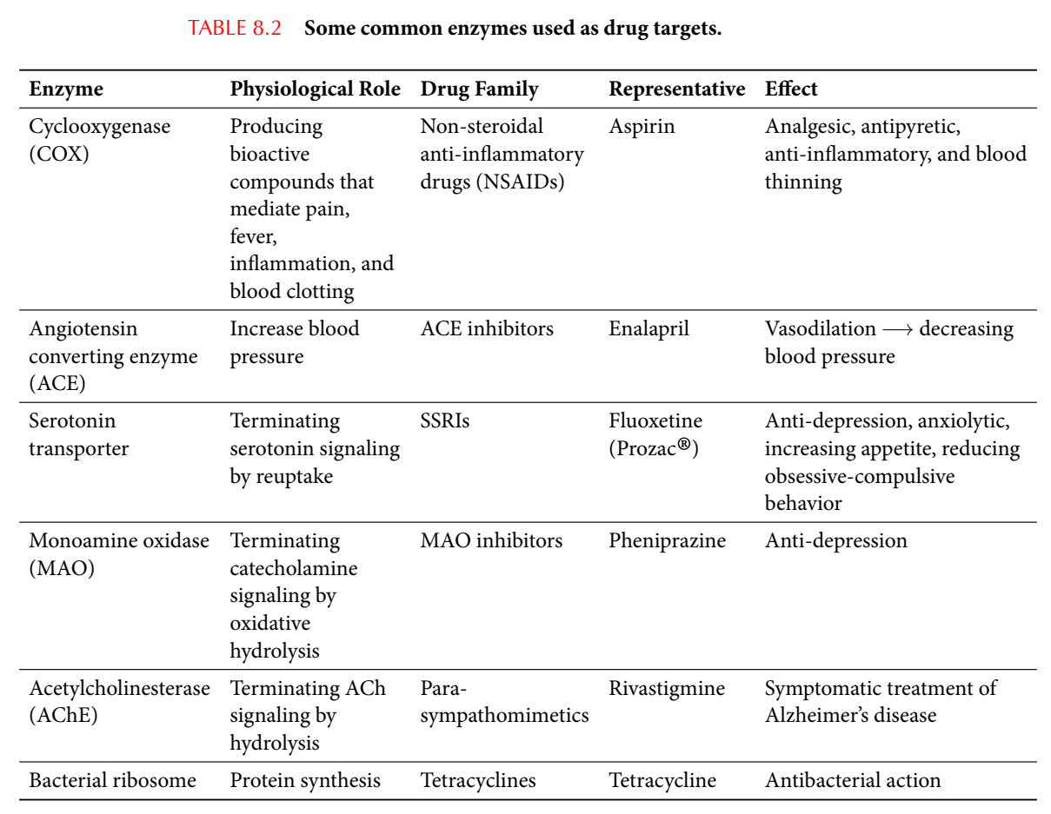
Enzymes are common drug targets

Slide 59
Types of effectors
Competitive inhibitors
Bind to the primary protein site (active site in enzyme, orthosteric site in receptors)
Often resemble the substrate’s chemical structure
Non-competitive effectors
Bind an allosteric protein site
Change protein activity or change the match between the primary binding site to the ligand
Need not resemble the substrate in chemical structure

Slide 60
Types of competitive inhibitors
Reversible inhibitors
Require large concentration to compete with substrate → off-target binding → side-effects
Irreversible inhibitors
Act at low concentrations
Block enzyme permanently → toxicity
‘Suicide inhibitors’ (only in enzymes)
Become irreversible by target enzyme → less toxic

Slide 61
Competitive drugs act by 'molecular mimicry'
Phenylethylamine (PEA)
Dopamine
Adrenaline
Methylphenidate (Ritalin®)
(Catecholamine reuptake inhibitor)
Notes:
Ritalin blocks the transporters of dopamine and adrenaline, thus decreasing reuptake and increasing catecholamine transmission.
Figure 8-14. Molecular mimicry in pharmaceutical drugs. The figure shows the example of the catecholamine reuptake inhibitor methylphenidate (Ritalin®), which mimics the catecholamines adrenaline and dopamine. All catecholamines contain the phenyl-ethyl-amine (PEA) group within their structure (a). The structures of dopamine (b), adrenaline (c) and methylphenidate (d) are shown, with the PEA group in black in all molecules, and other, additional chemical groups in red.

Slide 62
Competitive drugs act by 'molecular mimicry'
Structural similarities between β-adrenergic receptors’ agonist and antagonist:
Adrenaline (agonist)
Alprenolol (antagonist)
Notes:
Figure 8-15. Structural similarities between β adrenergic receptors’ agonist (adrenaline) and antagonist (alprenolol). The aromatic ring and 2-(methyl-amino)-ethanol group, both common to the two molecules, are colored in black, whereas the other chemical groups are in red.

Slide 63
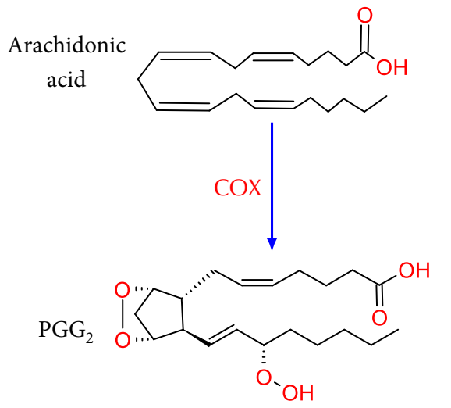
Competitive drugs act by 'molecular mimicry'
Cyclooxygenase (COX)-targeting drugs
COX turns arachidonic acid into prostaglandin G₂
Notes:
PGG2 is a labile intermediate peroxide. COX creates it, but immediately reduces it to the corresponding alcohol, PGH2. The latter is transformed to the other prostaglandins by other enzymes.
Figure 8-16. Ibuprofen's mode of action. (a) The conversion of arachidonic acid into PGG₂.

Slide 64
Competitive drugs act by 'molecular mimicry'
Cyclooxygenase (COX)-targeting drugs
COX is targeted by non-steroidal anti-inflammatory drugs (NSAID; e.g. ibuprofen) that are used to reduce fever, pain, and inflammation
Ibuprofen
Arachidonic acid
Notes:
COX-1 is constitutively expressed in many tissues (including the stomach) and regulates many signaling and homeostatic processes. COX-2 is generally expressed only in cells where prostaglandins are upregulated (e.g., during inflammation), and therefore is the preferred target for NSAIDS.
(b) The structures of arachidonic acid and ibuprofen. The red rectangles mark the similar chemical groups in the two molecules.

Slide 65
Non-competitive (allosteric) drugs
Do not compete with ligand – no molecular mimicry
Main advantages:
More specific (allosteric sites are less conserved)
Allow modulation of protein activity
Main disadvantage: difficult to design
Notes:
Allosteric drugs are difficult to design because they require knowledge on the allosteric site and its effects on the protein’s activity.

Slide 66
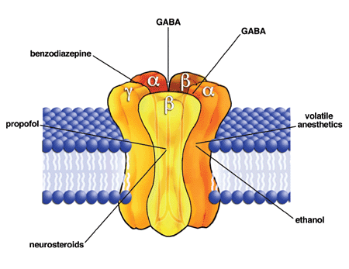
Non-competitive (allosteric) drugs
Example: benzodiazepines (Valium®, Xanax®) – activate GABA receptors by increasing affinity to GABA
David M. Lovinger, Wikimedia (URL)
Notes:
Benzodiazepines, barbiturates, ethanol, anesthetics, and propofol, all are positive allosteric modulators of the GABA_{A} ionotropic receptor - a chloride channel (GABA_{B} is a GPCR).

Slide 67
General drug design approaches
Ligand-based approach
New drug is searched by similarity to known active drugs
Knowledge of protein structure is unnecessary
Receptor-based approach
New drug is searched based on its interactions with the protein
Knowledge of protein and ligand structures is necessary

Slide 68
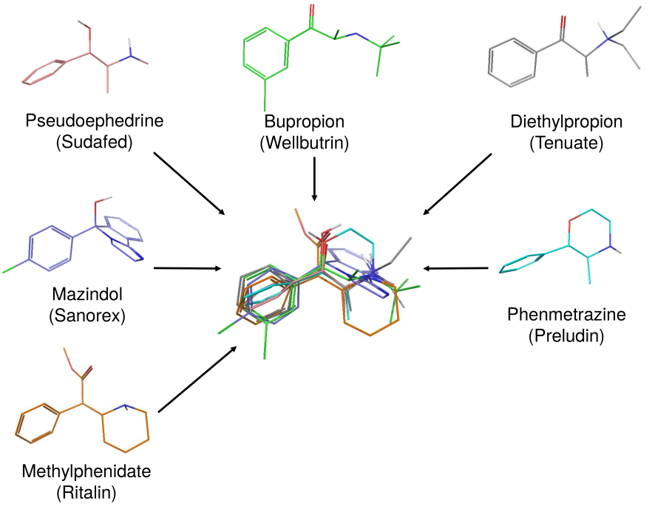
Rational design of competitive inhibitors
The ligand-based approach (pharmacophore)
Superposing all known drugs
Attention deficit disorder (ADD) drugs
Notes:
The ligand-based approach looks for chemical features that are similar in drugs that are already known to act on the protein in the desired way. It usually consists of two stages. The first is to superpose the drugs. This shows us which chemical groups are common, but it’s hard to rely on it to actually decide which part of the group has to be used for a new drug.
Figure 8-17. Generation of a simple, two-dimensional pharmacophore hypothesis using the ligand-based approach. (a) Superimposition of six drug molecules that are used for different diseases, but that all inhibit dopamine uptake by the dopamine transporter (brand names and names of the active ingredients are noted). These include methylphenidate, which is used to treat attention deficit disorders (ADD); pseudoephedrine, which is used to treat various conditions (e.g., asthma and rhinitis); diethylpropion and phenmetrazine, which are used to treat obesity; bupropion, which is an antidepressant, and mazindol; which is used to treat Duchenne muscular dystrophy. The superimposed structures are shown in the center.

Slide 69
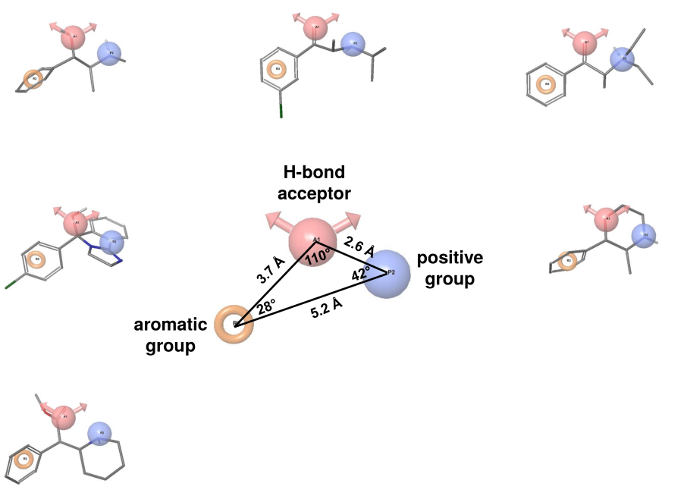
Rational design of competitive inhibitors
The ligand-based approach (pharmacophore)
Constructing a pharmacophore hypothesis
Attention deficit disorder (ADD) drugs
Notes:
The second stage is to look only at functional features of the molecules and see how they are distributed in structural space. This requires a computer algorithm that can sample all possible conformations of each molecule and look for those that give the best fit in the superposition. If we also have activity data for each molecule, we can calculate which shared feature is more important for the activity (SAR).
(b) A 2D pharmacophore hypothesis that best fits the six drug molecules listed in (a) (calculated by Elon Yariv using Phase ^{[297]} (Schrödinger, Inc.)). The pharmacophore summarizes the important groups in the drug as three centers, each having a different physicochemical property. The first center, which is represented here by the orange doughnut-like shape, is aromatic. The second center is a hydrogen-bond acceptor. It is represented as a magenta sphere with two arrows, indicating the direction of the accepted hydrogen bonds. The third center, represented by the blue sphere, is a positively-charged group. The distances and angles between the centers are noted. The individual drug molecules used for calculating the pharmacophore are shown around it, with the three centers specified in each. As can be seen, in all of the molecules, the second center of the pharmacophore (a hydrogen-bond acceptor) is populated by an oxygen-containing species: a ketone, hydroxyl, ester or ether group. Also, in all molecules, the third center (a positively-charged group) is populated by an amino group.

Slide 70
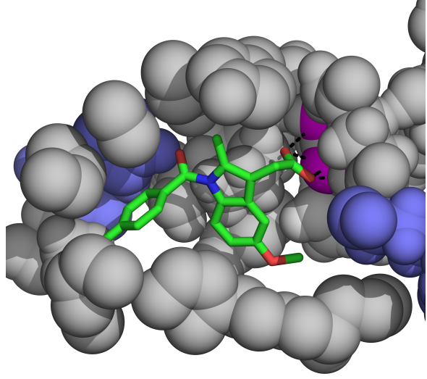
Rational design of competitive inhibitors
The receptor-based approach
The anti-inflammatory drug indomethacin within the binding site of one of its target proteins
Notes:
The receptor-based approach looks at the binding site and uses its features to design the new drug.
Figure 8-18. Interaction sites in the target protein. The figure shows the anti-inflammatory drug indomethacin (sticks colored by atom-type) within the binding site of one of its target proteins (spheres). Atoms involved in nonpolar interactions with the drug are colored in gray. Basic residues that interact electrostatically with electronegative atoms in the drug are colored in blue. Atoms involved in hydrogen bonds with the drug (black dashed lines) are colored in magenta. For clarity, only the residues mentioned above are shown.

Slide 71
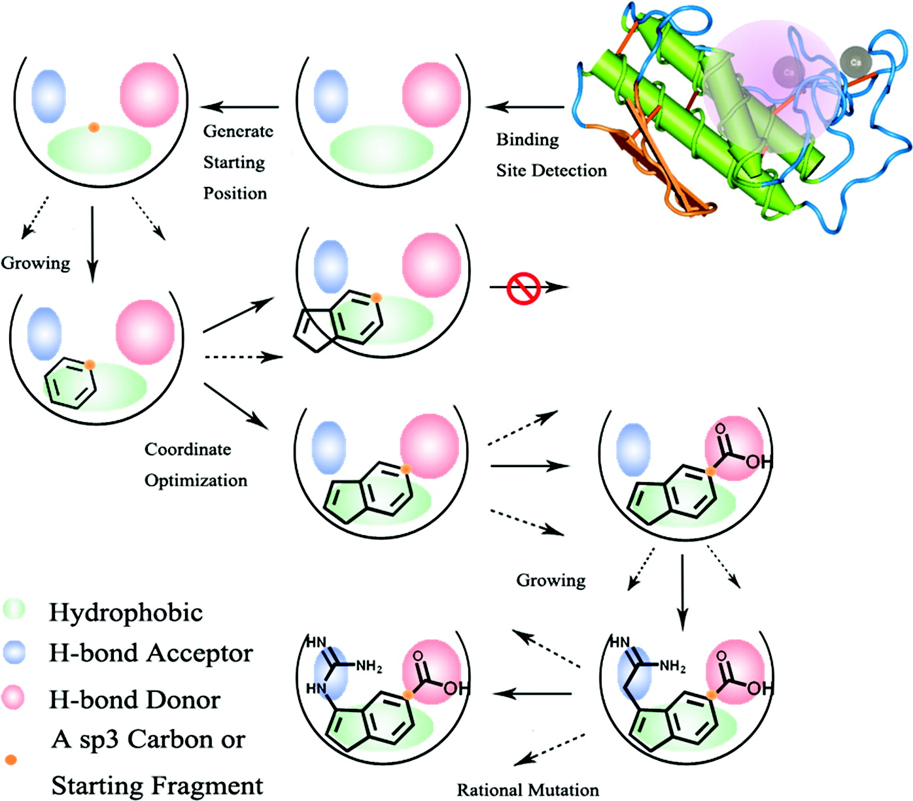
Rational design of competitive inhibitors
The receptor-based approach
Designing a drug from scratch - nearly impossible
J. Chem. Inf. Model. (2011) 51: 1083–1091
Notes:
Doing it from scratch is nearly impossible, therefore scientists usually screen known molecules, by the millions. The screening can be in the lab, which is slow and requires a binding/functional assay, or computational, which is much faster.
Figure 8-18. Interaction sites in the target protein. The figure shows the anti-inflammatory drug indomethacin (sticks colored by atom-type) within the binding site of one of its target proteins (spheres). Atoms involved in nonpolar interactions with the drug are colored in gray. Basic residues that interact electrostatically with electronegative atoms in the drug are colored in blue. Atoms involved in hydrogen bonds with the drug (black dashed lines) are colored in magenta. For clarity, only the residues mentioned above are shown.

Slide 72
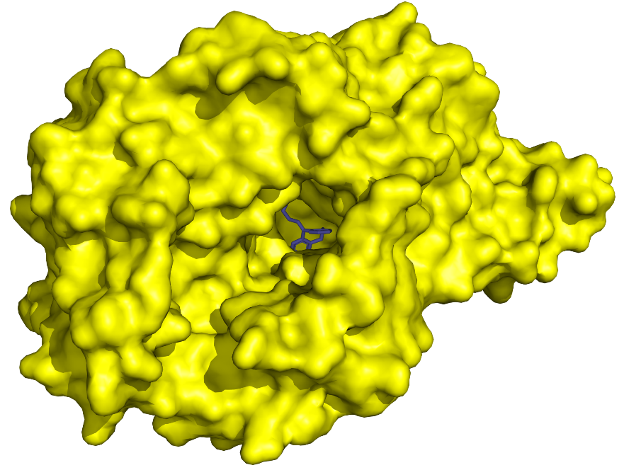
Rational design of competitive inhibitors
The receptor-based approach
Solution: screening known drugs:
Lab: slow, requires a binding/functional assay
Virtual: fast, no assay is required, less accurate (~10% of predicted compounds actually bind the target protein)
Notes:
The image shows the sodium-dependent dopamine receptor bound to the tricyclic antidepressant nortriptyline. Around the structure are other antidepressants that might bind to this target protein.

Slide 73
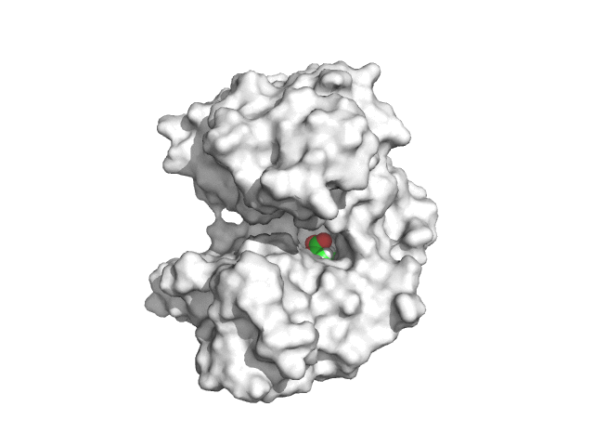
Rational design of competitive inhibitors
The receptor-based approach: virtual screening
When the binding site is unknown (blind docking):
Ligand docking simulation
(PELE Web Server [URL])

Slide 74
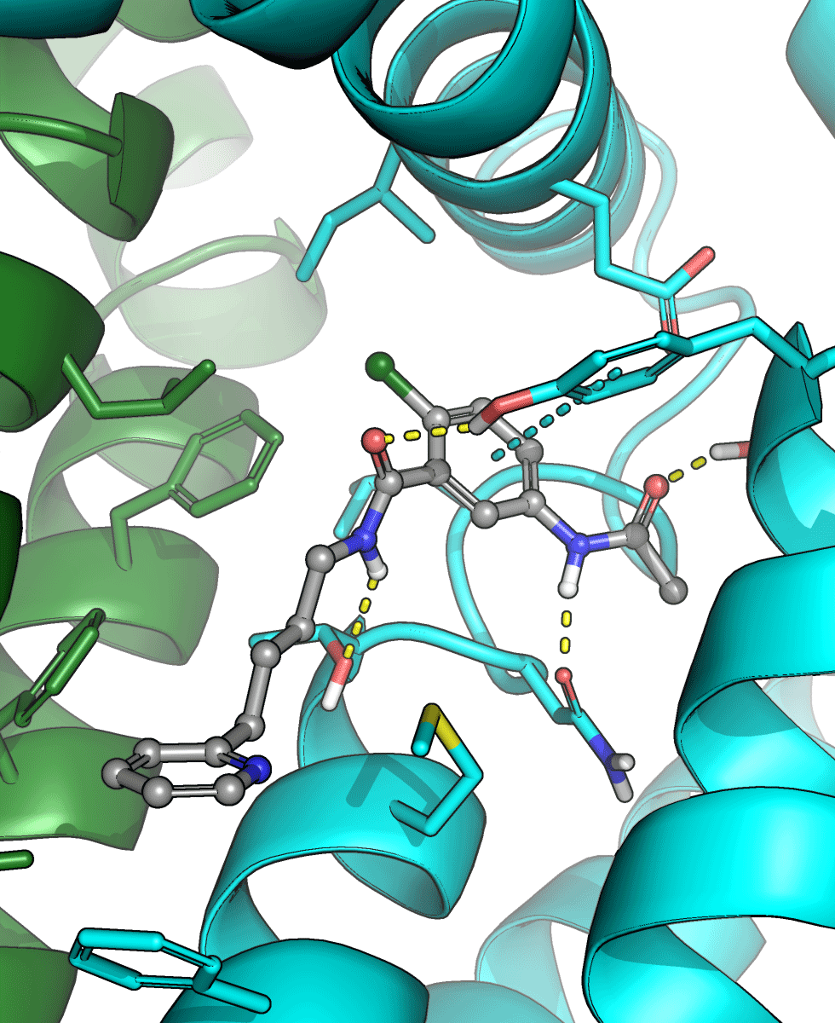
Rational design of competitive inhibitors
The receptor-based approach: virtual screening
When the binding site is known:
Each potential drug is docked
The total energy is calculated in each pose by summing all interactions
The lowest-energy pose is selected
The best potential drug is selected by comparing results for all screened drugs
Lead optimization – with more accurate methods
Notes:
The success rate of virtual screening is 5-10% when things go right. It may be better, but often much worse.

Slide 75
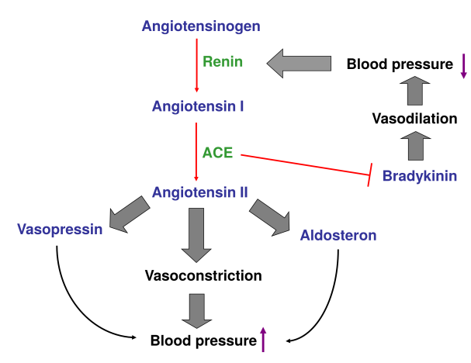
Case study: angiotensin-converting enzyme (ACE) inhibitors
The renin-angiotensin system
Reacts to low blood pressure (dehydration, injury, anaphylaxis)
Targeted by anti-hypertension drugs
Notes:
Chronic hypertension is one of the most common medical conditions in the developed world, affecting ~26% of the world's adult population. It is potentially life-threatening, due to the resulting cardiovascular complications, such as kidney failure, heart failure, and stroke.
Renin – kidney enzyme. ACE – multi-tissue enzyme; angiotensinogen – liver glycoprotein; angiotensins I/II, vasopressin, bradykinin – peptides; aldosterone – steroid hormone.
ACE acts both by creating the vasoconstrictor angiotensin II and by degrading bradykinin, a peptide vasodilator.
Angiotensin II directly causes constriction of blood vessels, but also acts indirectly by increasing vasopressin production in the brain (a peptide hormone that constricts blood vessels and increases water reabsorption in the kidney) and aldosterone secretion from the adrenal cortex (steroid hormone that increases water reabsorption in the kidney by affecting transport proteins in the kidney).
Figure 8-19. A schematic description of the renin-angiotensin-aldosterone (RAA) system. Proteins, peptides, or small molecules involved in the system are in blue, whereas enzymes are in green. Biochemical reactions are presented as red arrows. The increase or decrease of blood pressure is marked by the short purple arrows. Wide filled arrows lead from a condition to its effect, or mark hormonal induction (except for the vaspressin/aldosterone effects on blood pressure, which are marked by the curved black arrows). Finally, the red -| shape represents the degradation of bradykinin by angiotensin-converting enzyme (ACE). The RAA system includes a main biochemical path leading from the large protein angiotensinogen to the vasoconstrictor angiotensin II. The path is facilitated by two enzymes, renin and ACE. Angiotensin II reduces blood pressure directly, by inducing vasoconstriction, or indirectly, by inducing the release of the hormones vasopressin and aldosterone. ACE is involved the decrease of blood pressure by creating angiotensin II, but also by degrading bradykinin, a peptide with vasodilating activity.

Slide 76
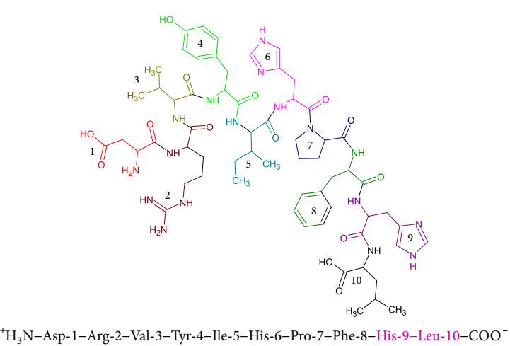
Case study: ACE inhibitors
Angiotensin I
The last two residues are cut off by ACE, producing angiotensin II
Notes:
Figure 8-20. Angiotensin I. The structure (top) and sequence (bottom) of the ten amino acid peptide are shown. Each of the residues in the structure is colored differently and numbered. The last two residues that are cleaved of the peptide by ACE are colored pink in the sequence.

Slide 77
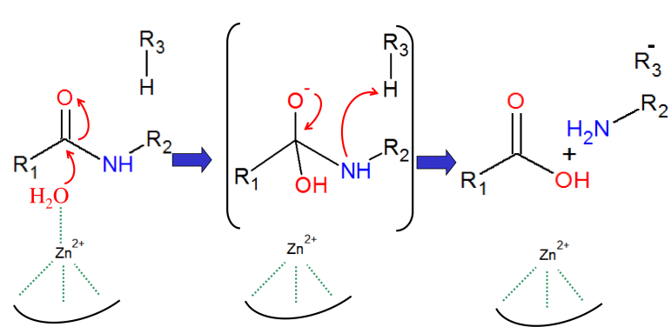
Case study: ACE inhibitors
The ACE reaction
ACE is a low specificity carboxypeptidase
Mechanism involves a tetrahedral transition state
Notes:
Figure 8-21. The mechanism of ACE. (a) A schematic representation of ACE mechanism of action. Red arrows mark electronic rearrangements, green dotted lines represent coordinative bonds, and the curved line below the zinc cation represents the enzyme binding pocket in which the zinc resides. The catalyzed reaction includes zinc-induced polarization and de-protonation of a water molecule, which then acts as a nucleophile. A tetrahedral transition state is formed (in parentheses), followed by protonation of the scissile amide nitrogen and peptide bond cleavage. The process is depicted in general, i.e. no specific ACE residues are noted.

Slide 78
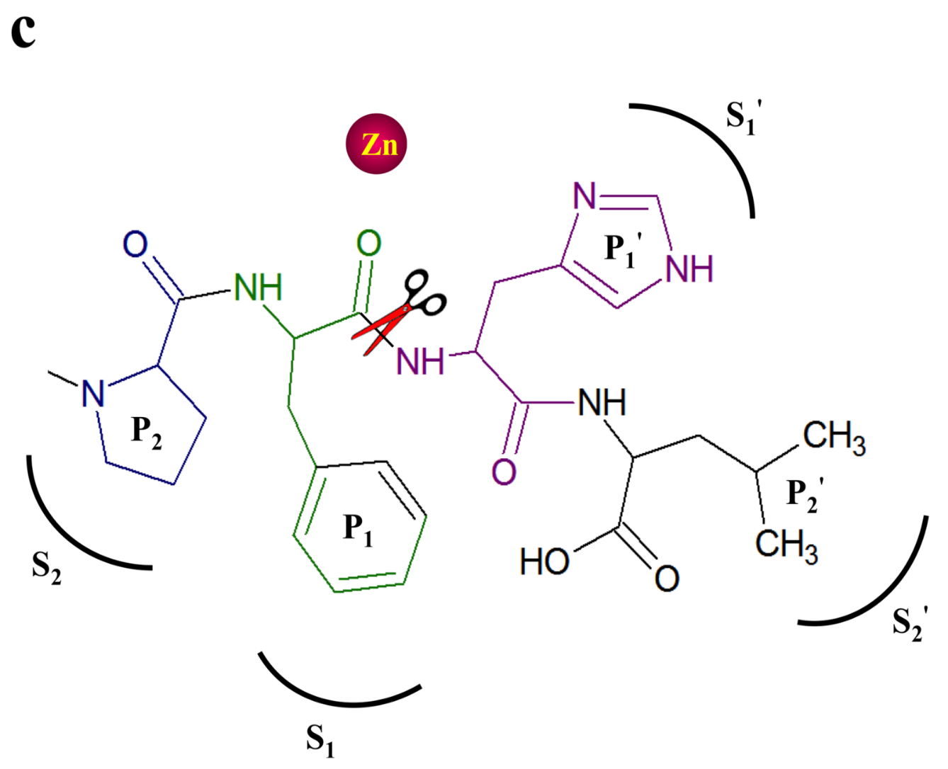
Case study: ACE inhibitors
The 4 positions in the substrate in relation to the cleaved bond (P₂, P₁, P₁' and P₂') and their corresponding enzyme binding sites (S₂, S₁, S₁' and S₂')
Notes:
(c) The four positions in the substrate/inhibitor (P₂, P₁, P₁' and P₂'), noted in relation to the zinc-coordinated ketone group, and their corresponding binding subsites in the active site of ACE (S₂, S₁, S₁' and S₂'). The scissors symbol marks the ester bond (in the substrate) cleaved by the enzyme

Slide 79
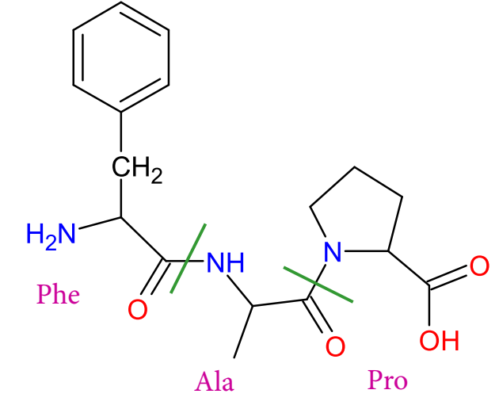
Case study: ACE inhibitors
Starting point: the Phe-Ala-Pro peptide (viper; known ACE-inhibitor)
Notes:
Figure 8-23. Steps in the development of the first ACE inhibitor, captopril. (a) The Phe-Ala-Pro peptide from the venom of the South American pit viper Bothrops jararaca. The boundaries between amino acids are marked by the blue lines.

Slide 80
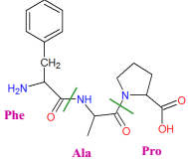
Case study: ACE inhibitors
Step1: targeting Zn²⁺
Methyl-succinyl-Pro
Captopril
IC₅₀=22µM
IC₅₀~20nM
Notes:
Methyl-succinyl-Pro is a derivate of the natural peptide Phe-Ala-Pro, but also has a Zn-coordinating groups.
Figure 8-23. Steps in the development of the first ACE inhibitor, captopril (c) Methyl-succinyl-Pro (left), and sulphydryl/mercapto derivative captopril (right). The only difference between the two inhibitors lies in one group (circled)

Slide 81
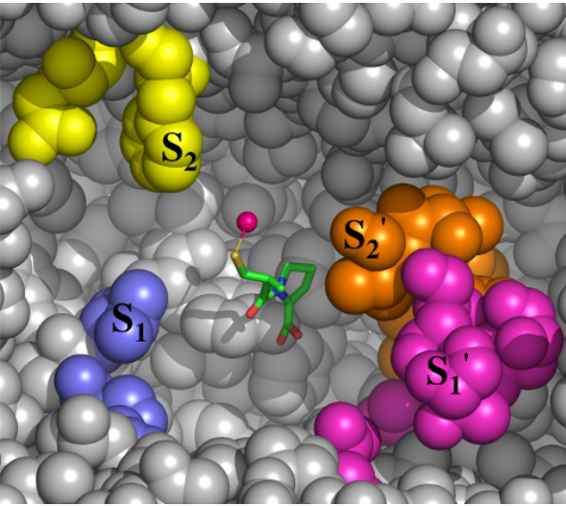
Case study: ACE inhibitors
Step1: targeting Zn²⁺
The design was later confirmed by the solved ACE-captopril crystal structure
Notes:
When the structure of ACE bound to captopril was solved in 2004 ^{[343]}, it confirmed the vision of Cushman and Ondetti; the inhibitor was placed inside the active site with its sulfhydryl group coordinating the zinc ion, the methyl group occupying the S₁' subsite, and the prolyl group occupying the S₂' subsite.
(d) The structure and orientation of captopril inside the active site of human tACE (PDB entry: 1uzf). Captopril is shown as sticks, colored by atom type, and the enzyme is shown as gray spheres. The S₂, S₁, S₁' and S₂' subsites in ACE are colored differently and noted. The coordination of the zinc cation (pink sphere) by the sulphydryl group of captopril is clearly seen. For clarity, some atoms of the enzyme were removed.

Slide 82
Case study: ACE inhibitors
Step2: targeting S₁
Captopril had unpleasant side-effects (e.g. rash)
Solution: non-SH inhibitor that binds S₁ with high affinity

Slide 83
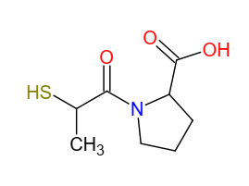
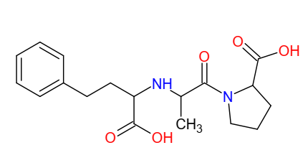
Case study: ACE inhibitors
Step2: targeting S₁
Enalaprilat
Thiol group
Captopril
Enalaprilat
Notes:
The use of N-carboxy-alkyl derivates was inspired by similar compounds, known to inhibit another peptidase, thermolysin.
Figure 8.24. Steps in the development of the ACE inhibitor lisinopril. (b) Enalaprilat and (c) lisinopril, both designed using the N-carboxy-alkyl dipeptide scaffold. In both, a methylbenzene group substitutes for the N-carboxy group, but they differ in the identity of the first amino acid (alanine in enalaprilat and lysine in lisinopril). (d) The structure and orientation of lisinopril inside the active site of human tACE (PDB entry 1o86). Lisinopril and the enzyme are presented as in Figure 8.23d. For clarity, some atoms of the enzyme are omitted. The general shape of the S₁' pocket is delineated by the dashed lines. (e) Some of the polar contacts formed between lisinopril and ACE residues. Lisinopril is shown as sticks, and the ACE residues are shown as lines. The polar contacts are shown as dashed black lines.

Slide 84
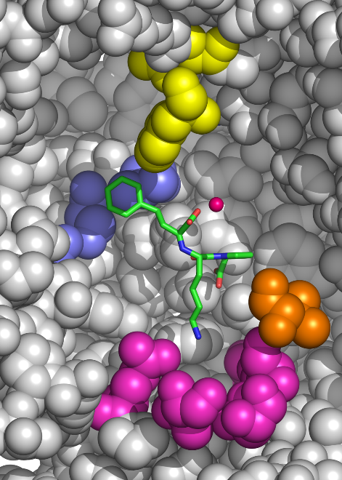
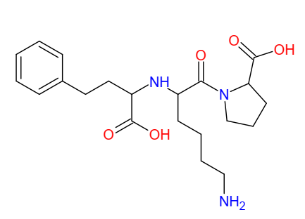
Case study: ACE inhibitors
S₂
Step3: targeting S₁'
Lisinopril (Lys instead of Ala)
S₁
S₂'
S₁'
Enalaprilat
Lisinopril
Notes:
Lisinopril was also found to be active (with greater affinity to ACE than Enalapirat), although the reason was not known (has Lys instead of Ala). This was later explained by the structure of the ACE-lisinopril complex: the long pentylamine side-chain of lisinopril fits snugly into the deep S1’ subsite, where it is stabilized electrostatically by Glu162. Note also that the phenyl group faces the S1 site, as planned, and the carboxyl group near it stabilizes the zinc.
Figure 8.24. Steps in the development of the ACE inhibitor lisinopril. (b) Enalaprilat and (c) lisinopril, both designed using the N-carboxy-alkyl dipeptide scaffold. In both, a methylbenzene group substitutes for the N-carboxy group, but they differ in the identity of the first amino acid (alanine in enalaprilat and lysine in lisinopril). (d) The structure and orientation of lisinopril inside the active site of human tACE (PDB entry 1o86). Lisinopril and the enzyme are presented as in Figure 8.23d. For clarity, some atoms of the enzyme are omitted. The general shape of the S₁' pocket is delineated by the dashed lines. (e) Some of the polar contacts formed between lisinopril and ACE residues. Lisinopril is shown as sticks, and the ACE residues are shown as lines. The polar contacts are shown as dashed black lines.

Slide 85
S₂
S₁
Lisinopril
S₂'
S₁'
Notes:
The long pentylamine side-chain of lisinopril fits snugly into the deep S1’ subsite, where it is stabilized electrostatically by Glu162. Note also that the phenyl group faces the S1 site, as planned, and the carboxyl group near it stabilizes the zinc.
(d) The structure and orientation of lisinopril inside the active site of human tACE (PDB entry: 1o86). Lisinopril and the enzyme are presented as in figure 8-20d. For clarity, some atoms of the enzyme were removed. The general shape of the S₁' pocket is delineated by the dashed lines.

Slide 86
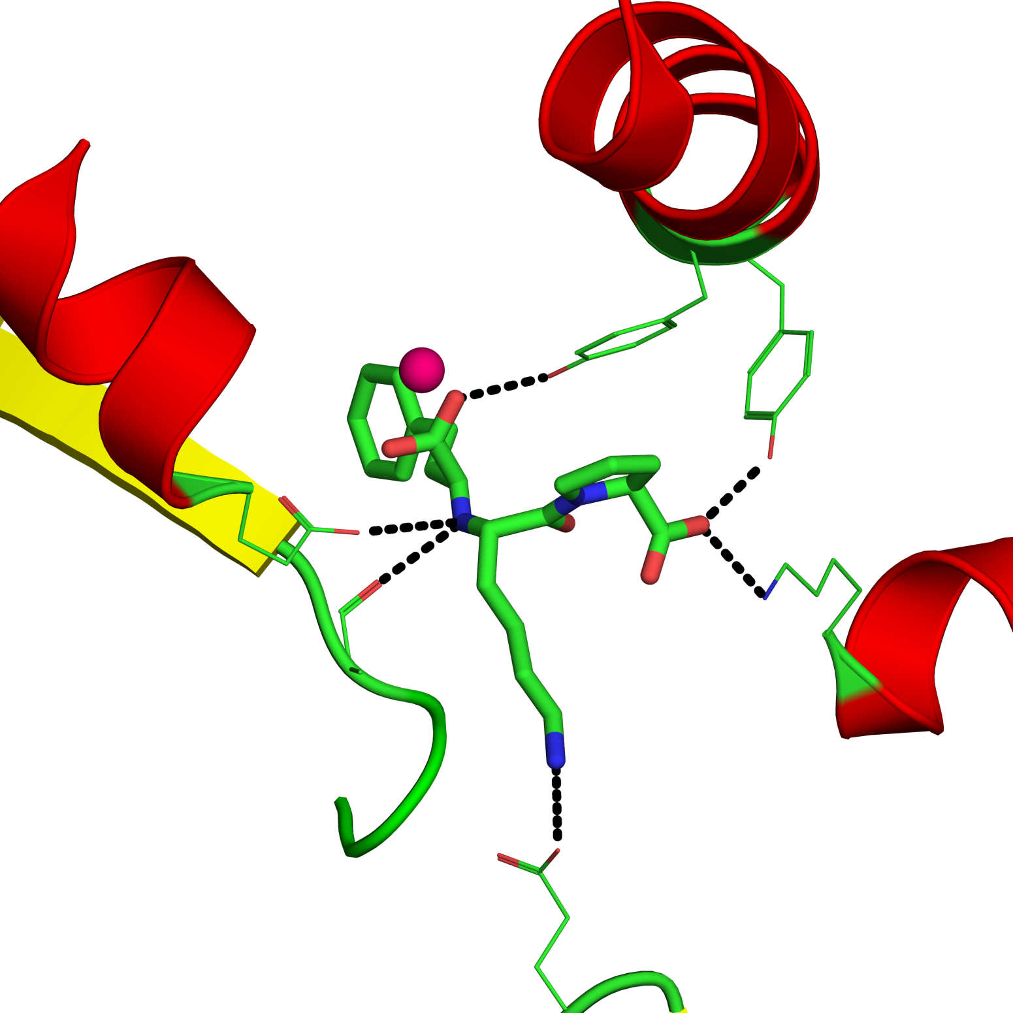
S₂
Tyr523
Zn
Tyr520
S₁
Lys511
Glu384
S₂’
Ala354
S₁’
Glu162
Notes:
The long pentylamine side-chain of lisinopril fits snugly into the deep S1’ subsite, where it is stabilized electrostatically by Glu162. In addition, lisinopril forms polar interactions via its amide nitrogen and two carboxylate groups, and uses the carboxy-alkyl group to coordinate the Zn²⁺ cation
(e) Some of the polar contacts formed between lysinopril and ACE residues. Lisinopril is shown as sticks and the ACE residues are shown as lines. The polar contacts are shown as dashed black lines.

Slide 87
Case study: ACE inhibitors
Conclusions so far
Nonpolar groups in P₁ increase activity
Zn²⁺ binding is important and can be done by different chemical species
The S₁’ site prefers long, positively charged groups
Zn
Notes:
The emphasis in the design of the previous inhibitors was conferring strong zinc-binding abilities, while trying to minimize side-effects.

Slide 88
Case study: ACE inhibitors
Step4: C-domain-selective inhibition using negative design
Some side effects result from bradykinin buildup
Thus, only one ACE domain should be inhibited
Notes:
Bradykinin is another molecule that is degraded by ACE. Its buildup causes certain symptoms, such as persistent cough and angioedema.
ACE has two domains (C’ and N’, 50% identical), both can degrade bradykinin, but the C’ domain is more active on angiotensin then the N’ domain. Thus, inhibiting only one domain may reduce the side effects resulting from bradykinin buildup.

Slide 89
Case study: ACE inhibitors
Step4: C-domain-selective inhibition using negative design: ketone-based inhibitors
Binds both domains equally
Slight C-domain selectivity
Notes:
In contrast to the previous inhibitors, the ketomethylene inhibitors contained carbon instead of NH group, ketone instead of carboxyl (weak Zn binding), and a P₂ group. Thus, ketomethylene inhibitors do not rely on strong zinc binding, but rather on the binding of additional groups in the enzyme. This makes sense considering that Zn is present in both domains, whereas the P₂ residues differ between them.
Figure 8-25. Keto-methylene inhibitors. (a) The differences between keto-methylene inhibitors (represented by kAP) and the N-carboxy-alkyl dipeptides (represented by lisinopril). Both inhibitors include a dipeptide unit. However, the amide nitrogen of the N-carboxy-alkyl dipeptides is substituted with a carbon atom (blue rectangles), and the carboxyl group is substituted with a ketone group (red rectangles). In addition, the keto-methylene inhibitors also include an S₂ group, which is missing in the N-carboxy-alkyl dipeptides.

Slide 90
Case study: ACE inhibitors
Step4: C-domain-selective inhibition using negative design: ketone-based inhibitors
Both Lisinopril and kAF can bind to the C domain and inhibit it.
Only Lisinopril can bind to the N domain; kAF is kept out because of steric clashes with Tyr-369.
Phe-391 (C domain)
Tyr-369 (N domain)
kAF
Lisinopril
Notes:
Comparison of the structures of the C and N domains explained the basis of selectivity. For example, the change of Phe to Tyr in the N-domain added a hydroxyl group, which made it difficult for the P₂ benzoyl group of kAF to be accommodated inside the S₂ subsite of the N domain.
(c) The figure shows three ACE-inhibitor complexes: C domain-lisopril (PDB entry 1o86, red), N domain-lisinopril (PDB entry 2c6n, blue), and C domain-kAF (PDB entry 3bkk, yellow). The inhibitors of the last two structures are shown, represented as sticks. The residues occupying position 391 (369 in the N domain) in the three structures are in wireframe representation. For clarity, the other residues and the backbone of the structures are not shown. As clearly seen in the figure, the added benzoyl group at the S₂ position of kAF can be accommodated in the C domain (red and yellow), but to a much lesser extent in the N domain. The same should be true for kAP and kAW, as the three keto-methylene inhibitors share the same benzoyl group at the S₂ position.

Slide 91
Case study: ACE inhibitors
Step4: C-domain-selective inhibition using negative design: ketone-based inhibitors
Steric clash between kAF and Tyr-369
Tyr-369
kAF
OH group
Notes:
(d) The same as in c, except that both kAF and Tyr369 of the N domain are represented as spheres, to emphasize the steric clash between them. The atoms responsible for the clash are those of the Tyr-OH group, marked by the arrow.

Slide 92
The renin-angiotensin system
ACE2, a different ACE type, converts angiotensins I+II to peptides that lower blood pressure (negative regulator)
Vasodilation
ACE2

Slide 93
The renin-angiotensin system
ACE2 is also targeted by the spike protein of SARS-CoV-2 as an entry point to host cell
Nat. Struct. Mol. Biol. (2020) 27: 846–854

Slide 94
The renin-angiotensin system
ACE2 is also targeted by the spike protein of SARS-CoV-2 as an entry point to host cell

Slide 95
Summary of the chapter
Protein-ligand interactions are crucial to protein function.
Different PL complexes have diverse affinities that match their biological purpose.
The binding energy can be measured or calculated, and it is a balance between opposing forces and thermodynamic properties.
The binding specificity is best described by the conformational selection model, which acknowledges the inherent dynamics of folded proteins.

Slide 96
Summary of the chapter
The binding specificity results from the geometric and electrostatic match between the ligand and the protein binding site.
Many proteins show binding promiscuity, which serves their biological function. The promiscuity is achieved via different mechanisms.
Proteins with key physiological roles are often targeted by toxins that evolved to bind them, and are used as targets for pharmaceutical drugs and warfare agents.

Slide 97
Summary of the chapter
Drug development process requires various consideration of binding affinity, and specificity, as well as of possible side effects.
Drugs are often designed to exploit the biological mechanisms of their target proteins, to obtain better binding.

