Slide 1
Chapter 4:
Thermodynamics & Protein Stability
Notes:
The previous parts of the course focused on protein architectures, from secondary structure, through simple motifs, to large motifs that form domains. This is one aspect of structural biology. The other aspect is the physical one, which looks at the thermodynamic stability of proteins’ folds due to the forces acting on them, the dynamics of the folded structure, and the folding process. These aspects will be the focus of this and the following presentation, respectively.

Slide 2
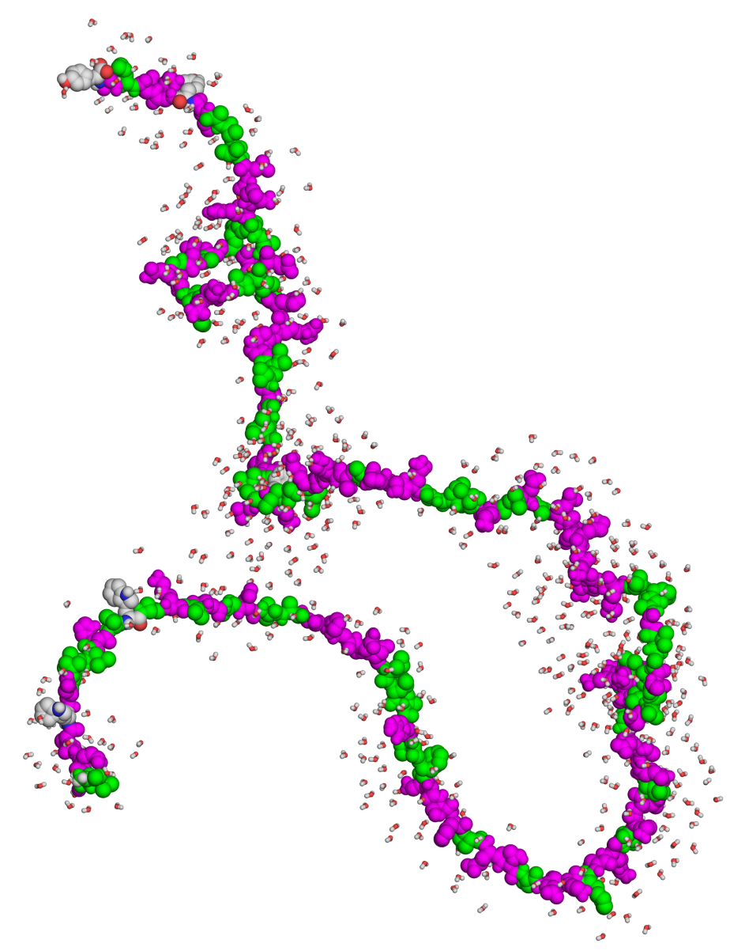
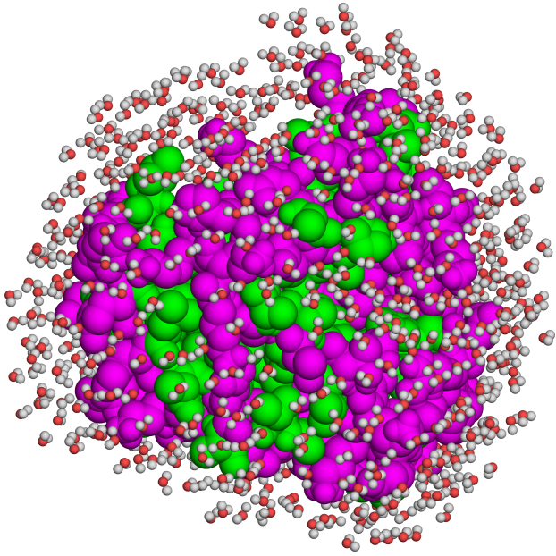
Overview
Unfolded
Folded
ΔG_{folding} = G_{folded} – G_{unfolded} < 0
Notes:
Folding is a spontaneous process, which means it involves a negative change in free energy.

Slide 3
Overview
Unfolded
Folded
ΔG_{folding} = -5 to -20 kcal/mol
Notes:
However, measurements show that this free energy change is small. For comparison, the dissociation of a single covalent bond requires ~65-175 kcal/mol.

Slide 4
Overview
However, even at -5 kcal/mol the native structure dominates (99.9%)
Thus, evolution had no drive to create more stable proteins (except under extreme conditions)
Notes:
Figure 5.5. Backbone dynamics of folded proteins. The conformational dynamics of chemotaxis Y protein is illustrated by superimposing 46 allowed conformations of the single protein, solved by NMR (PDB entry 1cey). The structures are colored according to secondary structure (helices are red, sheets are yellow, and loops are green).

Slide 5
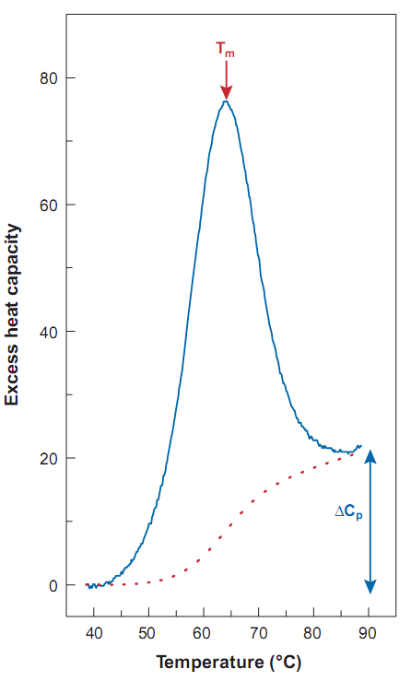
Overview
Understanding protein stability requires breaking ΔG_{folding} into separate contributions
The basic breakdown to enthalpy (ΔH) and entropy (-TΔS) is convenient because they can be measured
ΔG = ΔH - TΔS
ΔH
Notes:
Figure 4-2. DSC measurement of the thermal denaturation of the protein ubiquitin. The curve depicts C_{P} as a function of temperature, where T_{m} is the transition temperature. ΔH is the area under the curve.

Slide 6
Overview
ΔH can be further broken down to potential (ΔU), kinetic (ΔK) and pressure-volume (Δ(PV)) changes
ΔG = ΔH – TΔS_{sys}
(constant temp)
(ΔE + Δ(PV))
(ΔU + ΔK)
(K is proportional to k_{B}T)
In biological systems:
ΔG = ΔU – TΔS_{sys}
Notes:
The change in kinetic energy at a fixed temperature is zero.

Slide 7
Overview
However, these do not provide molecular-level information (individual interactions)
Solution: combining thermodynamic data from measurements and/or calculations that refer to the molecular states of the system
ΔG_{tot} = ΔG_{elec} + ΔG_{np} + ΔG_{vdW} + ΔG_{ent}
Electrostatic
van der Waals
Protein entropy
Nonpolar
(solvent entropy)
Notes:
Electrostatic and vdW interactions involve mainly enthalpy changes, whereas nonpolar interactions involve solvent entropy changes.

Slide 8
Overview
For example: force-field-based calculations
covalent bond length
covalent bond angle
covalent bond dihedral angle
improper dihedral angle
vdW interactions
electrostatic interactions
Introduction to Proteins, Kessel and Ben-Tal, 2018
Notes:
Box 3-1 Figure 1. A simple force field. (a-d) The dependency of the potential energy of the system on the following covalent bond factors: (a) Length, b_{i}. (b) Valence angle, θ_{i} (c) Dihedral angle, φ_{I}, and (d) improper dihedral angle, ω_{i}, i.e. deviation from planarity. In all cases, the interaction is depicted as a comparison between the actual value found in the coordinate file (e.g., b_{i} and θ_{i}) and the theoretical equilibrium value (e.g., b_{i,0} and θ_{i,0}). (e) The dependency of the van-der Waals potential energy on the distance (r_{ij}) between interacting atoms i and j. (f) The dependency of the electrostatic potential energy on the local dielectric (D), and the distance (r_{ij}) between atoms i and j, with charges q_{i} and q_{j}. The parameters k_{b,i}, k_{θ,i}, k_{φ,i}, k_{ω,i}, are the force constants of interactions a-d, respectively. A_{ij} and B_{ij} are parameters associated with the van der Waals interaction.

Slide 9
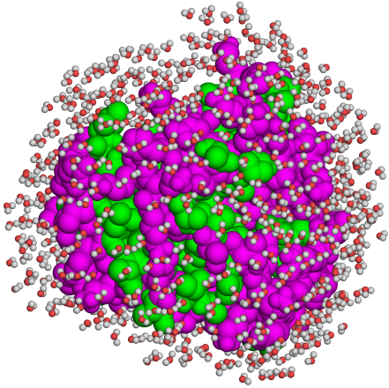
Interactions and physical effects
Components
Nonopolar (ΔG_{np})
-
Intraprotein
van der Waals (ΔG_{vdW})
Protein-solvent
Protein-solvent, protein-protein
Electrostatic (ΔG_{elec})
Protein-solvent
Protein-solvent, protein-protein
Protein entropy (ΔG_{ent})
High
Low

Slide 10
Nonpolar and vdW interactions
Nonpolar - exist only in the folded state → drive folding
vdW - exist in both the folded and unfolded states, but stronger in the tightly-packed protein core than in the unfolded state → drive folding

Slide 11
Nonpolar and vdW interactions
ΔG_{np} + ΔG_{vdW} can be estimated based on partitioning experiments of nonpolar amino acids:
[A_{o}]
water
org. solvent
K_{eq} =
[A_{w}]
ΔG⁰ = -RTlnK_{eq}
membrane
The energy correlates with surface area (SA): ΔG ≈ -0.025ΔSA [kcal/mol] (SA in Å²)
Notes:
When the experiment is done with completely hydrophobic molecules the results refer only to nonpolar and vdW interactions. Since the vdW interactions are almost the same for the two liquids, the results refer mainly to nonpolar interactions.
Octanol was used in the experiments because it is a good mimic of the protein’s core, which not entirely nonpolar. The 0.0025 coefficient was actually obtained from water-cyclohexane partitioning, to get the upper bound of this energy.
Mutational and partitioning studies yield a similar correlations between ΔG_{np} and ΔSA. For example, -2 kcal/mol for the complete burial of a methyl group (SA=80 Å²).

Slide 12
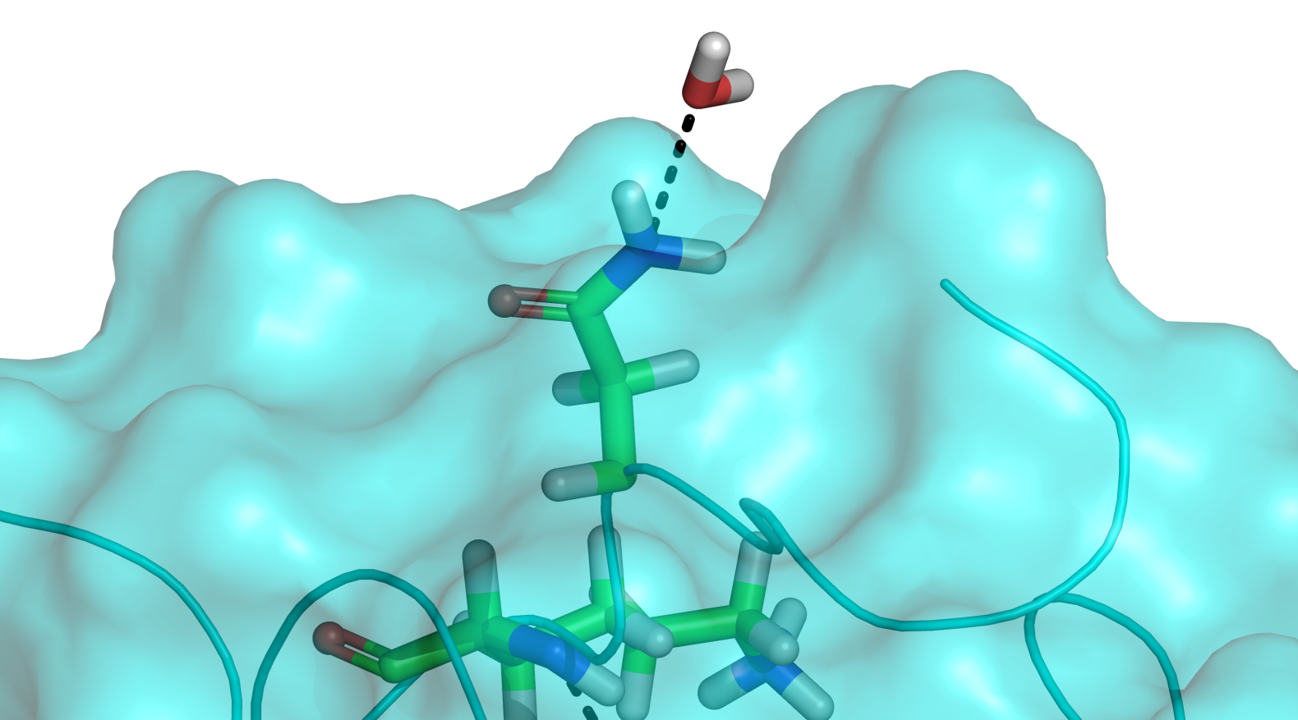
Electrostatic interactions
Surface-water interactions
Exist both in the unfolded and folded state → do not contribute to folding

Slide 13
Electrostatic interactions
Surface charge-charge interactions
Efficiently screened by the solvent → marginal contribution to folding

Slide 14
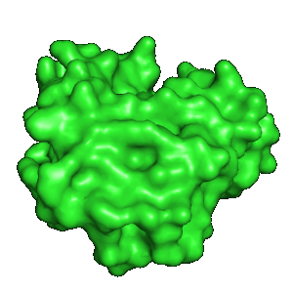
Electrostatic interactions
Core charge-charge interactions
Favorable pairwise interactions (G_{coul} = )
Unfavorable polarization interactions (G_{pol} = ; )
ε = 80
+
+
-
ε = 2-4
-
Notes:
Figure 4-4. Two views of charge desolvation during protein folding. In the unfolded state, protein charges (partial or full) are electrostatically screened by the surrounding water molecules (A). Theoretically, during folding, these charges would be de-solvated inside the protein core, loosing the screening of each the charges (B). However in reality, buried charges are almost always surrounded by other charges, which provide at least partial screening (C).

Slide 15
Electrostatic interactions
Core charge-charge interactions
ΔG_{elec} depends on the charges’ micro-environment
Extensive charge network → favorable ΔG_{elec}
Increasing the number of Coulomb interactions
Increasing ε (up to ~20) → decreasing desolvation
-
+
G_{pol} =
+
-
-
+
Notes:
The total free energy of burying core charges is under dispute, however, there seems to be more weight in the stabilization direction. Still, even in studies showing stabilization, the value of the total electrostatic energy varies from 0 to -7.5 kcal/mol for a salt bridge, and 0 to -3.6 kcal/mol for a hydrogen bond.
Figure 4-4. Two views of charge desolvation during protein folding. In the unfolded state, protein charges (partial or full) are electrostatically screened by the surrounding water molecules (A). Theoretically, during folding, these charges would be de-solvated inside the protein core, loosing the screening of each the charges (B). However in reality, buried charges are almost always surrounded by other charges, which provide at least partial screening (C).

Slide 16
Electrostatic interactions
Why bury charges in the first place?
Functionality: catalysis, ligand binding
Fine-tuning the folded structure: conformational change → loss of ΔG_{Coul}, higher ΔG_{pol}
G_{pol} =
+
-
Notes:
Figure 4-4. Two views of charge desolvation during protein folding. In the unfolded state, protein charges (partial or full) are electrostatically screened by the surrounding water molecules (A). Theoretically, during folding, these charges would be de-solvated inside the protein core, loosing the screening of each the charges (B). However in reality, buried charges are almost always surrounded by other charges, which provide at least partial screening (C).

Slide 17
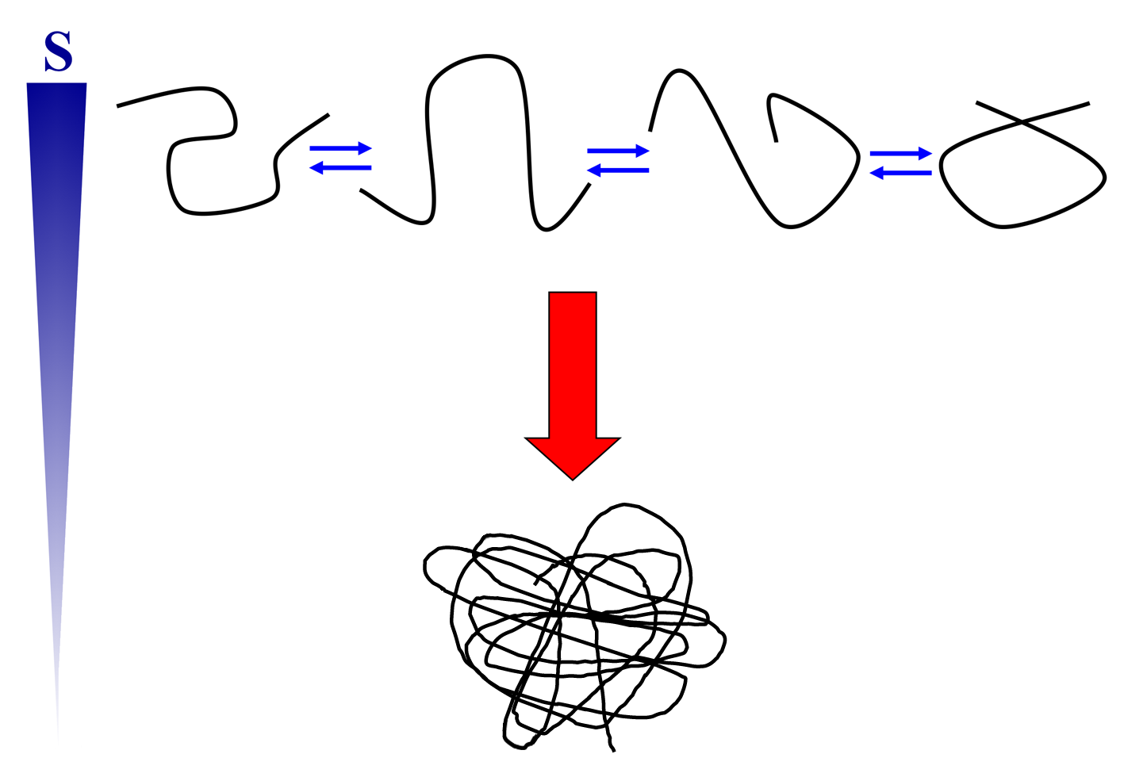
Entropy changes
Folding involves partial loss of configurational entropy → opposes folding
ΔG_{con} = -TΔS_{con}
Notes:
Figure 4.1.2. Entropy changes accompanying the folding of a biopolymer. The unfolded (top) and folded (bottom) states of the polymer chain are depicted simplistically. The entropy (S) change of the polypeptide chain during the process is shown on the left. The unfolded state is an ensemble of conformations existing in equilibrium, whereas the folded state has only one average conformation*. Thus, the entropy change (of the polypeptide) of the folding process is negative.
* As explained in detail in Chapter 5, the native state is itself an ensemble of conformations, which exist in equilibrium. However, it is much smaller than the unfolded state's ensemble. Thus, a significant drop in the entropy of the polypeptide chain takes place upon folding.

Slide 18
Entropy changes
Estimates:
ΔS_{con}: 4-6 cal/(mol ºK) per residue
ΔG_{con}: 1.2-1.9 kcal/mol per residue, at 37 °C (98.6 °F)
ΔG_{con} = -TΔS_{con}
For an ‘average’ residue (SA ≈ 100 Å²) buried in core:
ΔG_{np} = -0.025ΔSA = -2.5 kcal/mol
ΔG_{con}: 1.2-1.9 kcal/mol
Thus, nonpolar interactions overcompensate for the entropy loss, but not by much
Notes:
The small difference between dGnp and dGcon is multiplied by the number of amino acids, so it should be much larger. However, since an upper bound coefficient is used to calculate dGnp (0.0025), and since not all amino acids become 100% buried, the difference between the opposing forces is not that large.

Slide 19
Summary
Proteins folding is driven by nonpolar interactions and to a lesser extent by vdW interactions
Electrostatic interactions (H-bonds, salt bridges) stabilize/destabilize, depending on the charges’ environment. They also help fine-tune the folded structure and contribute to function
Entropy changes are the main force opposing folding
The opposing forces partially compensate for each other, resulting in a relatively small net stabilization (~5-20 kcal/mol)

Slide 20
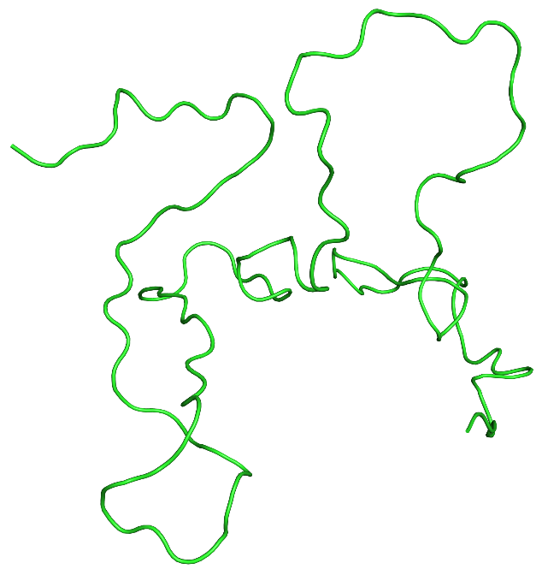
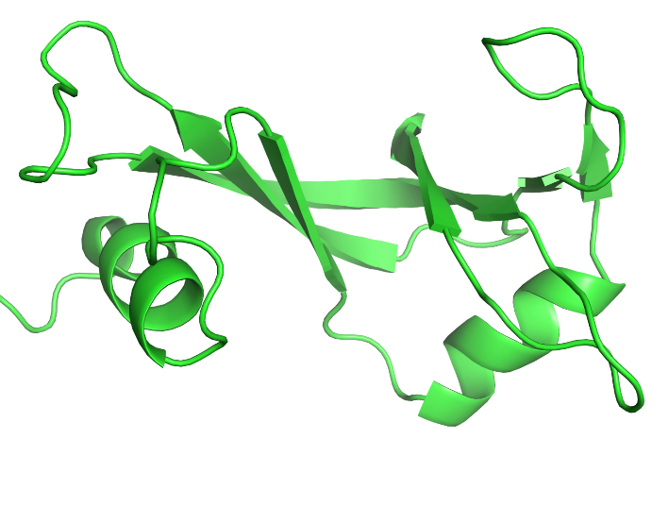
Denaturation
What is denaturation?
Loss of protein activity due to environmental changes
Results from changes in protein structure or dynamics
Used to study protein stability and the folding process
denaturation
renaturation
Native
Folded
Active
Denatured
Unfolded
Inactive
Notes:
Proteins fold spontaneously into their native states because under the conditions that exist within living organisms these folded structures have the least energy, and therefore they are the most stable form of the protein chain. However, when these conditions change, sometimes momentarily, the proteins may lose their native folds and their biological activity. This process is called denaturation.
The scheme is taking denaturation to the extreme; the native structure doesn’t necessarily have to be lost completely to lose activity.

Slide 21
Denaturation
Thermal
~45 ºC (~113 ºF) or higher
Increased atomic motions (K α k_{B}T) → weakening of non-covalent interactions
Cold
0 - 5 ºC (32-41 ºF): decreased dynamics → reversible drop in activity
< 0 ºC (32 ºF): ice formation → loss of solubility → sedimentation → loss of activity
Notes:
A more thermodynamic explanation to thermal denaturation: added kinetic energy → unfolded state entropy increases much more than folded state entropy → entropy difference between the two states becomes large enough to drive unfolding.

Slide 22
Denaturation
pH-induced
Due to changes in protonation & ionization of residues
Direct – changes in catalytic or ligand-binding residues
Indirect – unfavorable change in the electrostatic free energy of the folded state → structural changes
pH drop
+
-
+
+
Lys-NH₃⁺
-
Asp-COO⁻
Notes:
The scheme shows an example for indirect loss of activity: a salt bridge is broken due to a pH drop, which protonates an Asp/Glu, making it electrically neutral. The loss of Coulombic stabilization and the increase in polarization energy may lead to structural changes and loss of activity.

Slide 23
Denaturation
Pressure-induced
Results from 'pushing' water into protein core
Chemical
Organic solvents – stabilize the unfolded state
Urea/guanidinium chloride – most likely acts by disrupting polar interactions (e.g. backbone-backbone H-bonds)

Slide 24
Adaptation to extreme environments
Hyperthermophiles (80-113 ºC; 176-235 ºF)
Structural rigidification – Pro↑ Gly↓ aromatics↑
Strengthening the core – more nonpolar and secondary structure-promoting residues
Strengthening of electrostatic interactions inside protein – more salt bridges
Strengthening protein-solvent interactions (more H-bonding residues on the surface) – increase solubility
Notes:
In multicellular organisms the cells are protected from denaturation thanks to homeostasis. In unicellular organisms the cells must cope with changing conditions.
Such adaptations appear in certain organisms, many of which belong to the Archaea kingdom, which live constantly under extreme environmental conditions: high temperatures (e.g., geysers, warm springs, openings of volcanoes, hydrothermal vents), high salt concentration (e.g., the Dead Sea), or high pressure (e.g., the ocean floor).
Secondary-structure formation is beneficial to stability for two reasons. First, it reduces local chain motions. Second, it allows the pairing of polar backbone groups in hydrogen bonds, which reduces the exposure of these groups to the nonpolar core of the protein.
Salt bridges in hyperthermophiles may be stabilizing due to decrease of the desolvation penalty by (1) optimization of charge masking via polar networks, (2) the fact that the water’s dielectric is decreased at high temperatures, which decreases the dielectric difference between the water and protein core.

Slide 25
Adaptation to extreme environments
Psychrophiles (< 15 ºC; 59 ºF)
Increasing the internal dynamics – polar-small ↑, nonpolar ↓ residues in the core
Strengthening protein-solvent interactions (more H-bonding residues) – increase solubility
Notes:
Both thermophiles and psychrophiles increase solubility for different reasons: in the former the added kinetics of protein and solvent makes the bonds between them short-lasting. In the latter the decreased kinetics makes solvent-solvent Hbonds long-lasting, thus reducing the number of protein-solvent bonds.

Slide 26
Protein Engineering for Increased Stability

Slide 27
Industrial enzymes
Which industries?
Food (e.g. fermentation, emulsification)
Textile (e.g. laundry detergents, fabric processing)
Pharmaceuticals (both as drugs and catalysts in drug synthesis)
Why engineer enzymes?
Increase stability (longer shelf life, harsh conditions) & solubility
Protect from inactivation by harsh conditions (e.g. oxidation)
Increase catalytic efficiency (faster production)
Change substrate specificity (e.g. for unnatural substrates)

Slide 28
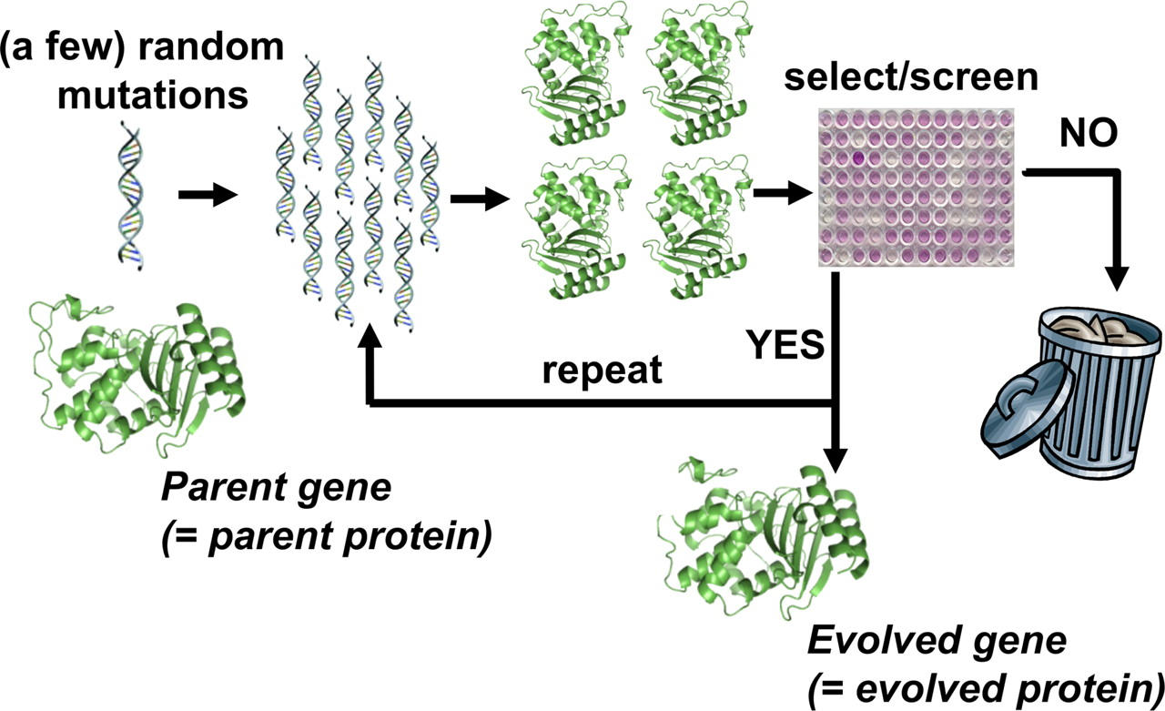
Engineering
Strategies
Rational – for a small number of mutations around active site
Random (e.g. directed evolution) – for a large number of mutations or outside active site
Semi-rational – integrates both rational and random
Directed evolution experiment
PNAS (2009) 106: 9995-10000

Slide 29
Engineering enzymes for increased stability
Mutations that are used resemble those found in hyperthermophiles:
Structural rigidification – Pro↑ Gly↓ aromatics↑ S-S ↑
Strengthening the core – more nonpolar and secondary structure-promoting residues
More salt bridges

Slide 30
Summary of Chapter 4
Protein chains fold into the native structure because it has the least energy. Still, the folded structure is only marginally more stable than the open chain, which keeps it flexible – a property crucial for its activity.
The non-covalent interactions that stabilize the folded structure can be studied by combining experimental methods that measure changes in free energy, enthalpy, entropy, and potential energy during folding, with computational methods that interpret these quantities on the biophysical level of forces and interactions.

Slide 31
Summary of Chapter 4
The hydrophobic effect is the main driving force for protein folding, and the resulting the loss of chain entropy is the main force opposing the process. The effect of electrostatic interactions depend on the immediate environment of electric charges within each protein.
The different interactions and effects compensate partially for one another, resulting in a small net energy of stabilization.

Slide 32
Summary of Chapter 4
A protein may undergo denaturation due to environmental changes in temperature, pH, and pressure, as well as exposure to certain chemical compounds
Proteins in organisms that live under extreme conditions have developed amino acid compositions that counteract the destabilizing forces, and this way avoid denaturation.
Understanding the above phenomena allows scientists to stabilize industrial proteins by engineering them at the amino acid level.

