Slide 1
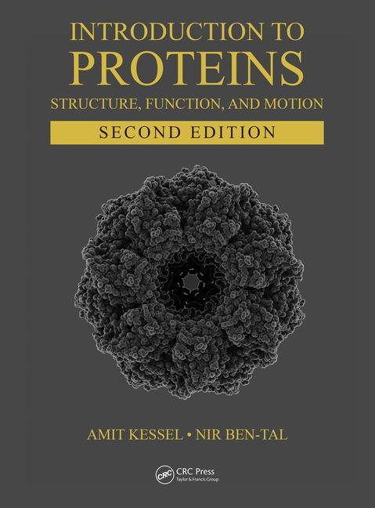
This PPT presentation is provided as suppl. material to the book:
Introduction to Proteins: Structure, Function, and Motion
2nd Edition (2018)
Amit Kessel & Nir Ben-Tal

Slide 2
Chapter 9:
Enzymatic Catalysis

Slide 3
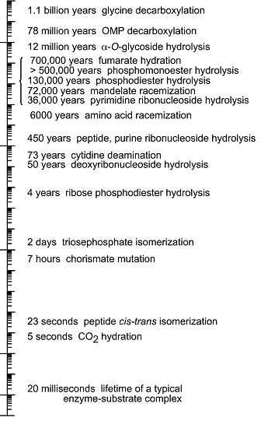
Metabolic reactions require catalysis
Metabolic reactions must occur very fast to sustain life (10⁻⁵ – 10² sec)
Many chemical reactions are slow
Catalysts can accelerate reactions without heating
Enzymes are biological catalysts, made of proteins
Notes:
Figure 9.1. The half-lives of some spontaneous chemical reactions in water (the image is adapted from ^{[14]}).

Slide 4
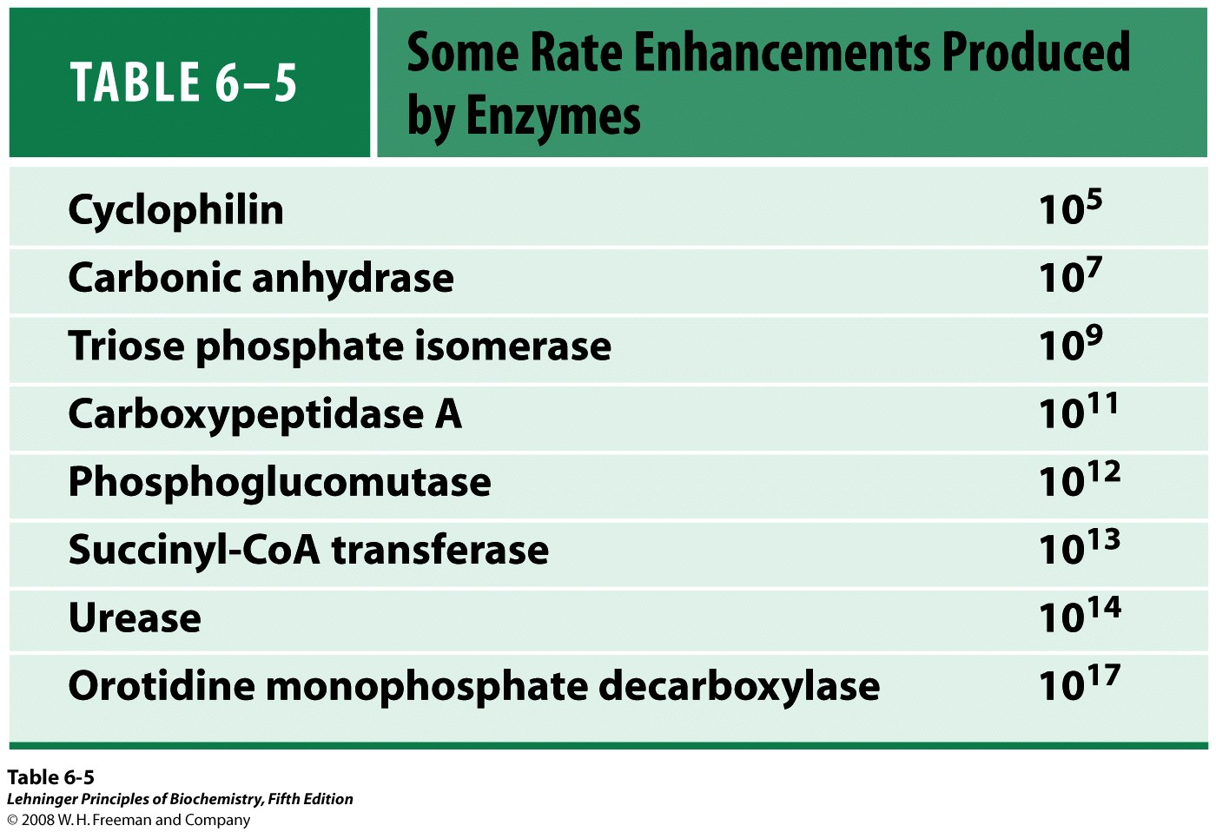
Why enzymes?
Enzymes are efficient – acceleration rates of up to 17 orders of magnitudes

Slide 5
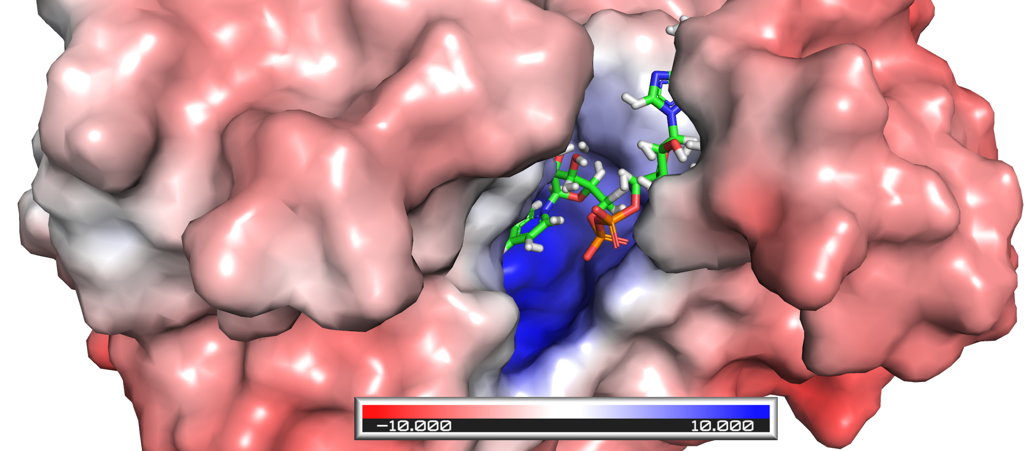
Why enzymes?
Enzymes are substrate-specific (active site complements the substrate geometrically and electrostatically)
Geometric and electrostatic complementarity between phenylalanine dehydrogenase and its substrate

Slide 6
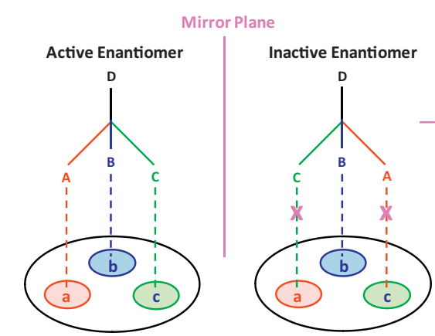
Why enzymes?
Enzymes are substrate-specific (active site complements the substrate geometrically and electrostatically)
Some enzymes are enantiospecific
(J Pharm Biomed Anal. 69:133-47)

Slide 7
Why enzymes?
Enzymes are reaction-specific
1
Oxidation-reduction (redox):
2
Group transfer:
3
Hydrolysis:
Notes:
Figure 9.3. Examples of the six types of reactions catalyzed by enzymes, according to the EC method. (The individual reactions are adapted from the MetaCyc database ^{[29]}.) For clarity, explicit hydrogens are not shown, except around centers in which the number of hydrogen atoms changes during the reaction. (a) Oxidation-reduction (redox): oxidation of ethanol to acetaldehyde, catalyzed by alcohol dehydrogenase ^{ϴ1}. The oxidation involves the transfer of a hydride species (blue) from ethanol’s C_{α} to NAD⁺ and the deprotonation of its hydroxyl group (red). (b) Group transfer: amino transfer from alanine to α-ketoglutarate, catalyzed by alanine aminotransferase ^{ϴ2}. The transfer of the amino group (blue) from the first co-substrate involves reduction of the corresponding carbon atom to a keto group (red), and vice versa in the other co-substrate. However, since these events involve internal electron transfer between amino and keto groups, the reaction is not considered to be redox (see more in subsection 9.1.5.2.1). (c) Hydrolysis: breakdown of aspirin to salicylate (blue) and acetate (green) by using water (red), as catalyzed by aspirin hydrolase ^{ϴ3}. (d) Water-independent cleavage of covalent bonds: breakdown of isocitrate to glyoxylate (blue) and succinate (red), catalyzed by isocitrate lyase ^{ϴ4}. (e) Isomerization: interconversion between fumarate (trans bond) and maleate (cis bond), catalyzed by maleate cis-trans isomerase ^{ϴ5}. (f) Ligation: the attachment of two D-alanine molecules (blue and red), catalyzed by D-alanine-D-alanine ligase ^{ϴ6}.

Slide 8
Why enzymes?
Enzymes are reaction-specific
4
Water-independent lysis:
5
Isomerization:
6
Ligation:
Notes:
Figure 9.3. Examples of the six types of reactions catalyzed by enzymes, according to the EC method. (The individual reactions are adapted from the MetaCyc database ^{[29]}.) For clarity, explicit hydrogens are not shown, except around centers in which the number of hydrogen atoms changes during the reaction. (a) Oxidation-reduction (redox): oxidation of ethanol to acetaldehyde, catalyzed by alcohol dehydrogenase ^{ϴ1}. The oxidation involves the transfer of a hydride species (blue) from ethanol’s C_{α} to NAD⁺ and the deprotonation of its hydroxyl group (red). (b) Group transfer: amino transfer from alanine to α-ketoglutarate, catalyzed by alanine aminotransferase ^{ϴ2}. The transfer of the amino group (blue) from the first co-substrate involves reduction of the corresponding carbon atom to a keto group (red), and vice versa in the other co-substrate. However, since these events involve internal electron transfer between amino and keto groups, the reaction is not considered to be redox (see more in subsection 9.1.5.2.1). (c) Hydrolysis: breakdown of aspirin to salicylate (blue) and acetate (green) by using water (red), as catalyzed by aspirin hydrolase ^{ϴ3}. (d) Water-independent cleavage of covalent bonds: breakdown of isocitrate to glyoxylate (blue) and succinate (red), catalyzed by isocitrate lyase ^{ϴ4}. (e) Isomerization: interconversion between fumarate (trans bond) and maleate (cis bond), catalyzed by maleate cis-trans isomerase ^{ϴ5}. (f) Ligation: the attachment of two D-alanine molecules (blue and red), catalyzed by D-alanine-D-alanine ligase ^{ϴ6}.

Slide 9
Why enzymes?
Enzymes are reaction-specific
The specificity is used for classifying enzymes
E.C: 2. 1. 4. 2
transferase
transferring 1-carbon group
transferring an amidino group
transferring to glycine
Notes:
Figure 9.4. The Enzyme Classification method (Taken from the MetaCyc database ^{[29]}). (b) The reaction catalyzed by the enzyme.

Slide 10
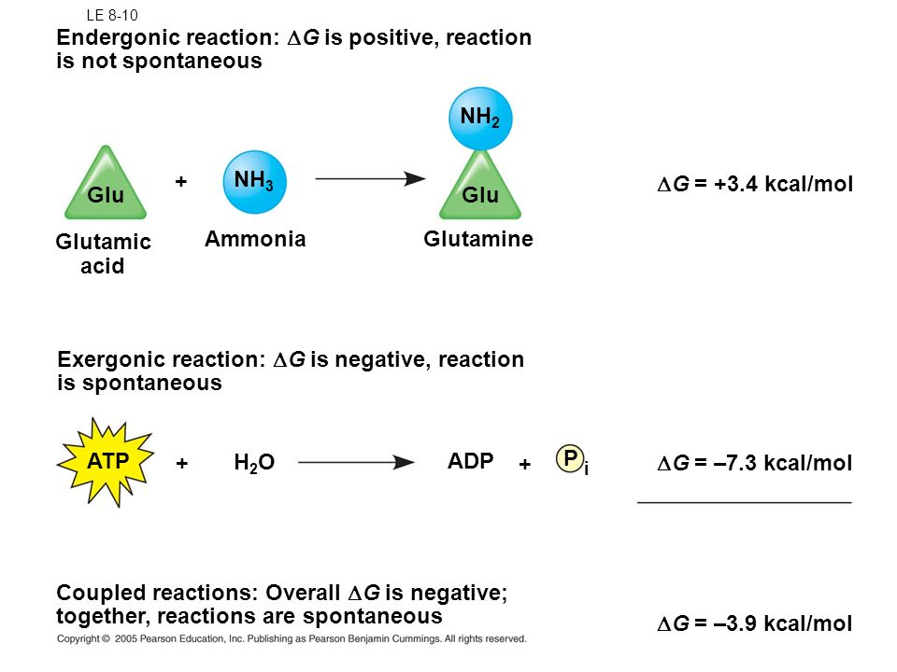
Why enzymes?
Enzymes can couple energy-demanding reactions to ATP hydrolysis
The coupling is done by phosphate transfer from ATP to one of the substrates and its destabilization

Slide 11
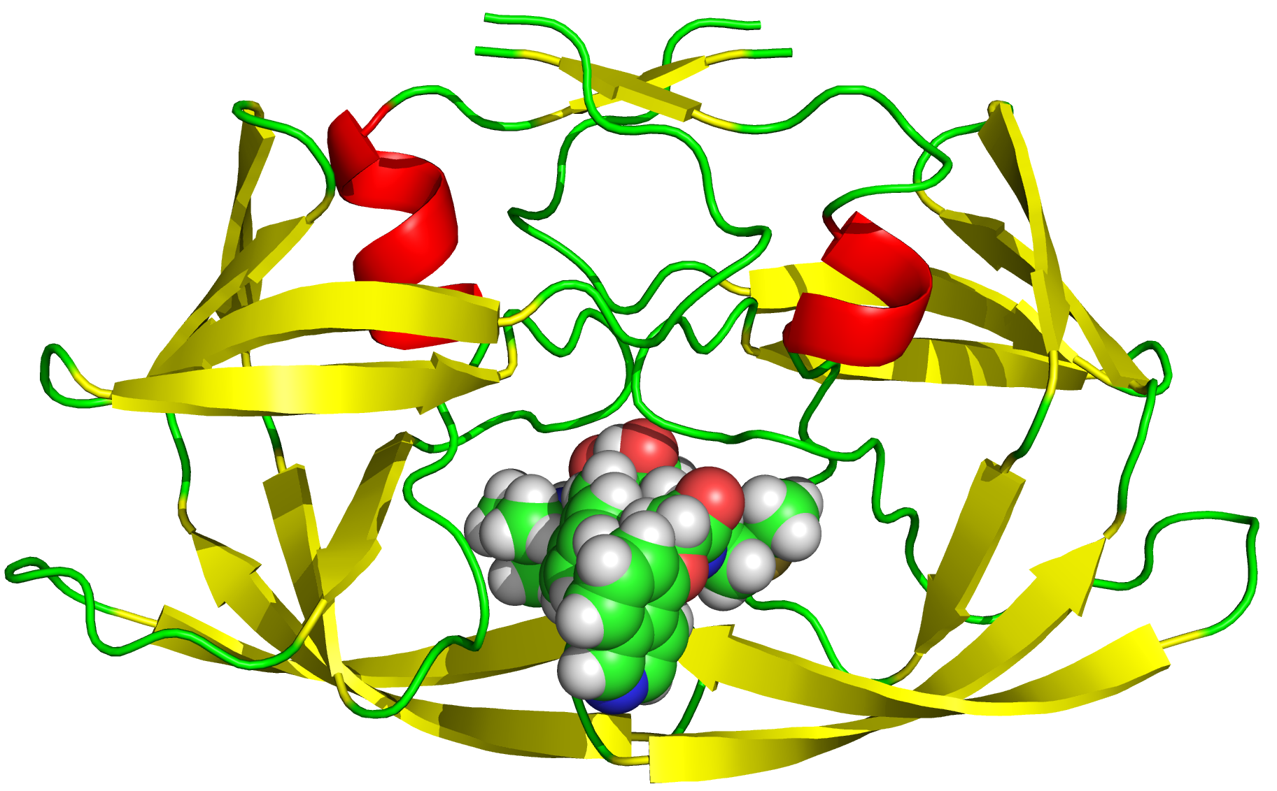
Why enzymes?
Enzymes can be regulated
The regulation can be done by the following means:
Small molecules (competition, allostery)
Phosphorylation
Degradation
Synthesis
Inhibition of HIV-1 protease by KNI-272
Notes:
Structure of HIV-1 protease with KNI-272, a tight-binding transition-state analog containing allophenylnorstatine (1hpx)

Slide 12
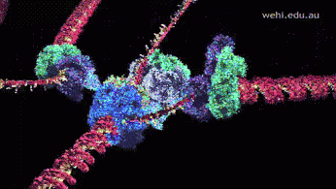
Why enzymes?
Certain enzymes can create large molecular machines for carrying out complex tasks
Examples:
DNA polymerase (genome replication)
RNA polymerase (gene expression)
Spliceosome (gene expression)
Ribosome (protein translation)
DNA polymerase
(http://www.wehi.edu.au/education/wehitv/molecular_visualisations_of_dna/)

Slide 13
The principles of catalysis
Chemical reactions convert reactants to products through a high-energy transition state
A
A#
B+C
Reactant
Transition state
Products
G_{A}
G_{A}#
G_{B}
(Ea)

Slide 14
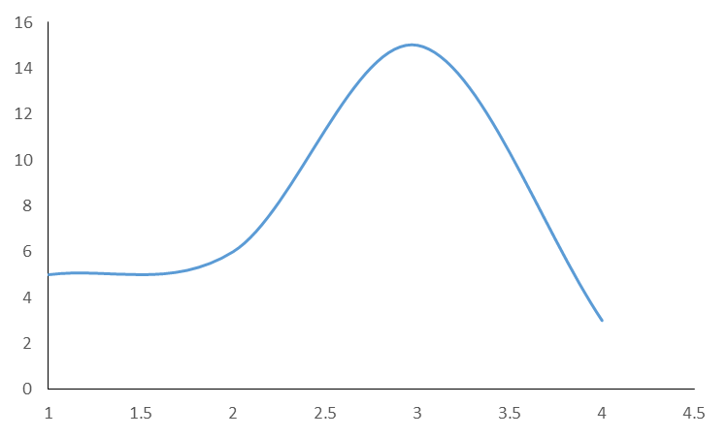
The principles of catalysis
The transition state energy (Ea) determines the reaction rate (k)
(Arrhenius’ equation)
G (kcal/mol)
A#
Ea
A
ΔG
B+C

Slide 15
The principles of catalysis
The rate-limiting step of the reaction (k_{cat}) depends on several factors:
(Eyring-Polanyi equation)
γ (generalized transmission coefficient) – relates to the fraction of product-yielding encounters between reactants.
k_{B} – Boltzmann’s constant.
h – Planck’s constant.
k_{B}T/h (the universal frequency factor) – the rate factor for crossing the transition state. Also, the upper limit of covalent bond breaking frequency.

Slide 16
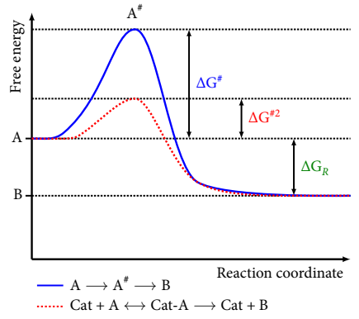
The principles of catalysis
Catalysts accelerate reactions by lowering the transition state energy
Simple catalyst (e.g. metal):
Notes:
Figure 9.2. Energetics of a chemical reaction in the absence and presence of a catalyst. (a) The effect of a simple catalyst. The blue plot depicts a chemical reaction, in which a hypothetical reactant (A) is transformed into a product.

Slide 17
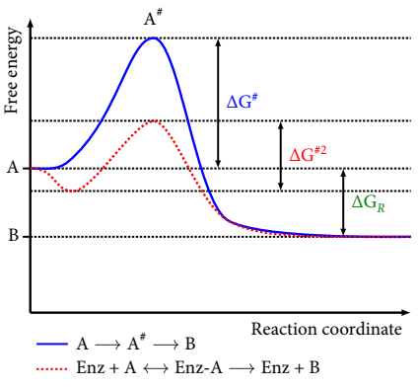
The principles of catalysis
Catalysts accelerate reactions by lowering the transition state energy
Enzyme:
Enzyme-substrate complex
(‘Michaelis complex’)
Notes:
Figure 9.2. Energetics of a chemical reaction in the absence and presence of a catalyst. (b) (see the top right part of the figure). The reaction involves a transition state (A#), whose free energy exceeds that of the reactant by ΔG#. In the presence of a catalyst (Cat), the reaction path changes*; the catalyst binds to the reactant rapidly, forming a complex denoted ‘Cat-A’. After binding, the substrate is transformed into the product, and released (the red dashed plot). Since the free energy difference between reactant and product (ΔG_{R}) remains the same, the overall energetics of the reaction does not change*². However, the transition state in the catalyzed reaction is much lower in free energy (ΔG^{#2}) compared with the transition state in the uncatalyzed reaction (ΔG#). In other words, the reaction needs less energy to overcome the barrier imposed by the transition state. Since the magnitude of this needed energy ('activation energy', Ea) correlates with the time needed for the reaction to be completed, the energy-catalyzed reaction is faster than the uncatalyzed reaction. (b) The effect of an enzyme catalyst (Enz). When the catalyst is an enzyme, the substrate binds to a pocket in the enzyme, which stabilizes it, and this leads to a favorable drop in the energy of the system. This in turn makes the activation energy slightly higher than in the case of a simple catalyst, but still lower than in the uncatalyzed reaction.

Slide 18
Class 1: oxidoreductases
One of the two largest enzyme classes (~28%)
Catalyze the transfer of electrons between two molecules:
Different numbers of electrons can be transferred
Two electrons are often transferred with a proton (H⁺), as a hydride ion (H⁻)
Oxygen atoms from O₂ may also be transferred

Slide 19
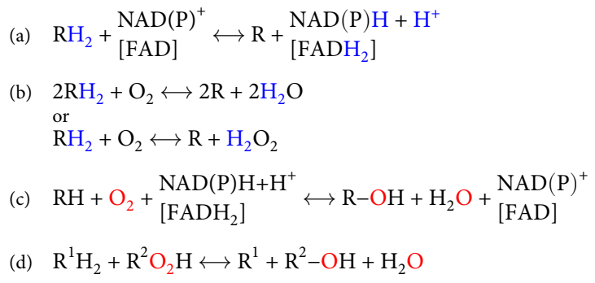
Class 1: oxidoreductases
Different types of oxidoreductases catalyze different redox reactions:
Dehydrogenases:
Oxidases:
Monooxygenases:
Peroxidases:
Notes:
Figure 9.6. General schemes describing the reactions catalyzed by (a) dehydrogenases, (b) oxidases, (c) monooxygenases (sometimes called hydroxylases because their products contain a hydroxyl group), and (d) peroxidases (R²O₂H is an alkyl peroxide). FAD in square brackets is an alternative to NADH or NADPH.

Slide 20
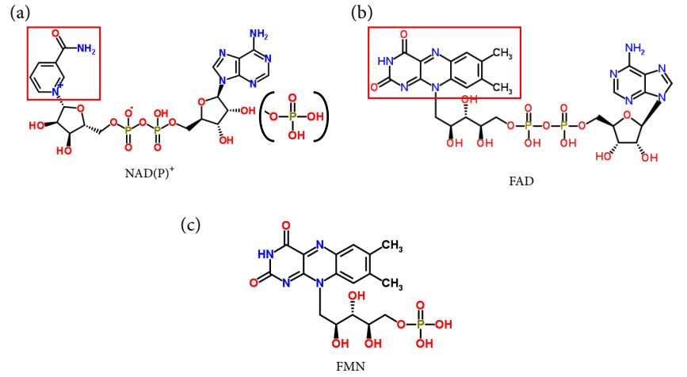
Class 1: oxidoreductases
Dinucleotide cofactors within the enzyme often mediate the transfer:
Notes:
Figure 9.5. Common nucleotide coenzymes involved in redox catalysis. (a) Nicotinamide dinucleotide (NAD⁺), derived from niacin (vitamin B₁; see section 9.4 below). In the related NADP⁺, a phosphate group is attached to one of the hydroxyls (shown in parentheses). The part of the molecule involved in electron transfer is the nicotinamide ring (marked by a red square). (b) Flavin adenine dinucleotide (FAD), derived from riboflavin (vitamin B₂; see section 9.4 below). The part of the molecule involved in electron transfer is the isoalloxazine ring system (marked by a red rectangle). (c) Flavin adenine mononucleotide (FMN), which is also derived from riboflavin and has the same reactive ring system as FAD. The structures are taken from the ChemSpider database ^{[42]}.

Slide 21
Class 1: oxidoreductases
In NAD⁺ and NADP⁺, a nicotinamide group (vitamin B₃ derivate) receives a hydride ion:
Notes:
Figure 9.7. Oxidation-reduction of NAD(P)H and FADH₂. (a) Reduction of the nicotinamide ring of NAD(P)⁺ by hydride transfer to the ring’s C4, at either the pro-S or pro-R positions ^{ϴ1}.

Slide 22
Class 1: oxidoreductases
In NAD⁺ and NADP⁺, a nicotinamide group (vitamin B₃ derivate) receives a hydride ion:
Animation:
Notes:
Figure 9.7. Oxidation-reduction of NAD(P)H and FADH₂. (a) Reduction of the nicotinamide ring of NAD(P)⁺ by hydride transfer to the ring’s C4, at either the pro-S or pro-R positions ^{ϴ1}. (b) Reduction of the isoalloxazine ring system of FAD (or FMN) by transfer of two electrons to the N1 and N5 atoms of FAD. Top: the simultaneous transfer of two electrons to FAD ^{ϴ2}. The electrons are transferred as a hydride ion to N5, accompanied by electronic rearrangements and protonation of N1. Bottom: the two-step transfer of two electrons and two protons to FAD ^{ϴ3}. The first step transfers a single electron to N5, creating a semiquinone radical. The second step transfers a hydrogen radical (H∙) to N1, which, along with the radical transferred in the first step, creates a fully reduced hydroquinone. (c) The structural basis for the stereospecificity of L-lactate dehydrogenase (LDH). Left – the structure of LDH from Cryptosporidium parvum is shown (PDB entry 2fm3). Middle – a blow-up of the active site of subunit A, showing NADH and pyruvate (the substrate) as sticks. Right – pyruvate-stabilizing interactions in the active site. Pyruvate and NADH are positioned in the active site so H_{R} is facing pyruvate’s C2 atom (the hydride acceptor), while H_{S} (not shown) is facing the opposite direction. Thus, only H_{R} can be transferred to pyruvate. The hydrogen bonds and salt bridges that hold pyruvate in place are shown as black dashed lines, with the interacting side-chains also presented. (d) The mechanism of ketoreductases, which includes hydride transfer from NAD(P)H to the C_{α} atom of the keto acid, followed by protonation of the negatively charged oxygen to form the hydroxyl group ^{ϴ4}. The proton is taken from H₃O⁺. (e) The four ways in which a hydride ion can be transferred from NAD(P)H to a ketone substrate bound to the active site of a ketoreductase. S and L designate the small and large substituents of the substrate’s keto group (the example of acetophenone is shown at the bottom of the figure without explicit hydrogen atoms). With E1 and E2 enzymes, the hydride attacks the si-face of the carbonyl group, whereas with E3 and E4 enzymes, the hydride attacks the re-face, which results in the formation of (R) and (S)-alcohols, respectively. Taken from ^{[51]}.

Slide 23
Class 1: oxidoreductases
In FAD and FMN, a riboflavin group (vitamin B₂ derivate) receives a hydride ion
In one step:
Notes:
Figure 9.7. Oxidation-reduction of NAD(P)H and FADH₂. (b) Reduction of the isoalloxazine ring system of FAD (or FMN) by transfer of two electrons to the N1 and N5 atoms of FAD. Top: the simultaneous transfer of two electrons to FAD ^{ϴ2}. The electrons are transferred as a hydride ion to N5, accompanied by electronic rearrangements and protonation of N1.

Slide 24
Class 1: oxidoreductases
In FAD and FMN, a riboflavin group (vitamin B₂ derivate) receives a hydride ion
In one step (animation):
Notes:
Figure 9.7. Oxidation-reduction of NAD(P)H and FADH₂. (b) Reduction of the isoalloxazine ring system of FAD (or FMN) by transfer of two electrons to the N1 and N5 atoms of FAD. Top: the simultaneous transfer of two electrons to FAD ^{ϴ2}. The electrons are transferred as a hydride ion to N5, accompanied by electronic rearrangements and protonation of N1.

Slide 25
Class 1: oxidoreductases
In FAD and FMN, a riboflavin group (vitamin B₂ derivate) receives a hydride ion
Or in two steps:
Notes:
Figure 9.7. Oxidation-reduction of NAD(P)H and FADH₂. (b) Reduction of the isoalloxazine ring system of FAD (or FMN) by transfer of two electrons to the N1 and N5 atoms of FAD. Bottom: the two-step transfer of two electrons and two protons to FAD ^{ϴ3}. The first step transfers a single electron to N5, creating a semiquinone radical. The second step transfers a hydrogen radical (H∙) to N1, which, along with the radical transferred in the first step, creates a fully reduced hydroquinone.

Slide 26
Class 1: oxidoreductases
In FAD and FMN, a riboflavin group (vitamin B₂ derivate) receives a hydride ion
Or in two steps (animation):
Notes:
Figure 9.7. Oxidation-reduction of NAD(P)H and FADH₂. (b) Reduction of the isoalloxazine ring system of FAD (or FMN) by transfer of two electrons to the N1 and N5 atoms of FAD. Bottom: the two-step transfer of two electrons and two protons to FAD ^{ϴ3}. The first step transfers a single electron to N5, creating a semiquinone radical. The second step transfers a hydrogen radical (H∙) to N1, which, along with the radical transferred in the first step, creates a fully reduced hydroquinone.

Slide 27
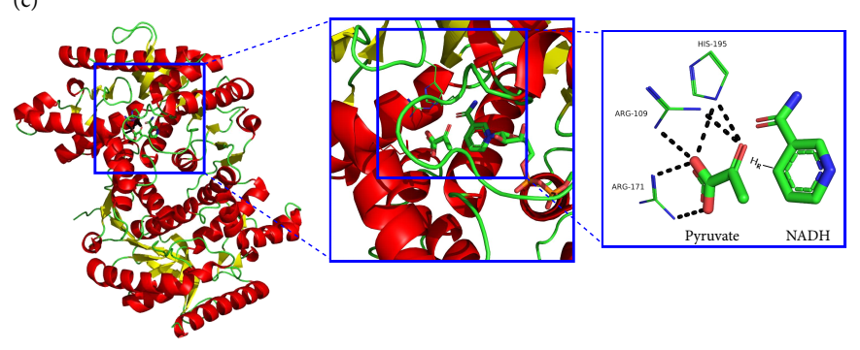
Class 1: oxidoreductases
Hydride ion transfer between the substrate and NAD(P)H is stereo-specific, due to active site positioning of the nicotinamide group
L-lactate dehydrogenase
Notes:
Figure 9.7. Oxidation-reduction of NAD(P)H and FADH₂. (c) The structural basis for the stereospecificity of L-lactate dehydrogenase (LDH). Left – the structure of LDH from Cryptosporidium parvum is shown (PDB entry 2fm3). Middle – a blow-up of the active site of subunit A, showing NADH and pyruvate (the substrate) as sticks. Right – pyruvate-stabilizing interactions in the active site. Pyruvate and NADH are positioned in the active site so H_{R} is facing pyruvate’s C2 atom (the hydride acceptor), while H_{S} (not shown) is facing the opposite direction. Thus, only H_{R} can be transferred to pyruvate. The hydrogen bonds and salt bridges that hold pyruvate in place are shown as black dashed lines, with the interacting side-chains also presented.

Slide 28
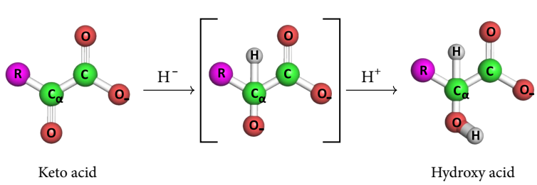
Class 1: oxidoreductases
Example 1: ketoreductases (E.C. 1.1.1.x)
Overall reaction:
Notes:
Figure 9.7. Oxidation-reduction of NAD(P)H and FADH₂ (d) The mechanism of ketoreductases, which includes hydride transfer from NAD(P)H to the C_{α} atom of the keto acid, followed by protonation of the negatively charged oxygen to form the hydroxyl group ^{ϴ4}. The proton is taken from H₃O⁺.

Slide 29
Class 1: oxidoreductases
Example 1: ketoreductases (E.C. 1.1.1.x)
Overall reaction (animation):
Notes:
Figure 9.7. Oxidation-reduction of NAD(P)H and FADH₂ (d) The mechanism of ketoreductases, which includes hydride transfer from NAD(P)H to the C_{α} atom of the keto acid, followed by protonation of the negatively charged oxygen to form the hydroxyl group ^{ϴ4}. The proton is taken from H₃O⁺.

Slide 30
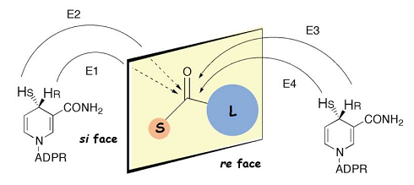
Class 1: oxidoreductases
Example 1: ketoreductases (E.C. 1.1.1.x)
Substrate positioning with respect to the nicotinamide determines which of the four ways for H⁻ transfer to the ketone is used:
Notes:
Figure 9.7. Oxidation-reduction of NAD(P)H and FADH₂ (e) The four ways in which a hydride ion can be transferred from NAD(P)H to a ketone substrate bound to the active site of a ketoreductase. S and L designate the small and large substituents of the substrate’s keto group (the example of acetophenone is shown at the bottom of the figure without explicit hydrogen atoms). With E1 and E2 enzymes, the hydride attacks the si-face of the carbonyl group, whereas with E3 and E4 enzymes, the hydride attacks the re-face, which results in the formation of (R) and (S)-alcohols, respectively. Taken from ^{[51]}.

Slide 31
Class 1: oxidoreductases
Example 2: amino acid dehydrogenases (E.C. 1.4.1.x)
Overall reaction:
Notes:
Figure 9.8. Amino acid dehydrogenases (AA-DH). (a) The reversible chemical reaction catalyzed by AA-DH.

Slide 32
Class 1: oxidoreductases
Example 2: amino acid dehydrogenases (E.C. 1.4.1.x)
Mechanism:
Notes:
Figure 9.8. Amino acid dehydrogenases (AA-DH). (b) The mechanism of reductive amination ^{ϴ}. The first step involves addition of ammonia (in blue) to the keto acid and protonation of the ketone oxygen. The resulting intermediate is a carbinolamine. The second step is elimination of the original ketone oxygen as water (in red) and formation of an imine intermediate. The last step is the transfer of a hydride ion (in purple) from NAD(P)H to C_{α} of the substrate, converting the imino intermediate into an amino acid.

Slide 33
Class 1: oxidoreductases
Example 2: amino acid dehydrogenases (E.C. 1.4.1.x)
Mechanism (animation):
Notes:
Figure 9.8. Amino acid dehydrogenases (AA-DH). (b) The mechanism of reductive amination ^{ϴ}. The first step involves addition of ammonia (in blue) to the keto acid and protonation of the ketone oxygen. The resulting intermediate is a carbinolamine. The second step is elimination of the original ketone oxygen as water (in red) and formation of an imine intermediate. The last step is the transfer of a hydride ion (in purple) from NAD(P)H to C_{α} of the substrate, converting the imino intermediate into an amino acid.

Slide 34
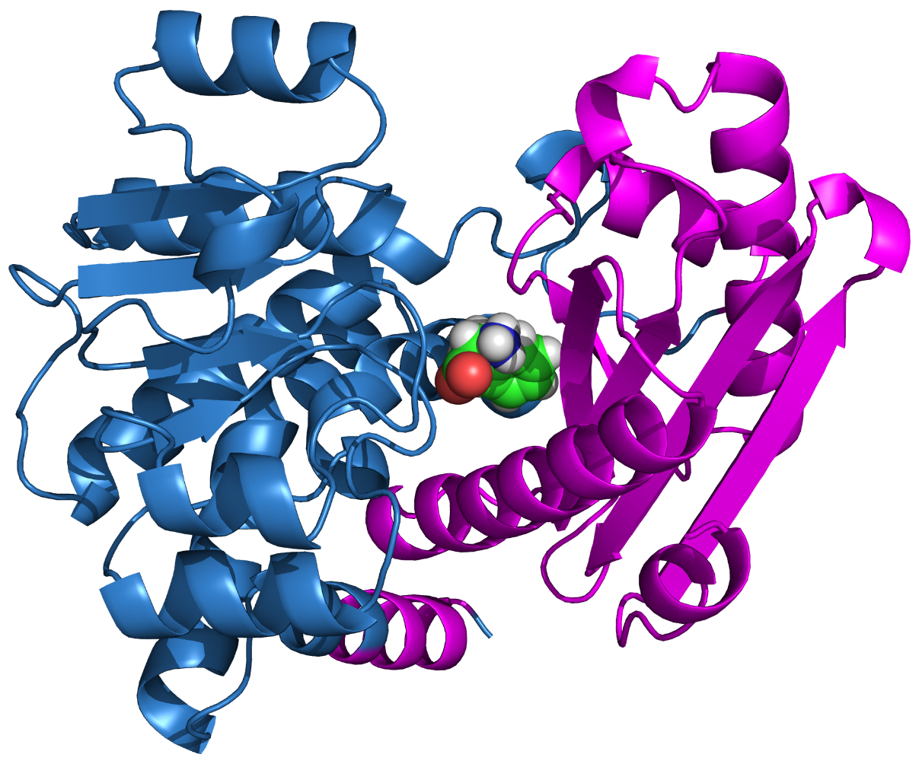
Class 1: oxidoreductases
Example 2: amino acid dehydrogenases (E.C. 1.4.1.x)
The shared ELFV dehydrogenase fold:
Notes:
Figure 9.8. Amino acid dehydrogenases (AA-DH). (c) The structure of phenylalanine dehydrogenase (PheDH; EC 1.4.1.20). The structure of PheDH from Rhodococcus sp. is shown (PDB entry 1c1d, chain A). The N-terminal domain is colored in magenta and the coenzyme-binding domain in cyan. The substrate, L-phenylalanine, is shown as spheres in the cleft between the two domains.

Slide 35
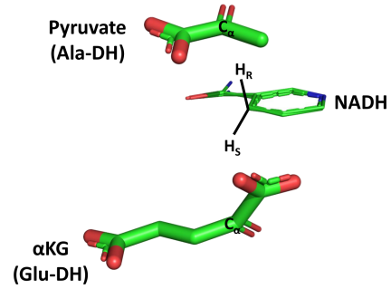
Class 1: oxidoreductases
Example 2: amino acid dehydrogenases (E.C. 1.4.1.x)
The relative substrate-NAD(P)H orientation differ between various members:
Notes:
Figure 9.8. Amino acid dehydrogenases (AA-DH). (d) The positions and orientations of the pyruvate in Ala-DH (PDB entry 2vhx) compared with those of α-ketoglutarate (α-KG) in Glu-DH (PDB entry 1hwy).

Slide 36
Class 2: Transferases
One of the two largest enzyme classes (~30%)
Catalyze the transfer of a chemical group (X) between a donor molecule (D) and an acceptor molecule (A):

Slide 37
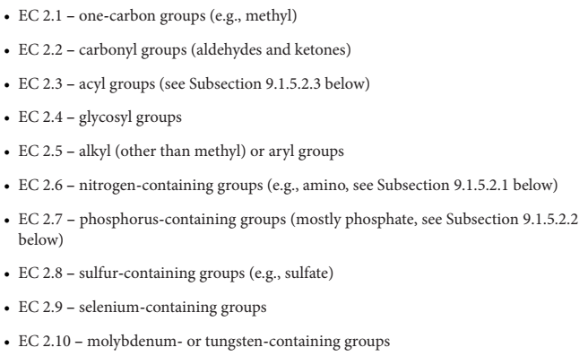
Class 2: Transferases
Classified by the type of transferred group:

Slide 38
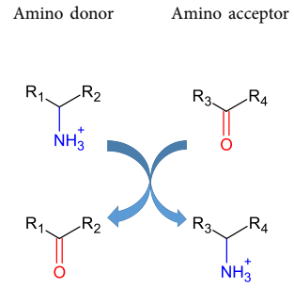
Class 2: Transferases
Example1: aminotransferases (EC 2.6.1.x)
Overall reaction:
Notes:
Figure 9.9. Reactions catalyzed by aminotransferases. (a) The general reaction catalyzed by aminotransferases, in which a donor (amine or amino acid) transfers its amino group to an acceptor (ketone or keto acid).

Slide 39
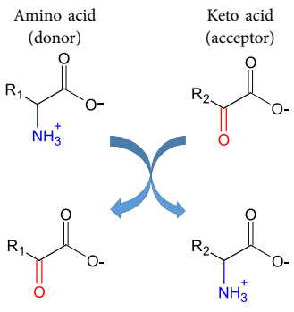
Class 2: Transferases
Example1: aminotransferases (EC 2.6.1.x)
Reactions involving amino acids:
Notes:
Figure 9.9. Reactions catalyzed by aminotransferases. (b) Biochemically relevant reactions, in which the donor is an amino acid and the acceptor is a keto acid. (c) The reaction catalyzed by aminotransferases in the degradation of L-amino acids in most tissues. The acceptor in this case is α-ketoglutaric acid (α-ketoglutarate in the deprotonated form), which is converted to L-glutamic acid (L-glutamate in the deprotonated form). (d) The reaction catalyzed by aminotransferases in the degradation of L-amino acids in muscles. The acceptor in this case is pyruvic acid (pyruvate in the deprotonated form), which is converted to L-alanine

Slide 40
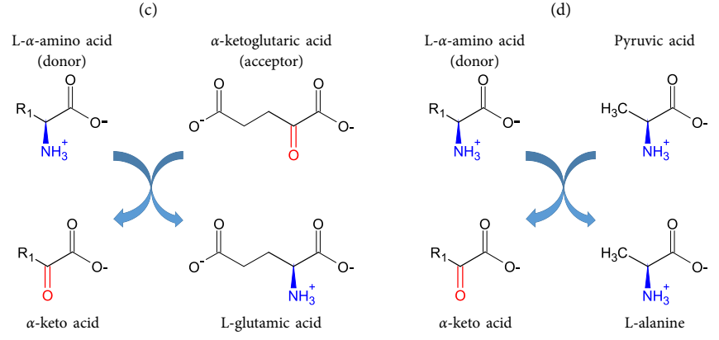
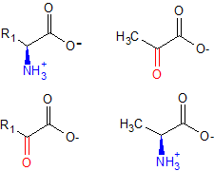
Class 2: Transferases
Example1: aminotransferases (EC 2.6.1.x)
α-aminotransferases transfer the NH₃ groups of α-amino acids in peripheral tissues to two types of keto acids:
Notes:
Figure 9.9. Reactions catalyzed by aminotransferases. (c) The reaction catalyzed by aminotransferases in the degradation of L-amino acids in most tissues. The acceptor in this case is α-ketoglutaric acid (α-ketoglutarate in the deprotonated form), which is converted to L-glutamic acid (L-glutamate in the deprotonated form). (d) The reaction catalyzed by aminotransferases in the degradation of L-amino acids in muscles. The acceptor in this case is pyruvic acid (pyruvate in the deprotonated form), which is converted to L-alanine

Slide 41
Class 2: Transferases
Example1: aminotransferases (EC 2.6.1.x)
Glutamate is often further aminated to glutamine :

Slide 42
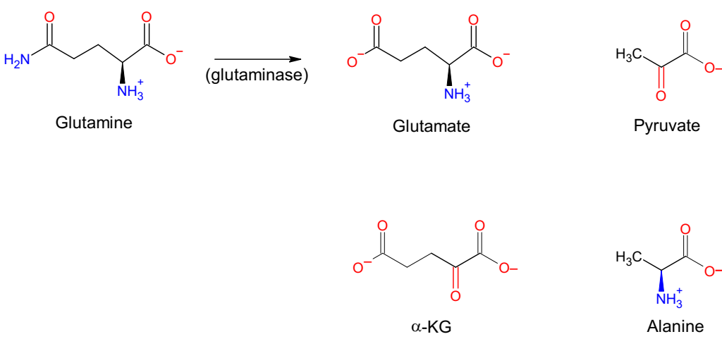
Class 2: Transferases
Example1: aminotransferases (EC 2.6.1.x)
Glutamate, glutamine and alanine carry their NH₃ groups to the liver, where alanine and glutamine turn back into Glu:
(Glu-AA)

Slide 43
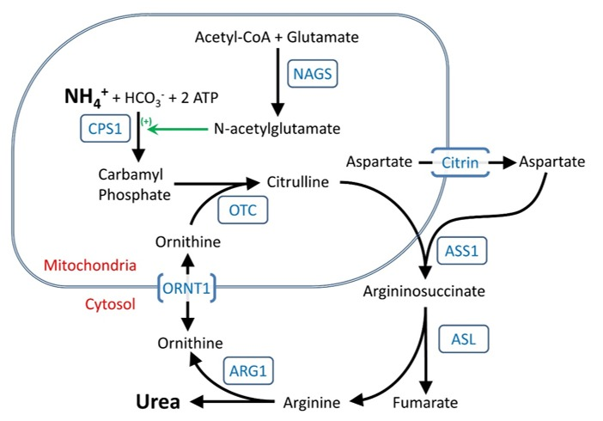
Class 2: Transferases
Example1: aminotransferases (EC 2.6.1.x)
The NH₃ molecules are then converted to urea , which is transported to the kidneys and excreted from the body in urine
https://www.ncbi.nlm.nih.gov/books/NBK1217/figure/ucd-overview.F1/

Slide 44
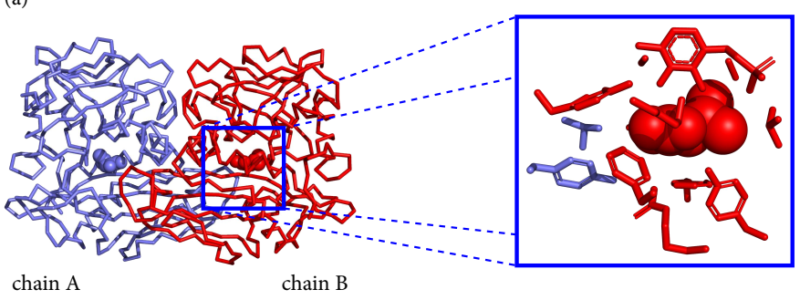
Class 2: Transferases
Example1: aminotransferases (EC 2.6.1.x)
α-aminotransferases are homodimers with two active sites per dimer:
Notes:
Figure 9.10. The structure of aminotransferases. (a) The three-dimensional structure of branched-chain aminotransferase (EC 2.6.1.42; PDB entry 3uzb). Left: overall structure, containing two chains (red and blue C_{α} traces) with two active sites (ligands are shown as spheres). Right: zoom-in view of an active site, showing contribution from both chains.

Slide 45
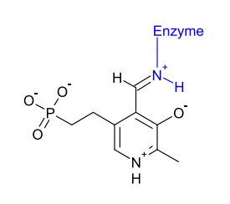
Class 2: Transferases
Example1: aminotransferases (EC 2.6.1.x)
α-aminotransferases use the cofactor pyridoxal phosphate (PLP) to transfer the NH₃ group
PLP is a derivate of vitamin B₆ (pyridoxine)
PLP is bound to the enzyme via a Schiff base
Notes:
Figure 9.11. The PLP coenzyme in aminotransferases. (a) Enzyme-PLP Schiff base. The enzyme group involved in the process is colored in blue.

Slide 46
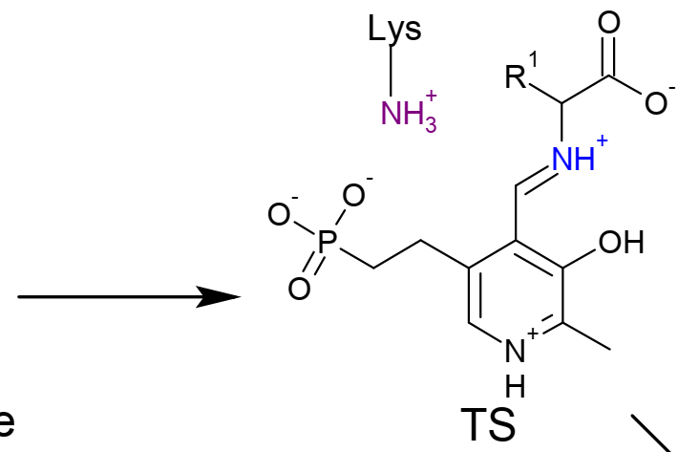
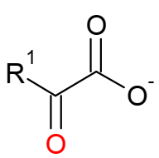
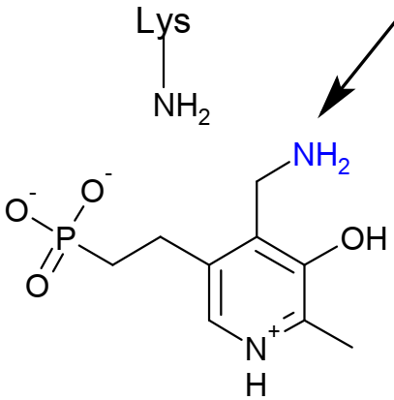
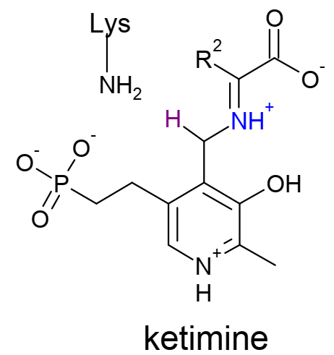
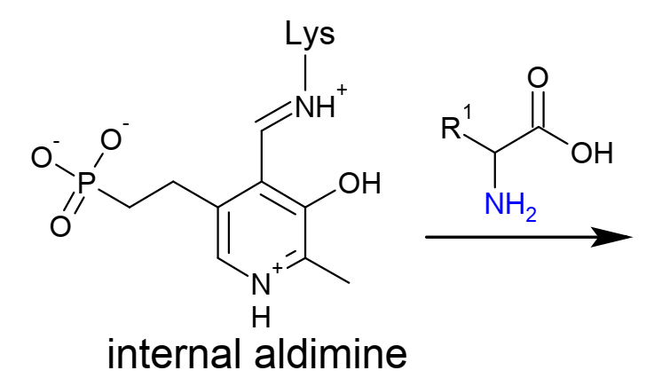
Class 2: Transferases
Example1: aminotransferases (EC 2.6.1.x)
Key reaction steps:

Slide 47
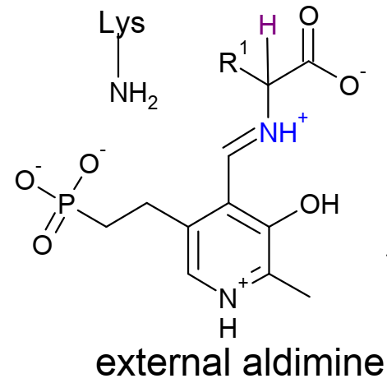
Class 2: Transferases
Example1: aminotransferases (EC 2.6.1.x)
The PLP-enzyme bond is replaced with an equivalent PLP-amino acid bond:
1
Notes:
Figure 9.11. The PLP coenzyme in aminotransferases. (c) The mechanism of transamination ^{ϴ}. Step 1: the amino group of the donor amino acid attacks PLP and forms a Schiff base with it (external aldimine). This process replaces the original Schiff base between PLP and a lysine residue of the enzyme (internal aldimine). Step 2: The C_{α} of the bound donor is deprotonated by the same lysine residue, creating a negatively charged carbanion. Step 3: Electronic rearrangement in the donor turns the aldimine into ketimine. Step 4: an active site water molecule deprotonates (not shown), and the resulting OH⁻ nucleophile attacks the donor’s C_{α}. As a result, the imine bond between the donor and PLP is broken, and the donor leaves the active site as a keto acid. PLP is now unattached to the enzyme or to an amino acid. Thus, it is in its amino form (called pyridoxamine phosphate or PMP). Step 5: the keto acid acceptor enters the active site, and its C_{α} is attacked by PMP’s amino group, resulting in their covalent binding (as ketimine). Step 6: PLP is deprotonated by the aforementioned lysine residue, which then transfers the proton to the acceptor’s C_{α}. The acceptor changes from a ketimine into an (external) aldimine. The protonation of the acceptor is the step that determines the configuration of the acceptor; when the proton is transferred to the acceptor from one side, the resulting amino acid has an L/(S) configuration, whereas protonation from the other side creates a D/(R) configuration. Step 7: the amino group of the lysine residue attacks PLP and forms a Schiff base with it (internal aldimine). As a result, the acceptor detaches from PLP and leaves as an amino acid.

Slide 48
Class 2: Transferases
Example1: aminotransferases (EC 2.6.1.x)
An active site lysine deprotonates C_{α} despite its high pKa
This is due to the stabilization of the resulting transition state carbanion by the positively charged ring of PLP (electron sink)
-
2
Notes:
Figure 9.11. The PLP coenzyme in aminotransferases. (c) The mechanism of transamination ^{ϴ}. Step 1: the amino group of the donor amino acid attacks PLP and forms a Schiff base with it (external aldimine). This process replaces the original Schiff base between PLP and a lysine residue of the enzyme (internal aldimine). Step 2: The C_{α} of the bound donor is deprotonated by the same lysine residue, creating a negatively charged carbanion. Step 3: Electronic rearrangement in the donor turns the aldimine into ketimine. Step 4: an active site water molecule deprotonates (not shown), and the resulting OH⁻ nucleophile attacks the donor’s C_{α}. As a result, the imine bond between the donor and PLP is broken, and the donor leaves the active site as a keto acid. PLP is now unattached to the enzyme or to an amino acid. Thus, it is in its amino form (called pyridoxamine phosphate or PMP). Step 5: the keto acid acceptor enters the active site, and its C_{α} is attacked by PMP’s amino group, resulting in their covalent binding (as ketimine). Step 6: PLP is deprotonated by the aforementioned lysine residue, which then transfers the proton to the acceptor’s C_{α}. The acceptor changes from a ketimine into an (external) aldimine. The protonation of the acceptor is the step that determines the configuration of the acceptor; when the proton is transferred to the acceptor from one side, the resulting amino acid has an L/(S) configuration, whereas protonation from the other side creates a D/(R) configuration. Step 7: the amino group of the lysine residue attacks PLP and forms a Schiff base with it (internal aldimine). As a result, the acceptor detaches from PLP and leaves as an amino acid.

Slide 49
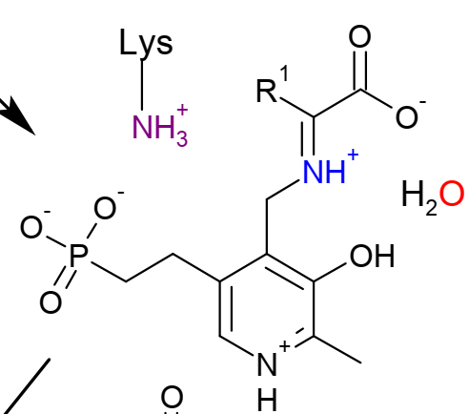
Class 2: Transferases
Example1: aminotransferases (EC 2.6.1.x)
The aldimine rearranges into a ketimine, which is attacked by water to facilitate release of the donor as a keto acid
-
3
4
Notes:
Figure 9.11. The PLP coenzyme in aminotransferases. (c) The mechanism of transamination ^{ϴ}. Step 1: the amino group of the donor amino acid attacks PLP and forms a Schiff base with it (external aldimine). This process replaces the original Schiff base between PLP and a lysine residue of the enzyme (internal aldimine). Step 2: The C_{α} of the bound donor is deprotonated by the same lysine residue, creating a negatively charged carbanion. Step 3: Electronic rearrangement in the donor turns the aldimine into ketimine. Step 4: an active site water molecule deprotonates (not shown), and the resulting OH⁻ nucleophile attacks the donor’s C_{α}. As a result, the imine bond between the donor and PLP is broken, and the donor leaves the active site as a keto acid. PLP is now unattached to the enzyme or to an amino acid. Thus, it is in its amino form (called pyridoxamine phosphate or PMP). Step 5: the keto acid acceptor enters the active site, and its C_{α} is attacked by PMP’s amino group, resulting in their covalent binding (as ketimine). Step 6: PLP is deprotonated by the aforementioned lysine residue, which then transfers the proton to the acceptor’s C_{α}. The acceptor changes from a ketimine into an (external) aldimine. The protonation of the acceptor is the step that determines the configuration of the acceptor; when the proton is transferred to the acceptor from one side, the resulting amino acid has an L/(S) configuration, whereas protonation from the other side creates a D/(R) configuration. Step 7: the amino group of the lysine residue attacks PLP and forms a Schiff base with it (internal aldimine). As a result, the acceptor detaches from PLP and leaves as an amino acid.

Slide 50
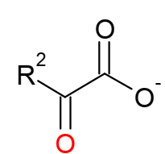
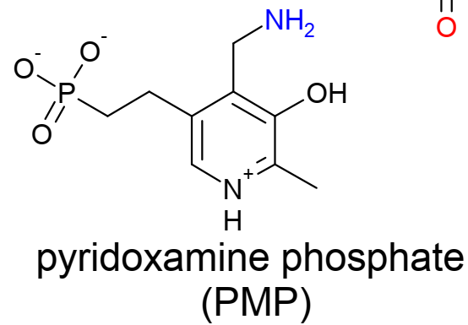
Class 2: Transferases
Example1: aminotransferases (EC 2.6.1.x)
PLP’s NH₂ group binds the acceptor keto acid
5
Notes:
Figure 9.11. The PLP coenzyme in aminotransferases. (c) The mechanism of transamination ^{ϴ}. Step 1: the amino group of the donor amino acid attacks PLP and forms a Schiff base with it (external aldimine). This process replaces the original Schiff base between PLP and a lysine residue of the enzyme (internal aldimine). Step 2: The C_{α} of the bound donor is deprotonated by the same lysine residue, creating a negatively charged carbanion. Step 3: Electronic rearrangement in the donor turns the aldimine into ketimine. Step 4: an active site water molecule deprotonates (not shown), and the resulting OH⁻ nucleophile attacks the donor’s C_{α}. As a result, the imine bond between the donor and PLP is broken, and the donor leaves the active site as a keto acid. PLP is now unattached to the enzyme or to an amino acid. Thus, it is in its amino form (called pyridoxamine phosphate or PMP). Step 5: the keto acid acceptor enters the active site, and its C_{α} is attacked by PMP’s amino group, resulting in their covalent binding (as ketimine). Step 6: PLP is deprotonated by the aforementioned lysine residue, which then transfers the proton to the acceptor’s C_{α}. The acceptor changes from a ketimine into an (external) aldimine. The protonation of the acceptor is the step that determines the configuration of the acceptor; when the proton is transferred to the acceptor from one side, the resulting amino acid has an L/(S) configuration, whereas protonation from the other side creates a D/(R) configuration. Step 7: the amino group of the lysine residue attacks PLP and forms a Schiff base with it (internal aldimine). As a result, the acceptor detaches from PLP and leaves as an amino acid.

Slide 51
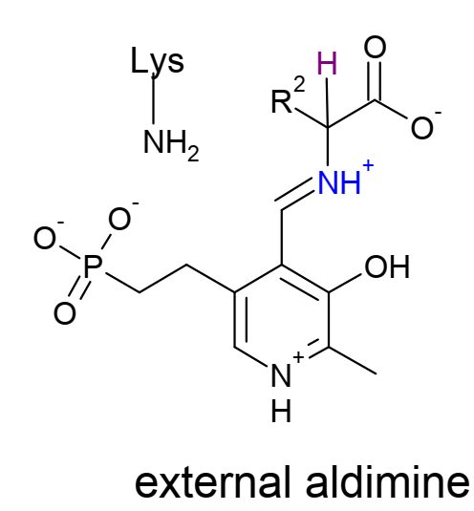
Class 2: Transferases
Example1: aminotransferases (EC 2.6.1.x)
The active site lysine protonates the acceptor’s C_{α} , turning it from an imino acid to an amino acid
The PLP-amino acid bond is replaced with an equivalent PLP-enzyme bond
6
7
Notes:
Figure 9.11. The PLP coenzyme in aminotransferases. (c) The mechanism of transamination ^{ϴ}. Step 1: the amino group of the donor amino acid attacks PLP and forms a Schiff base with it (external aldimine). This process replaces the original Schiff base between PLP and a lysine residue of the enzyme (internal aldimine). Step 2: The C_{α} of the bound donor is deprotonated by the same lysine residue, creating a negatively charged carbanion. Step 3: Electronic rearrangement in the donor turns the aldimine into ketimine. Step 4: an active site water molecule deprotonates (not shown), and the resulting OH⁻ nucleophile attacks the donor’s C_{α}. As a result, the imine bond between the donor and PLP is broken, and the donor leaves the active site as a keto acid. PLP is now unattached to the enzyme or to an amino acid. Thus, it is in its amino form (called pyridoxamine phosphate or PMP). Step 5: the keto acid acceptor enters the active site, and its C_{α} is attacked by PMP’s amino group, resulting in their covalent binding (as ketimine). Step 6: PLP is deprotonated by the aforementioned lysine residue, which then transfers the proton to the acceptor’s C_{α}. The acceptor changes from a ketimine into an (external) aldimine. The protonation of the acceptor is the step that determines the configuration of the acceptor; when the proton is transferred to the acceptor from one side, the resulting amino acid has an L/(S) configuration, whereas protonation from the other side creates a D/(R) configuration. Step 7: the amino group of the lysine residue attacks PLP and forms a Schiff base with it (internal aldimine). As a result, the acceptor detaches from PLP and leaves as an amino acid.

Slide 52
Class 2: Transferases
Example1: aminotransferases (EC 2.6.1.x)
Animation of overall process:
Notes:
Figure 9.11. The PLP coenzyme in aminotransferases. (c) The mechanism of transamination ^{ϴ}. Step 1: the amino group of the donor amino acid attacks PLP and forms a Schiff base with it (external aldimine). This process replaces the original Schiff base between PLP and a lysine residue of the enzyme (internal aldimine). Step 2: The C_{α} of the bound donor is deprotonated by the same lysine residue, creating a negatively charged carbanion. Step 3: Electronic rearrangement in the donor turns the aldimine into ketimine. Step 4: an active site water molecule deprotonates (not shown), and the resulting OH⁻ nucleophile attacks the donor’s C_{α}. As a result, the imine bond between the donor and PLP is broken, and the donor leaves the active site as a keto acid. PLP is now unattached to the enzyme or to an amino acid. Thus, it is in its amino form (called pyridoxamine phosphate or PMP). Step 5: the keto acid acceptor enters the active site, and its C_{α} is attacked by PMP’s amino group, resulting in their covalent binding (as ketimine). Step 6: PLP is deprotonated by the aforementioned lysine residue, which then transfers the proton to the acceptor’s C_{α}. The acceptor changes from a ketimine into an (external) aldimine. The protonation of the acceptor is the step that determines the configuration of the acceptor; when the proton is transferred to the acceptor from one side, the resulting amino acid has an L/(S) configuration, whereas protonation from the other side creates a D/(R) configuration. Step 7: the amino group of the lysine residue attacks PLP and forms a Schiff base with it (internal aldimine). As a result, the acceptor detaches from PLP and leaves as an amino acid.

Slide 53
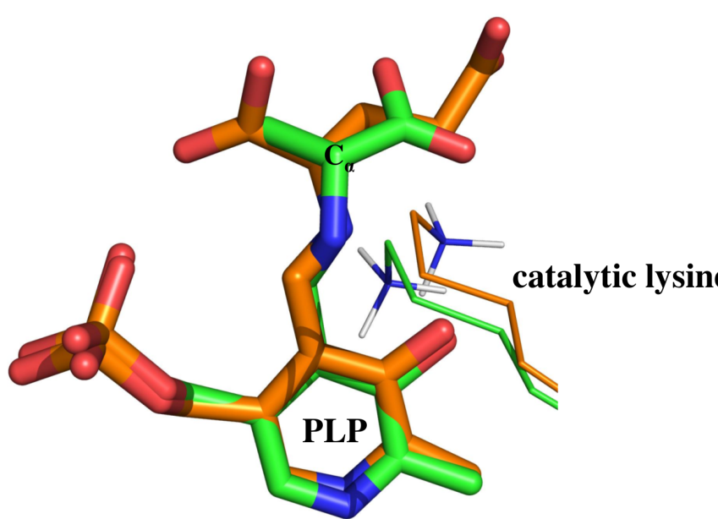
Class 2: Transferases
Example1: aminotransferases (EC 2.6.1.x)
The protonation determines the configuration of the product (S/R)
In the two enzymes below: catalytic Lys on the same side but substrates are opposite → protonation yields opposite configurations
Notes:
Figure 9.11. The PLP coenzyme in aminotransferases. (d) orientation of substrate (sticks) and catalytic machinery in branched-chain amino acid aminotransferase (EC 2.6.1.42, PDB entry 1iye; orange) and in D-amino acid aminotransferase (EC 2.6.1.21, PDB entry 3daa; green). While the catalytic lysine residues of the two enzymes reside on the same face of PLP, the substrates are bound in opposite directions. Thus, protonation of the substrate in the two enzymes results in opposite configurations.

Slide 54
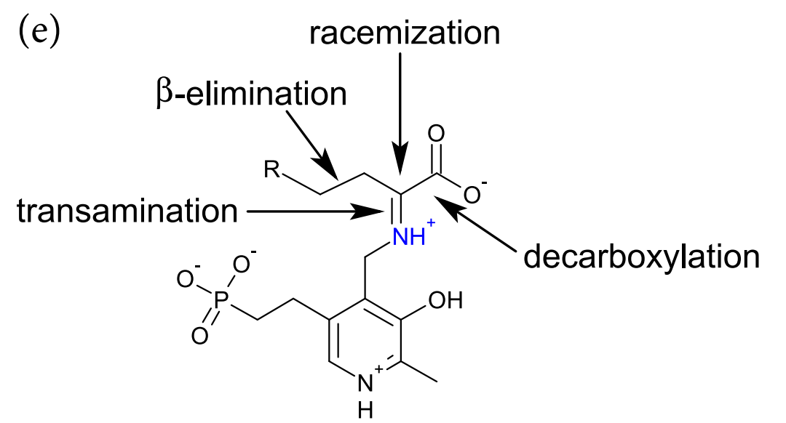
Class 2: Transferases
Example1: aminotransferases (EC 2.6.1.x)
PLP promotes covalent bond cleavage also in other reactions, catalyzed by other types of enzymes
Notes:
Figure 9.11. The PLP coenzyme in aminotransferases. (e) The cleavage of other bonds in molecules, facilitated by PLP. Decarboxylation involves α-elimination resulting in cleavage of the C_{α}-COOH bond. In racemization reactions the C_{α} hydrogen (not shown) is eliminated and re-added. Other reactions involve β or γ eliminations.

Slide 55
Class 2: Transferases
Example1: aminotransferases (EC 2.6.1.x)
The cleaved bond is always positioned parallel to PLP’s conjugated p orbitals, so the transition state carbanion is stabilized by resonance interactions with PLP’s π system
-
-
-
Notes:
Figure 9.11. The PLP coenzyme in aminotransferases. (f) The Dunathan stereoelectronic hypothesis, demonstrated for deprotonation and decarboxylation. The two substrates are bound to PLP such that the bond to C_{α} that is to be broken (the leaving group is in purple) is aligned with the π orbitals of PLP. The image is adapted from

Slide 56
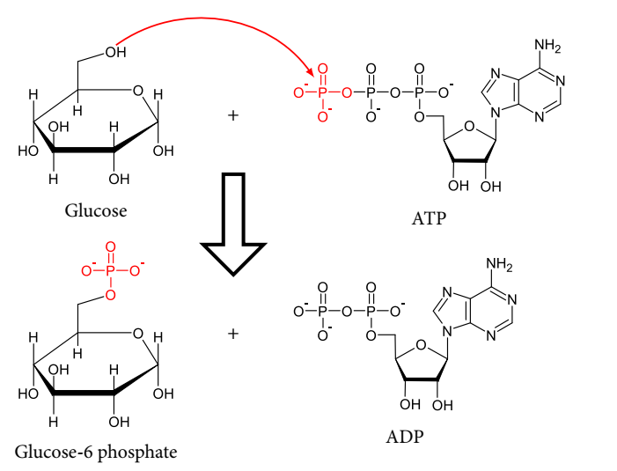
Class 2: Transferases
Example2: phosphoryltransferases (EC 2.7.x.x)
Transfer phosphoryl groups between molecules, many of which are metabolic intermediates
Activation of glucose by transfer of ATP’s γ-phosphoryl group
(Glycolysis’ 1st step, hexokinase; EC 2.7.1.1)
Notes:
Figure 9.12. Biologically relevant phosphorylations and acyl transfer reactions. (a) Glucose phosphorylation by hexokinase during glycolysis, creating a phosphoester bond. The reaction involves a nucleophilic attack of glucose’s hydroxyl at position C6 on the terminal phosphoryl group of ATP (the attack is shown by the red arrow). For clarity, explicit hydrogen atoms are not shown.

Slide 57
Class 2: Transferases
Example2: phosphoryltransferases (EC 2.7.x.x)
A phosphorylation may be catalyzed by an oxidoreductase if it is coupled to oxidation
Oxidation-coupled phosphorylation of G3P
(Glycolysis’ 7th step, G3P dehydrogenase; EC 1.2.1.12)
Notes:
Figure 9.12. Biologically relevant phosphorylations and acyl transfer reactions. (a) Glucose phosphorylation by hexokinase during glycolysis, creating a phosphoester bond. The reaction involves a nucleophilic attack of glucose’s hydroxyl at position C6 on the terminal phosphoryl group of ATP (the attack is shown by the red arrow). For clarity, explicit hydrogen atoms are not shown.

Slide 58
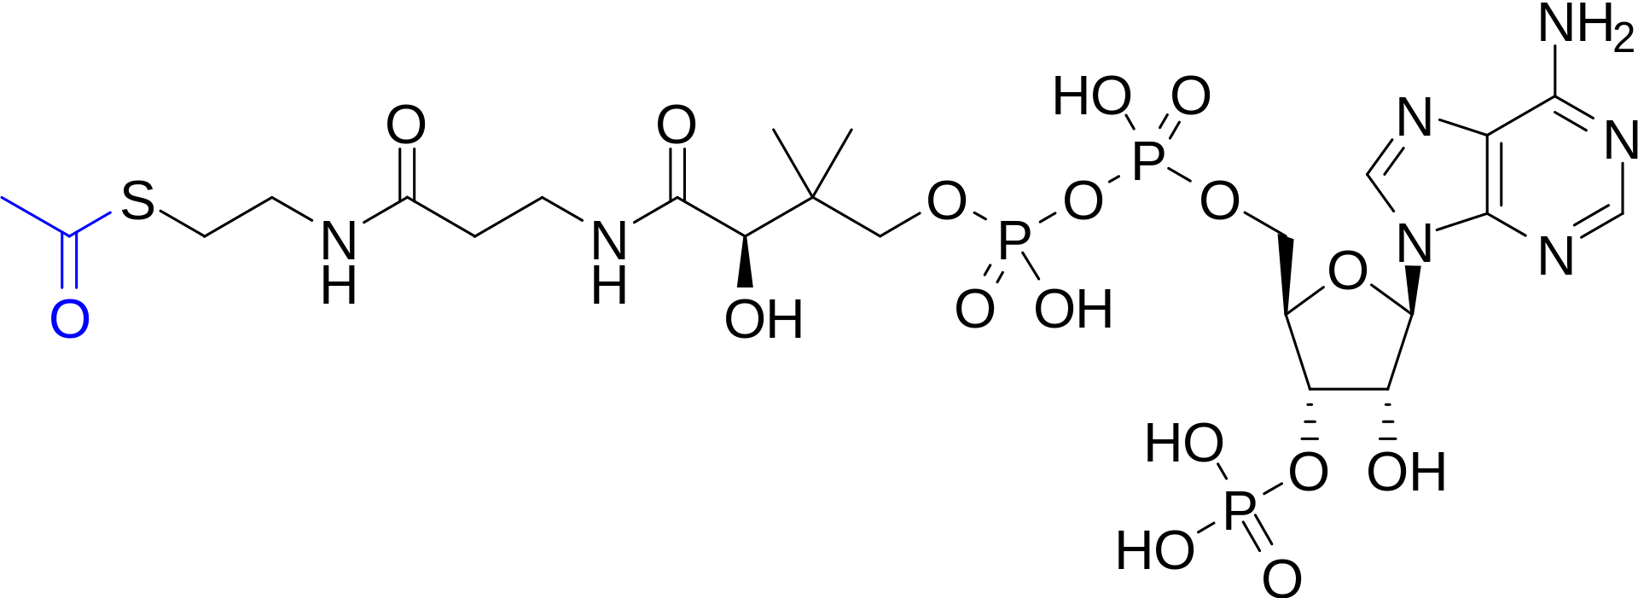
Class 2: Transferases
Example3: acetyltransferases (EC 2.3.1.x)
The donor of the acetyl group is coenzyme A (CoA; a vitamin B₅ derivate)
Cysteamine
Pantothenate
(B5)
ADP
Acetyl

Slide 59
Class 2: Transferases
Example3: acetyltransferases (EC 2.3.1.x)
(Kessel & Ben-Tal (2021) From Molecules to Cells: The Origin of Life on Earth)
Notes:
CoA is another example of a nucleotide enzyme cofactor, whose functional part is relatively small, and the rest, which is based on adenosine (RNA world relic?), serves as a molecular handle for the enzyme.

Slide 60
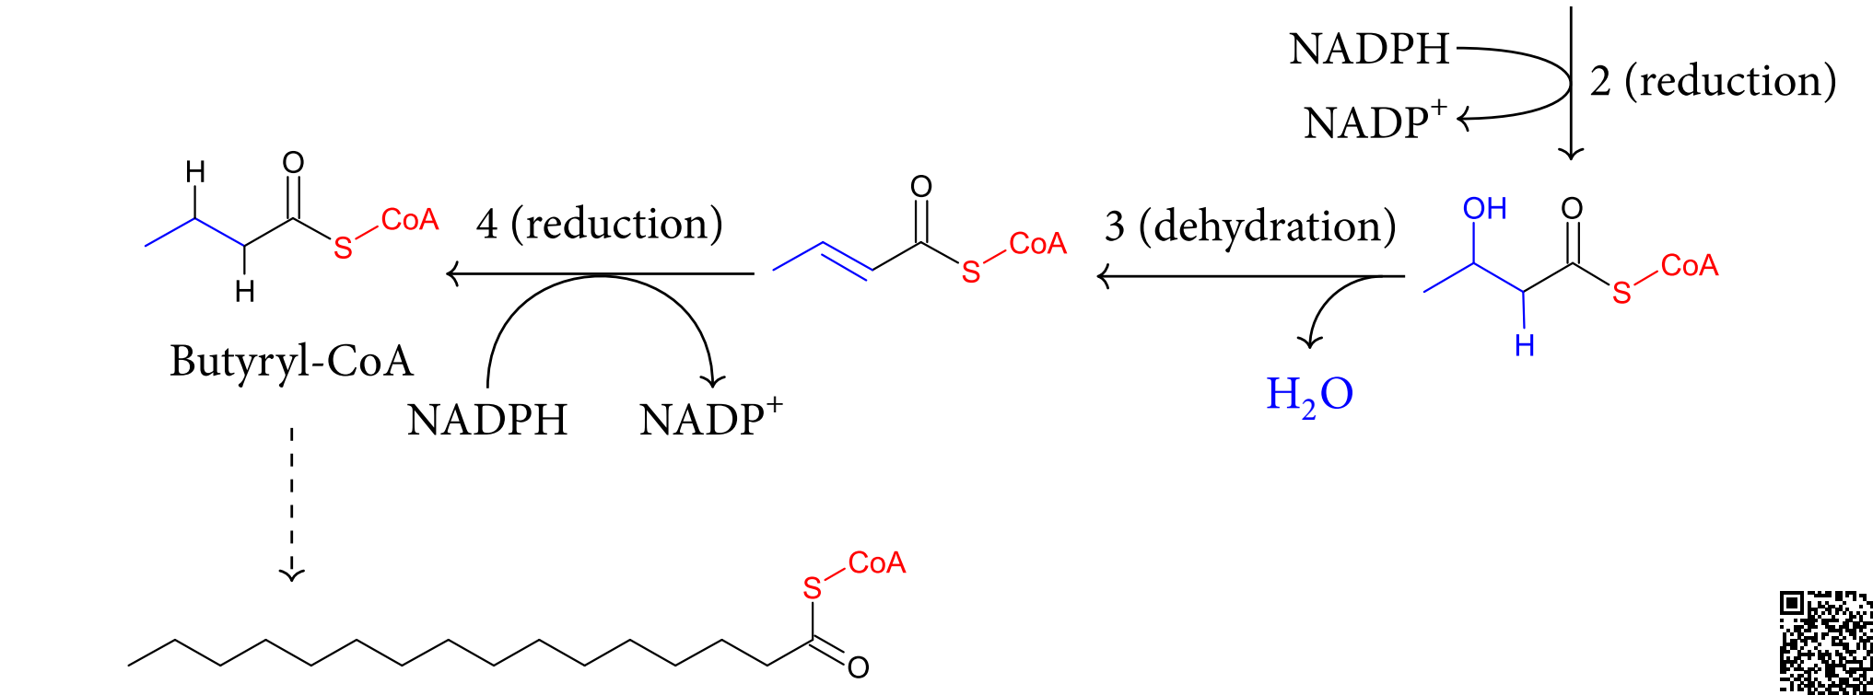
Class 2: Transferases
Example3: acetyltransferases (EC 2.3.1.x)
Common in biosyntheses (e.g. fatty acid synthesis)
Acetyl transfer in fatty acid biosynthesis
(fatty acid synthase; EC 2.3.1.85)
Notes:
Figure 9.12. Biologically relevant phosphorylations and acyl transfer reactions. (c) Acyl transfer in fatty acid synthesis ^{ϴ}. The pathway includes consecutive reactions that can be iterated to increase the chain length (dashed line leading to palmitoyl-CoA). Step 1: a decarboxylating Claisen condensation of acetyl-CoA and malonyl-CoA (in the enzyme-catalyzed reaction both reactants are attached to the enzyme via equivalent thioester bonds). Step 2: NADPH-dependent reduction of acetoacetyl-CoA’s keto group to a hydroxyl group. Step 3: water elimination (dehydration) of the C2-C3 bond. Step 4: NADPH-dependent reduction of the C2-C3 double bond.

Slide 61
Class 2: Transferases
Example3: acetyltransferases (EC 2.3.1.x)
The first step – a Claisen condensation that attaches two thioesters to create a β-keto thioester
Thioester (CoA-Ac) cleavage drives the reaction (more energy released than in COOR cleavage)
The decarboxylation renders the reaction unidirectional
(a β-keto thioester)
Acetyl transfer in fatty acid biosynthesis
(fatty acid synthase; EC 2.3.1.85)
Notes:
Figure 9.12. Biologically relevant phosphorylations and acyl transfer reactions. (c) Acyl transfer in fatty acid synthesis ^{ϴ}. The pathway includes consecutive reactions that can be iterated to increase the chain length (dashed line leading to palmitoyl-CoA). Step 1: a decarboxylating Claisen condensation of acetyl-CoA and malonyl-CoA (in the enzyme-catalyzed reaction both reactants are attached to the enzyme via equivalent thioester bonds). Step 2: NADPH-dependent reduction of acetoacetyl-CoA’s keto group to a hydroxyl group. Step 3: water elimination (dehydration) of the C2-C3 bond. Step 4: NADPH-dependent reduction of the C2-C3 double bond.

Slide 62
Class 2: Transferases
Example3: acetyltransferases (EC 2.3.1.x)
In the biosynthesis of cholesterol and ketone bodies the Claisen condenstation does not involve decarboxylation
The reversal of this reaction occurs in fatty acid breakdown, by the same type of enzyme
(a β-keto thioester)
Acetyl transfer in the biosynthesis of cholesterol and ketone bodies
(thiolase; EC 2.3.1.9)
Notes:
Figure 9.12. Biologically relevant phosphorylations and acyl transfer reactions. (d) Acyl transfer in the biosynthetic pathways of cholesterol and ketone bodies. In both cases, thiolase carries out a non-decarboxylating Claisen condensation to form acetoacetyl-CoA from two acetyl-CoA molecules

Slide 63
Class 2: Transferases
Example3: acetyltransferases (EC 2.3.1.x)
Animation of overall process:
Notes:
Figure 9.12. Biologically relevant phosphorylations and acyl transfer reactions. (c) Acyl transfer in fatty acid synthesis ^{ϴ}. The pathway includes consecutive reactions that can be iterated to increase the chain length (dashed line leading to palmitoyl-CoA). Step 1: a decarboxylating Claisen condensation of acetyl-CoA and malonyl-CoA (in the enzyme-catalyzed reaction both reactants are attached to the enzyme via equivalent thioester bonds). Step 2: NADPH-dependent reduction of acetoacetyl-CoA’s keto group to a hydroxyl group. Step 3: water elimination (dehydration) of the C2-C3 bond. Step 4: NADPH-dependent reduction of the C2-C3 double bond.

Slide 64
Class 3: Hydrolases
Third-largest class of enzymes (24%)
Use H₂O to break covalent bonds by nucleophilic substitution
Mechanism:
Nucleophilic attack of the substrate by the enzyme → enzyme-substrate (covalent) intermediate
Covalent attack of the substrate by H₂O → release of product

Slide 65
Class 3: Hydrolases
Classified by the type of cleaved bond:

Slide 66
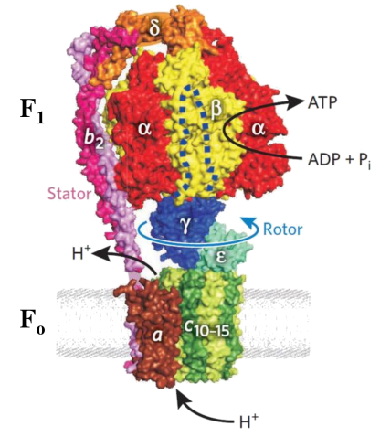
Class 3: Hydrolases
Example: ATP synthase (EC 3.6.3.14)
Catalyzes ATP hydrolysis/synthesis to/from ADP + P_{i}
Catalysis is coupled to H⁺ flow through a channel domain
catalytic domain
ATP + H₂O ↔ ADP + P_{i}
H⁺ channel
Notes:
Figure 9.13. ATP synthase. (a) A structural model of the bacterial ATP synthase. F_{O} is the transmembrane part of the enzyme, responsible for proton transfer. F₁ is the extramembrane part of the enzyme, responsible for ATP synthesis/hydrolysis. The subunits of the enzyme are noted. The image is taken from ^{[81]}.

Slide 67
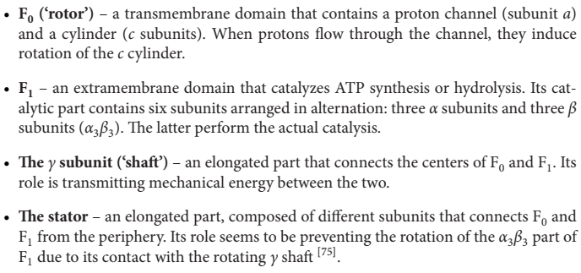
Class 3: Hydrolases
Example: ATP synthase (EC 3.6.3.14)
The enzyme contains multiple subunits and three main parts:
a
Notes:
Figure 9.13. ATP synthase. (a) A structural model of the bacterial ATP synthase. F_{O} is the transmembrane part of the enzyme, responsible for proton transfer. F₁ is the extramembrane part of the enzyme, responsible for ATP synthesis/hydrolysis. The subunits of the enzyme are noted. The image is taken from ^{[81]}.

Slide 68
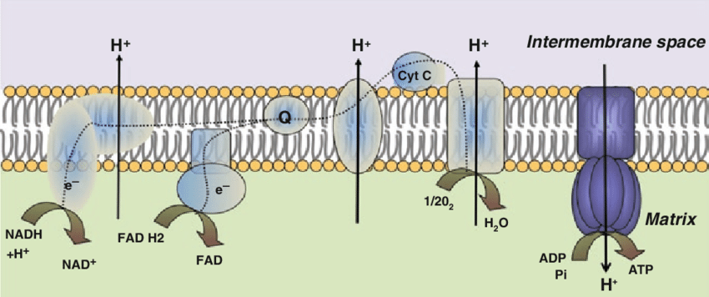
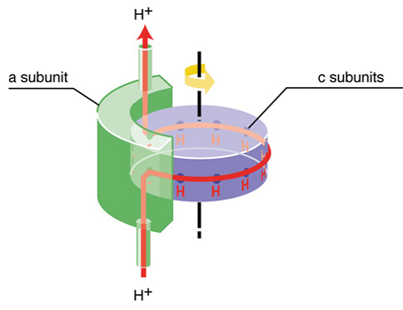
Class 3: Hydrolases
Example: ATP synthase (EC 3.6.3.14)
In respiration, an H⁺ gradient is built across the plasma membrane (in bacteria) or mitochondrial membrane (in eukaryotes), and used to built ATP via ATP synthase
H⁺ flow through F₀ releases the potential energy of the gradient and induces rotation of the F₀ c-ring
B. Lu (ed.) Mitochondrial Dynamics and Neurodegeneration (2011)
Notes:
Figure 9.13. ATP synthase. (b) A schematic model explaining how the flow of protons through F_{O} generates rotation (see details in the main text). Taken from ^{[72]}.

Slide 69
Class 3: Hydrolases
Example: ATP synthase (EC 3.6.3.14)
The rotation’s mechanical energy is transmitted via the γ subunit to F₁, which leads to ATP synthesis by inducing conformational changes in the F₁ subunits
Notes:
Figure 9.13. ATP synthase. (a) A structural model of the bacterial ATP synthase. F_{O} is the transmembrane part of the enzyme, responsible for proton transfer. F₁ is the extramembrane part of the enzyme, responsible for ATP synthesis/hydrolysis. The subunits of the enzyme are noted. The image is taken from ^{[81]}.

Slide 70
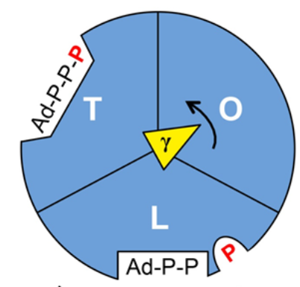
Class 3: Hydrolases
Example: ATP synthase (EC 3.6.3.14)
Each of the three β subunits of F₁ may exist in three states:
O – does not bind any molecule; faces the γ subunit bulge
T – binds ATP
L – binds ADP+ P_{i}
The rotation of the γ subunit induces conformational changes in the β subunits, which shifts them between the O, T, and L states
Notes:
Figure 9.13. ATP synthase. (c) Binding-change model for ATP synthase. Each of the αβ subunits of F₁ may possess an empty (O), ADP+Pi-binding (L) or ATP-binding (T) conformation, depending on its interactions with the γ subunit (green arrow). Proton flow through F_{O} leads to its revolution, which is transmitted to F₁ by the γ subunit. A 360° revolution of the latter takes each β subunit through all of the three conformations, which constitute a complete cycle of ATP synthesis by the three β subunits. This happens in three main steps, each involving a 120° revolution of the γ subunit. The conformation of each β subunit (one is red, the other is blue and the third is green) is shown at each of the steps. The image is adapted from Figure 19-26 in Lehninger (5th edition).

Slide 71
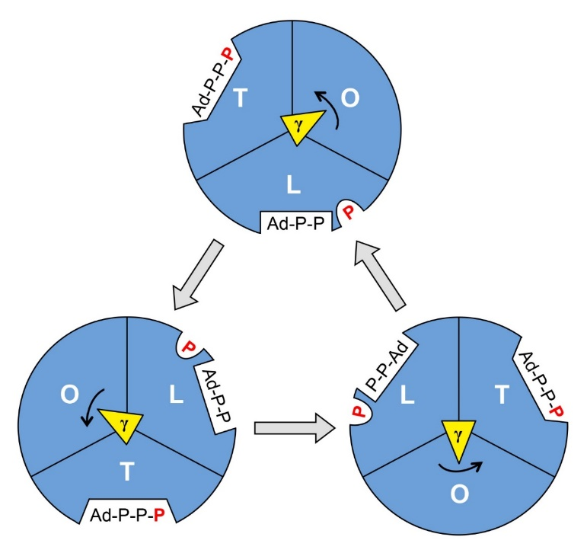
Class 3: Hydrolases
Example: ATP synthase (EC 3.6.3.14)
Every 120° rotation of the γ subunit causes the following:
Notes:
Figure 9.13. ATP synthase. (c) Binding-change model for ATP synthase. Each of the αβ subunits of F₁ may possess an empty (O), ADP+Pi-binding (L) or ATP-binding (T) conformation, depending on its interactions with the γ subunit (green arrow). Proton flow through F_{O} leads to its revolution, which is transmitted to F₁ by the γ subunit. A 360° revolution of the latter takes each β subunit through all of the three conformations, which constitute a complete cycle of ATP synthesis by the three β subunits. This happens in three main steps, each involving a 120° revolution of the γ subunit. The conformation of each β subunit (one is red, the other is blue and the third is green) is shown at each of the steps. The image is adapted from Figure 19-26 in Lehninger (5th edition).

Slide 72
Class 4: Lyases
Catalyze elimination or addition reactions without using H₂O (non-hydrolytic) or oxidation
The reaction often involves formation of a double bond or a ring

Slide 73
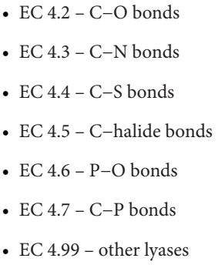
Class 4: Lyases
Classified by type of cleaved bond:

Slide 74
Class 4: Lyases
Certain decarboxylation lyases use PLP, others use thiamine pyrophosphate (TPP; vitamin B₁ derivate)
Like in PLP, TPP’s electron sink (thiazolium ring) stabilizes a carbanion of the transition state, formed by deprotonation
pyridinium ring
PLP
TPP
Notes:
Figure 9.15. The use of thiamine pyrophosphate (TPP) for decarboxylation of α-keto acids. (a) The chemical structure of thiamine pyrophosphate. The active thiazolium ring is marked.

Slide 75
Class 4: Lyases
Certain decarboxylation lyases use PLP, others use thiamine pyrophosphate (TPP; vitamin B₁ derivate)
However, in PLP enzymes the carbanion forms in the substrate
-
Carbanion formation in PLP enzymes
Notes:
Figure 9.15. The use of thiamine pyrophosphate (TPP) for decarboxylation of α-keto acids. (b) The catalytic mechanism involving TPP (see main text) ^{ϴ1}.

Slide 76
Class 4: Lyases
Certain decarboxylation lyases use PLP, others use thiamine pyrophosphate (TPP; vitamin B₁ derivate)
Whereas in TPP lyases it forms in the TPP itself, (H⁺ is abstracted from the thiazolium’s C2)
Carbanion formation in TPP enzymes
Notes:
Figure 9.15. The use of thiamine pyrophosphate (TPP) for decarboxylation of α-keto acids. (b) The catalytic mechanism involving TPP (see main text) ^{ϴ1}.

Slide 77
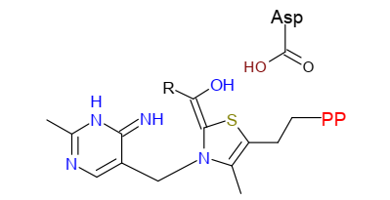
Class 4: Lyases
Example: α-keto acid decarboxylase (EC 4.1.1.x)
The carbanion then attacks the substrate, creating a covalent intermediate that destabilizes the C-C bond and results in decarboxylation
Notes:
Figure 9.15. The use of thiamine pyrophosphate (TPP) for decarboxylation of α-keto acids. (b) The catalytic mechanism involving TPP (see main text) ^{ϴ1}.

Slide 78
Class 4: Lyases
Example: α-keto acid decarboxylase (EC 4.1.1.x)
The overall process:
Notes:
Figure 9.15. The use of thiamine pyrophosphate (TPP) for decarboxylation of α-keto acids. (b) The catalytic mechanism involving TPP (see main text) ^{ϴ1}.

Slide 79
Class 4: Lyases
Example: α-keto acid decarboxylase (EC 4.1.1.x)
Animation of overall process:
Notes:
Figure 9.15. The use of thiamine pyrophosphate (TPP) for decarboxylation of α-keto acids. (b) The catalytic mechanism involving TPP (see main text) ^{ϴ1}.

Slide 80
Class 4: Lyases
Example: α-keto acid decarboxylase (EC 4.1.1.x)
Decarboxylation of β-keto acids happens spontaneously (no TPP/PLP are required) because the negative charge is stabilized by enolate-ketolate tautomerism
c-I
Notes:
Figure 9.15. The use of thiamine pyrophosphate (TPP) for decarboxylation of α-keto acids. (c) Spontaneous decarboxylation of β-keto acid (I) ^{ϴ2} vs. TPP-facilitated decarboxylation of α-keto acids (II) ^{ϴ3}. In both cases the carboxyl group is in red and the keto group is in purple. Only the thiazolium ring of TPP is shown. The α and β positions in the molecules are marked. In α-keto acid decarboxylation, a β-carbonyl group is absent, and TPP acts as a ‘surrogate’ β-group to stabilize the negative charge on the transition state.

Slide 81
Class 4: Lyases
Example: α-keto acid decarboxylase (EC 4.1.1.x)
Animation of the process:
Notes:
Figure 9.15. The use of thiamine pyrophosphate (TPP) for decarboxylation of α-keto acids. (c) Spontaneous decarboxylation of β-keto acid (I) ^{ϴ2} vs. TPP-facilitated decarboxylation of α-keto acids (II) ^{ϴ3}. In both cases the carboxyl group is in red and the keto group is in purple. Only the thiazolium ring of TPP is shown. The α and β positions in the molecules are marked. In α-keto acid decarboxylation, a β-carbonyl group is absent, and TPP acts as a ‘surrogate’ β-group to stabilize the negative charge on the transition state.

Slide 82
Class 4: Lyases
Example: α-keto acid decarboxylase (EC 4.1.1.x)
The tautomerism is impossible in α-keto acids, and TPP acts as a surrogate charge-stabilizing β-group
c-II
Notes:
Figure 9.15. The use of thiamine pyrophosphate (TPP) for decarboxylation of α-keto acids. (c) Spontaneous decarboxylation of β-keto acid (I) ^{ϴ2} vs. TPP-facilitated decarboxylation of α-keto acids (II) ^{ϴ3}. In both cases the carboxyl group is in red and the keto group is in purple. Only the thiazolium ring of TPP is shown. The α and β positions in the molecules are marked. In α-keto acid decarboxylation, a β-carbonyl group is absent, and TPP acts as a ‘surrogate’ β-group to stabilize the negative charge on the transition state.

Slide 83
Class 4: Lyases
Example: α-keto acid decarboxylase (EC 4.1.1.x)
Animation of the process:
Notes:
Figure 9.15. The use of thiamine pyrophosphate (TPP) for decarboxylation of α-keto acids. (c) Spontaneous decarboxylation of β-keto acid (I) ^{ϴ2} vs. TPP-facilitated decarboxylation of α-keto acids (II) ^{ϴ3}. In both cases the carboxyl group is in red and the keto group is in purple. Only the thiazolium ring of TPP is shown. The α and β positions in the molecules are marked. In α-keto acid decarboxylation, a β-carbonyl group is absent, and TPP acts as a ‘surrogate’ β-group to stabilize the negative charge on the transition state.

Slide 84
Class 4: Lyases
Example: α-keto acid decarboxylase (EC 4.1.1.x)
This is why α-keto acids are more stable and more common than β-keto acids as metabolites
Pyruvic acid
α-ketoglutaric acid
Glyoxylic acid
α
α
α
Common α-keto acids in metabolism

Slide 85
Class 5: Isomerases
One of the smallest enzyme classes (5%)
Catalyze the interconversion between isomers through geometric/structural changes
For example:
The transfer of a chemical group from one position to another in the substrate:
A change between the S and R stereo-configurations of a chiral center
A change between the cis and trans configurations of a double bond

Slide 86
Class 5: Isomerases
Classified by the type of catalyzed reaction:
EC 5.1: Racemases and epimerases
Catalyze an S↔R change
Racemases – when there is only one chiral center
Epimerases – in a single chiral center, when there are more
EC 5.2: Cis-trans isomerases
EC 5.3: Intramolecular oxidoreductases
Catalyze electron transfer within the substrate
Include tautomerases, which catalyze readily occurring interconversions (e.g. keto-enol)

Slide 87
Class 5: Isomerases
Classified by the type of catalyzed reaction:
EC 5.4: Intramolecular transferases (mutases)
Catalyze atom/group transfers within the substrate
Often involves positional switch between a hydrogen and another atom
Adenosylcobalamin (vitamin B₁₂ derivate) is used for amino group transfers and for carbon skeleton rearrangements
EC 5.5: Intramolecular lyases
Catalyze the interconversion between open and ring structures

Slide 88
Class 6: Ligases
The smallest enzyme class (3%)
Catalyze the covalent attachment of molecules, usually by using the energy released from ATP hydrolysis:

Slide 89
Class 6: Ligases
Classified by the type of bond formed in the reaction:

Slide 90
Class 6: Ligases
The mechanism of energy channeling involves transfer of ATP’s phosphate to the substrate, which changes the latter’s electronic properties and destabilizes bonds within it
For example: pantoate-beta-alanine ligase (EC 6.3.2.1)
The ad-phosphate facilitates C-O bond breaking in the substrate
Notes:
Figure 9.17. The mechanism of ligases. The figure shows the mechanism of pantoate-beta-alanine ligase (EC 6.3.2.1) ^{ϴ}. (b) The mechanism of the reaction, adapted from the MACiE database (entry M0229). Step 1 – a nucleophilic attack of (R)-pantoate’s carboxylate on the α-phosphate of ATP (written here as Ad-PO₄-PO₄-PO₄), creating an activated intermediate and releasing pyrophosphate (PP_{i}). Step 2 - a nucleophilic attack of β-alanine’s amino group (in its deprotonated form), creating (R)-pantethonate and releasing AMP (written here as Ad-PO₄).

Slide 91
Class 6: Ligases
Animation of the process:
Notes:
Figure 9.17. The mechanism of ligases. The figure shows the mechanism of pantoate-beta-alanine ligase (EC 6.3.2.1) ^{ϴ}. (b) The mechanism of the reaction, adapted from the MACiE database (entry M0229). Step 1 – a nucleophilic attack of (R)-pantoate’s carboxylate on the α-phosphate of ATP (written here as Ad-PO₄-PO₄-PO₄), creating an activated intermediate and releasing pyrophosphate (PP_{i}). Step 2 - a nucleophilic attack of β-alanine’s amino group (in its deprotonated form), creating (R)-pantethonate and releasing AMP (written here as Ad-PO₄).

Slide 92
Enzyme kinetics
Enzyme velocity diminishes over time, due to:
Decrease in substrate concentration
Product inhibition
pH changes, thermal inactivation, etc.
Notes:
The prime goal in studying enzymes is to understand their mechanisms. These, however, are complex and rely on multiple steps, each has its own rate and involves certain intermediates. There are several methods that allow us to focus on these steps, e.g. by measuring the rates or by crystallizing the intermediates and solving their structures. A different approach, which was used before these methods were available, is to use mathematical models that interpret measurements of the enzyme’s rate and its dependence on various parameters.
Figure 9.18. Formation of product over time in an enzymatic reaction. [P] is the Molar concentration of the reaction’s product. The slope of the plot in its linear region is the initial reaction velocity (V₀, see main text).

Slide 93
Enzyme kinetics
The initial velocity (V₀) of enzymatic reactions diminishes with substrate concentration (saturation kinetics)
Notes:
Figure 9.19. Catalyzed (blue plot) and uncatalyzed (red plot) initial reaction rates (V₀) with increasing substrate concentrations [S].

Slide 94
Enzyme kinetics
The saturation kinetics of enzymes is described by the Michaelis-Menten (M-M) model using two measurable parameters:
The maximal velocity at high substrate concentrations (V_{max})
The substrate concentration that yields ½ V_{max} (K_{M})
Notes:
Figure 9.20. Graphic representation of the Michaelis-Menten equation. V_{max} is the maximal velocity and K_{M} is the substrate concentration at which the rate is half of V_{max} (see explanation in the main text).

Slide 95
Enzyme kinetics
Assumptions of the M-M model:
Enzyme is at fixed concentration (Δ[E]_{t} = 0)
The reaction involves two basic steps:
Enzyme-substrate binding – a fast equilibrium process (K_{S} = k₋₁/k₁)
Catalysis and substrate release – slow (k₂ << k₁) and rate-limiting (k₂ ≈ k_{cat} ; V₀ = k₂[ES])

Slide 96
Enzyme kinetics
The resulting Michaelis-Menten Equation:
Notes:
Figure 9.20. Graphic representation of the Michaelis-Menten equation. V_{max} is the maximal velocity and K_{M} is the substrate concentration at which the rate is half of V_{max} (see explanation in the main text).

Slide 97
Enzyme kinetics
The Briggs-Haldane assumption:
[ES] is at steady state (d[ES] = 0), with K_{M} as its corresponding constant, defined as:
ES formation: k₁
ES breakdown: k₋₁+k₂
In steady state: k₁ ≈ (k₋₁+k₂)
Notes:
Briggs and Haldane derived the M-M equation under the steady-state assumption, showing that it was more important than the fast equilibrium assumption.

Slide 98
Enzyme kinetics
M-M model interpretation of saturation kinetics:
1. [S] >> K_{M} → K_{M} + [S] ≈ [S] → V₀ = V_{max}
V_{max} = k_{cat}[ES]
k_{cat}≈ k₂
[ES] = [E]_{t}
→ V₀ ≈ k₂[E]_{t}
1
2
3
Notes:
Figure 9.20. Graphic representation of the Michaelis-Menten equation. V_{max} is the maximal velocity and K_{M} is the substrate concentration at which the rate is half of V_{max} (see explanation in the main text).

Slide 99
Enzyme kinetics
M-M model interpretation of saturation kinetics:
2. [S] = K_{M} → K_{M} + [S] = 2[S] → V₀ = ½ V_{max}
1
2
3
Notes:
Figure 9.20. Graphic representation of the Michaelis-Menten equation. V_{max} is the maximal velocity and K_{M} is the substrate concentration at which the rate is half of V_{max} (see explanation in the main text).

Slide 100
Enzyme kinetics
M-M model interpretation of saturation kinetics:
V_{max}[S]
3. [S] << K_{M} → K_{M} + [S] ≈ K_{M} → V₀ ≈
K_{M}
V_{max} = k_{cat}[ES]
k_{cat}
→
V₀ ≈
[E]_{f}[S]
[E]_{t} ≈ [E]_{f}
K_{M}
([E]_{f} is constant)
1
2
3
Notes:
Figure 9.20. Graphic representation of the Michaelis-Menten equation. V_{max} is the maximal velocity and K_{M} is the substrate concentration at which the rate is half of V_{max} (see explanation in the main text).

Slide 101
Enzyme kinetics
Significance of the kinetic parameters:
(k₋₁ + k₂)
k₋₁
1.
K_{M} =
≈
≈ K_{s}
(inverse measure of affinity)
k₁
k₁
2.
V_{max} ≈ k_{cat} [E]_{t} → k_{cat} = V_{max}/[E]_{t}
(measure of reaction efficiency)
‘perfect’ enzyme – k_{cat} ≈ 10⁷ s⁻¹
‘average’ enzyme – k_{cat} ≈ 10¹ s⁻¹
Notes:
*k_{cat} and specificity constant values are taken from Biochemistry (2011) 50:4402

Slide 102
Enzyme kinetics
Significance of the kinetic parameters:
k_{cat}
3.
Specificity constant =
(
)
K_{M}
‘perfect’ enzyme ≈ 10⁹ M⁻¹s⁻¹
‘average’ enzyme ≈ 10⁵ M⁻¹s⁻¹
Notes:
*k_{cat} and specificity constant values are taken from Biochemistry (2011) 50:4402

Slide 103
Enzyme kinetics
The double-reciprocal (Lineweaver-Burk) plot:
Advantage: only ~5 values of substrate concentration are required to determine K_{M} and V_{max}
Notes:
Figure 9.21. The Lineweaver–Burk (double-reciprocal) plot.

Slide 104
Enzyme kinetics
Deviation from M-M kinetics happens when:
There are multiple catalytic steps (k₂ ≠ k_{cat})
[ES] is not at steady state
The enzyme displays cooperativity
There are multiple substrates
Substrate binding is irreversible
Notes:
Allosteric enzymes are said to disobey M-M kinetics, but this refers only to multi-subunit allosteric enzymes, which show cooperativity. Single-chain enzymes that are regulated by allosteric ligands obey the M-M kinetics, as happens, e.g. in non/un-competitive inhibition (see below).

Slide 105
Catalysis: the active site
Enzymes catalyze chemical reactions by lowering their transition state energy (a.k.a. activation energy; Ea)
Enzymatic catalysis is substrate- and reaction-specific
Both functionalities are obtained through the enzyme’s active site

Slide 106
Catalysis: the active site
The active site fulfils two functions:
Substrate binding
Mediated by multiple non-covalent interactions between substrate and enzyme, rendering it specific
a
b
2D
3D
Notes:
Figure 9.22. Enzyme-ligand interactions within the active site of orotidine 5′-phosphate decarboxylase (PDB entry 4o11). (a) A schematic, 2D projection of the interactions. The ligand, 6-hydroxy-UMP, is presented explicitly, whereas the interacting residues are presented as spheres. Nonpolar residues are in green, polar-uncharged residues are in cyan, basic residues are in blue, and acidic residues are in red. Hydrogen bonds are shown as purple arrows pointing from donor to acceptor. Solid and dashed arrows represent hydrogen bonds that involve protein backbone and side-chain atoms, respectively. The image was prepared with Maestro (Schrödinger, Inc.). (b) An explicit, 3D view of the electrostatic interactions depicted in (a). The ligand is represented as thick sticks; the interacting residues are shown as thin sticks; and the general shape of the active site is delineated by their semi-transparent surfaces. Hydrogen bonds are shown as cyan lines, and salt bridges are shown as red, dashed half-circles.

Slide 107
Catalysis: the active site
The active site fulfils two functions:
Substrate binding
Involves a diverse set of chemical groups, provided by amino acids, as well as bound organic and metal cofactors
Chemical groups in amino acid side chains:
Notes:
Figure 9.23. Chemical groups used by enzymes for binding and catalysis. The gray spheres represent the rest of each molecule.

Slide 108
Catalysis: the active site
The active site fulfils two functions:
Substrate conversion to product
The propensity of amino acids to be catalytic in each of the six enzyme classes
Notes:
Figure 9.24. Balloon plot showing the propensity of a residue to be catalytic in each of the six enzyme classes (EC 1, oxidoreductases; EC 2, transferases; EC 3, hydrolases; EC 4, lyases; EC 5, isomerases; EC 6, ligases). The diameter of each circle represents the corresponding propensity; thus, the larger the circle, the higher the propensity of the residue to be catalytic. The circle is shown in blue if the propensity is greater than (or equal to) 1, and red if the propensity is < 1. For Asn, Phe and Tyr in EC6 there was no available information. (the image is taken from ^{[30]}.)

Slide 109
Catalysis: the active site
Catalytic residues tend to be highly evolutionary conserved
The conservation of enzyme residues, mapped on sequence and on structure
Notes:
Evolutionary conserved residues in the multiple sequence alignment (left) and 3D structure (right) of glucokinase (PDB ID: 4rch). The most highly conserved residues, colored here in maroon, tend to appear in the active sites of enzymes. In the structure shown, the active site is in the middle, where the enzyme’s cognate substrate is bound (shown as spheres). The evolutionary conservation of the protein was calculated with the ConSurf server (http://consurf.tau.ac.il/2016/)

Slide 110
Catalysis: the active site
Binding residues that determine substrate specificity tend to be a little less conserved
The conservation of enzyme residues, mapped on sequence and on structure
Notes:
Evolutionary conserved residues in the multiple sequence alignment (left) and 3D structure (right) of glucokinase (PDB ID: 4rch). The most highly conserved residues, colored here in maroon, tend to appear in the active sites of enzymes. In the structure shown, the active site is in the middle, where the enzyme’s cognate substrate is bound (shown as spheres). The evolutionary conservation of the protein was calculated with the ConSurf server (http://consurf.tau.ac.il/2016/)

Slide 111
Catalysis: mechanisms
Enzymes lower Ea by various strategies that stabilize the transition state or chemically promote its formation
For example:
Substrate confinement → correct positioning of substrates against each other and against catalytic residues
Non-covalent stabilization of reaction intermediates
Transfer of electrons between enzyme and substrate atoms (redox catalysis)
Transfer of protons between enzyme and substrate atoms (acid-base catalysis)
Chemical bonding between enzyme and substrate (covalent catalysis)

Slide 112
Catalysis: mechanisms
Substrate confinement:
In solution, reactants move freely (large entropy) → most encounters do not result in reaction
The enzyme’s active site positions the substrates correctly for reacting
(https://mybiochemlife.wordpress.com/2013/03/21/enzymes/)

Slide 113
Catalysis: mechanisms
Substrate confinement:
The decrease in entropy is unfavorable, but compensated by:
Enzyme-substrate binding interactions (decreasing enthalpy)
Water release from binding site (increasing entropy)
(Communications Chemistry 3(1):19)

Slide 114
Catalysis: mechanisms
Substrate confinement:
In cases where other mechanisms have not been found, this effect my be particularly important
For example, the ribosomal peptidyl transferase center:
tRNA
tRNA
Ester aminolysis (occurs readily)
(Chem. Rev. (2020), 120: 4848−4878)
Notes:
The ribosomal PTC is thought to use substrate confinement catalysis based on the following:
No enthalpy-based mechanisms have been found in this enzyme, such as acid-base, nucleophilic catalyses (PNAS 101: 7897–7901, 2004; Nat. Struc. Biol. 13: 423-428).
The reaction (ester aminolysis) occurs readily and is near equilibrium (note that the formation of the ester is ‘paid’ for by ATP hydrolysis, when the amino acid is loaded onto the tRNA in a preceding step).
The measured entropic component of Ea reduction by the enzyme is much bigger than the enthalpic component (PNAS 101: 7897–7901, 2004), although the former may also result from the release of water molecules from the active site, not necessarily from substrate confinement.

Slide 115
Catalysis: mechanisms
Non-covalent stabilization:
The active site is much more complementary to the substrate’s transition state than to its ground state
Thus, enzyme-substrate binding promotes the conversion of the ground state to the transition state
Notes:
Table 8.1. Binding energies and corresponding dissociation constants of different protein-ligand complexes. * A higher value (-14 kcal/mol (Kd ≈ 10-10)) was obtained for antibodies that underwent a process called 'maturation'. In this process, B-cell lymphocytes adapt to the invading pathogen by producing antibodies with better compatibility with the antigens produced by the pathogen. *2 A similar, yet slightly higher value of ≈ -18 kcal/mol (Kd = 60 fM) was measured for the binding of trypsin to pancreatic trypsin inhibitor, which is itself a protein [47]. *3 Higher values have also been suggested. For example, Schramm [56] indicated an enzyme-transition state dissociation constant (Kd) ranging from 10–14 to 10–23 mol L–1. This corresponds roughly to a binding free energy of -19 to -31 kcal/mol.

Slide 116
Catalysis: mechanisms
Non-covalent stabilization:
The transition state often has electrostatic features that are different from the ground state, due to charge delocalization
For example, the substrate may become negatively charged
Example 1:
Formation of a negatively charged carbanion
Notes:
Figure 9.25. Formation and stabilization of electrically charged transition states. For clarity, the images below refer to reaction intermediates that are chemically and electrically similar to the substrate in its transition state. (a) Formation of a negatively charged intermediate (red) during the conversion of ethyl bromide to ethane ^{ϴ1}. The conversion involves deprotonation of the substrate, and consequent formation of a carbanion (in red). 'B' represents a basic group responsible for deprotonation. In the second step, the bromide (blue) leaves the molecule, resulting in double bond formation.

Slide 117
Catalysis: mechanisms
Non-covalent stabilization:
The transition state often has electrostatic features that are different from the ground state, due to charge delocalization
For example, the substrate may become negatively charged:
Example 2:
Formation of a negative intermediate in the enolase reaction
Notes:
Figure 9.25. Formation and stabilization of electrically charged transition states. For clarity, the images below refer to reaction intermediates that are chemically and electrically similar to the substrate in its transition state. (c) Schematic depiction of 2-phosphoglycerate conversion into phosphoenolpyruvate by enolase ^{ϴ2}. The water elimination reaction starts with proton abstraction from the substrate’s C2, resulting in a di-anion intermediate (the abstracted proton is in blue and the added charge to the intermediate is encircled). The second step involves the loss of OH⁻ (in red) from the C3 hydroxymethyl group.

Slide 118
Catalysis: mechanisms
Non-covalent stabilization:
The active site is electrostatically pre-organized to stabilize the transition state
By amino acids side-chain/main-chain groups
Stabilization of a negatively charged transition state in trypsin by amino acids
Notes:
Figure 9.25. Formation and stabilization of electrically charged transition states. For clarity, the images below refer to reaction intermediates that are chemically and electrically similar to the substrate in its transition state. (b) Electrostatic stabilization of a tetrahedral transition state analogue by amide groups in the active site of trypsin (PDB entry 1haz). The analogue is presented as blue sticks, with a (-) sign designating the oxyanion’s negative charge. The charge is stabilized by the backbone amide groups of Gly193 and Ser195, via hydrogen bonds (black dashed lines).

Slide 119
Catalysis: mechanisms
Non-covalent stabilization:
The active site is electrostatically pre-organized to stabilize the transition state
Or by metal cations (e.g. Mg²⁺, Cu²⁺, Zn²⁺, Mn²⁺, Co²⁺, Fe²⁺)
Stabilization of a charged intermediate in enolase by magnesium cations
Notes:
Figure 9.25. Formation and stabilization of electrically charged transition states. For clarity, the images below refer to reaction intermediates that are chemically and electrically similar to the substrate in its transition state. (d) Polar interactions (dashed lines) between two Mg²⁺ cations (magenta spheres) in the active site of enolase (PDB entry 1one) and oxygen atoms belonging to the substrate’s carboxylate and phosphate groups. The substrate (2-phosphoglycerate) is presented as sticks. The backbone of the protein is shown as ribbons, where α-helices are in red, β-strands in yellow, and loops in green.

Slide 120
Catalysis: mechanisms
Non-covalent stabilization:
The active site is electrostatically pre-organized to stabilize the transition state
Or by metal cations (e.g. Mg²⁺, Cu²⁺, Zn²⁺, Mn²⁺, Co²⁺, Fe²⁺)
The metal cations reduce the substrate’s negative potential
Notes:
Figure 9.25. Formation and stabilization of electrically charged transition states. For clarity, the images below refer to reaction intermediates that are chemically and electrically similar to the substrate in its transition state. (e) The negative electrostatic potential (-25 k_{B}T/e < Φ < 0 k_{B}T/e) of 2-phosphoglycerate in the absence (left) and in the presence (right) of the two Mg²⁺ ions. The potential was calculated using the Adaptive Poisson-Boltzmann Solver (APBS) ^{[193]} and visualized by PyMol ^{[194]}.

Slide 121
Catalysis: mechanisms
Covalent catalysis and electronic polarization:
Many enzymes use amino acids’ S, O, and N atoms to bond covalently with the substrate via a nucleophilic attack
The covalent bond is transient, but promotes the formation of the transition state
Notes:
Figure 9.26. Covalent catalysis. (a) Nucleophilic substitution of a ketone. The transient covalent bond formed between the nucleophile (N:) and the ketone substrate creates a negatively charged transition state with a tetrahedral geometry. The charge is marked by the red arrow.

Slide 122
Catalysis: mechanisms
Covalent catalysis and electronic polarization:
The most common amino acids in covalent catalysis are Cys, Lys, Asp, and Ser, and to a lesser extent His, Thr, Glu, and Tyr
pKa = 8.6
pKa = 13

Slide 123
Catalysis: mechanisms
Covalent catalysis and electronic polarization:
Deprotonation of hydroxyls can be facilitated through electronic bond polarization, by a nearby general base
Notes:
Figure 9.26. Covalent catalysis. (b) Electronic polarization of methanol’s O-H bond (left) by a nearby ammonia group (right). The dashed green line is the hydrogen bond that forms between the two interacting molecules. The numbers signify the Mulliken charges on the methanol oxygen and hydrogen atoms, determined at the B3LYP/6-31+G(d,p) level. The values for methanol alone in the gas phase are shown in parentheses. In the presence of ammonia, the charge difference between oxygen and hydrogen is ~14% higher than in the absence of ammonia. This difference results from both the increased electron density on the oxygen atom and the increased positive charge on the hydrogen atom. The image is adapted from ^{[70]} (Copyright (2006) American Chemical Society).

Slide 124
Catalysis: mechanisms
Covalent catalysis and electronic polarization:
Example: amide bond cleavage by trypsin
Overall reaction:
Notes:
Figure 9.26. Covalent catalysis. (c) The enzymatic activity of trypsin (EC. 3.4.21.4). I. The overall reaction, which includes hydrolysis of a peptide bond inside the protein, C-terminus to either a lysine or an arginine. In this case an arginine (blue) is flanked by a C-terminus amino acid (green) and an N-terminus amino acid (red).

Slide 125
Catalysis: mechanisms
Covalent catalysis and electronic polarization:
Example: amide bond cleavage by trypsin
Mechanism (first steps):
Polarization and deprotonation of Ser195 by His56
Ser195 attacks substrate → acyl-enzyme intermediate
Notes:
Figure 9.26. Covalent catalysis. (c) The enzymatic activity of trypsin (EC. 3.4.21.4). II. The catalytic mechanism of trypsin from Fusarium oxysporum (PDB entry 1pq5) ^{ϴ}. Step 1: deprotonation of Ser195 by His56 and subsequent nucleophilic attack of Ser195 on the carbonyl carbon of the peptide bond. This yields a tetrahedral acyl-enzyme intermediate. Step 2: The oxyanion initiates an elimination reaction that cleaves the peptide bond, releasing the new N-terminus of the protein, which protonates from His56. Step 3: His56 deprotonates water, which attacks the carbonyl carbon bound to Ser195 in a nucleophilic addition. Step 4: The oxyanion initiates an elimination that cleaves the acyl bond to Ser195, releasing the C-terminus of the protein. Ser195 then deprotonates His56, regenerating the active site. The image is adapted from the MACiE database ^{[34]} (entry M0173).

Slide 126
Catalysis: mechanisms
Covalent catalysis and electronic polarization:
Example: amide bond cleavage by trypsin
Mechanism (first steps):
Protonation of substrate by His56 → bond cleavage in substrate
Notes:
Figure 9.26. Covalent catalysis. (c) The enzymatic activity of trypsin (EC. 3.4.21.4). II. The catalytic mechanism of trypsin from Fusarium oxysporum (PDB entry 1pq5) ^{ϴ}. Step 1: deprotonation of Ser195 by His56 and subsequent nucleophilic attack of Ser195 on the carbonyl carbon of the peptide bond. This yields a tetrahedral acyl-enzyme intermediate. Step 2: The oxyanion initiates an elimination reaction that cleaves the peptide bond, releasing the new N-terminus of the protein, which protonates from His56. Step 3: His56 deprotonates water, which attacks the carbonyl carbon bound to Ser195 in a nucleophilic addition. Step 4: The oxyanion initiates an elimination that cleaves the acyl bond to Ser195, releasing the C-terminus of the protein. Ser195 then deprotonates His56, regenerating the active site. The image is adapted from the MACiE database ^{[34]} (entry M0173).

Slide 127
Catalysis: mechanisms
Covalent catalysis and electronic polarization:
Example: amide bond cleavage by trypsin
Mechanism (animation of entire process)
Notes:
Figure 9.26. Covalent catalysis. (c) The enzymatic activity of trypsin (EC. 3.4.21.4). II. The catalytic mechanism of trypsin from Fusarium oxysporum (PDB entry 1pq5) ^{ϴ}. Step 1: deprotonation of Ser195 by His56 and subsequent nucleophilic attack of Ser195 on the carbonyl carbon of the peptide bond. This yields a tetrahedral acyl-enzyme intermediate. Step 2: The oxyanion initiates an elimination reaction that cleaves the peptide bond, releasing the new N-terminus of the protein, which protonates from His56. Step 3: His56 deprotonates water, which attacks the carbonyl carbon bound to Ser195 in a nucleophilic addition. Step 4: The oxyanion initiates an elimination that cleaves the acyl bond to Ser195, releasing the C-terminus of the protein. Ser195 then deprotonates His56, regenerating the active site. The image is adapted from the MACiE database ^{[34]} (entry M0173).

Slide 128
Catalysis: mechanisms
Covalent catalysis and electronic polarization:
Bond polarization by a bound Schiff base (an inductive effect) in acetoacetate decarboxylase
Mechanism:
Notes:
Figure 9.27. Schiff base-mediated covalent catalysis. (a) Decarboxylation of a β-keto acid with a Schiff base intermediate ^{[205]} ^{ϴ1}. The mechanism involves (1) attack of an active site nucleophile (R₁-NH₂) on the β-keto carbon, forming a Schiff base. (2) Decarboxylation. (3) Rearrangement of electrons. (4) Protonation of the substrate’s double bond by an active site general acid. (5) Attack of an active site water nucleophile on the Schiff base, resulting in the breaking of the Schiff base and creation of a ketone.

Slide 129
Catalysis: mechanisms
Covalent catalysis and electronic polarization:
Bond polarization by a bound Schiff base (an inductive effect) in acetoacetate decarboxylase
Animation:
Notes:
Figure 9.27. Schiff base-mediated covalent catalysis. (a) Decarboxylation of a β-keto acid with a Schiff base intermediate ^{[205]} ^{ϴ1}. The mechanism involves (1) attack of an active site nucleophile (R₁-NH₂) on the β-keto carbon, forming a Schiff base. (2) Decarboxylation. (3) Rearrangement of electrons. (4) Protonation of the substrate’s double bond by an active site general acid. (5) Attack of an active site water nucleophile on the Schiff base, resulting in the breaking of the Schiff base and creation of a ketone.

Slide 130
Catalysis: mechanisms
Metal cation catalysis:
Catalytic metals in enzymes:
Zinc (Zn²⁺)
Copper (Cu²⁺/Cu⁺)
Magnesium (Mg²⁺)
Manganese (Mn²⁺/Mn³⁺)
Iron (Fe³⁺/Fe²⁺)
Cobalt (Co²⁺/Co³⁺)
Molybdenum (Mo³⁺/Mo⁴⁺/Mo⁶⁺)
Vanadium (V⁵⁺)
Tungsten (W⁴⁺/W⁶⁺)

Slide 131
Catalysis: mechanisms
Metal cation catalysis:
Types of reactions:
Oxidation-reduction
Hydrolysis
Phosphate and oxygen transfer
Specific roles of catalytic metals:
Electron transport
Electrostatic stabilization of negatively charged species
Activation of substrates, coenzymes, and water molecules for catalysis by electronic bond polarization

Slide 132
Catalysis: mechanisms
Metal cation catalysis:
Metal-induced water deprotonation in carbonic anhydrase
Mechanism:
Notes:
Figure 9.28. The use of metal-induced water deprotonation in the mechanism of carbonic anhydrase ^{ϴ}. (A) The deprotonated water molecule (i.e., OH⁻ group) is attached to an active site zinc cation, which is also coordinated to three histidine side-chains. (B-C) The OH⁻ group then acts as nucleophile and attacks the carbon of CO₂ to form bicarbonate (HCO₃⁻). (D) The metal then binds a new water molecule for the next catalytic cycle. The image is taken from ^{[94]}.

Slide 133
Catalysis: mechanisms
Metal cation catalysis:
Metal-induced water deprotonation in carbonic anhydrase
Animation:
Notes:
Figure 9.28. The use of metal-induced water deprotonation in the mechanism of carbonic anhydrase ^{ϴ}. (A) The deprotonated water molecule (i.e., OH⁻ group) is attached to an active site zinc cation, which is also coordinated to three histidine side-chains. (B-C) The OH⁻ group then acts as nucleophile and attacks the carbon of CO₂ to form bicarbonate (HCO₃⁻). (D) The metal then binds a new water molecule for the next catalytic cycle. The image is taken from ^{[94]}.

Slide 134
Catalysis: mechanisms
Acid-base catalysis:
The most common mechanism (~75% of reactions)
Involves H⁺ transfer between enzyme and substrate
Requires enzyme groups that act as Brønsted acids/bases:
Specific acid and base: H₃O⁺ and OH⁻
General acids/bases: His (31%), Glu (21%), Asp (~16%)
(pKa = 6.5)
(pKa ≈ 4)
Notes:
The prevalence of acid-base catalysis as an enzymatic strategy largely accounts for the well known dependency of enzymatic activity on the pH of the enzyme’s environment.

Slide 135
Catalysis: mechanisms
Acid-base catalysis:
Example1: triosephosphate isomerase (glycolysis)
(Glu)
Notes:
Figure 9.29. General acid/base catalysis in triosephosphate isomerase ^{ϴ}. The general base (a Glu residue) is denoted as 'B⁻'. The proton involved in the catalytic mechanism is colored in blue. The keto group that becomes hydroxylated by a His residue (not shown) is colored in red, and the delocalized double bond is in green. The reaction is reversible and depicted here in one direction for clarity.

Slide 136
Catalysis: mechanisms
Acid-base catalysis:
Example1: triosephosphate isomerase (glycolysis)
Animation:
Notes:
Figure 9.29. General acid/base catalysis in triosephosphate isomerase ^{ϴ}. The general base is denoted as 'B⁻'. The proton involved in the catalytic mechanism is colored in blue. The keto group that becomes a hydroxyl is colored in red, and the delocalized double bond is in green. The reaction is reversible and depicted here in one direction for clarity.

Slide 137
Catalysis: mechanisms
Acid-base catalysis:
Example2: fumarate hydratase (Krebs cycle)
Overall reaction:
4
3
4
3
2
1
2
1
Notes:
Figure 9.30. The reversible interconversion between fumarate and L-malate by fumarate hydratase (fumarase). (a) The overall reaction. The added hydrogen atom and OH group are marked by the red arrows. Note that the numbering of Fumarate is based on the product L-malate (fumarate is symmetrical, so carbons 1/4 and 2/3 are equivalent).

Slide 138
Catalysis: mechanisms
Acid-base catalysis:
Example2: fumarate hydratase (Krebs cycle)
Mechanism:
His
His
His
4
3
4
4
2
3
2
3
2
1
1
1
Ser
Ser
Ser
Notes:
Figure 9.30. The reversible interconversion between fumarate and L-malate by fumarate hydratase (fumarase). (b) The reaction mechanism ^{ϴ}. In the first step an enzyme group (Ser side chain) functioning as a general base. (B:) abstracts a proton from a water molecule, and the resulting OH group (in red) is stereospecifically attached to C2 of fumarate to create a carbanion transition state. In the second step, an enzyme group functioning as a general acid (A-H, a His) donates its proton to C3 of the transition state (though a water molecule, not shown), in the anti position ^{[217]}. For clarity, the reactions are depicted as unidirectional.

Slide 139
Catalysis: mechanisms
Acid-base catalysis:
Example2: fumarate hydratase (Krebs cycle)
Animation:
Notes:
Figure 9.30. The reversible interconversion between fumarate and L-malate by fumarate hydratase (fumarase). (b) The reaction mechanism ^{ϴ}. In the first step an enzyme group functioning as a general base (B:) abstracts a proton from a water molecule, and the resulting OH group (in red) is stereospecifically attached to C2 of fumarate to create a carbanion transition state. In the second step, an enzyme group functioning as a general acid (A-H) donates its proton to C3 of the transition state, in the anti position ^{[217]}. For clarity, the reactions are depicted as unidirectional.

Slide 140
Catalysis: mechanisms
Dynamics-related mechanisms:
The timescales of protein dynamics and catalysis overlap
Notes:
Figure 9.31. Timescales of proteins and enzymatic catalysis. k_{B} is the Boltzmann constant, T represents the ambient temperature, and h is the Planck constant. k_{B}T/h is the universal frequency factor, commonly used in transition state theory (see subsection 9.1.2 above). The image is taken from ^{[231]}.

Slide 141
Catalysis: mechanisms
Dynamics-related mechanisms:
Enzymes use atomic motions to promote catalysis:
Facilitate ligand diffusion into active site and product release – by ‘breathing’ motions that create tunnels on the surface
Optimize substrate binding – by induced fit motions
Increase catalytic rate – by fast motions (10⁻¹³-10⁻⁹ s) that optimize quantum phenomena and help crossing energy barriers

Slide 142
Enzyme cofactors
Perform certain tasks better than amino acids:
Binding or transfer of a chemical group in the substrate
Stabilizing charged intermediates electrostatically
Transfer of electrons or protons to/from the substrate
Polarization of a chemical bond in the substrate or enzyme
Substrate transport between different enzyme parts
Channeling light energy to the substrate (activation)
Notes:
Enzyme cofactors carry out various roles in catalysis, which amino acids are unable to perform, at all or not as efficiently.

Slide 143
Enzyme cofactors
Include two main types:
Cationic metals (e.g. Mg²⁺, Cu²⁺, Zn²⁺, Mn²⁺, Co²⁺, Fe²⁺)
Notes:
We usually divide cofactors to two groups. The first is metal cations.

Slide 144
Enzyme cofactors
Include two main types:
Organic coenzymes, many derived from vitamins. For example:
Thiamine pyrophosphate (TPP) – vitamin B₁
Flavin adenine dinucleotide (FADH₂) – vitamin B₂
Nicotinamide adenine dinucleotide (NADH) – vitamin B₃
Coenzyme A (CoA) – vitamin B₅
Biotin – vitamin B₇/H
Tetrahydrofolate (THF) – vitamin B₉ (folic acid)
Cobalamin (CoB₁₂) – vitamin B₁₂
Notes:
The second is organic molecules, many of which are derived from vitamins (especially B-group vitamins).

Slide 145
Enzyme cofactors
Perform certain tasks better than amino acids
Example1: Cationic metals
Positively charged → binding and stabilizing negatively charged species, polarize chemical bonds
Exist in various oxidation states → transfer electrons, coordinate O, S, N atoms
Notes:
One of the general aspects related to cofactors is that there are some roles common to several cofactors. For example, metal cations are usually employed to stabilize negatively charged species and polarize chemical bonds. This is because they are all positively charged, often with a double charge. The fact that many of them are transition metals that can shift between different oxidation states also allows them to transfer electrons and coordinated electronegative atoms.
Figure 9.25. Formation and stabilization of electrically charged transition states. (b) Electrostatic stabilization of a tetrahedral transition state analogue by amide groups in the active site of trypsin (PDB entry 1haz). The analogue is presented as blue sticks, with a (-) sign designating the oxyanion’s negative charge. The charge is stabilized by the backbone amide groups of Gly193 and Ser195, via hydrogen bonds (black dashed lines).

Slide 146
Enzyme cofactors
Perform certain tasks better than amino acids
Example2: Organic cofactors that transfer chemical groups between substrates or substrate and enzyme
Notes:
In organic cofactors, a common role that is observed is the carrying and transferring of chemical groups.

Slide 147
Enzyme cofactors
Perform certain tasks better than amino acids
Example3: coenzyme B₁₂ in intramolecular rearrangements
Structure of CoB₁₂
Notes:
Even an exotic role like creating radicals for catalysis is performed by more than one cofactor. CoB₁₂ uses this mechanism for intramolecular rearrangements.
Figure 9.32. Coenzyme B₁₂ (CoB₁₂). (a) Structure of one of the forms of CoB₁₂, adenosylcobalamin. The structure includes a corrin ring coordinating a central cobalt cation (Co³⁺). The Co³⁺ cation is also coordinated by two nucleotide groups above and below the corrin ring axis. In the presented structure the group above the ring is adenosine. However, the identity of this group may be different in other forms of CoB₁₂ (e.g., a methyl group in methylcobalamin). The bond between Co³⁺ and this group is the reactive part of the coenzyme.

Slide 148
Enzyme cofactors
Perform certain tasks better than amino acids
Example3: coenzyme B₁₂ in molecular rearrangements
The catalyzed reaction in mutases (EC 5.4.x.x)
Notes:
Figure 9.32. Coenzyme B₁₂ (CoB₁₂). (b) The molecular rearrangement reaction catalyzed by CoB₁₂-dependent mutases. The reactions involve a position replacement between a hydrogen and a carbon/oxygen/nitrogen-containing group (X), without mixing the transferred hydrogen with the hydrogen atoms that are present in the surrounding solution.

Slide 149
Enzyme cofactors
Perform certain tasks better than amino acids
Example3: coenzyme B₁₂ in molecular rearrangements
Mechanism (radical-induced homolytic cleavage of bonds)
Notes:
Figure 9.32. Coenzyme B₁₂ (CoB₁₂). (c) The mechanism of the molecular rearrangement described in (b) and catalyzed by CoB₁₂-dependent mutases (see main text for details) ^{ϴ}. The substrate and product of the reaction are marked by thick red rectangles, and the two intermediates are marked by thin green rectangles. The images are taken from ^{[57]}

Slide 150
Enzyme cofactors
Perform certain tasks better than amino acids
Example3: coenzyme B₁₂ in molecular rearrangements
Mechanism (animation)
Notes:
Figure 9.32. Coenzyme B₁₂ (CoB₁₂). (c) The mechanism of the molecular rearrangement described in (b) and catalyzed by CoB₁₂-dependent mutases (see main text for details) ^{ϴ}. The substrate and product of the reaction are marked by thick red rectangles, and the two intermediates are marked by thin green rectangles. The images are taken from ^{[57]}

Slide 151
Enzyme cofactors
Perform certain tasks better than amino acids
Example4: S-adenosylmethionine (SAM) in methylations
Electron drawing by S⁺ makes the CH₃ electrophilic and easily transferable to nearby nucleophiles
Notes:
..whereas SAM uses it for methylations.
Figure 9.33. Main reaction modes of S-adenosylmethionine (SAM). SAM includes a positively charged sulfur atom, bound to a methyl group (red), a 5ʹ-deoxyadenosyl group (blue) and a 3-amino-3-carboxypropyl group (green). (a) Heterolytic cleavage of the sulfur-methyl group, allowing SAM to function as a methyl donor. Curly arrows indicate the movement of pairs of electrons. Nu represents a nucleophile (an electron-pair donor).
SAM is also able to undergo a homolytic cleavage, separating the methionine from the nucleotide (not shown). The latter becomes a very reactive radical that abstract a hydrogen atom from the substrate. This mechanism catalyzes intramolecular rearrangement reactions rather than methylations.

Slide 152
Enzyme cofactors
Overall similar to biological metabolites
Many contain amino acids and adenosine
Notes:
Another common feature of cofactors is that many of them contain adenosine, an amino acid, or both. Scientists believe that this has to do with how life emerged on Earth. The first bioactive molecules that existed are thought to be RNA and peptides, which probably acted together to form active complexes. The organic cofactors used today are thought to be remnants of this primordial world, and therefore they are built from the building blocks that constructed the first biomolecules.
Figure 9.34. Similarity between organic cofactors and natural metabolites. (a) Amino acids in the structures of the cofactors glutathione, SAM and CoA (colored). Glutathione is a tripeptide built from glutamate bound via its γ carboxyl to cysteine and glycine. SAM contains methionine, and CoA contains β-alanine and decarboxylated cysteine moieties.

Slide 153
Enzyme cofactors
Overall similar to biological metabolites
Some contain the pteridine ring system, which is synthesized from GTP
Notes:
There are also cofactors that are based on other common metabolites, such as GTP.
Figure 9.34. Similarity between organic cofactors and natural metabolites. (b) The pteridine ring system (in blue) in the structures of the cofactors FAD, THF, molybdopterin and tetrahydrobiopterin.

Slide 154
Enzyme cofactors
Contain chemical groups with specialized functions
Bond polarization:
Pyridinium
(PLP)
Thiazolium
(TPP)
Ureido
(Biotin)
Notes:
We saw that cofactors carry out specific catalytic functions. In the case of coenzymes, that’s thanks to specialized functional groups, and here too, some features are reused by different cofactors despite the fact they are using different groups. For example, PLP, TPP and biotin use rings that can polarize chemical bonds via inductive effects.
Biotin polarizes its bond with CO₂, making the carbon a good electrophile for attack by the molecule to which it is transferred (e.g. pyruvate).

Slide 155
Enzyme cofactors
Contain chemical groups with specialized functions
Hydride ion transfer:
Nicotinamide
(NADH, NADPH)
Isoalloxazine
(FAD, FMN)
Notes:
..NADH, NADPH, FAD, and FMN use nicotine and isoalloxazine rings that can transfer hydride ions between substrates thanks to their ability to undergo electronic delocalization.

Slide 156
Enzyme cofactors
Contain chemical groups with specialized functions
Single carbon transfer:
Sulfonium
(SAM)
Amino
(THF)
Notes:
..SAM and THF are able to transfer sine-carbon groups thanks to their sulfonium and amino groups, which polarize the carried carbon.

Slide 157
Enzyme cofactors
Contain chemical groups with specialized functions
Acyl transfer:
Thiol
(CoA)
Thiol
(lipoic acid)
Notes:
..CoA and lipoic acid use the same thiol group to bind acyl groups through thioester bonds.

Slide 158
Enzyme cofactors
CoA activates acyl groups for subsequent condensations via a thioester bond
Thioesters are less stable than oxygen esters because they do not experience electronic resonance
a
b
Notes:
..these bonds are used for activating metabolites, so they can be used in subsequent reaction. Thioesters bonds are more suitable than oxygen-esters for this purpose because their breakdown releases more energy.
Figure 9.35. Electronic resonance displayed by oxygen esters (a) but not by thioesters (b).

Slide 159
Enzyme cofactors
CoA activates acyl groups for subsequent condensations via a thioester bond
Therefore, breaking of a thioester bond provides more energy for subsequent condensations than breaking of an oxygen ester bond
Notes:
..these bonds are used for activating metabolites, so they can be used in subsequent reaction. Thioesters bonds are more suitable than oxygen-esters for this purpose because their breakdown releases more energy.
Figure 9.36. Cleavage reaction of oxygen esters (a) and thioesters (b).

Slide 160
Enzyme inhibition
Cells use small molecules to regulate the rates of metabolic enzymes
Many of the small regulators act by inhibiting specific enzymes
The regulators bind specifically and reversibly to binding sites in their target enzymes:
The active site: is targeted by regulators that compete with the enzyme’s natural substrate
A non-active site: is targeted by regulators that act by inducing conformational changes in the enzyme

Slide 161
Enzyme inhibition
Many pharmaceutical drugs act by binding reversibly or irreversibly to specific enzymes and inhibiting them

Slide 162
Enzyme inhibition
Competitive inhibition
The inhibitor competes with the enzyme’s natural substrate for binding to the active site
Notes:
Figure 9.37. Competitive inhibition. (a) A schematic representation of the inhibition. The substrate competes with the structurally similar inhibitor for binding to the active site of the enzyme (green shape). K_{I} is the dissociation constant of the inhibitor from the substrate-free enzyme.

Slide 163
Enzyme inhibition
Competitive inhibition
K_{M(app)} > K_{M} (apparent affinity is low due to competition)
Notes:
Figure 9.37. Competitive inhibition. (b) The Lineweaver-Burk (double reciprocal) plot of the inhibition (Equation 9.21). The green lines designate the inhibited enzyme, with the dashed line representing the plot under higher inhibitor concentration or lower K_{I}. The plot shows the apparent K_{M} of the inhibited reaction to be higher than the K_{M} of the uninhibited reaction, with no change in V_{max}.

Slide 164
Enzyme inhibition
Competitive inhibition
V_{max} is unchanged because of inhibitor displacement at high substrate concentrations
Notes:
Figure 9.37. Competitive inhibition. (b) The Lineweaver-Burk (double reciprocal) plot of the inhibition (Equation 9.21). The green lines designate the inhibited enzyme, with the dashed line representing the plot under higher inhibitor concentration or lower K_{I}. The plot shows the apparent K_{M} of the inhibited reaction to be higher than the K_{M} of the uninhibited reaction, with no change in V_{max}.

Slide 165
Enzyme inhibition
Competitive inhibition
Competitive inhibitors are usually similar in structure and chemical properties to the enzyme’s natural substrate
Krebs Cycle intermediate
Naturally occurring inhibitor
Bacterial precursor of folic acid
Synthetic inhibitor
(enzyme: succinate dehydrogenase)
(enzyme: dihydropterolate synthase)
Notes:
Figure 9.37. Competitive inhibition. (c) Examples of the structural similarity between reversible competitive inhibitors and the natural substrates of their target enzymes. Top: malonate and succinate. Bottom: sulfonamide and para-aminobenzoic acid (PABA).

Slide 166
Enzyme inhibition
Competitive inhibition
Efficient competitive inhibitors are often transition state analogues
Example1: oseltamivir (Tamiflu®)
Notes:
Figure 9.37. Competitive inhibition. (d, e) Examples of reversible transition-state analogues. As in Figure 9.25, for clarity we present transition state-like intermediates instead of a full representation of the reaction’s transition state. (d) Oseltamivir (Tamiflu®). Top - the mechanism of terminal sialic acid cleavage from the host membrane by neuraminidase (the circled OR designates the attachment point of sialic acid to the rest of the glyco-conjugate). Bottom - the chemical structure of oseltamivir, a competitive inhibitor of neuraminidase. The arrow designates the double bond that exists both in the substrate’s transition state and in oseltamivir (the figure is adapted from ^{[284]}).

Slide 167
Enzyme inhibition
Competitive inhibition
Efficient competitive inhibitors are often transition state analogues
Example2: Aliskiren
Notes:
Figure 9.37. Competitive inhibition. Figure 9.37. Competitive inhibition. (d, e) Examples of reversible transition-state analogues. As in Figure 9.25, for clarity we present transition state-like intermediates instead of a full representation of the reaction’s transition state. (e) Aliskiren. Top – the mechanism of peptide bond cleavage by renin ^{ϴ}. In the first step a polarized water molecule attacks the carbonyl group of the peptide bond (marked by the red arrow). This, with the simultaneous protonation of the carbonyl oxygen by an active site aspartate, creates a tetrahedral intermediate. In the second step the amide group of the peptide bond is protonated by a second active site aspartate, and the bond is cleaved. Bottom – the chemical structure of aliskiren. The peptidomimetic bond is marked by the red arrow.

Slide 168
Enzyme inhibition
Uncompetitive inhibition
The inhibitor binds to an allosteric site in the substrate-bound enzyme
Notes:
Figure 9.38. Uncompetitive inhibition. (a) A schematic representation of the inhibition. The inhibitor binds only to a substrate-bound form of the enzyme. It binds to a conformation that cannot release the substrate or turn it into a product (1’). This conformation is in equilibrium with the ‘normal’ substrate-bound conformation, which can do both (1). Inhibitor binding stabilizes conformation 1’ and therefore leads to enzyme inhibition. The binding also shifts the equilibrium between the substrate-free and the substrate-bound forms of the enzyme to the right, therefore elevating the apparent affinity of the enzyme to its substrate.

Slide 169
Enzyme inhibition
Uncompetitive inhibition
Inhibitor binding stabilizes a less active conformation that binds the substrate more strongly than the native one
Thus: K_{M(app)} > K_{M} (increased affinity) and V_{max(app)} < V_{max}
Notes:
Figure 9.38. Uncompetitive inhibition. (a) A schematic representation of the inhibition. The inhibitor binds only to a substrate-bound form of the enzyme. It binds to a conformation that cannot release the substrate or turn it into a product (1’). This conformation is in equilibrium with the ‘normal’ substrate-bound conformation, which can do both (1). Inhibitor binding stabilizes conformation 1’ and therefore leads to enzyme inhibition. The binding also shifts the equilibrium between the substrate-free and the substrate-bound forms of the enzyme to the right, therefore elevating the apparent affinity of the enzyme to its substrate.

Slide 170
Enzyme inhibition
Uncompetitive inhibition
Notes:
Figure 9.38. Uncompetitive inhibition. (b) The Lineweaver-Burk plot of the inhibition (Equation 9.25). The green lines designate the inhibited enzyme under two inhibitor concentrations or inhibition constants, as described in Figure 9.37a. The plot shows both the apparent K_{M} and V_{max} of the inhibited reaction to be lower than in the uninhibited reaction.

Slide 171
Enzyme inhibition
Uncompetitive inhibition
Uncompetitive inhibition is relatively rare
Known examples:
Inhibition of inositol monophosphatase (EC 3.1.3.25) by lithium, a mood-stabilizing drug used to treat bipolar disorders
inhibition of 3-phosphoshikimate 1-carboxyvinyltransferase (EC 2.5.1.19) by the herbicide N-phosphonomethylglycine (a.k.a. glyphosate, trade name Roundup)

Slide 172
Enzyme inhibition
Non-competitive & mixed inhibition
The inhibitor binds to an allosteric site in either the substrate-free or substrate-bound enzyme
Notes:
Figure 9.39. Non-competitive inhibition. (a) A schematic representation of the inhibition. The inhibitor may bind to the substrate-free enzyme with a dissociation constant of K_{I(f)}, or to the substrate-bound enzyme with a dissociation constant of K­_{I(b)}. In each case, the inhibitor binds to a certain conformation of the enzyme (1’ and 2’, respectively) that is in equilibrium with a corresponding ‘normal’ conformation (1 and 2) but is less active than the normal conformation.

Slide 173
Enzyme inhibition
Non-competitive & mixed inhibition
It stabilizes a conformation less active than the native one
Thus: V_{max(app)} < V_{max}
Notes:
Figure 9.39. Non-competitive inhibition. (a) A schematic representation of the inhibition. The inhibitor may bind to the substrate-free enzyme with a dissociation constant of K_{I(f)}, or to the substrate-bound enzyme with a dissociation constant of K­_{I(b)}. In each case, the inhibitor binds to a certain conformation of the enzyme (1’ and 2’, respectively) that is in equilibrium with a corresponding ‘normal’ conformation (1 and 2) but is less active than the normal conformation.

Slide 174
Enzyme inhibition
Non-competitive & mixed inhibition
In non-competitive inhibition: K_{I(b)} = K_{I(f)}
Notes:
Figure 9.39. Non-competitive inhibition. (a) A schematic representation of the inhibition. The inhibitor may bind to the substrate-free enzyme with a dissociation constant of K_{I(f)}, or to the substrate-bound enzyme with a dissociation constant of K­_{I(b)}. In each case, the inhibitor binds to a certain conformation of the enzyme (1’ and 2’, respectively) that is in equilibrium with a corresponding ‘normal’ conformation (1 and 2) but is less active than the normal conformation.

Slide 175
Enzyme inhibition
Non-competitive & mixed inhibition
Notes:
Figure 9.39. Non-competitive inhibition. (b) The Lineweaver-Burk (double reciprocal) plot of the inhibition (Equation 9.28). The green lines designate the inhibited enzyme under two inhibitor concentrations or inhibition constants, as described in Figure 9.37b. The plot shows the apparent V_{max} of the inhibited reaction to be lower than that of the uninhibited reaction, with no change in K_{M}.

Slide 176
Enzyme inhibition
Non-competitive & mixed inhibition
In mixed inhibition: K_{I(b)} ≠ K_{I(f)}
Thus, substrate binding increases or decreases K_{I}
Notes:
Figure 9.39. Non-competitive inhibition. (a) A schematic representation of the inhibition. The inhibitor may bind to the substrate-free enzyme with a dissociation constant of K_{I(f)}, or to the substrate-bound enzyme with a dissociation constant of K­_{I(b)}. In each case, the inhibitor binds to a certain conformation of the enzyme (1’ and 2’, respectively) that is in equilibrium with a corresponding ‘normal’ conformation (1 and 2) but is less active than the normal conformation.

Slide 177
Enzyme inhibition
Non-competitive & mixed inhibition
Some non-competitive inhibitors distort the active site and reduce affinity to the substrate
Example: inhibition of muscle phosphofructokinase-1 (PFK-1) by ATP – product inhibition
ATP
ATP
Glucose
PFK-1
2×Pyruvate
1
2
3
4
5
6
7
8
9
10
Product inhibition of glycolytic PFK-1 by downstream-produced ATP

Slide 178
Enzyme inhibition
Non-competitive & mixed inhibition
Examples for non-competitive inhibitors used as pharmaceutical drugs:
Protein kinase inhibitors, e.g. the anti-cancer drug imatinib (Gleevec®)
Non-nucleoside reverse transcriptase inhibitors such as nevirapine (Viramune®) – used as anti-HIV drugs to treat AIDS
Imatinib (Gleevec®)
Nevirapine (Viramune®)

Slide 179
Summary
Notes:
Table 9.1. Summary of Michaelis-Menten kinetics in reversible inhibition modes.

Slide 180
Enzyme inhibition
Irreversible inhibition
Bind tightly (usually covalently) to the active site, preventing substrate binding
Include certain pharmaceutical drugs:

Slide 181
Enzyme inhibition
Irreversible inhibition
Includes also organophosphate pesticides and nerve agents (see Box 8.1)
Tabun
Sarin
VX
Soman
Notes:
Box 8-1 Figure 3. Organophosphates (OP). (b) Strong OP used as nerve agents.

Slide 182
Enzyme inhibition
Irreversible inhibition
Includes also organophosphate pesticides and nerve agents (see Box 8.1)
Example: covalent binding of Soman to acetylcholinesterase (AChE)
Notes:
Box 8-1 Figure 3. Organophosphates (OP). (c) Soman-phosphoryated serine residue.

Slide 183
Enzyme inhibition
Irreversible inhibition
Irreversible inhibitors have increased toxicity
Toxicity can be reduced by using suicide inhibitors:
Administered as inert compounds
Activated only when bound to the target enzyme
Activation of clavulanic acid (Augmentin®), a suicide inhibitor, by β-lactamase
Notes:
Figure 9.40. Clavulanic acid (Augmentin) as a suicide inhibitor ^{ϴ}. When clavulanic acid binds to the active site of β-lactamase, a serine nucleophile in the enzyme’s active site attacks its amide’s carbonyl carbon and forms a stable enzyme-inhibitor acyl intermediate, which induces cleavage of the lactam bond (step 1). Another active site nucleophile (N:) initiates a second attack on the molecule, which induces cleavage of a C-O bond in the second ring (step 2) ^{[279]}. This, in turn, leads to a C-N bond cleavage that separates the enzyme-bound part from the rest of the molecule (steps 3 and 4). Whereas the latter leaves the active site as product, the former remains permanently attached to the enzyme. The mechanism involves several protonation/deprotonation events that are not shown here, for clarity.

Slide 184
Enzyme inhibition
Irreversible inhibition
Activation of clavulanic acid (Augmentin®) by β-lactamase (animation):
Notes:
Figure 9.40. Clavulanic acid (Augmentin) as a suicide inhibitor ^{ϴ}. When clavulanic acid binds to the active site of β-lactamase, a serine nucleophile in the enzyme’s active site attacks its amide’s carbonyl carbon and forms a stable enzyme-inhibitor acyl intermediate, which induces cleavage of the lactam bond (step 1). Another active site nucleophile (N:) initiates a second attack on the molecule, which induces cleavage of a C-O bond in the second ring (step 2) ^{[279]}. This, in turn, leads to a C-N bond cleavage that separates the enzyme-bound part from the rest of the molecule (steps 3 and 4). Whereas the latter leaves the active site as product, the former remains permanently attached to the enzyme. The mechanism involves several protonation/deprotonation events that are not shown here, for clarity.

Slide 185
Industrial uses of enzymes
Diagnosis of medical pathologies
Structural damage to organs may result from:
Ischemia (inadequate blood supply to the organ )
Infection (e.g. hepatitis)
Tumors
Mechanical trauma
Inflammation
Autoimmune disease
Drugs or toxins
Notes:
CPK – creatine phosphokinase
LDH – lactate dehydrogenase
ALT – alanine aminotransferase
AST – aspartate aminotransferase
GGT – gamma-glutamyl transpeptidase
AP – alkaline phosphatase

Slide 186
Industrial uses of enzymes
Diagnosis of medical pathologies
Certain enzymes reside only within specific organs
Organ damage → spillage of enzymes into circulations
Thus, blood levels of such enzymes allows diagnosis of organ damage
Examples of organ damages and related diagnostic enzymes:
Myocardial infarction: CPK, LDH, carbonic anhydrase
Liver damage (cirrhosis, hepatitis): ALT, AST, GGT, AP
Pancreatitis: α-amylase, pancreatic lipase
Notes:
CPK – creatine phosphokinase
LDH – lactate dehydrogenase
ALT – alanine aminotransferase
AST – aspartate aminotransferase
GGT – gamma-glutamyl transpeptidase
AP – alkaline phosphatase

Slide 187
Industrial uses of enzymes
Catalyzing the production of required materials
Several industries require chemical catalysis
Chemical catalysts are non-specific and polluting
Enzymes are therefore used instead in certain cases

Slide 188
Industrial uses of enzymes
Catalyzing the production of required materials
Examples:

Slide 189
Industrial uses of enzymes
Catalyzing the production of required materials
In the pharmaceutical industry, several enzymes are used to produce active ingredients with high specificity
These enzyme catalyze various chemical reactions
Some have been engineered for improved activity/stability
Examples:
Notes:
Table 9.2 Examples of enzymatic reactions developed for the production of drug intermediates ^{[329, 335]}. For each drug, the table shows the disease or condition treated by the drug, the type of enzyme used for producing the drug, the specific chemical reaction catalyzed by the enzyme, and the company which developed the enzymatic process. The catalyzed reactions involve carbonyl (C=O), hydroxyl (C-OH), chloro (C-Cl), cyano (C-C≡N), amino (C-NH₂), carboxyl (COOH), ethyl-ester (COO-Et), and methyl-ester (COO-Me) groups.

