Slide 1
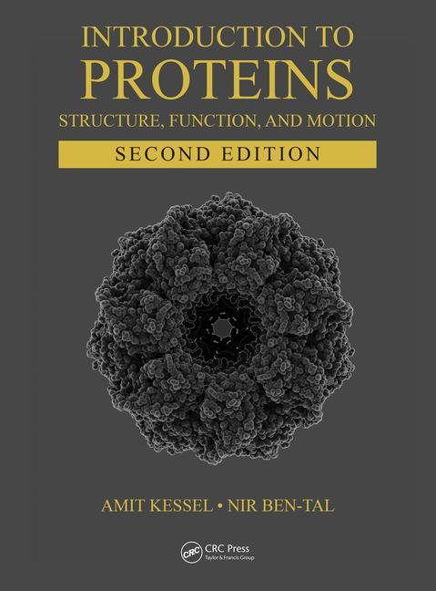
This PPT presentation is provided as suppl. material to the book:
Introduction to Proteins: Structure, Function, and Motion
2nd Edition (2018)
Amit Kessel & Nir Ben-Tal

Slide 2
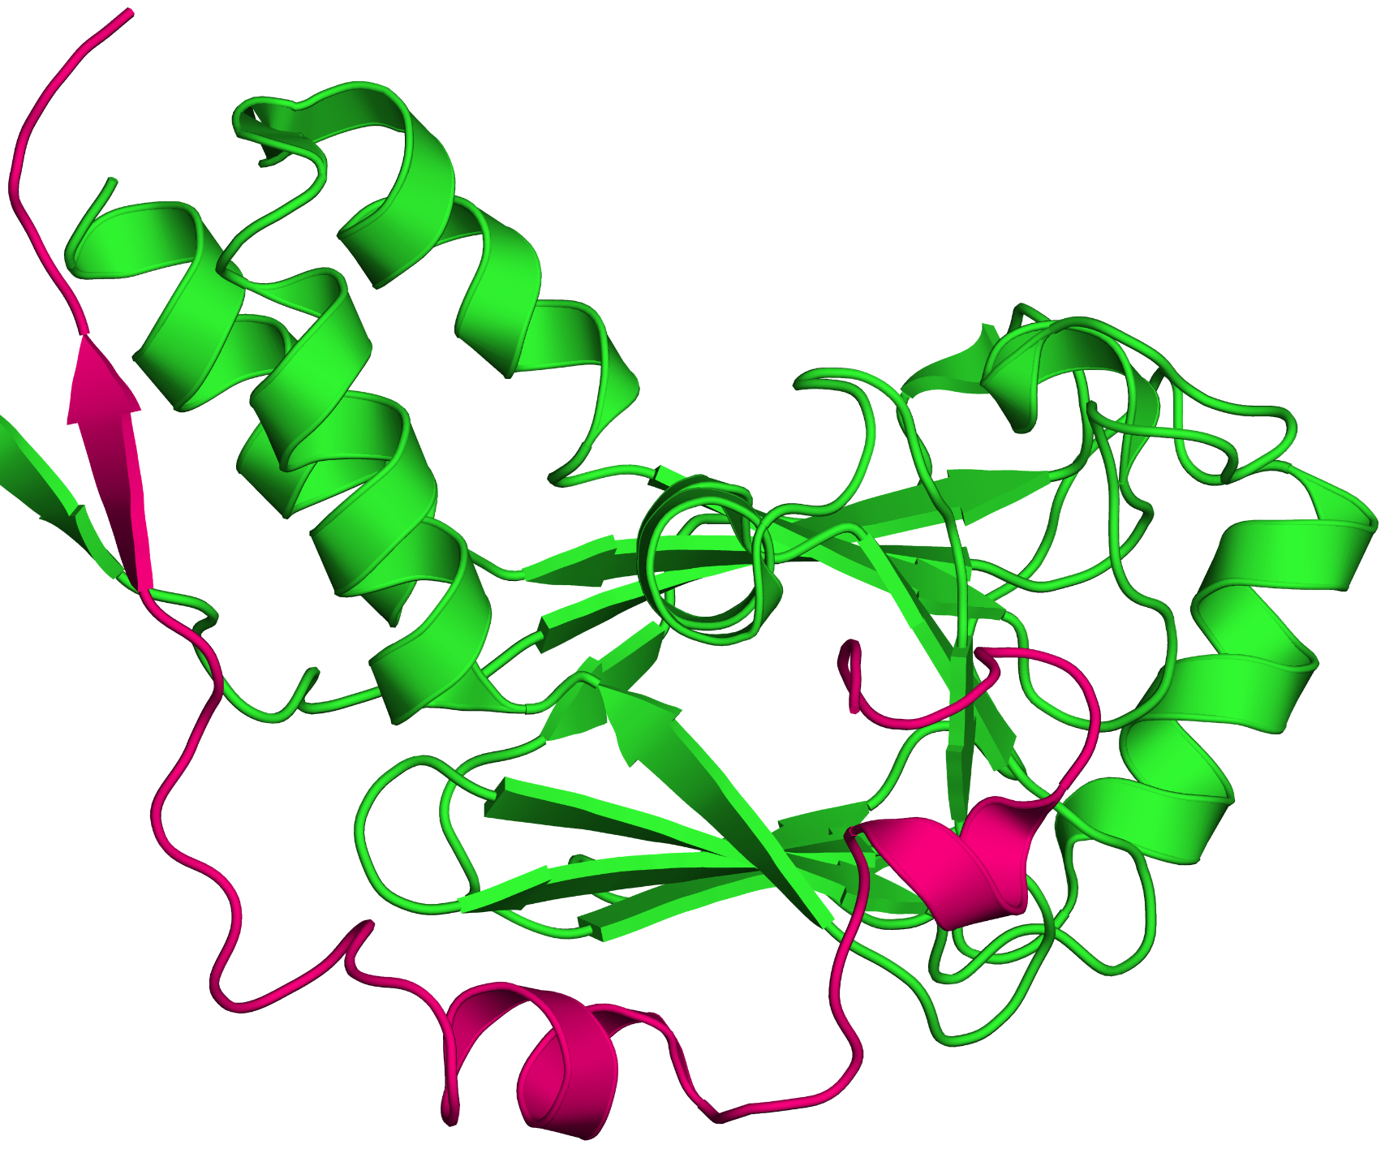
a
Figure 6.1

Slide 3
b

Slide 4
Figure 6.2

Slide 5
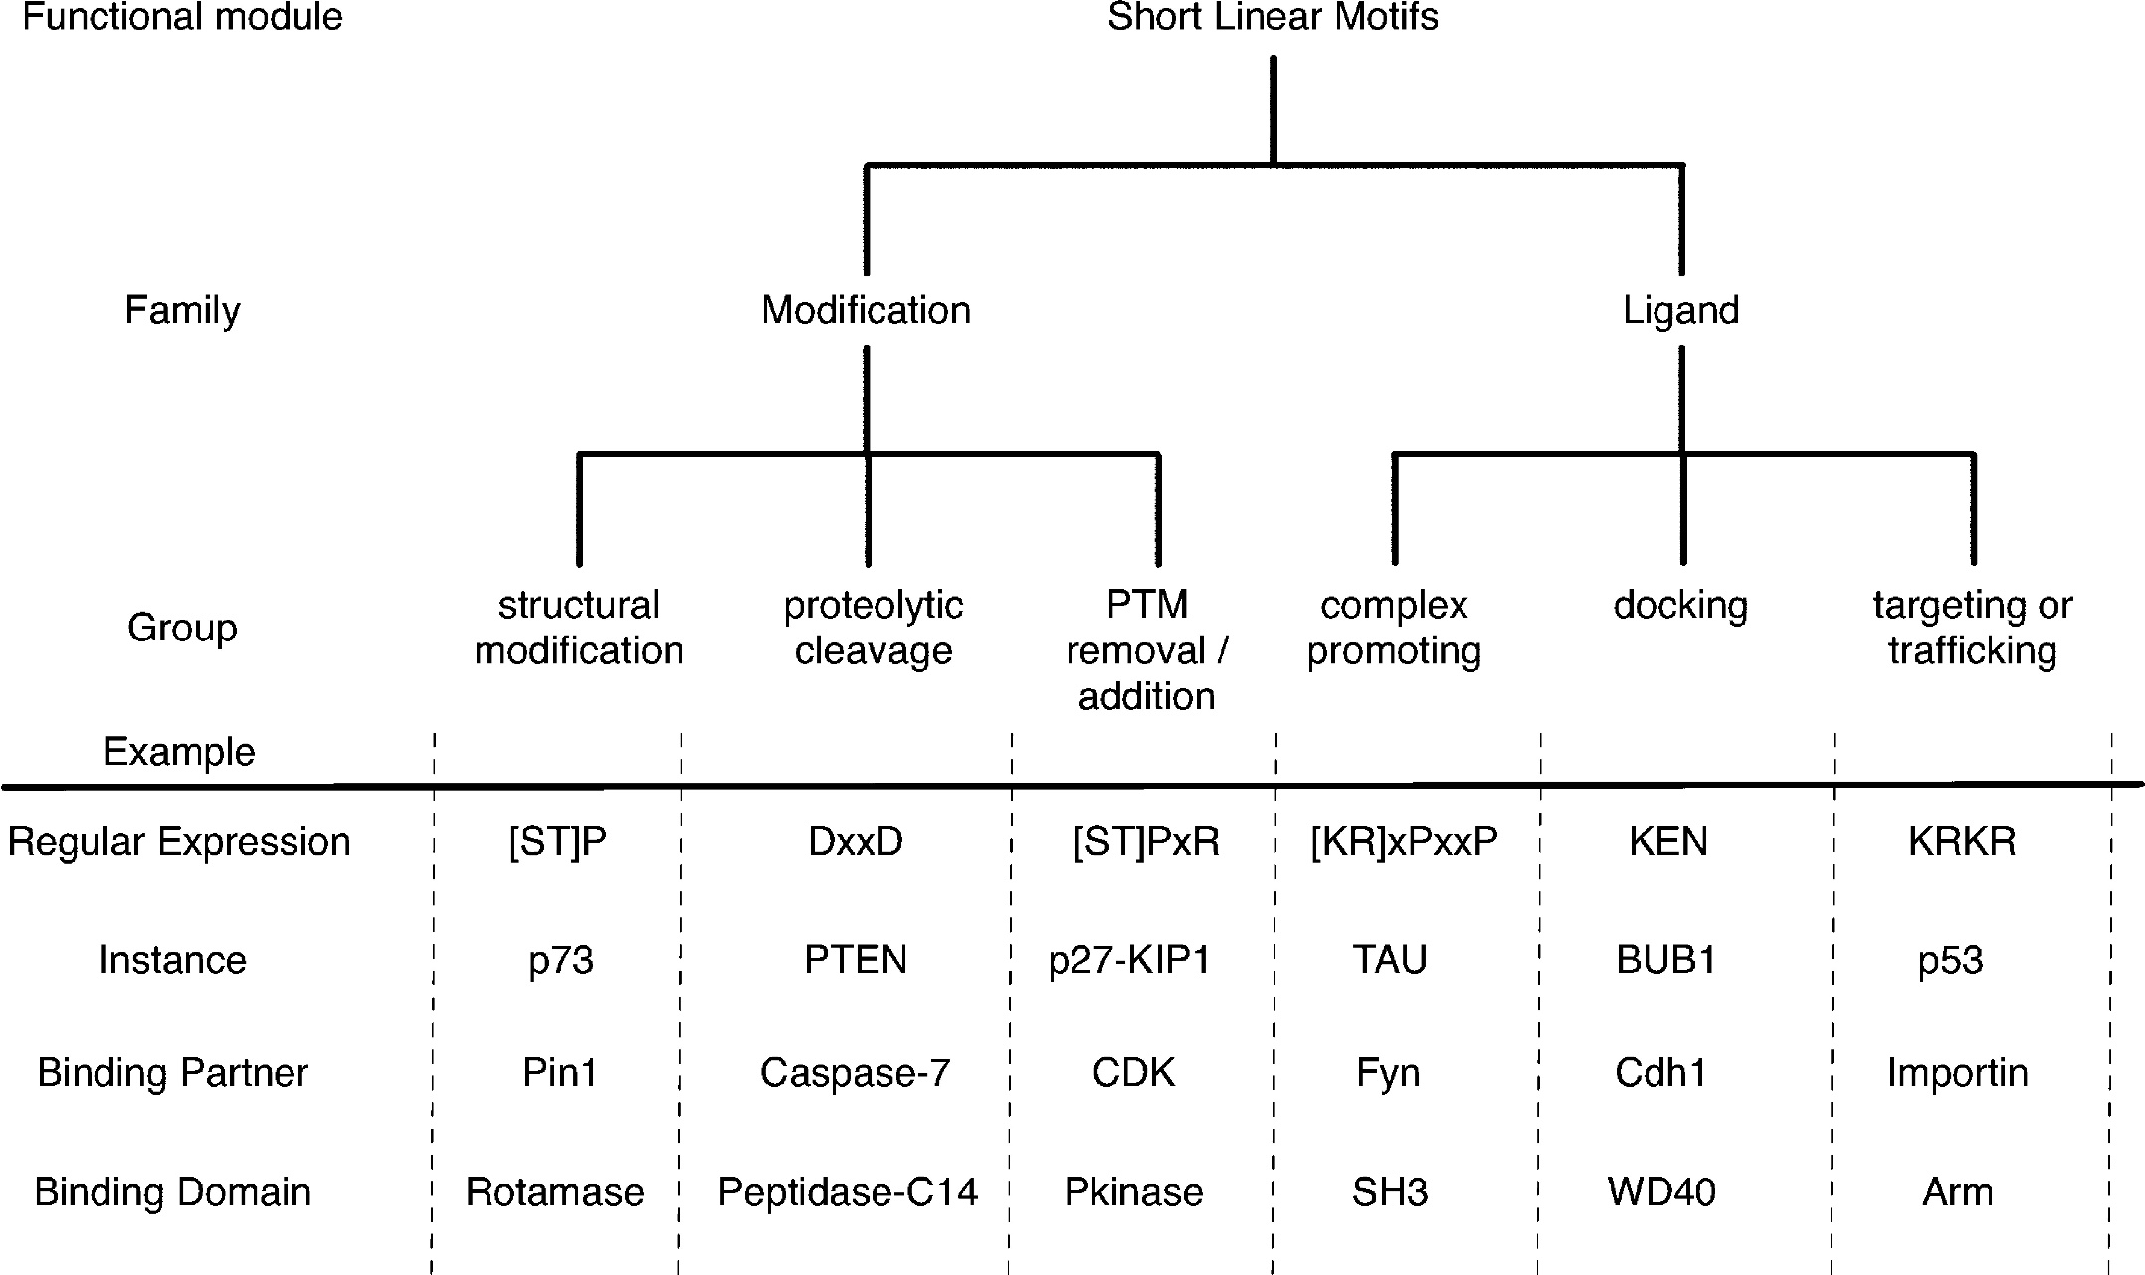
a
Figure 6.3

Slide 6
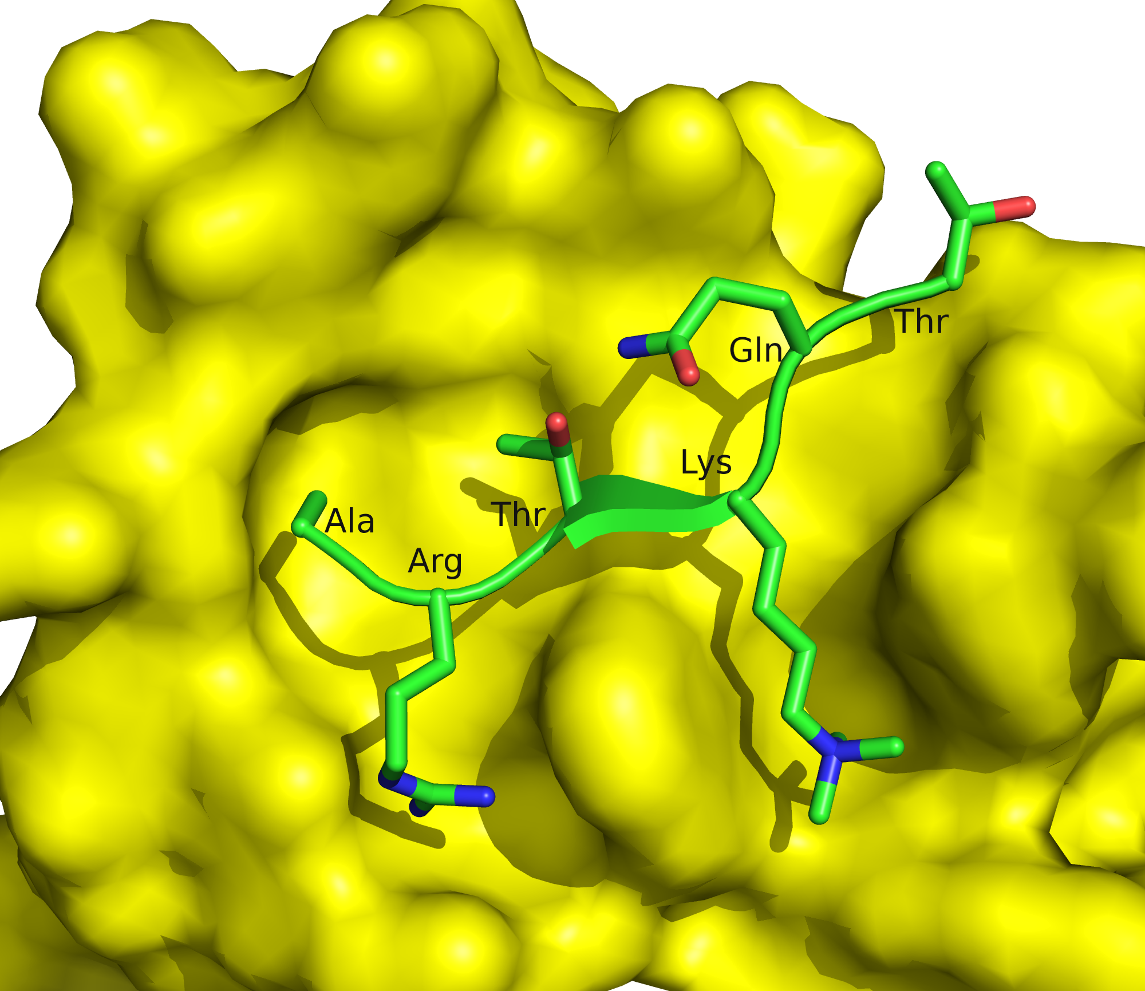
b
left

Slide 7
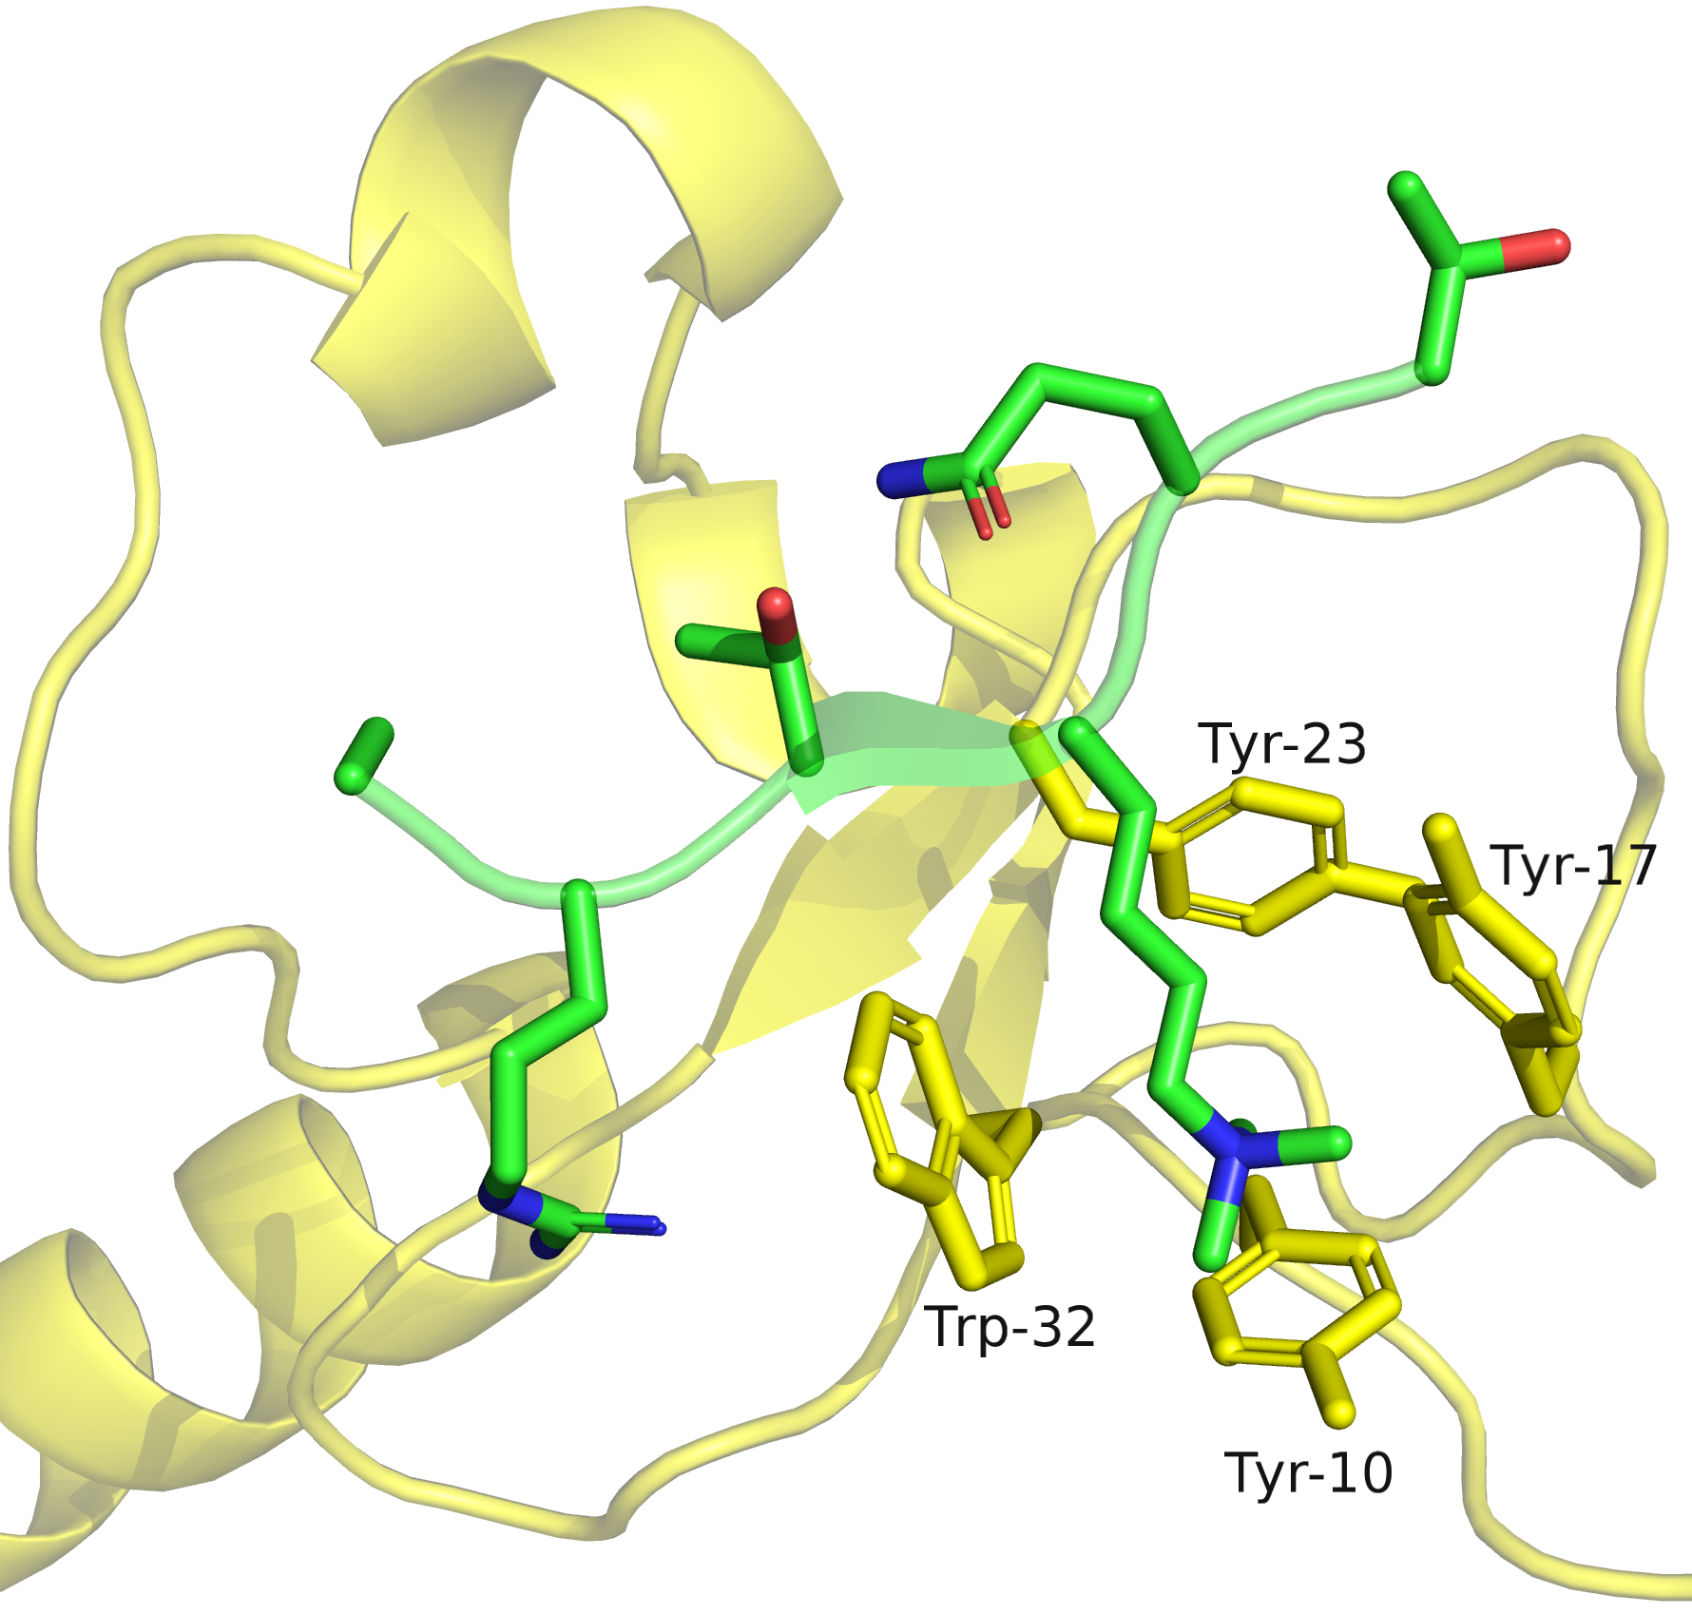
right

Slide 8
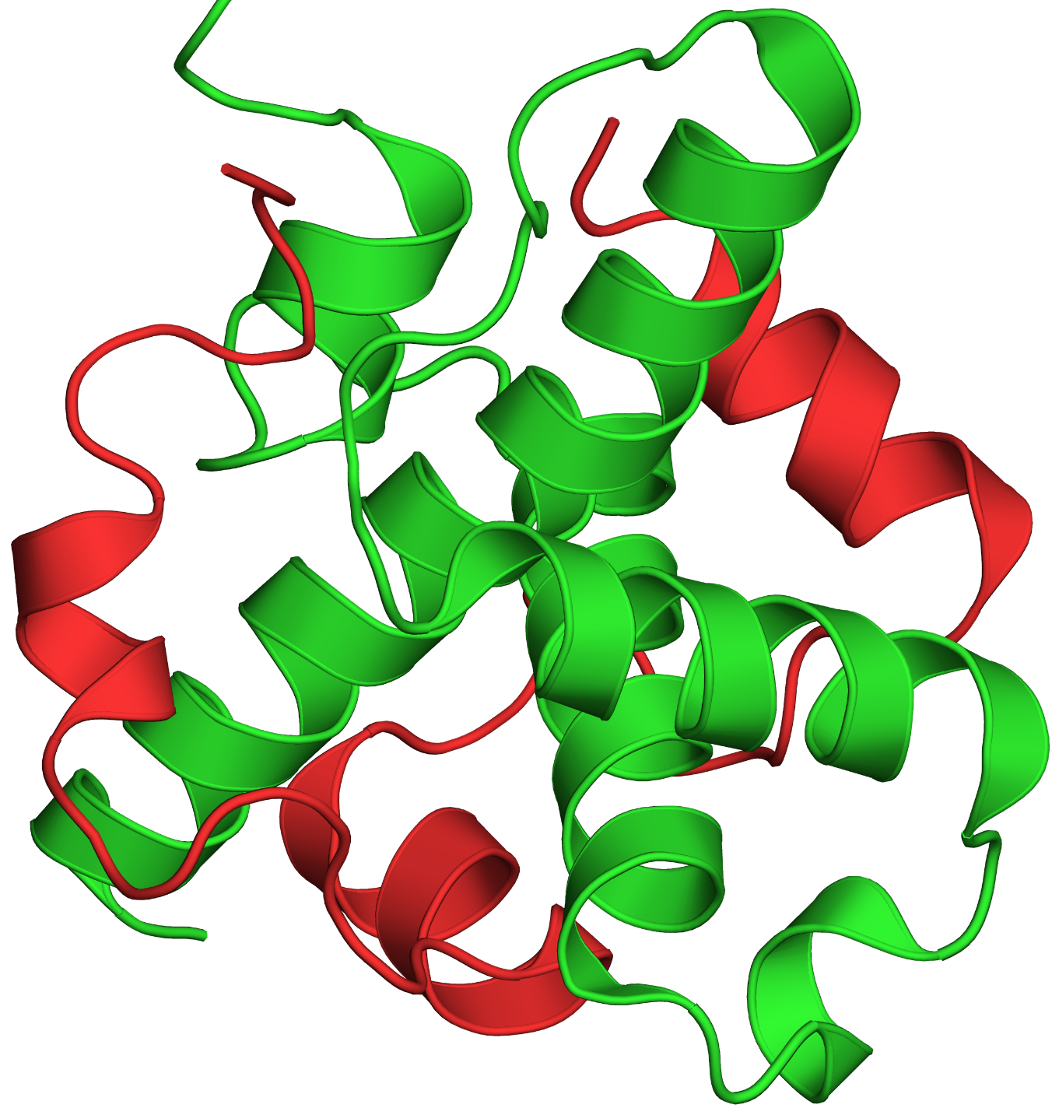
a
Figure 6.4

Slide 9
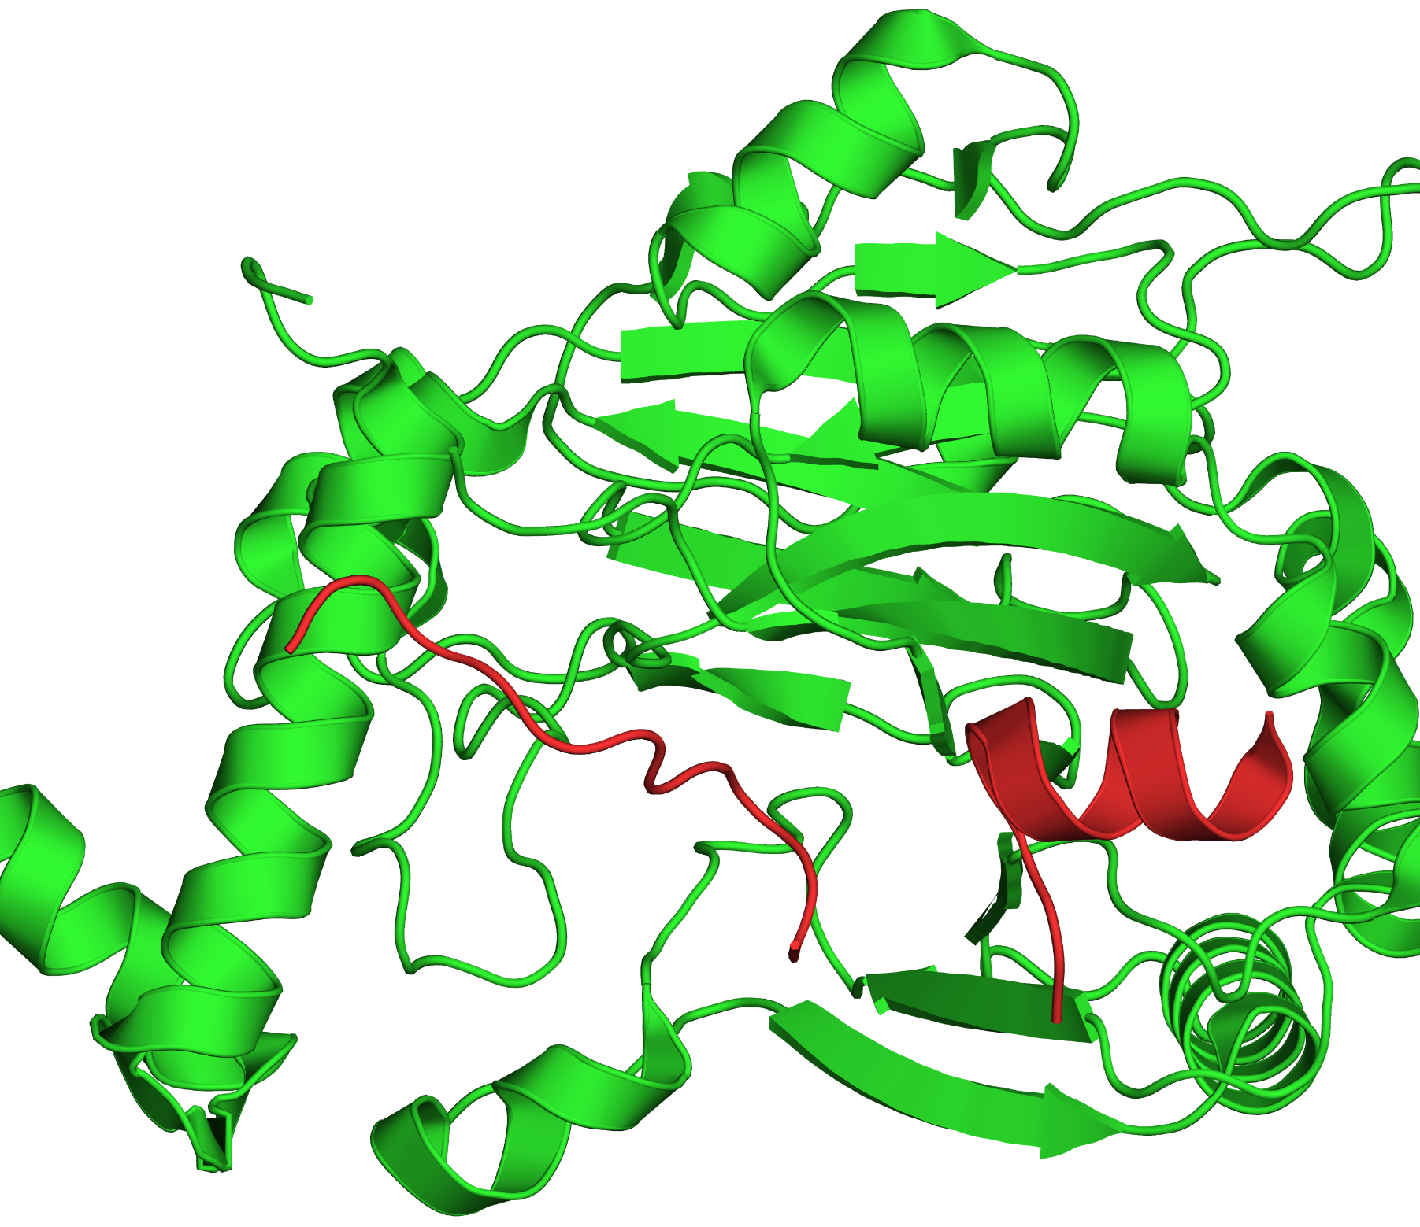
b

Slide 10
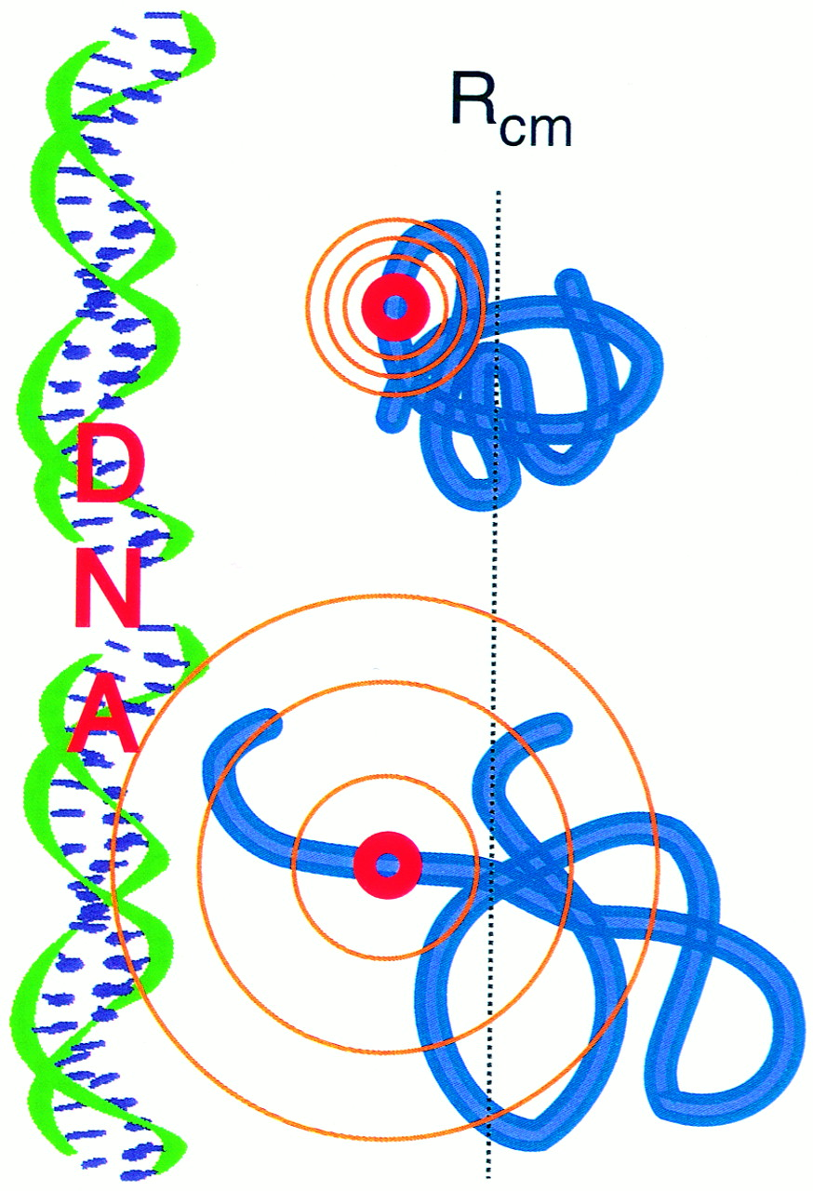
Figure 6.5

Slide 11
Box 6.1

Slide 12
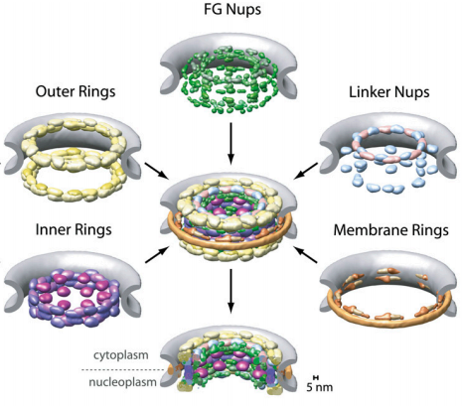
Figure 6.1.1

Slide 13
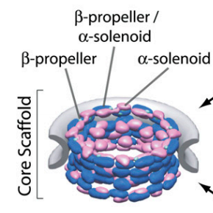
a
Figure 6.1.2

Slide 14
b
c
Figure 6.1.2

Slide 15
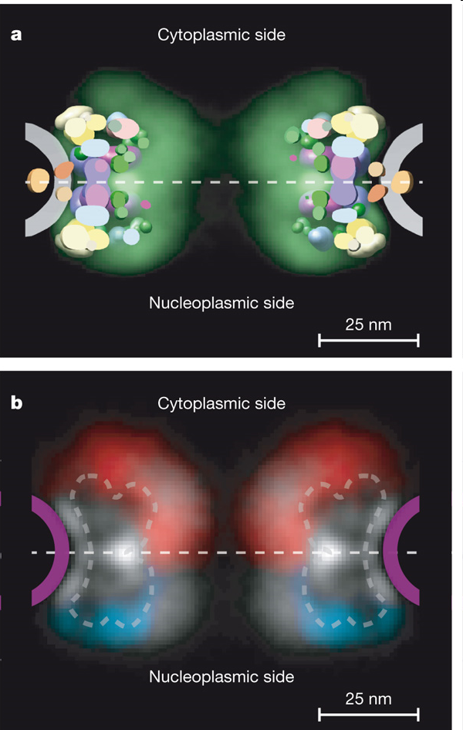
Figure 6.1.3

