Slide 1
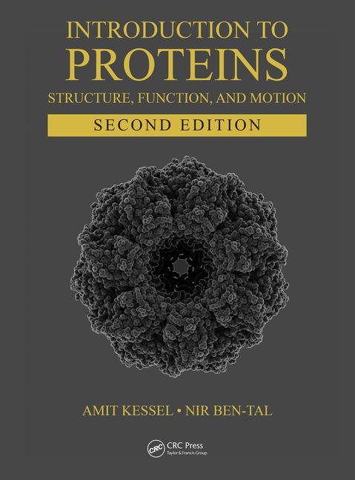
This PPT presentation is provided as suppl. material to the book:
Introduction to Proteins: Structure, Function, and Motion
2nd Edition (2018)
Amit Kessel & Nir Ben-Tal

Slide 2
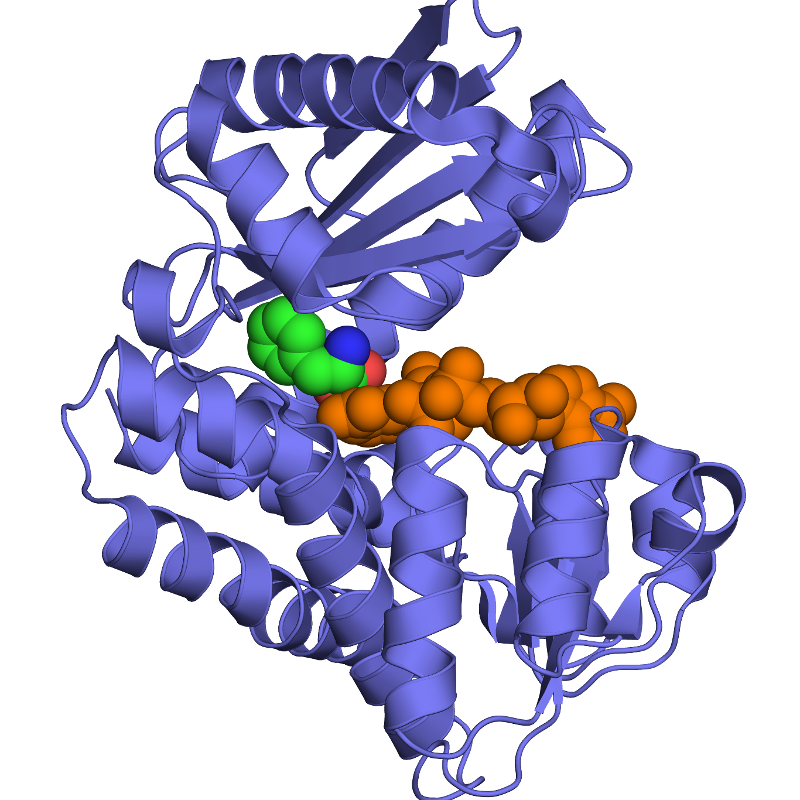
a
Figure 8.1

Slide 3
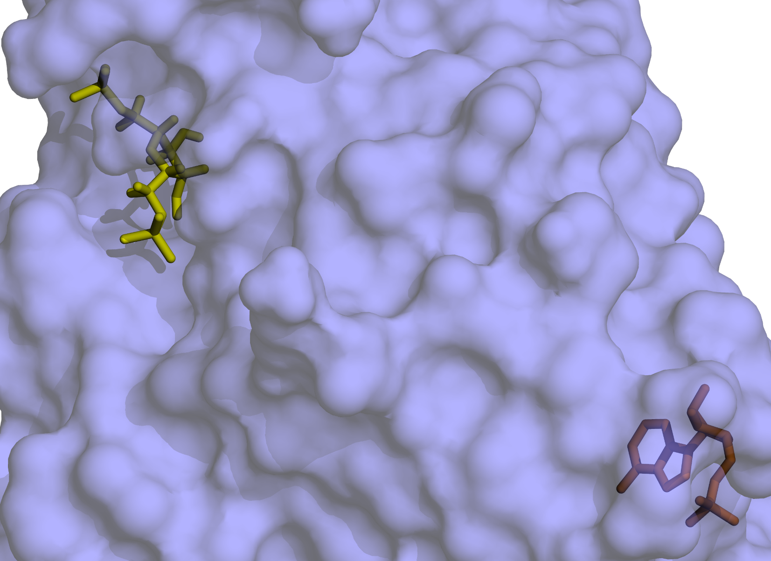
b
AHG
AMP

Slide 4
a
+
Figure 8.2

Slide 5
b
+

Slide 6
c

Slide 7
Figure 8.3

Slide 8
ΔG_{PL}
L
+
L
P
P
ΔG_{L→L'}
ΔG_{PL→PL'}
ΔG_{PL'}
L'
+
L'
P
P
Figure 8.4

Slide 9
Figure 8.5

Slide 10
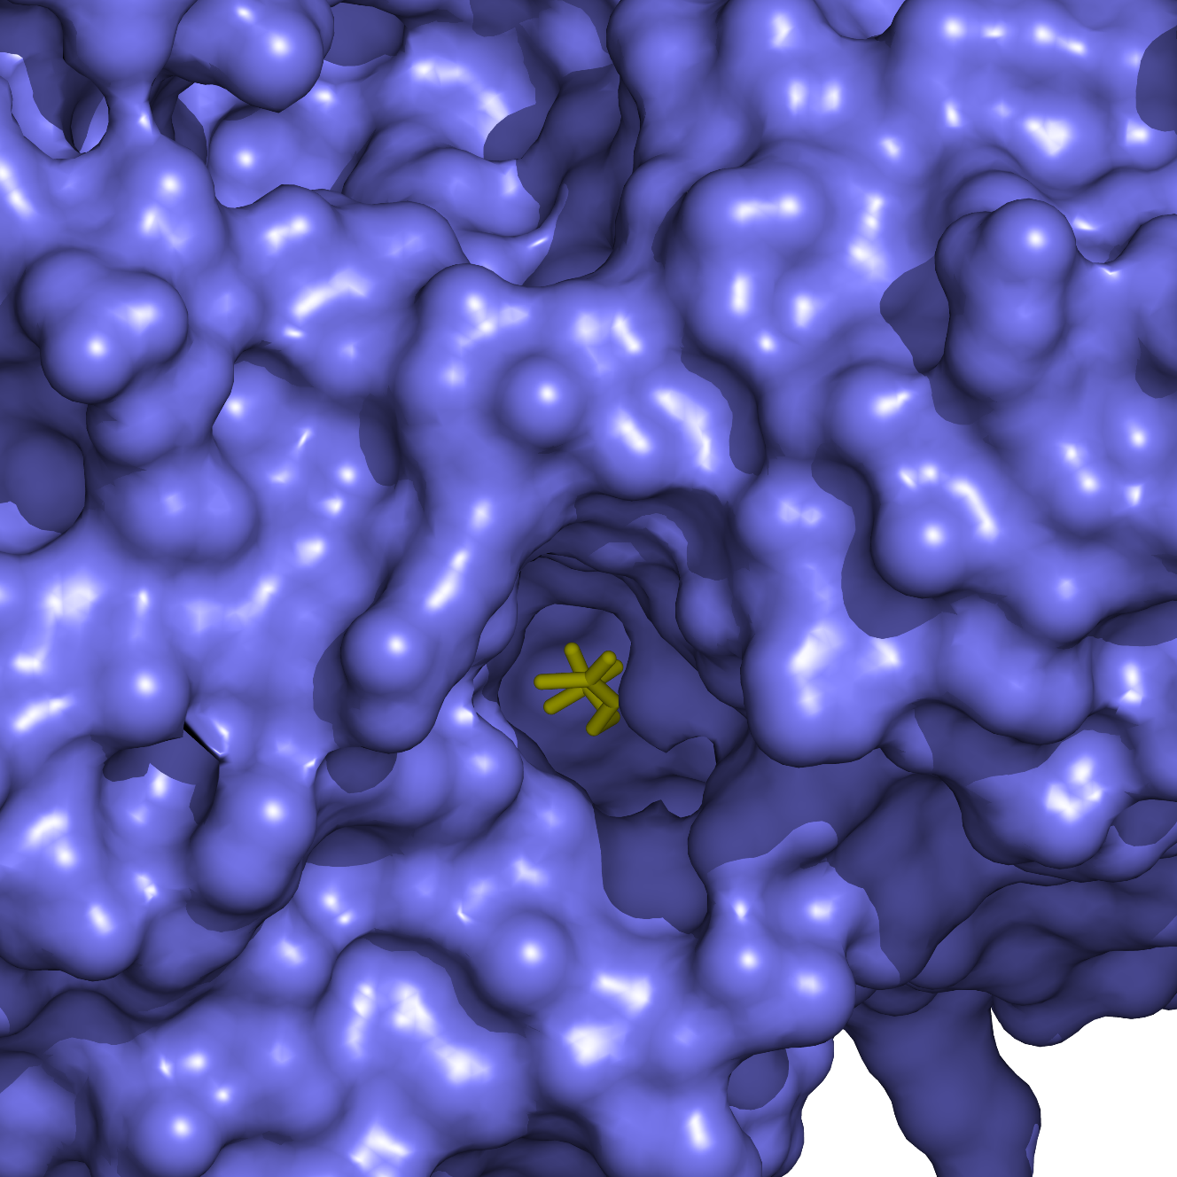
a
Figure 8.6

Slide 11
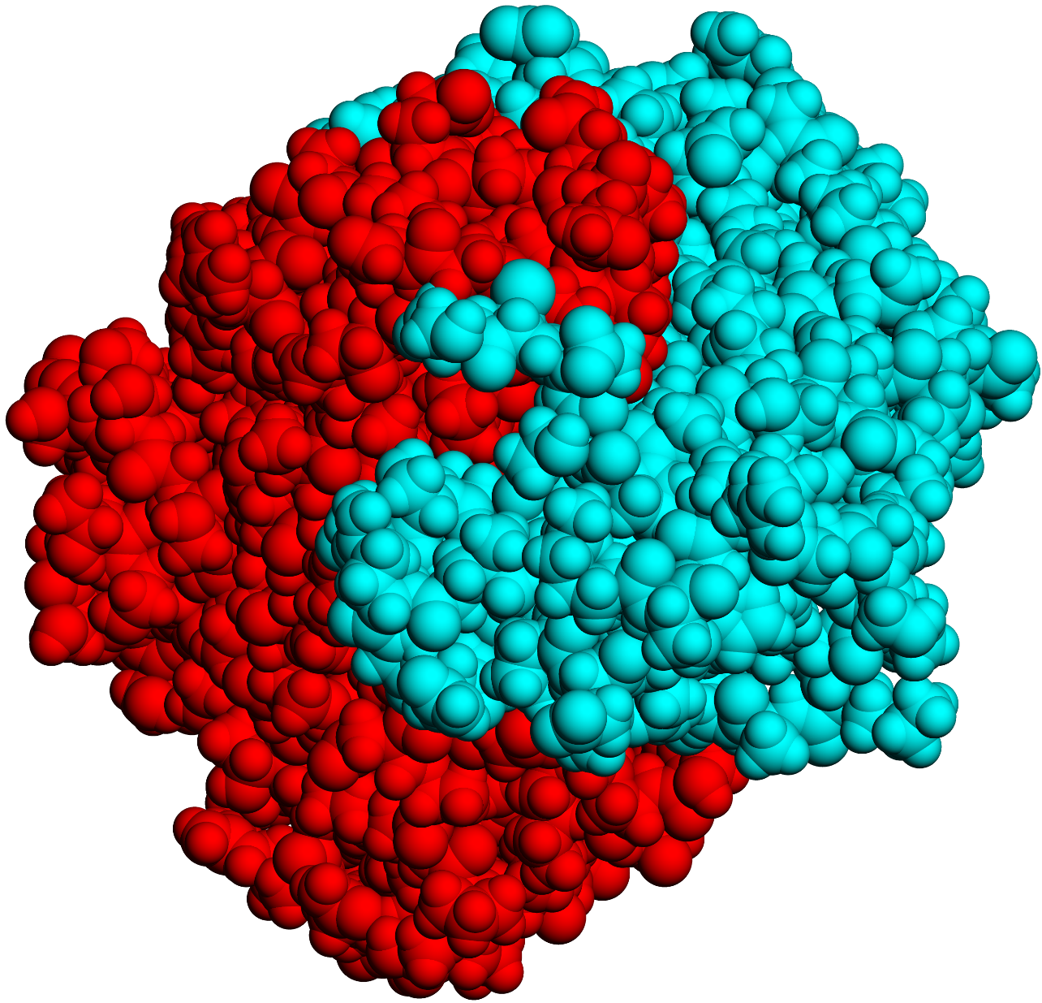
b

Slide 12
a
Figure 8.7

Slide 13
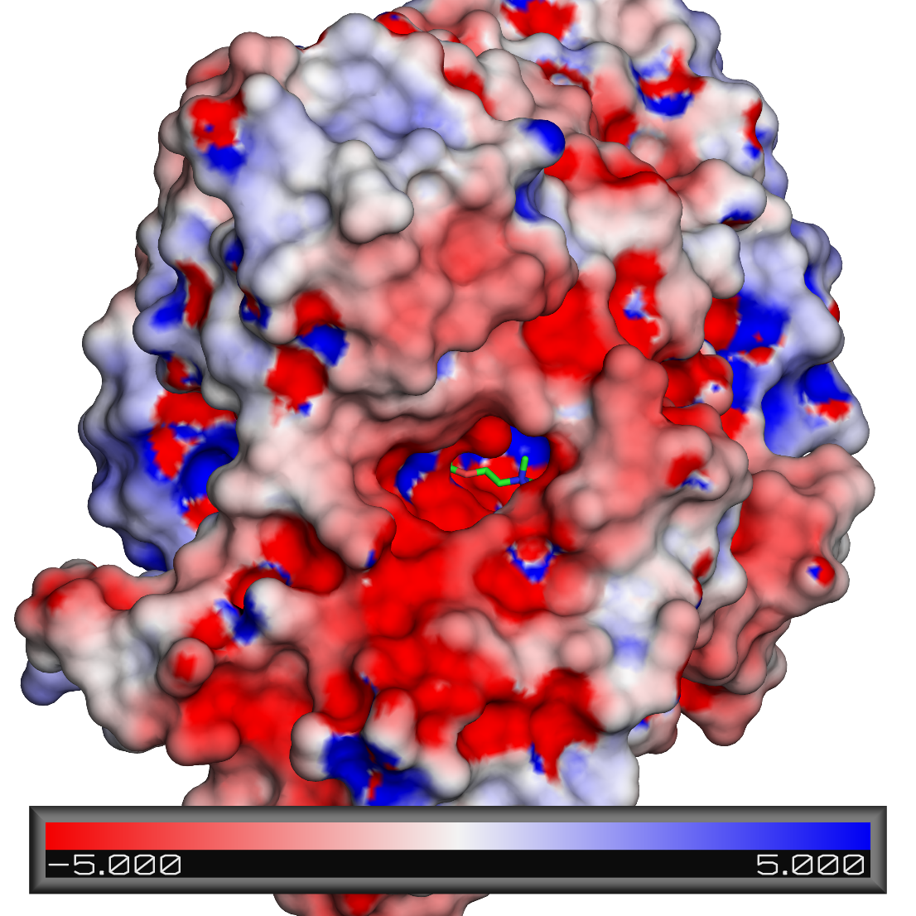
b

Slide 14
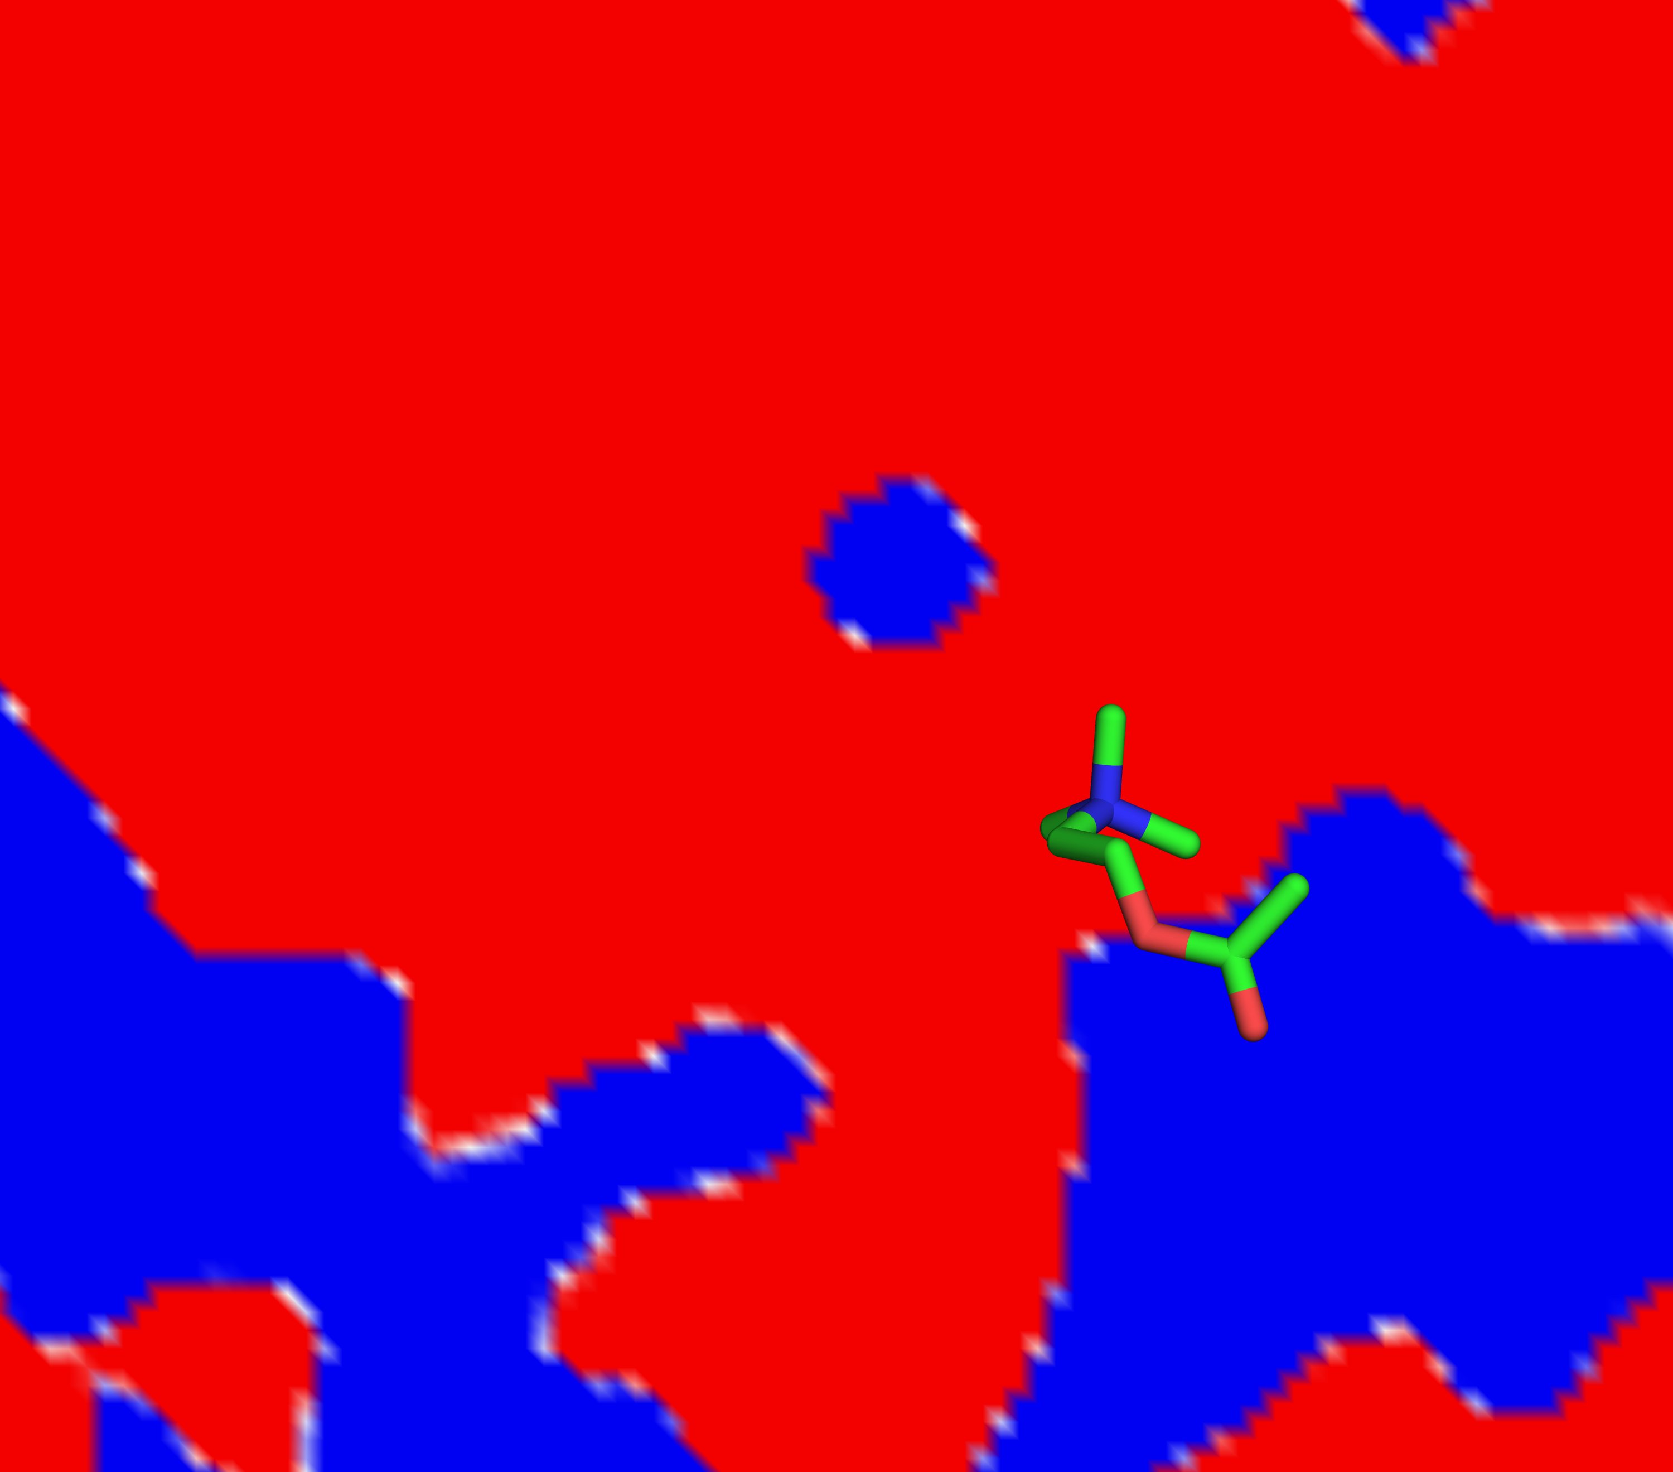
c

Slide 15
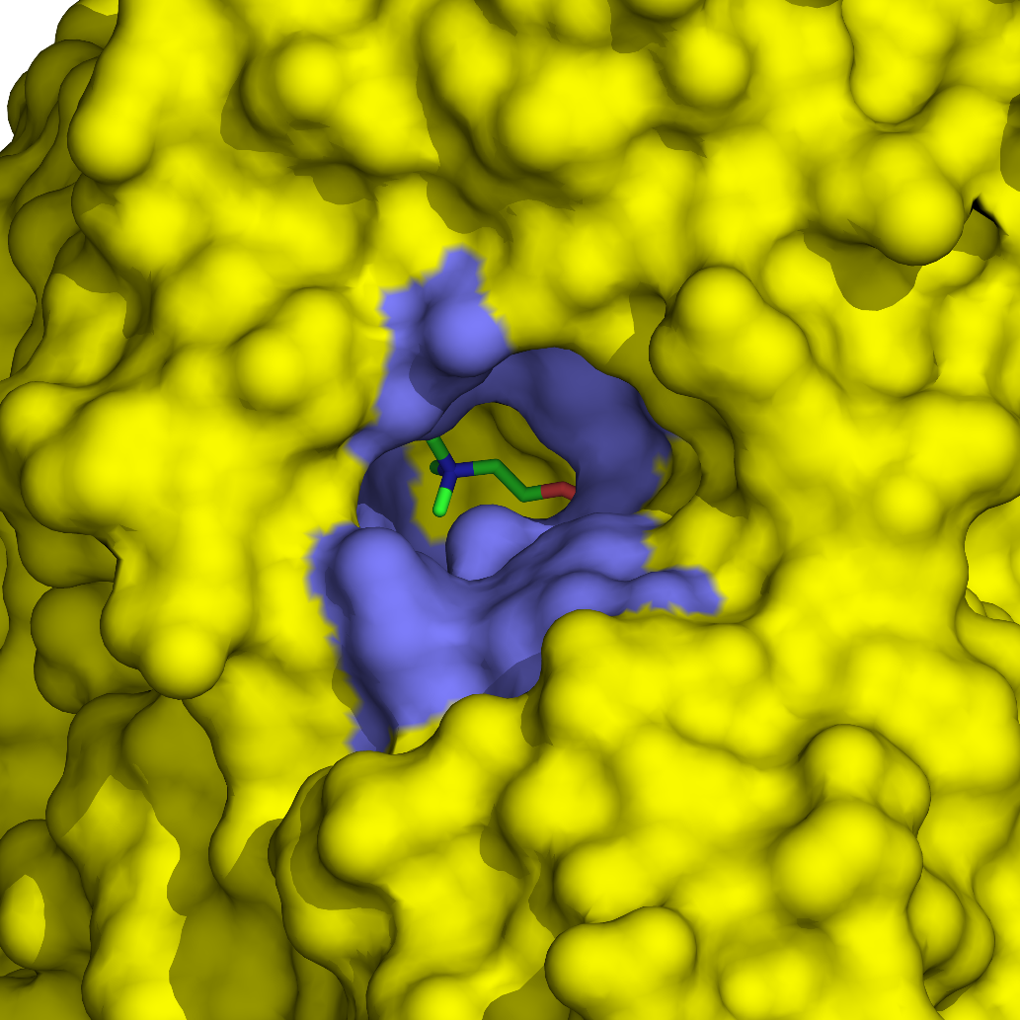
d
180º
W-84

Slide 16
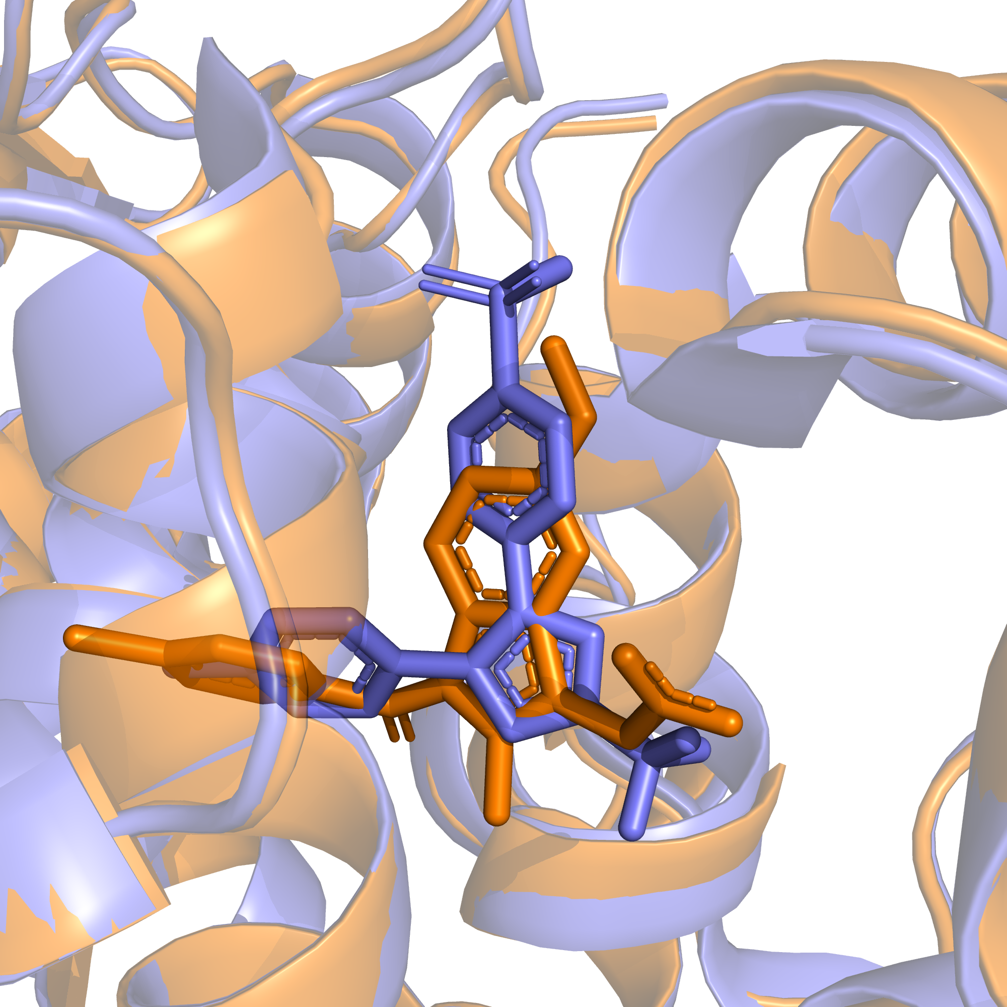
a
Figure 8.8

Slide 17
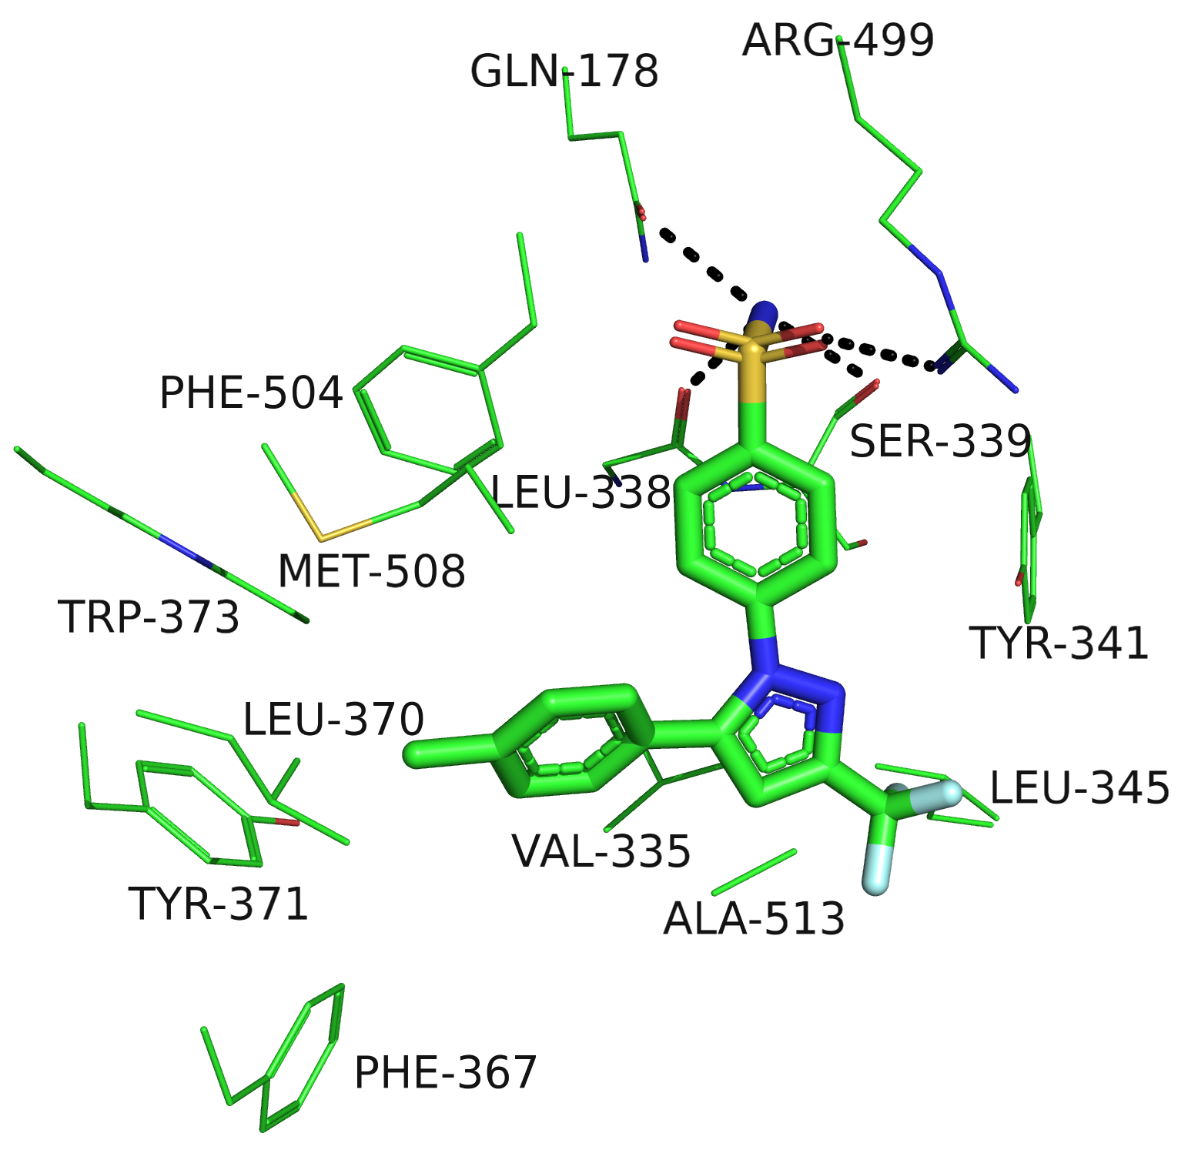
b

Slide 18
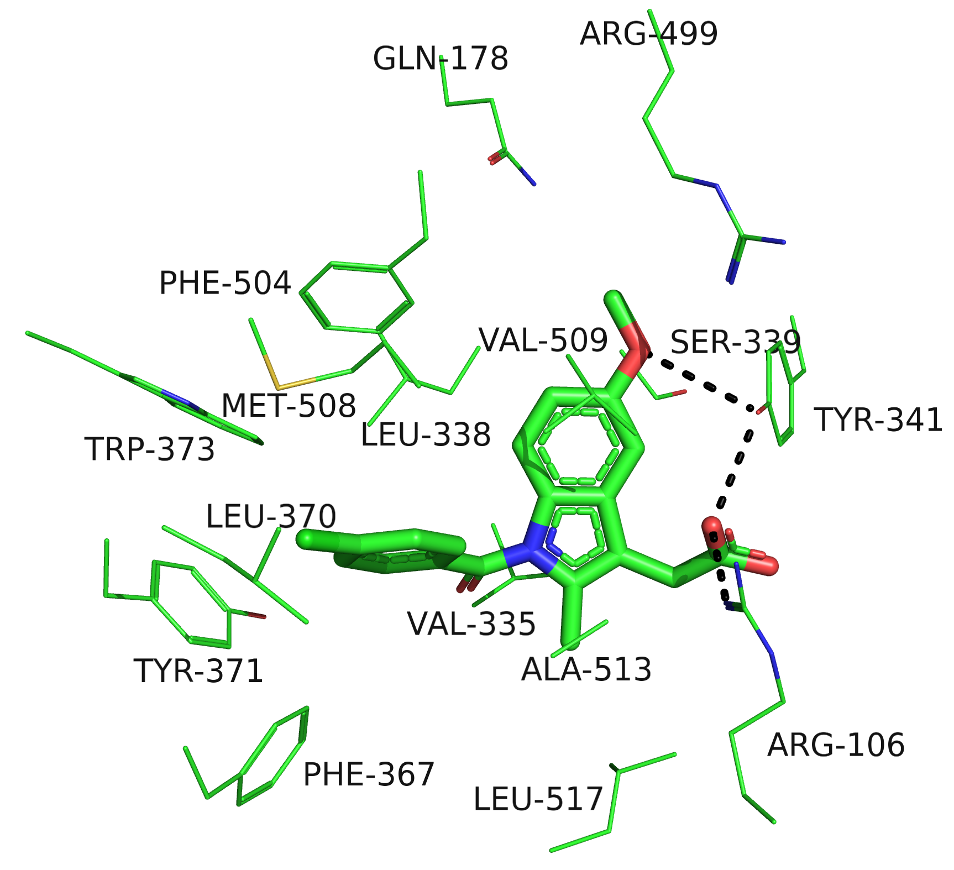
c

Slide 19
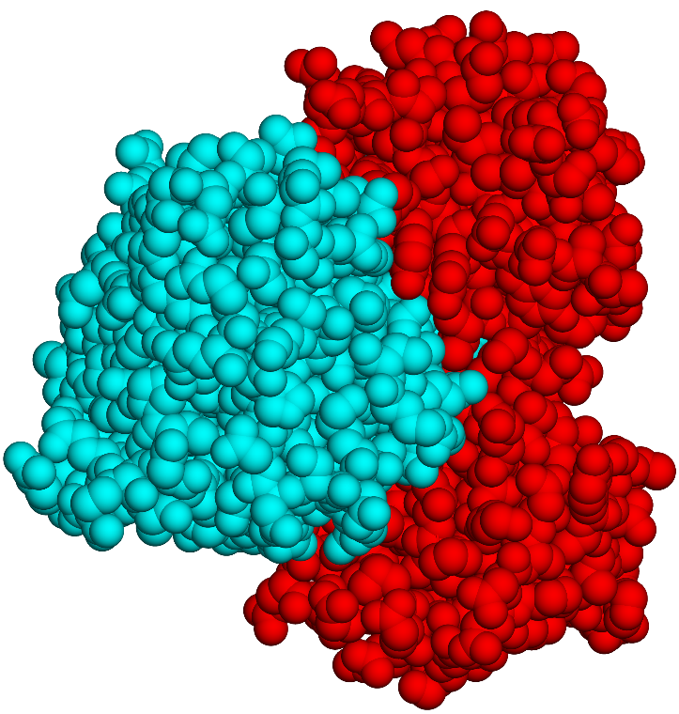
Figure 8.9

Slide 20
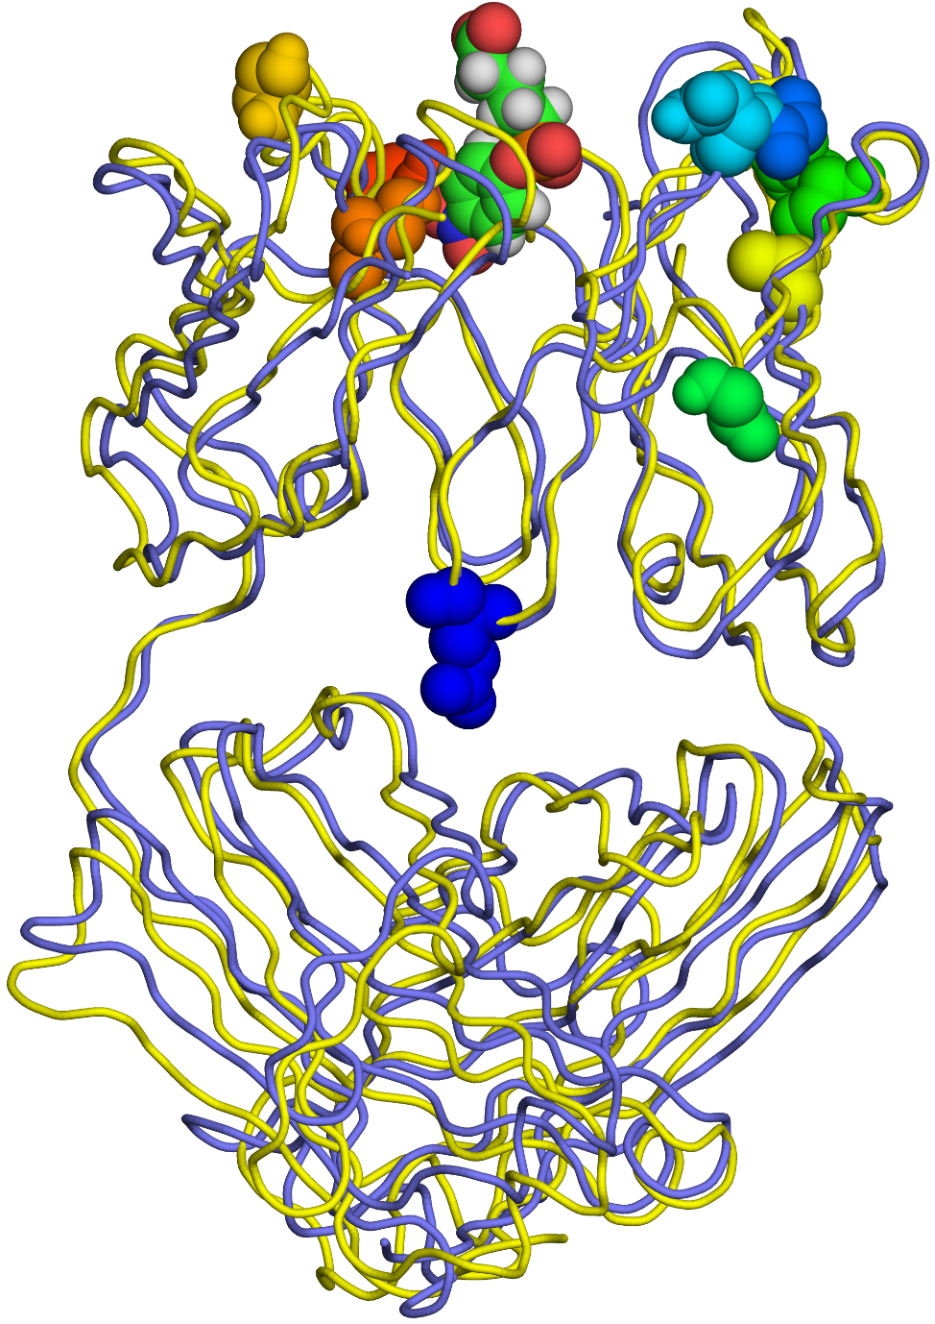
a
V_{H}
V_{L}
Fab
C_{H1}
C_{L}
Figure 8.10

Slide 21
b
Antigen
Arg-96
Light chain

Slide 22
c
Heavy chain
Tyr-33

Slide 23
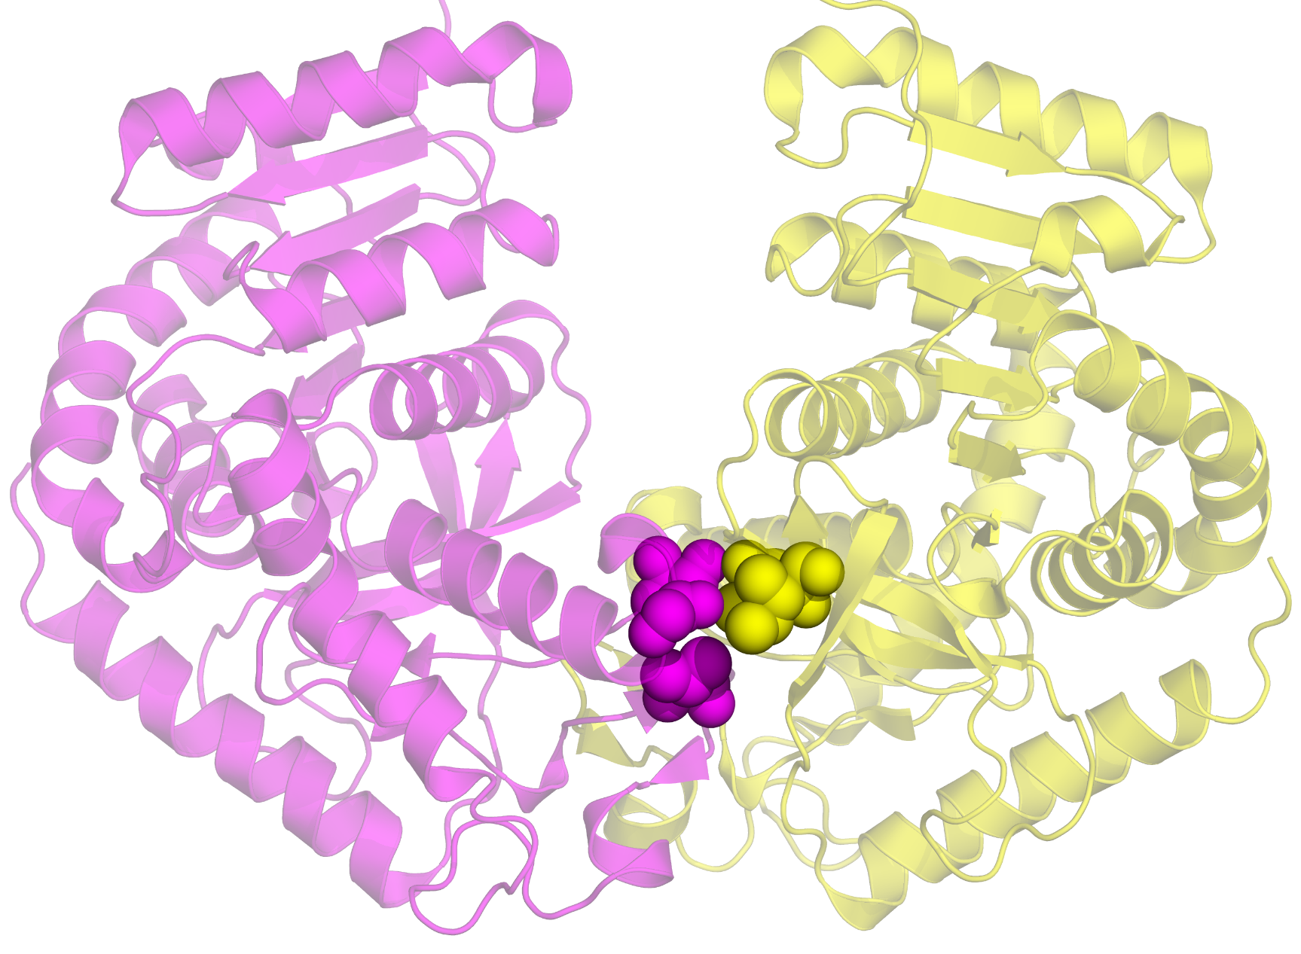
a
Figure 8.11

Slide 24
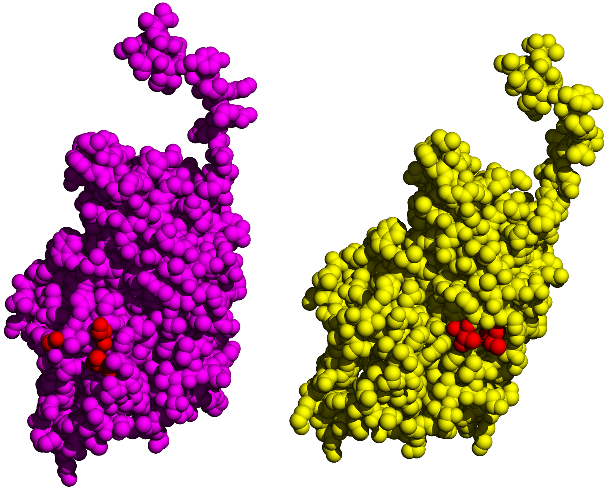
b

Slide 25
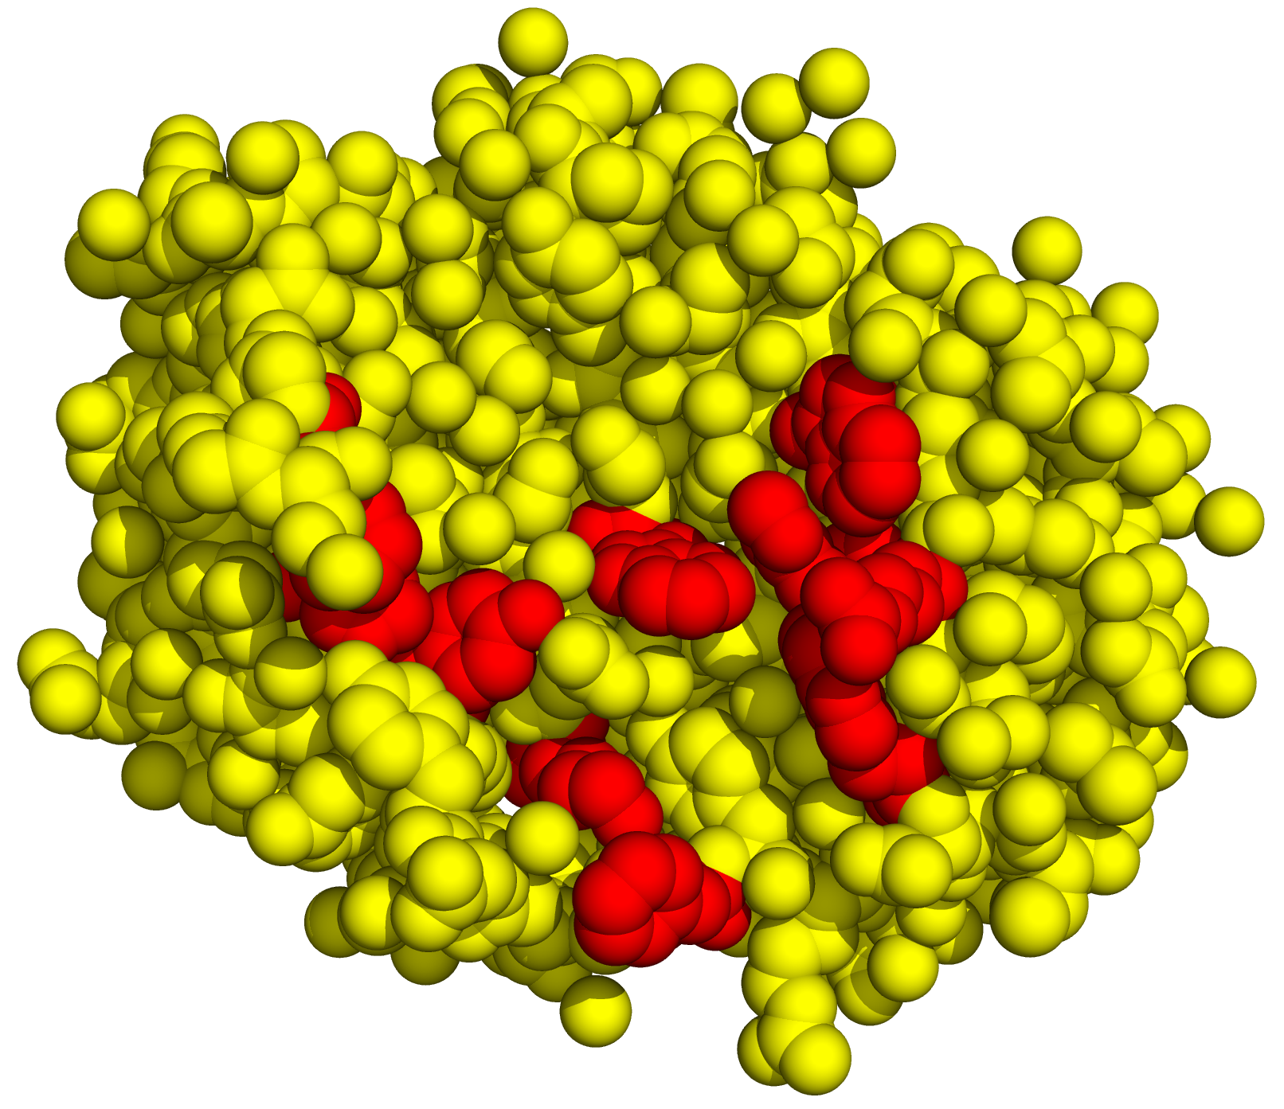
c

Slide 26
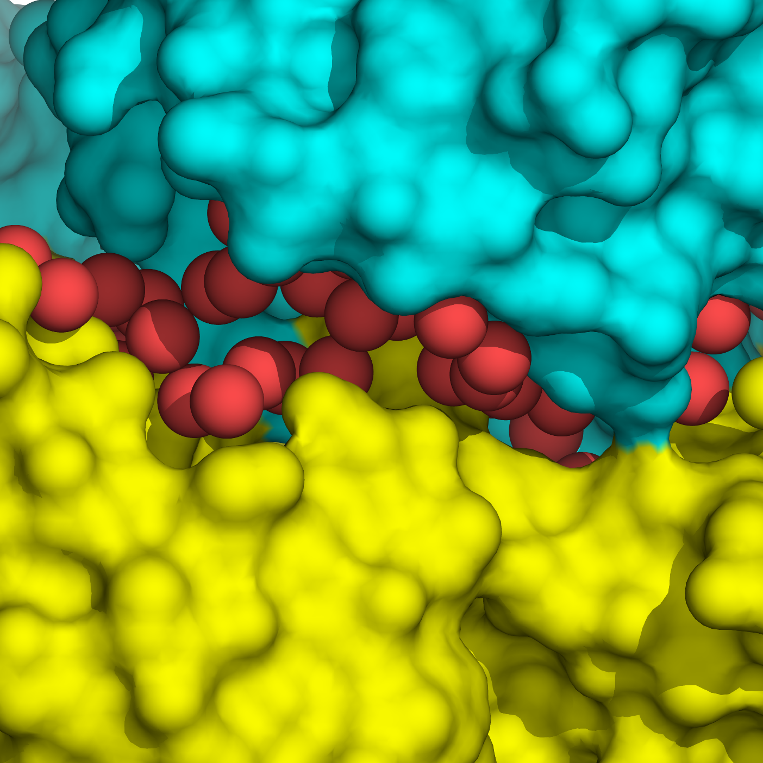
a
Figure 8.12

Slide 27
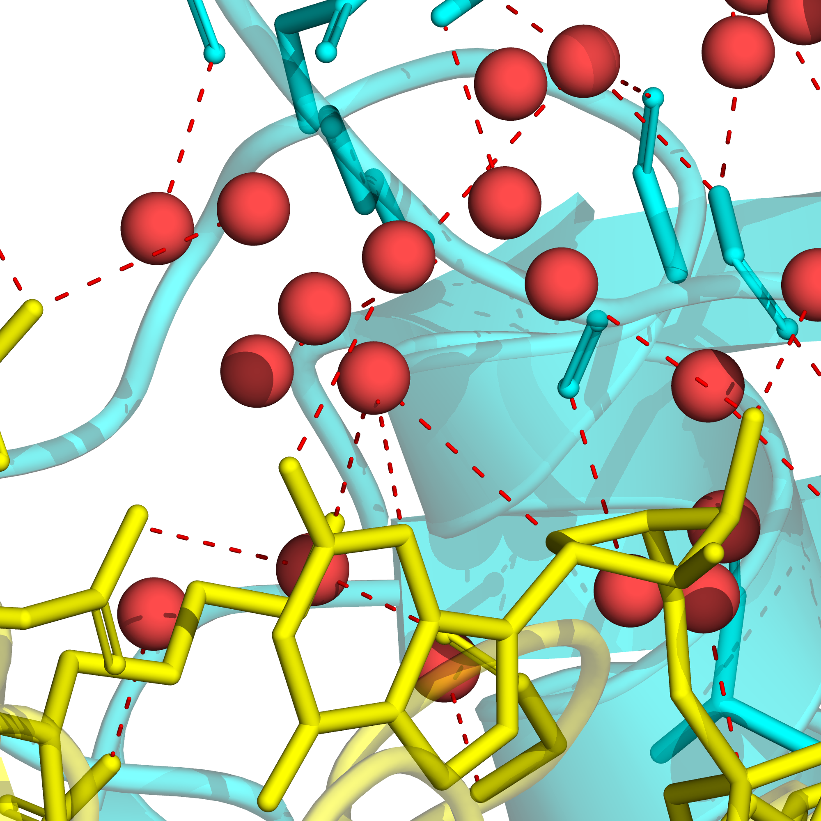
b

Slide 28
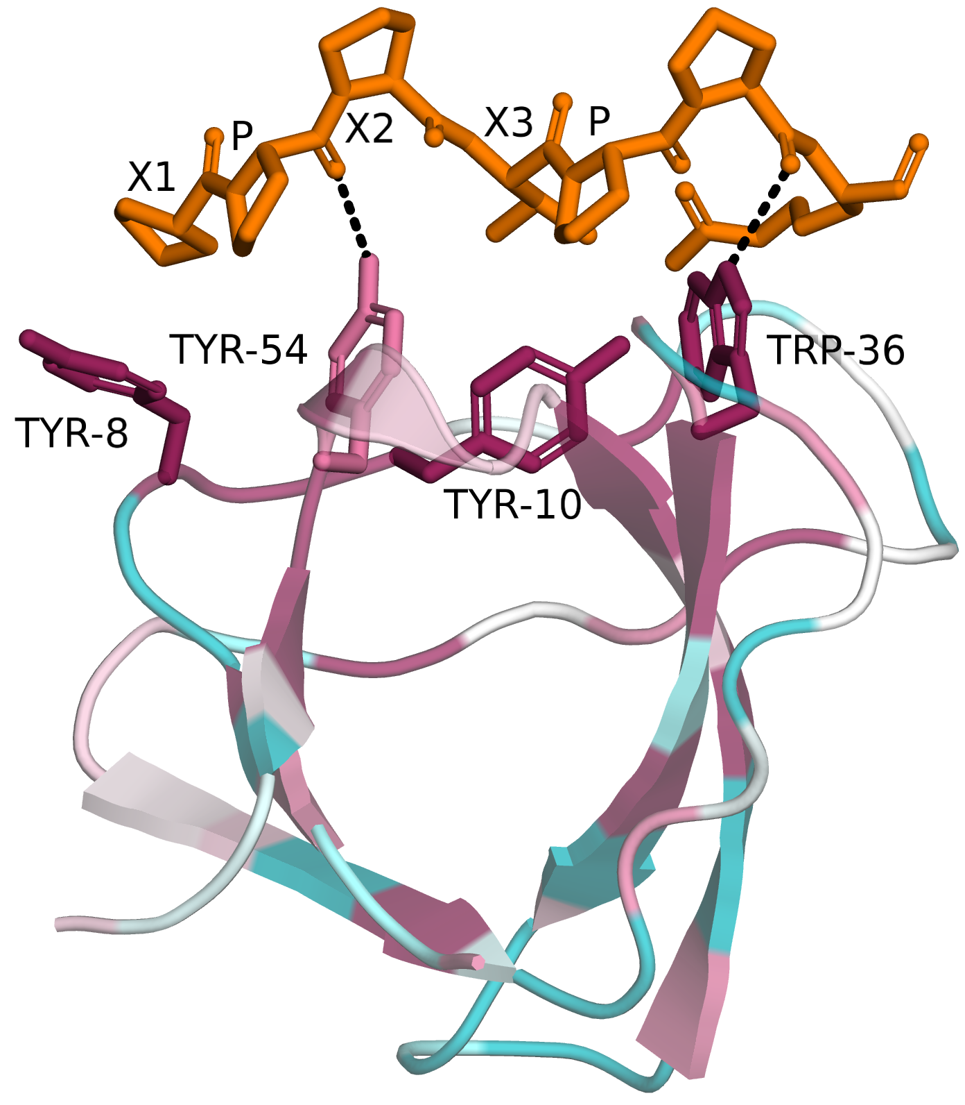
a
Figure 8.13

Slide 29
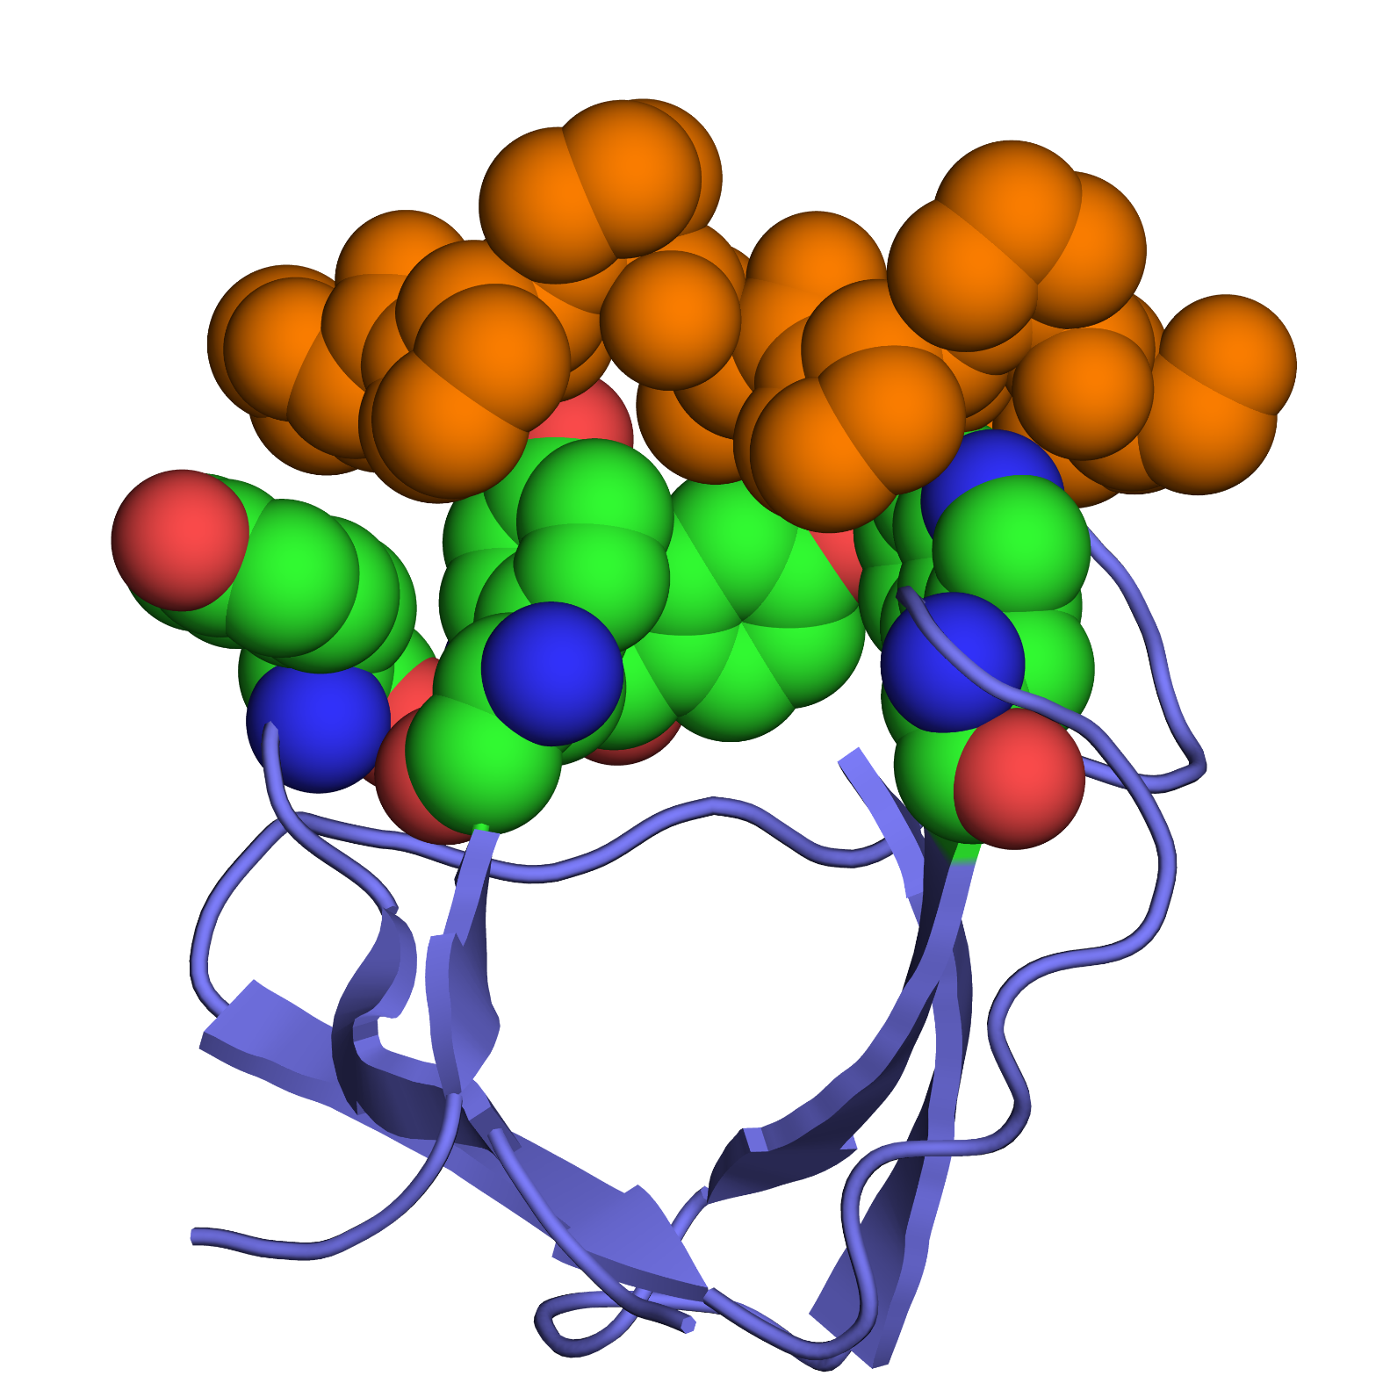
b
X₂
X₃
X₁
P
P
Y-54
Y-10
W-36
Y-8

Slide 30
c
X₂
P
X₁
C_{β}
C_{α}
C_{δ}

Slide 31
a
b
c
d
Figure 8.14

Slide 32
Adrenaline
Alprenolol
Figure 8.15

Slide 33
a
Arachidonic acid
COX
PGG₂
Figure 8.16

Slide 34
b
Ibuprofen
Arachidonic acid

Slide 35
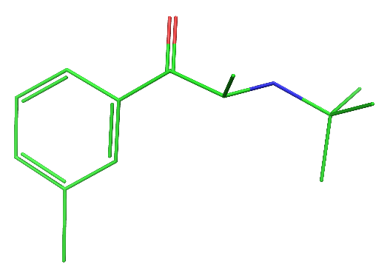
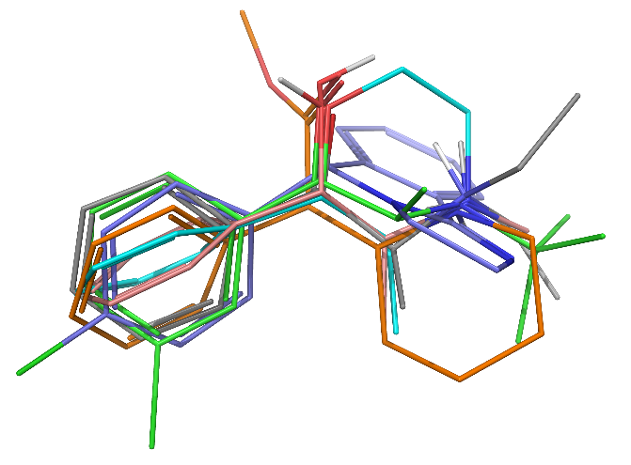
a
Pseudoephedrine (Sudafed)
Bupropion (Wellbutrin)
Diethylpropion (Tenuate)
Mazindol (Sanorex)
Phenmetrazine (Preludin)
Methylphenidate (Ritalin)
Figure 8.17

Slide 36
b
H-bond acceptor
110°
2.6 Å
positive group
3.7 Å
42°
28°
5.2 Å
aromatic group

Slide 37
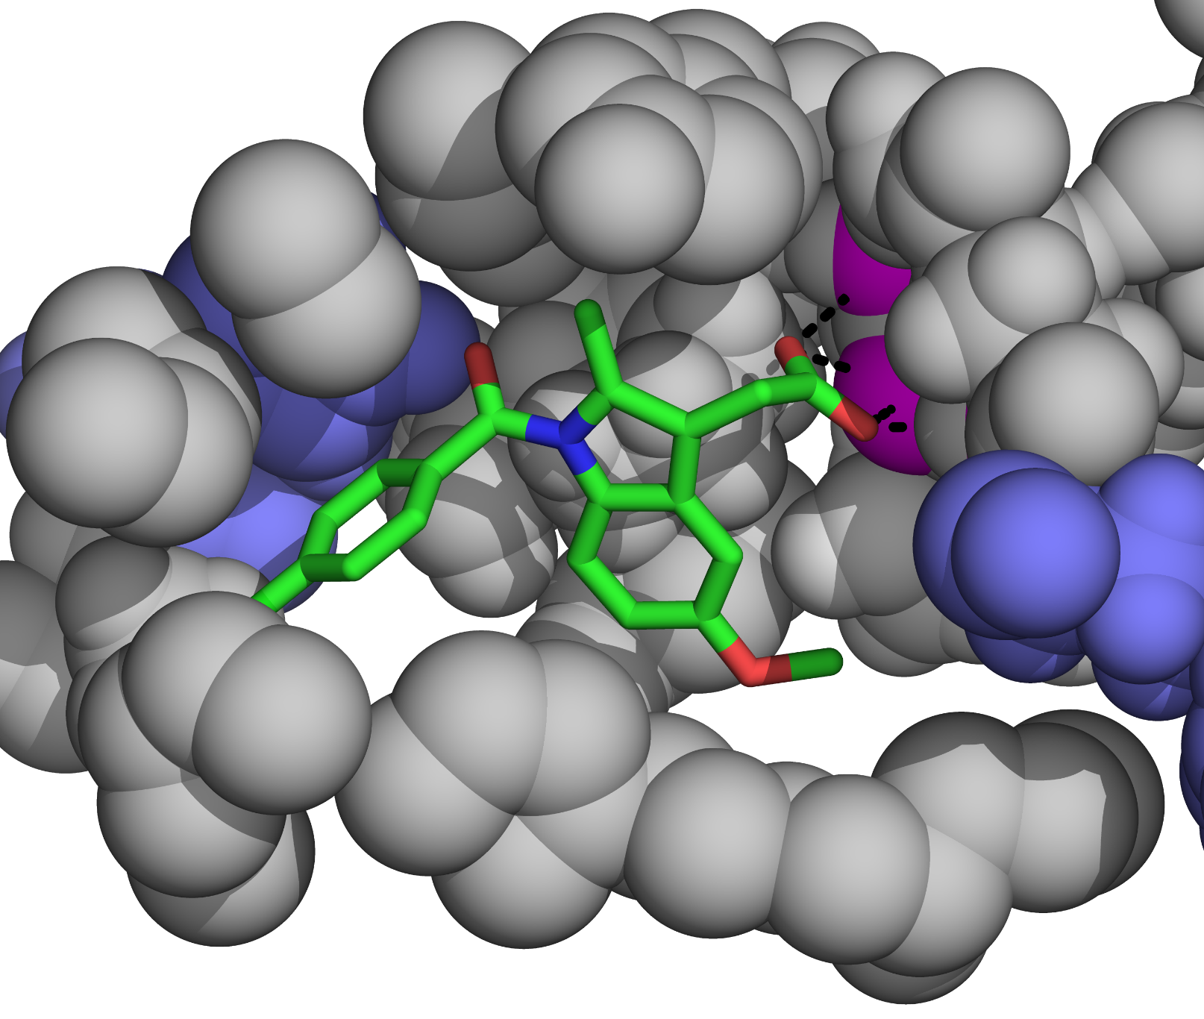
Figure 8.18

Slide 38
Angiotensinogen
Renin
Blood pressure
Angiotensin I
Vasodilation
ACE
Bradykinin
Angiotensin II
Vasopressin
Aldosteron
Vasoconstriction
Blood pressure
Figure 8.19

Slide 39
4
6
3
1
7
5
2
8
9
10
⁺H₃N-Asp₁-Arg₂-Val₃-Tyr₄-Ile₅-His₆-Pro₇-Phe₈-His₉-Leu₁₀-COO⁻
Figure 8.20

Slide 40
a
-
H₂O
Figure 8.21

Slide 41
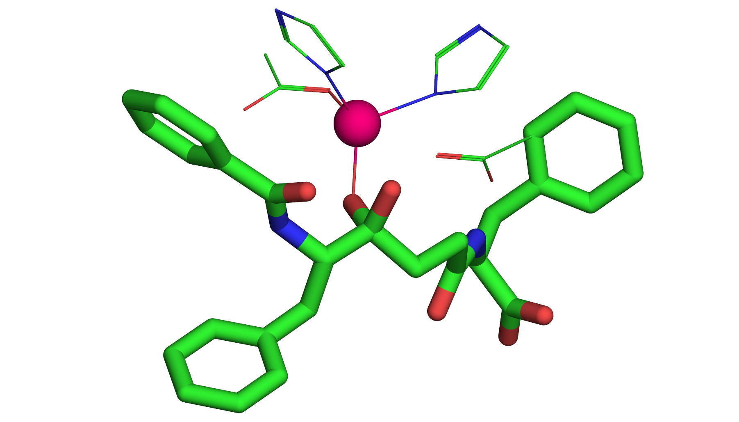
b
His387
His383
Glu411
Zn
Glu384
Scissile bond (in substrate)

Slide 42
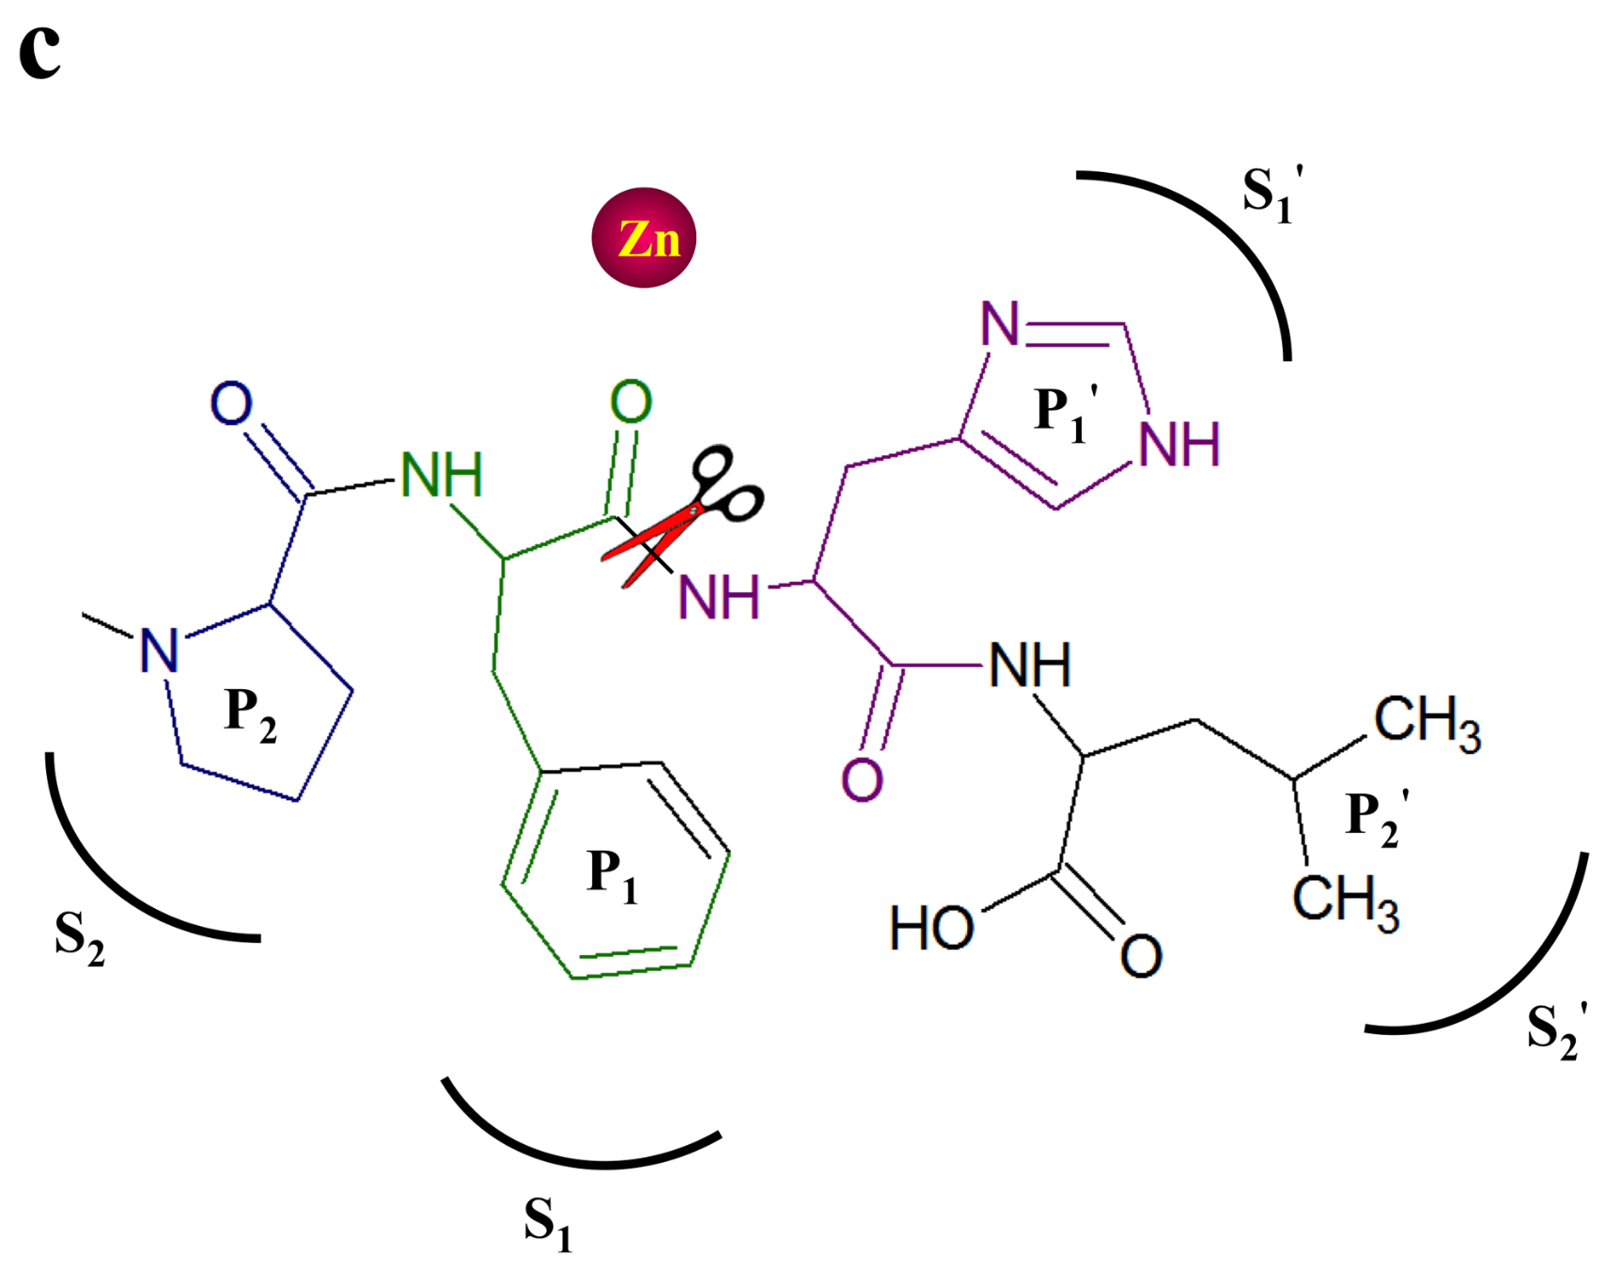

Slide 43
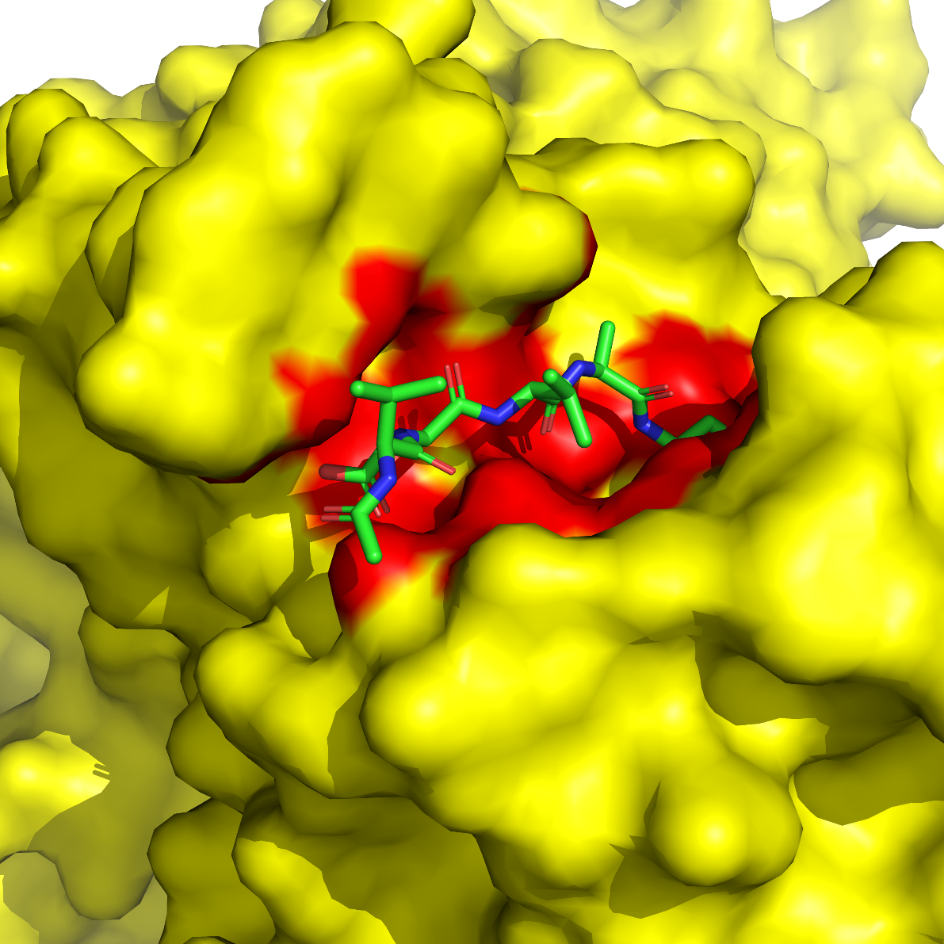
a
Figure 8.22

Slide 44
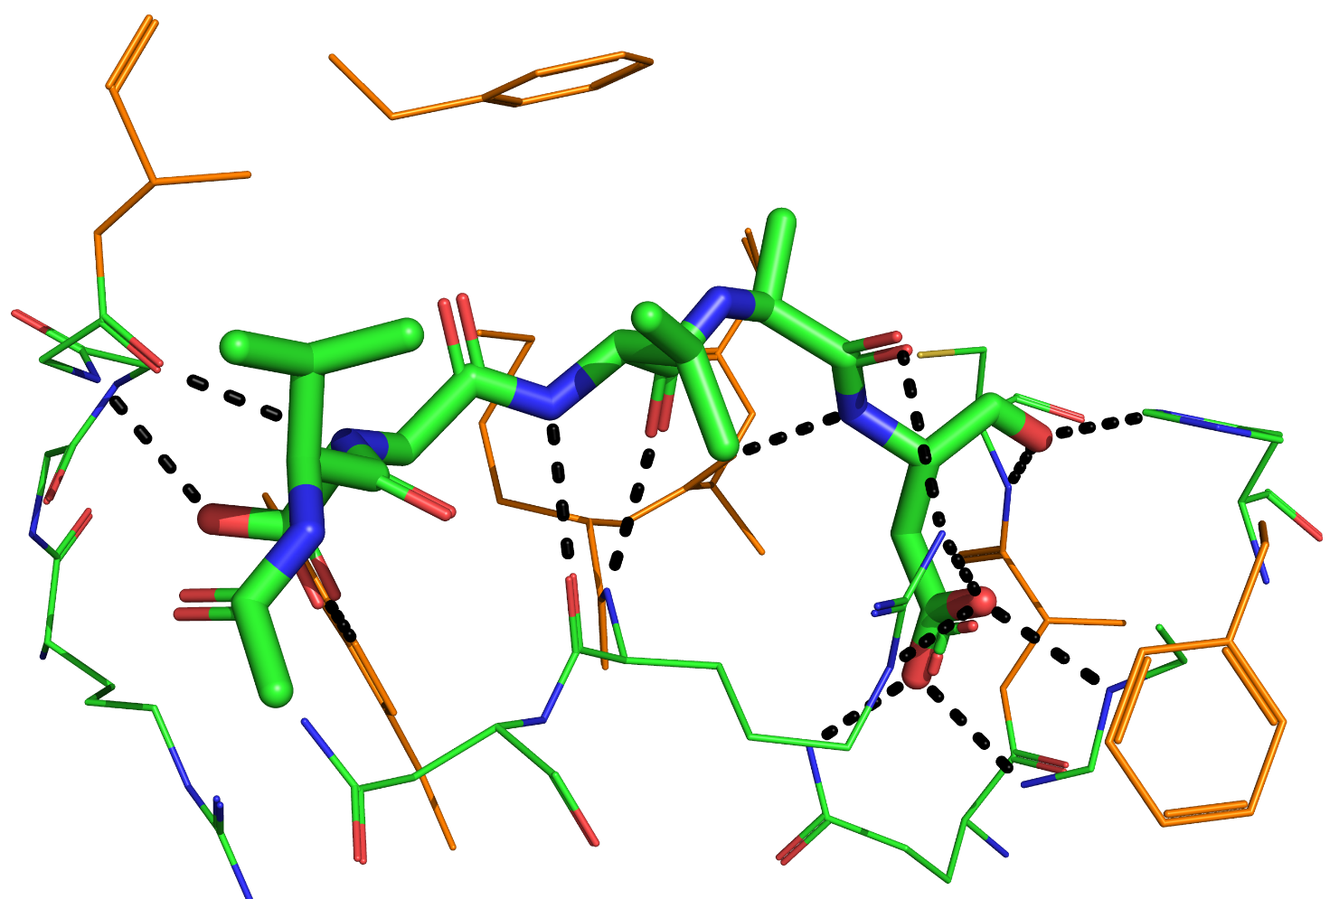
b

Slide 45
a
b
Phe
Ala
Pro
c
Figure 8.23

Slide 46
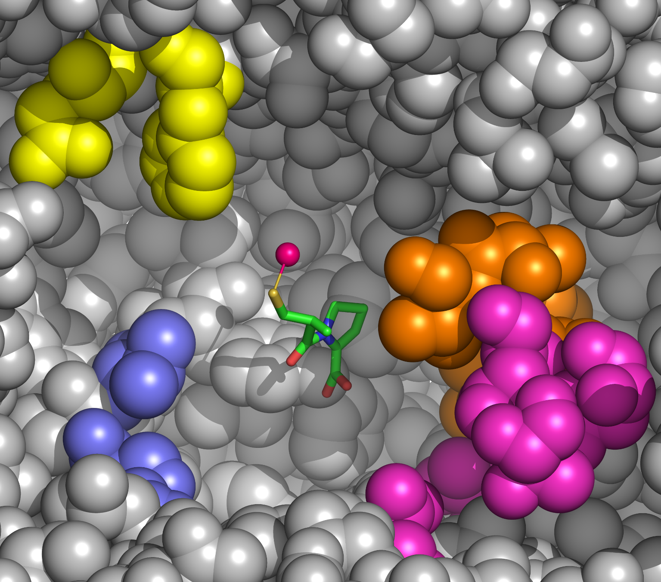
d
S₂
S₂'
S₁
S₁'

Slide 47
a
1st amino acid
N-carboxy-alkyl group
2nd amino acid
Figure 8.24

Slide 48
b
carboxyl
Methyl-benzene
Ala
Pro

Slide 49
c
carboxyl
Methyl-benzene
Lys
Pro

Slide 50
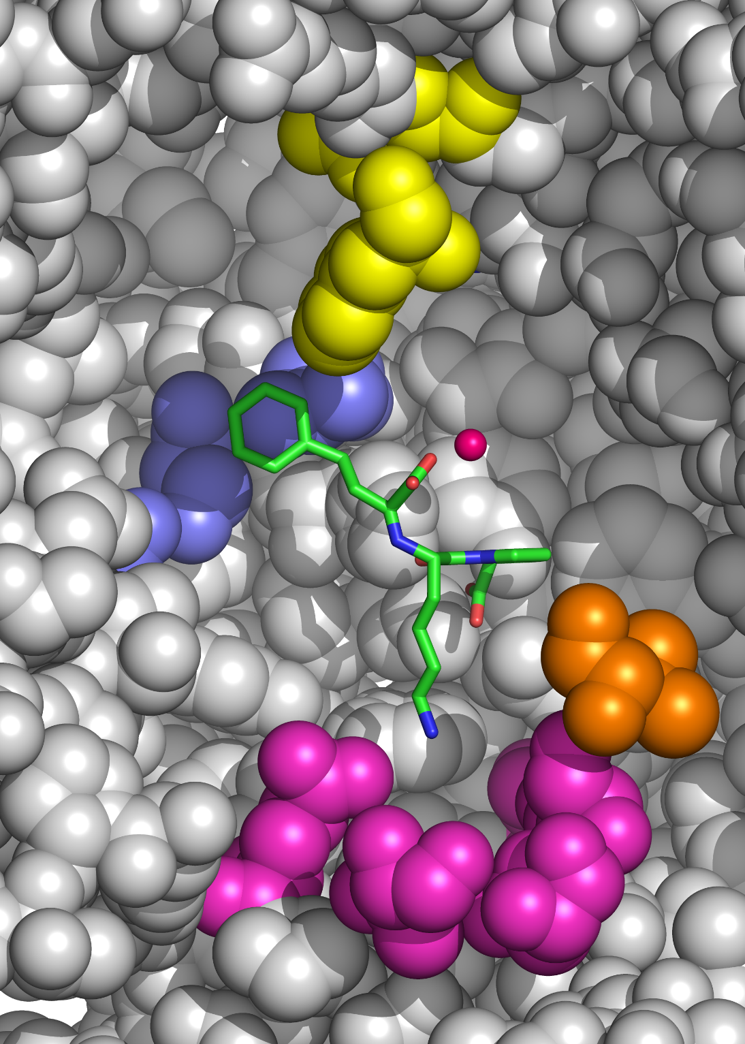
d
S₂
S₁
S₂'
S₁'

Slide 51
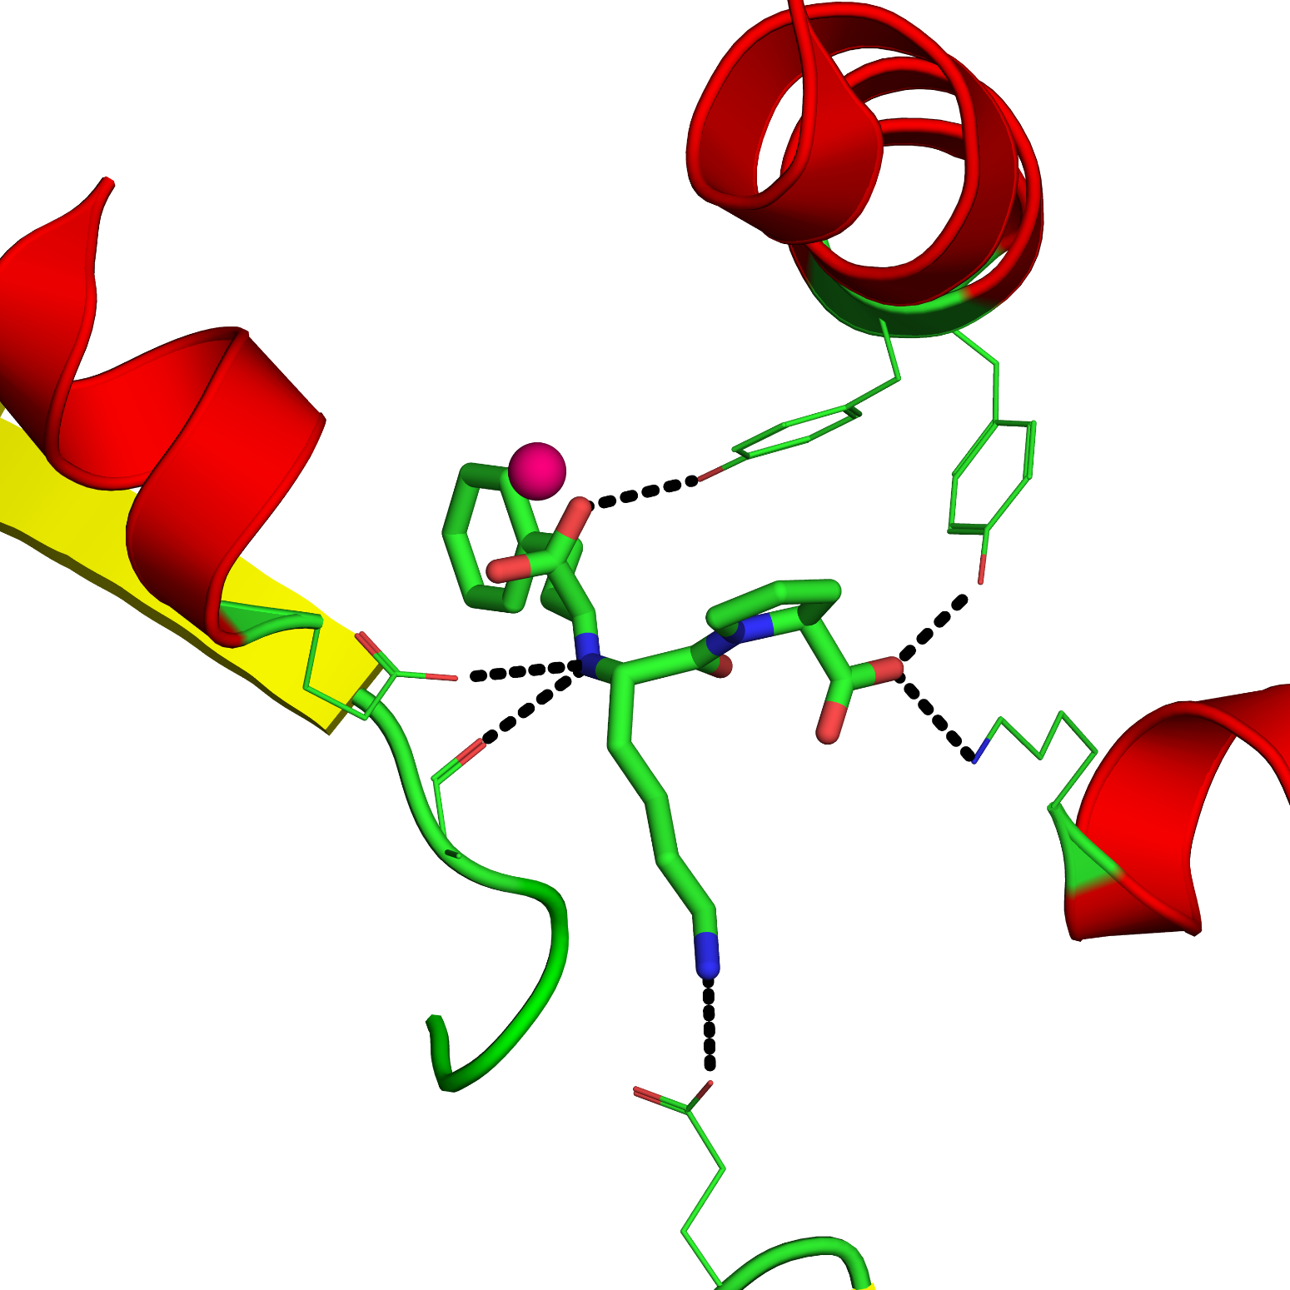
e
Tyr523
Zn
Tyr520
Lys511
Glu384
Ala354
Glu162

Slide 52
a
P₁
P₁'
P₂'
Lys
Pro
Lisinopril
Pro
Gly
kAP
P₂
Figure 8.25

Slide 53
b
kAP
kAF
kAW

Slide 54
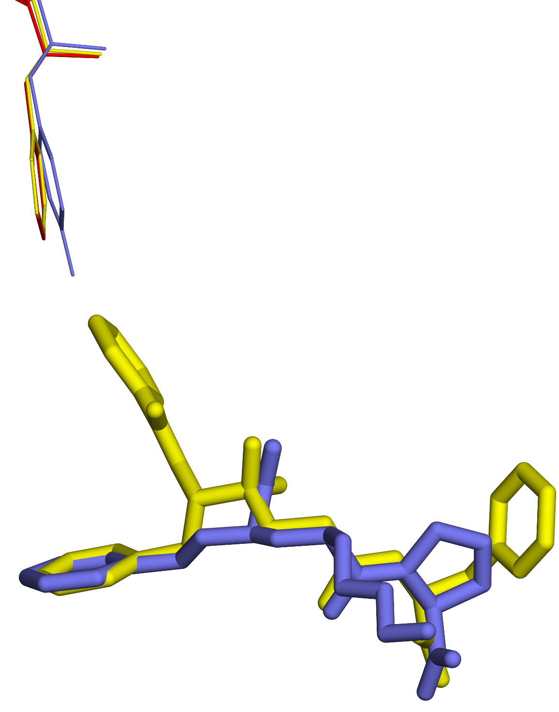
c
Phe-391/
Tyr-369
kAF
Lisinopril

Slide 55
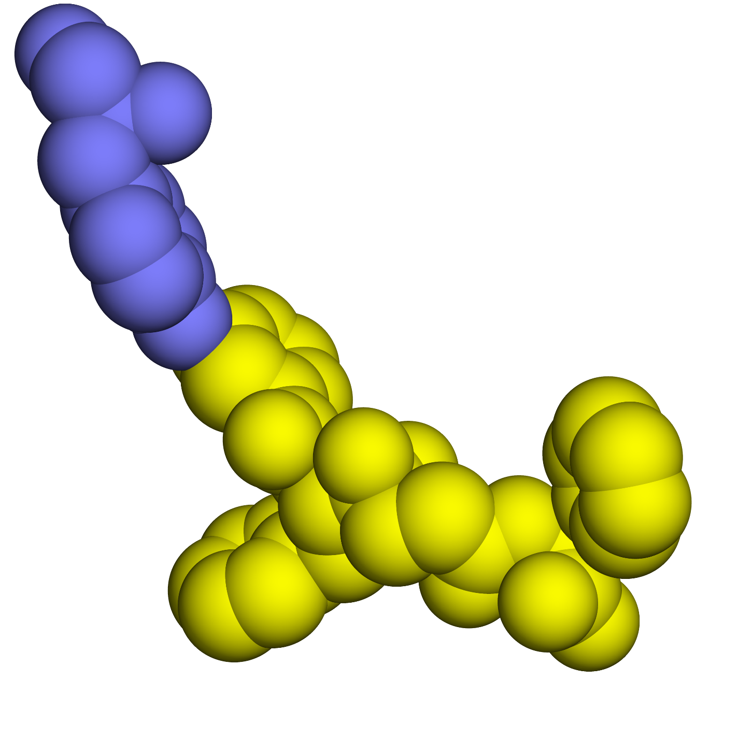
d
Tyr-369
kAF
OH group

Slide 56
Box 8.1

Slide 57
a
+
acetylcholine
acetic acid
choline
Figure 8.1.1

Slide 58
b
Glu-327
His-440
Ser-200
H+
Trp-84
ACh
acyl-enzyme bond
Phe-330

Slide 59
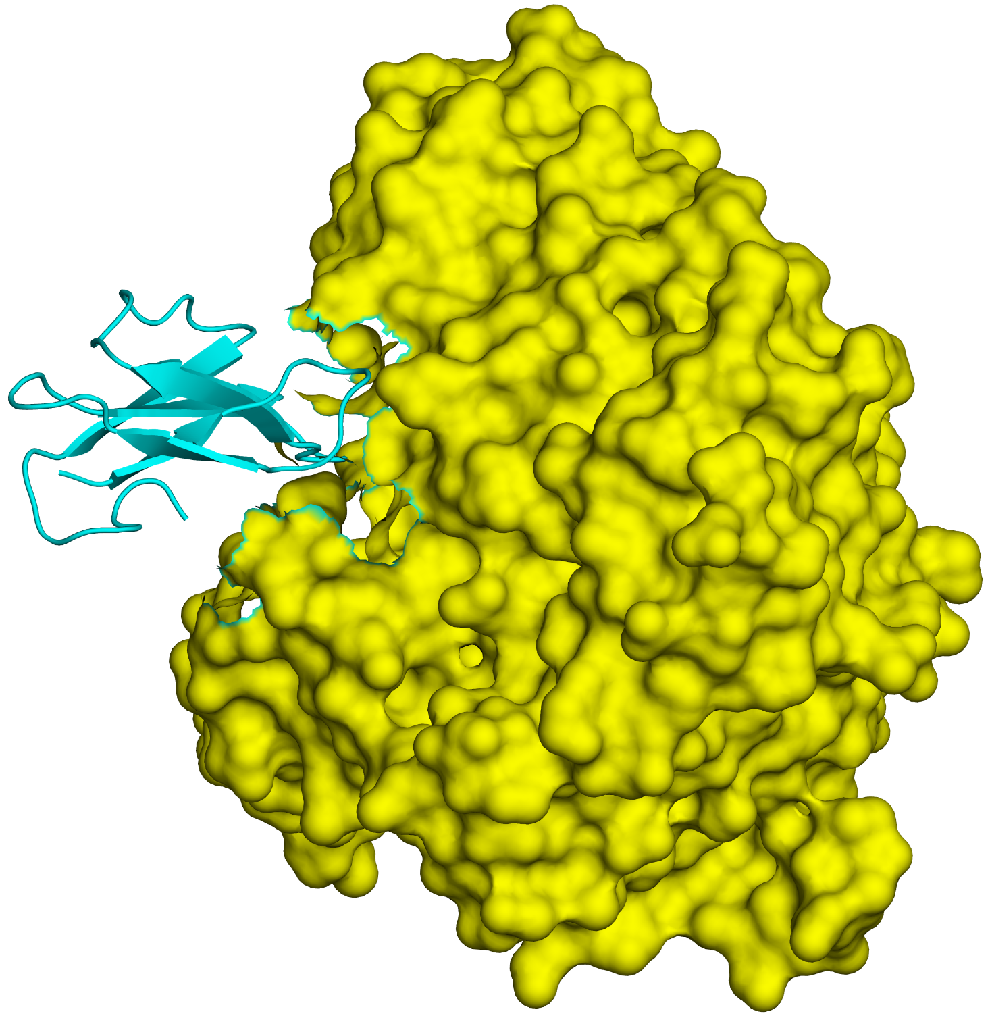
a
AChE
Fasciculin-2
Figure 8.1.2

Slide 60
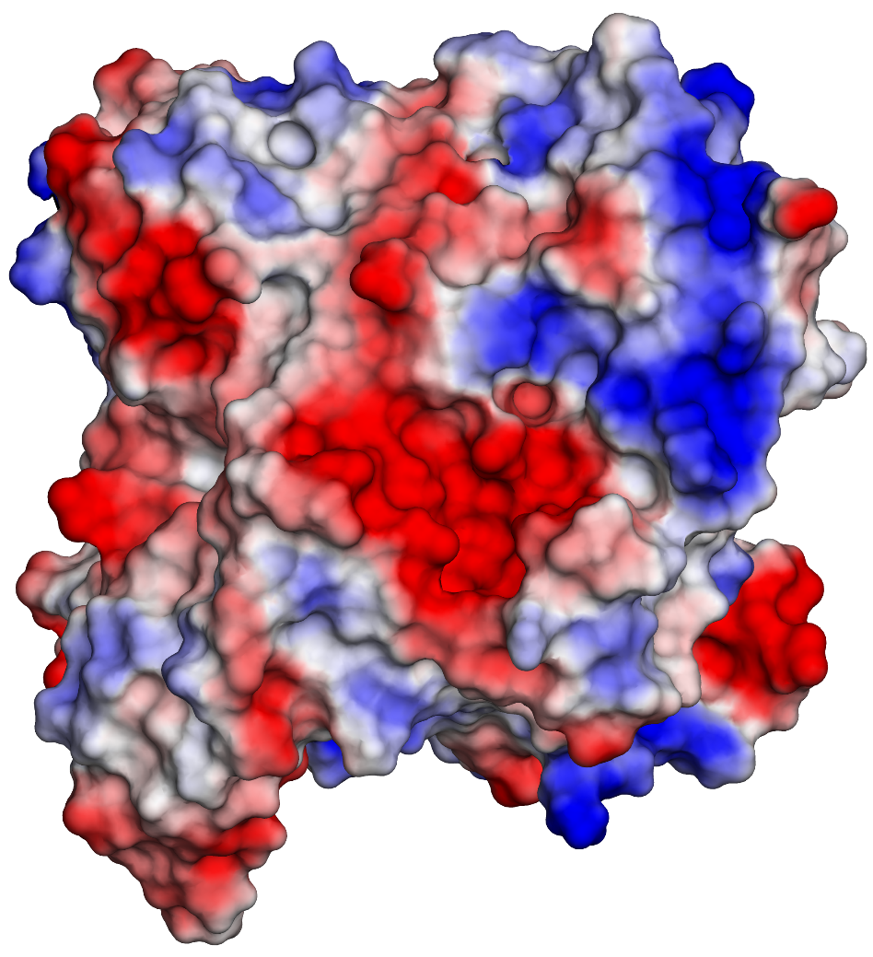
b

Slide 61
a
Parathion
Malathion
Figure 8.1.3

Slide 62
b
Sarin
Tabun
VX
Soman

Slide 63
c
Phosphoester
AChE
Soman

Slide 64
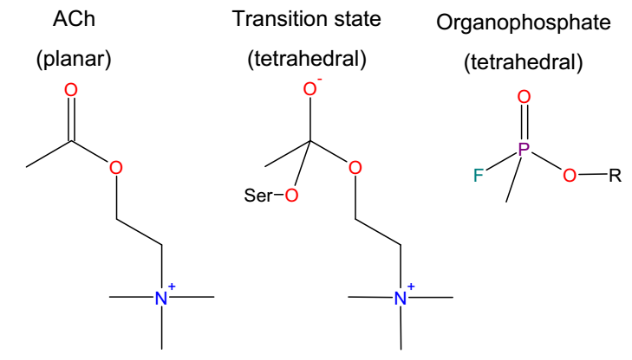
d

Slide 65
a
Physostigmine
Neostigmine
Rivastigmine
Figure 8.1.4

Slide 66
b
carbamoyl
AChE
Neostigmine

Slide 67
a
Figure 8.1.5

Slide 68
b
Pralidoxime

Slide 69
Box 8.2

Slide 70
a
H⁺
Phenol
Phenolate
Figure 8.2.1

Slide 71
b
c
p-nitro phenol
p-ethyl phenol

Slide 72
a
Primary
Secondary
Tertiary
Quaternary
Figure 8.2.2

Slide 73
b
c
Aniline
Sulfonamide

Slide 74
d
H⁺
Imide

Slide 75
e
..
Pyrrole

Slide 76
f
Acetamide (keto form)
Acetamide (enol form)

Slide 77
g

Slide 78
a
b
..
..
c
A phenothiazine
A dibenzazepine
Figure 8.2.3

Slide 79
d
Isoproterenol
Di-chloro-isoproterenol

Slide 80
Levorphanol
Dextromethorphan
Figure 8.2.4

