Slide 1
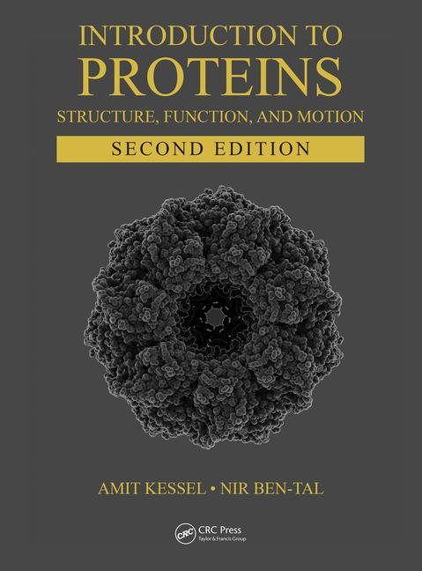
This PPT presentation is provided as suppl. material to the book:
Introduction to Proteins: Structure, Function, and Motion
2nd Edition (2018)
Amit Kessel & Nir Ben-Tal

Slide 2
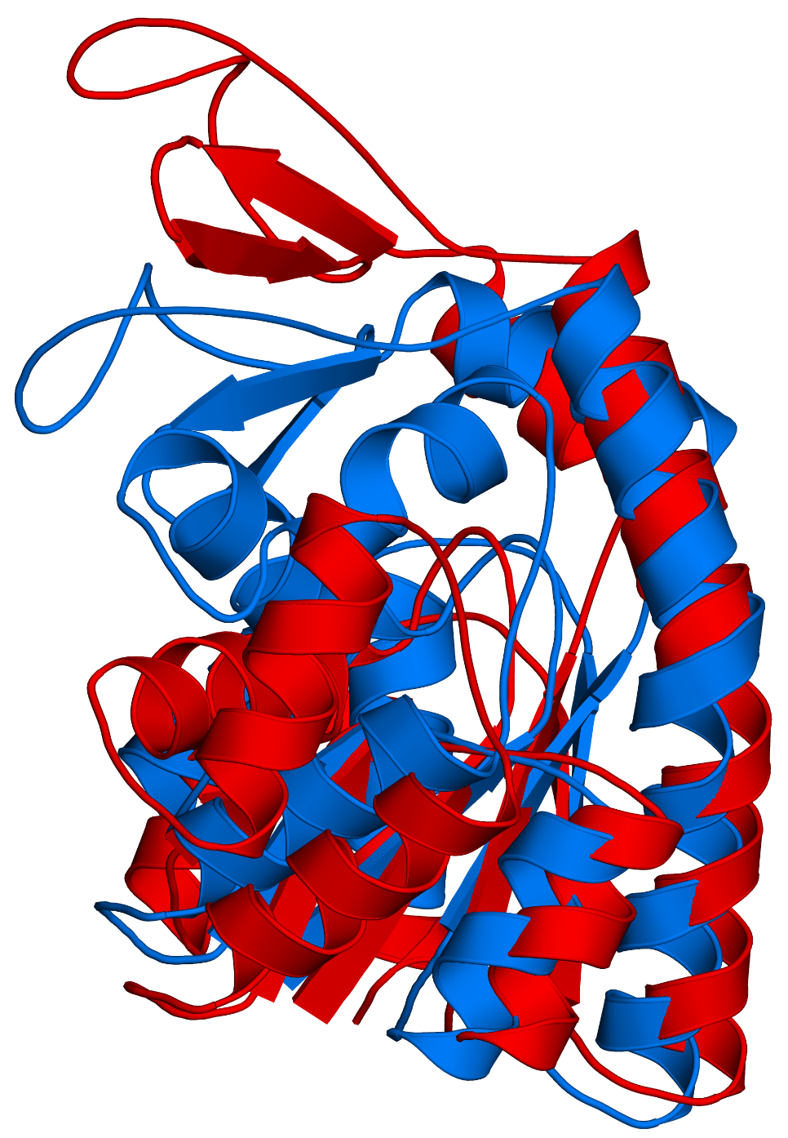
Figure 5-1

Slide 3
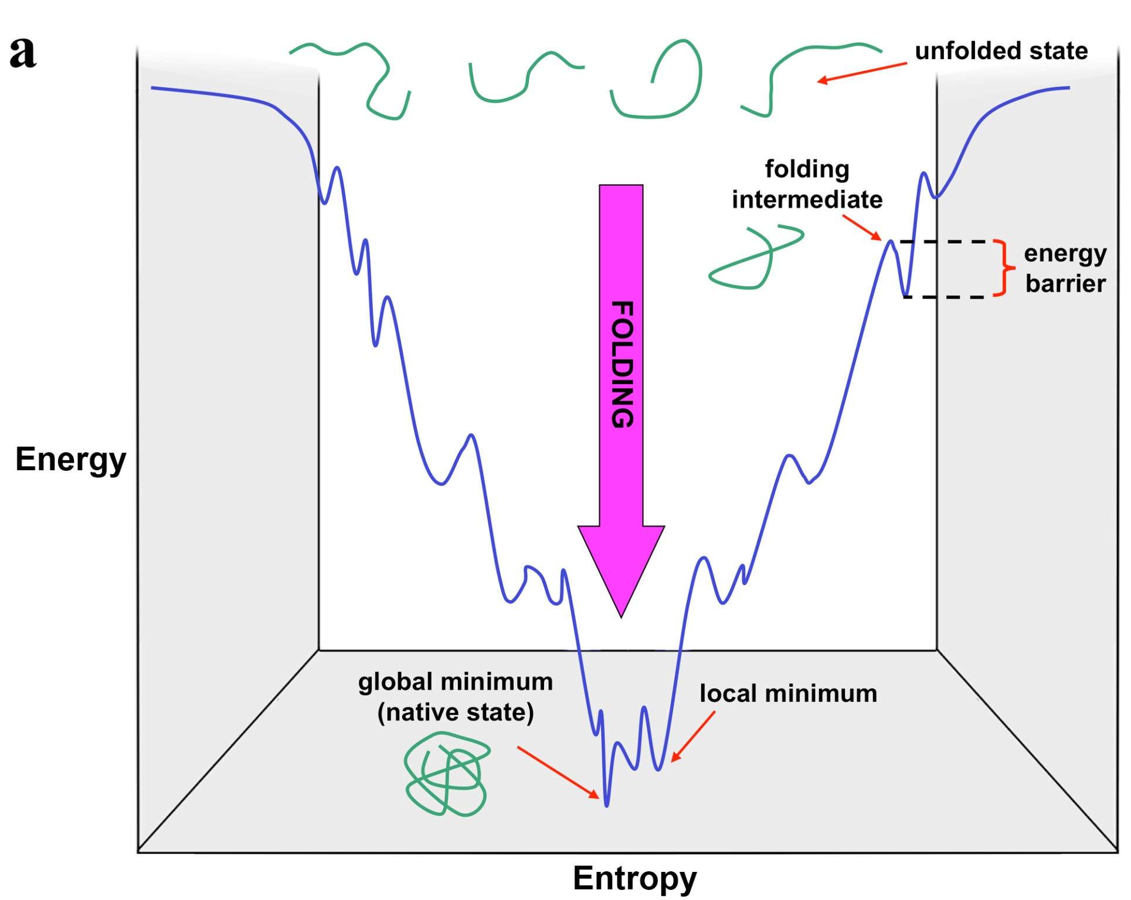
Figure 5-2

Slide 4
b

Slide 5
a
b
c
Figure 5-3

Slide 6
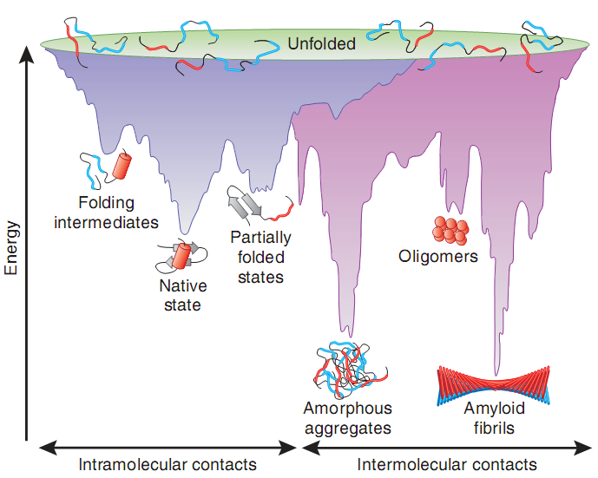
Figure 5-4

Slide 7
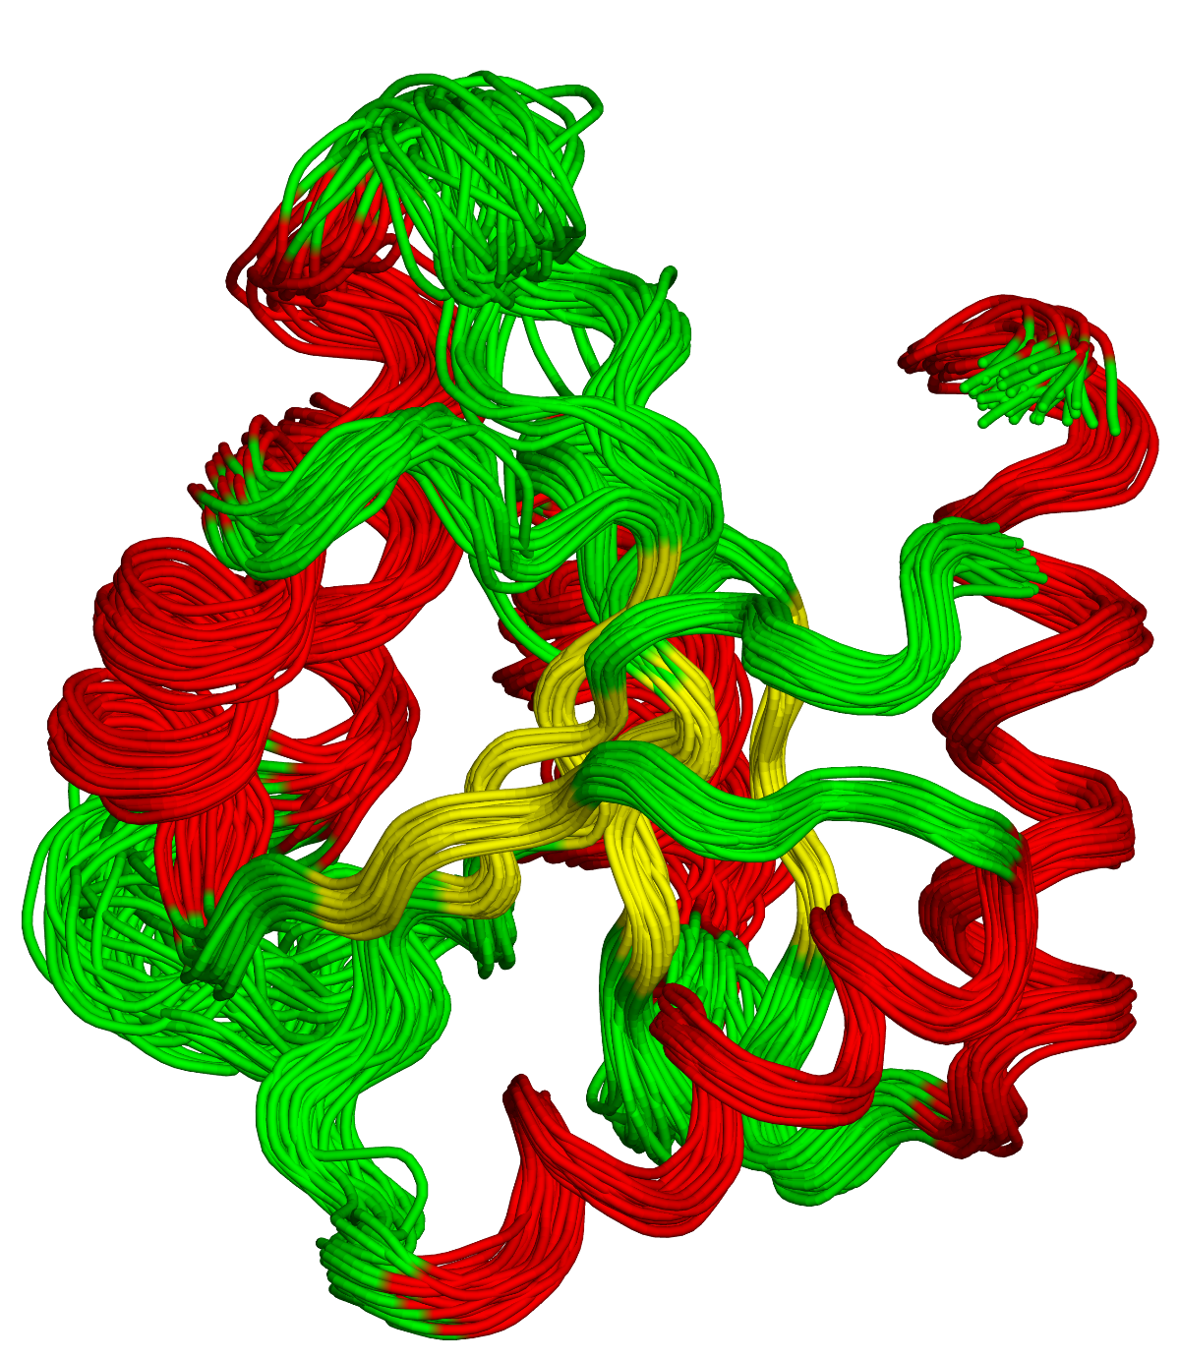
Figure 5-5

Slide 8
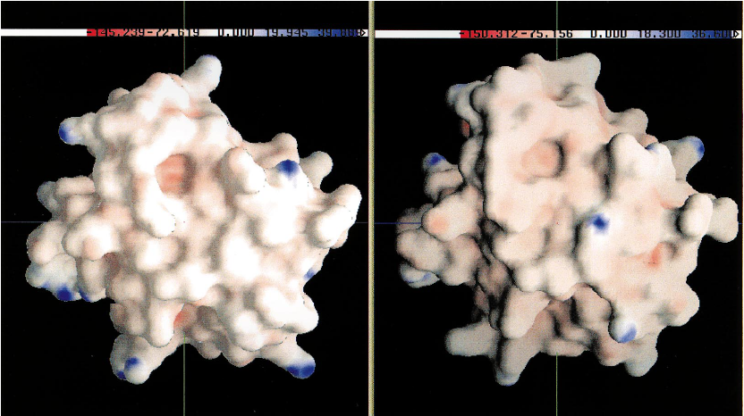
Figure 5-6

Slide 9
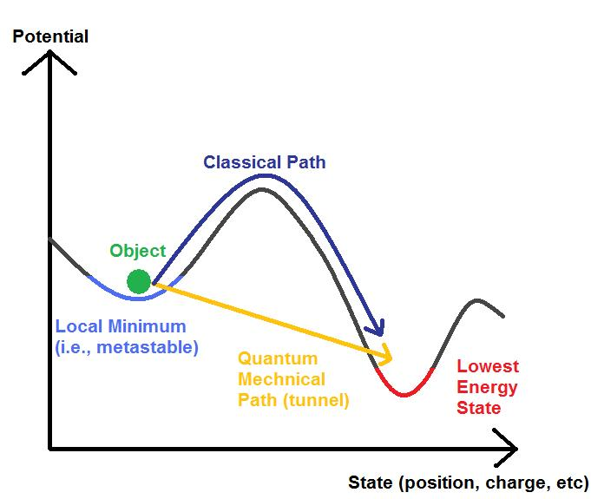
a
Figure 5.7

Slide 10
b
Energy
R
TS
P
Reaction Coordinate

Slide 11
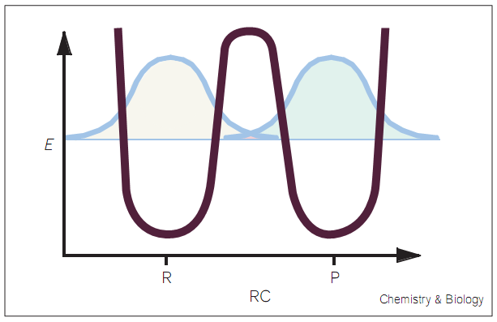
c

Slide 12
Ltn10
Ltn40
Figure 5.8

Slide 13
a
ligand
Figure 5-9

Slide 14
b
L
+
L
R₀
R₁
K_{R}
(ΔG_{R})
K₀
K₁
(ΔG₀)
(ΔG₁)
L
+
L
T₀
T₁
K_{T}
(ΔG_{T})

Slide 15
c
inhibitor
activator
inactive
active
substrate

Slide 16
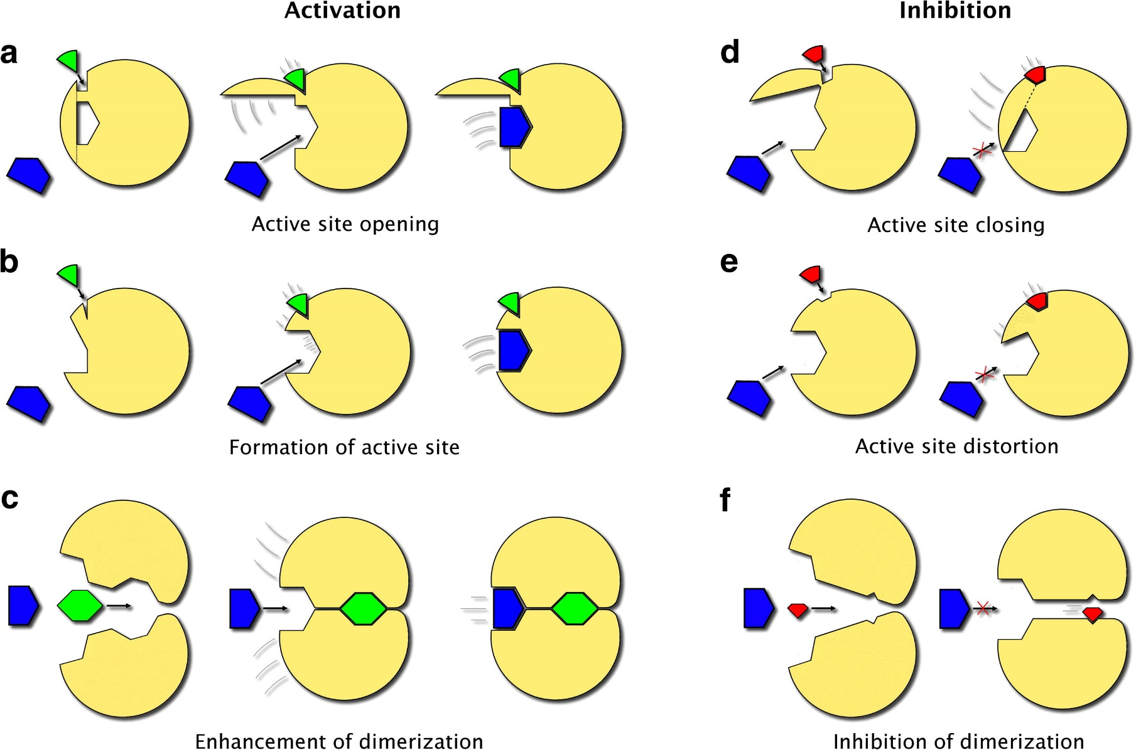
d
I
IV
II
V
III
VI

Slide 17
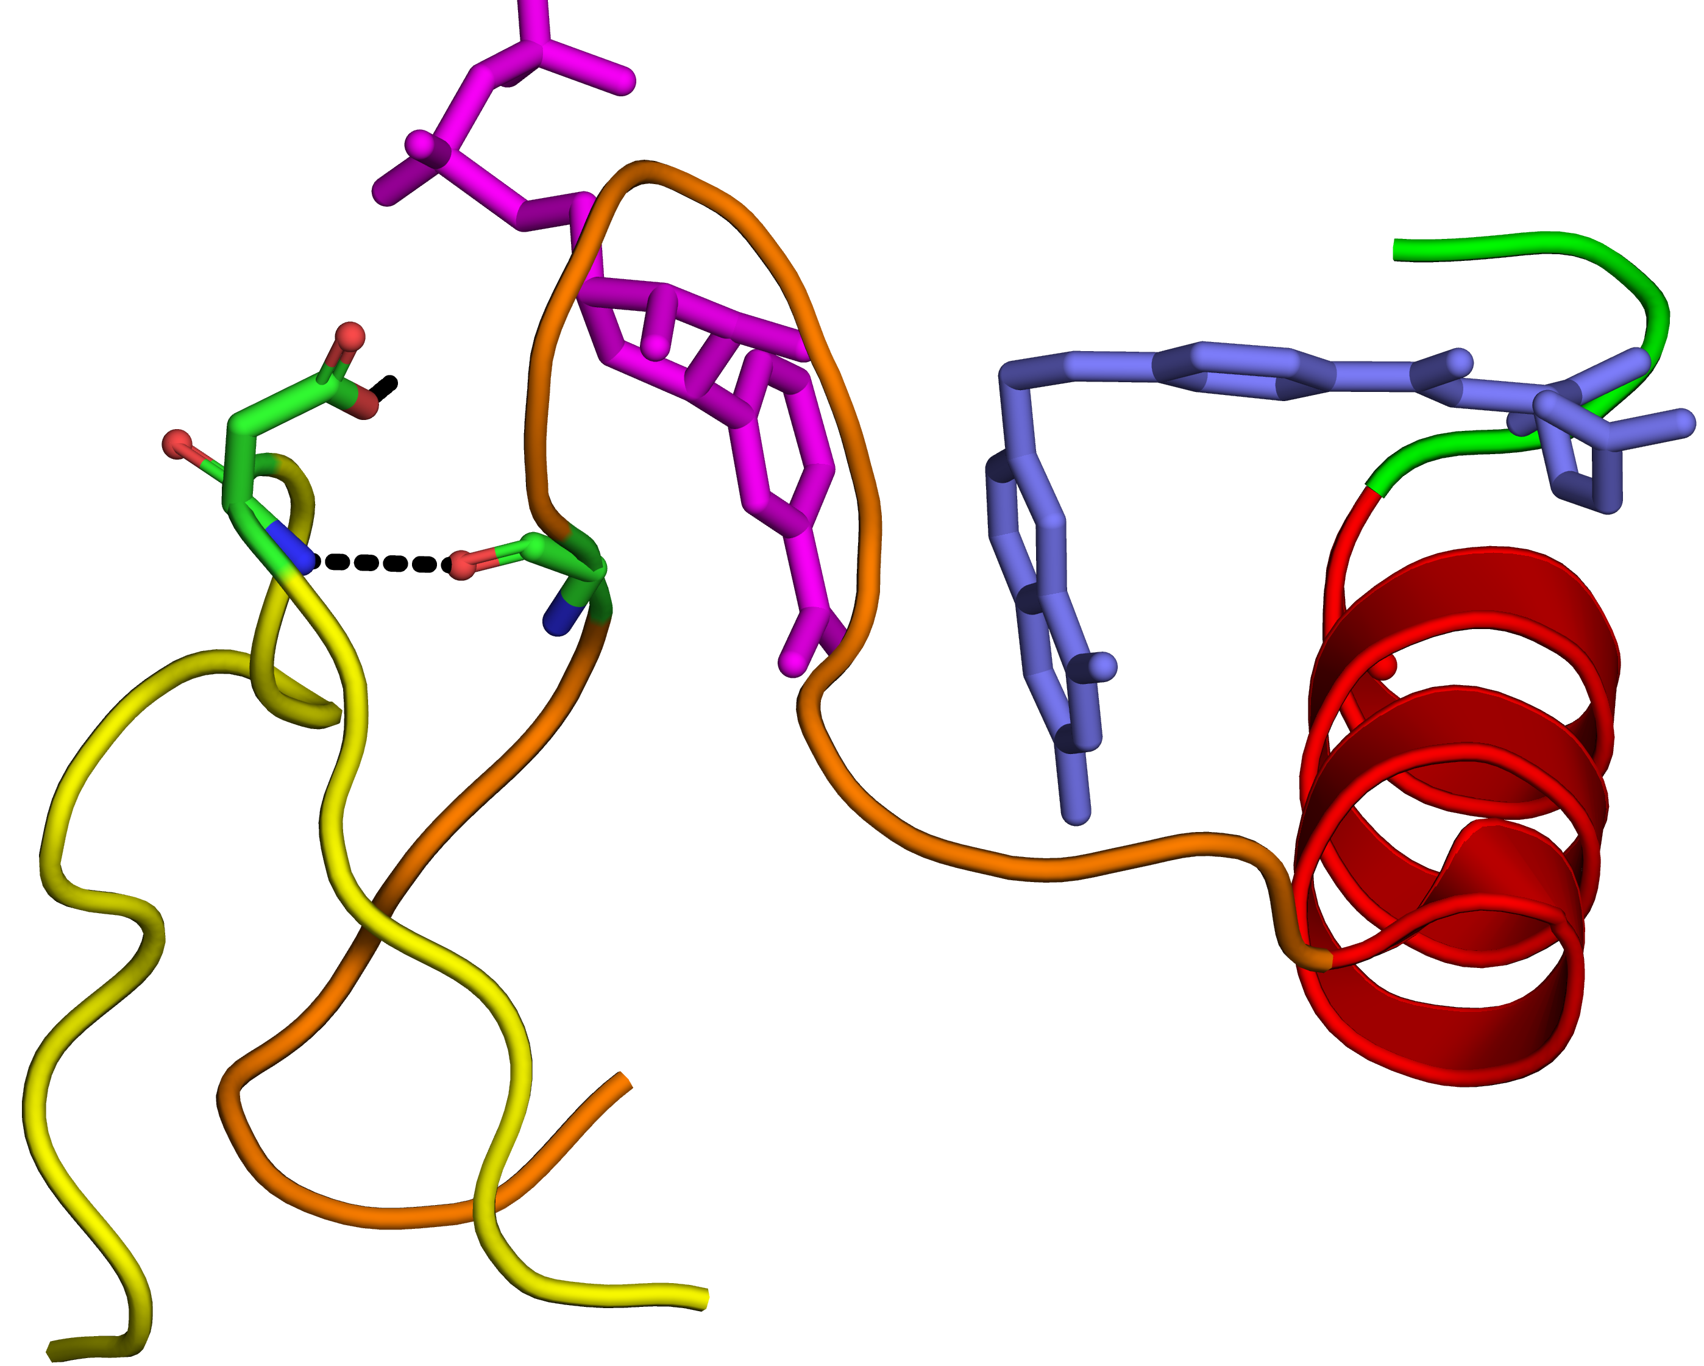
NADPH
Catalytic site
Asp122
H⁻
DHF
Gly15
Figure 5-10

Slide 18
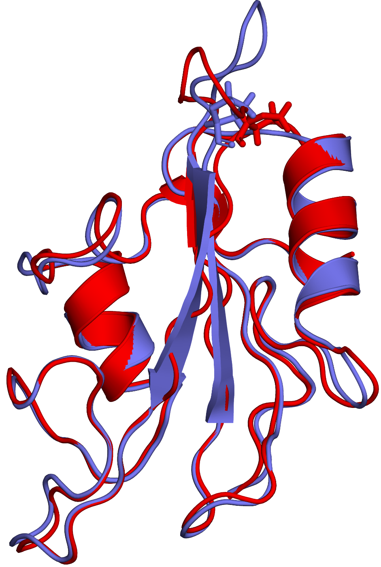
a
CD loop
Pro-287
Figure 5-11

Slide 19
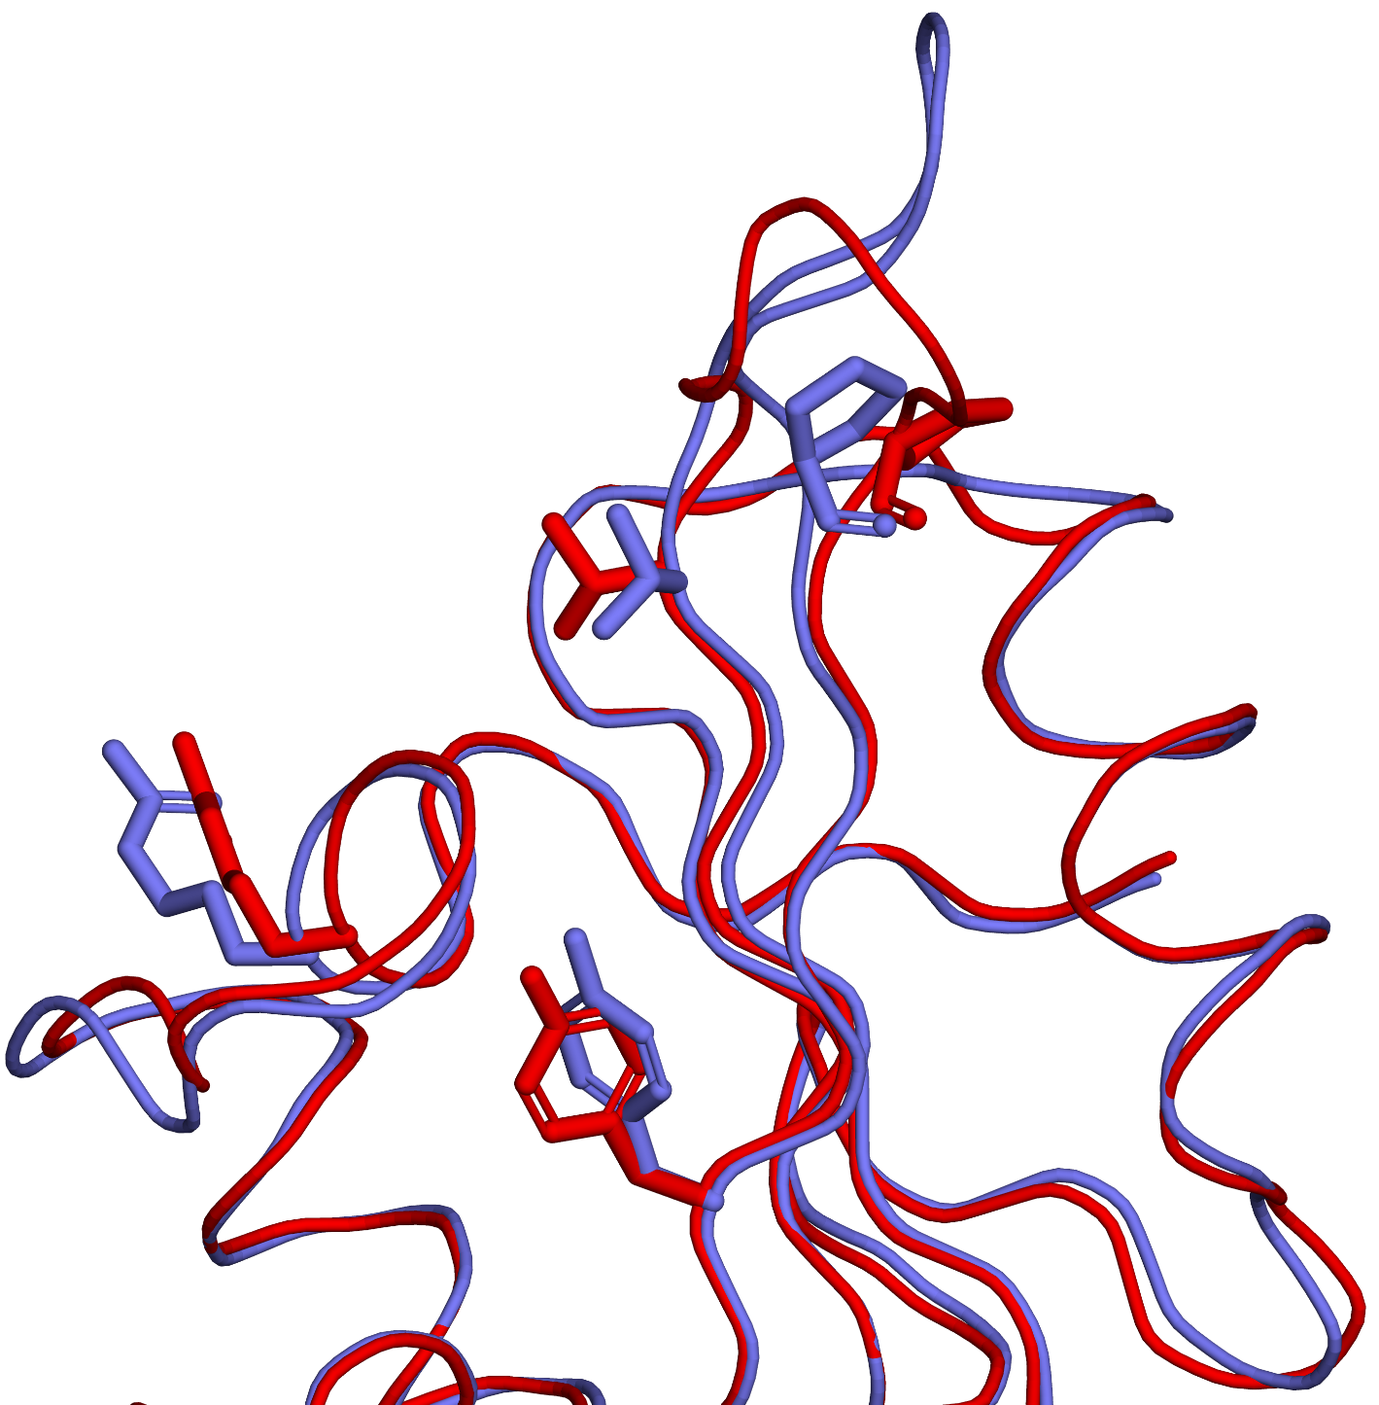
b
Pro-287
Thr-279
Arg-104
Tyr-292

Slide 20
Box 5.1

Slide 21
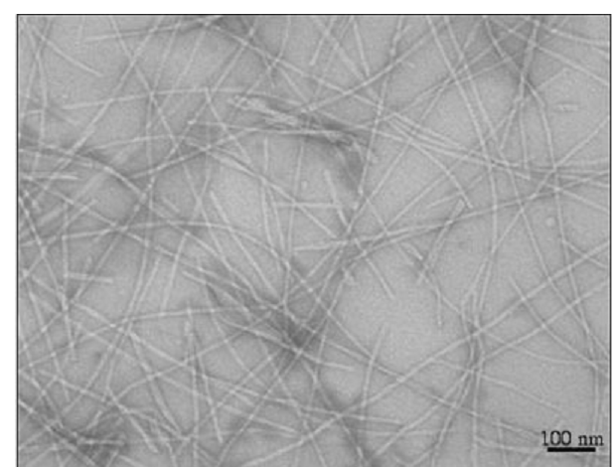
Figure 5.1.1

Slide 22
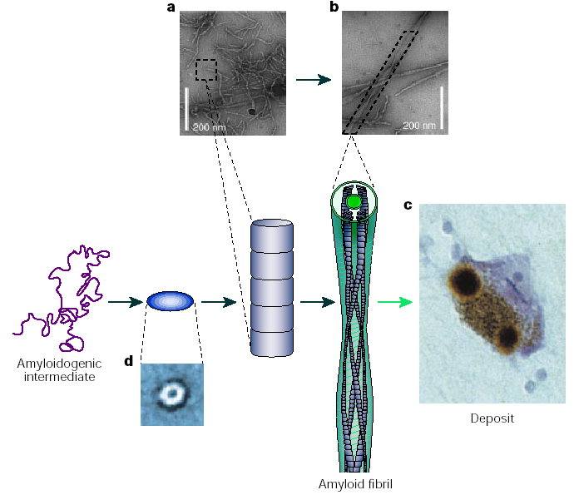
1
2
3
4
Figure 5.1.2

Slide 23
a
Figure 5.1.3

Slide 24
b

Slide 25
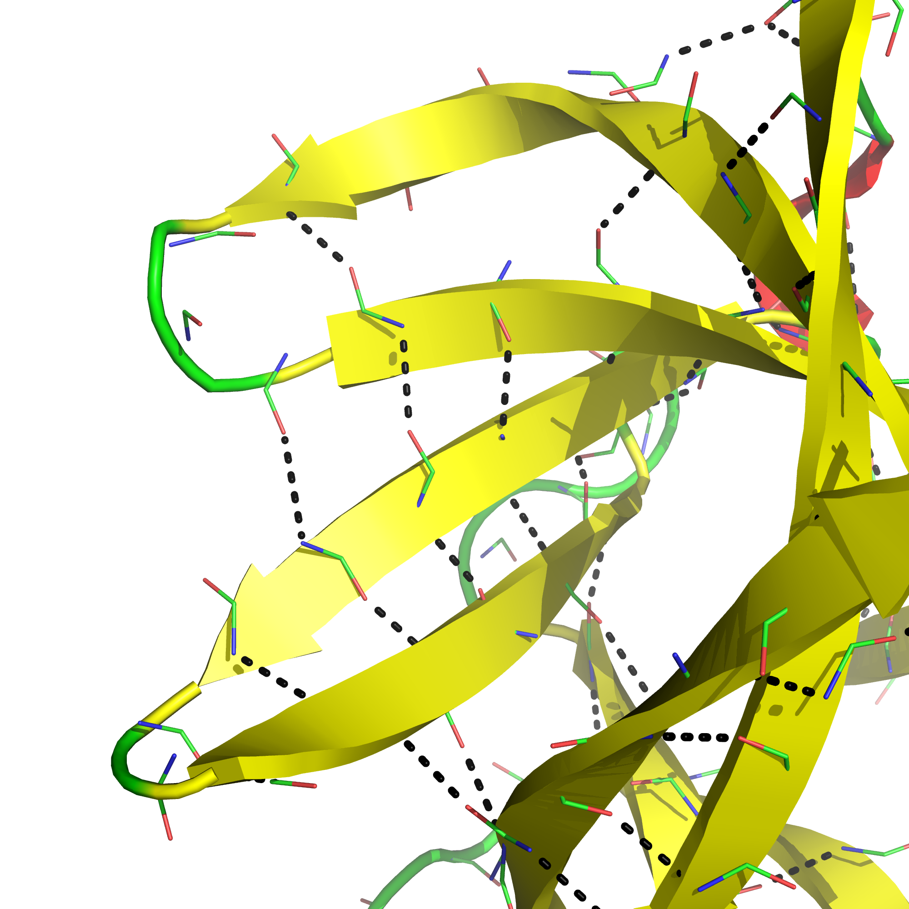
4
5
8
9
Figure 5.1.4

Slide 26
Box 5.2

Slide 27
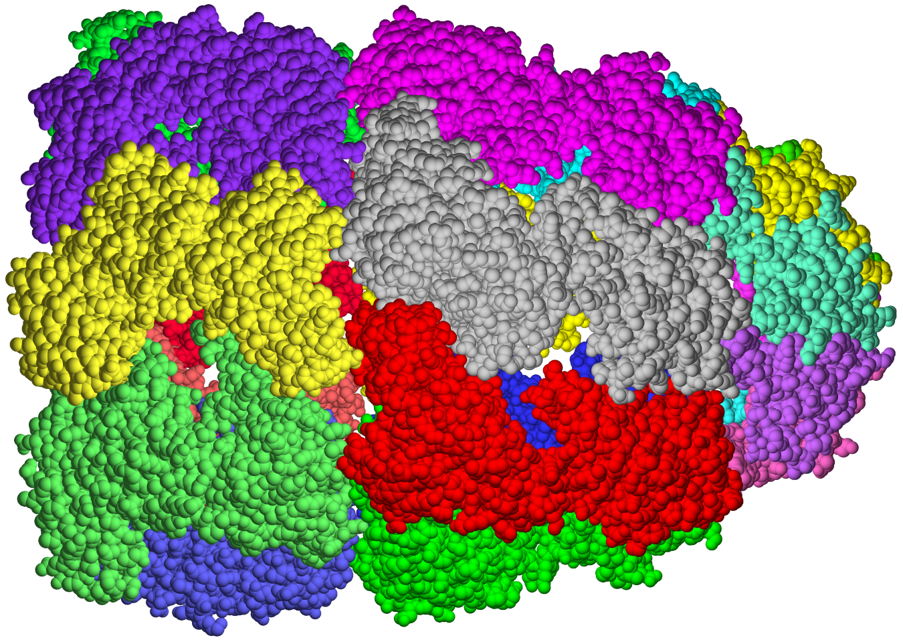
GroEL
GroES
Equatorial region
Apical region
Figure 5.2.1

Slide 28
1
2
3
4
5
Figure 5.2.2

Slide 29
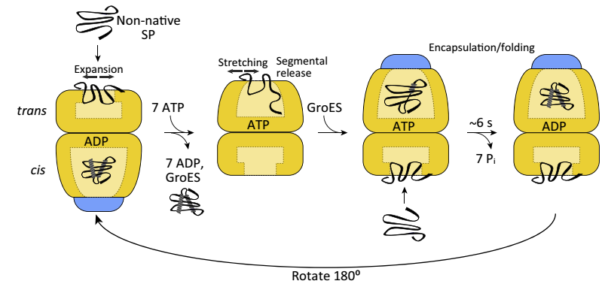
1
2
3
Figure 5.2.3

Slide 30
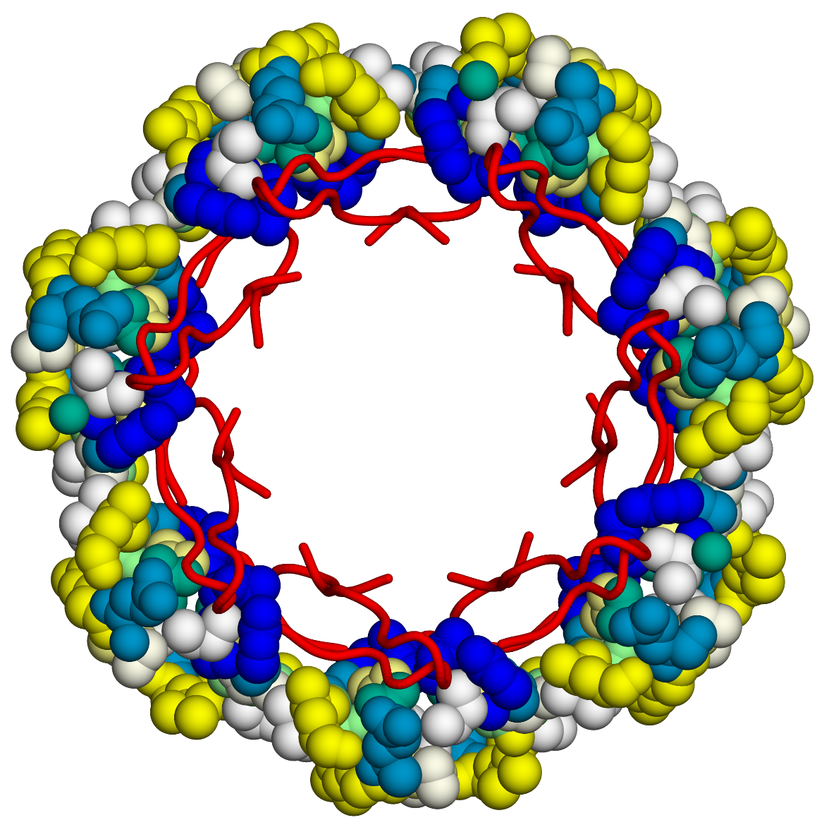
a
90°
Figure 5.2.4

Slide 31
b

Slide 32
a
Figure 5.2.5

Slide 33
b

Slide 34
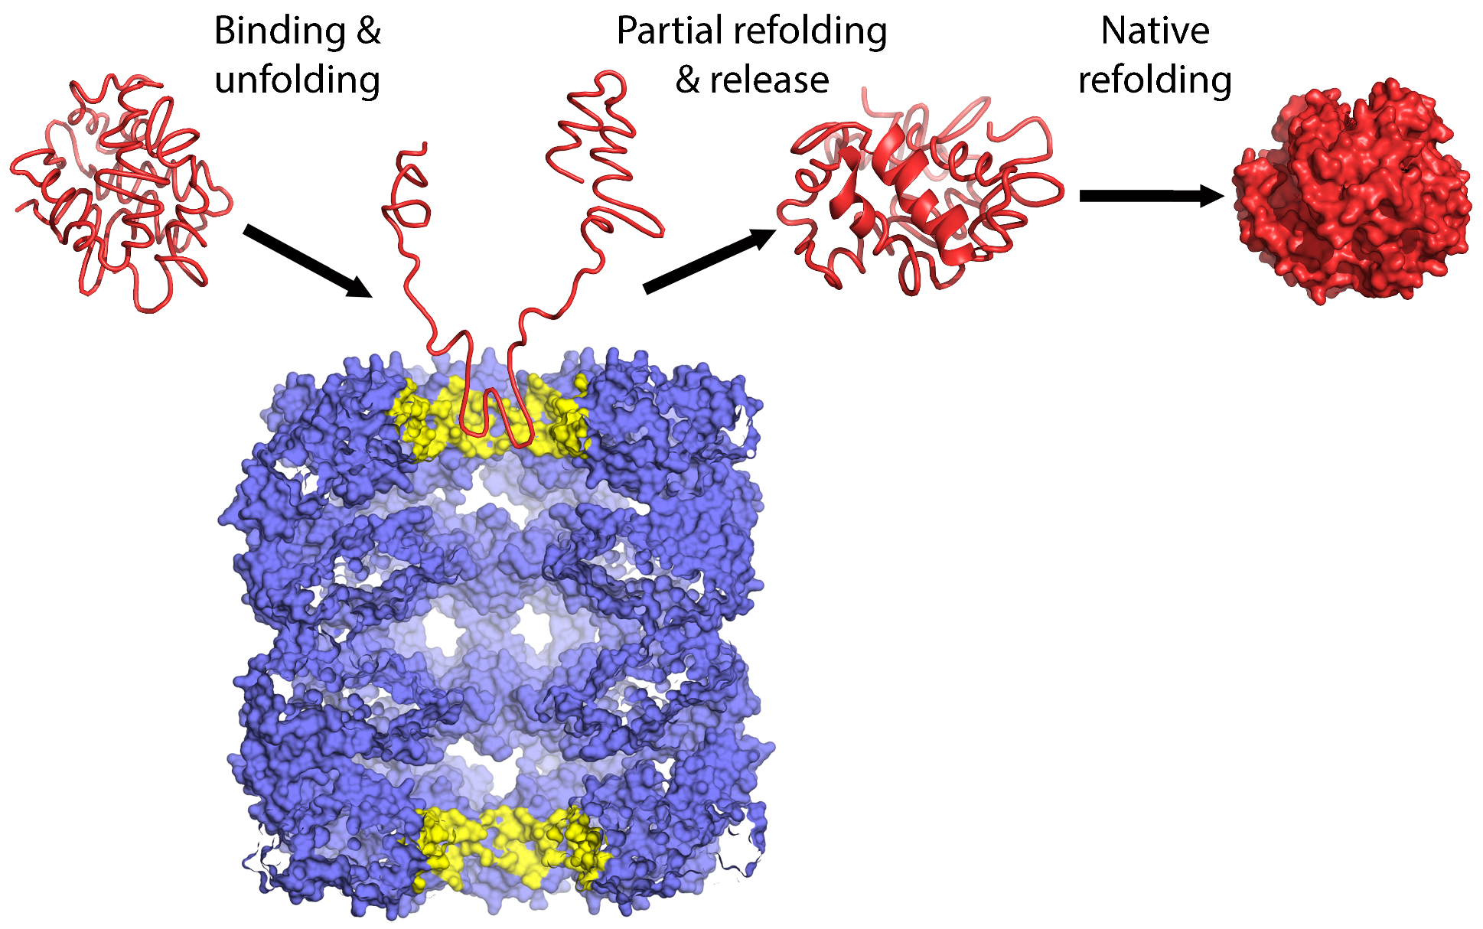
Figure 5.2.6

Slide 35
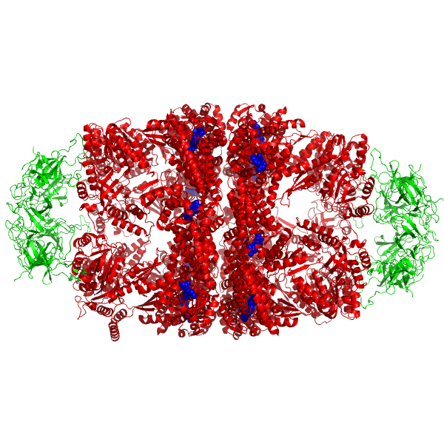
HSP10
HSP60
HSP10
Figure 5.2.7

Slide 36
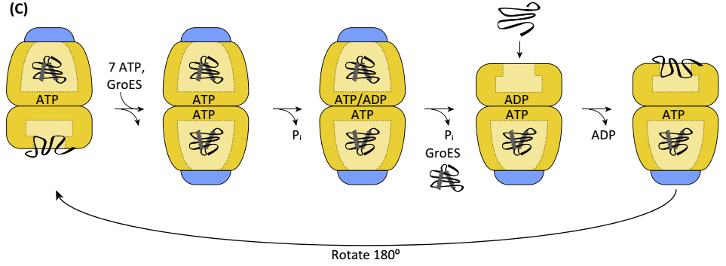
1
2
3
4
Figure 5.2.8

Slide 37
Box 5.3

Slide 38
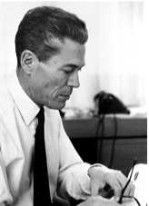
Figure 5.3.1

Slide 39
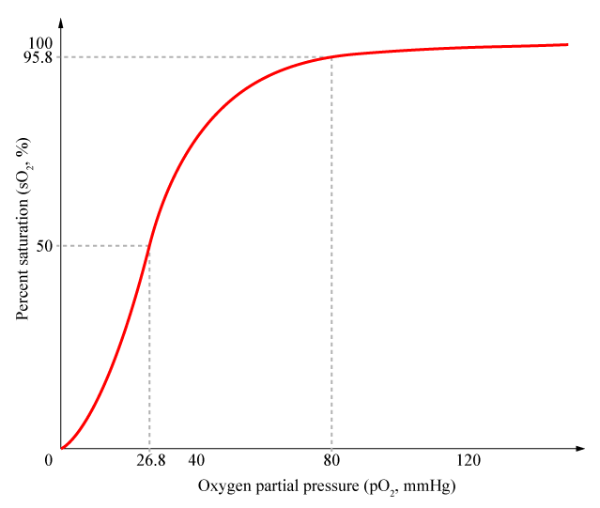
Lungs
Tissues
Figure 5.3.2

Slide 40
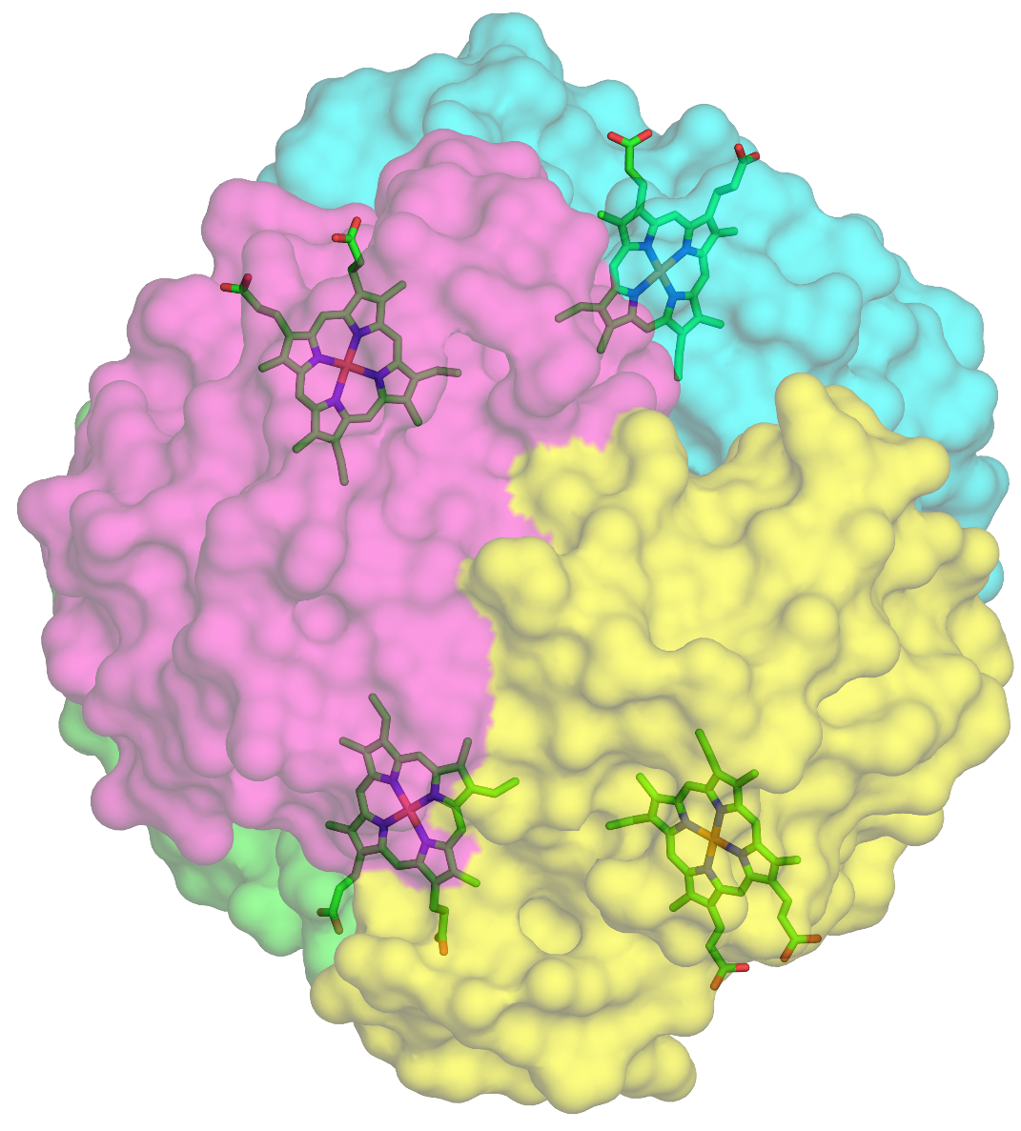
a
Figure 5.3.3

Slide 41
b
Oxygen
Pyrrole ring

Slide 42
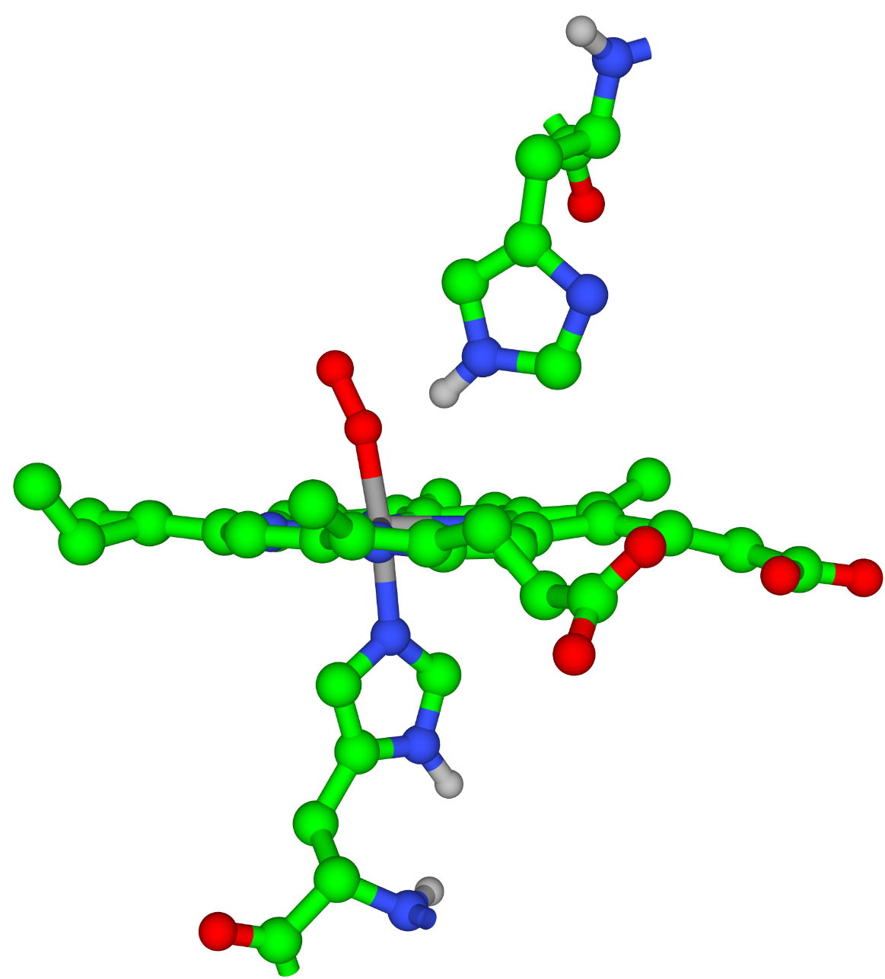
c
Distal His
Proximal His

Slide 43
Figure 5.3.4

Slide 44
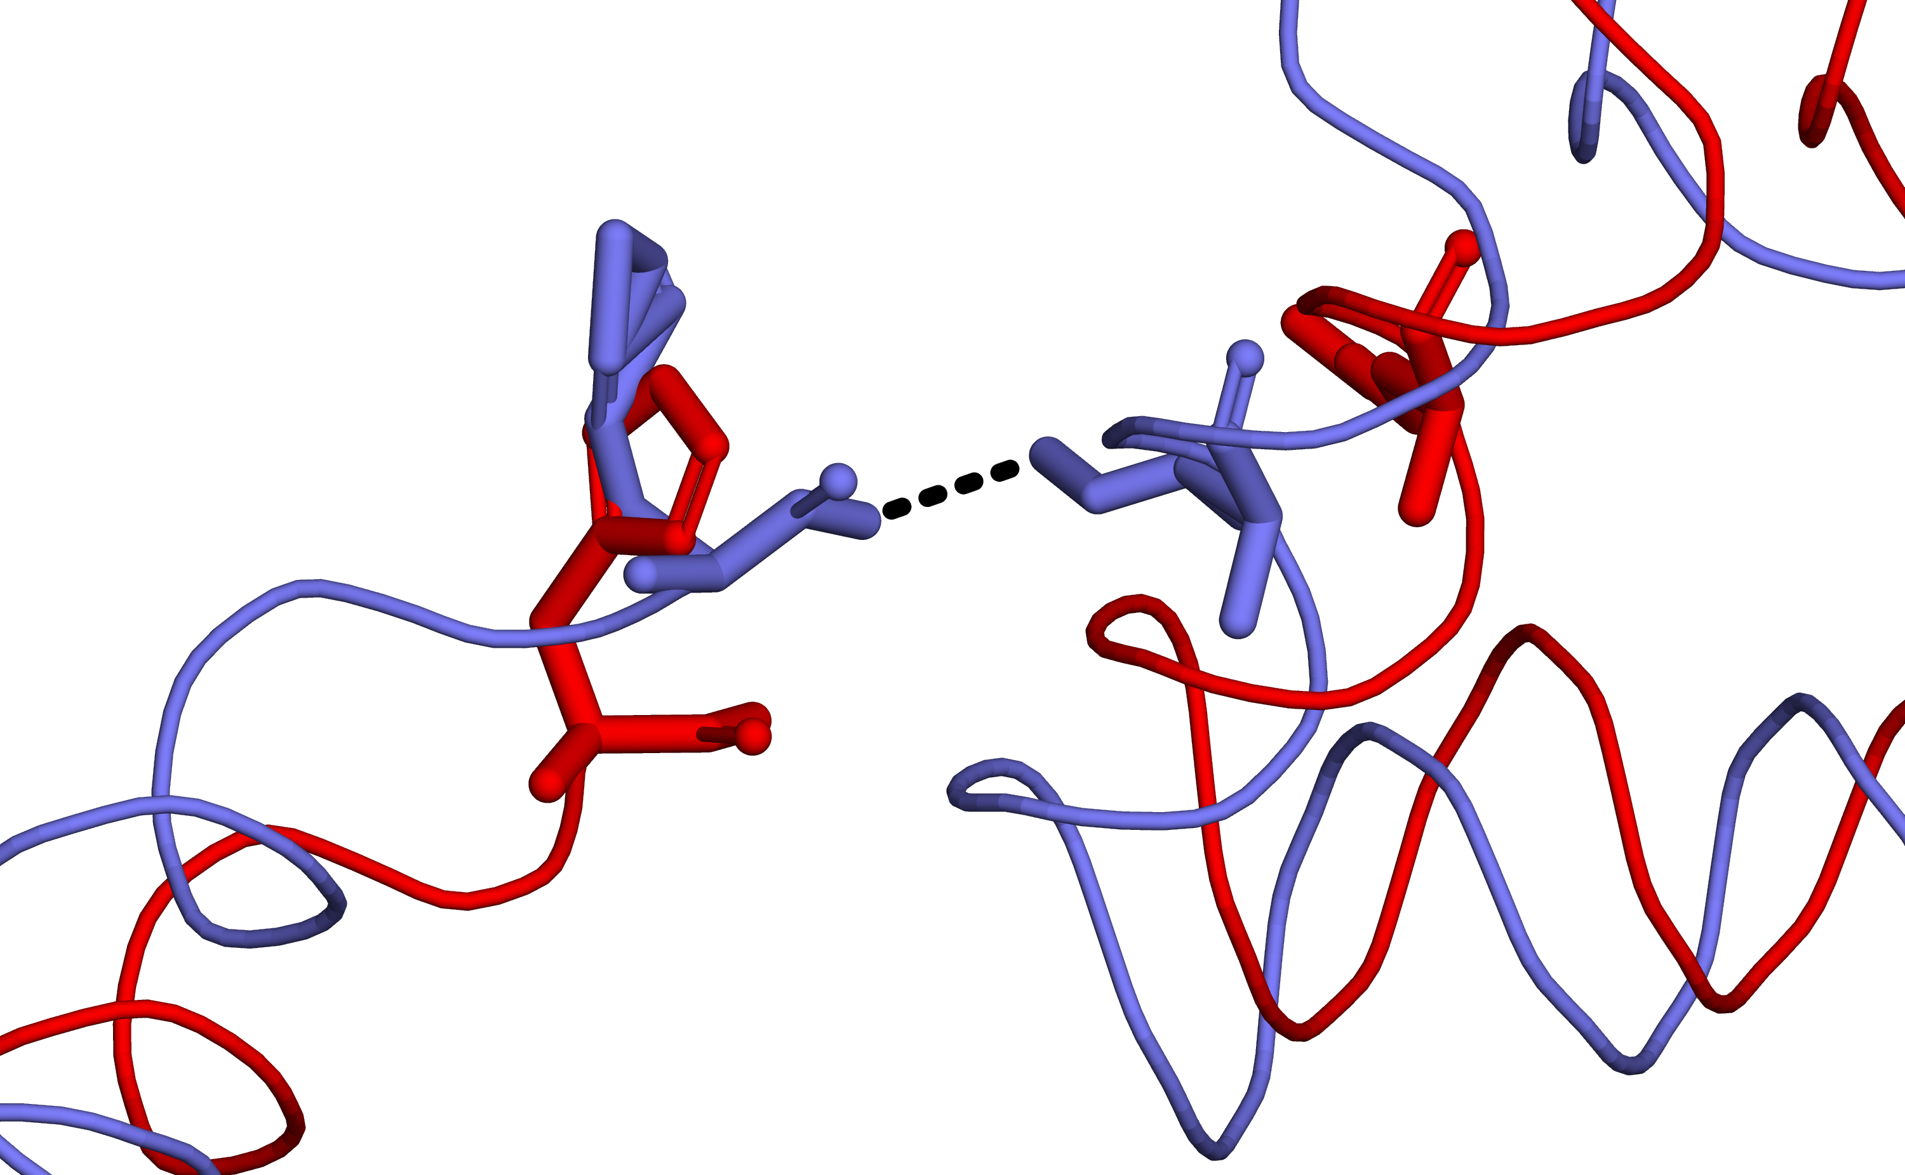
His-146
Lys-40
N_{ε}
O_{XT}
Figure 5.3.5

Slide 45
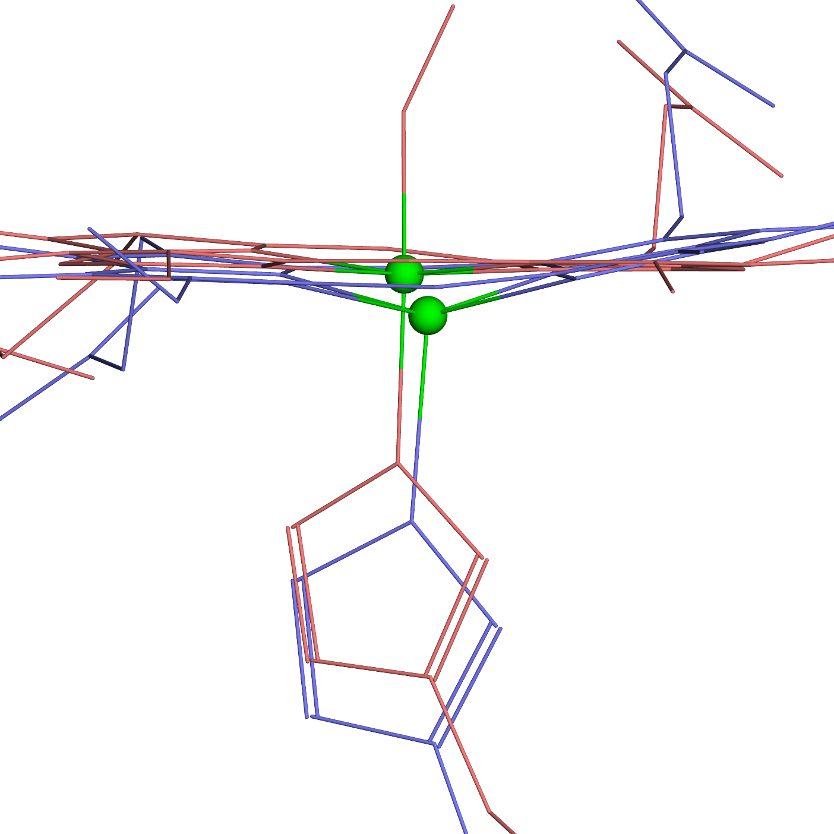
a
O₂
Heme
Fe²⁺
Proximal His
Figure 5.3.6

Slide 46
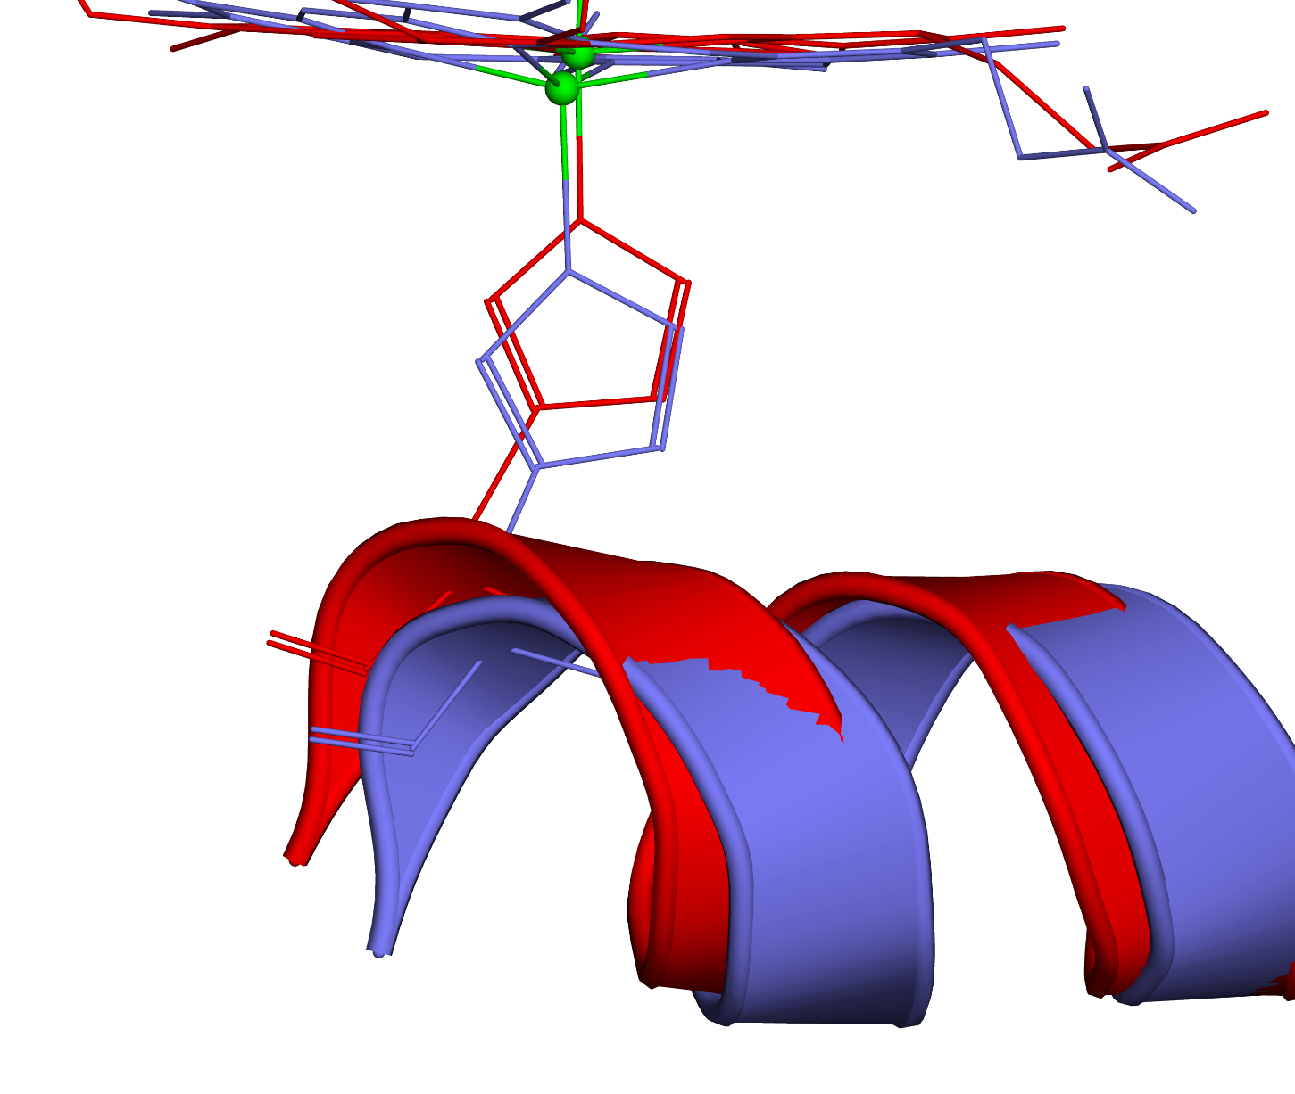
b
Proximal His
F helix

Slide 47
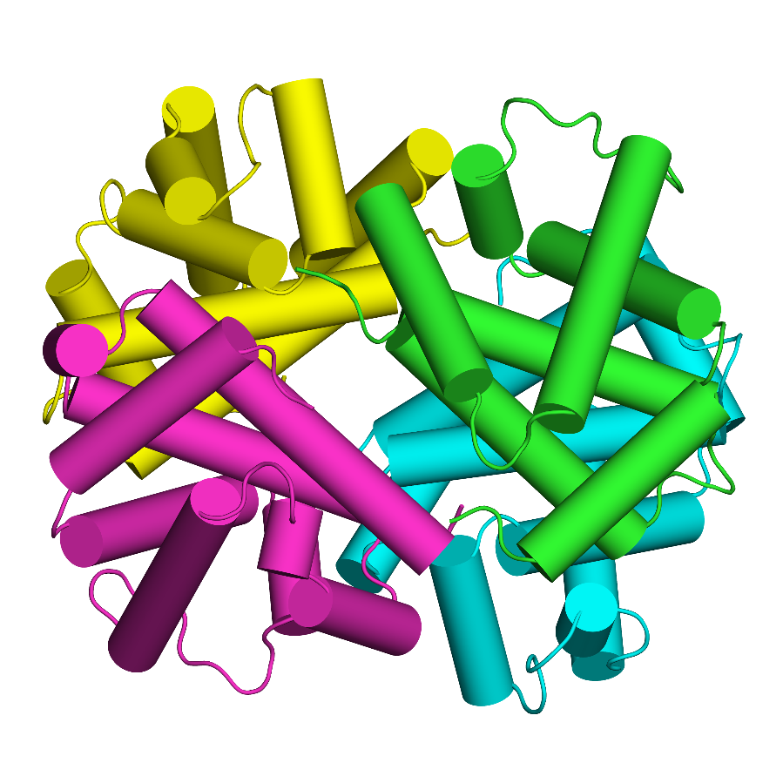
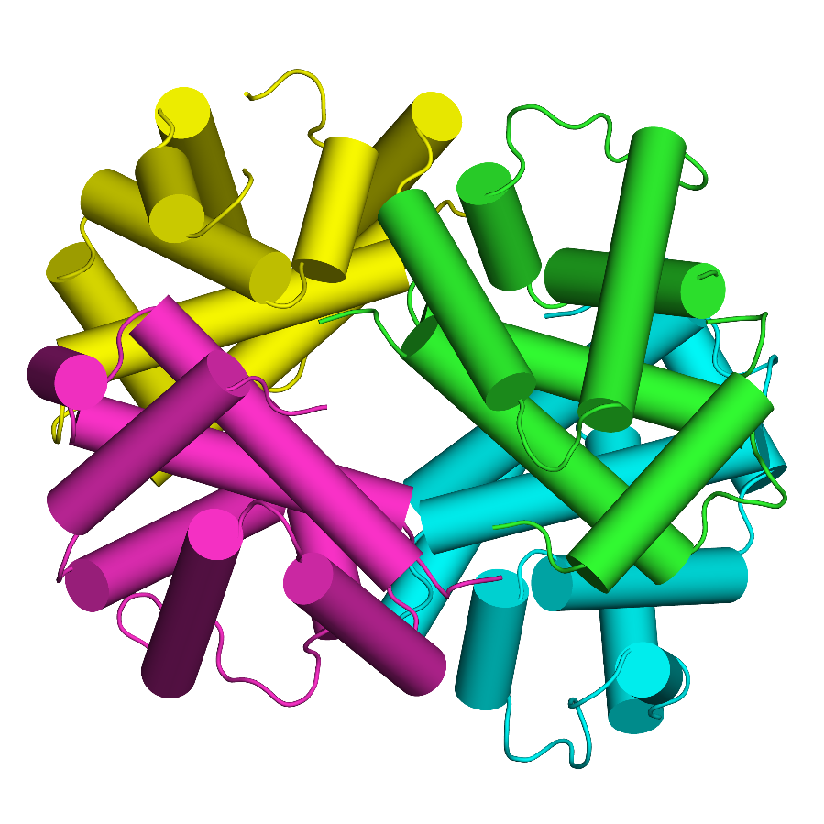
c
Oxy
Deoxy

Slide 48
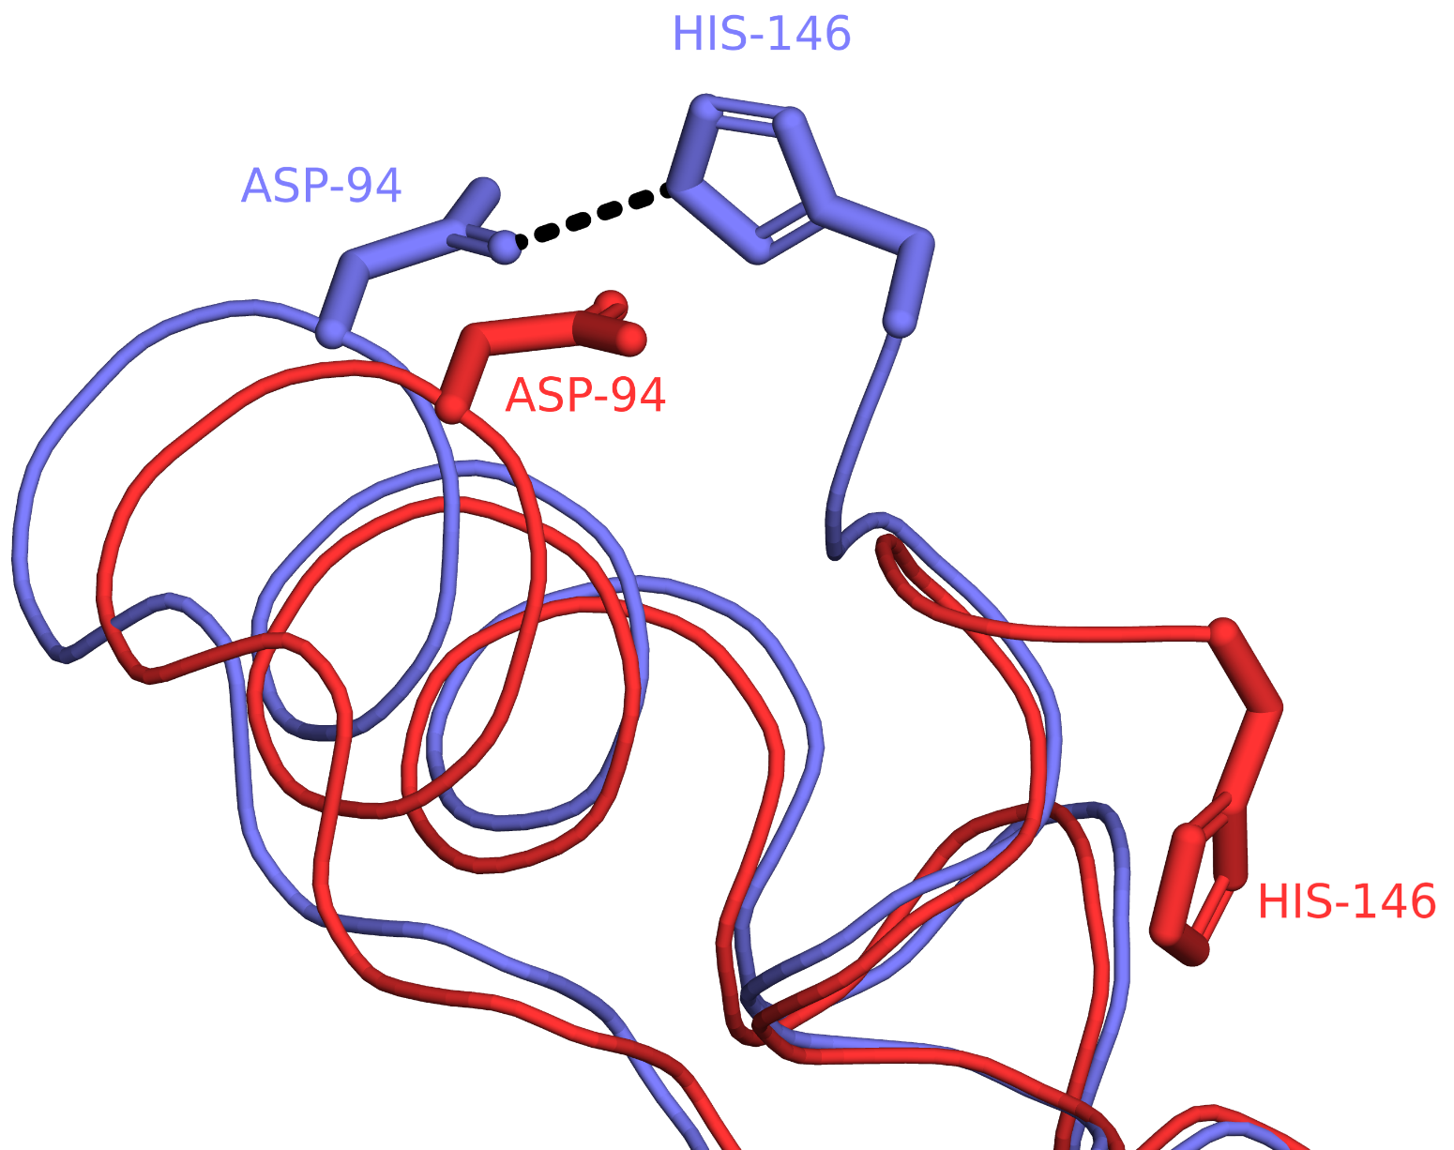
Figure 5.3.7

