Slide 1
Chapter 1:
Introduction

Slide 2
Structural Biology
The study of structure-function relationships in macromolecules

Slide 3
The importance of macromolecules
Macromolecules:
Large (10³ – 10⁶ atoms)
Polymeric – made of smaller building blocks that self-assemble into long chains with complex 3D structure
Have key roles in living organisms

Slide 4
The importance of macromolecules
Proteins – numerous roles (see below)
Nucleic acids (DNA, RNA) - encoding and expression of genetic information
Proteins
(Glutamine synthase)
Nucleic acids
(DNA)
Notes:
Figure 1-3. The four types of macromolecules in biological cells and tissues. (a) Proteins. The enzyme glutamine synthase is shown, with atoms presented as spheres. Each of the six subunits is colored differently. (b) Nucleic acids. The B-DNA double helix is shown, with covalent bonds shown as sticks. The color code follows the convention: carbon atoms are green, oxygen atoms are red, hydrogen atoms are white, nitrogen atoms are blue, and phosphorus atoms are orange.

Slide 5
The importance of macromolecules
Carbohydrates
Energy stores in animals (glycogen) and plants (starch)
Building blocks of plant cell wall (cellulose) and insect exoskeleton (chitin)
Molecular recognition
Notes:
(c) Complex carbohydrates. The image shows cycloamylose (a.k.a. cyclodextrin), an enzymatic product of starch. Cycloamylose is a cyclic oligosaccharide, in which the α-D-glucopyranoside units are linked via 1→4 glycosidic bonds

Slide 6
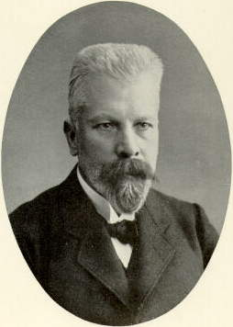
The importance of macromolecules
Louis Pasteur: microorganisms ferment sugar to alcohol
Berthelot & Buchner: chemical processes can be catalyzed by cellular extracts (the zymase concept)
Later:
Zymases are actually proteins (enzymes)
Proteins are the products of genes
Genes are encoded in DNA
Eduard Buchner

Slide 7
Why Are Proteins Interesting?
The most abundant macromolecules:
~50% of the cell’s dry mass
No. of proteins ≈ 4 times the number of their coding genes
Up to 15,000 different proteins in one cell
Notes:
In humans: 20,500 genes but ~100,000 different proteins (these genes are only ~1.5% of our total DNA (PNAS 111: 6131–6138)).
Expression: up to 15,000 distinct proteins in one cell.

Slide 8
Why Are Proteins Interesting?
Functionally diverse:
Catalysis of metabolic processes
Energy transfer
Gene expression
Transport of solutes across membranes
Cellular communication
Molecular recognition
Defense
Forming intracellular & extracellular structures

Slide 9
Protein Roles: Enzymatic Catalysis
Life processes are based on thousands of chemical reactions (metabolic pathways, transport, mechanics, etc.)
Cellular needs: 10⁻⁵-10² seconds for each reaction
Chemical reactions: seconds to 10⁹ years (room temp)

Slide 10
Protein Roles: Enzymatic Catalysis
Enzymes:
Efficient (10¹¹-10¹⁶ acceleration, up to 10²¹)
Specific (substrate, reaction)
Can be controlled
Can couple endergonic to exergonic reactions
+
+

Slide 11
Protein Roles: Enzymatic Catalysis
Enzymes are reaction-specific
Notes:
Figure 9.3. Examples of the six types of reactions catalyzed by enzymes, according to the EC method. (The individual reactions are adapted from the MetaCyc database ^{[29]}.) For clarity, explicit hydrogens are not shown, except around centers in which the number of hydrogen atoms changes during the reaction. (a) Oxidation-reduction (redox): oxidation of ethanol to acetaldehyde, catalyzed by alcohol dehydrogenase ^{ϴ1}. The oxidation involves the transfer of a hydride species (blue) from ethanol’s C_{α} to NAD⁺ and the deprotonation of its hydroxyl group (red). (b) Group transfer: amino transfer from alanine to α-ketoglutarate, catalyzed by alanine aminotransferase ^{ϴ2}. The transfer of the amino group (blue) from the first co-substrate involves reduction of the corresponding carbon atom to a keto group (red), and vice versa in the other co-substrate. However, since these events involve internal electron transfer between amino and keto groups, the reaction is not considered to be redox (see more in subsection 9.1.5.2.1). (c) Hydrolysis: breakdown of aspirin to salicylate (blue) and acetate (green) by using water (red), as catalyzed by aspirin hydrolase ^{ϴ3}. (d) Water-independent cleavage of covalent bonds: breakdown of isocitrate to glyoxylate (blue) and succinate (red), catalyzed by isocitrate lyase ^{ϴ4}. (e) Isomerization: interconversion between fumarate (trans bond) and maleate (cis bond), catalyzed by maleate cis-trans isomerase ^{ϴ5}. (f) Ligation: the attachment of two D-alanine molecules (blue and red), catalyzed by D-alanine-D-alanine ligase

Slide 12
Protein Roles: Enzymatic Catalysis
Enzymes are reaction-specific

Slide 13
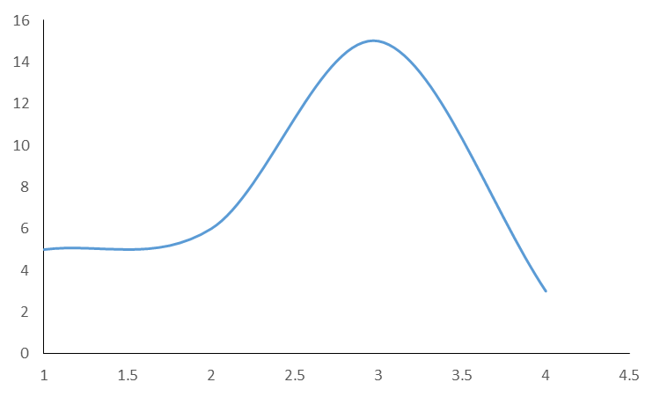
Protein Roles: Enzymatic Catalysis
Enzymes act by stabilizing the transition state of chemical reactions (lowering the activation energy)
G (kcal/mol)
gas constant
rate
A’
(Arrhenius’ equation)
Ea
A
ΔG
B+C
A → [A’] → B+C
Notes:
Enzymes catalyze reactions by lowering their transition states. The way they do it is through a diverse set of mechanisms.

Slide 14
Protein Roles: Enzymatic Catalysis
Electrostatic stabilization
Acid/base catalysis
Transition state
Metal catalysis
Covalent catalysis
Notes:
Enzymes catalyze reactions by lowering their transition states. The way they do it is through a diverse set of mechanisms.

Slide 15
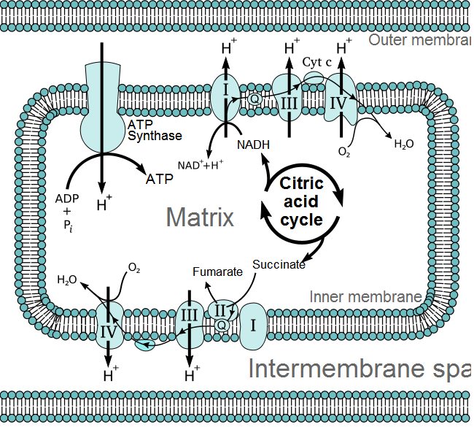
Protein Roles: Energy Transfer
Proteins extract energy from the environment
Outer membrane
Intermembranal Space
Notes:
Figure 1-6. Cellular respiration within mitochondria. The schematic illustration shows the main players of this multi-component system. The citric acid (Krebs) cycle completes the aerobic oxidation of foodstuff inside the mitochodrial matrix. The high-energy electrons released by this process are first stored as NADH & FADH₂, than passed on to the first component of the electron transport chain, embedded within the inner mitochondrial membrane. The electrons pass through several cytochromes and finally passed to molecular oxygen, which is reduced to water. The electron chain contains 3 protein complexes (I, III, IV), which use the energy released upon electron transport to pump protons from the matrix into the intramembranal space. The energy stored in the gradient is released when the latter dissipates via ATP synthase, a protein complex that couples proton movement to ATP synthesis from ADP and inorganic phosphate.

Slide 16
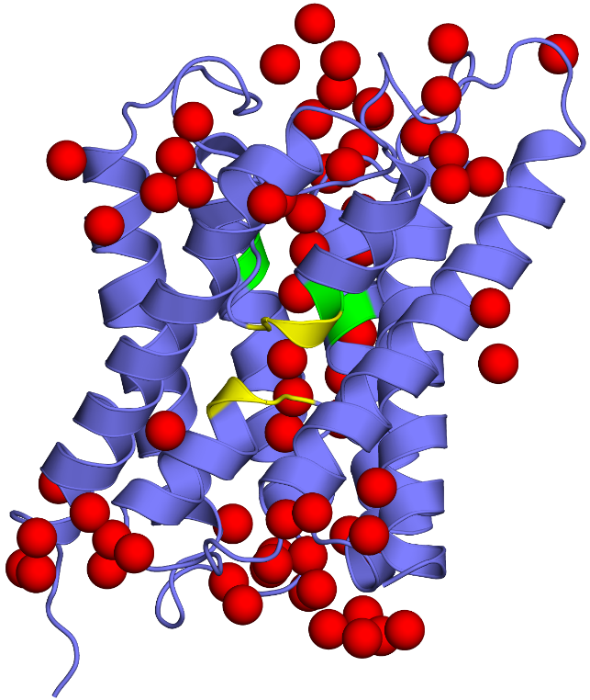
Protein Roles: Import and export of solutes
Some membrane-bound proteins transfer ions and molecules across the cell’s membrane
These include channels and transporters (carriers)
Aquaporin channel
KcsA (K⁺) channel
Notes:
Figure 7-14 (right) and 7-15b (left). Structural characteristics of channel proteins and transporters.

Slide 17
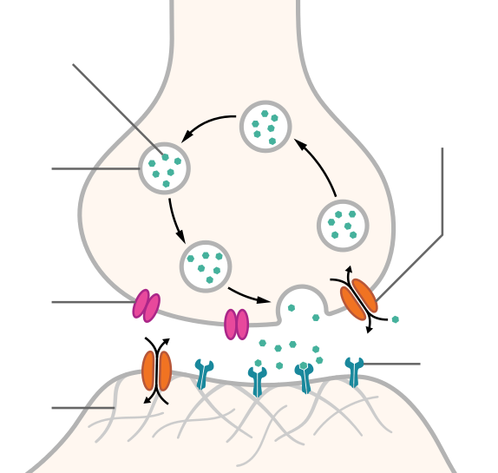
Protein Roles: Cellular Communication
Many cells communicate with one another via chemical messengers
Examples: neurotransmitters (nervous system), hormones (endocrine system) – between distant cells
Thomas Splettstoesser (2015) Wikimedia (URL)

Slide 18
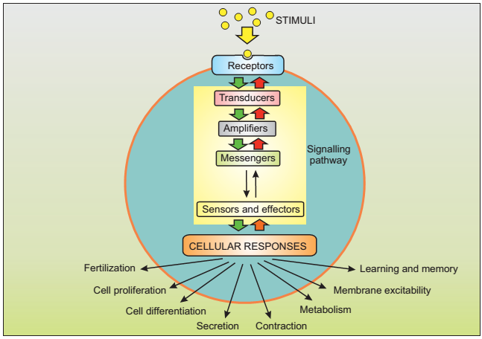
Protein Roles: Cellular Communication
The messengers bind to membrane receptors, which are proteins, and their message is relayed into the cell

Slide 19
Protein Roles: Cellular Communication
The transduction of the external signal into the cell requires multiple elements, many of which are proteins

Slide 20
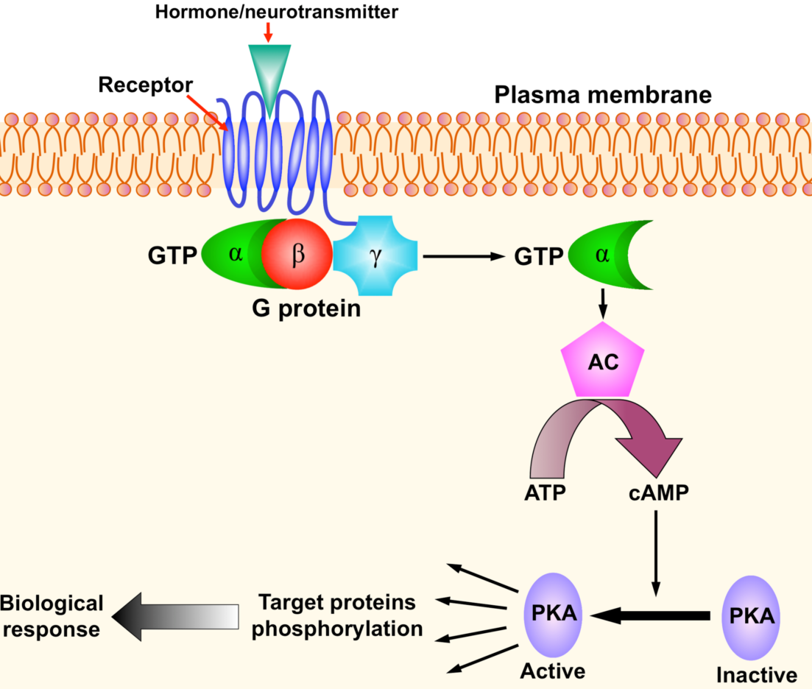
Protein Roles: Cellular Communication
Example: GPCR activation
Notes:
Figure 1.7. The main players in a typical signal transduction cascade. (b) The cAMP-PKA cascade. Binding of an external chemical messenger (hormone, neurotransmitter, etc.) to a membrane-bound protein receptor induces the activation of an enzyme called a G-protein, which acts as a transducer. This activation makes one of the protein's subunits detach from the other, bind to the enzyme adenylyl cyclase (AC), and activate it. Activated AC catalyzes the conversion of ATP into cyclic AMP, which acts as an intracellular messenger. It binds to and activates the enzyme amplifier PKA, which in turn phosphorylates a large set of cytoplasmic proteins. The phosphorylated proteins may activate other cellular components, or perform a certain function (that is, they may act as sensors and/or effectors). In any case, this signal transduction eventually leads to changes in the cell's behavior, i.e., to a biological response.

Slide 21
Protein Roles: Cellular Communication
Surface receptors also mediate direct cell-cell communication
The receptor are chemically and physically adapted to recognize their target protein

Slide 22
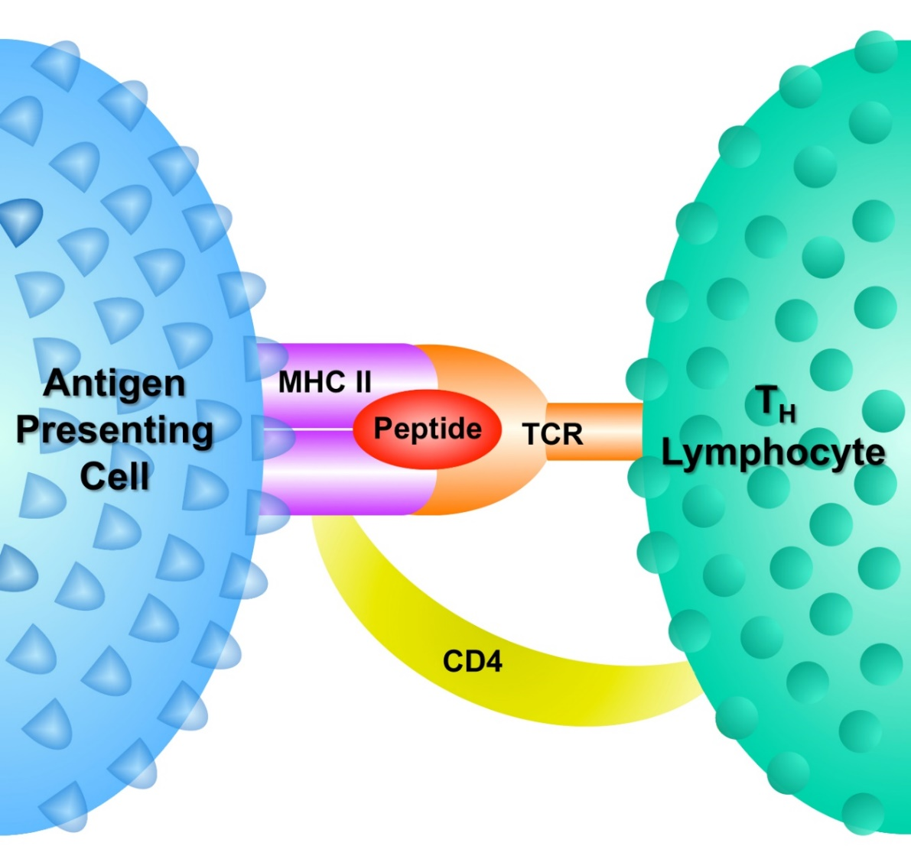
Protein Roles: Defense
Protein-protein recognition is also part of cell’s defense mechanisms
Notes:
Figure 1-8. Proteins involved in the interactions between an antigen presenting cell and a T_{H} lymphocyte. Antigen-presenting cells (APC), such as macrophages, can internalize bacteria, cleave their proteins to peptides, and present these peptides onto their surface while bound to some of their own proteins, called MHC-II (major histocompatibility complex type II). T_{H} lymphocytes, a type of immune cells, can recognize the APC-foreign antigen complex using their own cell-surface proteins. Specifically, the T-cell receptor (TCR) of the lymphocyte specifically recognizes the foreign antigen presented onto the APC, whereas another protein, called CD4 (complementarity determinant number 4), recognizes the MHC-II protein. There are other recognition proteins that are not presented here. The recognition described above allows the T_{H} lymphocyte to alert the rest of the immune system about the presence of a pathogen inside the body, which leads to the amounting of a full-scale immune response against it.

Slide 23
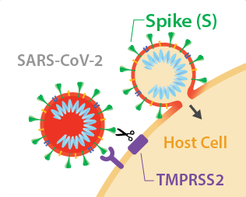
Protein Roles: Viral infection
Viral proteins co-evolved with cellular surface proteins, facilitating cell entry and infection
Example – SARS-CoV2:
The spike protein binds to two surface receptors:
ACE2 – allows attachment to the cell
TMPRSS2 – cleaves parts of the spike protein, allowing membrane fusion
ACE2
https://www.abmgood.com/Coronavirus-SARS-CoV-2-Receptors

Slide 24
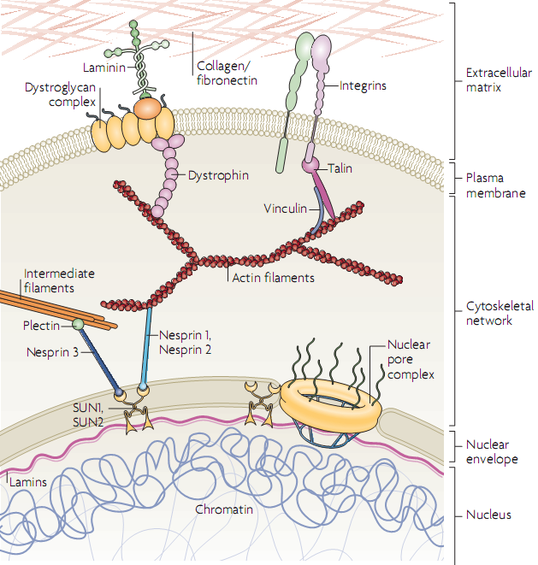
Protein Roles: Building Cells and Tissues
Nat. Rev. Mol. Cell. Biol. (2009) 10: 63-73
Notes:
Figure 2.48. Connectivity of the extracellular matrix and intracellular elements. The figure shows the continuous protein network starting from collagen and fibronectin fibers outside the cell, to membrane-crossing elements such as integrins, to intracellular elements such as actin- and intermediate-filaments of the cytoskeleton, and finally to elements inside the cell nucleus, such as lamins.

Slide 25
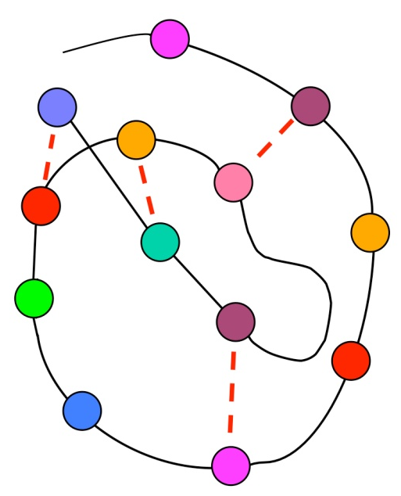
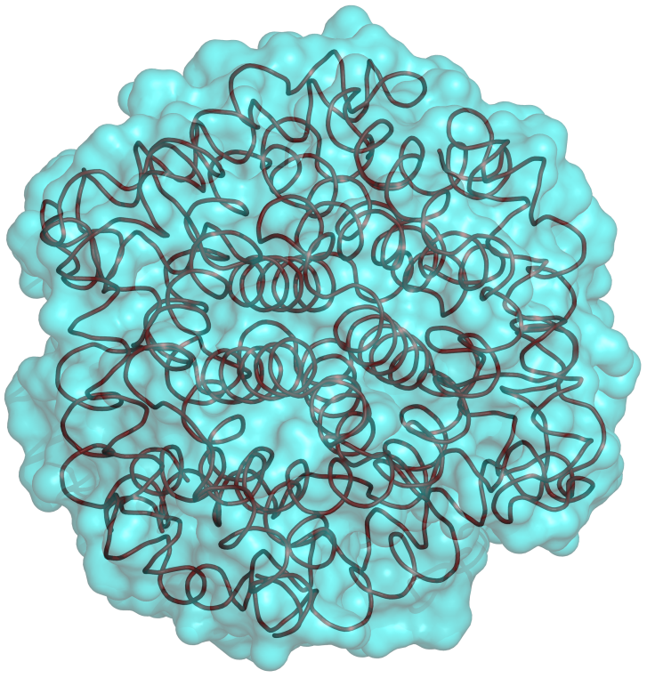
Proteins’ functionality results from their chemical and structural complexity
Each protein is built from a chain of amino acids that folds into a 3D structure due to attraction and repulsion forces
Notes:
How can proteins, which are made from the same material, have so many different functions? The answer has to do with the structural and chemical diversity of proteins. Proteins are made of chains of amino acids. There are 20 types of amino acids and each protein chain is a combination of these types. The chemical properties of the amino acids makes some attract to each other whereas others are repelled from each other. This drives the chain to fold into a 3D structure that maximizes attraction and minimizes repulsion. Since each protein has a different sequence of amino acids, each folds into a different structure.
What does that have to do with functional diversity?
Figure 1-10. The principle structure and folding of proteins. (a) The protein's amino acid sequence, shown schematically as beads on a string. The different colors represent the physical-chemical diversity of amino acids. (b) A folding intermediate, in which some of the total possible amino acid interactions are satisfied (represented by dotted lines). (c) The final (native) structure of the protein.

Slide 26
Proteins’ functionality results from their chemical and structural complexity
The action of all proteins involves ligand binding:
Enzyme-substrate
Receptor-hormone/neurotransmitter
G-protein-GTP
Histone-DNA
Hemoglobin-O₂
Channel/transporter-ion/solute
Cytoskeleton proteins
Extracellular proteins
Notes:
The action of virtually all proteins involves binding of a ligand (small molecule, another macromolecule).

Slide 27
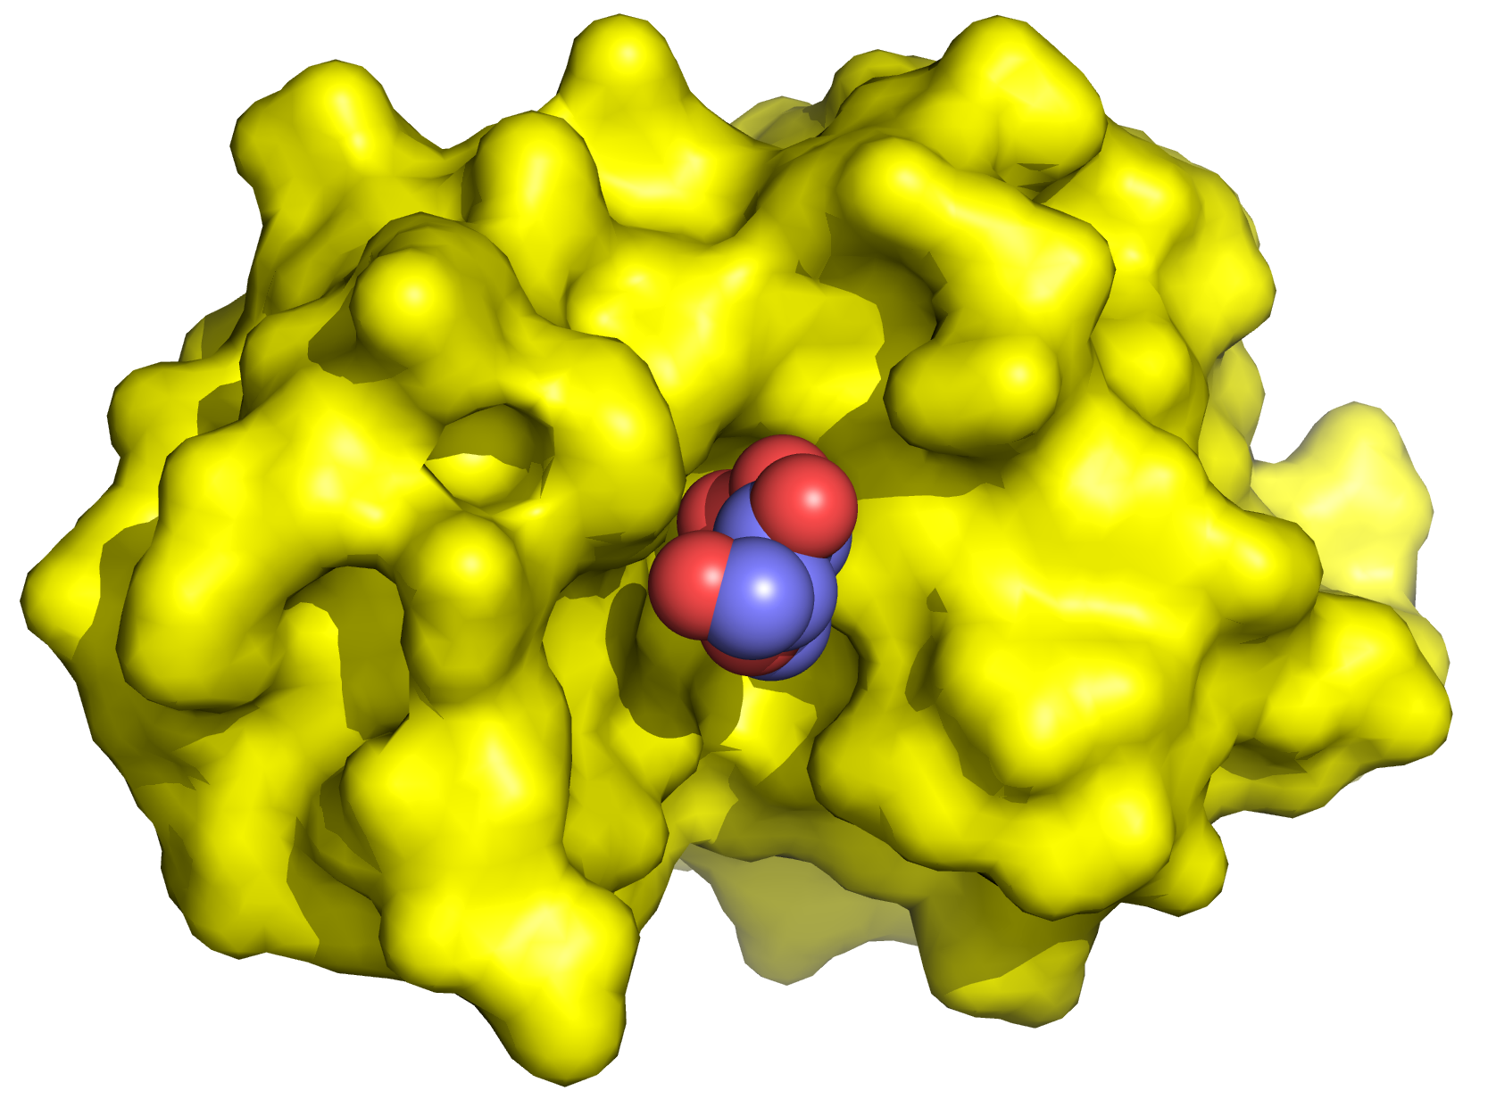
Proteins’ functionality results from their chemical and structural complexity
Ligand binding occurs at specific proteins sites
The binding involves non-covalent interactions of ligand with amino acids in the binding site
Notes:
Figure 1.11. Structure-function relationship in the binding site of an enzyme (lysozyme). Left: The overall structure of an enzyme (PDB entry 9lyz). The contours of the enzyme are shown as a yellow surface. The substrate (blue spheres) is shown within the binding site (red circle). Right: A magnification of the binding site, showing the substrate and some of the enzyme’s amino acids that participate in the binding (green sticks) and catalysis (orange sticks) of the substrate.

Slide 28
Proteins’ functionality results from their chemical and structural complexity
In enzymes, the amino acids within the binding site change the ligand (substrate) chemically
Notes:
Figure 1.11. Structure-function relationship in the binding site of an enzyme (lysozyme). Left: The overall structure of an enzyme (PDB entry 9lyz). The contours of the enzyme are shown as a yellow surface. The substrate (blue spheres) is shown within the binding site (red circle). Right: A magnification of the binding site, showing the substrate and some of the enzyme’s amino acids that participate in the binding (green sticks) and catalysis (orange sticks) of the substrate.

Slide 29
Proteins’ functionality results from their chemical and structural complexity
Each protein:
Different amino acid sequence → different 3D structure → different binding/catalytic sites
Notes:
Figure 1.11. Structure-function relationship in the binding site of an enzyme (lysozyme). Left: The overall structure of an enzyme (PDB entry 9lyz). The contours of the enzyme are shown as a yellow surface. The substrate (blue spheres) is shown within the binding site (red circle). Right: A magnification of the binding site, showing the substrate and some of the enzyme’s amino acids that participate in the binding (green sticks) and catalysis (orange sticks) of the substrate.

Slide 30
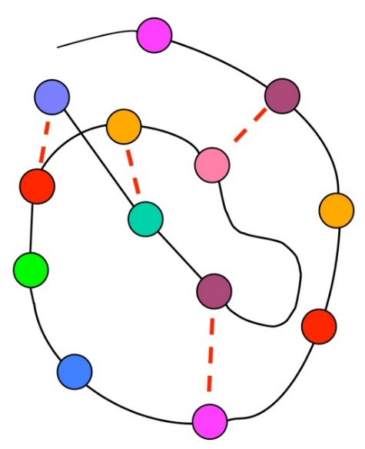
Non-covalent interactions
Non-covalent interactions:
Drive the folding of the protein chain into a specific 3D structure
Drive the binding of ligands (substrate, hormone, messenger, allosteric modulator) to a binding/catalytic site in the proteins

Slide 31
Non-covalent interactions
Much weaker than covalent bonds
Make biomolecules flexible, and allow them to interact reversibly with each other

Slide 32
Non-covalent interactions
Notes:
Figure 1.12. Main non-covalent interactions found in proteins. (a) The relationship between the interaction types (see more detailed description in the main text). The dominant interactions in proteins are colored in blue. vdW: van der Waals.

Slide 33
Electrostatic interactions
Charge 1
Charge 2
Charge-charge:
(ionic)
+
-
Charge
Dipole
δ-
δ+
Charge-dipole:
+
δ-
δ+
Dipole 1
Dipole 2
δ+
δ-
δ+
δ-
Dipole-dipole:
δ-
δ+
δ-
δ+
Notes:
Figure 1.12. Main non-covalent interactions found in proteins. (b) Types of charges involved in attractive electrostatic interactions. + and – indicate full positive and negative charges (respectively) on the atoms. δ+ and δ- indicate (permanent) partial positive and negative charges (respectively). Left: A schematic representation of the interactions. The covalent bonds are marked by bars, and the electrostatic interaction is marked by the orange dotted line. Right: Examples of the interactions, between the following groups: a positively-charged ammonium and a negatively charged carboxylate (top), a positively-charged ammonium and a hydroxyl dipole (middle), and an amino dipole and a hydroxy dipole (bottom).

Slide 34
Electrostatic interactions
Ionic interactions (salt bridges)
Occur between charges
Attractive or repulsive, depending on the sign of the interacting charges

Slide 35
Electrostatic interactions
Ionic interactions (salt bridges)
long-range interactions (e.g. in tutorial)
ε
q_{i}
r_{ij}
q_{j}
[Å]
[kcal/mol]
Notes:
The charges are in proton charge units (+1, -2, etc.).
Figure 1-13. Electrostatic interaction between two point charges of opposite sign. (a) The charges are depicted as two points, with r_{ij} denoting the distance separating them. One of the charges, q_{i}, is positive (blue) whereas the other, q_{j}, is negative (red). The gray box represents the medium, of dielectric constant ε, in which the charges are placed. Note that in cases where the charges are also chemical entities (atoms, molecules), they too have a dielectric constant.

Slide 36
Electrostatic interactions
Ionic interactions (salt bridges): the dielectric (ε)
The capability of a medium to mask electrostatic interactions
Results from the polarity of the molecules composing the medium
Vacuum (ε = 1): E = -332 kcal/mol
Oil (ε ≈ 2): E = -166 kcal/mol
Water (ε ≈ 80): E ≈ -4 kcal/mol
r = 1
Na⁺
Cl⁻

Slide 37
Electrostatic interactions
Polarity
r
Debye = 3.34×10⁻³⁰ Coulomb (q) × meter (r)
Notes:
Polarity involves a dipole, that is, a bond that connects two partial charges of opposite signs, formed by the electronegativity difference (full charges involve extra/fewer electrons in binding orbitals, like the binding of nitrogen’s unpaired electrons to a 4th hydrogen, or the extra electron of a carboxyl group). The polarity of the bond is usually described by the dipole moment, which is the separation of the charges, and whose direction is from the negative charge to the positive charge. This is because the dipole moment correlates with the size of the electric field emanating from the dipole.
The units of the dipole moment are Coulombmeter (thus, q must be in Coulombs), or Debye, which are 3.34×10⁻³⁰ Coulomb×meter.
The dipole moment equation shown assumes that the two partial charges are of the same magnitude. When they are not, two half-dipoles can be calculated (one for each charge, with r/2), and then summed to get the value of the entire dipole (for that, the negative dipole must be considered as positive).
Box 1-2 Figure 1. The polarity of a water molecule. The electronegativity value of each atom is noted. The most electronegative atom and its bonded partner are noted by red and blue numbers, respectively. δ+ and δ- denote the positive and negative poles of each bond.
Box 1-2 Figure 3. The nonpolar nature of methane. The electronegativity values and colors are presented as in Figure 1. The hydrogen atom bonded by the bold triangle sticks out of the paper, whereas the one bonded by the stripped triangle retreats into the paper.

Slide 38
Electrostatic interactions
H
H
O
H
H
H
H
O
O
H
H
H
H
H
H
O
H
H
O
H
H
H
H
O
+
O
-
O
O
H
H
H
H
H
H
O
O
O
H
H
O
H
H
H
H
H
H
O
O
O
Notes:
Box 1-2 Figure 4. Charge screening by surrounding water molecules. The dotted lines represent hydrogen bonds. The angle separating the two O-H bonds in water molecules is 104.45º. Here we used a smaller value for graphic purposes.

Slide 39
Electrostatic interactions
Charge-medium interaction
The Born model:
q .
r
→ ΔE_{transfer} = 166 (q²/r) (1/ε_{o} - 1/ε_{w})
water-to-oil transfer (r = 1.6Å):
ΔE = 166 (1²/1.6)(1/2-1/80) = 50 kcal/mol
Notes:
The transfer of polar solutes between media of different polarity is highly relevant in biological systems, which contain both high-dielectric media (cytoplasm, intercellular fluid, blood, lymph, urine) and low-dielectric media (plasma membrane, membranes of eukaryotic organelles, the blood-brain barrier)

Slide 40
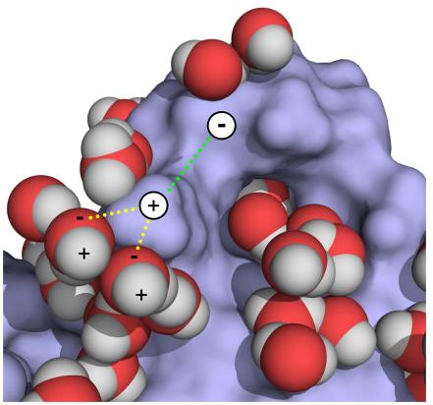
Electrostatic interactions
The total electrostatic energy
Notes:
Figure 1.14. Components of the total electrostatic interaction. (b) the interacting charges (white circles with + or - signs) are in a protein. The surface area of the protein is shown in blue, along with the first layer of solvent water molecules around it (red and white spheres). Two types of electrostatic interactions are presented: between charges within the protein (green dotted line), and between protein and solvent charges (yellow dotted lines).

Slide 41
Electrostatic interactions
Hydrogen bonds
Notes:
Note that the scheme describes hydrogen bonds in proteins, which is why the heavy atom on the right is bonded to carbon. Generally speaking, hydrogen bonds can be between any two dipoles that ‘share’ a hydrogen.
Figure 1-15. The hydrogen bond. (a-left) A general depiction of the hydrogen bond between a donor D and an acceptor A. δ+ and δ- indicate the sign of the partial positive and negative charges (respectively) on the atoms. The single and double covalent bonds are marked by bars and the hydrogen bond is marked by the orange dotted line.

Slide 42
Electrostatic interactions
Hydrogen bonds
Typical distances:
D--A: 2.8-3.0 Å
H--A: ~2 Å
Notes:
Figure 1-15. The hydrogen bond. (a-right) examples of hydrogen bonds found in proteins. The R groups signify the moieties bound to the reactive groups; in all cases the heavy atom in the reactive group is bound to a carbon atom in the R group.

Slide 43
Electrostatic interactions
Hydrogen bonds
Like ionic interactions hydrogen bonds depend on q, r, and ε
Unlike ionic interactions hydrogen bonds are geometry-dependent
Hydrogen bonds are weaker and more distance-dependent than ionic interactions (r³ instead of r)
H
A
θ_{i}
θ_{j}
r
( )
D
C
Notes:
In the equation, μ should be in Debye, and the resulting energy is in kcal/mol.
(b) The three geometric parameters used to characterize hydrogen bonds (see main text for details). The bond is shown schematically, with the four involved atoms represented as spheres, and each of the covalent bonds between them represented as a bar. (c) The electrostatically-preferable hydrogen bond geometry. As explained in the main test, quantum-mechanical effects might favor a non-colinear configuration. In addition, entropy considerations would favor non-colinear configurations, as there are more such configurations for each fixed angle, which is non-zero. Atoms and bonds are represented as in b.

Slide 44
Electrostatic interactions
Hydrogen bonds
Water
1 Å
O
H
N
C
μ = 1.5 D
μ = 0.2 D
-14.4[1.5×0.2(2cos(0)cos(0) – sin(0)sin(0))]
E_{Coul} =
= -0.11 kcal/mol
80(1³)
ε
r
Notes:
The equation shows that even when the hydrogen bond is strongest (linear and short), the potential energy is much lower than that of the ionic bond (~4 kcal/mol). Note, however, that if the interactions was between two OH and NH groups (μ of N-H is 1.3 D), the energy would be 0.7 kcal/mol.
The moment dipole values are taken from Ouellette and Rawn (2018) Organic chemistry, 2ed, Chapter 1, Section 1.9. (https://www.sciencedirect.com/topics/chemistry/bond-moment)

Slide 45
Electrostatic interactions
π (aromatic) interactions
Notes:
Figure 1.16. Weak electrostatic interactions in proteins. (a) (I) Electrostatic properties of aromatic rings. Delocalization of π electrons in aromatic rings (in this case benzene) creates a partially negative charge above and below the ring plane (marked by the dashed line), and a partially positive charge at the ring plane.

Slide 46
Electrostatic interactions
π (aromatic) interactions
Dipole-dipole
Ion-dipole
Dipole-dipole
Notes:
(II) Cation-π interactions between an Na⁺ ion (purple sphere) and an indole ring (shown as sticks with carbon atoms colored green and nitrogen atoms colored blue) in the protein lysozyme (PDB entry 1lpi). (III) π-hydrogen bond between an OH group and a phenol ring (both shown as sticks) in the protein glutathione transferase (PDB entry 6gst). The atoms are colored as in II, with the hydrogen atom colored white. (b) Interactions between thiol groups (represented here by SH₂) and aromatic rings. The three geometric configurations shown in the figure are known to be common in proteins ^{[148]}. Configuration I represents simple electrostatic interactions between (i) the lone electron pair of S (shown as red dots) and the positive potential around the plane of the aromatic ring (the potential’s extrema are shown as blue spheres (created using TorchLite*^{[165]})), and (ii) the partial positive charges of the thiol’s hydrogen atoms (δ+ signs) and the π electron clouds above and below the ring’s plane (red shapes, created using TorchLite).

Slide 47
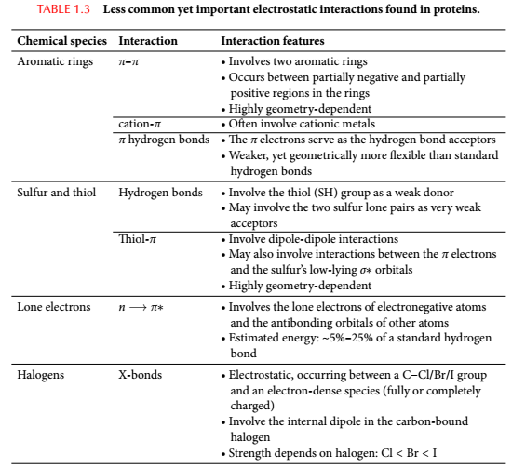
Electrostatic interactions

Slide 48
van der Waals Attraction (Dispersion)
Interaction between induced dipoles (all atom types)
δ-
δ+
δ-
δ+

Slide 49
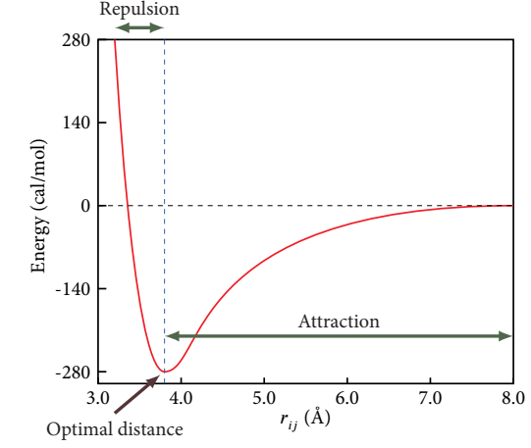
van der Waals Interactions (Dispersion)
Highly distance-dependent (optimal only at short distances)
Notes:
Figure 1-17. van der Waals interactions. The van der Waals interaction energy as a function of the distance between the nuclei within an Argon dimer. The energy was calculated using an empirical potential of Aziz (J. Chem. Phys. 99: 4518-4525). The long-ranged (electrostatic) attraction, resulting from the dispersion force between the atoms, and the repulsion, resulting from Pauling's exclusion principle at short distance, are noticeable.

Slide 50
van der Waals Interactions (Dispersion)
The van der Waals distance signifies the atomic boundary
r_{vdW}
Notes:
Figure 1-17. van der Waals interactions. The van der Waals interaction energy as a function of the distance between the nuclei within an Argon dimer. The energy was calculated using an empirical potential of Aziz (J. Chem. Phys. 99: 4518-4525). The long-ranged (electrostatic) attraction, resulting from the dispersion force between the atoms, and the repulsion, resulting from Pauling's exclusion principle at short distance, are noticeable.

Slide 51
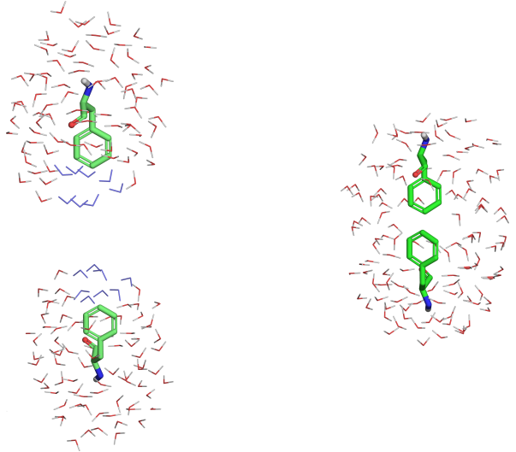
Nonpolar interactions
Notes:
At room temperature the hydrophobic effect is entropy driven. Above ~110 °C it is enthalpy driven (Baldwin 1986 PNAS 83: 8069-8072,). This is because at high temperature the water molecules in the cages around the isolated solutes are almost as dynamic as in bulk water. So, when the solutes bind to each other there is only negligible change in entropy, which leaves only the enthalpy changes. These result from breaking the hydrogen bonds between the water molecule in the cage, which means the enthalpy change is positive (unfavorable). So, at high temperature the hydrophobic effect is weaker, or even unfavorable.
Figure 1-18. The hydrophobic effect. The effect is demonstrated by the amino acid phenylalanine (Phe), which possesses a polar region containing amide and carbonyl groups, and a large nonpolar region containing a benzene ring. (a) Two Phe molecules in solvent. Each of the molecules is surrounded by a hydration shell, in which the water molecules are more ordered than in the bulk. The Phe are shown as sticks and the surrounding water molecules as lines. Water molecules that separate the two Phe are in blue. (b) Association of the two Phe molecules pushes the water molecules separating them (in blue) into the bulk, and a single hydration shell is formed around the complex. The order of the released water molecules decreases, which means that the overall entropy of the system increases.

Slide 52
Nonpolar interactions
For example: alanine-alanine side chains
Water
buried
+
14 Å²
E_{np} = -0.025(14 Å²) = -0.35 kcal/mol
Notes:
At room temperature the hydrophobic effect is entropy driven. Above ~110 °C it is enthalpy driven (Baldwin 1986 PNAS 83: 8069-8072,). This is because at high temperature the water molecules in the cages around the isolated solutes are almost as dynamic as in bulk water. So, when the solutes bind to each other there is only negligible change in entropy, which leaves only the enthalpy changes. These result from breaking the hydrogen bonds between the water molecule in the cage, which means the enthalpy change is positive (unfavorable). So, at high temperature the hydrophobic effect is weaker, or even unfavorable.
Figure 1-18. The hydrophobic effect. The effect is demonstrated by the amino acid phenylalanine (Phe), which possesses a polar region containing amide and carbonyl groups, and a large nonpolar region containing a benzene ring. (a) Two Phe molecules in solvent. Each of the molecules is surrounded by a hydration shell, in which the water molecules are more ordered than in the bulk. The Phe are shown as sticks and the surrounding water molecules as lines. Water molecules that separate the two Phe are in blue. (b) Association of the two Phe molecules pushes the water molecules separating them (in blue) into the bulk, and a single hydration shell is formed around the complex. The order of the released water molecules decreases, which means that the overall entropy of the system increases.

Slide 53
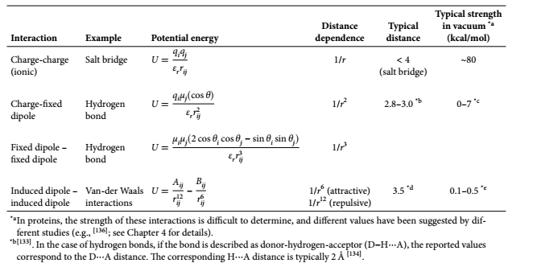
Summary
Notes:
Table 1.2. A summary of the the main types of electrostatic interactions found in proteins. Van der Waals interactions are also described here because of their electrostatic nature. q is the full charge (in electron charges), μ is the dipole moment (in Debye), r_{ij} is the distance between the charges (in Å), and ε_{r} is the relative dielectric constant of the medium. The θ angles in the second and third equations are defined in Figure 1.15b. To obtain the energy in kcal/mol, the following pre-factors should be used: 332 for the first equation, 69.1 for the second equation, and 14.4 for the third equation. * In proteins, the strength of these interactions is difficult to determine, and different values have been suggested by different studies (e.g., ^{[137]}; see Chapter 4 for details). *² ^{[134]}. In the case of hydrogen bonds, if the bond is described as donor-hydrogen-acceptor (D-H∙∙∙A), the reported values correspond to the D∙∙∙A distance. The corresponding H∙∙∙A distance is typically 2 Å

Slide 54
Summary of Chapter 1
Macromolecules are important for life processes in all living organisms.
Proteins are the most functionally diverse macromolecules.
The functional diversity of proteins results from their chemical and structural complexity, and is based to a large extent on their ability to form versatile binding sites to other molecules.

Slide 55
Summary of Chapter 1
Whereas the chains of proteins are constructed by forming covalent bonds, the folding and binding capabilities of the chains rely on weaker non-covalent interactions.
Most non-covalent interactions are electrostatic in nature.
Non-polar interactions result from the hydrophobic effect, which has to do with the entropy of the water solvent.

