Slide 1
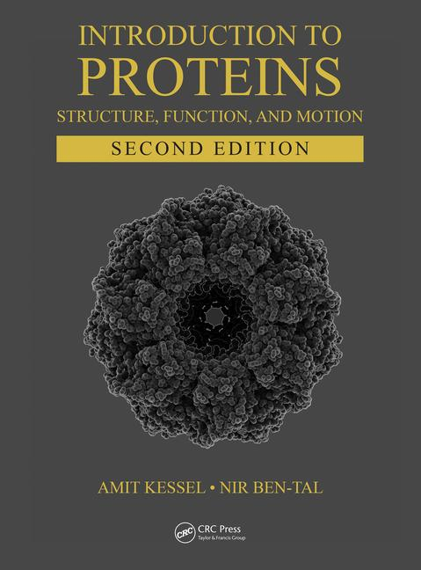
This PPT presentation is provided as suppl. material to the book:
Introduction to Proteins: Structure, Function, and Motion
2nd Edition (2018)
Amit Kessel & Nir Ben-Tal

Slide 2
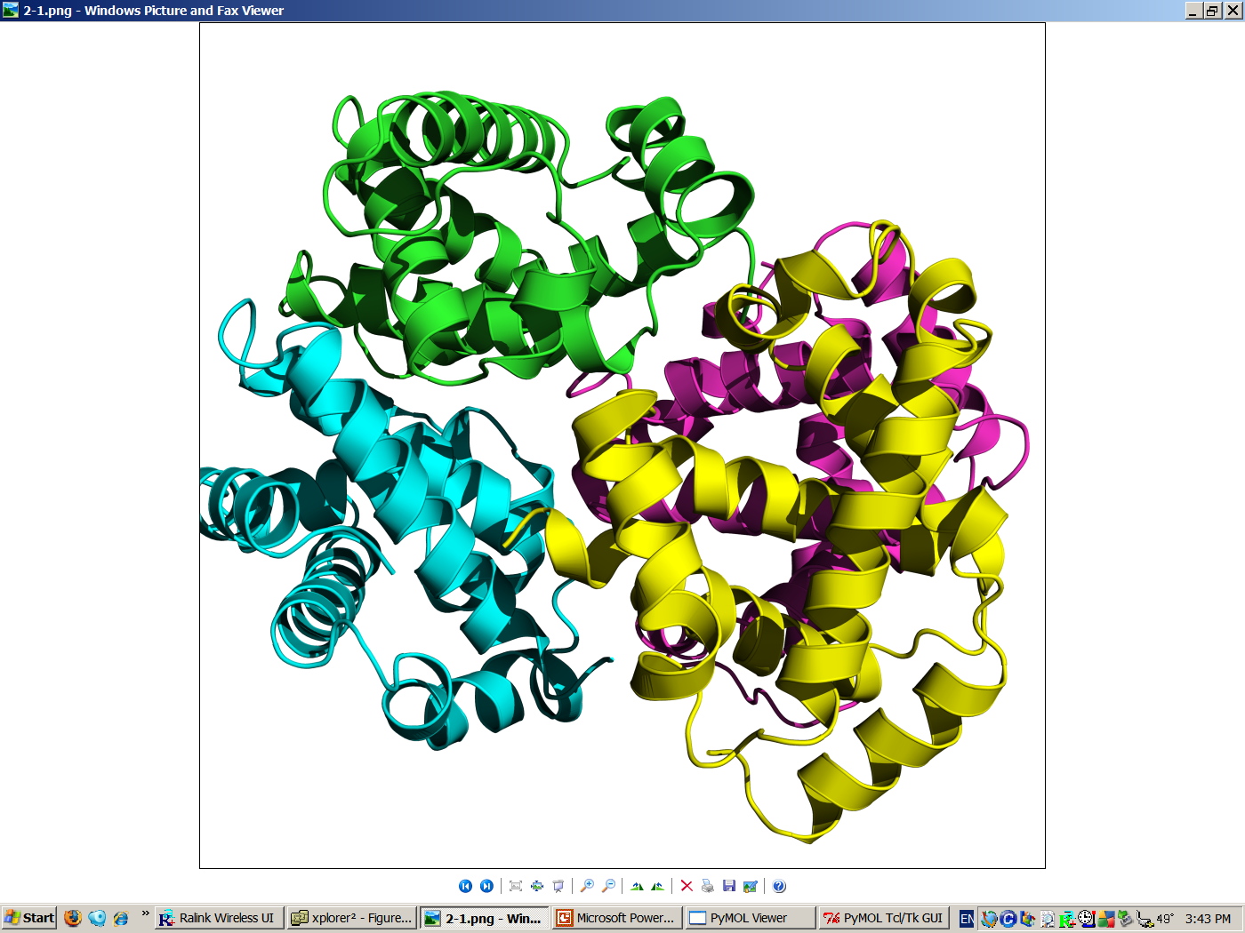
APGDAG
Primary
Secondary
Tertiary
Quaternary
Figure 2.1

Slide 3
a
NAD⁺
O
O
C
O
C
O⁻
TPP
Lipoic Acid
+
C
O
S-CoA
CH₃
FAD
(pyruvate)
Pyruvate Dehydrogenase Complex
C
O
+
NADH
CH₃
HS-CoA
(acetyl-CoA)
Figure 2.2

Slide 4
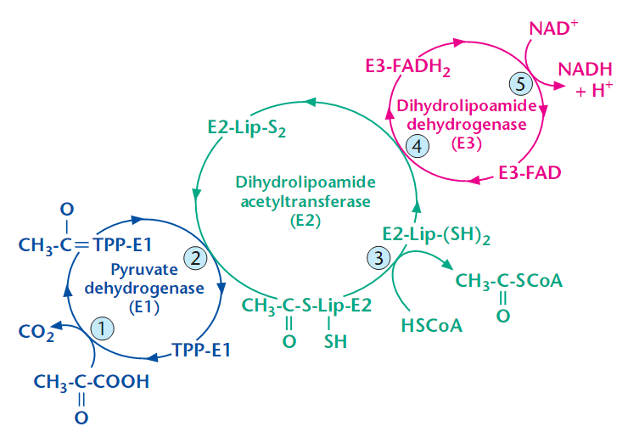
b

Slide 5
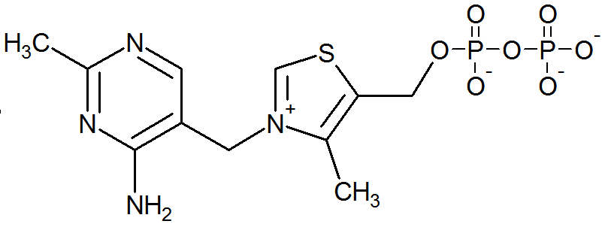
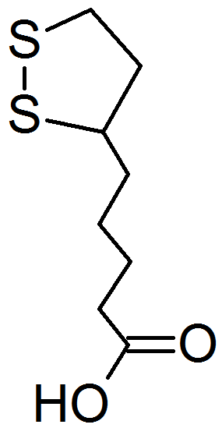
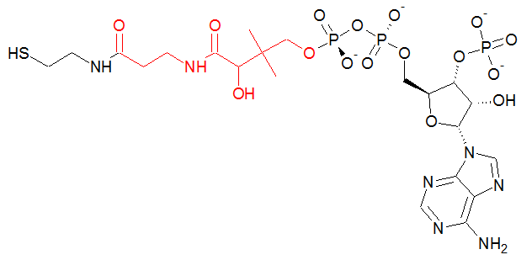
c
H
Thiamine pyrophosphate (TPP)
Pantothenic acid (B₅)
Lipoic acid
Coenzyme A

Slide 6
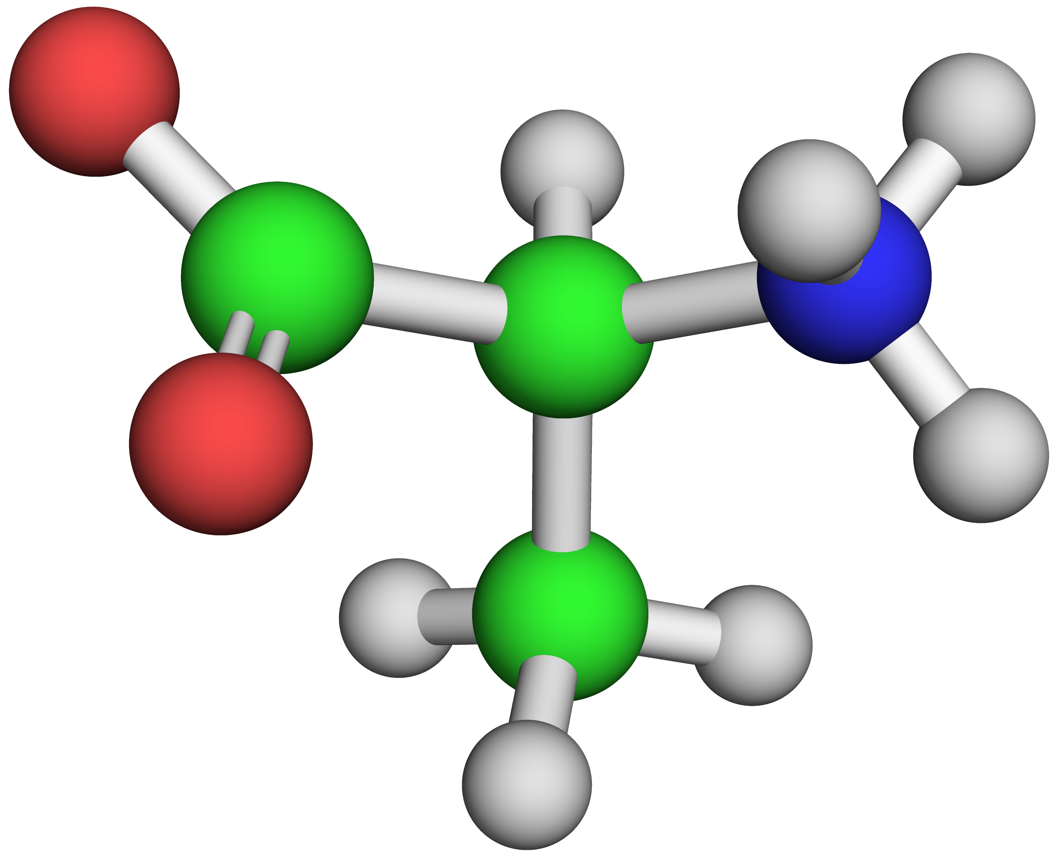
α-carboxyl
α-amino
(-)
O
C
(+)
Backbone
N
C_{α}
O
C_{β}
Sidechain
Figure 2.3

Slide 7
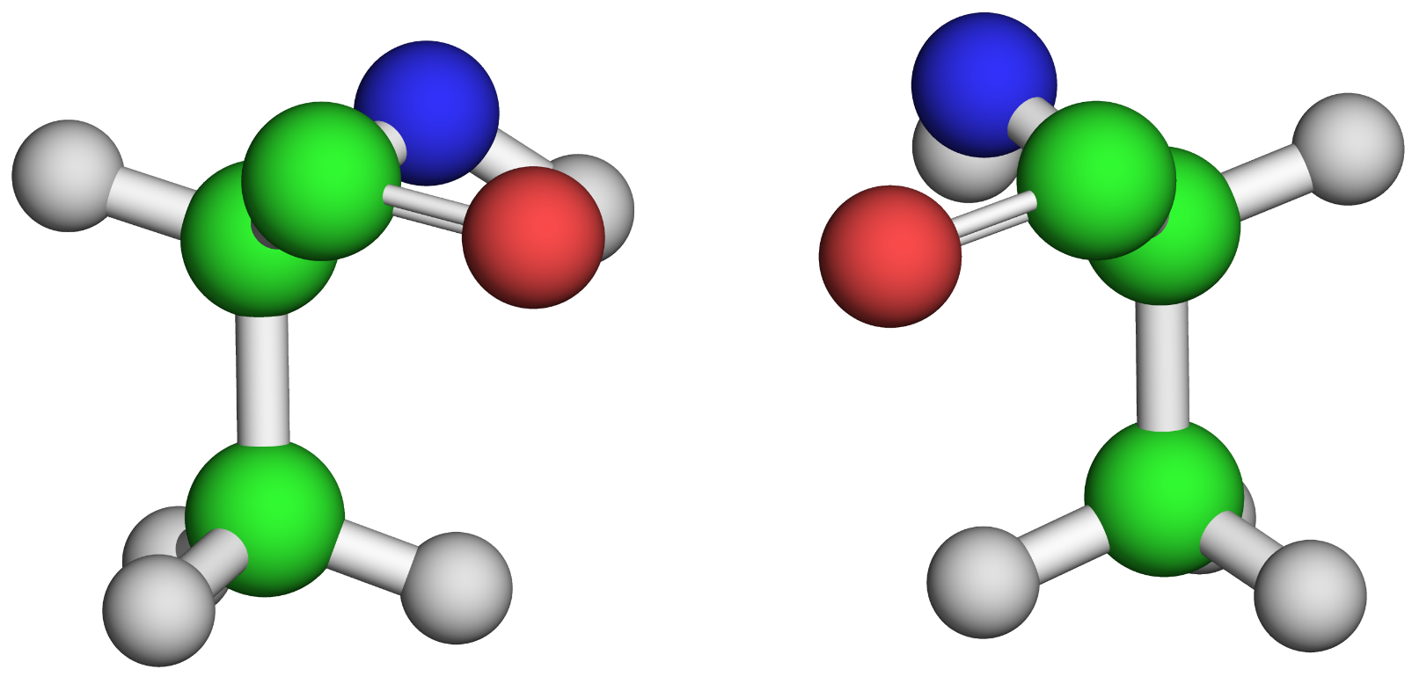
N
N
C
C
C_{α}
O
O
C_{α}
C_{β}
C_{β}
L-Alanine
D-Alanine
Figure 2.4

Slide 8
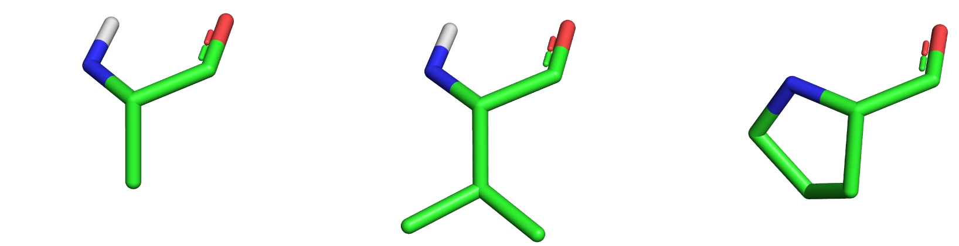

a
Alanine (Ala, A)
Valine (Val, V)
Proline (Pro, P)
Leucine (Leu, L)
Isoleucine (Ile, I)
Methionine (Met, M)
Figure 2.5

Slide 9
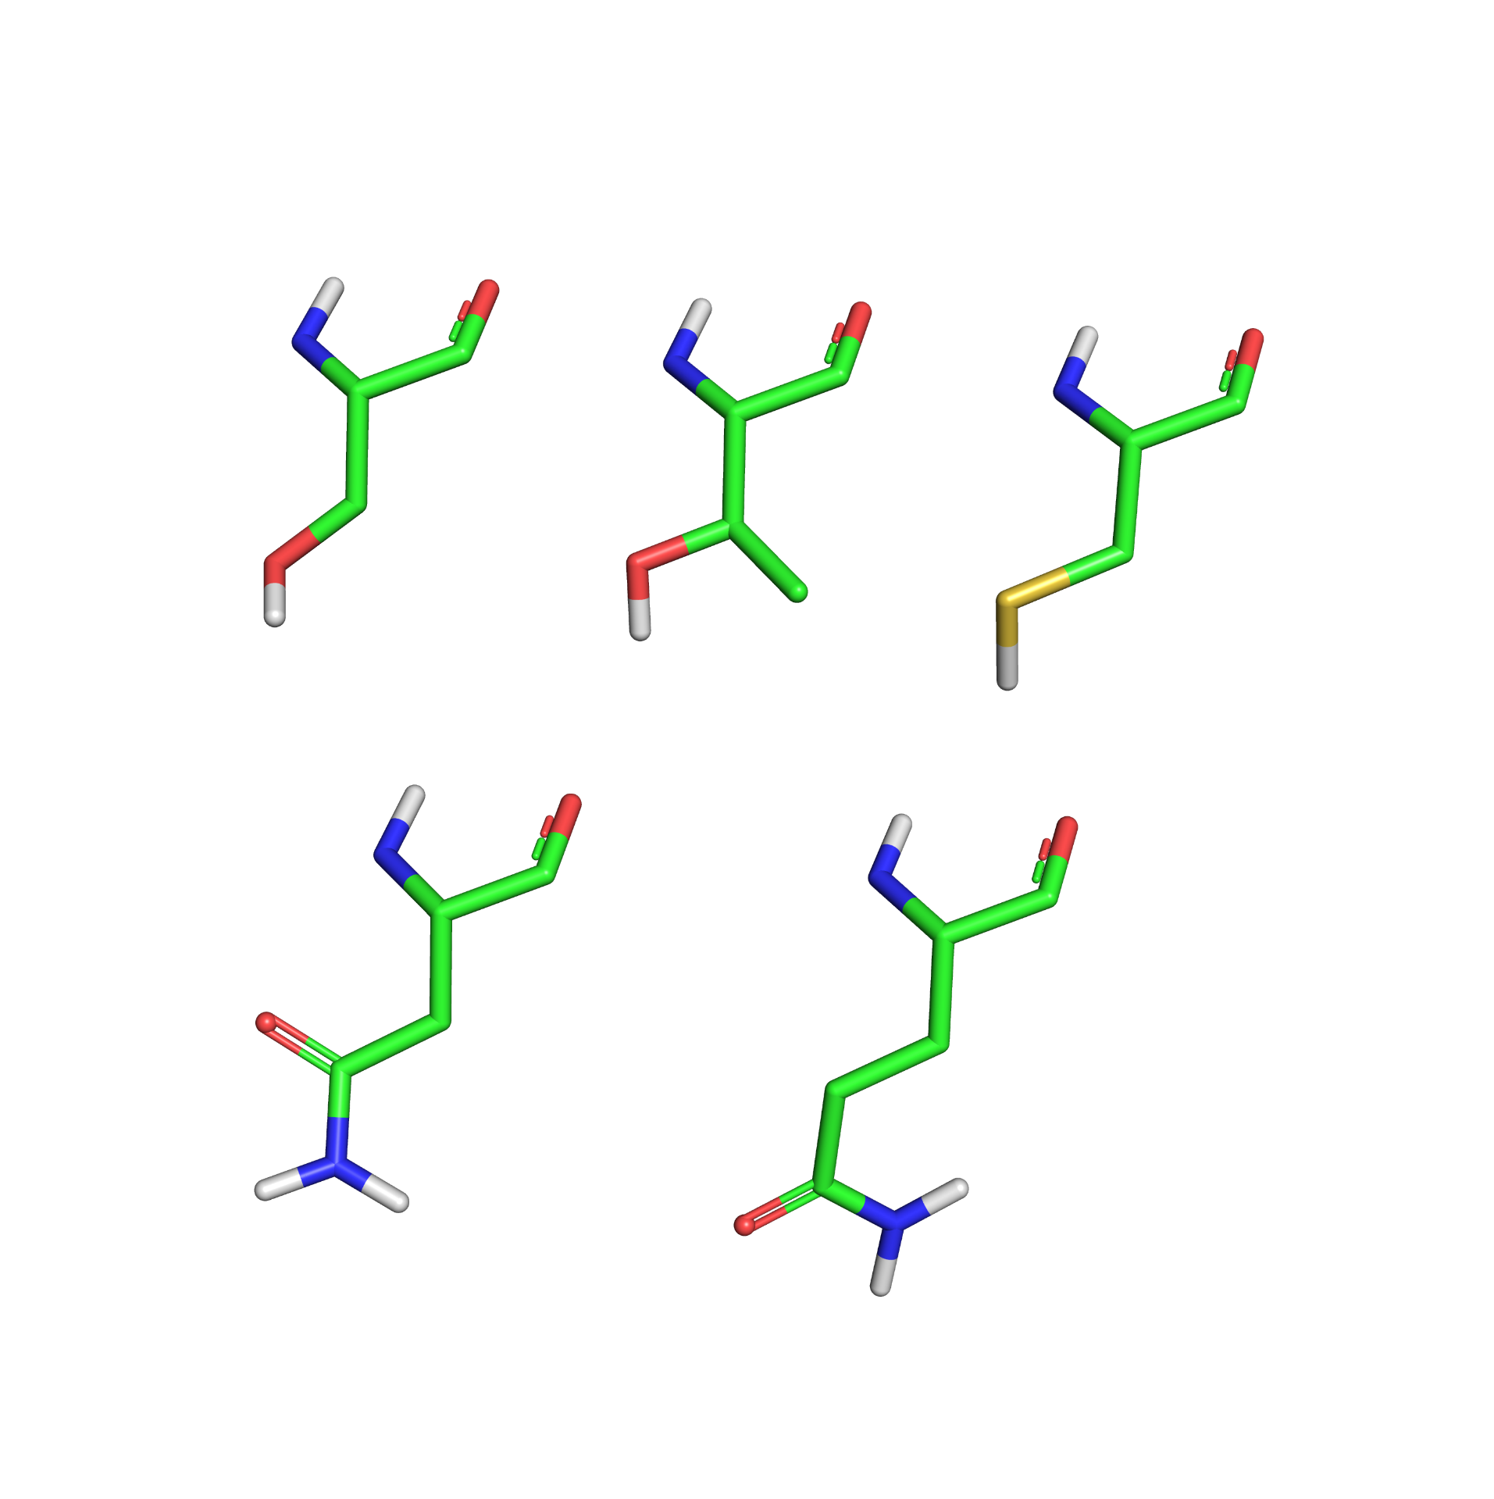
b
Serine (Ser, S)
Threonine (Thr, T)
Cysteine (Cys, C)
Asparagine (Asn, N)
Glutamine (Gln, Q)

Slide 10
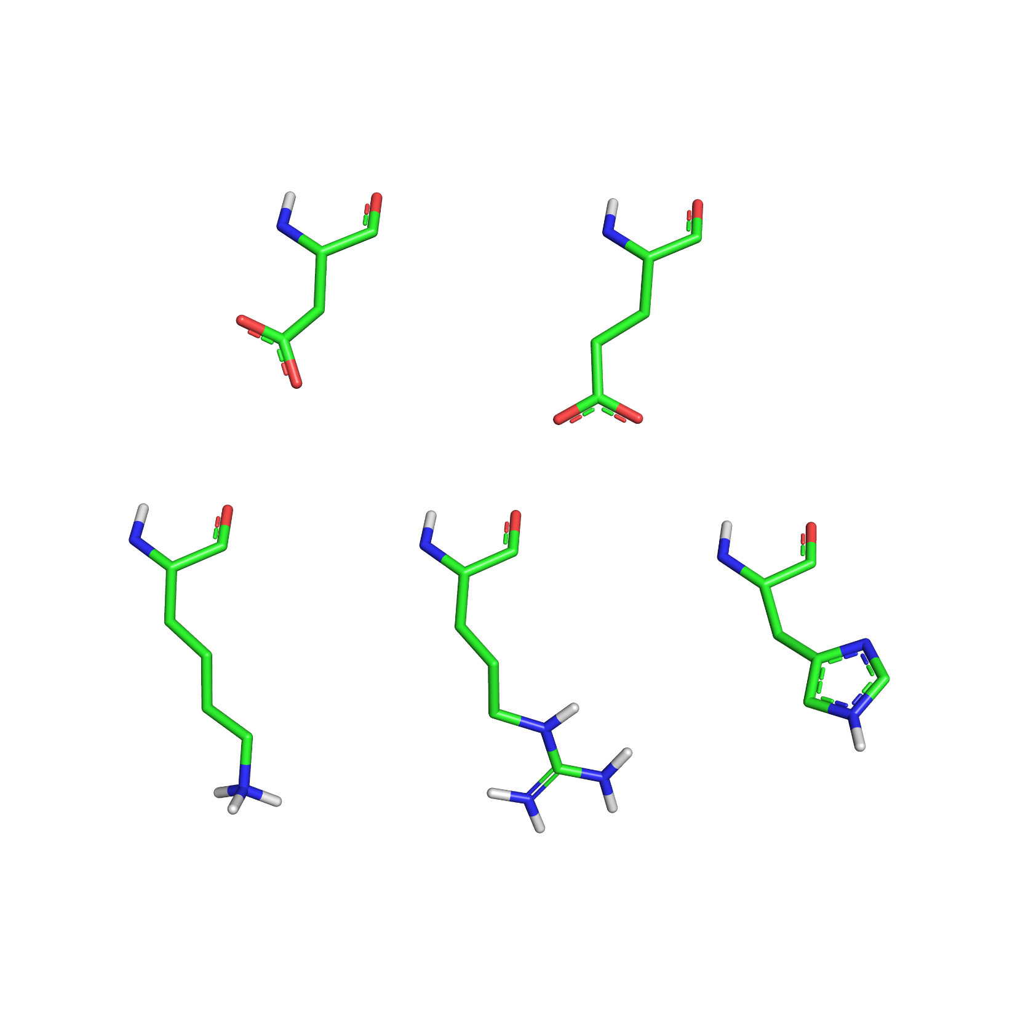
c
(-)
(-)
Aspartate (Asp, D)
Glutamate (Glu, E)
(+)
(+)
Lysine (Lys, K)

Slide 11
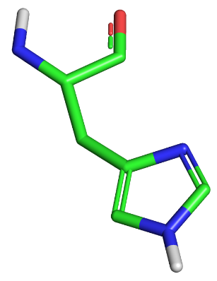
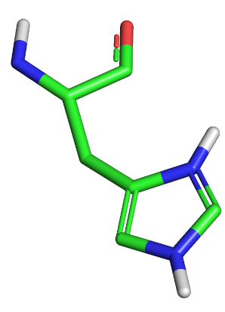
c (cont.)
δ₁
(+)
ε₂
Histidine (His, H)
(+)
Arginine (Arg, R)

Slide 12
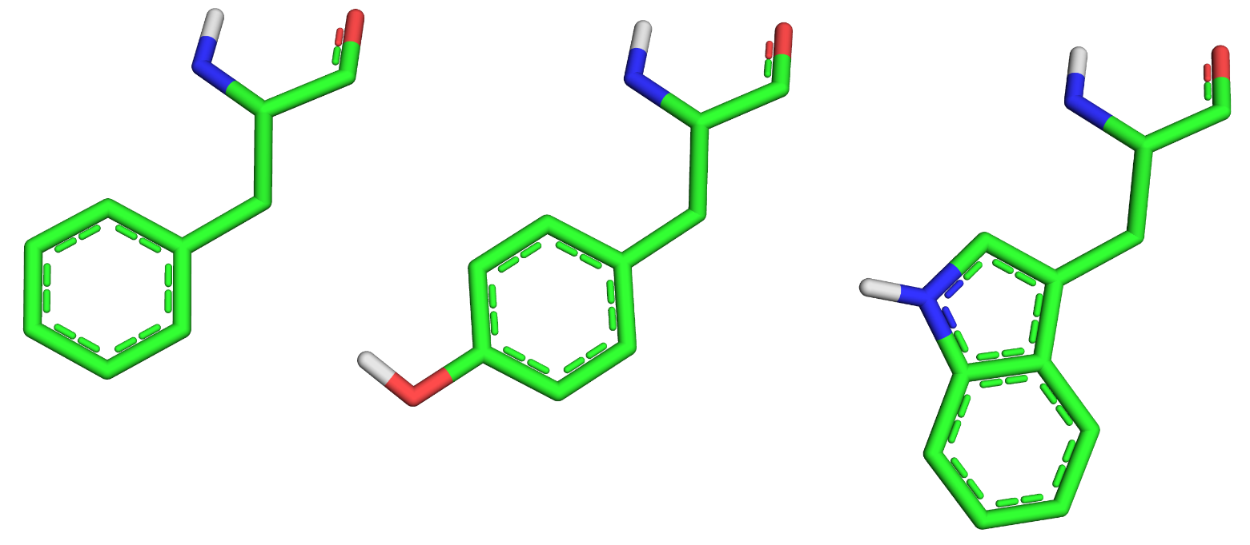
d
Phenylalanine (Phe, F)
Tyrosine (Tyr, Y)
Tryptophan (Trp, W)

Slide 13
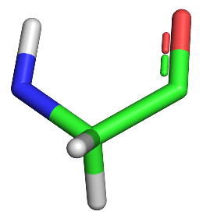
e
Glycine (Gly, G)

Slide 14
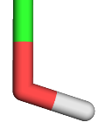
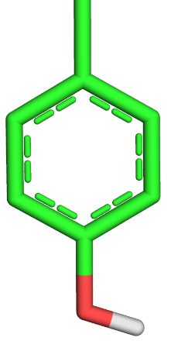
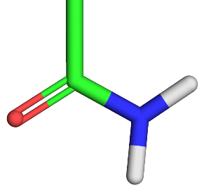
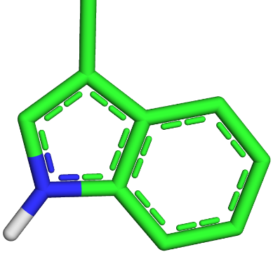
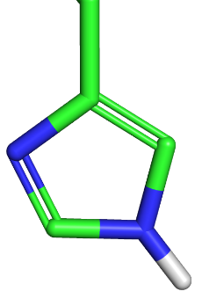
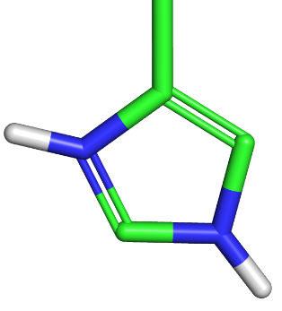
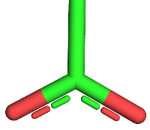
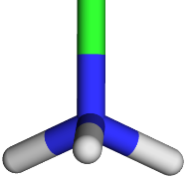
a
Ser/Thr
Tyr
Asn/Gln
Trp
His0
His+
Asp/Glu
Lys
(+)
(+)
(-)
Figure 2.6

Slide 15
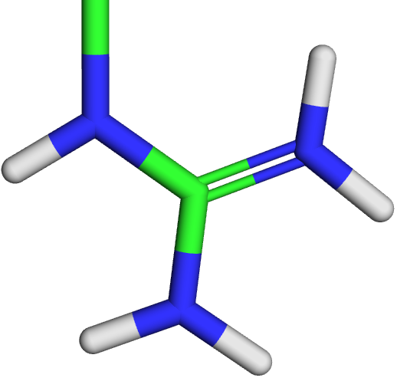
a (cont.)
Arg
(+)

Slide 16
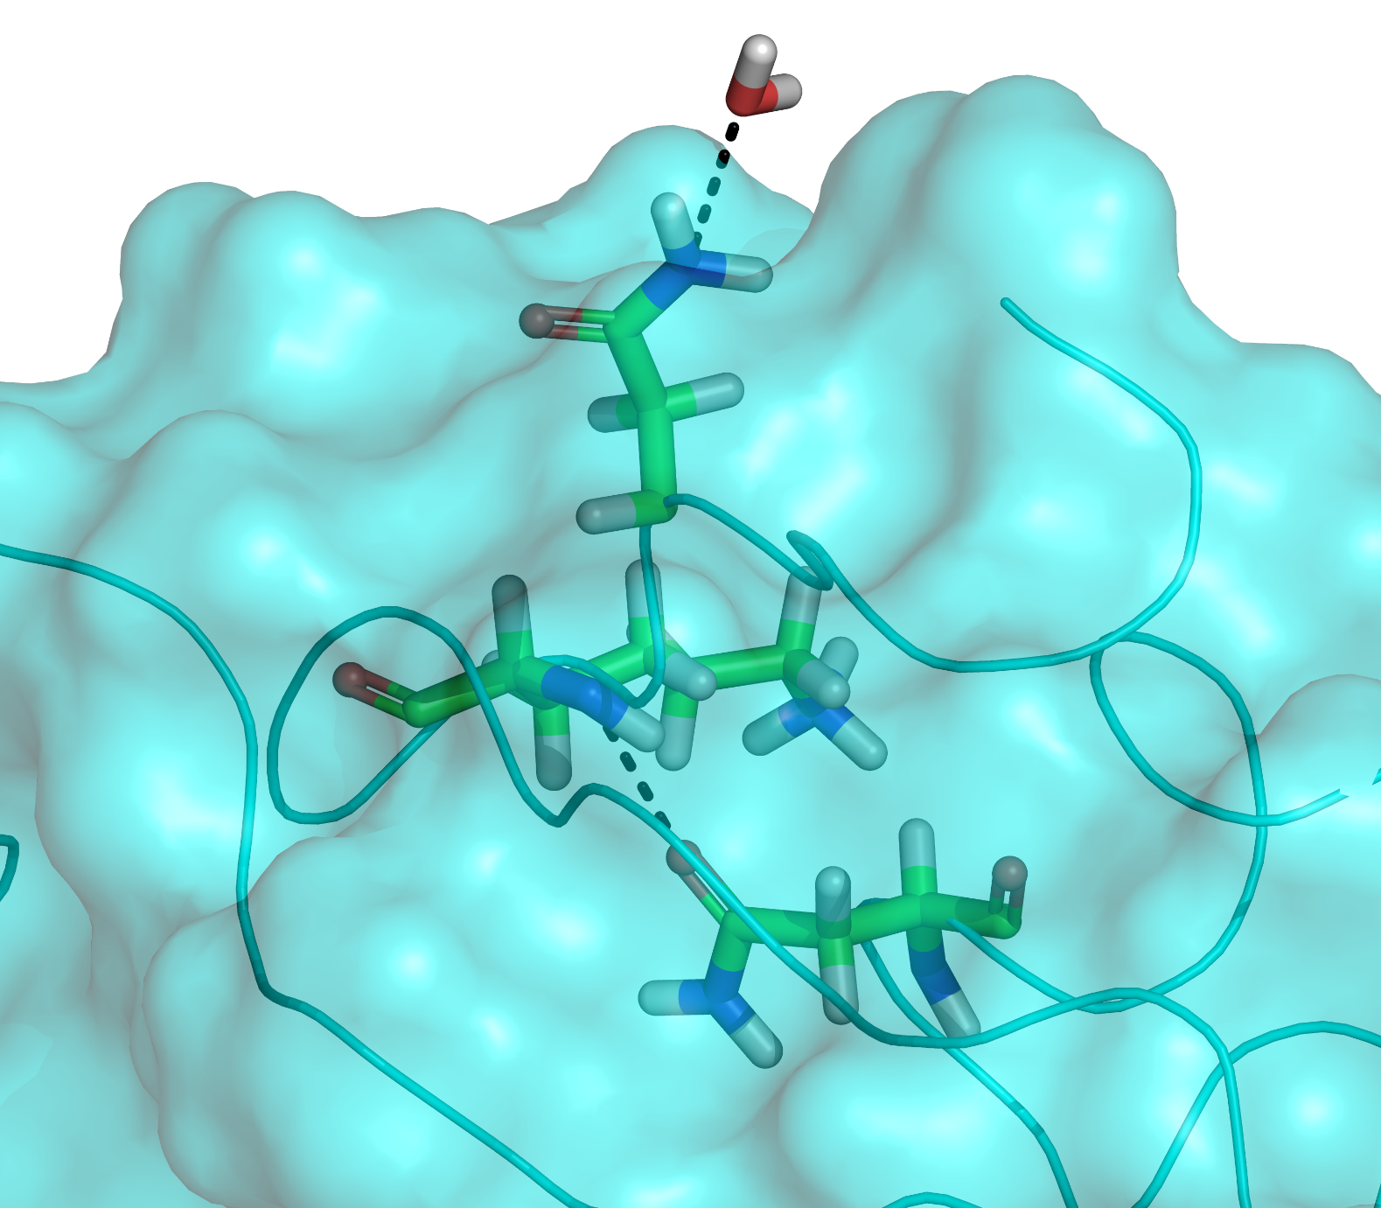
b

Slide 17
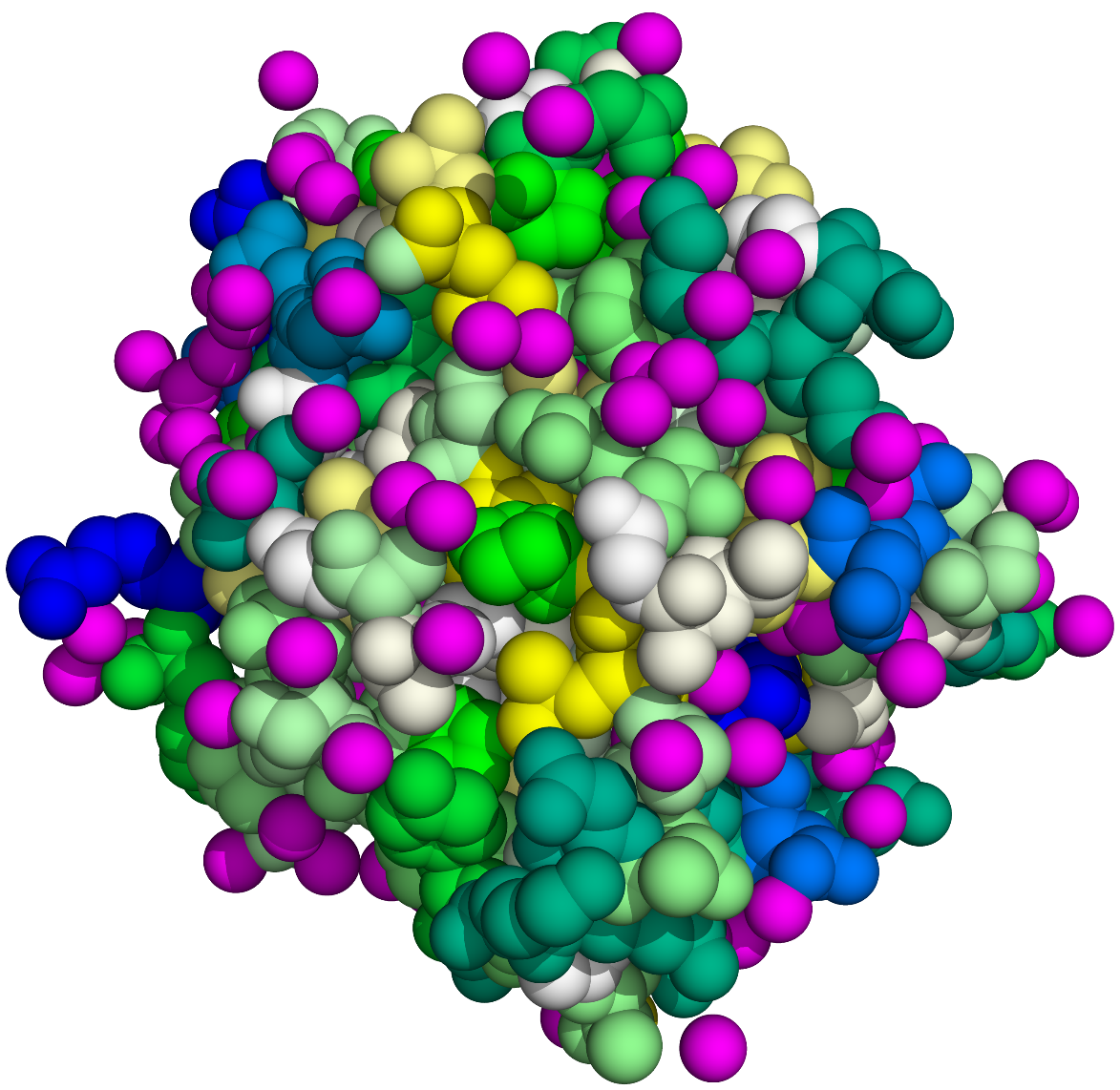
Figure 2.7

Slide 18
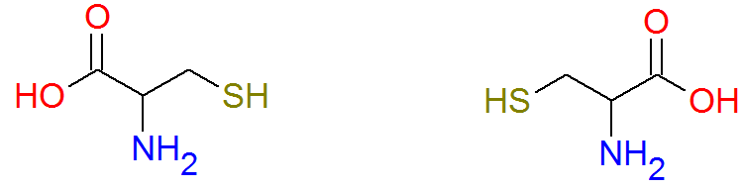
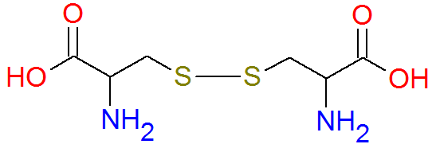
a
+
2H⁺ + 2e⁻
2H⁺ + 2e⁻
Figure 2.8

Slide 19
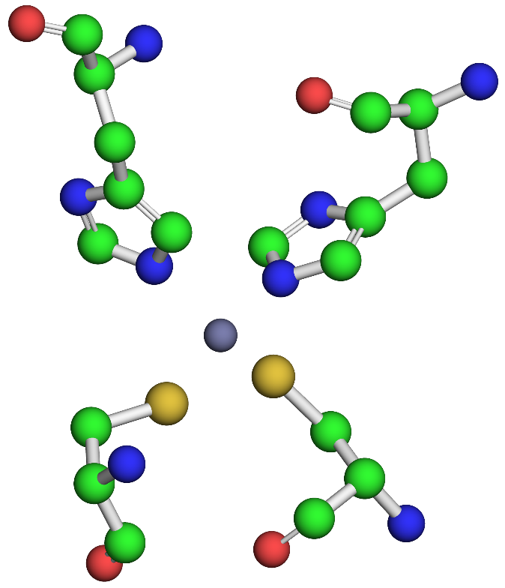
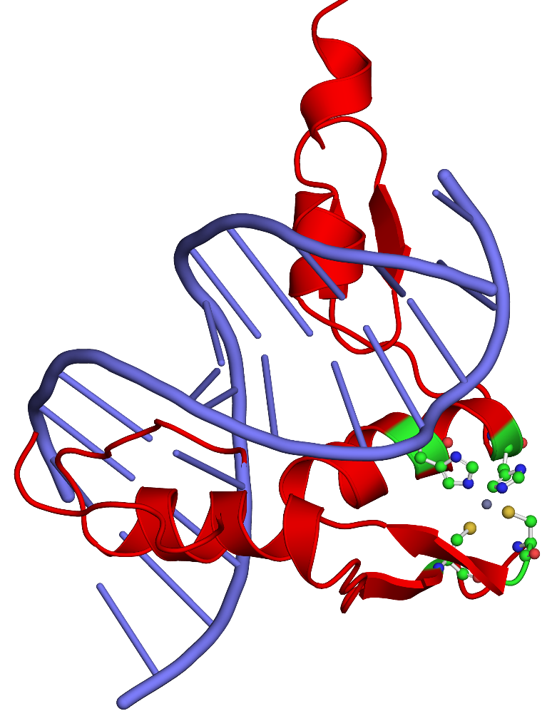
b

Slide 20
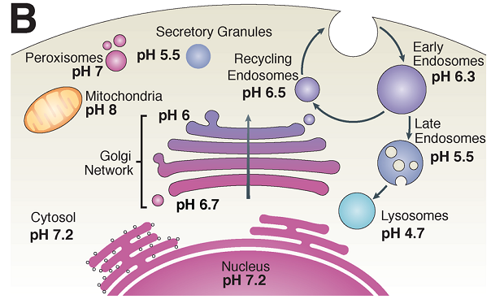
Figure 2.9

Slide 21
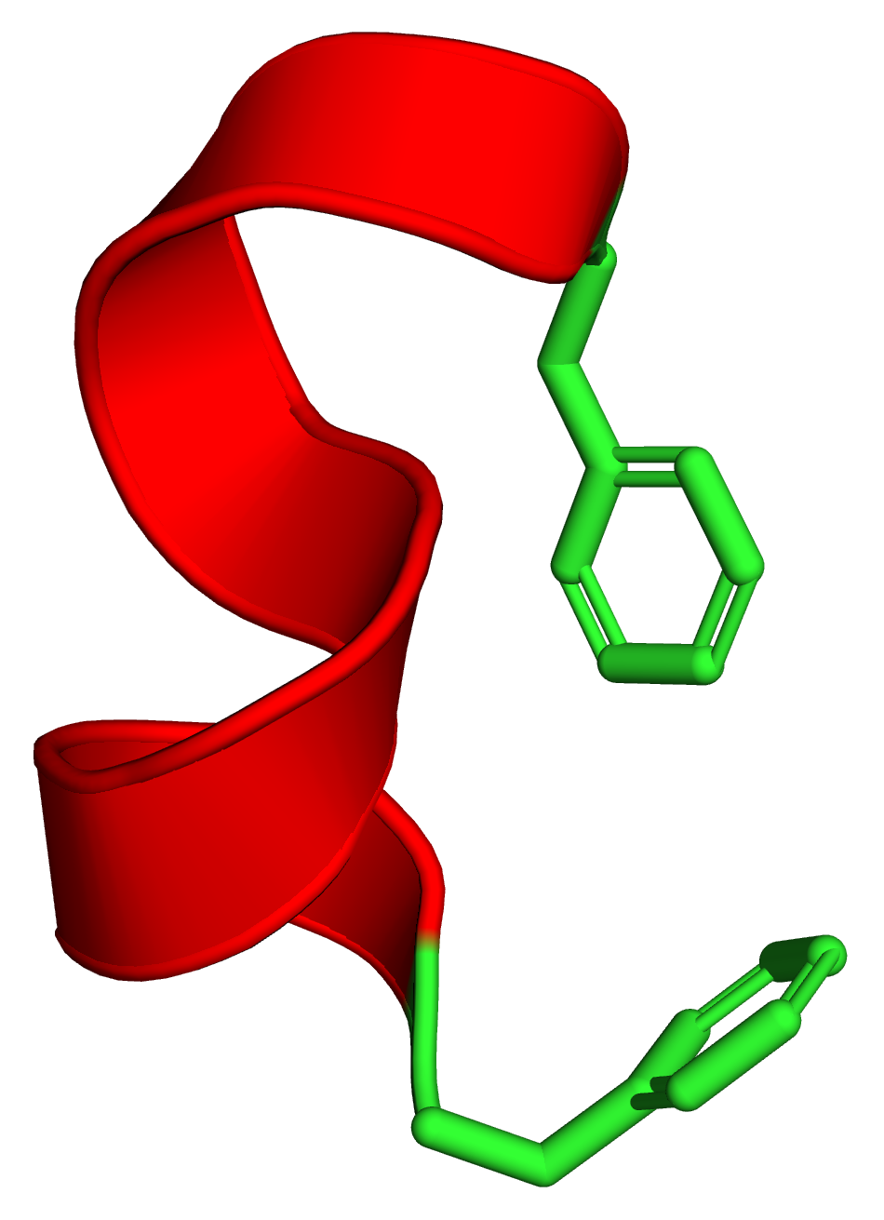
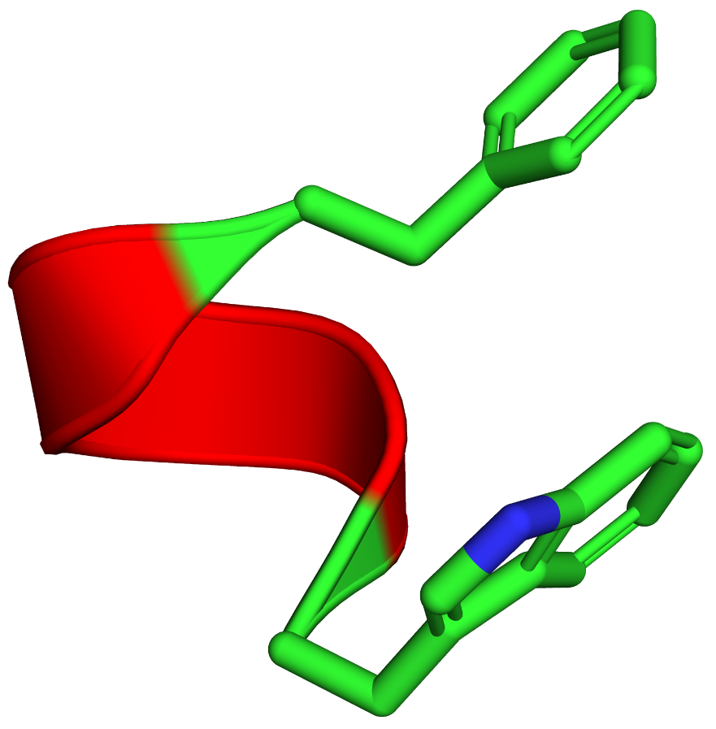
a
b
Phe-498
Phe-310
Trp-494
Phe-302
Figure 2.10

Slide 22
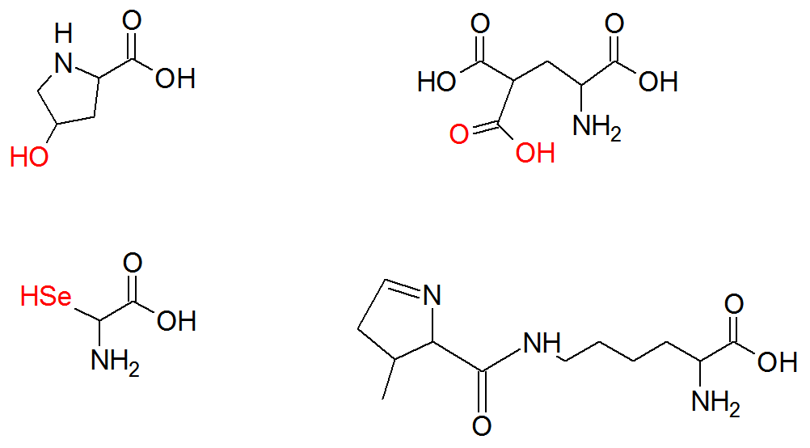
γ
β
α
Hydroxy-proline
γ –Carboxy-glutamate
Seleno-cysteine
Pyrrolysine
Figure 2.11

Slide 23
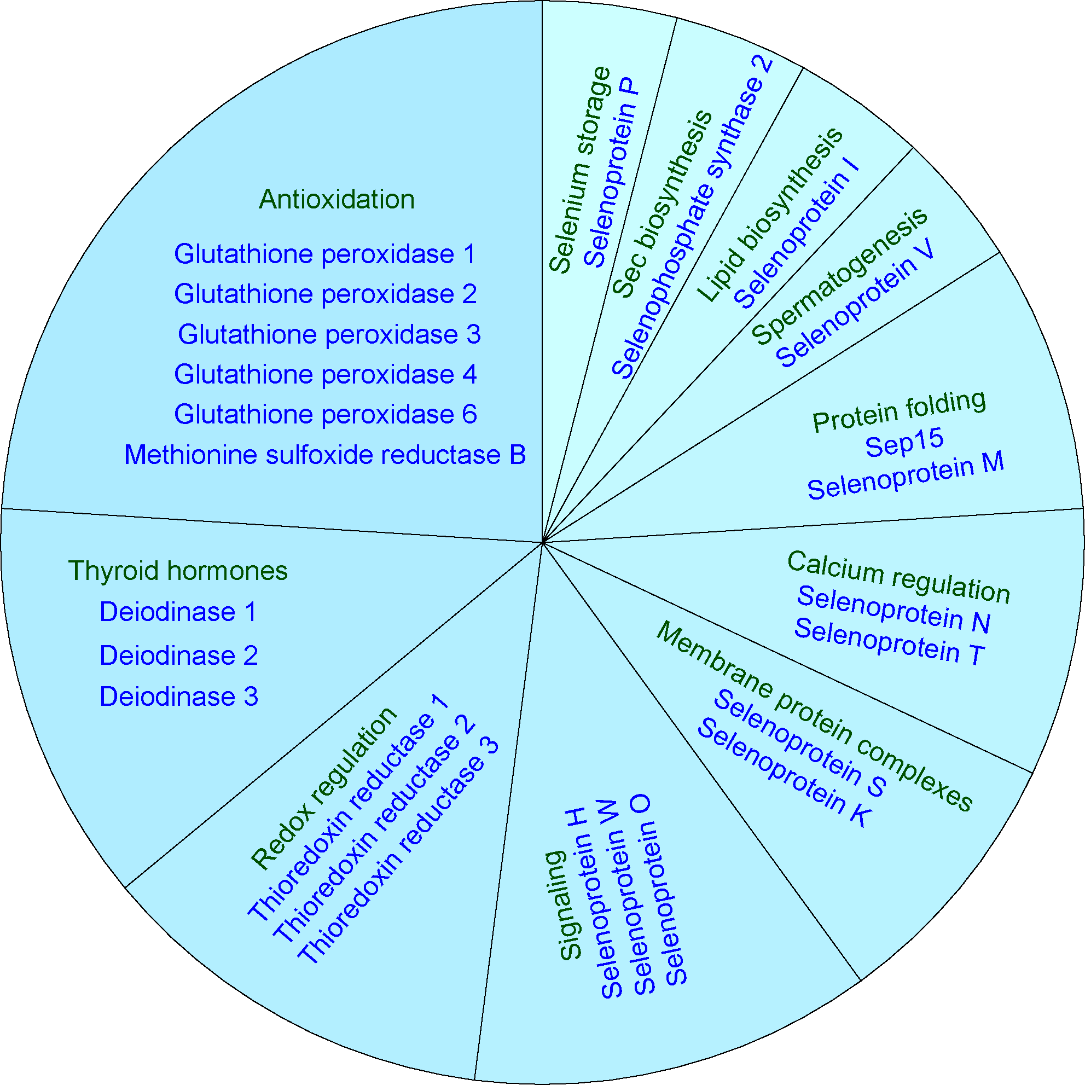
Figure 2.12

Slide 24
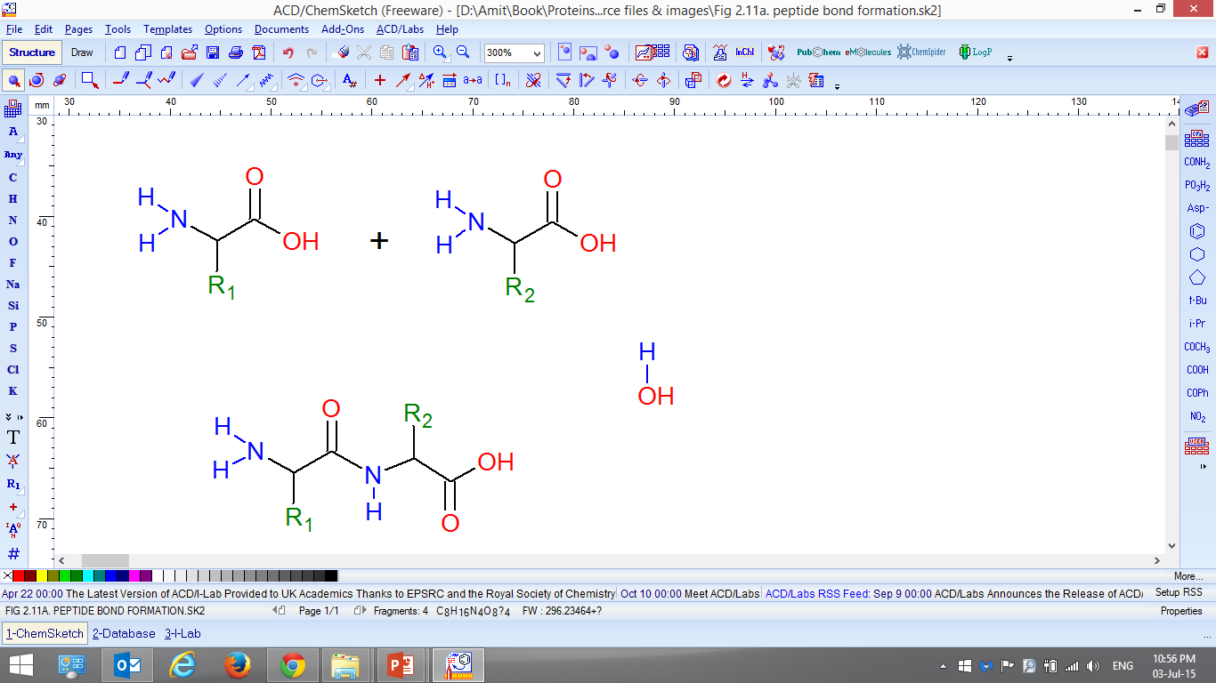
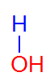
a
δ-
N-terminus (N’)
δ-
C-terminus (C’)
δ+
δ+
Figure 2.13

Slide 25
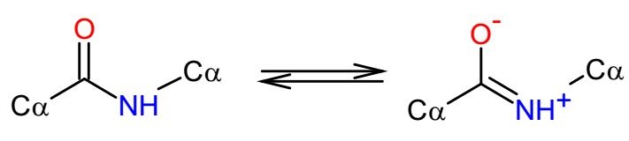
b

Slide 26
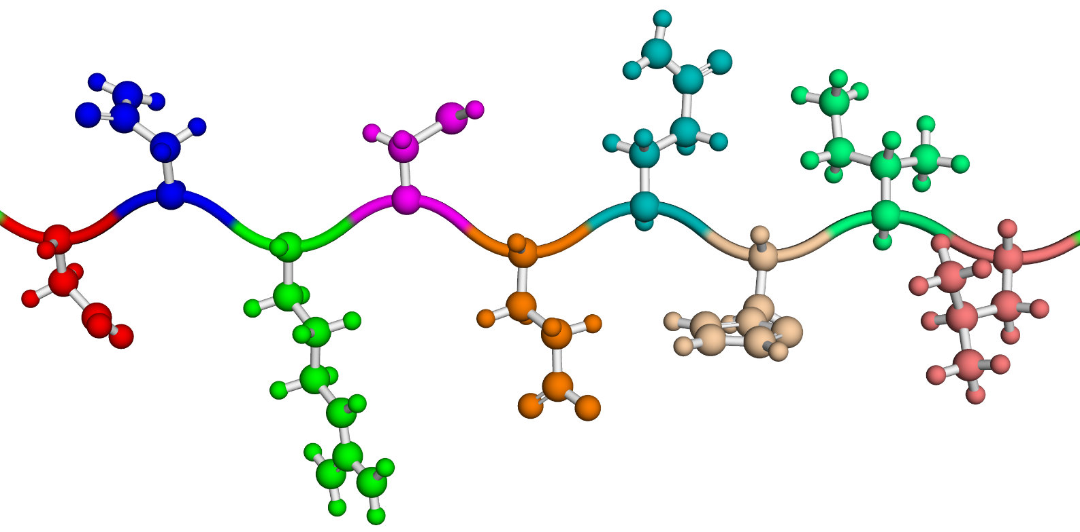
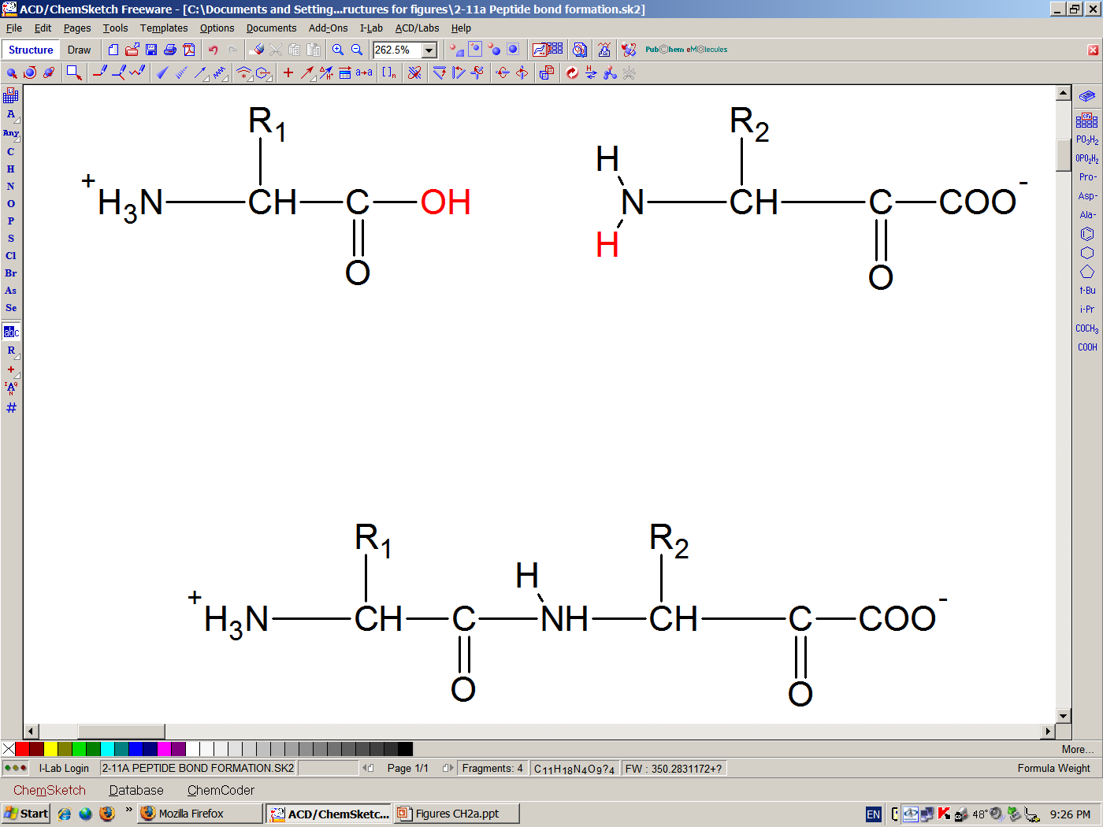
c
Asp--Asn--Arg--Cys--Glu--Gln--His--Ile--Leu

Slide 27
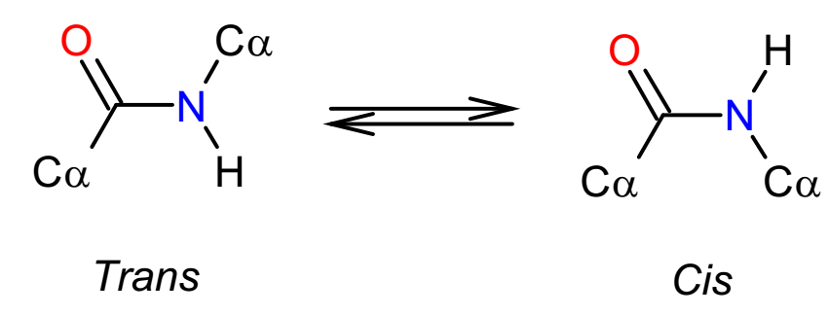
a
Figure 2.14

Slide 28
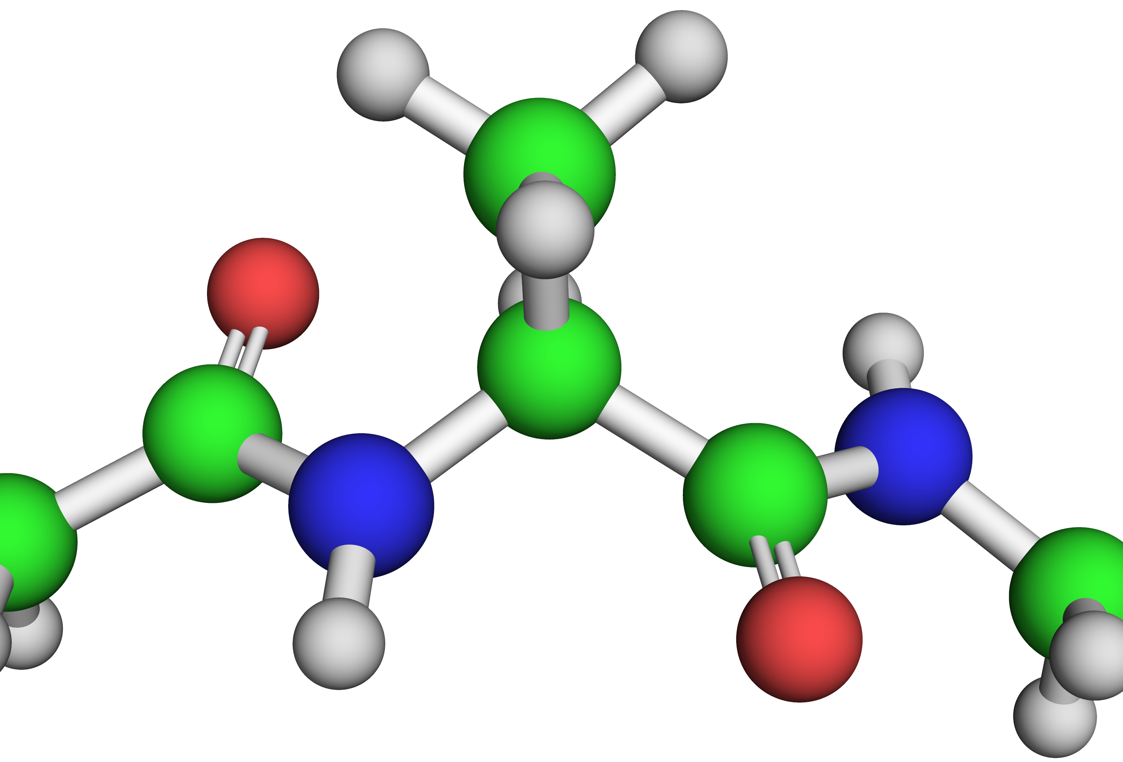
b
Side chain
O
C_{α}
C
N
N
C
ψ
φ
O

Slide 29
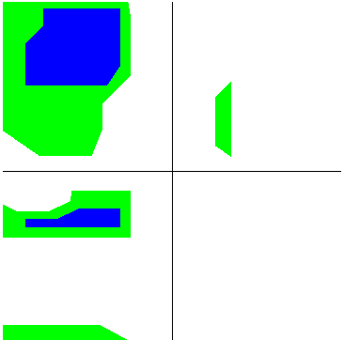
c
β
α_{left}
ψ
α_{right}
φ

Slide 30
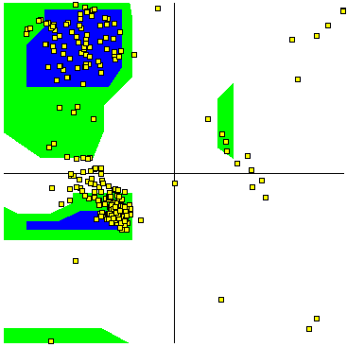
d
ψ
φ

Slide 31
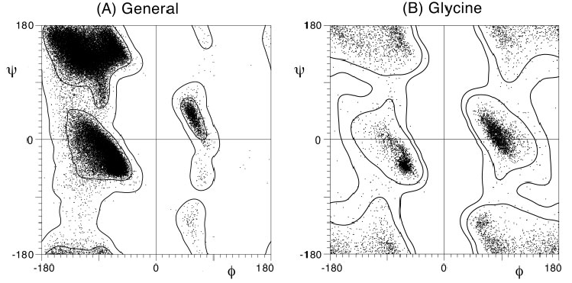
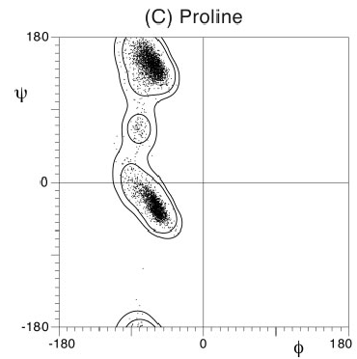
e

Slide 32
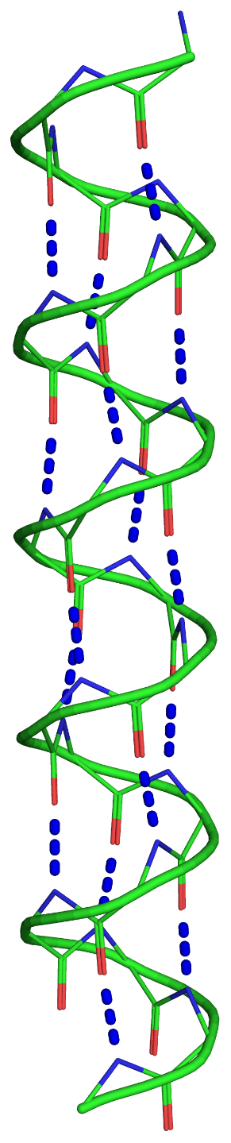
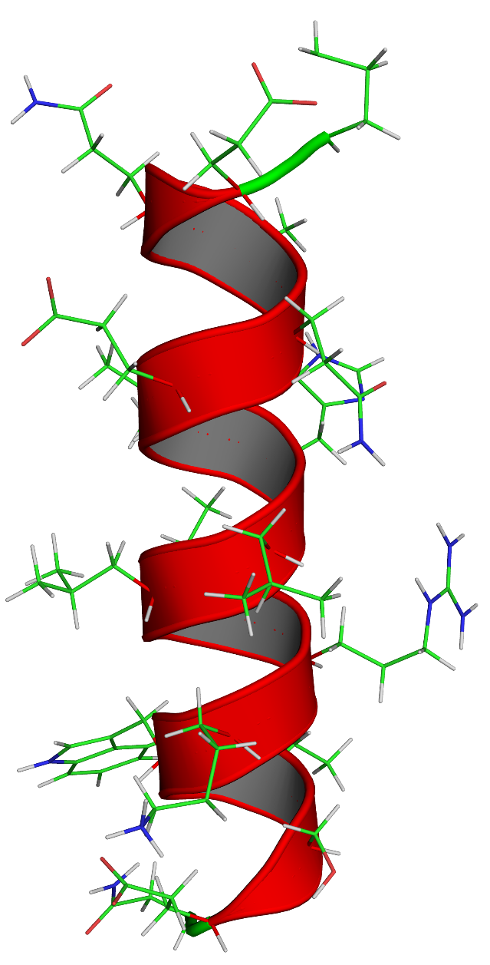
a
b
N’
i
i+4
C’
Figure 2.15

Slide 33
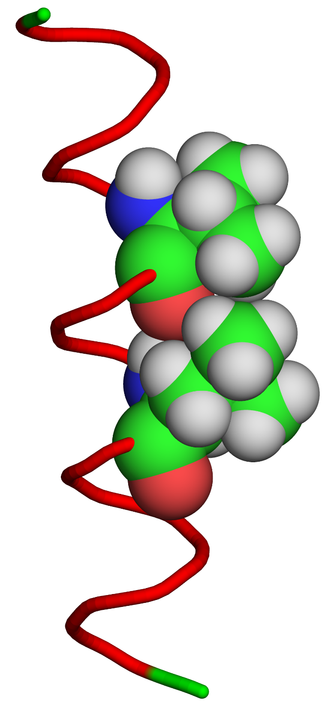
c
Val 6
Leu 10

Slide 34
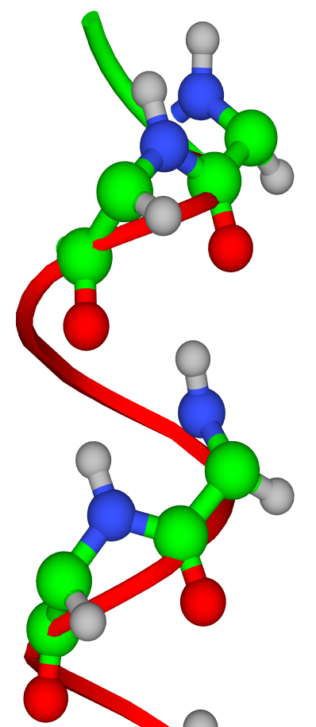

N’
d
e
e
δ+
δ-
δ+
H
(+)
δ-
δ+
δ-
N
C
δ+
δ+
(-)
O
δ-
δ-
δ-
C’

Slide 35

a
b
Asp₁-Thr₂-Val₃-Thr₄-Gln₅-Ala₆-Ala₇-Ser₈-Gln₉-Val₁₀-Leu₁₁-Asp₁₂-Lys₁₃
Figure 2.16

Slide 36

c

Slide 37

a
b
c
d
Figure 2.17

Slide 38

e
e

Slide 39

a
i
i+1
i+2
C_{α}
C_{α}
C_{α}
~3.5 Å
Figure 2.18

Slide 40



b
top view
N’
C’
side view

Slide 41




c
d
e

Slide 42

Figure 2.19

Slide 43

c
+

Slide 44



a
b
1
2
3
c
4
Figure 2.20

Slide 45
0.00
Pro: -3.16
Figure 2.21

Slide 46


Globular
Fibrous
Figure 2.22

Slide 47


Unfolded
Folded
Figure 2.23
Notes:
* הצורה הלא מקופלת של החלבון נוצרה באמצעות MD ללא הגבלות, על ידי BALLlView ( ). הוספת שכבת הממס הראשונה מסביב לשתי צורות החלבון נעשתה על ידי PDB_hydro server באתר קבוצת Delarue, במכון פסטר, פריס.

Slide 48


a
1RTP
b
X, Y: Asp/Gln
Z: Asp/Gln/Ser
Y: Main-chain carbonyl
X: H₂O
Z: Asp/Glu
Figure 2.24

Slide 49


c
d
myosin light chain
Ca²⁺
Free
Bound

Slide 50


e
f

Slide 51

g
TF
DNA

Slide 52

h
λ repressor
DNA

Slide 53

a
b
c
3
2
1
4
Figure 2.25

Slide 54
d
3
2
1
4

Slide 55

e
β-sheet
β-sheet

Slide 56


f
g
antigen binding site
light chains
V_{L}
C_{L}
C_{H2}
C_{H1}
V_{H}
C_{H3}
heavy chains

Slide 57


h
V_{L}
antigen binding site
C_{L}
C_{H1}
V_{H}
C_{H2}
C_{H3}

Slide 58


i
j

Slide 59

1st loop
a
N’
C’
C’
N’
C’
N’
2nd loop
Figure 2.26

Slide 60

b

Slide 61

c
α₄₋₅
α₅₋₆
α₁₋₂
α₂₋₃
C’
β₆
α₃₋₄
β₅
β₄
β₃
β₁
β₂
N’

Slide 62

G12
d
G10
G15
G
β₂
X
X
V8
α₁₋₂
X
G19
G
β₁
L31
L22
V6

Slide 63

e
FADH₂
S13
G12
M14
G10
β₂
β₁
α₁₋₂

Slide 64



g
f
GTP
Pγ
Pα
Pβ
Mg²⁺
Lys
h

Slide 65
i

Slide 66


a
b
2
1
8
3
7
6
4
5
Figure 2.27

Slide 67

c

Slide 68


d
e
Substrate
Ser211
Gly232
Gly171
Gly233
Lys13
His95

Slide 69


f
g
C’
N’

Slide 70


a
b
Figure 2.28

Slide 71


Jelly Roll
Immunoglobulin (Ig)
Figure 2.29

Slide 72


Rossmann
P-loop

Slide 73


TIM barrel
Globin-like

Slide 74


β-trefoil
Ferredoxin-like

Slide 75


a
7
8
9
10
linker
domain
b
Figure 2.30

Slide 76
phosphotyrosine binding
phosphorylation
polyproline binding
SH3
Kinase
Lck (Src family)
SH2
phospholipid binding
PH
SH3
Kinase
Tec (Btk family)
SH2
Figure 2.31

Slide 77
a
Class
Structure
Fold
Superfamily
Structure/Sequence (evolution)
Familiy
Domain
Figure 2.32

Slide 78





b

Slide 79







c
Class:
α/β proteins
*
Fold:
TIM β/α-barrels
*
Superfamily:
TIM
*
Family:
TIM
*

Slide 80













d
Class:
All α proteins
*
Fold:
Globin-like
*
Superfamily:
Globin-like
*
Family:
Globins
*

Slide 81
e
Class
Architecture
Topology/Fold
Homologous superfamily
Family

Slide 82











f
Class:
Mixed α/β (3)
*
Architecture:
α-β barrels (3.20)
*
Topology/fold:
TIM Barrel (3.20.20)
*
Homologous superfamily:
Aldolase class I (3.20.20.70)
*
Family:
Isomerase (3.20.20.70.1)

Slide 83

Figure 2.33

Slide 84


a
β₁
α₁
β₂
α₂
b
Figure 2.34

Slide 85
c
1
2
3
4
5
6
7
HbA:
VAL
HIS
LEU
THR
PRO
GLU
GLU
CH₂
CH₂
COO⁻
1
2
3
4
5
6
7
HbS:
VAL
HIS
LEU
THR
PRO
VAL
GLU
CH
CH₃
CH₃

Slide 86


d
β₂
β₁
Val⁶
Leu⁸⁸
Phe⁸⁵

Slide 87

Figure 2.35

Slide 88

Figure 2.36

Slide 89



a
b
c
Figure 2.37

Slide 90
1
1
2
2’
1’
+
2’
1’
2
Figure 2.38

Slide 91

Figure 2.39

Slide 92

Figure 2.40

Slide 93




a
b
c
d
Figure 2.41

Slide 94


e
f

Slide 95


g
h

Slide 96


i
j

Slide 97

a
Figure 2.42

Slide 98
b

Slide 99
c

Slide 100

F-actin
G-actin
Figure 2.43

Slide 101

a
Figure 2.44

Slide 102

b

Slide 103

Figure 2.45

Slide 104


Figure 2.46

Slide 105

a
Figure 2.47

Slide 106

b
Association of tropocollagen into collagen fibers
Fibril
Fiber

Slide 107

Figure 2.48

Slide 108

Figure 2.49

Slide 109


a
b
Figure 2.50

Slide 110

c
Relaxed
Extended

Slide 111

a
Figure 2.51

Slide 112
b
3
7
5
1
6
2
4
4
2
6
1
7
5
3

Slide 113

c

Slide 114

d
Parallel coiled-coil dimer
Anti-parallel tetramer
Octamer
ULF

Slide 115


a
b
7/2 residues
Figure 2.52

Slide 116

c
Hyp
Pro
Gly
Hyp
Pro
Gly

Slide 117

d

Slide 118

e

Slide 119
Box 2.1

Slide 120

Arsenate
Arsenite
Figure 2.1.1

Slide 121

Arsenate
Phosphate
Figure 2.1.2

Slide 122


H₂O
Free lipoic acid
Blocked lipoic acid
Figure 2.1.3

Slide 123

Figure 2.1.4

Slide 124
Box 2.2

Slide 125

10⁷
6.3×10⁻⁵
4.0×10⁻¹⁰
K_{a}
pK_{a}
4.2
-7
9.4
HCl
HCN
Figure 2.2.1

Slide 126

a
Figure 2.2.2

Slide 127


b
H
+

Slide 128


a
[HA] > [A⁻]
[HA] < [A⁻]
(-)
(-)
[HA] = [A⁻]
b
[HB⁺] > [B]
[HB⁺] < [B]
(+)
(+)
[HB⁺] = [B]
Figure 2.2.3

Slide 129

(+)
(-)
Figure 2.2.4

Slide 130
Box 2.4

Slide 131

Figure 2.4.1

Slide 132

Figure 2.4.2

Slide 133

Figure 2.4.3

Slide 134

Figure 2.4.4

Slide 135

Figure 2.4.5

Slide 136

Figure 2.4.6

Slide 137


(+)
+
(-)
E (=∇Φ)
Φ
Figure 2.4.7
Figure 2.4.7

Slide 138

Figure 2.4.8

Slide 139

Figure 2.4.9

Slide 140
Box 2.5

Slide 141

Figure 2.5.1

Slide 142

Figure 2.6.1

