Slide 1
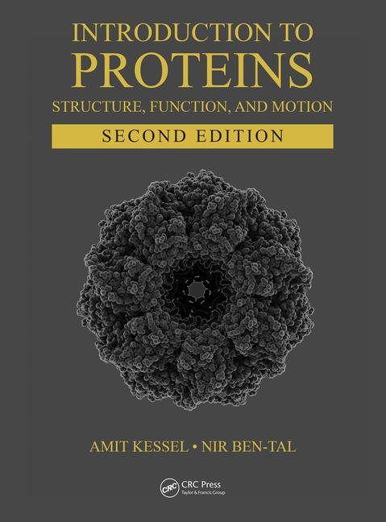
This PPT presentation is provided as suppl. material to the book:
Introduction to Proteins: Structure, Function, and Motion
2nd Edition (2018)
Amit Kessel & Nir Ben-Tal

Slide 2
a
b
ΔGº
+ ATP
+ ADP
Gº_{A} Gº_{B}
ΔGº = Gº_{B} – Gº_{A} < 0
Figure 4.1

Slide 3
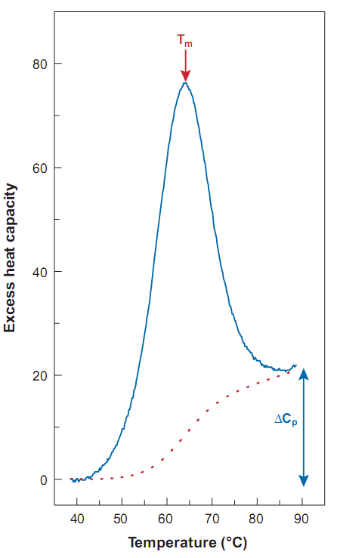
Figure 4.2

Slide 4
Buried
Sub-surface
Surface
Figure 4.3

Slide 5
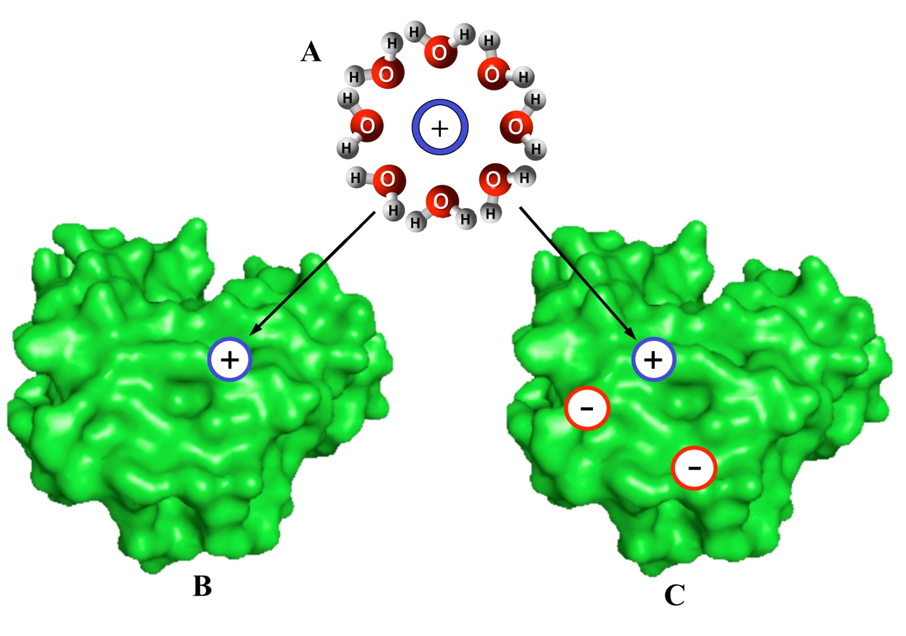
Figure 4.4

Slide 6
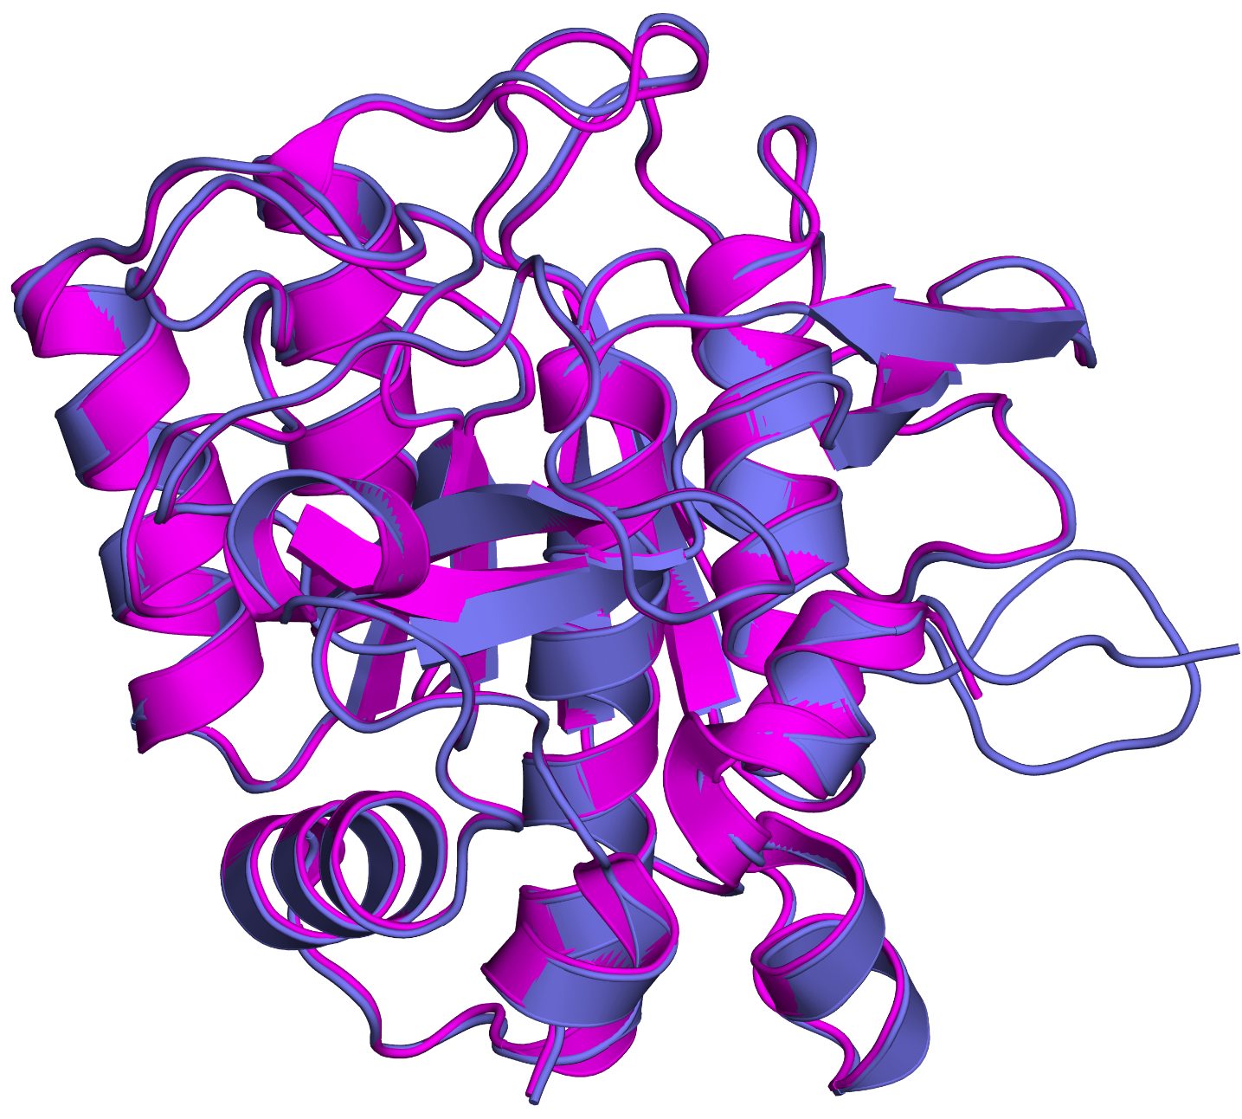
a
Figure 4.5

Slide 7
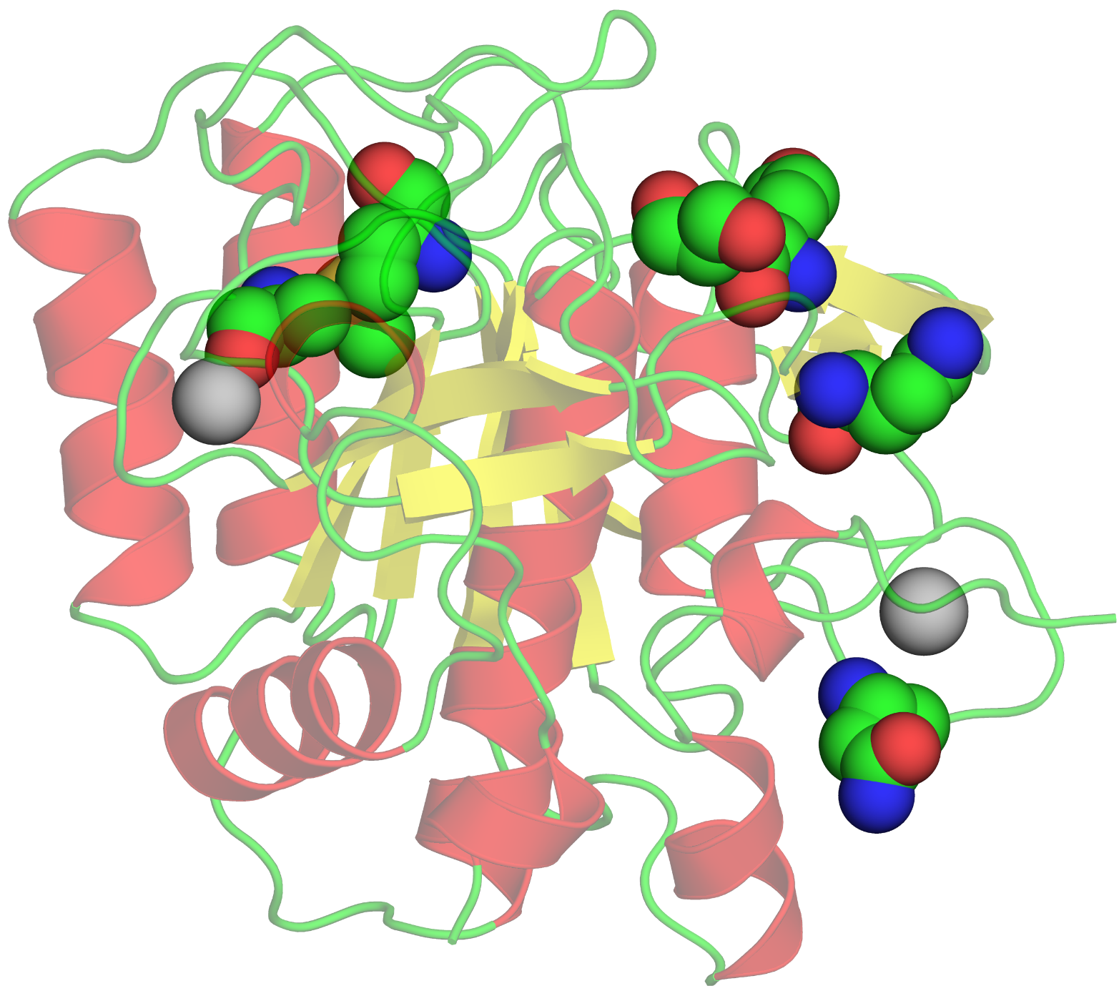
b

Slide 8
Box 4.1

Slide 9
6CO₂ + 6H₂O
Glucose
ADP
+
P_{i}
ATP
ADP
+
P_{i}
ATP
Palmitate
Figure 4.1.1
7Acetyl-CoA

Slide 10
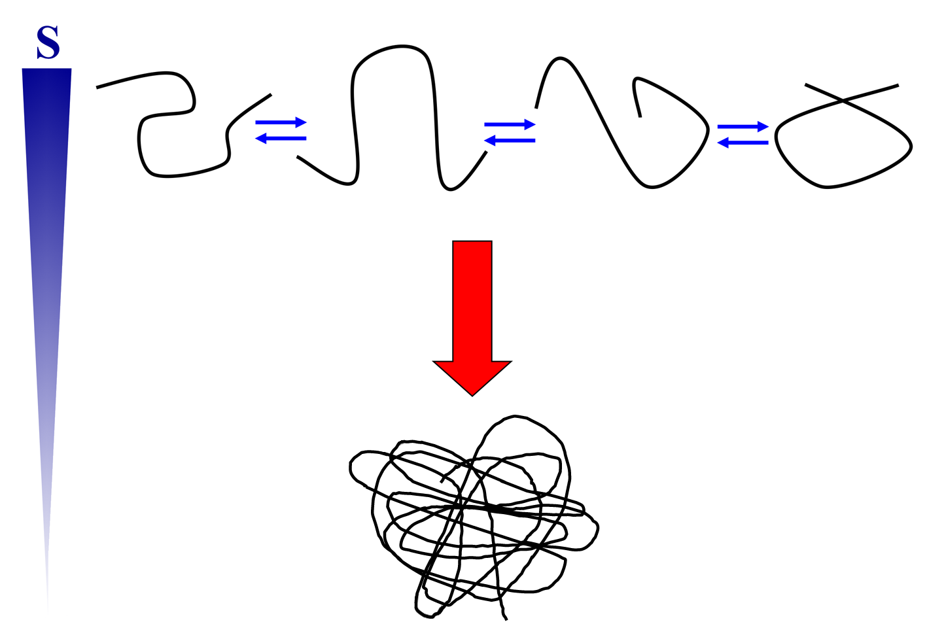
Figure 4.1.2

